Slide 1




The Cloud Services Innovation Platform:
Enabling Service Based Environmental Modelling Using Infrastructure-as-a-Service Cloud Computing
Olaf David
iEMSs – Leipzig, Germany - July 2012
olaf.david@colostate.edu
USDA – Natural Resources Conservation Service
Colorado State University, Fort Collins, Colorado USA

Slide 2
USDA-NRCS Science Delivery
USDA-NRCS
  Conservationists
    County level field offices
    Consult directly with farmers
  Models
    Many agency environmental models
    Legacy desktop applications
    Annual updates
    Slow, restricted science delivery

Slide 3
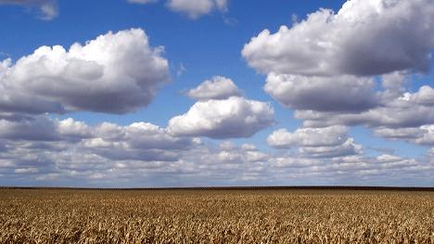
IaaS Cloud Advantages
Scalability
Granular Scaling
VM Migration
Legacy Infrastructure
Fault Tolerance
Virtualization
Service Isolation
Server Partitioning
Availability
Datacenter Savings
Energy Savings

Slide 4
Cloud Services Innovation Platform
Model services architecture
  Support science delivery
  Desktop models → web services
  IaaS cloud deployment
  Scalable compute capacity:
    For peak loads
      Year end reporting
    For compute intensive models
      Watershed models
Rusle2
STIR
CSIP
WEPS
SCI
Watershed
Modeling

Slide 5
Object Modeling System 3.0
Environmental Modeling Framework
  Component based modeling
  Java annotations reduce model code coupling
    Inversion of control design pattern
Component oriented modeling
  New model development
    Java/Groovy
  Legacy model integration
    FORTRAN
    C/C++

Slide 6
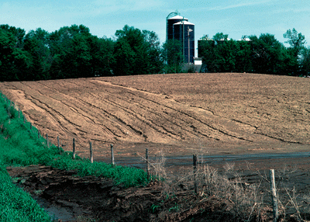
RUSLE2 Model
“Revised Universal Soil Loss Equation”
Combines empirical and process-based science
Prediction of rill and interrill soil erosion resulting from rainfall and runoff
USDA-NRCS agency standard model
  Used by 3,000+ field offices
  Helps inventory erosion rates
  Sediment delivery estimation
  Conservation planning tool

Slide 7
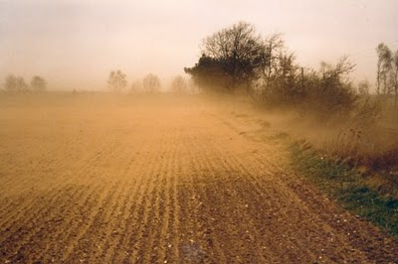
Wind Erosion Prediction System (WEPS)
Soil loss estimation based on weather and field conditions
Models environmental concerns
  Creep/saltation, suspension, particulate matter
USDA-NRCS agency standard model
  Process-based daily time step → 150 years
  Used by 3,000+ field offices
  Erosion control simulation
  Conservation planning tool

Slide 8
Cloud Application Deployment
Service Requests
Application
Servers
Load Balancer
Load Balancer
cache/logging
noSQL datastores
rDBMS / spatial DB

Slide 9
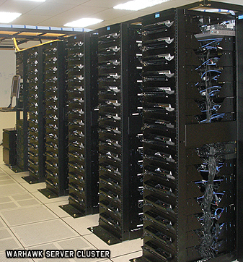
Eucalyptus 2.0 Private Clouds
Two eucalyptus clouds
  ERAMSCLOUD
    (9) Sun X6270 blade servers
    Dual quad core CPUs, 24 GB ram
  OMSCLOUD
    Various commodity hardware
Eucalytpus 2.0.3
  Amazon EC2 API support
  Managed mode network w/ private VLANs, Elastic IPs
  Dual boot for hypervisor switching
    Ubuntu (KVM), CentOS (XEN)

Slide 10
CSIP Model Services
Multi-tier client/server application
  RESTful webservice, JAX-RS/Java w/ JSON
App Server
Apache Tomcat
Geospatial rDBMS
File Server
nginx
Logger & shared cache
memcached
30+ million shapes
1000k+ files, 5+GB
POSTGRESQL
OMS3
RUSLE2
POSTGIS
WEPS

Slide 11
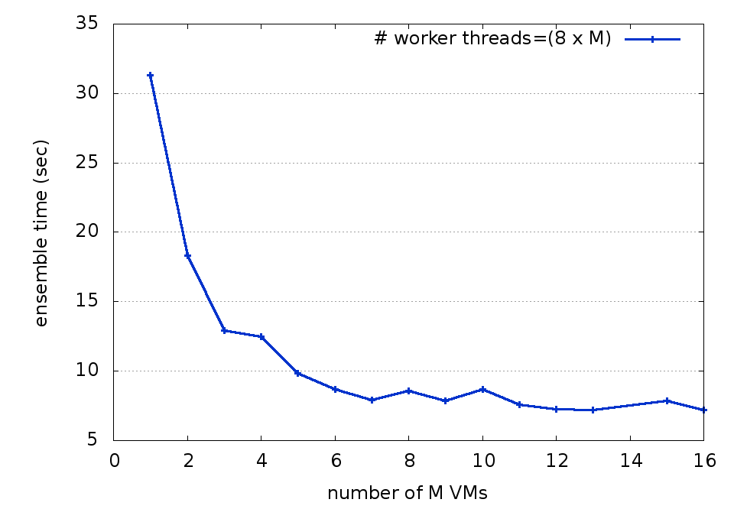
Performance Gains through Cloud Scaling
Increasing Model VMs and worker threads
Notes:
Important Note: Beyond 8 VM’s we had to host multiple model VM’s on each physical machine, so performance gains were minimal

Slide 12
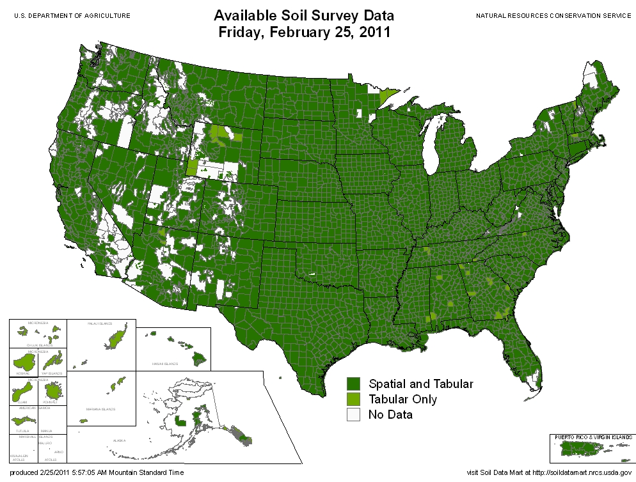
CSIP Geospatial Dataservices
Soils geospatial database mirror
  Data provisioning for model runs
  Full US dataset, ~300GB, 30 million polygons
Split dataset by chunks (sharding)
  Longitudinal divisions
  Enables scaling by region
  Supports <10 ms query response
  Uses “VM local” ephemeral storage
    Faster than Elastic Block Storage (EBS)

Slide 13
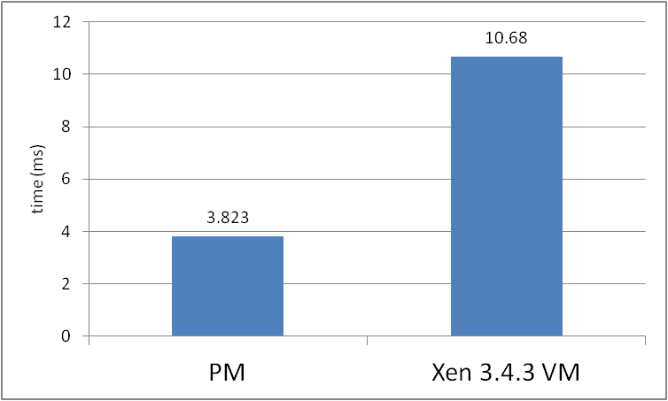
Geospatial query performance
Soils geospatial data for state of TN
4.6GB, 1,700,000 polygons
Tested 1,000+ geospatial queries:
  XEN VM = 10.68 ms average RT
  Physical machine = 3.823 ms average RT
  Virtualization Overhead:
  = 179% !!!

Slide 14
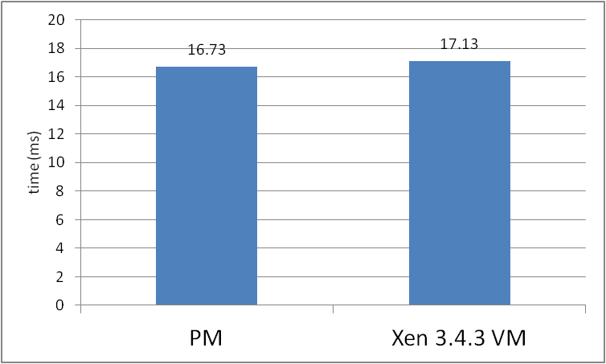
Geospatial query performance - 2
Soils geospatial data for entire U.S.
300 GB, 30,000,000 polygons
Tested 3,000+ geospatial queries
  8 XEN VMs (hosted on 3 machines) = 17.13 ms avg RT
  1 Physical machine = 16.73 ms avg RT
  Virtual Overhead
  = ~2% !!!
IaaS cloud
scalability eliminates
virtualization overhead !

Slide 15
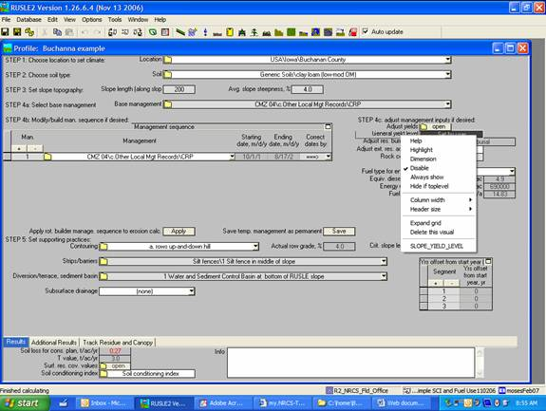

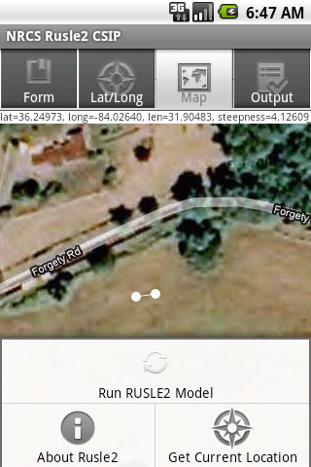
RUSLE2 Model

Slide 16
Key Results
RUSLE2 deployment scaling
  1,000 model runs in ~36 seconds across 8 nodes
Geospatial data services support
  300 GB spatial data hosted across 8 VMs (3 PMs)
  Virtualiztion overhead reduced from 178% to 2%
Android application support

Slide 17
Future Work
HTML 5.0 mobile app
Additional model services
  WEPS (Wind Erosion Prediction System)
  STIR (Soil Tillage Intensity Rating)
  SCI (Soil Conditioning Index)
  Watershed model(s)
    Use geospatial subbasin(s)
    Improvement over statistical averaging approaches
    Distribute subbasin calculations to separate VMs

Slide 18
Questions

