Slide 1




Dynamic Scaling for
Service Oriented Applications:
Implications of Virtual Machine Placement on
Infrastructure-as-a-Service Clouds
Wes Lloyd, Shrideep Pallickara, Olaf David,
Mazdak Arabi, Ken Rojas
March 13, 2014
Colorado State University, Fort Collins, Colorado USA
IC2E 2014: IEEE International Conference on Cloud Engineering

Slide 2
Outline
Background
Research Problem
Research Questions
Experimental Setup
Experimental Results
Conclusions

Slide 3
Background

Slide 4

Dynamic Scaling for
Service Oriented Applications
Hot Spot Detection
VM Launch Latency
Future Load Prediction
Pre-provisioning
WHEN
WHAT
WHERE

Slide 5
Dynamic Scaling for
Service Oriented Applications
Size
Vertical Scaling
Quantity
Horizontal Scaling
Load Balancing
VM
WHAT
VM
VM
VM
VM
VM
VM
VM
VM
VM
VM
VM
VM
VM
VM
VM
VM

Slide 6
Dynamic Scaling for
Service Oriented Applications
Physical Host
VM
VM
VM
Physical Host
VM
VM
VM
VM
VM Scheduling
VM
VM
VM
VM
WHERE
Physical Host
VM
VM
VM
VM
VM
Physical Host
VM
VM
VM
VM
Launch Requests

Slide 7
Research Problem

Slide 8
IaaS Cloud: VM Placement
Physical Host
In practice there are two predominant VM placement schemes
  Greedy – fill first: consolidate
  Round-robin – spread first: load balance
Commonly provided by
  Eucalyptus, OpenStack, OpenNebula, Apache CloudStack
What are the performance implications for dynamic scaling?
  For SOAs, are they sufficient?
Physical Host
VM
VM
Physical Host
VM
VM
VM
VM

Slide 9
Research Questions

Slide 10
Research Questions
RQ1:
RQ2:
What performance implications result from VM placement location when dynamically scaling service oriented applications?
  How important is VM placement for scaling in response to increasing service demand?
How do resource costs (# of VMs) vary when dynamically scaling service oriented applications as a result of VM placement location?

Slide 11
Experimental Setup

Slide 12
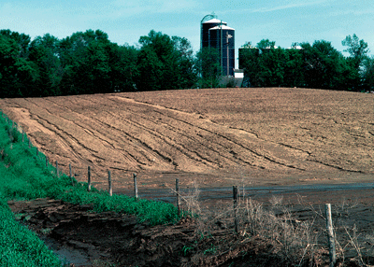

Modeling
Services
USDA-NRCS - Soil erosion models
  RUSLE2: soil loss from rainfall and runoff
  WEPS: soil loss from wind
App Server
Apache Tomcat
Geospatial rDBMS
File Server
nginx
Logging
redis
~6 million shapes
340k XML files
POSTGRESQL
OMS3
RUSLE2/
WEPS
POSTGIS

Slide 13
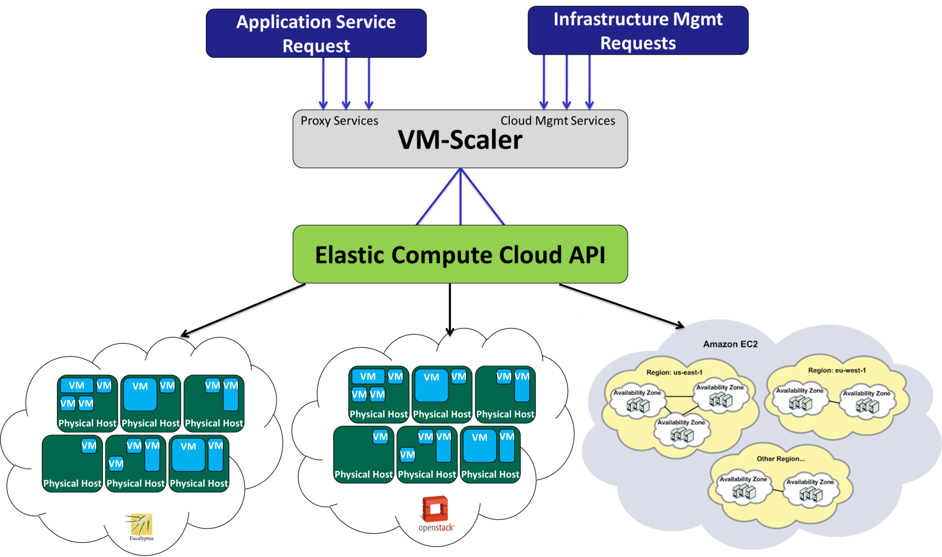
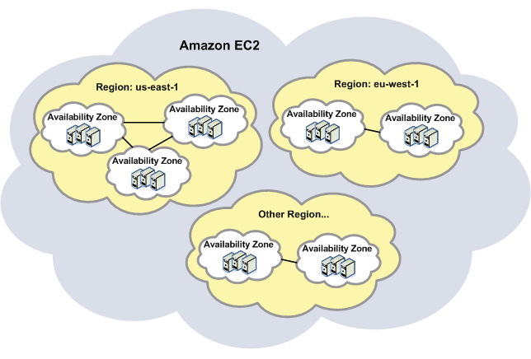


VM-Scaler
Least-Busy VM Scheduler
future
Application Service Request
Infrastructure Mgmt Requests
Proxy Services
Cloud Mgmt Services
VM-Scaler
Elastic Compute Cloud API
Physical Host
Physical Host
Physical Host
Physical Host
Physical Host
Physical Host
VM
VM
VM
VM
VM
VM
VM
VM
VM
VM
VM
VM
VM
VM
VM
VM
Physical Host
Physical Host
Physical Host
Physical Host
Physical Host
Physical Host
VM
VM
VM
VM
VM
VM
VM
VM
VM
VM
VM
VM

Slide 14
Least-Busy VM Placement
Resource Utilization Data
RU-sensors collect Virtual/Physical machine data @ 15s/intervals
Busy-Metric used to calculate aggregate load at each physical machine
  Flexible metric design
  Objective not to design perfect metric / VM scheduler
CPU
- Total CPU time
weighted 2X
Disk
- Disk sector reads (DSR)
- Disk sector writes (DSW)
Network
- Network bytes sent (NBR)
- Network bytes received (NBS)
Virtualization
- Total VM count per host

Slide 15
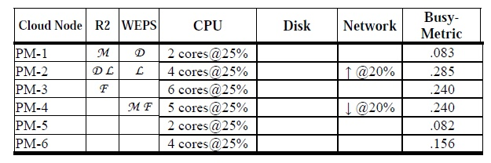
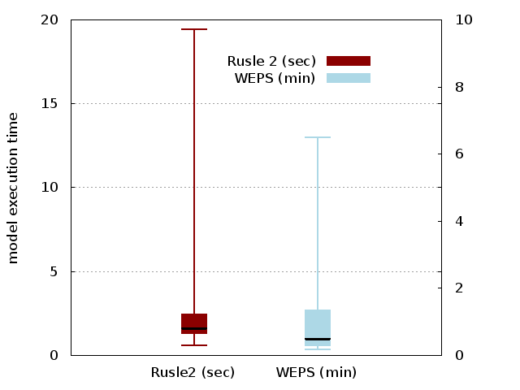
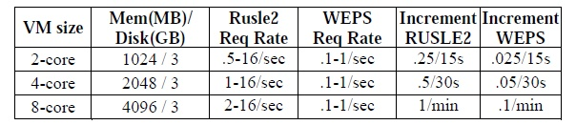
Dynamic Scaling Tests
Shared cluster load simulation
Modeling workloads
▪ Initial load before scaling
▪ Simulates multi-tenant
cloud environments
Rusle2: 7,000 runs/test
WEPS: 300 runs/test

Slide 16
Experimental Results

Slide 17
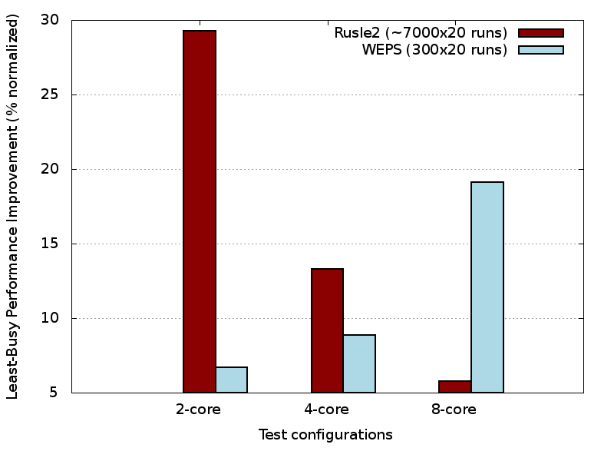
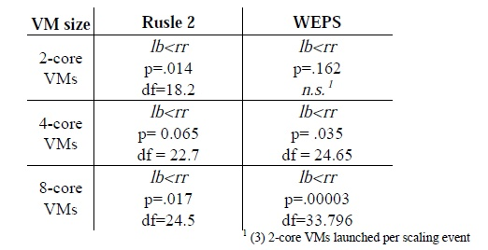
Application Performance Improvement vs. Round-Robin VM Placement
Average Performance Improvement:
~16.1% RUSLE2
~11.6% WEPS_
~14% aggregate
Normalized %
Performance Improvement
Statistical significance

Slide 18
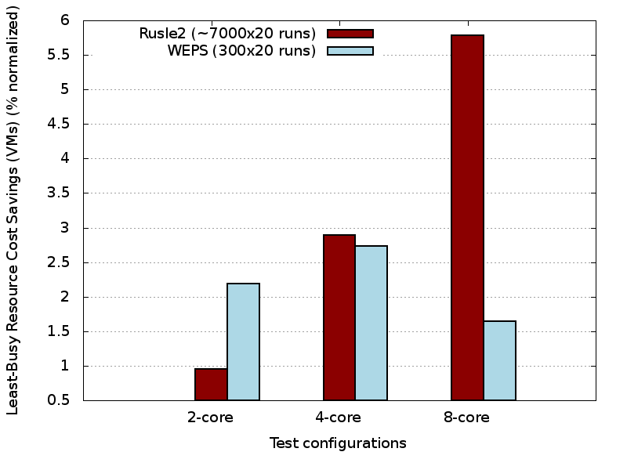
Resource Cost Savings vs. Round-Robin VM Placement
Average Savings:
~2.7% fewer VMs
~14.7 fewer CPU cores
Resource Cost Savings
% Fewer VMs

Slide 19
Conclusions

Slide 20
Conclusions
RQ1:
RQ2:
Least-Busy VM placement enabled
performance improvements up to:
29% (RUSLE2), 19% (WEPS)
▪ When dynamically scaling
▪ In the presence of a shared load
These performance improvements were realized using slightly fewer (2.7 %) virtual machines.
Abstraction of physical hardware using IaaS clouds leads to the simplistic view:
(1) Resources are homogeneous
(2) Scaling infinitely provides linear performance increases
Our results demonstrate:
(1) The importance of fine grained resource management for supporting infrastructure elasticity
(2) Where hardware is not infinite

Slide 21
Questions

Slide 22
Extra Slides

Slide 23

Gaps in Related Work
Prior work investigates:
  WHEN to scale – hot spot detection
  WHAT to scale – size and number of VMs
  WHERE to scale
    Task/job scheduling
    VM placement/migration across nodes
No studies have investigated implications of VM placement for dynamic scaling application infrastructure…

Slide 24
Average Model Execution Time

Slide 25
LeastBusy VM Placement
LeastBusy VM placement
  “Busy Metric” rates resource utilization of physical hosts and virtual machines
  Resource
  Identifies
  Parallel launch: launch N VMs per scaling event
    Double-schedule MAX BusyMetric threshold
    Only if min distance (BusyMetric) to nearest neighbor

Slide 26
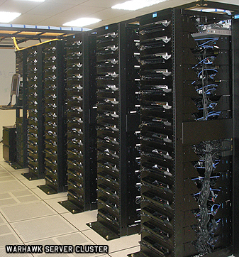
Eucalyptus 3 Private Cloud
(9) Sun X6270 blade servers
  Dual Intel Xeon 4-core 2.8 GHz CPUs
  24 GB ram, 146 GB 15k rpm HDDs
  CentOS 5.6 x86_64 (host OS)
  Ubuntu 9.10 x86_64 (guest OS)
Eucalytpus 3.1
  Amazon EC2 API support
  8 Nodes (NC), 1 Cloud Controller (CLC, CC, SC)
  Managed mode networking with private VLANs
  XEN hypervisor v 4.1, paravirtualization

Slide 27
RUSLE2 Components
Virtual Machine |  | Description
M | Model | Apache Tomcat 6.0.20, Wine 1.0.1, RUSLE2 Model, Object Modeling System (OMS 3.0)
D | Database | Postgresql-8.4, and PostGIS 1.4.0-2. soil data: 1.7 million shapes, 167 million points management data: 98 shapes, 489k points climate data: 31k shapes, 3 million points 4.6 GB for the state of TN
F | File Server | nginx http server 0.7.62 57,185 XML files consisting of 305MB.
L | Logger | Codebeamer 5.5 running 32-bit ApacheTomcat 6.0 Custom REST/JSON logging service as wrapper.

Slide 28
SC1
SC2
SC3
SC4
M D
F L
M D
F
L
M D
F L
M D
F
L
SC5
SC6
SC7
M
D
F L
M
D F
L
M
D
F
L
(15) Tested Component Deployments
  Each VM deployed to separate physical machines
  All components installed on composite image
  Script enabled/disabled components to achieve configs
SC8
SC9
SC10
M
D
F L
M
D L
F
M F
D L
SC11
SC12
SC13
M F
D
L
M L
D F
M L
D
F
SC14
SC15
M D
L
F
M L
F
D

Slide 29
Tested Resource Utilization Variables
CPU
CPU time
c
Disk
- Disk sector reads (dsr)
- Disk sector reads completed (dsreads)
Network
- Network bytes sent (nbr)
- Network bytes received (nbs)

Slide 30
Amazon Web Services:
White Paper on Application Deployment
Amazon white paper suggests:
  “bundling the logical construct of a component into an Amazon Machine Image so that it can be deployed more often.”
  J. Varia, Architecting for the Cloud: Best Practices, Amazon Web Services White Paper, 2010, https://jineshvaria.s3.amazonaws.com/public/ cloudbestpractices-jvaria.pdf
To support application scaling

Slide 31
Service Isolation Advantages
MongoDB
Enables
  Horizontal scaling
  Fault tolerance
tomcat7
nginx
MongoDB
MongoDB
PostgreSQL
MySQL
MongoDB
MongoDB
MemcacheDB
MongoDB
SCALE
MongoDB

Slide 32

Service Isolation Overhead
Isolation requires
  Separate operating system instances
  More network traffic
PostgreSQL
tomcat7
nginx

Slide 33
Provisioning Variation
Request(s) to
launch VMs
VMs Share PM
CPU / Disk / Network
VM
Physical Host
Physical Host
Physical Host
VM
VM
VM
VM
VM
VM
Ambiguous
Mapping
VM
VM
VM
VM
VM
Physical Host
Physical Host
Physical Host
VM
VM
VM
VM
VM
VM
VMs Reserve
PM Memory Blocks
PERFORMANCE

Slide 34
Infrastructure Management
Service Requests
  Scale Services
  Tune Application Parameters
  Tune Virtualization Parameters
Application
Servers
Load Balancer
Load Balancer
distributed cache
noSQL data stores
rDBMS

Slide 35
Application Profiling Variables
Predictive Power

Slide 36

Application Deployment Challenges
VM image composition
Service isolation vs. scalability
Resource contention among components
Provisioning variation
  Across physical hardware

Slide 37
Resource Utilization Variables
Statistic |  | Description
P/V | CPU time | CPU time in ms
P/V | cpu usr | CPU time in user mode in ms
P/V | cpu krn | CPU time in kernel mode in ms
P/V | cpu_idle | CPU idle time in ms
P/V | contextsw | Number of context switches
P/V | cpu_io_wait | CPU time waiting for I/O to complete
P/V | cpu_sint_time | CPU time servicing soft interrupts
V | dsr | Disk sector reads (1 sector = 512 bytes)
V | dsreads | Number of completed disk reads
V | drm | Number of adjacent disk reads merged
V | readtime | Time in ms spent reading from disk
V | dsw | Disk sector writes (1 sector = 512 bytes)
V | dswrites | Number of completed disk writes
V | dwm | Number of adjacent disk writes merged
V | writetime | Time in ms spent writing to disk
P/V | nbr | Network bytes sent
P/V | nbs | Network bytes received
P/V | loadavg | Avg # of running processes in last 60 sec

Slide 38
Experimental Data
Script captured resource utilization stats
  Virtual machines
  Physical Machines
Training data: first complete run
  20 different ensembles of 100 model runs
  15 component configurations
  30,000 model runs
Test data: second complete run
  30,000 model runs

Slide 39


Application Deployments
n=# components; k=# components per set
Permutations
Combinations
But neither describes partitions of a set!

Slide 40


Bell’s Number
Number of ways a set of n elements can be partitioned into non-empty subsets
n | k
4 | 15
5 | 52
6 | 203
7 | 877
8 | 4,140
9 | 21,147
n | . . .
n = #components
VM deployments
config 1
config 2
Model
1 VM : 1..n components
M
D
M
D
F
Database
Component
Deployment
F
L
L
File Server
config n
Log Server
M
L
D
Application “Stack”
F
. . .
k= #configs
# of Configurations

Slide 41
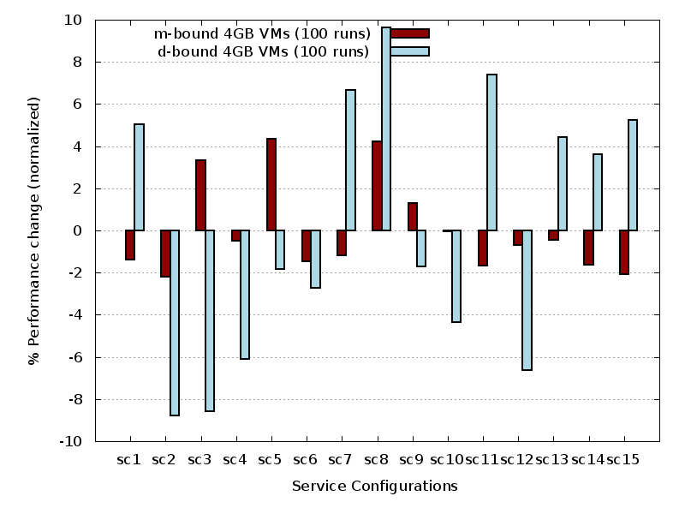
XEN Mbound vs Dbound Performance Same Ensemble

Slide 42
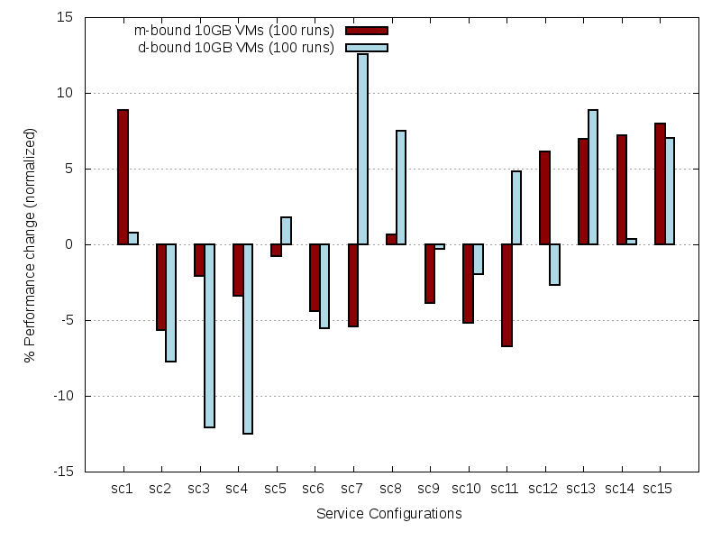
XEN 10 GB VMs

Slide 43
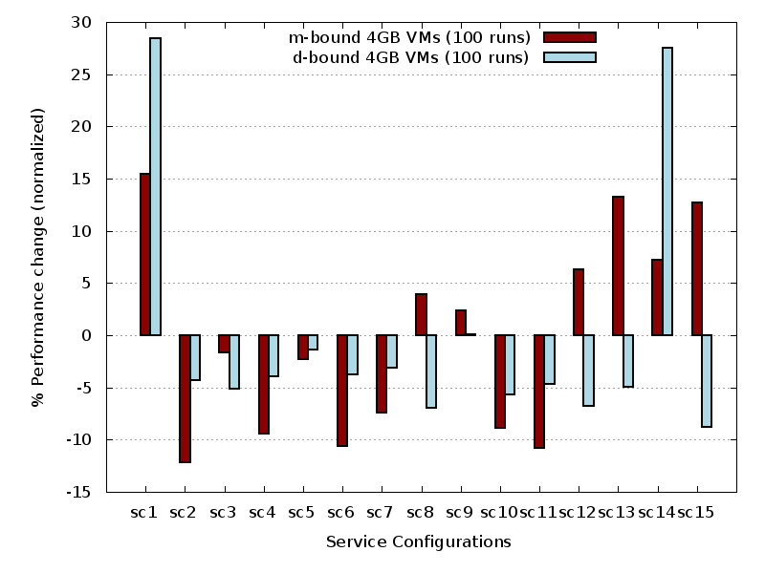
KVM Mbound vs Dbound Performance
Same Ensemble

Slide 44
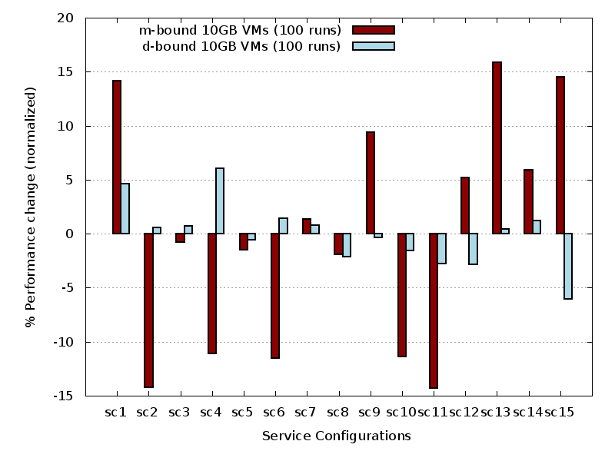
KVM 10GB Performance
Same Ensemble

Slide 45
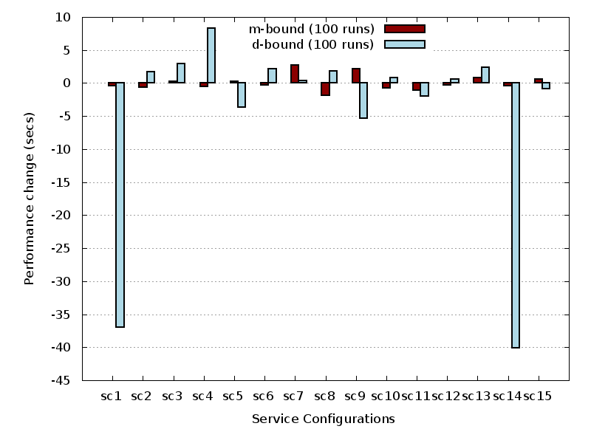
KVM 10 GB Performance Change
Same Ensemble

Slide 46
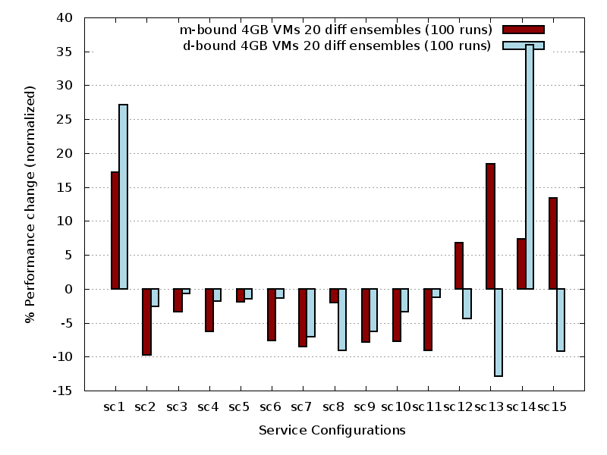
KVM Performance Comparison
Different Ensembles

Slide 47
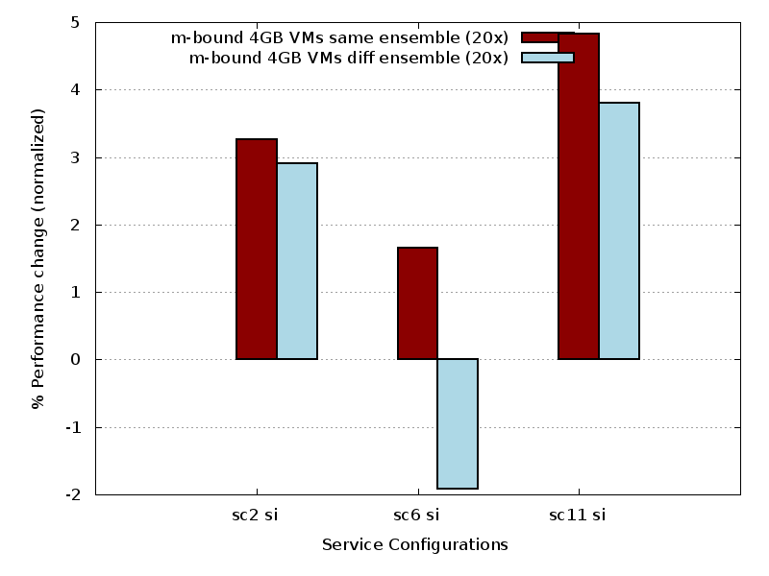
KVM Performance Change
From Service Isolation

Slide 48
Service Configuration Testing
Big VMs
  All application services installed on single VM
  Scripts enable/disable services to achieve configurations for testing
  Each VM deployed on separate host
Provisioning Variation (PV) Testing
  KVM used
  15 total service configurations
  46 possible deployments

Slide 49
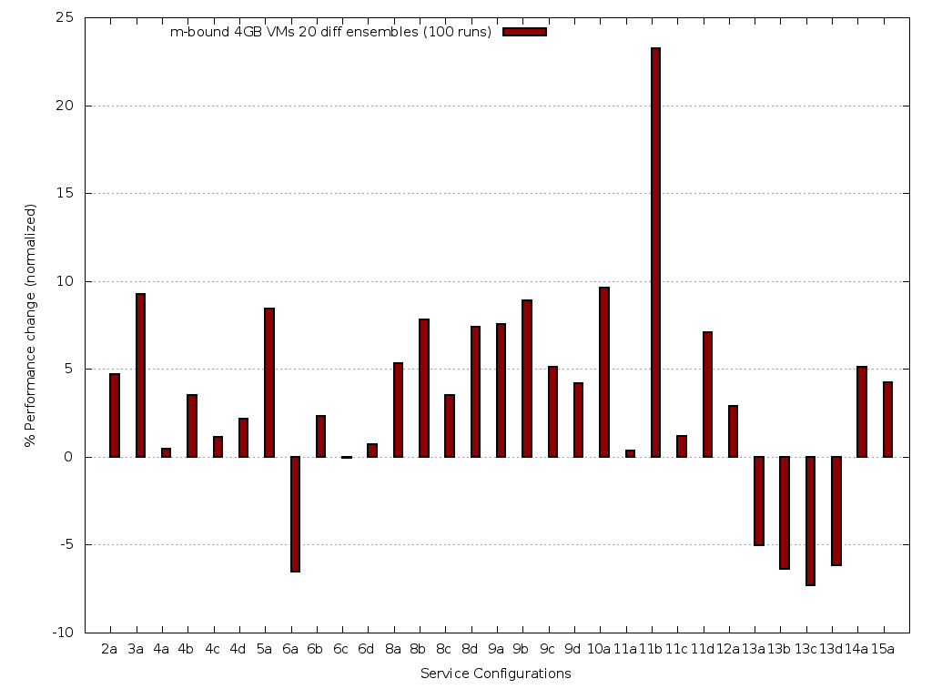
PV: Performance Difference vs. Physical Isolation

Slide 50
Service Configuration Testing - 2
Big VMs used in physical isolation were effective at identifying fastest service configurations
Fastest configurations isolate “L” service on separate physical host; and VMs
  Some provisioning variations faster
Other SC provisioning variations remained slow
  SC4A-D, SC9C-D
  Only SCs w/ avg ensemble performance < 30 seconds

Slide 51



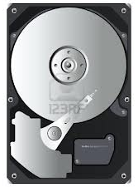
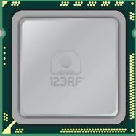

Can Resource Utilization Statistics
Model Application Performance?

Slide 52
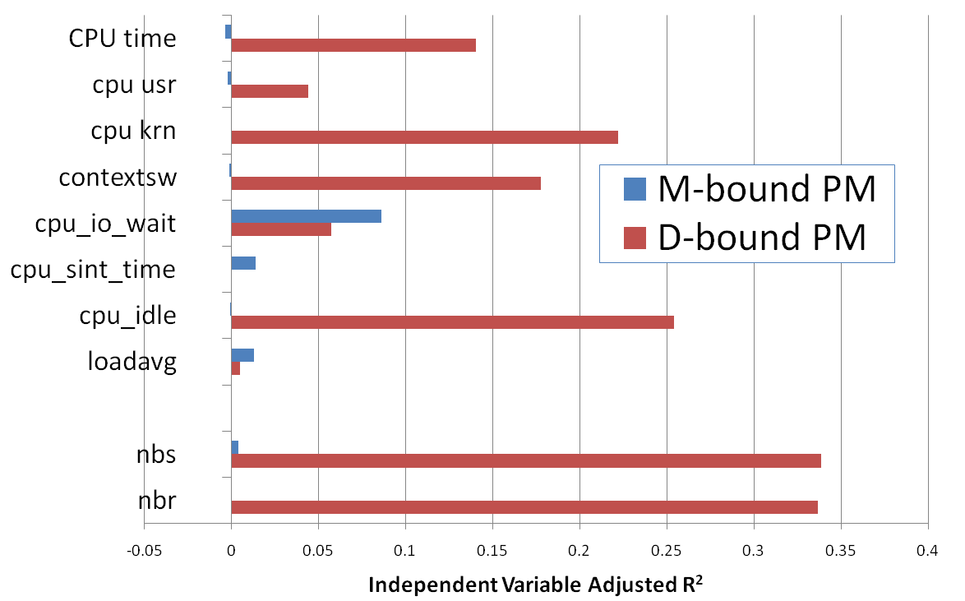
RQ1 – Which are the best predictors? PM Variables
CPU
Network I/O

Slide 53
RQ2 – How should VM resource utilization data be used by performance models?
Combination:
  RU_{data}=RU_{M}+RU_{D}+RU_{F}+RU_{L}
Used Individually:
  RU_{data}={RU_{M}; RU_{D}; RU_{F}; RU_{L};}

Slide 54
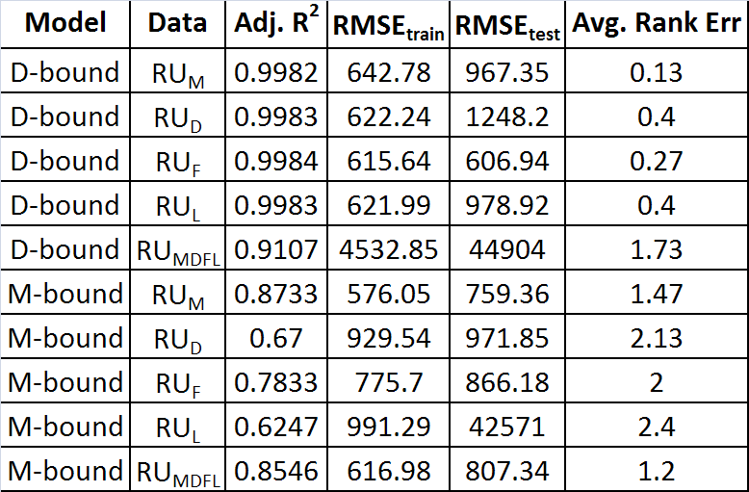
RQ2 – How should VM resource utilization data be used by performance models?
D-bound separate
RU_{M} or RU_{MDFL}
for M-bound was better !
D-bound combined
M-bound separate
Treating VM data separately
for D-bound was better !
Note the larger RMSE
for D-bound RU_{MDFL}!
M-bound combined

Slide 55
RQ3 – Which modeling techniques were best?
Multiple Linear Regression (MLR)
Stepwise Multiple Linear Regression (MLR-step)
Multivariate Adaptive Regression Splines (MARS)
Artificial Neural Network (ANNs)

Slide 56
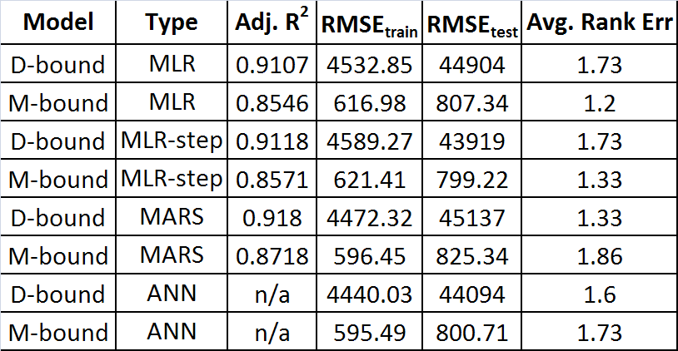
RQ3 – Which modeling techniques were best?
Multiple
Linear
Regression
Stepwise
MLR
Multivariate
Adaptive
Regresion
Splines
RU_{MDFL} data used to
compare models.
Had high RMSE_{test} error
for D-Bound (32% avg)
Artifical
Neural
Network
Model performance did not vary much
Best vs. Worst
D-Bound M-Bound
.11% RMSE_{train} .08%
.89% RMSE_{test} .08%
.40 rank err .66

Slide 57
Resource Utilization Statistics
CPU
- CPU time
- CPU time in user mode
- CPU time in kernel mode
- CPU idle time
- # of context switches
- CPU time waiting for I/O
- CPU time serving soft interrupts
- Load average (# proc / 60 secs)
Disk
- Disk sector reads
- Disk sector reads completed
- Merged adjacent disk reads
- Time spent reading from disk
- Disk sector writes
- Disk sector writes completed
- Merged adjacent disk writes
- Time spent writing to disk
c
Network
- Network bytes sent
- Network bytes received
PM
PM
VM
VM
VM
VM
VM

