Slide 1
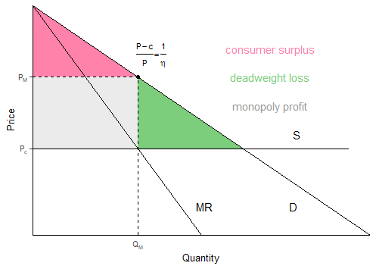
Monopolist pricing: marginal revenues = marginal costs, facing entire demand curve

Slide 2
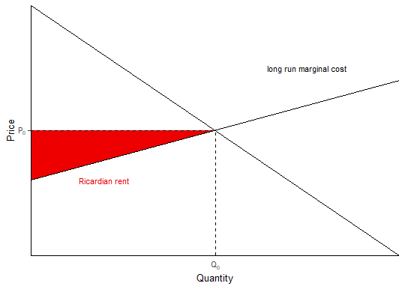
Ricardian Rents in a competitive market with upward sloping demand curve

Slide 3
Drastic Process Innovation: monopolist vs. startup
Notes:
If the monopolist innovates it is sacrificing the red square. It must subtract that from the green square. It also incurs the fixed costs of innovation.
A new entrant into a competitive market can create a new process that drastically reduces costs, way below the costs currently characterizing the competitive price, pre-invention.
Because the post-invention marginal costs are so low, the new entrant can charge monopoly prices that are much lower than the monopoly price charged by a monopolist pre-invention.
So even though there are deadweight losses compared to what a competitive market would look like with the new marginal costs, the price is lower than the competitive price pre-invention and the quantity is greater than the quantity pre-invention.

Slide 4
Drastic Product Innovation: monopolist vs. startup
Notes:
Even though there are deadweight losses when a startup enters the market and establishes a monopoly with
a product innovation, consumers are better off than they were before that in a competitive market with the old
demand curve. The startup shifts out the demand curve so drastically that the new monopoly price (Va +c)/2 is actually less than the Va-Vb, the increase in value between the product before the invention and the product after the invention. Obviously, the amount produced also increases.
Va (willingness to pay for new product) – Vb (willingness to pay for old product)

