Slide 1
Liberalism & Science: what are they & what are they good for?
Professor Victor Menaldo
University of Washington
2020

Slide 2
Outline
What is liberalism?
What is the origin of liberalism?
What is academic freedom?
How are liberalism & academic freedom useful?
Who benefits from liberalism & academic freedom?
What is science?
How do we use the scientific method to find answers to questions about the material & social world?

Slide 3
What is liberalism?
1) Set of values, rights & institutions beyond partisanship & ideologies.
The USA’s two major parties have their origins in liberalism
2) Idea that individuals are born free & equal & are worthy of respect.
3) Idea that governments should be limited in their power & accountable to their citizens.
4) Idea that facts, logic & evidence are sometimes superior to opinions, specious reasoning & anecdotes.
5) Idea that pursuit of democracy, human rights & science can lead to genuine social progress.
Notes:
An optimistic conservatism that wasn’t backward-looking at all. Although there were darker versions, at its best it was energetic, reformist, and generous, predicated on faith in the United States, a belief in the greatness of American democracy, and an ambition to share that democracy with the rest of the world.

Slide 4
What are the roots of liberalism?
1) Codification of liberalism occurred in Western Europe during 1700s (The Enlightenment).
2) Its heritage not Western European!!!
Hunter gatherer societies: individuals had to find ways to coordinate, cooperate, share, make collective decisions & compromise. This required deliberation & debate.
Ancient Greeks invented democracy, valorized reason & practiced rudimentary forms of science. They were not Europeans in the modern sense (their DNA traces to Iran, Egypt & Turkey).
Roman Empire, including citizens from North Africa & Middle East, recognized key liberal tenets:
By a natural right all men are born free; & nature having set all men upon a level & made them equals, no servitude or subjection can be conceived without inequality; & this [inequality] cannot be made without usurpation of force in others, or voluntary compliance in those who resign their freedom & give away their degree of natural being.
Uplian, a jurist from Lebanon (Roman Empire), circa 200 CE.
Islamic caliphates practiced religious tolerance & afforded significant rights to women.
3) It’s political basis of modern world & has been embraced by governments & cultures worldwide.
Notes:
Liberals from across the world:
Ghandi
Mandela
Obama

Slide 5
What is academic freedom?
Idea that scholars who work in higher education should pursue truth above all other objectives.
Idea that pursuit of truth requires devotion to facts, logic & evidence.
Idea that to truly contribute to pursuit of truth & knowledge, scholars should not be pressured by governments or their employers or popular culture to pursue some lines of inquiry over others or to presume the answer to a question before using the scientific method or other objective processes to actually figure out the answer.
Idea that tenure protects scholars from punishment for pursuing unpopular lines of inquiry or reaching inconvenient conclusions.

Slide 6
How are liberalism & academic freedom useful in the university & beyond?
Liberalism fuels humanism & science; prioritizes free inquiry & methods that promote knowledge, including criticism & debate.
Effective tool not only for obtaining truth, but advancing social justice.
Key to advancing social justice not latching onto set of predetermined means but identifying & fighting for right ends. Ecosystem of open debate & criticism helps discover best means to advance objectives such as equality, progress & justice.
Help smoke out & challenge bad ideas. If bad ideas are censored or repressed, they find another way of surfacing & then it’s too late: we won't be able to use facts, logic & evidence to arrest them.
Allow people to change their mind on their own, without coercion & based on persuasion—that’s a firmer ground for advancing worthy ends.

Slide 7
Who benefits from liberalism?
Liberalism is especially for the weak. The strong don’t need legal or cultural protections around free speech because they’re already protected by power & wealth. They don't need protest & dissent as tool to advance their interests. Minorities & poor people need ability to speak out & organize to fight oppression:
No freedom (of speech or assembly) to oppose slavery in the pre-Civil War South or Southwest.
No freedom of expression or assembly for African Americans during the Jim Crow era.
No freedom of expression & assembly for Native Americans on the frontier during western expansion.
No freedom of expression & assembly for Mexican-Americans when Texas Rangers massacred them in Porvenir, Texas.
No tolerance for anti-interventionist views in 1917-18, in the run up to WWI.
No tolerance for free speech during 1950s. This led to firing of “heterodox” professors during McCarthy era, including purging @ UW by President Raymond Allen of three tenured professors accused of harboring Communist sympathies.
No tolerance for anti-war views during the early years of the Vietnam conflict.
Notes:
A little over a decade later, civil rights leaders were on the receiving end of a relentless campaign to suppress their right to free speech and assembly:
Martin Luther King Jr. penned his Letter from a Birmingham Jail after being arrested for protesting nonviolently;
Robert Moses was arrested in 1962 for handing out leaflets urging African Americans to vote;
John Lewis was arrested in Selma for holding up a sign that read “One Man / One Vote” outside the courthouse.
Like King, many others were threatened and murdered for protesting segregation and other forms of institutionalized racism in the United States.

Slide 8
What is Science?
NOT body of findings or accumulated knowledge.
All “knowledge” is preliminary.
Method to settle claims.

Slide 9
What is Science?
Call into question established beliefs:
Restate assertions as questions to be investigated.
Be open to possibility that evidence may reject what you/others believe to be true.
Be skeptical—question dogma & knowledge based on authority.
Notes:
Not about who is making claim. Her reputation or intelligence does not matter.

Slide 10
What is Science About? Asking Questions
State questions as hypotheses:
Questions about relationship between variables: how variation in one dimension maps onto variation on another dimension
Questions about change: why things switch from one state to another
Notes:
Heights of people.
Blood pressure.
Points on a test.
SAT scores
Salaries.

Slide 11
Propose a Theory with Causal Mechanism
Our assumptions motivate a chain of causally related events linking the variables together:
A → B → C → D → E → F
A is the independent variable, F is the dependent variable, & B, C, D & E are intervening variables.
The theory provides a story about why A leads to F.
Notes:
Elaborating a hypothesis about relation of one variable to another.
Hypothesis embedded in a theory that is logical & internally consistent.
Theory provides mechanism as to why two variables co-vary.

Slide 12
What is science? A particular way of answering questions
Scientific method = attempt to reject an answer to a question.
What set of facts, which if true, would cause me to change my mind?
Actively look for evidence or experiment that may reject my hypothesis.

Slide 13
What is Science? A particular way of answering questions
Identify variables embedded in a hypothesis.
Operationalize: measure those variables.
Test: use/generate data to examine relationship between variables.
Generalization: does relationship hold outside this particular test?
Notes:
Break down complex thing into components—simplify away from details/isolate specific attributes.
What if we wanted to identify & measure how democratic a country is? How would we identify, observe & measure?
Replication: ensure finding not a fluke. Extrapolate beyond the specific data used to test hypotheses
Predictions about future based on inferences gained from testing hypotheses

Slide 14
Why do some people develop lung cancer?
Hypothesis: The greater the degree to which someone is exposed to cigarette smoke, the higher the odds she will develop lung cancer.

Slide 15
What is the Causal Mechanism?
Tar & other toxic chemicals = radiological poisons.
Heavy metals bind to DNA
When they bind to DNA → genetic mutations
Mutations → runaway cell division that make healthy cells cancerous
Notes:
polonium-210 & lead-210 (heavy elements that cause damage to cells)

Slide 16
How do we know?
Longitudinal study of 34,439 medical specialists from 1951 to 2001:
2/3 of persistent cigarette smokers born in 1920s would eventually die.
Heaviest smokers 50 times more likely than non-smokers to get lung cancer.

Slide 17
Hypothesis Testing: Observational Data
Lung cancer studies are OBSERVATIONAL. We look at correlation btwn. smoking & propensity for cancer only AFTER folks decided for themselves whether/how much to smoke.
In other words: researchers do not manipulate the treatment variable.

Slide 18
Hypothesis Testing: Experiments
Gold Standard to test hypothesis: a double blind experiment with random assignment.
Produce two (identical) groups = treatment & comparison group
What differs? One group exposed to treatment & other gets placebo.
Outcomes for treatment group then compared to outcomes for control group

Slide 19
Question: what reduces pain?
Hypothesis: Ingesting 650 mg of aspirin will reduce pain.
Causal mechanism: Aspirin dulls the pain signals sent by nerve endings to the central nervous system:
Cells in damaged tissues make chemicals (prostaglandins) using an enzyme called COX-2 (Cyclooxygenase 2).
These chemicals stimulate nerve endings.
When nerve endings stimulated, we feel pain.
Aspirin sticks to COX-2 enzymes & prevents them from making prostaglandins.
Notes:
Damaged tissues → enzyme → chemicals that stimulate nerve endings
Aspirin sticks to enzyme & blocks it from producing chemicals that stimulate pain.
Cox 2 inhibitor

Slide 20
Research Design
Randomly assign aspirin to 1/2 of a sample experiencing pain & sugar pill to other half.
For every 40 year old librarian in treatment group, there’s a 40 year old librarian in control group.
For every 23 year old hipster in treatment group, there’s a 23 year old hipster in control group.
You can rule out possibility that hipsters may have lower pre-treatment levels of pain, or be less susceptible to aspirin.
Notes:
How do you rule out the fact that hipsters may be overrepresented in treatment group?

Slide 21
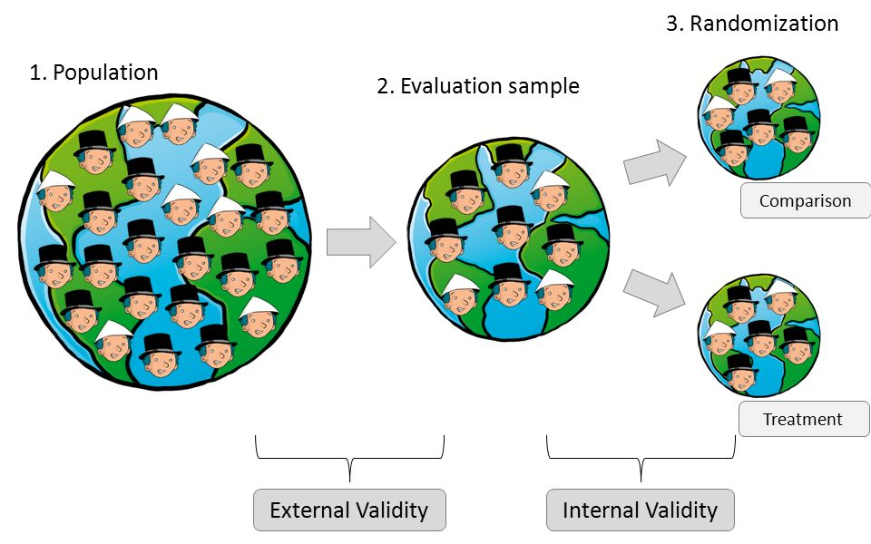
Eliminating the Hipster Effect?

Slide 22
An Experiment…
Research Subjects
Three hundred fifty outpatients with postoperative pain after surgical removal of impacted third molars
Independent Variable
Each randomly assigned, on a double-blind basis, a single oral dose of 650 mg of COX inhibitor or placebo. 175 received inhibitor. The other 175 received sugar pill.
Dependent Variable
Using a self-rating record, subjects rated their pain & its relief hourly for 6 hours after medicating:
summed pain intensity
peak pain intensity
total relief
peak relief
hours of 50% relief

Slide 23
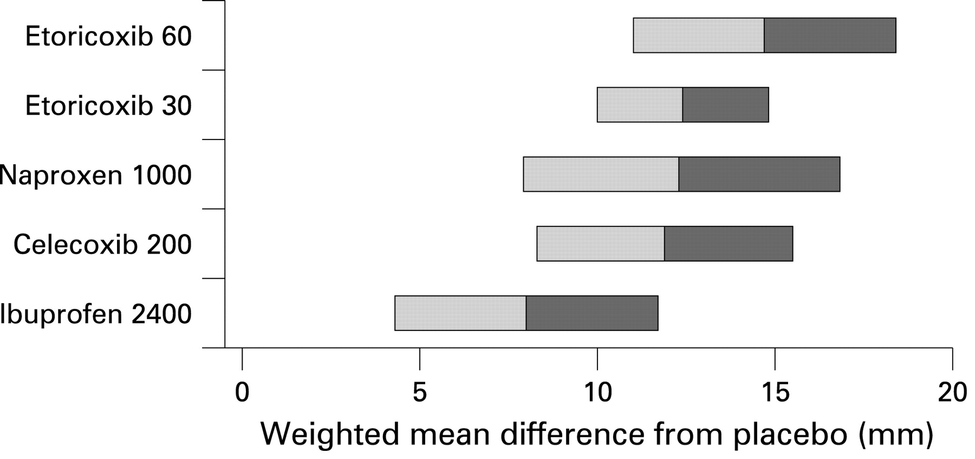
Hours of 50% Relief: Results
Source: Moore, Moore, Derry, Peloso, Gammaitoni, & Wang (2010).
Notes:
Sample size of 1050: 875 split into 5 different treatment groups (175 per group) versus 175 for control group.
Hours of 50% relief. Point estimate is 7.5 hours.
We are 95% certain that folks who take Ibprofen are, on average, likely to get btwn 4.5 & 12 more hours of 50% pain relief than those who don’t.
This range of pain relief (4.5 to 12 hrs.) is the 95% confidence interval around our prediction.
When we generalize from the test sample to the population there is some uncertainty about the magnitude of the effect (margin of error).

