Slide 1
Population, Resources, Environment
Stevan Harrell
ANTH/SISEA 406
15 January, 2014

Slide 2
What do we Need to Know about Population?
How has population grown through history?
What determines population growth?
What drives population growth?
How do population growth and density vary in different kinds of societies?
How does population growth affect the environment?
What does the future look like?

Slide 3
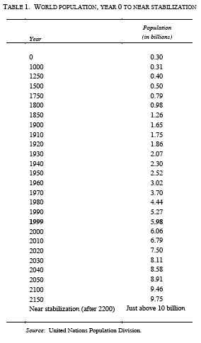
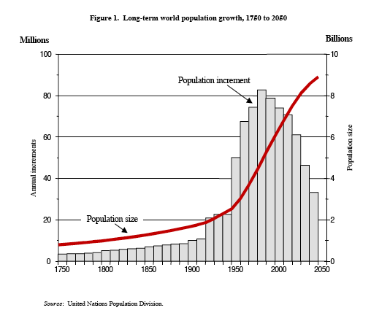
How has the world’s population grown through history?

Slide 4
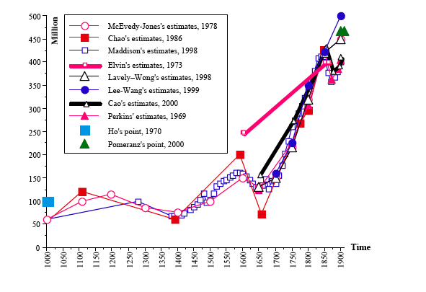
How has China’s population grown through history?
Kent G. Deng: Unveiling China’s True Population Statistics for the Pre-modern Era with Official Census Data. Population Review 43,2 2004.

Slide 5
What determines population growth?
Fertility: a measure of births per population per year
  Crude birth rate: number of births per total population per year
  Age specific fertility rate: number of births per woman of a specified age (e.g. 20-24) per year
  Total fertility rate: the average number of children born per woman: sum of ASFR for all ages

Slide 6
What determines population growth?
Mortality: A measure of deaths per population per year
  Crude death rate: the number of deaths per total population per year
  Age specific mortality rate: the number of deaths per population of a particular age (e.g.1-4 or 70-74) per year
  Life expectancy: the average number of years one can expect to live at a particular age

Slide 7
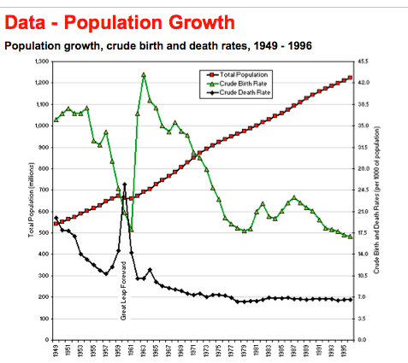
Fertility, Mortality, and Population, 1949-1996
http://www.iiasa.ac.at/Research/LUC/ChinaFood/data/pop/pop_10.htm

Slide 8
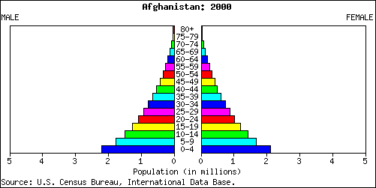
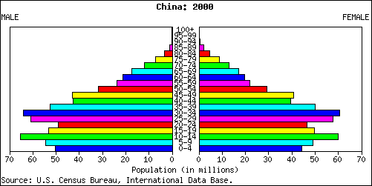
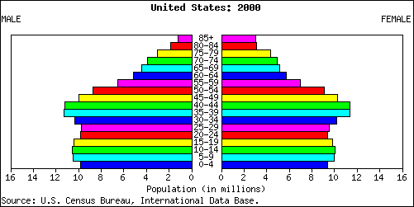
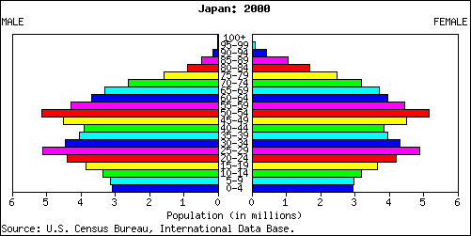
What determines population growth?
Age structure of a population

Slide 9
What drives population growth?
Measures
Rising fertility
  Earlier maturation
  Shorter birth interval
  Declining mortality at reproductive age
Declining mortality
  Control of infectious diseases, particularly in infancy
  Assured food supply
  Medical care??

Slide 10
What Drives Population Growth: Theories
Mortality driven:
  Invention of new technologies allows lowered mortality and excess of births over deaths
  People will reproduce until they come up against “positive checks” (Malthus)
Fertility driven:
  Population growth forces people to create new technologies to accommodate the extra people
  People are capable of limiting their fertility

Slide 11
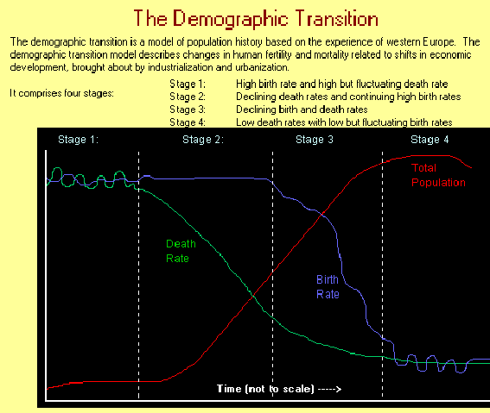
What Drives Population Growth:
Demographic Transition

Slide 12
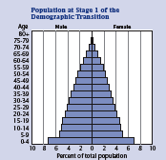
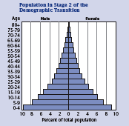
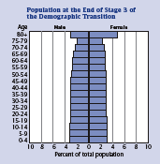
What Drives Population Growth:
Demographic Transition
High fertility
High mortality
High fertility
Low mortality
Low fertility
Low mortality

Slide 13
Effects of faster population growth
• Younger age structure
• More complex families
• Higher rates of migration
• Higher rates of conflict?
And, conversely, slower population growth
• Older age structure
• Less complex families
• Lower rates of migration
• Lower rates of conflict?

Slide 14
How does population growth affect the environment?
Some adverse affects, all else being equal
• Decreased habitat for other species
• Resource depletion
- Changes in land cover
- Deforestation and loss of carbon sinks
- Extinction of prey species
• Pollution
- Nitrogen from fertilizers and wastes
- Sulfur from combustion

Slide 15
How does population growth affect the environment?
But: all else is never equal
I = PAT:
Impact = population x affluence x technology

Slide 16
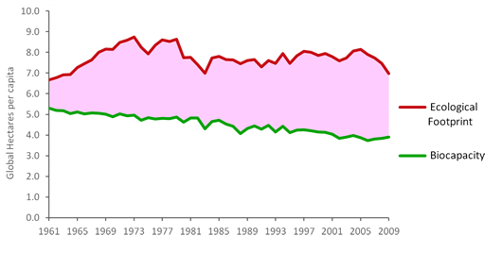
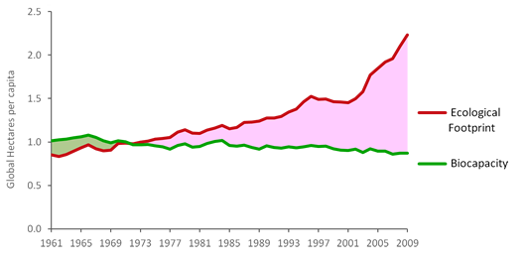
How does population growth affect the environment?
Ecological footprint: The amount of land it takes to support one person (in hectares)
Biocapacity: The amount of land
That can be used without degradation
China
U.S.A
Source: Global Footprint Network: www.footprintnetwork.org

Slide 17
What does the future look like?
Some representative Total Fertility Rates
Country | TFR 1985 | TFR 2000 | TFR 2005-2010
Rwanda | 7.8 | 5.7 | 5.4
Malawi | 7.4 | 5.3 | 6.0
Bangladesh | 5.5 | 3.1 | 2.4
India | 4.3 | 3.1 | 2.7
Mexico | 3.9 | 2.8 | 2.4
USA | 1.8 | 2.1 | 2.07
Japan | 1.7 | 1.5 | 1.3
China | 1.5 | 1.7 | 1.64
Italy | 1.5 | 1.3 | 1.4
World | 4.2 | 2.8

Slide 18
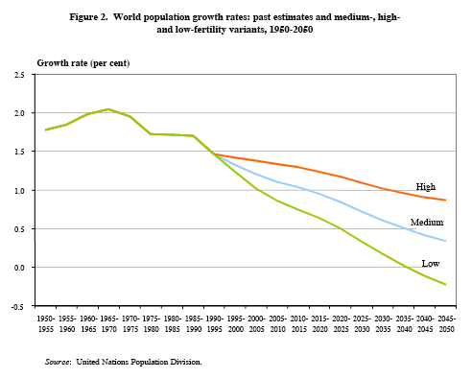
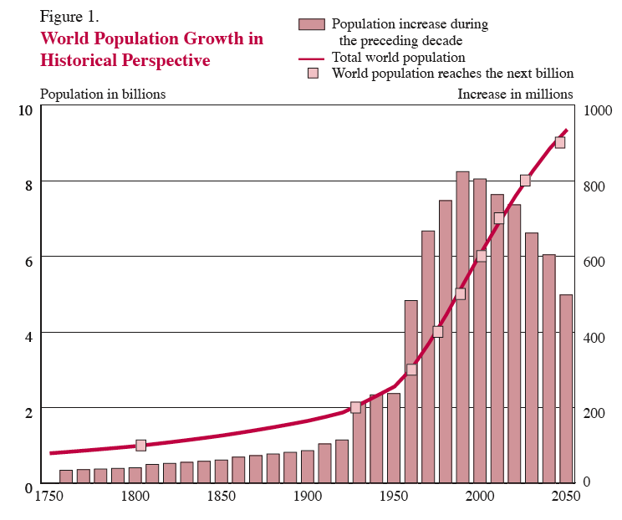
What does the future look like?

Slide 19
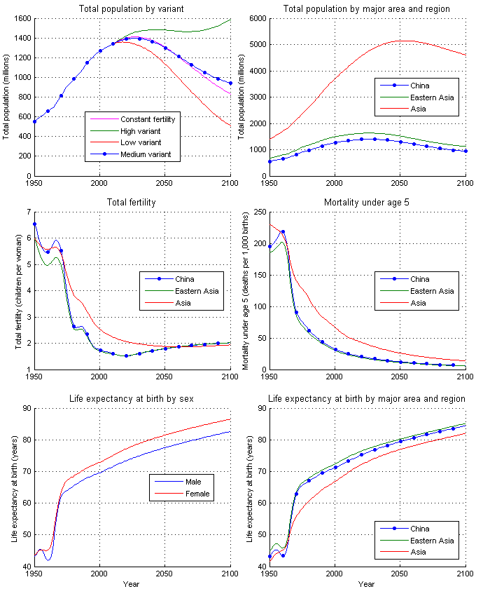
Future Projections: China

Slide 20
Birth and Death Rates, 1950-2100

Slide 21
What does the future look like?
I = PAT:
The effects of population growth on the environment will be magnified by increases in the affluence of world populations

Slide 22
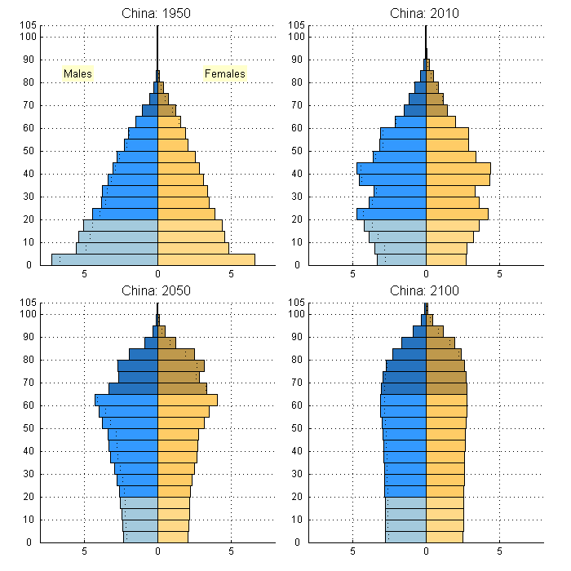
What does the future look like?
An aging population
Aging Population
Unbalanced
Sex-ratio

Slide 23
What does the future look like?
If the world population levels off at 10 billion mid-century
And global TFR declines to 1.9 and stays there, population in 3000 will be 2.14B, around the 1950 level
And global TFR declines to 1.7 and stays there, population in 3000 will be 76M, probably about the 2000 B.C.E. level
And global TFR declines to 1.3 and stays there, population in 3000 will be 24K, only a third enough to fill Husky Stadium

