Slide 1


human-machine interaction games
Sam Burden
Associate Professor
Associate Chair for Diversity, Equity, & Inclusion
Electrical & Computer Engineering
University of Washington
Seattle, WA USA
http://faculty.uw.edu/sburden

Slide 2
reach out if you want to talk
about mental health in academia:
sburden@uw.edu

Slide 3
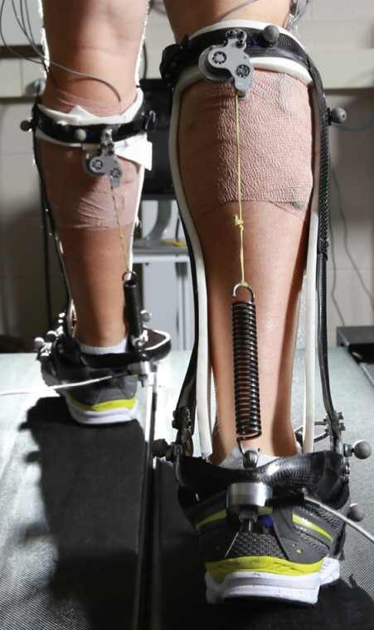
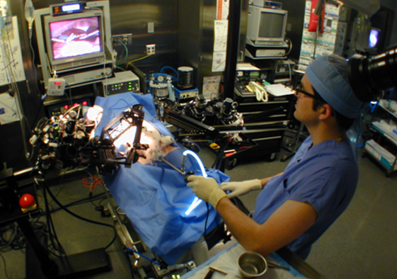
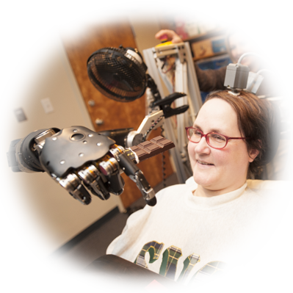



human interaction with the physical world
is increasingly mediated by machines
how can we predict and shape
human-machine interaction outcomes?
Hannaford, Rosen, Friedman, King, Roan, Cheng, Glozman, Ma, Kosari, White IEEE Tran Biomed Eng 2013 Raven-II: An Open Platform for Surgical Robotics Research
Wodlinger, Downey, Tyler-Kabara, Schwartz, Boninger, Collinger J Neural Eng 2015
Ten-Dimensional Anthropomorphic Arm Control in a Human Brain-Machine Interface
Collins, Wiggin, Sawicki Nature 2015
Reducing the Energy Cost of Human Walking Using an Unpowered Exoskeleton
Nothwang, Robinson, Burden, McCourt, Curtis IEEE Resilience Week 2016
The Human Should be Part of the Control Loop?

Slide 4
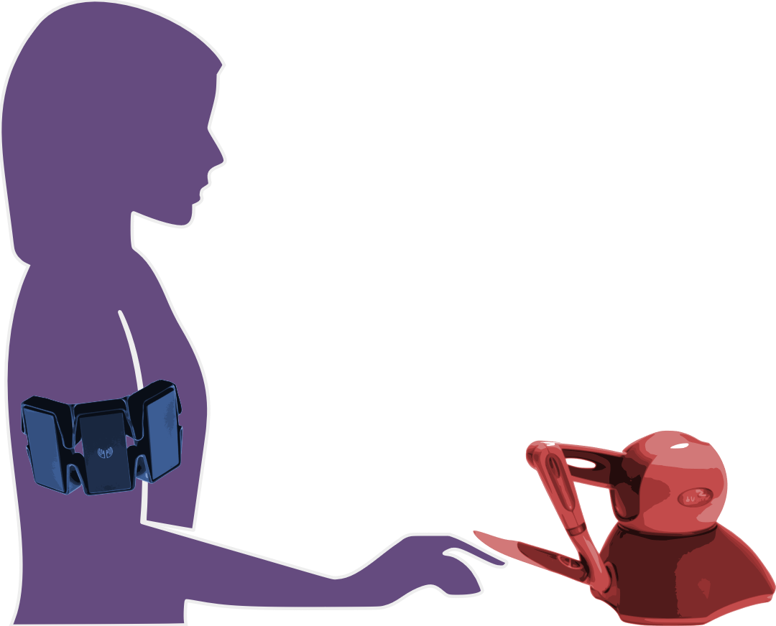
today’s talk:
how can we predict and shape outcomes of
human-machine interactions?
humans learn models of machines …
… so machines should learn models of humans

Slide 5
today’s talk:
how can we predict and shape outcomes of
human-machine interactions?
humans learn models of machines …
… so machines should learn models of humans

Slide 6
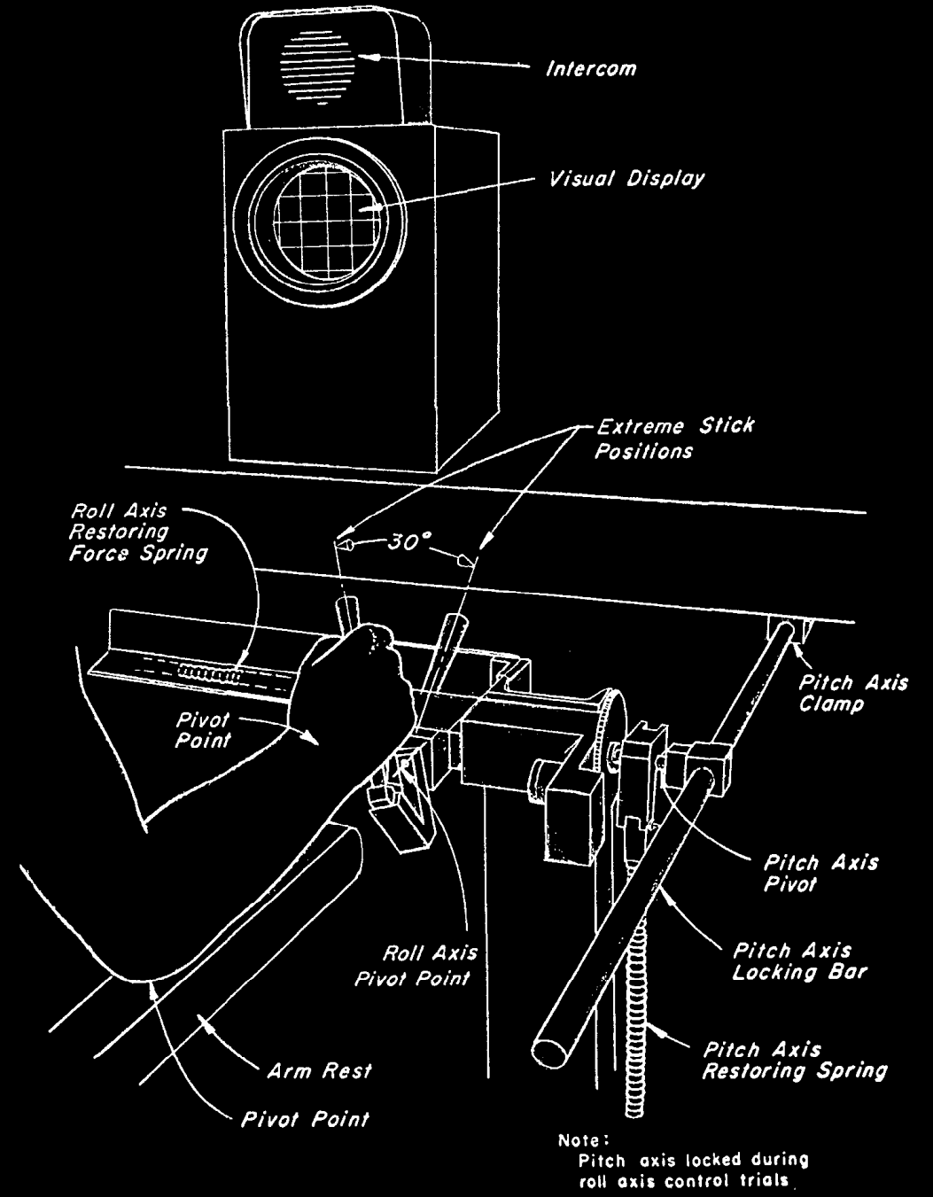
r
d
y
r
reference
y
output
u
disturbance
d
input
u
McRuer, Krendel J Franklin Institute 1959
The Human Operator as a Servo System Element
McRuer Automatica 1980
Human Dynamics in Man-Machine Systems

Slide 7
predicting behavior: what’s in ?
H
human-machine system
H
d
F
f
u
+
+
M
y
e
b
r
+
B
-

Slide 8

predicting behavior: what’s in ?
H
  theoretical and empirical evidence for pairing of system + inverse models
    Wolpert, Ghahramani, Jordan Science 1995
    Kawato Curr Opin Neurobiol 1999
feedforward ${F≈M}^{−1}$
system model
+
inverse model
  parallels in control theory, artificial intelligence: adaptive control, internal model principle, reinforcement learning
    Francis, Wonham Automatica 1976; Sastry, Bodson Prentice Hall 1989
    Sutton, Barto, Williams IEEE CSM 1992; Atkeson, Schaal ICML 1997
    Papavassiliou, Russell IJCAI 1999
Notes:
replace text with cartoon

Slide 9
human-machine system
H
d
F
f
u
+
+
M
y
e
b
r
+
B
-

Slide 10



H: humans use feedforward and feedback
human-machine system
feedforward
d
F
f
u
+
+
M
y
e
b
r
+
B
-
feedback
McRuer, Jex IEEE Transactions on Human Factors in Electronics 1967
A Review of Quasi-Linear Pilot Models
Yu, Gillespie, Freudenberg, Cook IEEE CDC 2014
Human control strategies in pursuit tracking with a disturbance input
Yamagami, Howell, Roth, Burden IFAC CPHS 2018
Contributions of feedforward and feedback control in a manual trajectory-tracking task

Slide 11

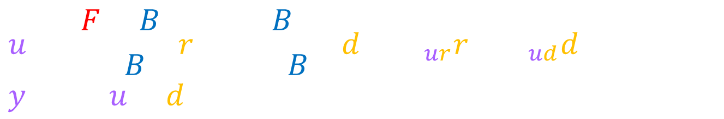
H: humans use feedforward and feedback
  test hypothesis:
  transcribe block diagram to algebraic equations
  solve equations for F, B
d
F
u
y
+
+
M
r
+
e
B
-
$$u=\frac{F+B}{1+BM}r+\frac{−BM}{1+BM}d=H_{ur}r+H_{ud}d, y=M(u+d)$$
  (1.)
$$F=\frac{H_{ur}+M^{−1}H_{ud}}{1+H_{ud}},B=\frac{−H_{ud}}{M(1+H_{ud})}$$
  (2.)
Cowan, Ankaralı, Dyhr, Madhav, Roth, Sefati, Sponberg, Stamper, Fortune, Daniel Int Comp Bio 2014
Feedback Control as a Framework for Understanding Tradeoffs in Biology
Yu, Gillespie, Freudenberg, Cook IEEE CDC 2014
Human control strategies in pursuit tracking with a disturbance input
Yamagami, Howell, Roth, Burden IFAC CPHS 2018
Contributions of feedforward and feedback control in a manual trajectory-tracking task

Slide 12
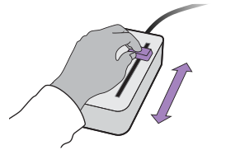


experiment: manual interface
  subjects use 1-dimensional joystick device to control cursor motion to track specified reference
Roth, Howell, Beckwith, Burden SPIE 2017
Toward experimental validation of a model for human sensorimotor learning and control in teleoperation
Yamagami, Howell, Roth, Burden IFAC CPHS 2018
Contributions of feedforward and feedback control in a manual trajectory-tracking task

Slide 13
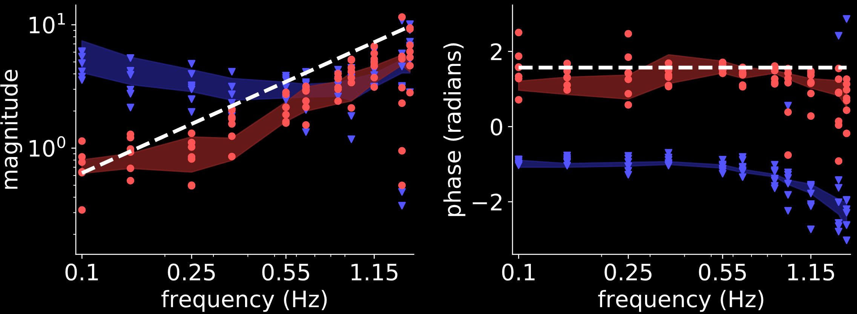





result: humans invert first-order model
$$(N=7)$$
d
$$M^{−1}$$
$$M=1/s$$
i.e. $\dot{y}=u$
(first-order)
F
u
y
+
+
M
$$F$$
r
+
e
B
-
$$B$$
Yamagami, Howell, Roth, Burden IFAC CPHS 2018
Contributions of feedforward and feedback control in a manual trajectory-tracking task

Slide 14
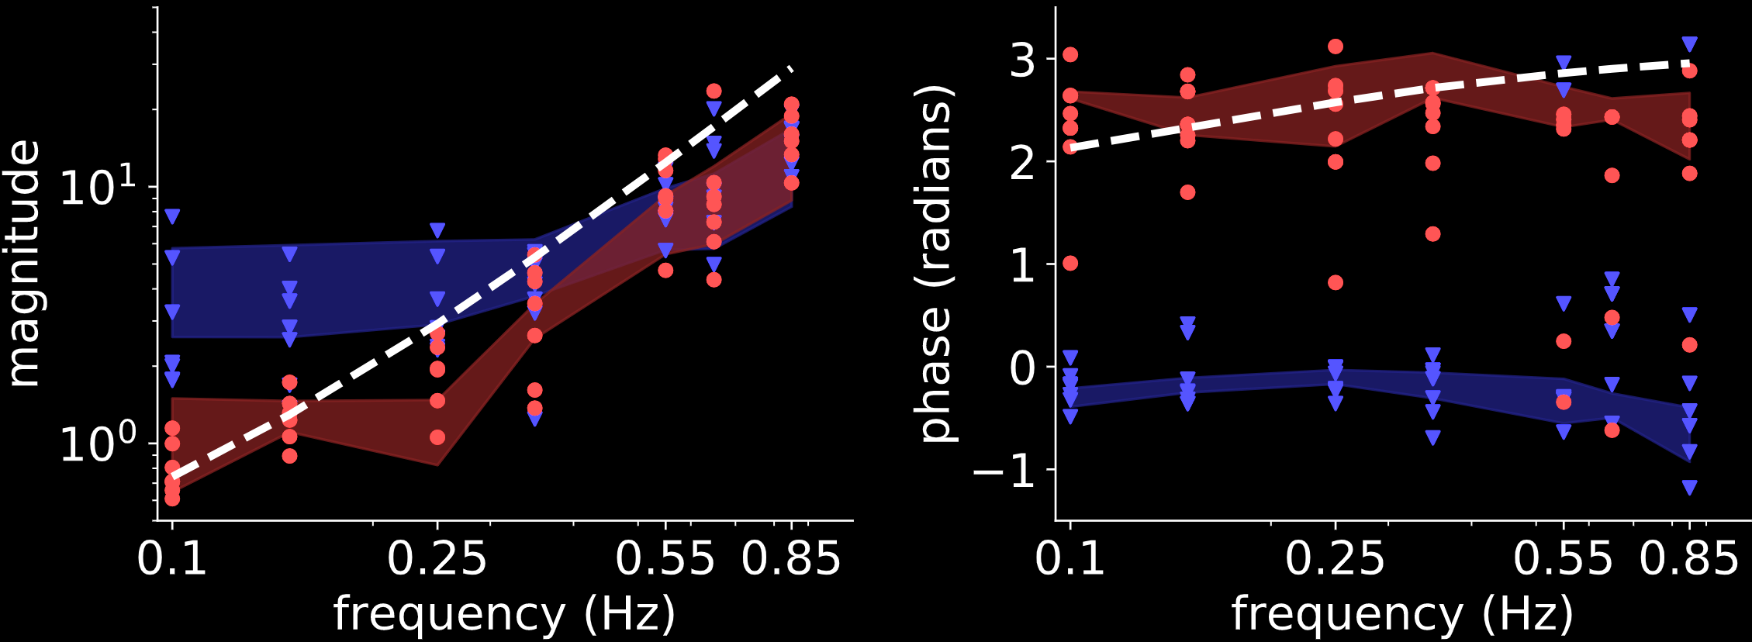


result: humans invert second-order model
$$(N=7)$$
d
$$M^{−1}$$
$$M=1/{s^{2}+s}$$
i.e. $\ddot{y}=u−\dot{y}$
(second-order)
F
u
y
+
+
M
$$F$$
r
+
e
B
-
$$B$$
Yamagami, Howell, Roth, Burden IFAC CPHS 2018
Contributions of feedforward and feedback control in a manual trajectory-tracking task

Slide 15
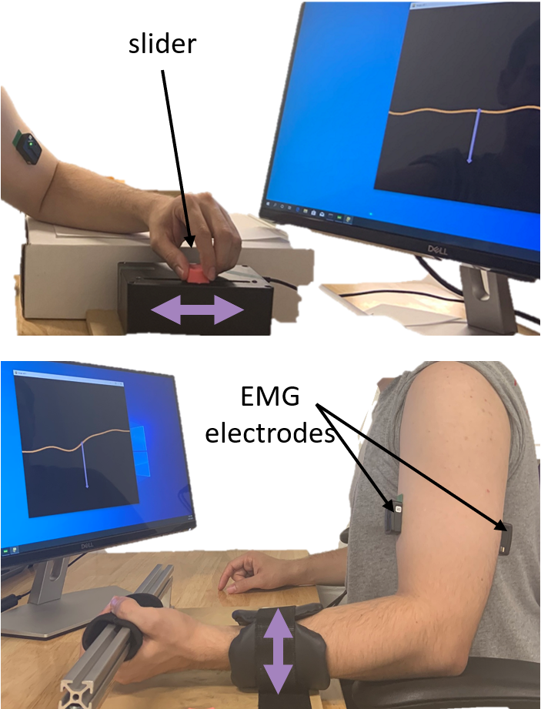
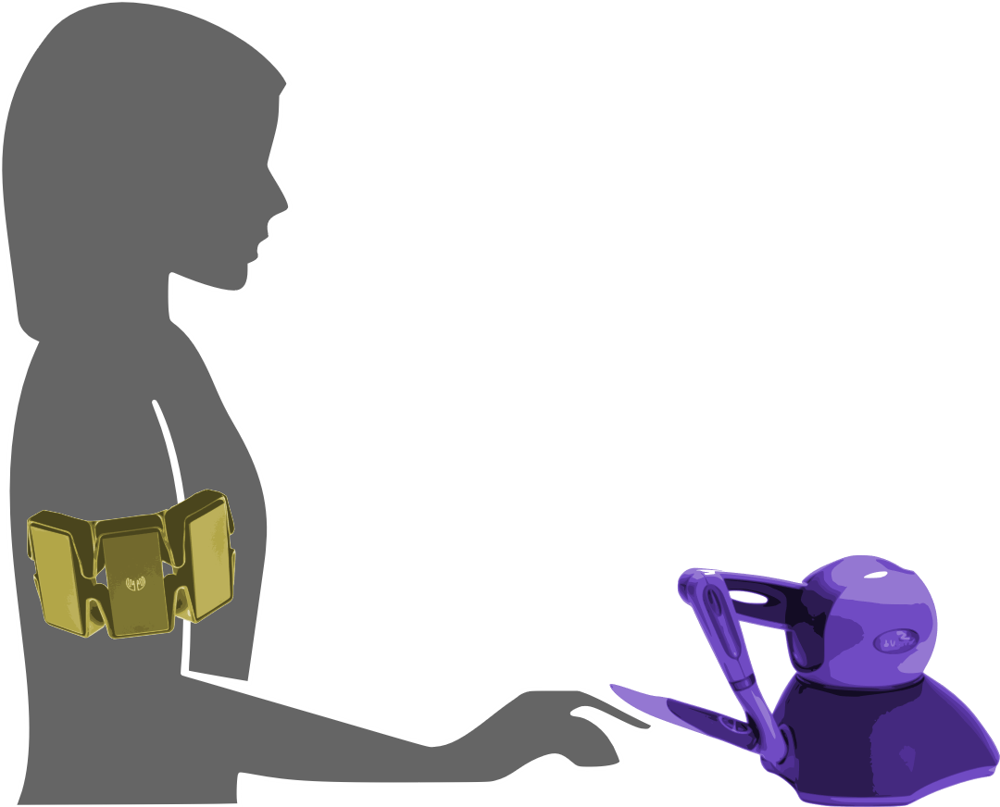

experiment: muscle vs manual
  manual: 1-dimensional joystick
  muscle: EMG on biceps/triceps
  task: reference tracking
Yamagami, Steele, Burden CHI 2020
Decoding intent with control theory: muscle vs manual interface performance

Slide 16
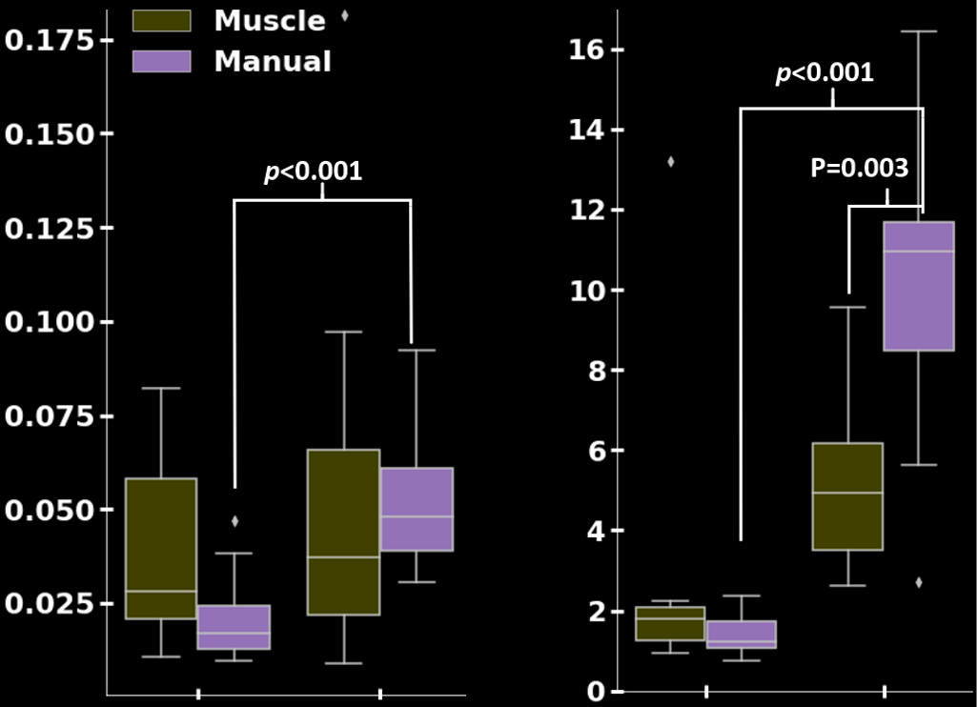









results:
muscle $≈$ manual
muscle $>$ manual
$$(N=11)$$
tracking error ${\left|r−y\right| }^{2}$
inversion error ${\left|F−M^{−1}\right| }^{2}$
$$\dot{y}=u$$
$$\ddot{y}=u−\dot{y}$$
$$\dot{y}=u$$
$$\ddot{y}=u−\dot{y}$$
Yamagami, Steele, Burden CHI 2020
Decoding intent with control theory: muscle vs manual interface performance

Slide 17
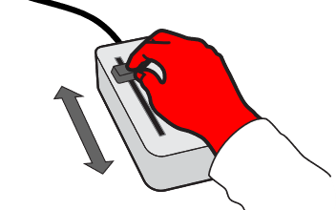
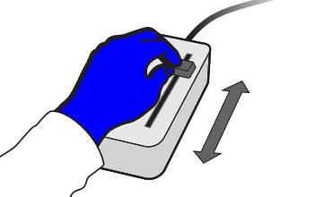

experiment: dominant vs non-dominant
  task: reference tracking + disturbance rejection
  group RL: dominant before non-dominant
  group LR: non-dominant before dominant
Yamagami, Peterson, Howell, Roth, Burden IEEE Tran Cybernetics 2021
Effect of Handedness on Learned Controllers and Sensorimotor Noise During Trajectory-Tracking

Slide 18
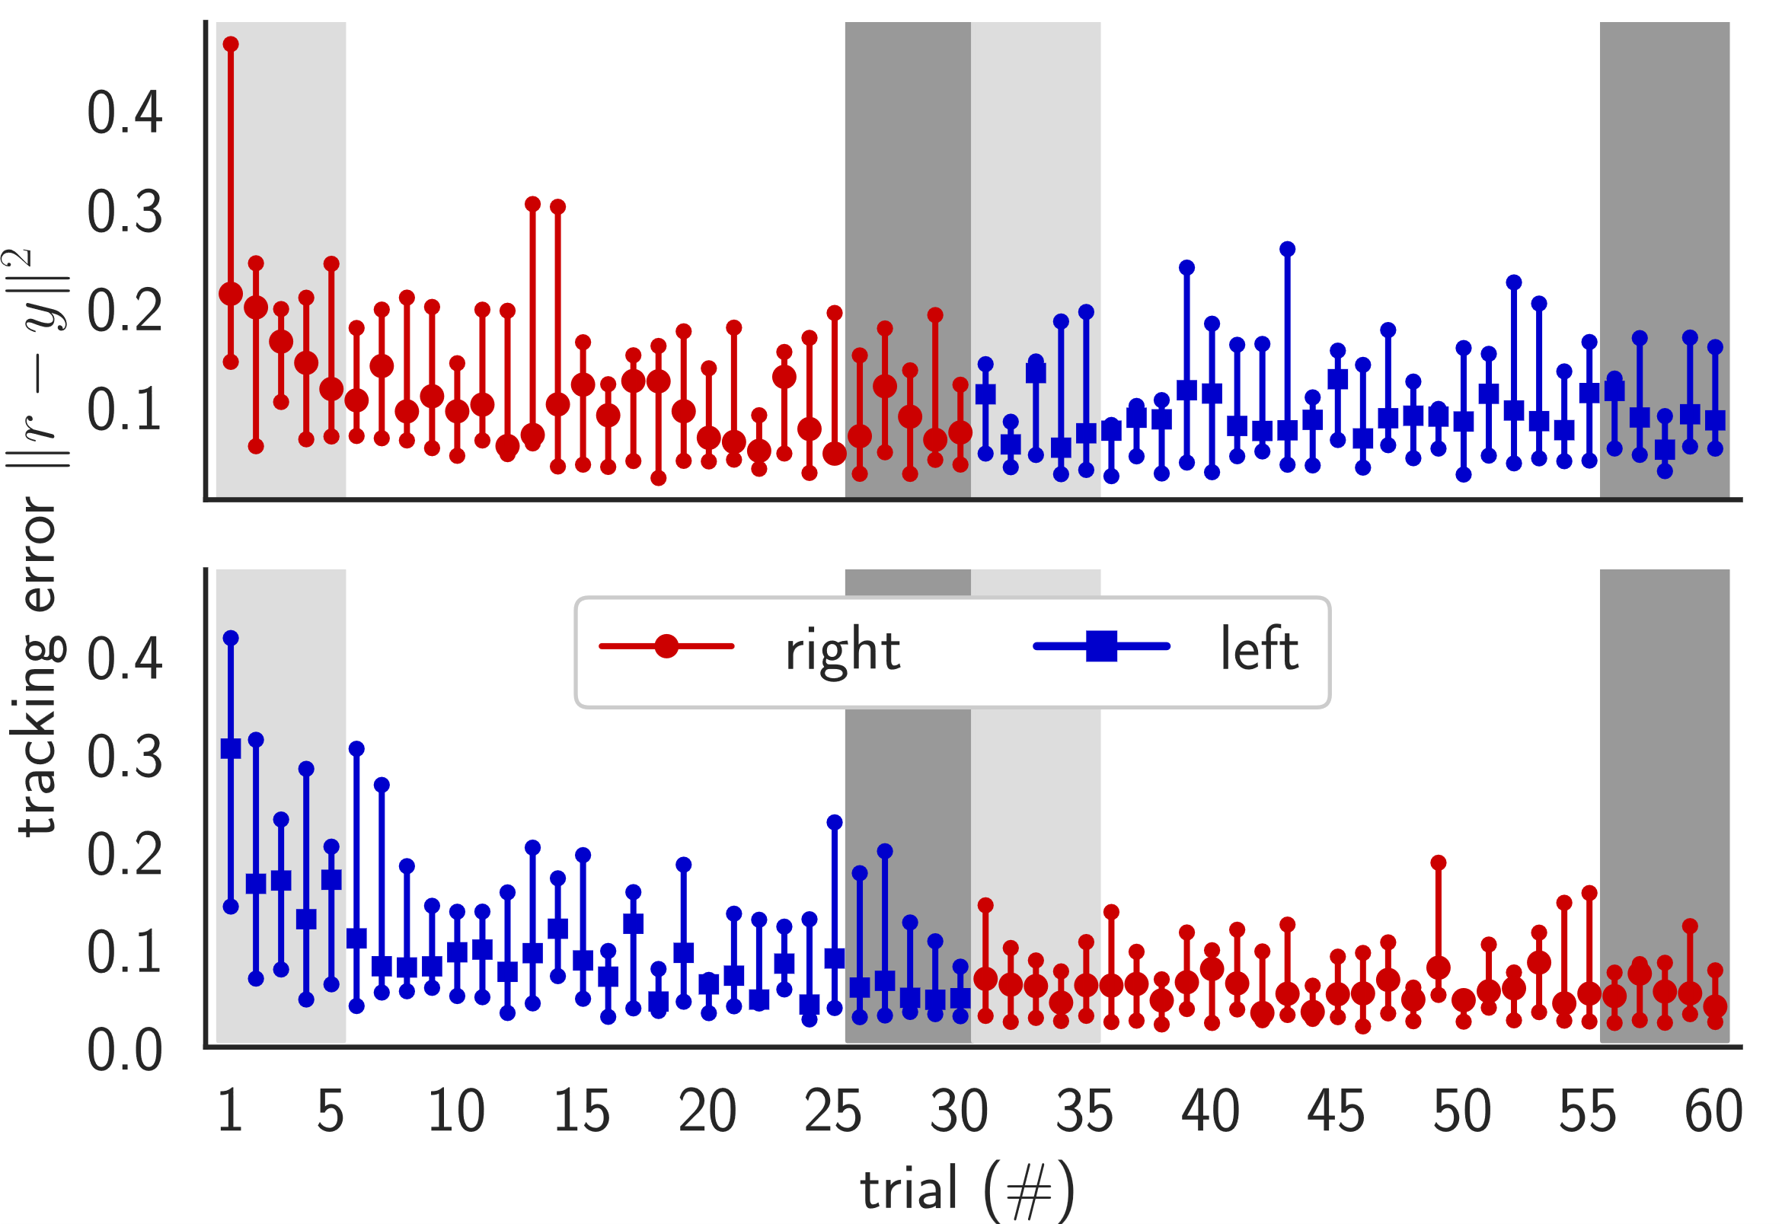
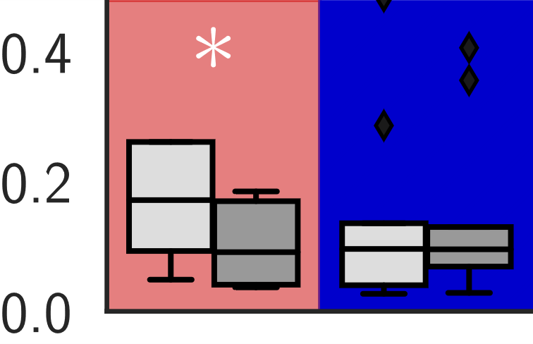
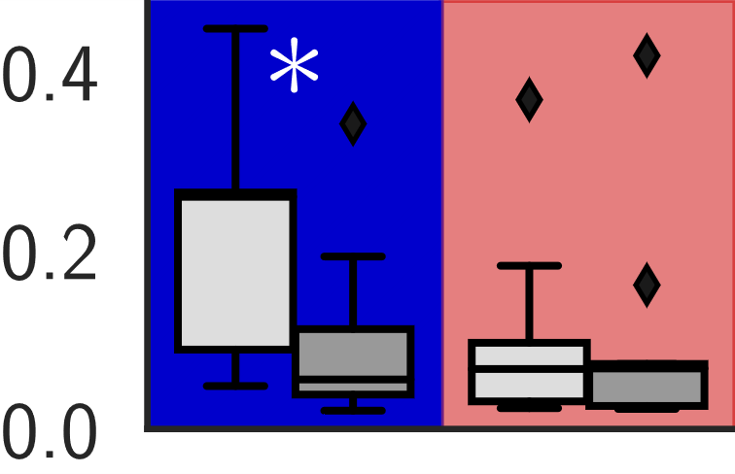




results:
dominant vs non-dominant
hands perform
the same
$${\left\|r−y\right\|}^{2}$$
RL
$$(N=9)$$
tracking transfers
$${\left\|r−y\right\|}^{2}$$
LR
$$(N=9)$$
Yamagami, Peterson, Howell, Roth, Burden IEEE Tran Cybernetics 2021
Effect of Handedness on Learned Controllers and Sensorimotor Noise During Trajectory-Tracking

Slide 19
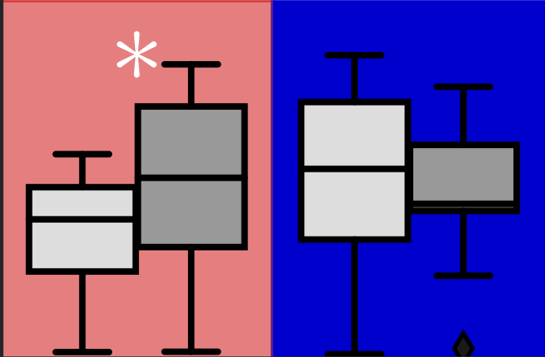
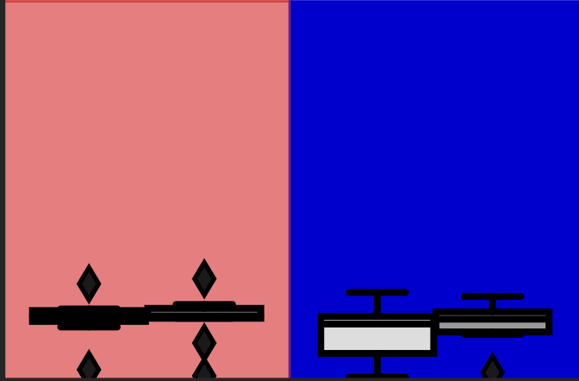
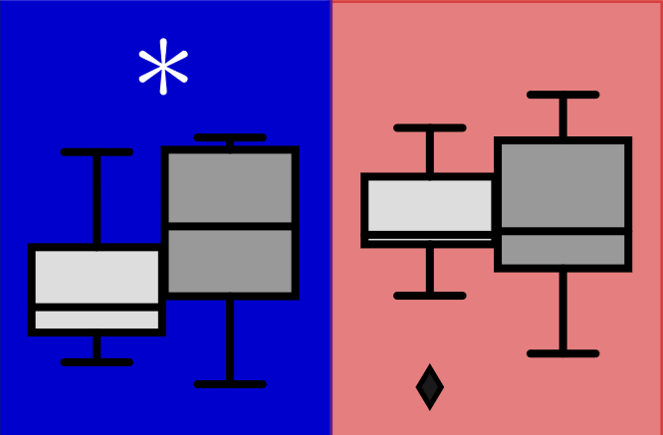
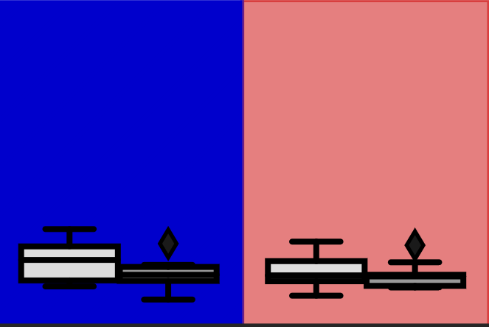








results:
feedback adapts …
… feedforward doesn’t
$$4$$
RL
$$2$$
$$(N=9)$$
$$0$$
$$\left\|B\right\|$$
$$\left\|F\right\|$$
$$4$$
LR
$$(N=9)$$
$$2$$
$$0$$
Yamagami, Peterson, Howell, Roth, Burden IEEE Tran Cybernetics 2021
Effect of Handedness on Learned Controllers and Sensorimotor Noise During Trajectory-Tracking

Slide 20
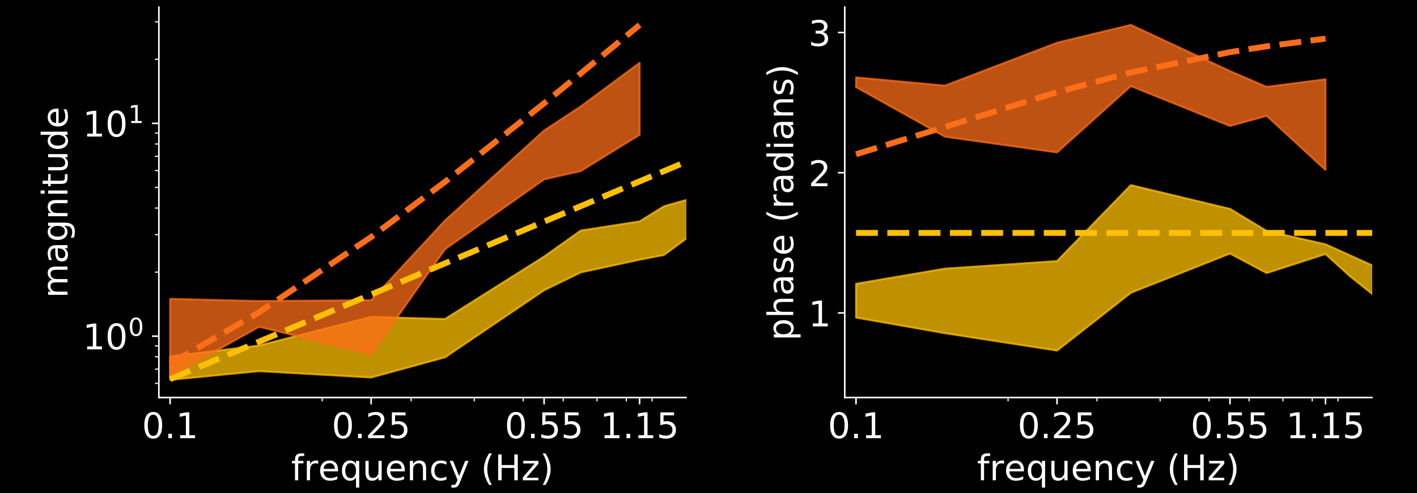


humans adapt to machines
d
H(M)
H(M)
vs.
H(M)
M
H
M
vs.
M
u
+
y
e
r
+
-
$$F≈M^{−1}=s^{2}+s$$
$$F≈M^{−1}=s$$

Slide 21

how can we predict and shape outcomes of
human-machine interactions?
humans learn models of machines …
… so machines should learn models of humans
takeaway: humans learn to $≈$invert machine dynamics

Slide 22

how can we predict and shape outcomes of
human-machine interactions?
humans learn models of machines …
… so machines should learn models of humans
takeaway: humans learn to $≈$invert machine dynamics

Slide 23




human-machine interaction game
d
H(M)
M(H)
H
M
u
+
y
e
r
+
-
human-machine interaction defines a game played between H and M
Chasnov, Parsa, Yamagami, Ratliff SPIE 2019
Experiments with sensorimotor games in dynamic
human/machine interaction

Slide 24




humans and machines seek to minimize “cost”
Merel, Pianto, Cunningham, Paninski PLoS Computational Biology 2015
Encoder-Decoder Optimization for Brain-Computer Interfaces
Müller, Vidaurre, Schreuder, Meinecke, von Bünau, Müller J Neural Eng 2017
A Mathematical Model for the Two-Learners Problem
Li, Carboni, Gonzalez, Campolo, Burdet Nature Machine Intelligence 2019
Differential Game Theory for Versatile Physical Human–robot Interaction
$$\min_{H}{c_{H}(H,M)}$$
$$\min_{M}{c_{M}(H,M)}$$
decision-making agents have “bounded rationality”
Simon Decision and Organization 1972
Theories of Bounded Rationality
Russell, Wefald Artificial Intelligence 1991
Principles of Metareasoning
Gershman, Horvitz, Tenenbaum Science 2015
Computational Rationality: A Converging Paradigm for Intelligence in Brains, Minds, and Machines
Papadimitriou, Piliouras ACM SIGecom Exchanges 2018
Game Dynamics as the Meaning of a Game
?
$$\dot{m}≈−∂_{m}c_{M} \left(h,m\right)$$
$$\dot{h}≈−∂_{h}c_{H}(h,m)$$
Notes:
One totally plausible thing is that they could try making small adjustments based on local information, namely gradient descent.
In this example, the machine and environment are static.
----------------------------------
For the single agent case, if you had a cost function, how would you go about minimizing it? Well, a good first order method is simply gradient descent.
Suppose the agent has a parabola-shaped cost function, single gradient descent will look like this
Here we
Decision making is also a dynamic process. Especially if you don’t know much about the environment or your cost function, you may need to explore/interact with the environment to ‘learn’ about it.
If there is a minimum, we expect gradient descent like updates to converge to it.
Suppose the human’s cost function is a \parabola shaped thing

Slide 25
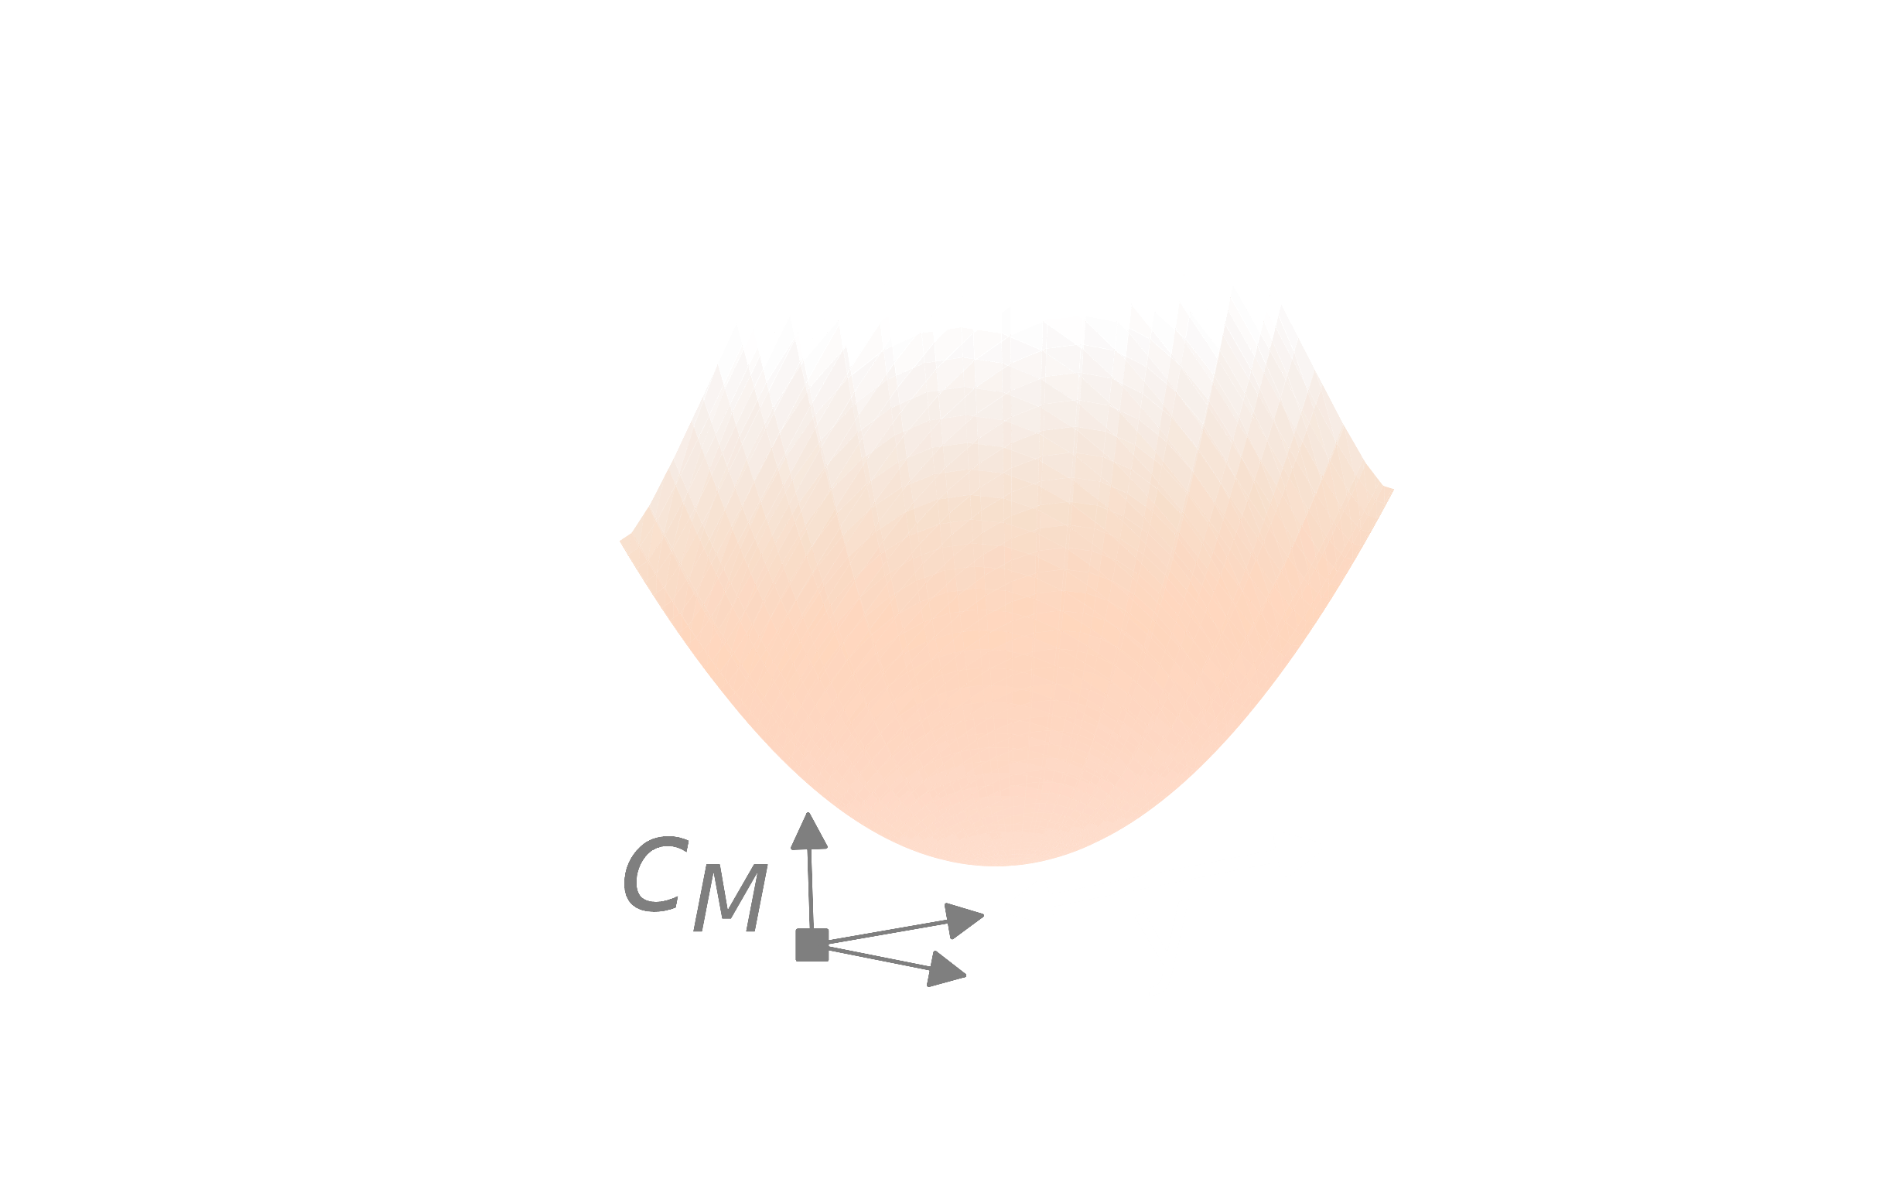
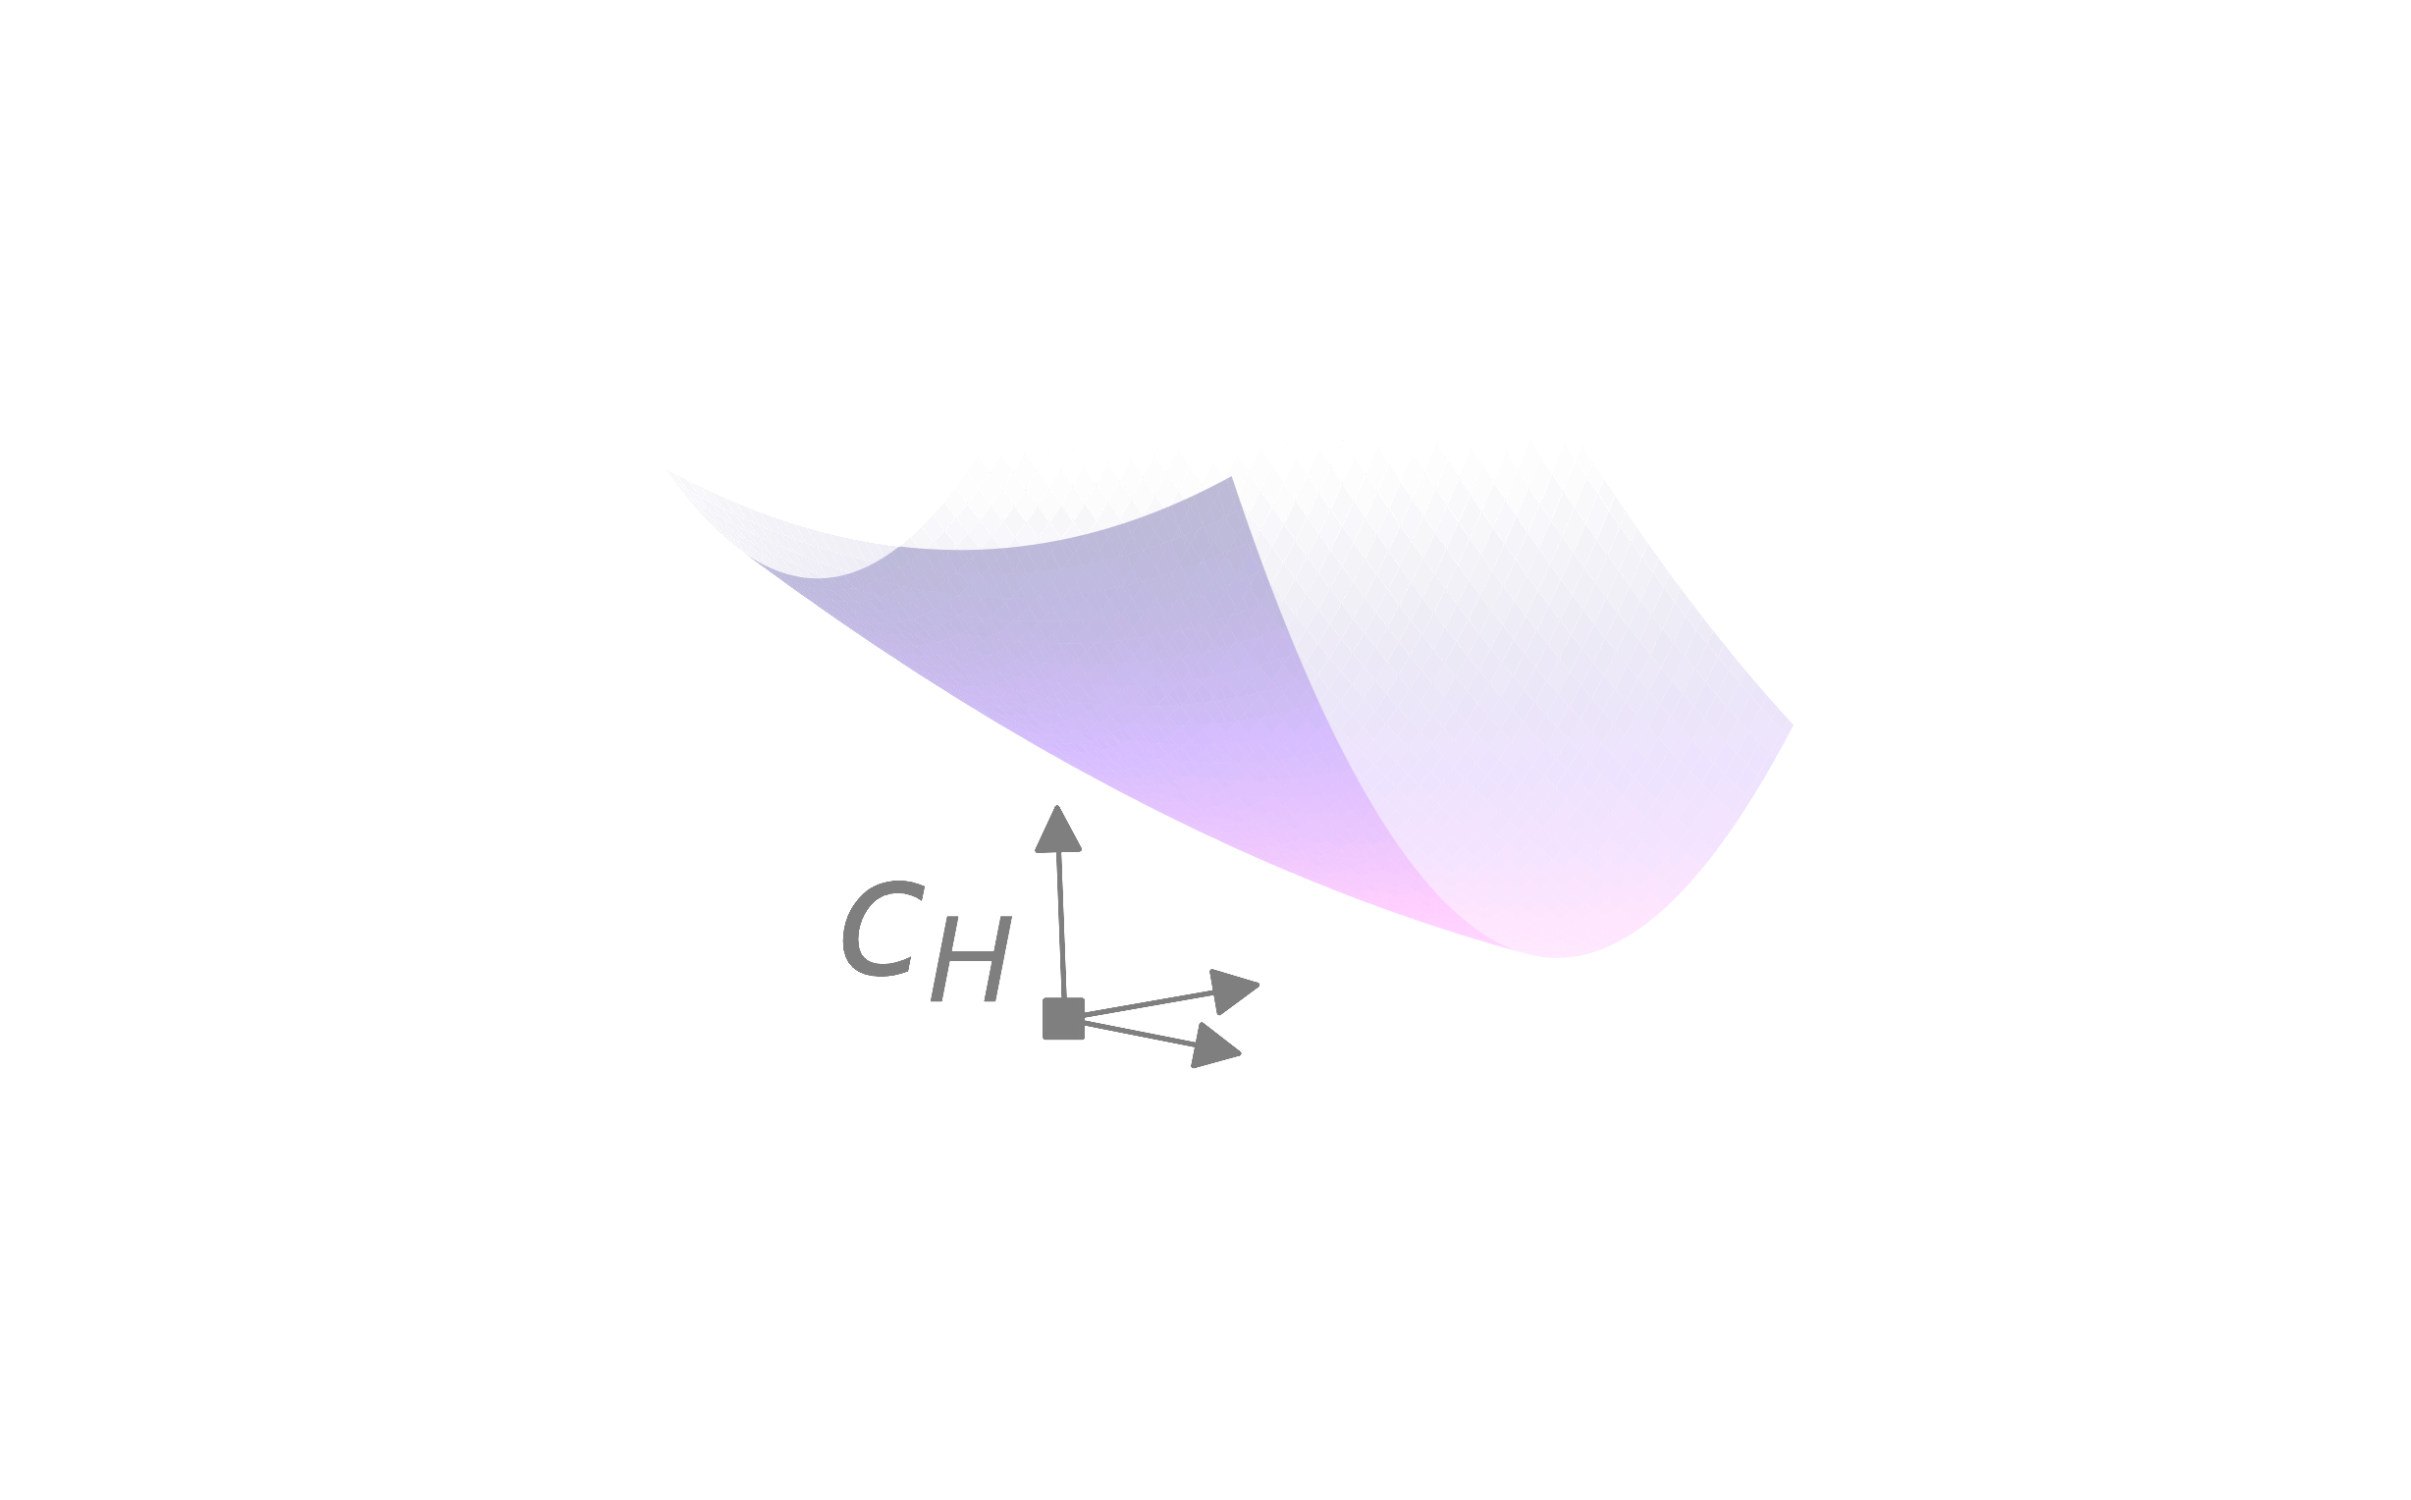
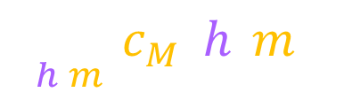
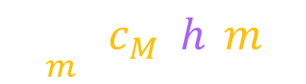

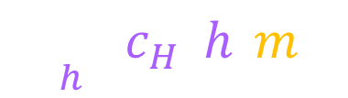



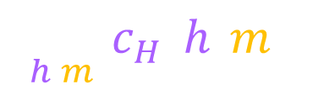
simplest human-machine interaction game
human’s cost $c_{H}(h,m)$
machine’s cost $c_{H}(h,m)$
$$h$$
$$m$$
global minima:
game equilibria:
$$\min_{h,m}{c_{H}(h,m)}$$
Nash
Nash PNAS 1950 Equilibrium points in N-Person games
$$\min_{h,m}{c_{M}(h,m)}$$
machine action m
best responses:
$$\min_{h}{c_{H}(h,m)}$$
$$\min_{m}{c_{M}(h,m)}$$
human action h

Slide 26
simplest human-machine interaction game
human’s cost $c_{H}(h,m)$
machine’s cost $c_{H}(h,m)$
$$h$$
$$m$$
global minima:
game equilibria:
$$\min_{h,m}{c_{H}(h,m)}$$
Nash
Nash PNAS 1950 Equilibrium points in N-Person games
$$\min_{h,m}{c_{M}(h,m)}$$
Stackelberg
(human-led)
machine action m
best responses:
von Stackelberg Marktform und Gleichgewicht 1934
$$\min_{h}{c_{H}(h,m)}$$
$$\min_{m}{c_{M}(h,m)}$$
human action h

Slide 27
simplest human-machine interaction game
human’s cost $c_{H}(h,m)$
machine’s cost $c_{H}(h,m)$
$$h$$
$$m$$
global minima:
game equilibria:
$$\min_{h,m}{c_{H}(h,m)}$$
Nash
Nash PNAS 1950 Equilibrium points in N-Person games
$$\min_{h,m}{c_{M}(h,m)}$$
Stackelberg
(human-led)
machine action m
best responses:
von Stackelberg Marktform und Gleichgewicht 1934
$$\min_{h}{c_{H}(h,m)}$$
conjectural
$$\min_{m}{c_{M}(h,m)}$$
Bowley Mathematical groundwork of economics: an introductory treatise 1924
human action h

Slide 28


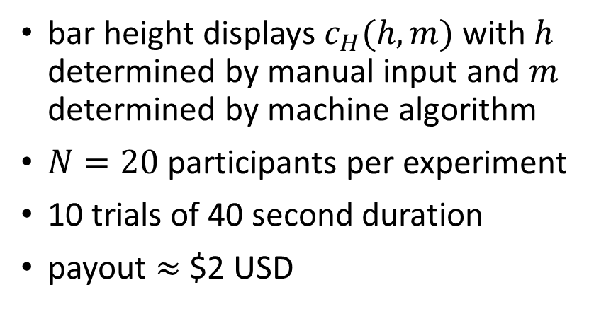
simplest human-machine interaction game
keep this as small as possible
bar height displays $c_{H}(h,m)$ with $h$ determined by manual input and $m$ determined by machine algorithm
$N=20$ participants per experiment
10 trials of 40 second duration
payout $≈$ $2 USD
Chasnov, Ratliff, Burden arXiv 2023
Human adaptation to adaptive machines converges to game-theoretic equilibria

Slide 29
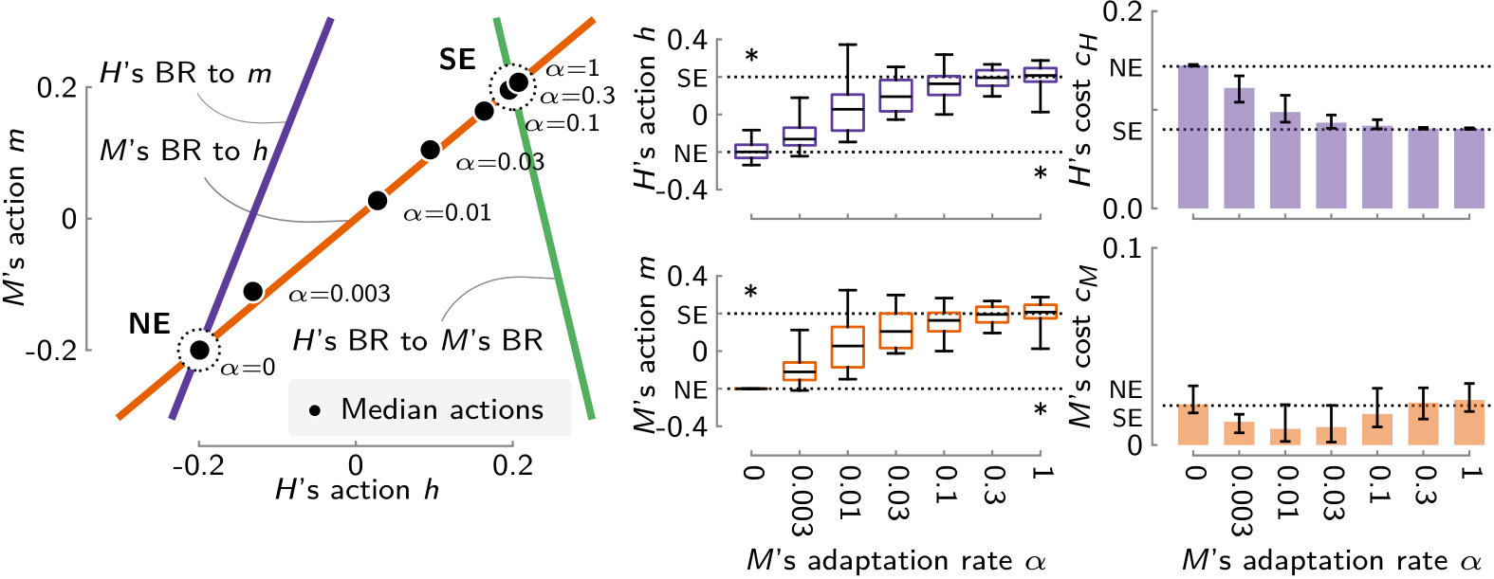

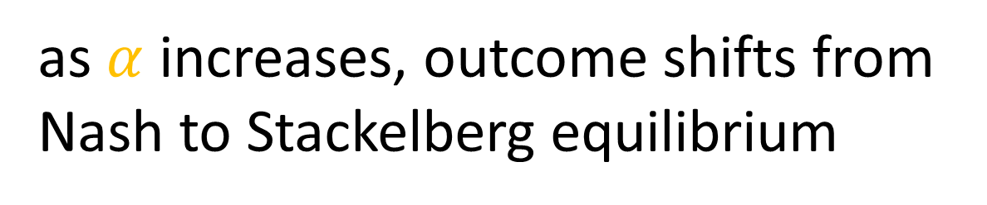

human-machine interaction game , experiment 1
algorithm:
$$\dot{m}=−α ∂_{m}c_{M} \left(h,m\right)$$
finding:
as $α$ increases, outcome shifts from Nash to Stackelberg equilibrium
$H$ uses gradient descent
Chasnov, Ratliff, Burden arXiv 2023
Human adaptation to adaptive machines converges to game-theoretic equilibria

Slide 30
human-machine interaction game , experiment 2
this infinite regress is well-known:
Harsanyi Games with Incomplete Information Played by “Bayesian” Players, Parts I-III Manage. Sci. 1967 Zamir Bayesian Games: Games with Incomplete Information 2012
Bowley, The Mathematical Groundwork of Economics Oxford University Press 1924
Figuieres, Jean-Marie, Querou, Tidball Theory of Conjectural Variations World Scientific 2004
Chasnov, Ratliff, Burden arXiv 2023
Human adaptation to adaptive machines converges to game-theoretic equilibria
we use the idea of conjectural variations

Slide 31



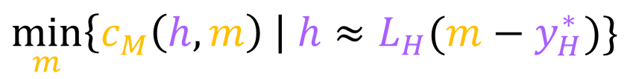

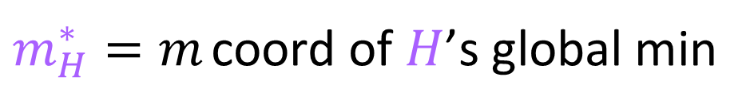

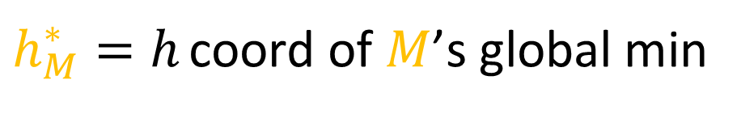
human-machine interaction game , experiment 2
  since cost is quadratic, machine’s best-response is linear,
  similarly, natural to hypothesize human responds linearly,
  what if machine estimates $L_{H}$?
  what if machine uses this
  internal model / conjecture
  to “outsmart” the human?
  if human responds similarly,
  iterating converges to consistent conjectural variations eq.
$$m=L_{M}(h−h_{M}^{∗})$$
$h_{M}^{∗}=h$ coord of $M$’s global min
$$h≈L_{H}(m−m_{H}^{∗})$$
$m_{H}^{∗}=m$ coord of $H$’s global min
slope $L_{H}$
machine action m
slope $L_{M}$
$$\min_{m}\left\{c_{M}\left(h,m\right) \right| h≈L_{H}(m−y_{H}^{∗})\}$$
human action h
Chasnov, Ratliff, Burden arXiv 2023
Human adaptation to adaptive machines converges to game-theoretic equilibria

Slide 32
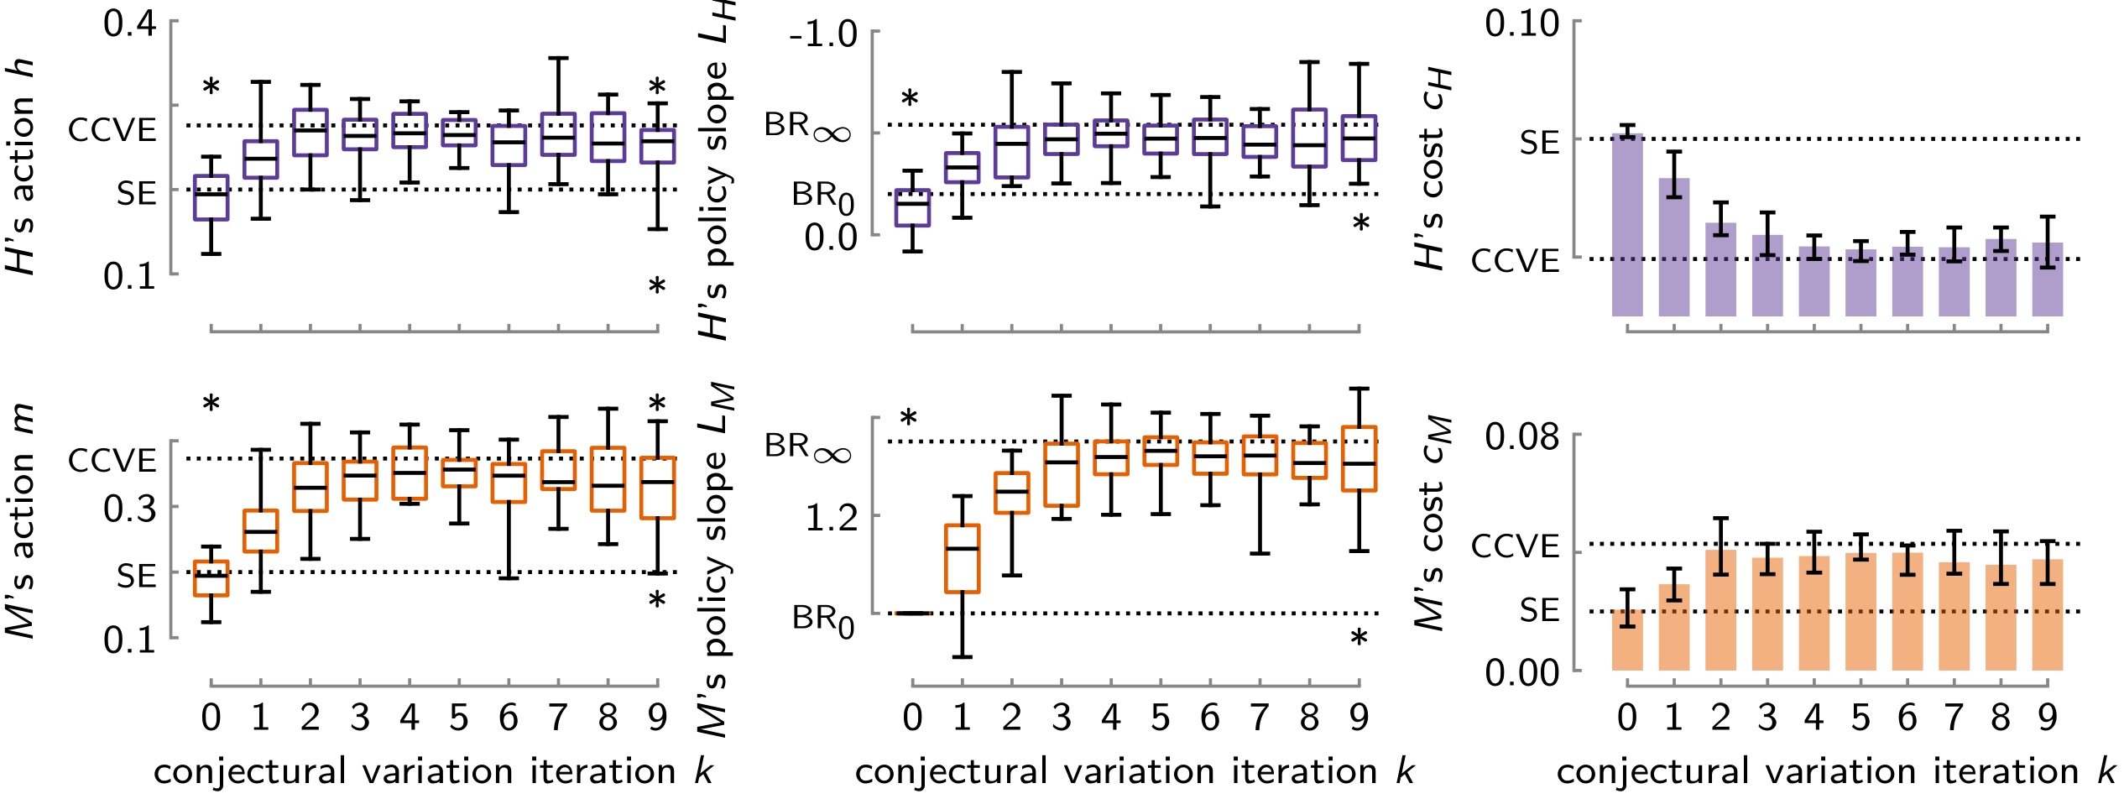
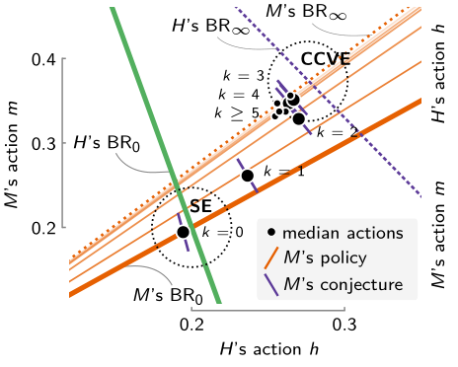

finding: conjectural iteration converges to consistent conjectural variations equilibrium (CCVE)
$H$ learns internal model
Chasnov, Ratliff, Burden arXiv 2023
Human adaptation to adaptive machines converges to game-theoretic equilibria

Slide 33
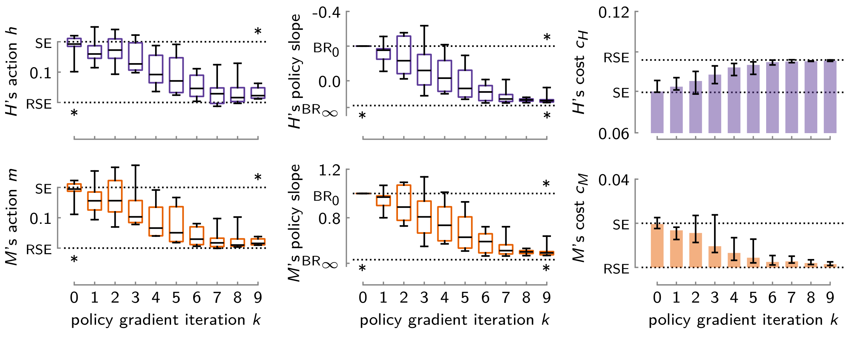

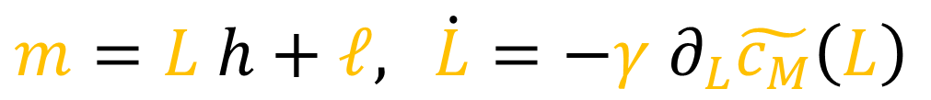
human-machine interaction game, experiment 3
algorithm:
$m=L h+ℓ,$ $\dot{L}=−γ ∂_{L}\tilde{c_{M}}\left(L\right)$
(policy gradient)
finding:
policy gradient converges to machine’s global minimum (RSE)
$M$ can “outsmart” $H$
Chasnov, Ratliff, Burden arXiv 2023
Human adaptation to adaptive machines converges to game-theoretic equilibria

Slide 34

simplest human-machine interaction game
human’s cost $c_{H}(h,m)$
machine’s cost $c_{H}(h,m)$
$M$ can choose from constellation of game theory equilibria
$$h$$
$$m$$
global minima:
game equilibria:
$$\min_{h,m}{c_{H}(h,m)}$$
Nash
Nash PNAS 1950 Equilibrium points in N-Person games
$$\min_{h,m}{c_{M}(h,m)}$$
Stackelberg
(human-led)
machine action m
best responses:
von Stackelberg Marktform und Gleichgewicht 1934
$$\min_{h}{c_{H}(h,m)}$$
conjectural
$$\min_{m}{c_{M}(h,m)}$$
Bowley Mathematical groundwork of economics: an introductory treatise 1924
human action h

Slide 35
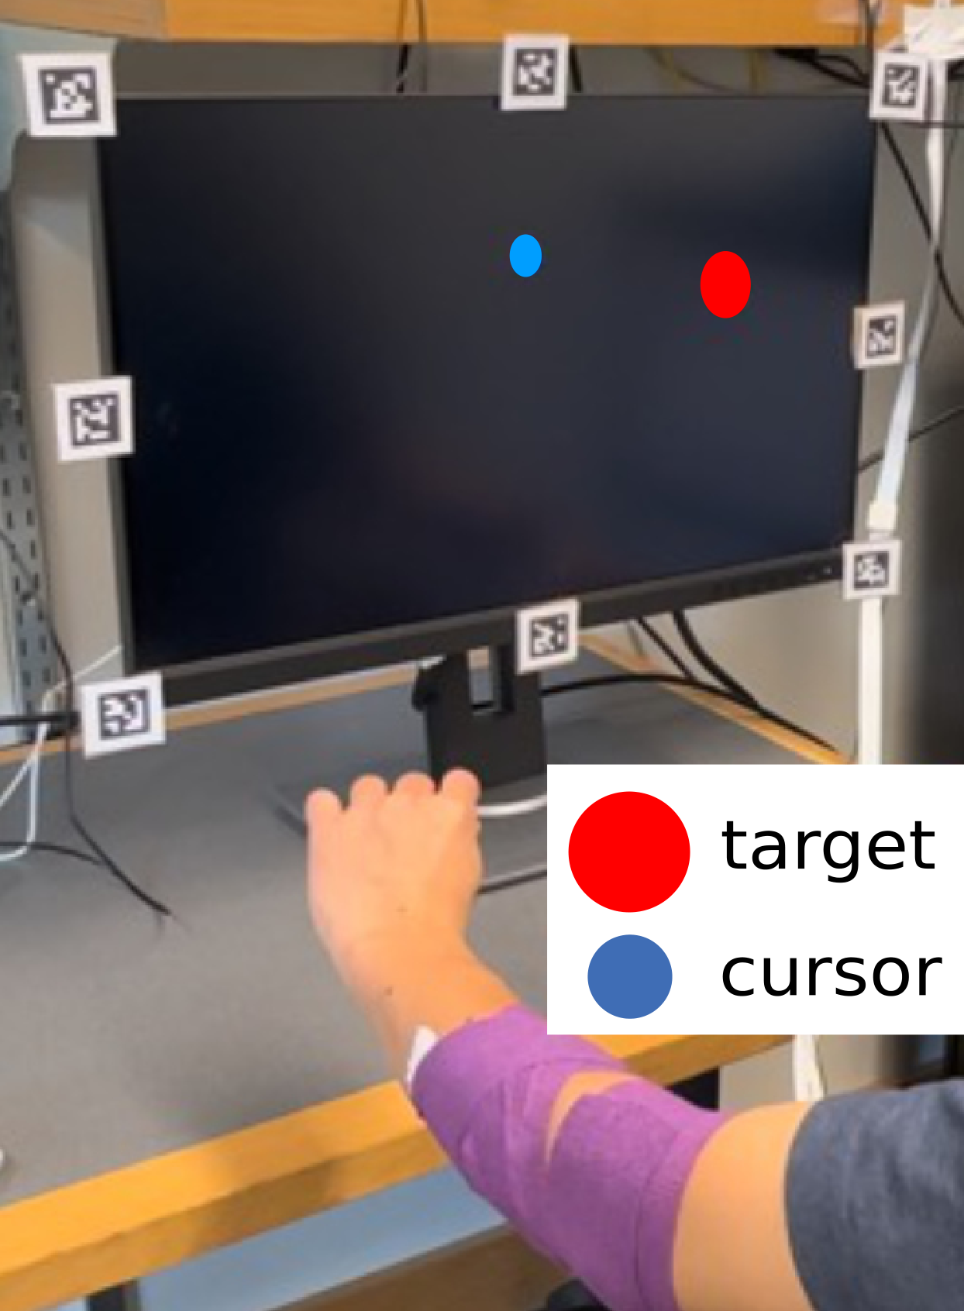
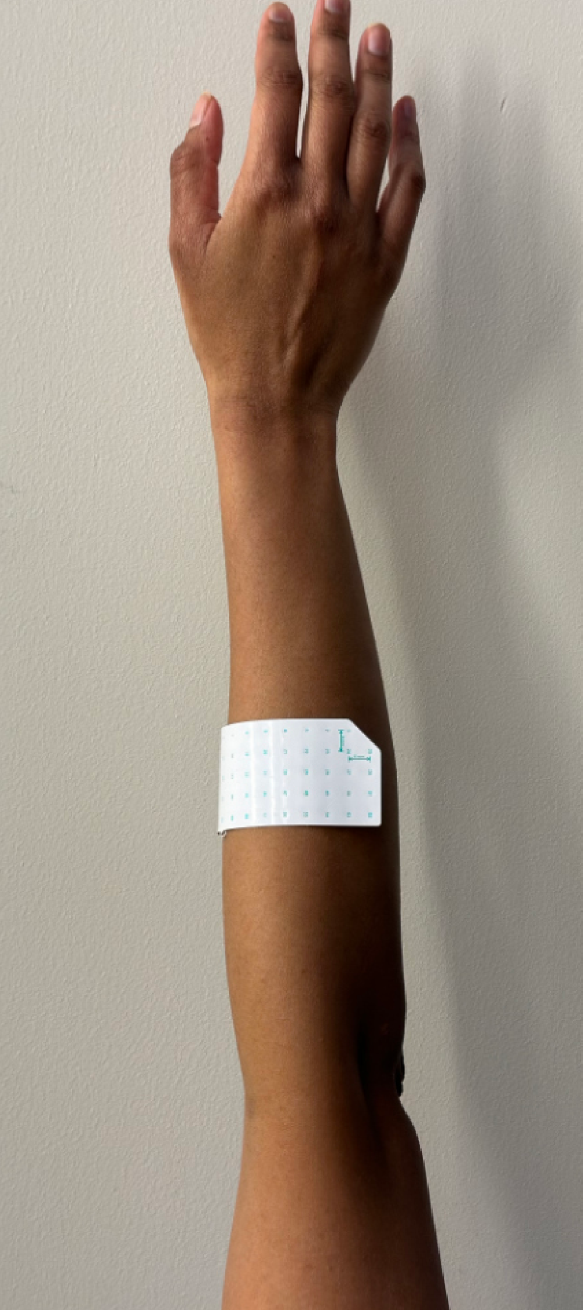

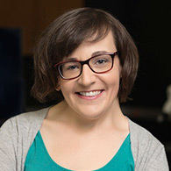

(non-invasive) brain-machine interface game
EMG (electromyography)
encodes neuromotor commands to muscles
r
y
d
D $\frac{1}{s}$
E
M
H
+
y
u
e
r
+
decoder computes cursor position by integrating linear combination of EMG signals
-
Madduri, Yamagami, Li, Burckhardt, Burden, Orsborn, bioRxiv 2024
Predicting and shaping human-machine interactions in co-adaptive neural interfaces

Slide 36


brain-machine interface game
E
d
encoder
decoder
u
+
D
y
e
r
+
-
$$c_{D}\left(E,D\right)={\left\|e\right\|}^{2}+{\left\|D\right\|}^{2}$$
machine cost
$$c_{E}\left(E,D\right)={\left\|e\right\|}^{2}+{\left\|E\right\|}^{2}$$
brain cost
Wu, Black, Gao, Serruya, Shaikhouni, Donoghue, Bienenstock NeurIPS 2002
Neural Decoding of Cursor Motion Using a Kalman Filter
Gilja, Nuyujukian, Chestek, Cunningham, Yu, Ryu, Shenoy COSYNE 2010
High-Performance Continuous Neural Cursor Control Enabled by a Feedback Control Perspective
Müller, Vidaurre, Schreuder, Meinecke, von Bünau, Müller J Neural Eng 2017
A Mathematical Model for the Two-Learners Problem
Madduri, Burden, Orsborn IEEE NER 2021
A game-theoretic model for co-adaptive brain-machine interfaces

Slide 37

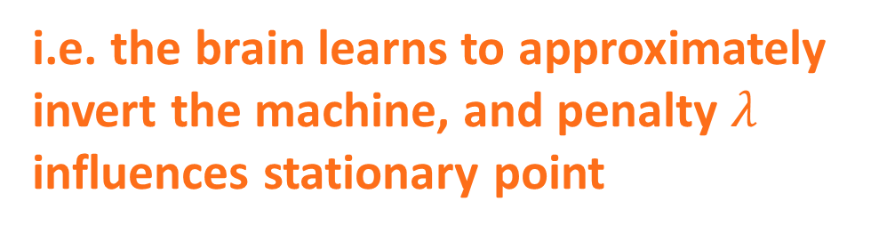


brain-machine interface game
$$c_{D}\left(E,D\right)={\left\|e\right\|}^{2}+{λ\left\|D\right\|}^{2}$$
machine cost
$$c_{E}\left(E,D\right)={\left\|e\right\|}^{2}+{λ\left\|E\right\|}^{2}$$
brain cost
error
vs
effort
prediction:
stationary points
$$D E=(1−λ) I$$
i.e. the brain learns to approximately invert the machine, and penalty $λ$ influences stationary point
Madduri, Burden, Orsborn IEEE NER 2021
A game-theoretic model for co-adaptive brain-machine interfaces

Slide 38



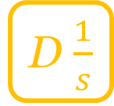


brain-machine interface game
encoder
feedforward
d
F
decoder
f
u
D $\frac{1}{s}$
+
+
y
e
b
r
+
B
-
feedback
predictions:
- encoder’s system order matches decoder’s,
$u≈F r+B e=\left(F_{0}+s F_{1}\right) r+\left(B_{0}+s B_{1}\right) e$
- decoder approximately inverts encoder,
$DF_{0}≈0$, $DF_{1}≈I,$
${\left(I+DB/s\right)}^{−1}DB/s$ is stable
Madduri, Yamagami, Li, Burckhardt, Burden, Orsborn, bioRxiv 2024
Predicting and shaping human-machine interactions in closed-loop, co-adaptive neural interfaces

Slide 39
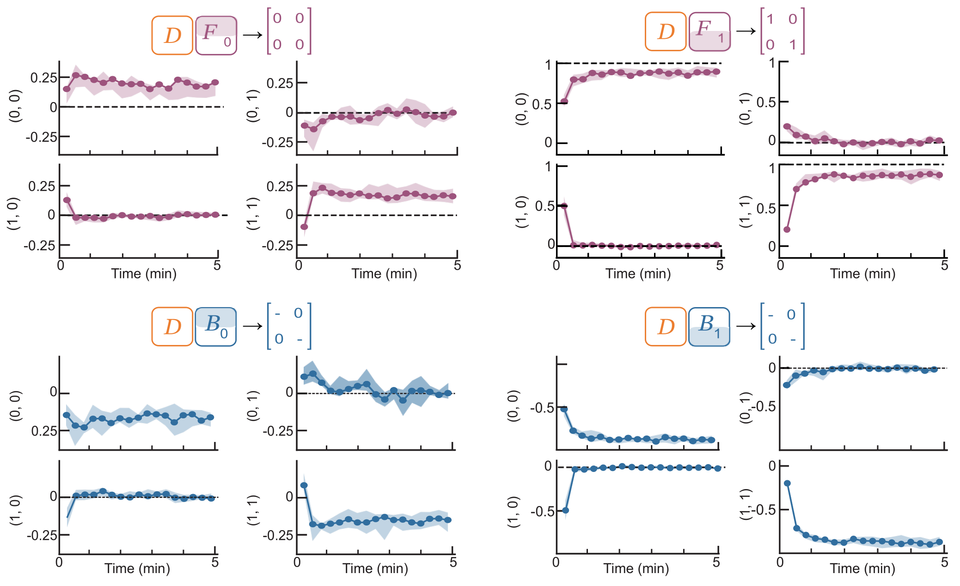


brain-machine interface game
$D F_{0}≈0$, $D F_{1}≈I$
matches control theory predictions
${DB}_{0}≾0$, ${DB}_{1}≾0$
Madduri, Yamagami, Li, Burckhardt, Burden, Orsborn, bioRxiv 2024
Predicting and shaping human-machine interactions in closed-loop, co-adaptive neural interfaces

Slide 40
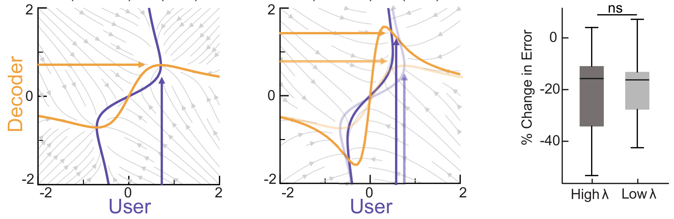

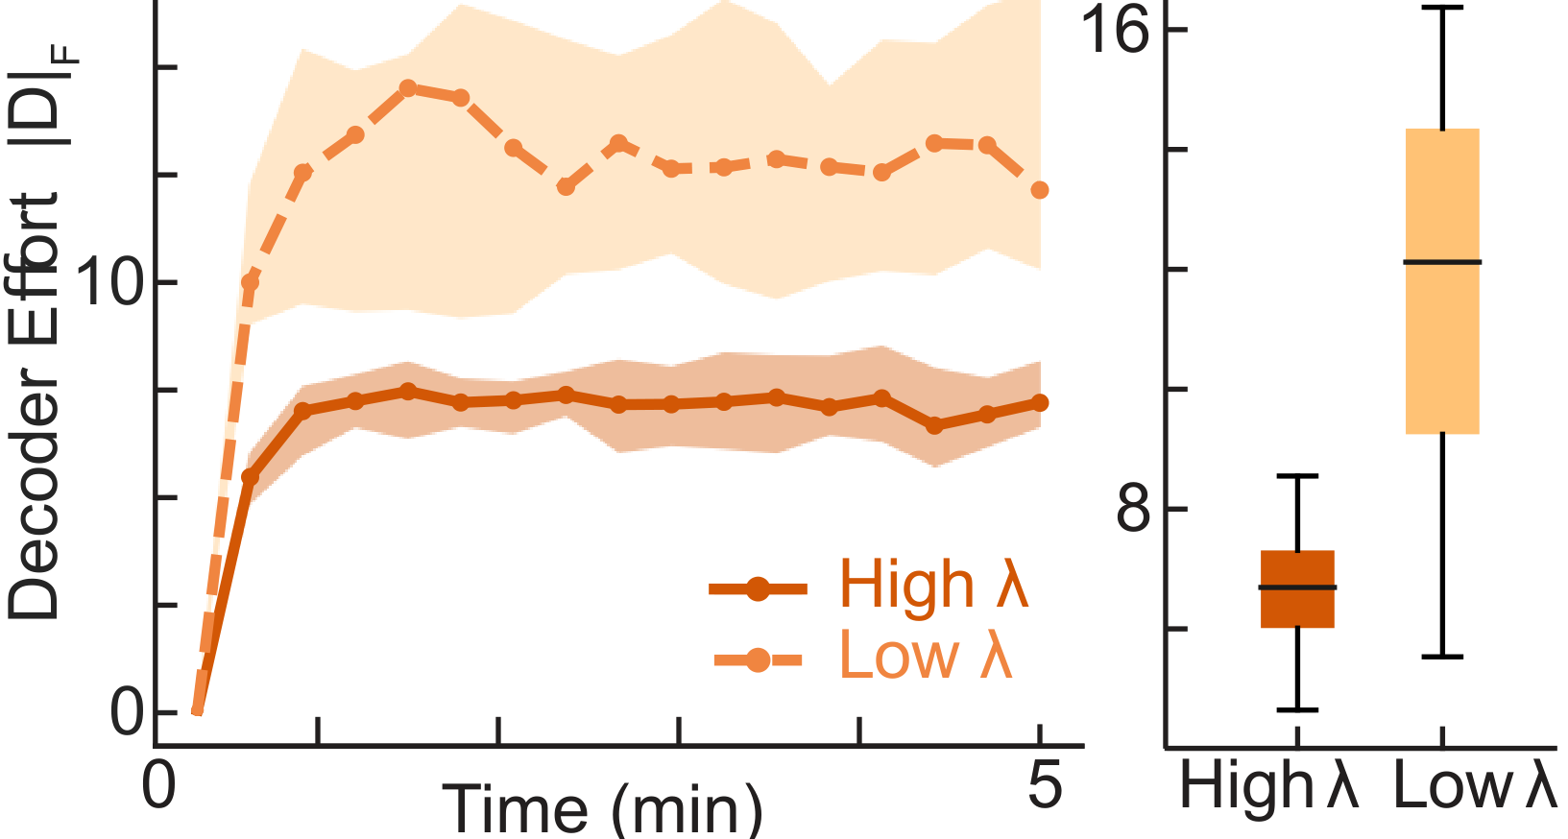
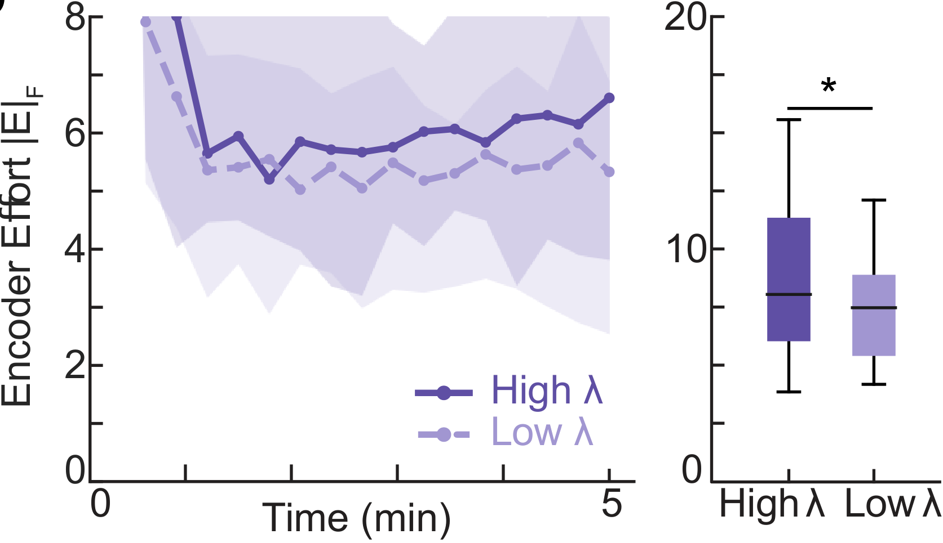







brain-machine interface game
high $λ$
low $λ$
$$c_{D}\left(E,D\right)={\left\|e\right\|}^{2}+{λ\left\|D\right\|}^{2}$$
$$D$$
$$e$$
matches game theory predictions
$$E$$
$$E$$
Madduri, Yamagami, Li, Burckhardt, Burden, Orsborn, bioRxiv 2024
Predicting and shaping human-machine interactions in closed-loop, co-adaptive neural interfaces

Slide 41
(non-invasive) brain-machine interface game
predicted and shaped outcomes
EMG (electromyography)
encodes neuromotor commands to muscles
r
y
d
D $\frac{1}{s}$
E
M
H
+
y
u
e
r
+
decoder computes cursor position by integrating linear combination of EMG signals
-
Madduri, Yamagami, Li, Burckhardt, Burden, Orsborn, bioRxiv 2024
Predicting and shaping human-machine interactions in co-adaptive neural interfaces

Slide 42
how can we predict and shape outcomes of
human-machine interactions?
humans learn models of machines …
… so machines should learn models of humans
takeaway: humans learn to $≈$invert machine dynamics
takeaway: machines can shape game outcomes

Slide 43
how can we predict and shape outcomes of
human-machine interactions?
humans learn models of machines …
… so machines should learn models of humans
A: need to study human-machine interaction games

Slide 44







sburden@uw.edu
http://faculty.uw.edu/sburden
thank you!
Momona Yamagami
Asst Prof in ECE at Rice
Ben Chasnov
Research Scientist at Meta
Maneeshika Madduri
freshly minted PhD
NSF CPS Medium #1836819:
Certifiable reinforcement learning for cyber-physical systems
NSF M3X CAREER #2045014: Human/Machine Collaborative Learning and Control of Contact-Rich Dynamics

