Slide 1

Toward Telelocomotion
Sam Burden
Assistant Professor
Electrical Engineering
University of Washington
Seattle, WA USA
http://faculty.uw.edu/sburden

Slide 2
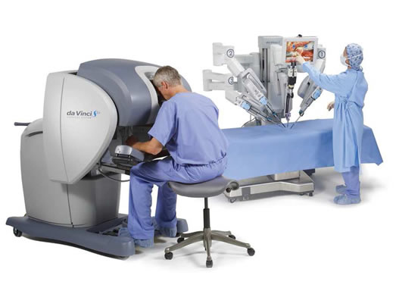
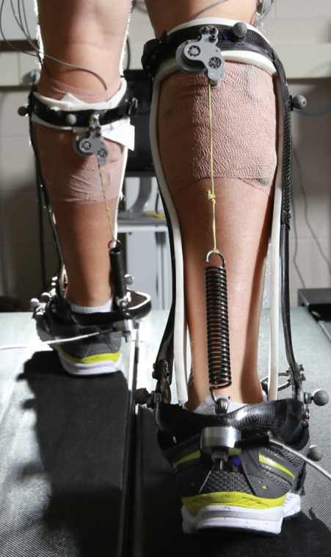
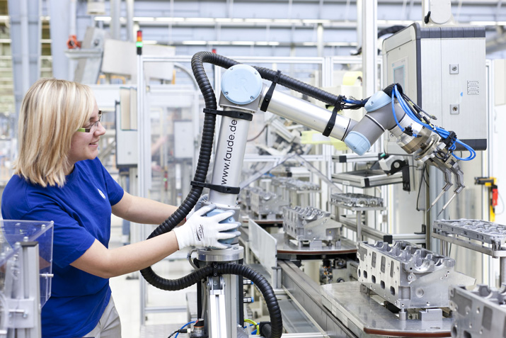
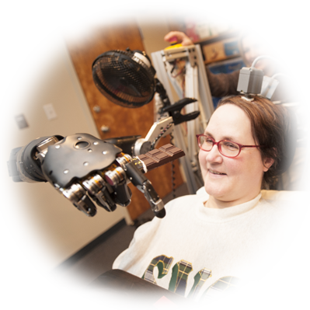
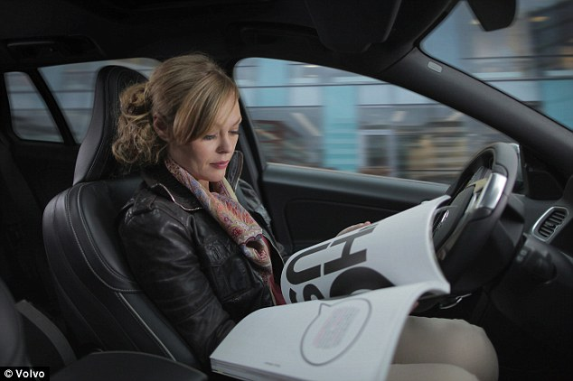

human interaction with the physical world
is increasingly mediated by automation
Human-Cyber-Physical Systems (HCPS)

Slide 3

Human-Cyber-Physical System:
robotic teleoperation
sensory feedback
sensory feedback
motor control inputs
Chiawakum Creek Fire near Lake Wenatchee, WA © Michael Stanford 2015 http://yourshot.nationalgeographic.com/photos/4181903/

Slide 4
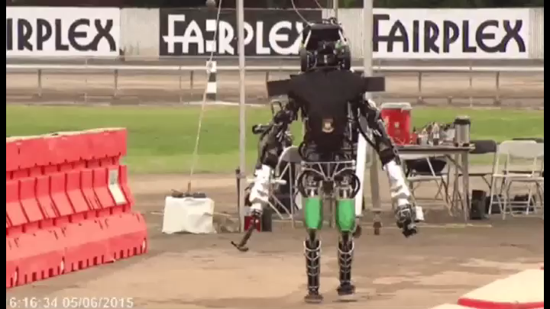
robots lack full autonomy

Slide 5
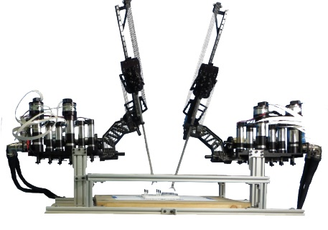
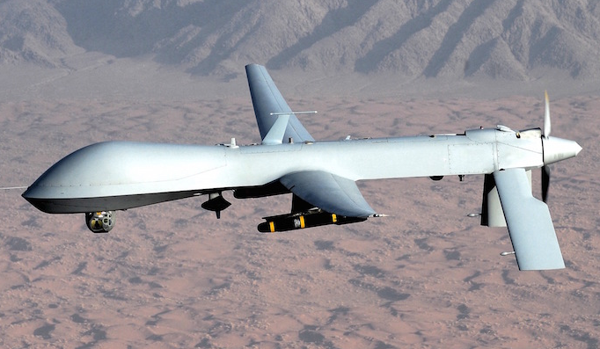
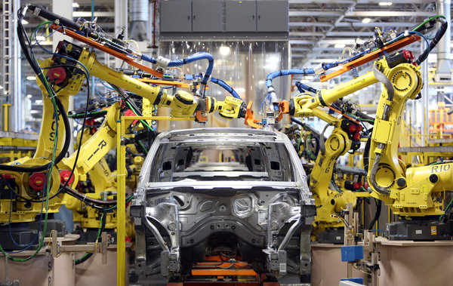
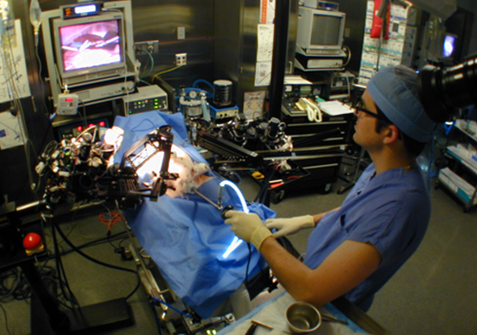
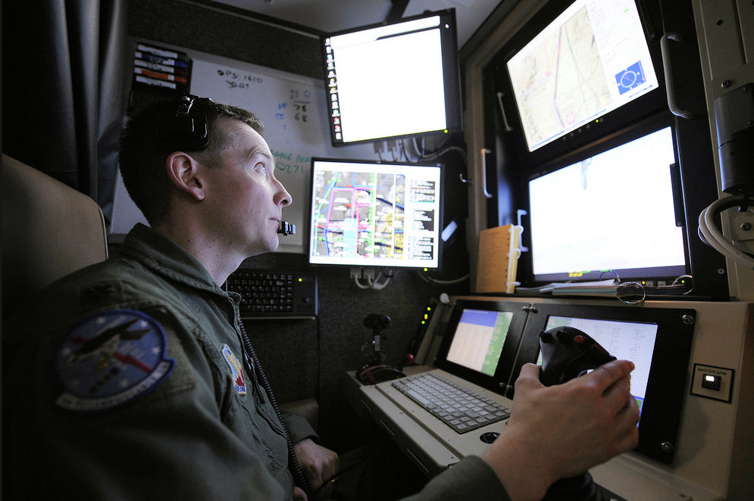




roles for humans and automation
legal, ethical, and political concerns
ensure humans will remain in-the-loop
Nothwang, Robinson, Burden, McCourt, Curtis IEEE Resilience Week 2016
The Human Should be Part of the Control Loop?

Slide 6
Human-Cyber-Physical System:
robotic teleoperation
sensory feedback
sensory feedback
motor control inputs
two decision-making agents in a dynamic world
Chiawakum Creek Fire near Lake Wenatchee, WA © Michael Stanford 2015 http://yourshot.nationalgeographic.com/photos/4181903/

Slide 7
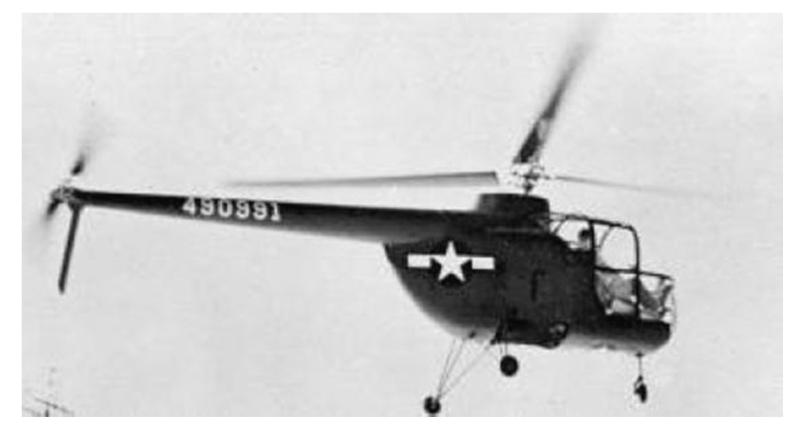
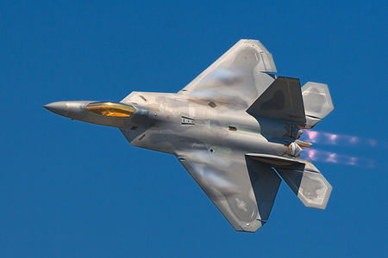
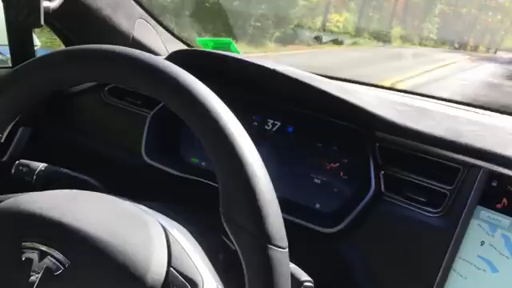
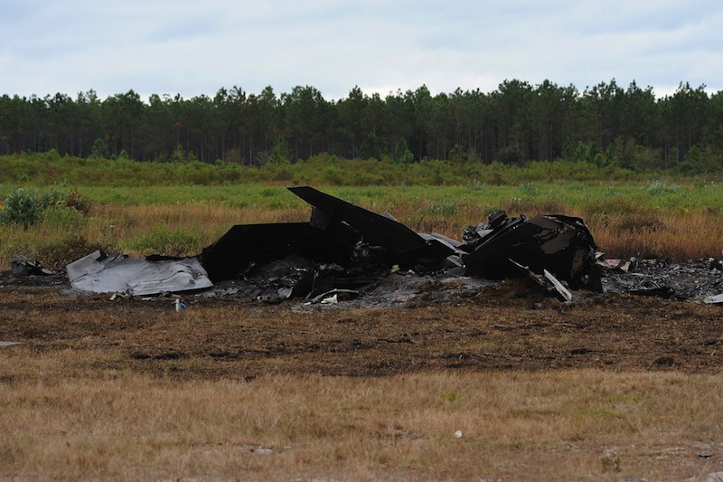
embedding humans amid automation
  pilot-induced oscillations in rotory & fixed-wing aircraft
    McRuer, Krendal 1974; Hess J. Guid. Cont. Dyn. 1997
    Pavel et al. Prog. Aero. Sci. 2013
  overreliance on enhanced safety features in cars
    Rudin-Brown, Parker Traffic Psych. Behav. 2004;
    Moore, Zuby Proc. Enhanced Safety Vehicles 2013

Slide 9
embedding humans amid automation
  pilot-induced oscillations in rotory & fixed-wing aircraft
    McRuer, Krendal 1974; Hess J. Guid. Cont. Dyn. 1997
    Pavel et al. Prog. Aero. Sci. 2013
  overreliance on enhanced safety features in cars
    Rudin-Brown, Parker Traffic Psych. Behav. 2004;
    Moore, Zuby Proc. Enhanced Safety Vehicles 2013
naïve coupling can lead to performance loss
ranging from mild to catastrophic

Slide 10
intervening in Human-Cyber-Physical Systems
any intervention alters the sensorimotor loop
sensory feedback
sensory feedback
motor control inputs
provably-safe interventions will require predictive models for sensorimotor loops

Slide 11
today’s talk:
predictive dynamical models
for sensorimotor control
M, M⁻¹
internal models
terra-dynamics

Slide 12
today’s talk:
predictive dynamical models
for sensorimotor control
M, M⁻¹
internal models
terra-dynamics

Slide 13
predictable behavior from internal models
forward model
  predicts sensory effects of motor actions
    Sutton, Barto Psych. Rev. 1981
    Jordan, Rumelhart Cog. Sci. 1992
    Wolpert, Ghahramani, Jordan Science 1995
inverse model
  computes action expected to yield desired behavior
    Kawato Curr. Opin. Neurobio. 1999
    Thoroughman, Shadmehr Nature 2000
    Conditt, Mussa-Ivaldi PNAS 1999
Notes:
replace text with cartoon

Slide 14
predictable behavior from internal models
  theoretical and empirical evidence for pairing of forward + inverse models
    Bhushan, Shadmehr Bio. Cybern. 1999; Sanner, Kosha Bio. Cybern. 1999
forward model
+
inverse model
  parallels in control theory, robotics, artificial intelligence: adaptive control, internal model principle, learning
    Francis, Wonham Automatica 1976; Sastry, Bodson Prentice Hall 1989
    Sutton, Barto, Williams IEEE CSM 1992; Atkeson, Schaal ICML 1997
    Papavassiliou, Russell IJCAI 1999
Notes:
replace text with cartoon

Slide 15
instantiating internal models
Forward model ( M : U → Y ): static vs. dynamic
  static map (linear or nonlinear)
    Hanuschkin, Ganguli, Hahnloser Front. Neural Circ. 2013
    Giret, Kornfeld, Ganguli, Hahnloser PNAS 2014
  dynamic map depends on
  intermediate state
    Thoroughman, Shadmehr Science 2000
    Wolpert, Diedrichsen, Flanagan Nature Neurosci. 2011
Inverse model ( M⁻¹ : Y → U ): hard to define
  static map may fail to be one-to-one or onto
  dynamic map may be acausal or need state estimate

Slide 16
dynamic forward model
  start with forward model in control-affine form
  under a technical condition* we change coordinates to
  forward model is simpler in (ξ,ζ) coordinates
*strict relative degree – easily satisfied for mechanical systems

Slide 17
dynamic inverse model
  start with simplified forward model
  to obtain inverse model, apply input u_{d} that matches* γ—th derivative of desired output y_{d} :
*augment with feedback to correct for initial condition error

Slide 18


pairing forward + inverse models
  closed-loop dynamics have undesirable property:
  states in ζ are unobservable
  generally impossible to compute inverting input u_{d} using sensor data
  by restricting system dynamics, can bypass this issue:
Theorem (Robinson, Scobee, Burden, Sastry):
If forward M and inverse M⁻¹ are stable models,
then feedforward input from internal model
asymptotically inverts system’s dynamics.
Robinson, Scobee, Burden, Sastry SPIE-DSS 2016
Dynamic inverse models in human-cyber-physical systems

Slide 19



inversion with stable model pair (M, M⁻¹)
M, M⁻¹
output y
input u_{d}
Theorem implies:
  for stable model pair, trajectories x₁ and x₂ converge to
  feedforward input “asymptotically inverts” dynamics
Robinson, Scobee, Burden, Sastry SPIE-DSS 2016
Dynamic inverse models in human-cyber-physical systems

Slide 20
if inverse model predicts human’s behavior
  by measuring human’s input u_{H}, can infer task η_{H}
  task η_{H} is an input to the unobservable dynamics ζ
  automation can solve optimal control problem to improve performance as measured by

Slide 21
future: provably-safe interventions
any intervention alters the sensorimotor loop
sensory feedback
sensory feedback
motor control inputs
if inverse model predicts human’s behavior,
the above intervention is provably-safe

Slide 22
today’s talk:
predictive dynamical models
for sensorimotor control
M, M⁻¹
internal models
terra-dynamics

Slide 23
today’s talk:
predictive dynamical models
for sensorimotor control
M, M⁻¹
internal models
terra-dynamics

Slide 24
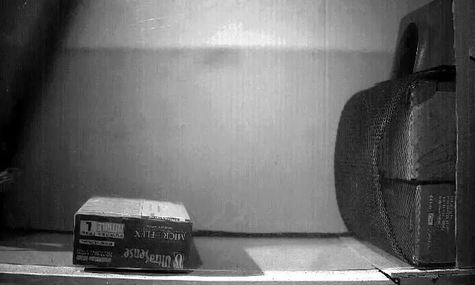
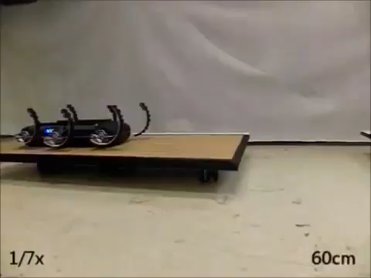

  locomotion through fluid governed by continuous hydro- and aero-dynamics
  locomotion on land governed by intermittent terra-dynamics
Vogel Life in moving fluids 1996
Li, Zhang, Goldman Science 2015
legged locomotion involves intermittent interaction
Tytell, Standen, Lauder JEB 2008
Cory, Moore, Tedrake B&B 2014
Libby, Moore, Chang-Siu, Cohen, Jusufi, Full Nature 2012
Johnson, Koditschek ICRA 2013

Slide 25
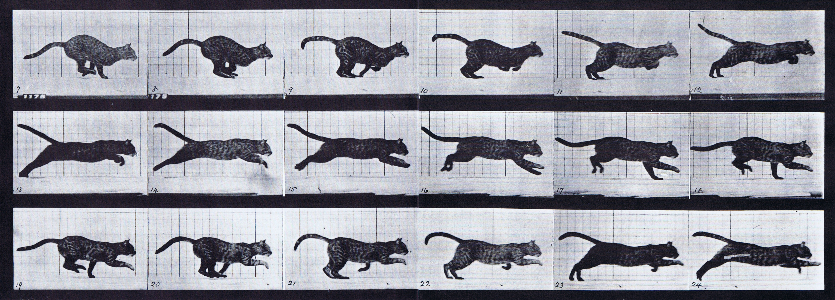
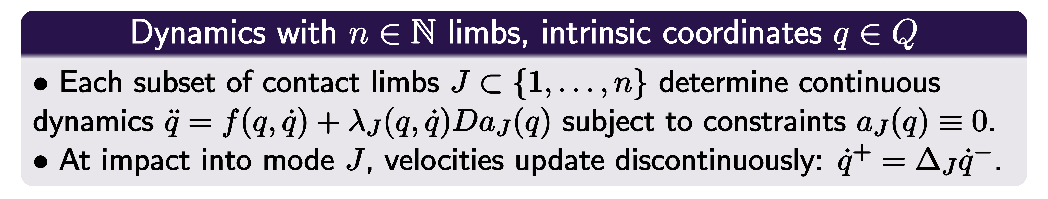


parsimonious models are piecewise-defined
Muybridge 1887 (reprinted by Dover in 1957)
Johnson, Burden, Koditschek IJRR 2016 (arXiv:1502.01538)
A hybrid systems model for simple manipulation and self-manipulation systems

Slide 26
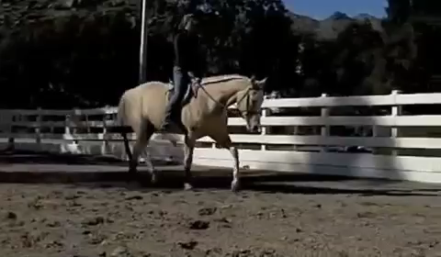
near-simultaneous footfalls are ubiquitous

Slide 27
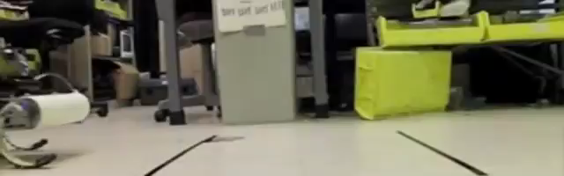

near-simultaneous footfalls are ubiquitous
Galloway, Haynes, Ilhan, Johnson, Knopf, Lynch, Plotnick, White, Koditschek UPenn 2010
Hyun, Seok, Lee, Kim IJRR 2014

Slide 28
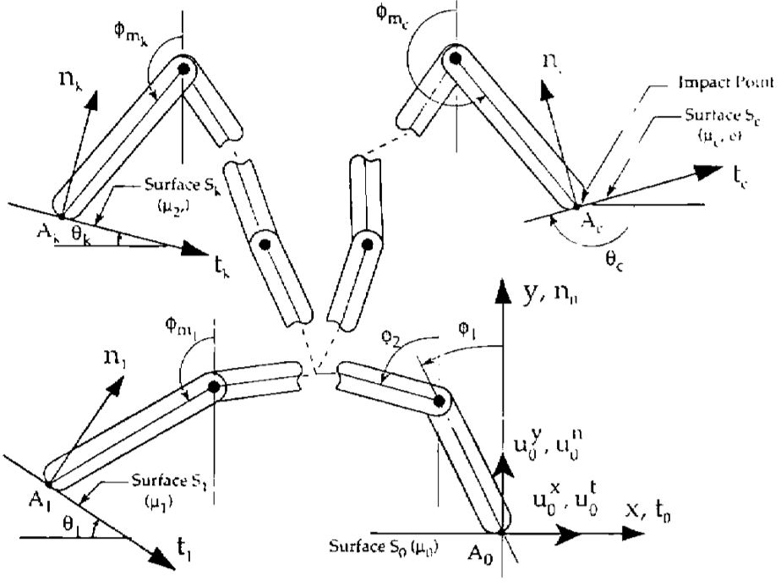
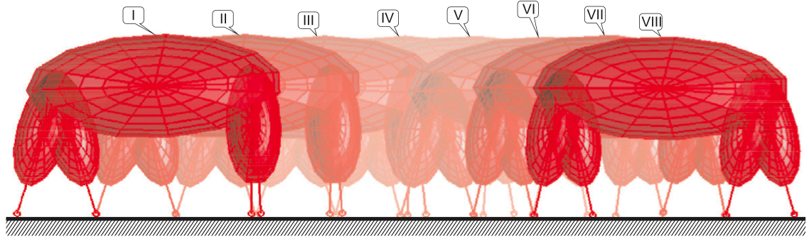
inconsistencies with inertially coupled limbs
  hand with rigid fingers exhibits 5 different post-grasp outcomes
Hürmüzlü and Marghitu IJRR 1994, JAM 1995
rigid limbs yield inconsistent terra-dynamics
  quadruped with rigid legs exhibits 3 distinct trot gaits
Remy, Buffington, Siegwart IJRR 2010

Slide 29

coupled vs decoupled limbs
coupled limbs
decoupled limbs
decoupled limbs yield consistent terradynamics
Pace, Burden (arXiv:1609.04056)
Decoupled limbs yield differentiable trajectory outcomes in locomotion and manipulation

Slide 30
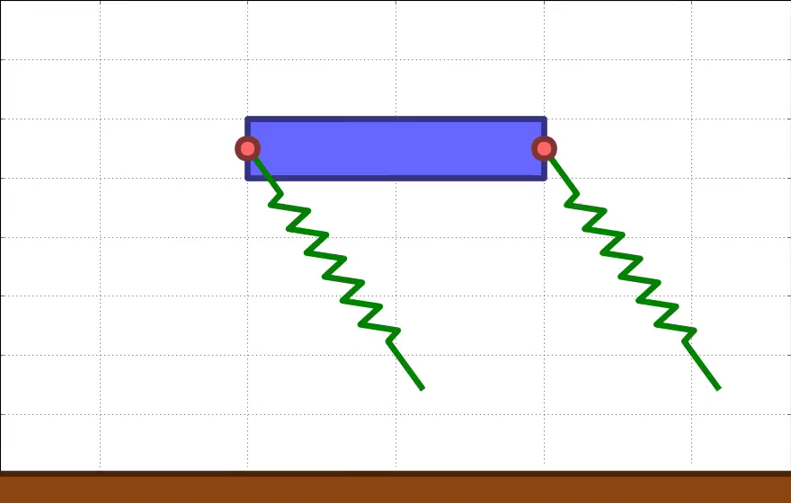

Slide 31
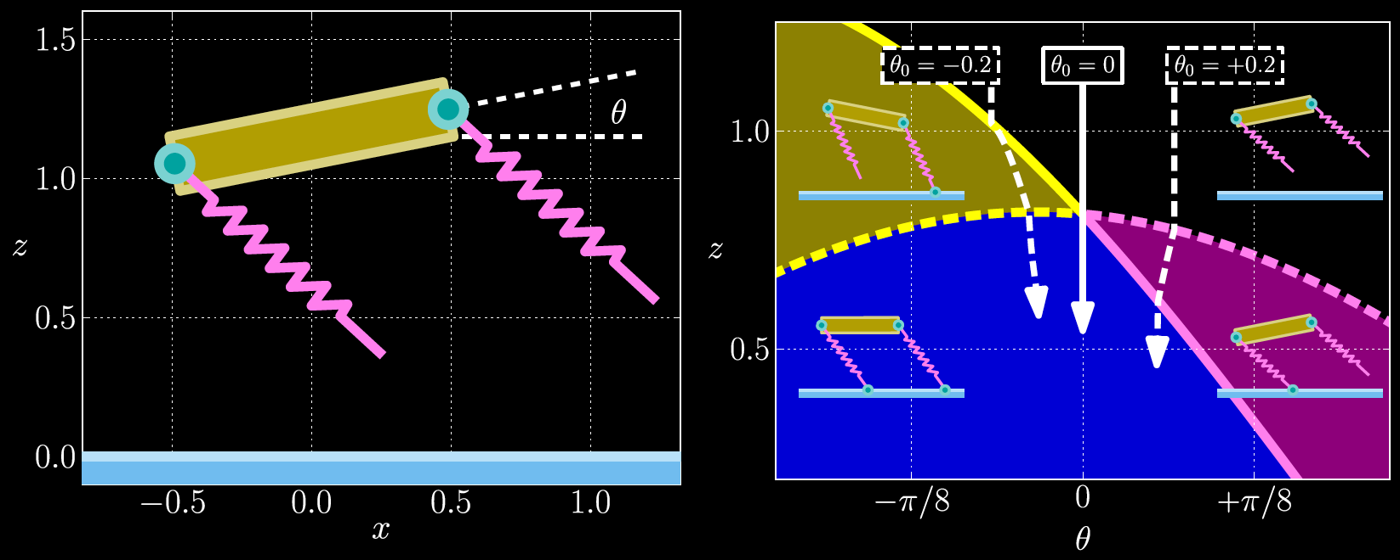

stabilization
Theorem: near-simultaneous footfalls passively stabilize rotations (e.g. pitch)
Burden, Sastry, Koditschek, Revzen SIADS 2016 (arXiv:1407.1775)
Event-Selected Vector Field Discontinuities Yield Piecewise-Differentiable Flows

Slide 32
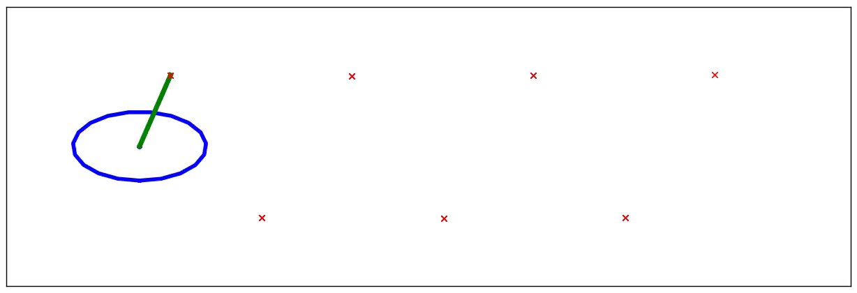
reduction
Theorem: n-leg polyped reduces to lateral leg-spring (LLS) after 1 stride
Burden, Revzen, Sastry IEEE TAC 2015 (arXiv:1308.4158)
Model reduction near periodic orbits of hybrid dynamical systems

Slide 33
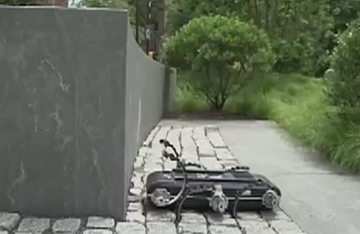
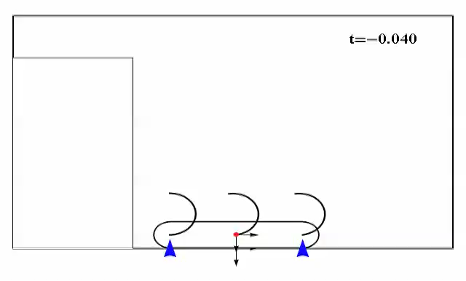
future: automated maneuver synthesis
  state-of-the-art: dynamic maneuvers tuned via exhaustive experiments
  can pose gait / maneuver synthesis via optimization:
Johnson, Koditschek ICRA 2013
  mixed-integer program is generally intractable
consistent terra-dynamics enable scalable (nonsmooth) optimization algorithms

Slide 34
Today’s talk:
predictive dynamical models
for sensorimotor control
M, M⁻¹
internal models
terra-dynamics

Slide 35
Human-Cyber-Physical System:
robotic teleoperation

Slide 36
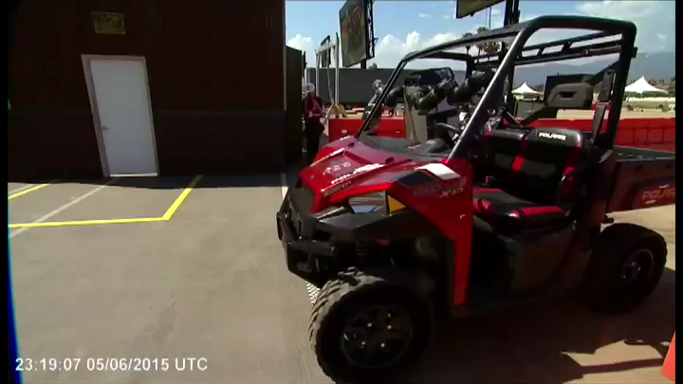

Slide 37
Human-Cyber-Physical System:
robotic teleoperation
future:
dynamic tele-manipulation & tele-locomotion

Slide 38
human interaction with the physical world
is increasingly mediated by automation
humans are the enabling technology

Slide 39









thank you!
ONR #N00014-13-1-0341:
Embedded Humans MURI
Will Nothwang
Mike McCourt
CPS #1565529:
Provably-safe interventions for Human-Cyber-Physical Systems
Ryan Robinson
Dexter Scobee
ARO YIP #W911NF-16-1-0158: Predictive models for sensorimotor control of legged locomotion
Shankar Sastry
Shai Revzen
Aaron Johnson
sburden@uw.edu
http://faculty.uw.edu/sburden
Dan Koditschek

