Slide 1



Assessing stability and controllability
of multi—legged gaits
Andrew Pace
PhD Student
Sam Burden
Assistant Professor
BioRobotics Lab
http://brl.ee.washington.edu
Electrical Engineering
University of Washington
Seattle, WA USA
http://faculty.uw.edu/sburden

Slide 2
takeaway(s):
Sam: legged locomotion can vary
differentiably between footfall sequences
Andrew: can apply familiar techniques
to assess stability and controllability

Slide 3

Sam: legged locomotion can vary
differentiably between footfall sequences
Andrew: can apply familiar techniques
to assess stability and controllability

Slide 4
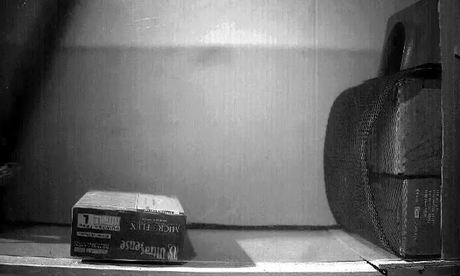
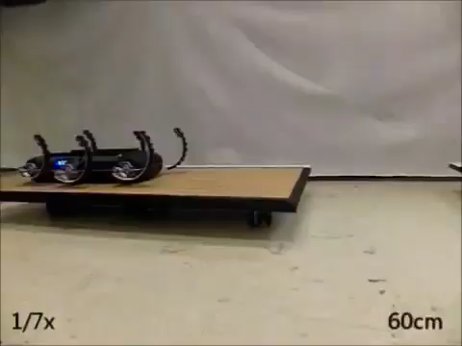
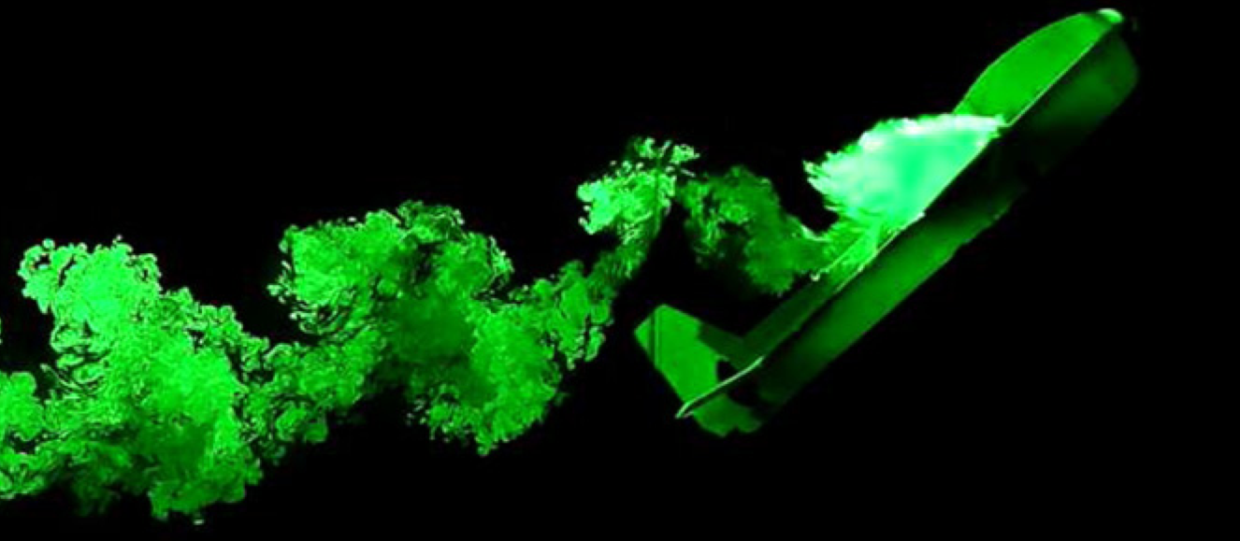
  locomotion through fluid governed by continuous hydro- and aero-dynamics
  locomotion on land governed by intermittent terra-dynamics
Vogel Life in moving fluids 1996
Li, Zhang, Goldman Science 2015
legged locomotion involves intermittent interaction
Tytell, Standen, Lauder JEB 2008
Cory, Moore, Tedrake B&B 2014
Libby, Moore, Chang-Siu, Cohen, Jusufi, Full Nature 2012
Johnson, Koditschek ICRA 2013

Slide 5
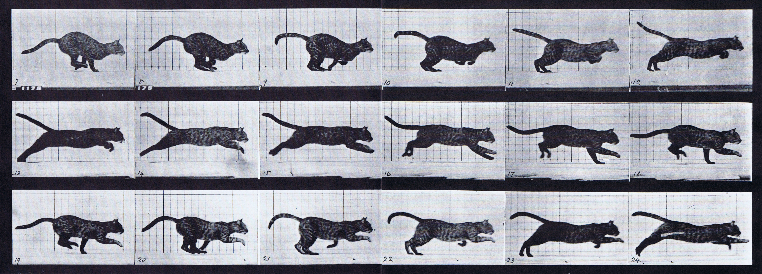


parsimonious models are piecewise-defined
Muybridge 1887 (reprinted by Dover in 1957)
  limbs in contact with ground
  ground penetration constraints
  continuous dynamics
  impact dynamics
Johnson, Burden, Koditschek IJRR 2016 (arXiv:1502.01538)
A hybrid systems model for simple manipulation and self-manipulation systems

Slide 6
  limbs in contact with ground
  ground penetration constraints
  continuous dynamics
  impact dynamics
  make the following assumptions:
  state space is a complete Riemannian manifold
  vector field is globally Lipschitz continuous
  constraints are never tangent to one another
  all the functions are sufficiently smooth
Theorem (Ballard):
trajectories exist and are unique in forward time
Ballard Archive for Rational Mechanics and Analysis 2000
The Dynamics of Discrete Mechanical Systems with Perfect Unilateral Constraints

Slide 7
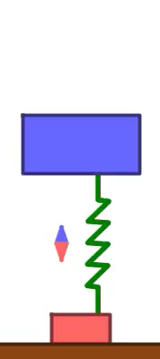

Slide 9
Theorem (Aizerman & Gantmacher et al):
when contact mode sequence is given,
final state varies differentiably w.r.t. initial state
Aizerman & Gantmacher 1958
Quarterly Journal of Mechanics and Applied Mathematics
Determination of Stability by Linear Approximation of a Periodic Solution of a System of Differential Equations with Discontinuous Right-Hand Sides
Grizzle, Abba, Plestan IEEE TAC 2002
Di Bernardo, Budd, Kowalczyk, Champneys Springer 2008
Burden, Revzen, Sastry IEEE TAC 2015

Slide 10
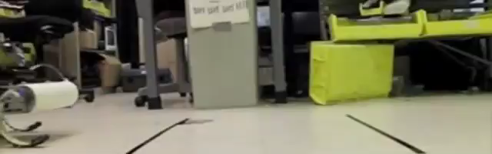

what if contact mode sequence can vary?
Galloway, Haynes, Ilhan, Johnson, Knopf, Lynch, Plotnick, White, Koditschek UPenn 2010
Hyun, Seok, Lee, Kim IJRR 2014

Slide 12
Theorem (Remy et al):
for simultaneous impacts, final state generally
varies discontinuously w.r.t. initial state
Hürmüzlü and Marghitu
International Journal of Robotics Research 1994
Rigid Body Collisions of Planar Kinematic Chains With Multiple Contact Points
Remy, Buffington, Siegwart
International Journal of Robotics Research 2010
Stability Analysis of Passive Dynamic Walking of Quadrupeds

Slide 13
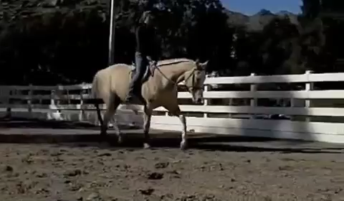
do all locomotors exhibit discontinuous dependence on initial conditions?

Slide 14
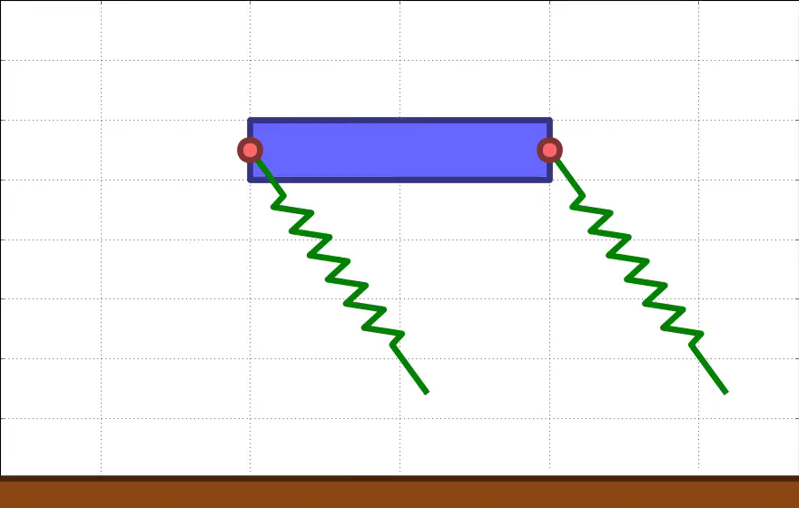
do all locomotors exhibit discontinuous dependence on initial conditions?

Slide 16
Theorem (Ballard):
if constraints are orthogonal* (in body frame),
final state varies continuously w.r.t. initial state
  *ensured, e.g., with series compliance
Ballard Archive for Rational Mechanics and Analysis 2000
The Dynamics of Discrete Mechanical Systems with Perfect Unilateral Constraints

Slide 17


Theorem (Burden, Sastry, Koditschek, Revzen):
if constraints are orthogonal (in body frame),
final state varies differentiably* w.r.t. initial state
  * technically piecewise-differentiably; for details, read:
Burden, Sastry, Koditschek, Revzen SIADS 2016 (arXiv:1407.1775)
Event-Selected Vector Field Discontinuities Yield Piecewise-Differentiable Flows

Slide 19
Theorem (Pace & Burden):
if constraints are orthogonal (in body frame)
and effort increments are not mode-dependent,
final state varies differentiably* w.r.t. initial state
  * actually classically differentiable!
Pace & Burden (in prep) 2016
On differentiability of legged locomotion

Slide 20
# “gaits” = 1!
Sam: legged locomotion can vary
differentiably between footfall sequences
nonlinear dynamics
— (minus)
combinatorial structure
Andrew: can apply familiar techniques
to assess stability and controllability

Slide 21

Sam: legged locomotion can vary
differentiably between footfall sequences
Andrew: can apply familiar techniques
to assess stability and controllability

Slide 22
how to compute a derivative
when differentiable:
Aizerman & Gantmacher 1958
Quarterly Journal of Mechanics and Applied Mathematics

Slide 23
how to compute a derivative
when differentiable:
  variational equation
Aizerman & Gantmacher 1958
Quarterly Journal of Mechanics and Applied Mathematics

Slide 24
how to compute a derivative
when differentiable:
  variational equation
  “saltation” update
Aizerman & Gantmacher 1958
Quarterly Journal of Mechanics and Applied Mathematics

Slide 25
how to compute a derivative
when differentiable:
  variational equation
  “saltation” update
  variational equation
Aizerman & Gantmacher 1958
Quarterly Journal of Mechanics and Applied Mathematics

Slide 26
how to compute a derivative
when piecewise-differentiable:
  variational equation
  “saltation” update
  e.g.
Burden, Sastry, Koditschek, Revzen SIADS 2016 (arXiv:1407.1775)
Event-Selected Vector Field Discontinuities Yield Piecewise-Differentiable Flows

Slide 27
how to assess stability
when differentiable:
  1. construct Poincaré map
  fixed point generates periodic orbit
  2. compute derivative
  check contractivity of this
  linear map

Slide 28
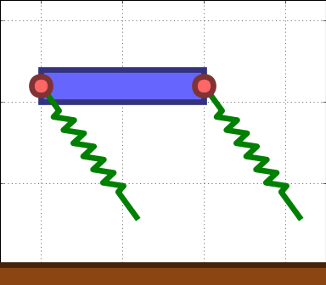
how to assess stability
when differentiable:

Slide 29
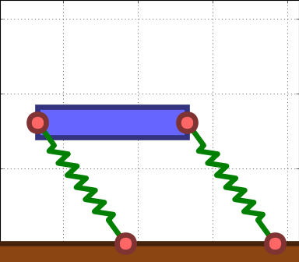
how to assess stability
when differentiable:

Slide 30
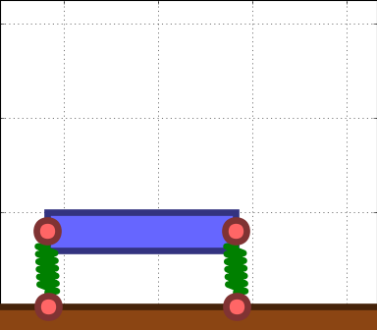
how to assess stability
when differentiable:

Slide 31
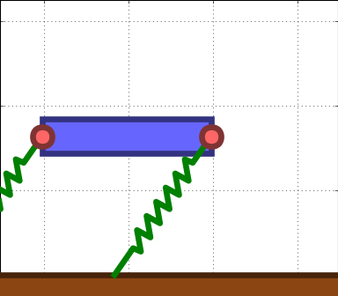
how to assess stability
when differentiable:

Slide 32
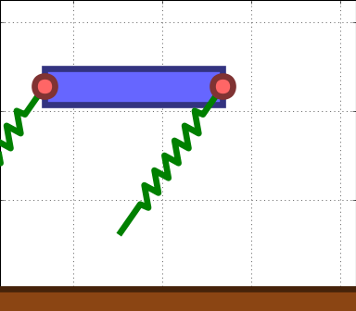
how to assess stability
when differentiable:

Slide 33
how to assess stability
when differentiable:
  1. construct Poincaré map
  fixed point generates periodic orbit
  2. compute derivative
  check contractivity of this
  linear map

Slide 34
how to assess stability
when piecewise-differentiable:
  1. construct Poincaré map
  fixed point generates periodic orbit
  2. compute derivative
  check contractivity of this
  piecewise-linear map
Burden, Sastry, Koditschek, Revzen SIADS 2016 (arXiv:1407.1775)
Event-Selected Vector Field Discontinuities Yield Piecewise-Differentiable Flows

Slide 35
how to assess instability
when piecewise-differentiable:
  1. construct Poincaré map
  fixed point generates periodic orbit
  2. compute derivative
  check instability of this
  piecewise-linear map
Ivanov Journal of Applied Mathematics and Mechanics 1998
The stability of periodic solutions of discontinuous systems that intersect several surfaces of discontinuity

Slide 36
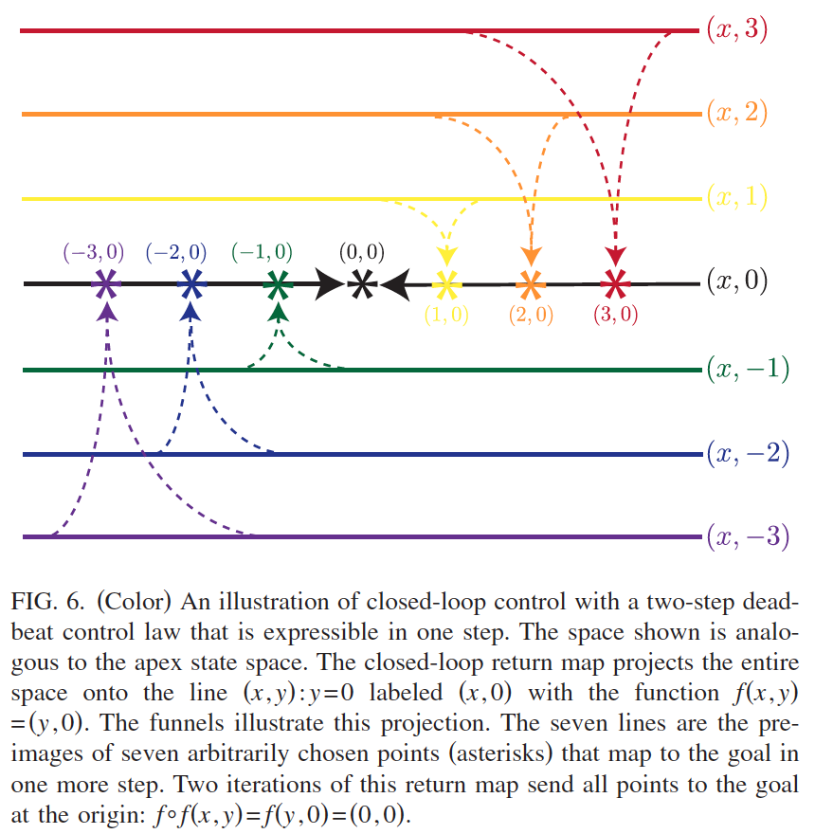
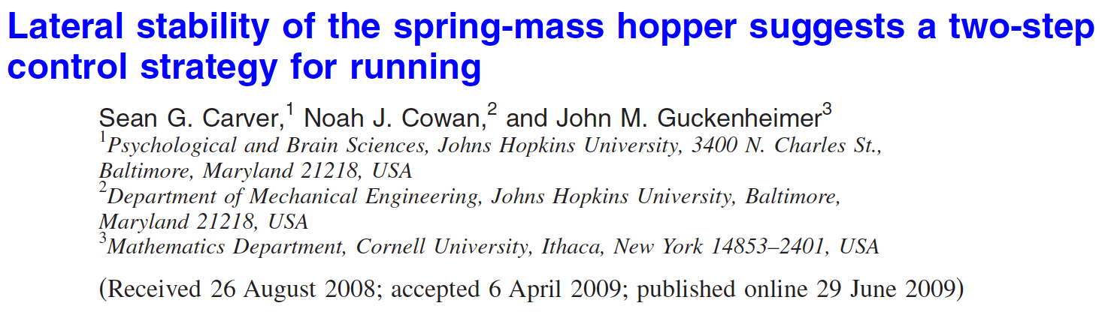
how to assess controllability
when differentiable:

Slide 37
how to assess controllability
when differentiable:
  1. controlled Poincaré map
  control input yields fixed point
  2. implicit function theorem
  check invertibility condition on derivative with respect to control

Slide 38
how to assess controllability
when piecewise-differentiable:
  1. controlled Poincaré map
  control input yields fixed point
  2. implicit function theorem
  check invertibility condition on derivative with respect to control

Slide 39
Sam: legged locomotion can vary
differentiably between footfall sequences
Andrew: can apply familiar techniques
to assess stability and controllability

Slide 40





thank you!
collaborators
apace2@uw.edu
http://brl.ee.washington.edu
sburden@uw.edu
http://faculty.uw.edu/sburden
Shankar Sastry
Shai Revzen
Aaron Johnson
Dan Koditschek
ARO YIP #W911NF-16-1-0158: Predictive models for sensorimotor control of legged locomotion

Slide 41
takeaway(s):
Sam: legged locomotion can vary
differentiably between footfall sequences
Andrew: can apply familiar techniques
to assess stability and controllability

Slide 42
formal definitions
  limbs in contact with ground
  ground penetration constraints
  continuous dynamics
  impact dynamics
  state space is a complete Riemannian manifold with respect to the (nondegenerate) inertia tensor
  vector field is globally Lipschitz continuous:
  constraints are never tangent to one another:
  all the functions are sufficiently smooth:

Slide 43
formal definitions
  limbs in contact with ground
  ground penetration constraints
  continuous dynamics
  impact dynamics
  constraints are orthogonal:
  effort increments are not mode-dependent:

Slide 44
formal definitions
  piecewise-differentiability:

