Slide 1
Religion in vietnam
Social Change in East Asia
Professor Sorensen
May 19, 2011

Slide 2
Religious Pluralism
Few Vietnamese volunteer that religion is an important part of their life (maybe ¼) but religious practices can be found everywhere
The Three Religions (tam giáo)
Confucianism
Daoism
Buddhism (mostly Mahayana)
Folk Religion
Ancestor veneration
Belief in ghosts and spirits—and shamans to contact them
Catholicism (about 7% of the population)
Indigenous religious
Cao Dai—mixture of Daoism, Buddhism and Christianiry
Hoa Hao—a syncretistic Buddhist sect
Constitutionally recognized religions—Buddhism, Catholicism, Protestantism, Islam, Cao Dai, and Hoa Hao

Slide 3
Temple to Confucius in Hanoi 2009

Slide 4
Hanoi Temple to Lake Turtle 2009

Slide 5
Buddhism
Buddhism introduced from the North into Red River Delta about 300 –600AD
Syncretetic mixture with Daoism, and indigenous practices
About half of the Vietnamese who report a religion mention Buddhism
10 million registered, but up to ¾ nominally Buddhist
Pure Land most common, but Zen more intellectual prestige

Slide 6
Lý Triều Quốc Sư Hanoi 2009
Notes:
Oldest Buddhist temple in Hanoi originally founded 1131 during the Ly Dynasty, though rebuilt many times since. Ly Trieu Quoc was the name of the monk who founded the temple. In Vietnamese chùa means pagoda, and sư means temple in Sino-Vietnamese. Inside there is probably a Shakyamuni Triad Manjusri on right and Samantabhadra on left.

Slide 7
靈老寺 Hue

Slide 8
Hòa Hào
Founded in 1939 based on Buddhism by Huỳnh Phú Sổ in Mekong Delta
Prophetic, peasant-based religion centered on the Mekong Delta where ¼ to ¾ of the population follows this faith
Strongly influenced by Theravada Buddhism which leads to a de-emphasis on temples, statues, and elaborate funerals
Politically anti-French, but not willing to follow the leadership of the Viet Minh
1947 Huynh executed by the communists which led the Hoa Hao adherents to attach the Viet Minh

Slide 9
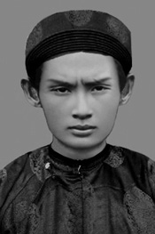
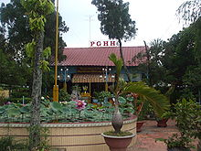
Founder of Hoa Hao and Temple
Huynh Phu So
Hoa Hao Temple

Slide 10
Cao Đài
Established in Tây Ninh in 1926 meaning “kingdom of heaven”
Monotheistic worship of “God the Father in Heaven”
Local “pope” communicates directly with God
Prayer, veneration of ancestors, nonviolence, vegetarianism leading to freedom from the cycle of birth and death
About 2.2 million followers
Cao Dai Video Clip

Slide 11
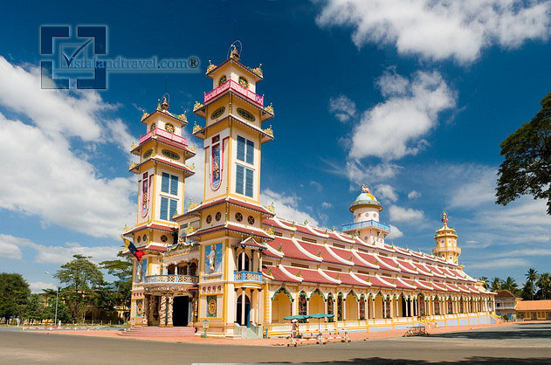
Cao Dai Temple Tay Ninh

Slide 12
Minority Religions
Chams (Austronesian people) Hindu or Muslim
Khmers Theravada Buddhism

Slide 13
Roman Catholic
First arrived with Jesuit Portuguese missionaries in 16th century—and current Vietnamese writing with diacritics (Quốc Ngữ) invented then
French missionaries arrived in 18th century after the suppression of the Jesuits
Currently 5.6 million members (7% of population)

Slide 14
Catholic Cathedral and a School in Hanoi 2009

Slide 15
Protestantism
First introduced in 1911 by Canadian missionary
Evangelical, with maybe 0.5-1.0 million
Current popularity among Montagnards

Slide 16
Folk Practices
Ancestor shelf with candles, incense sticks, scrolls, burner, and ancestral tablets in main room of most houses
Village Đình (meeting place/temple) where housewives may offer food to local guardian spirits called Thần Hoàng
Can be spirit of someone who died, or one of non-human origin
Village pagoda with or without monk (chùa)

Slide 17
Theoretical Approaches
Secularization hypothesis (Western social science)
Durkheim—consequence of increasing atomization of society
Weber—consequence of increasing bureaucratic rationality
Marx—disenchantment (Entzauberung) a consequence of improving material conditions
Feudal remnants hypothesis (indigenous)
Vestiges of premodern religion as a hindrance to progress

Slide 18
Anthropological Approaches
Alternative modernities?
Critique of alienating market relations?
Method of capturing modernity?
Method for imagining the capriciousness of global capitalism?
Or is it “tradition” reasserting itself?
If authors call it “re-invented” what do they mean by this?

Slide 19
Jellema
New commemorative practices re-imagine local and national communities
Discourse of ‘return to origins’ về nguồn and ‘remember the source’ nhớ nguồn
Free to revive religious practices since 2004
Not independent of the state
Đô temple enshrines the 8 kings of the Lỳ Dynasty (1009-1225)
Festival lunar 3:15 (3 days)
Temple to all Vietnamese as birthplace of illustrious native dynasty and of capital at Hanoi

Slide 20
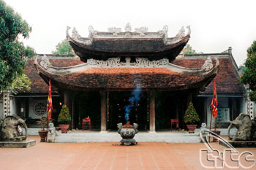
Đô Temple Đìng Bàng Village

Slide 21
Religious Connections
Yi Ch’ang-gŭn, head of the Hwasan Yi Clan of Korea arrives in Vietnam in 1994 to worship his ancestors
Descended from junior uncle of last Ly dynasty emperor
Story:
Ly Long Tuong was the younger uncle of the last Ly Emperor Hoe Tong who had become enamored of a young Miss Tran and installed she and her in-laws into the palace
The Trans led a coup and Ly Long Tuong escaped to be set adrift with ancestor worship parephernalia.
When Ly arrived in Koryŏ King Kojong enfeoffed him in Hwasan County (South Hwanghae)
When the Mongols invaded 1231-39 he fought effectively and became known in Korean folklore as the White Horse General who was locally worshiped as a guardian deity
This story is well-known in Korea because of the historical novel by Kang Mu-hak published in 1967 called The Emperor’s Junior Uncle Yi Yongsang

Slide 22
Intermediary Role
Yi Ch’ang-gŭn awarded Vietnamese citzenship in 2010 in ceremony in the La Thanh Hotel where he is known as Lý Xương Cân
By taking advantage of his ancestry 800 years ago the Korean Mr. Lee has reinvented himself as a business and diplomatic intermediary between Vietnam and South Korea
This role facilitated by ancestor worship practices in both Korea and Vietnam, and by state-promoted “return to origins” discourses facilitated through religion

Slide 23
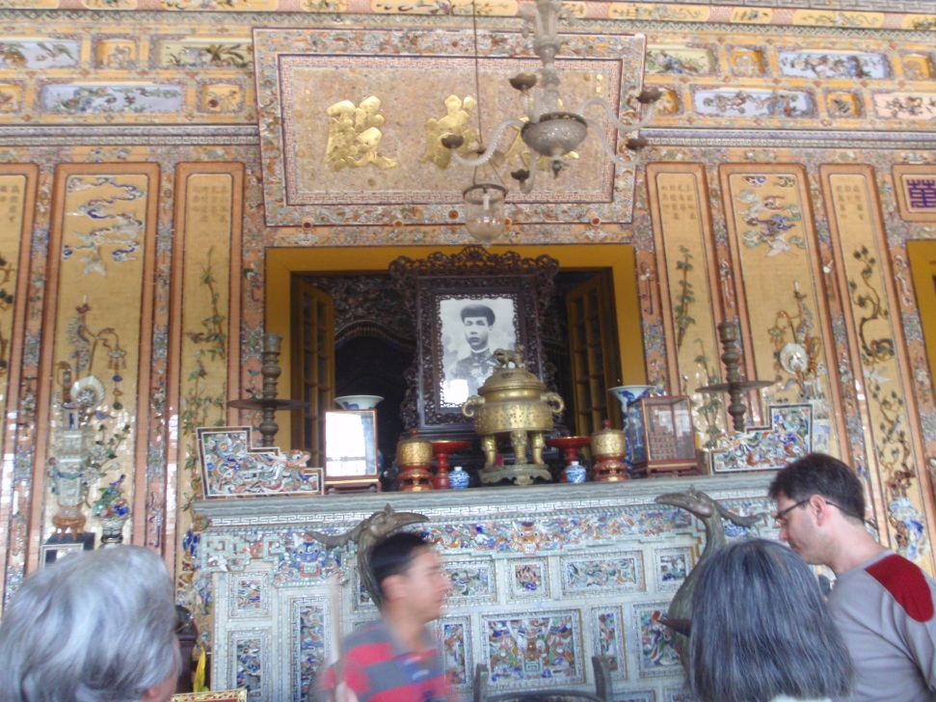
Mortuary Temple for a Nguyen Emperor near Hue

Slide 24
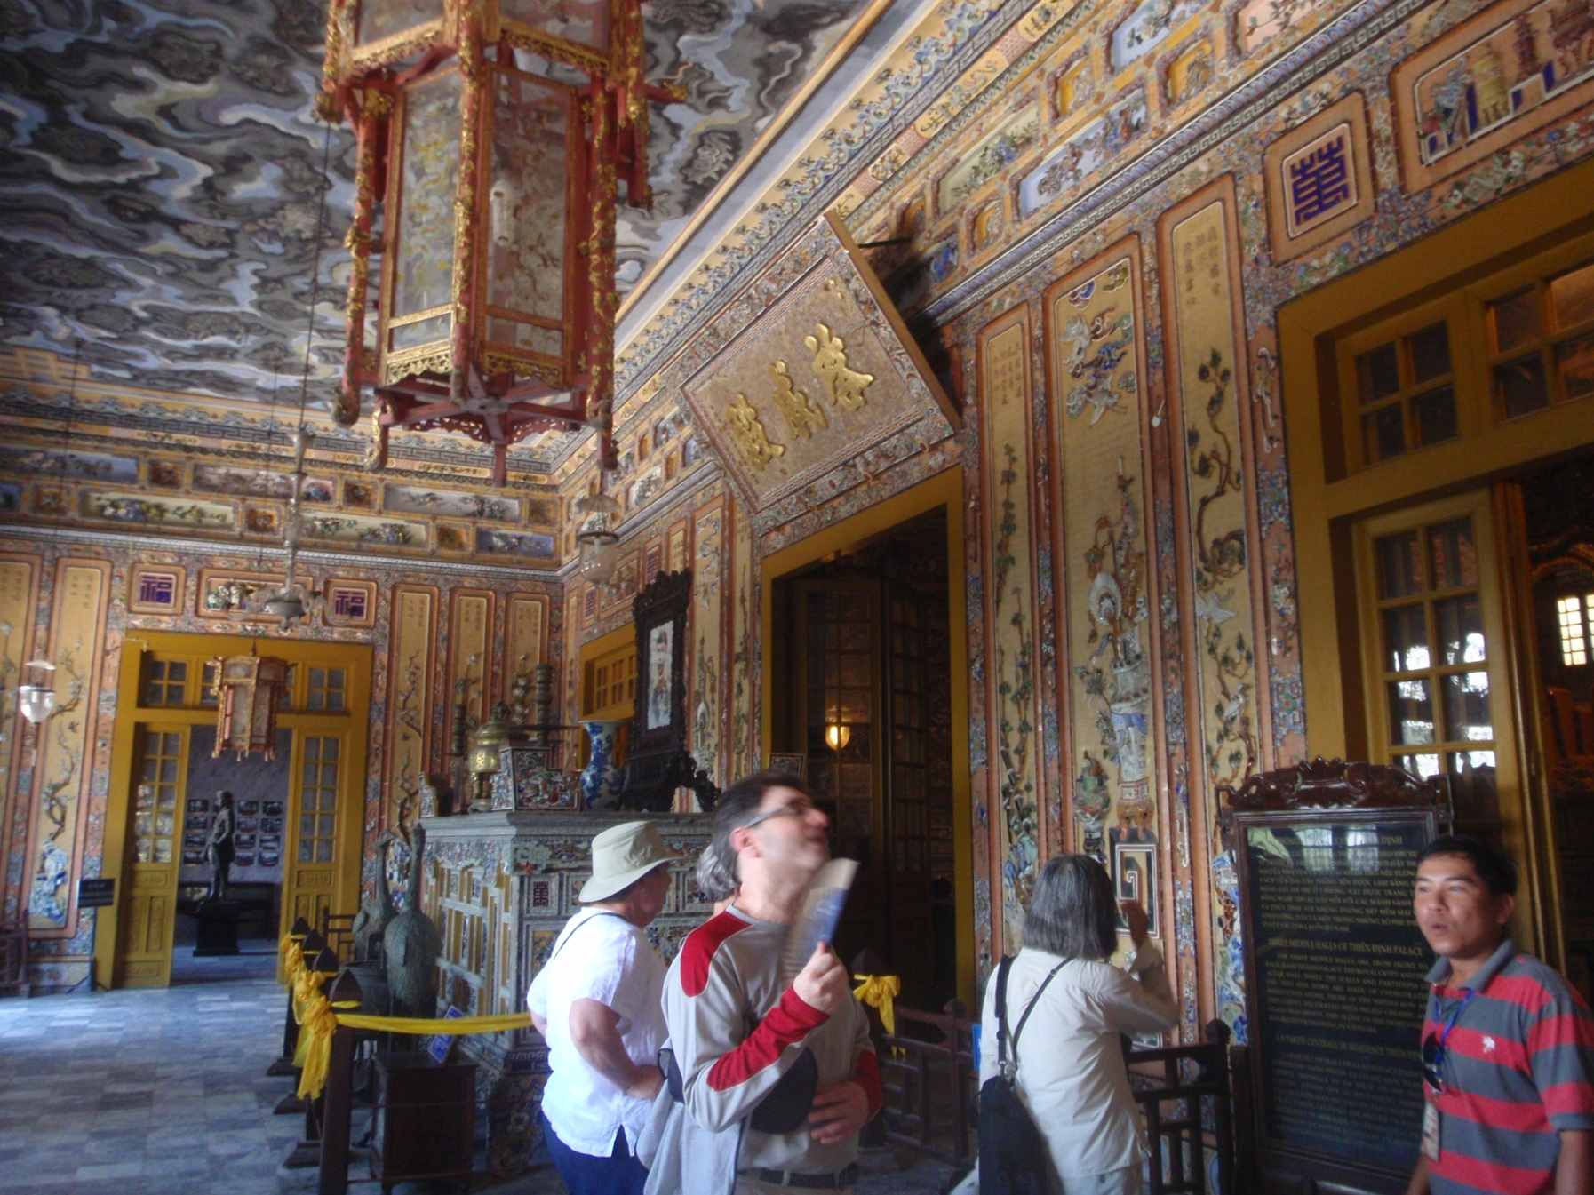

Slide 25
Ho Chi Minh Mausoleum

Slide 26
Ho’s Pavilion on Grounds of Governor’s Palace 2009

