Slide 1
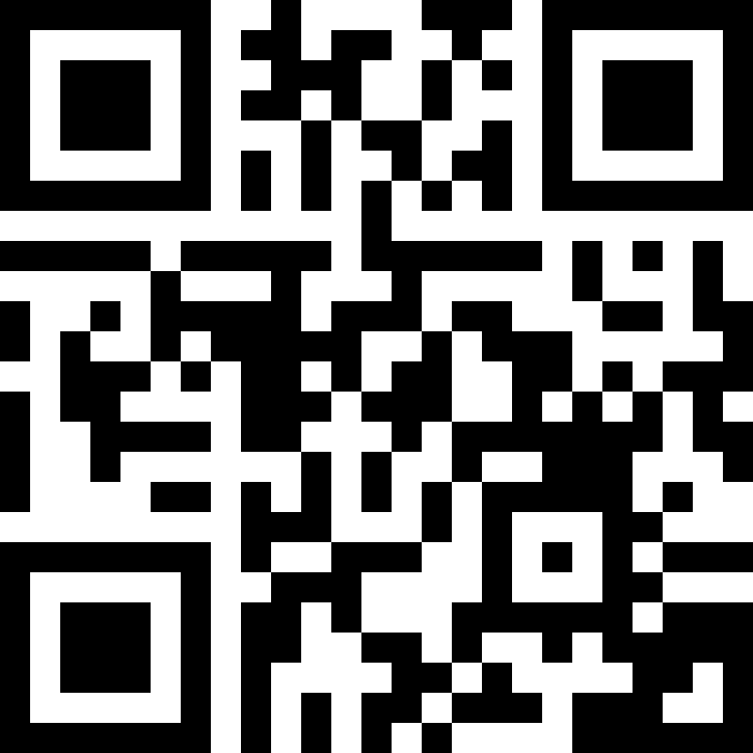
For the safety and inclusion of all members of our community, I urge our Society leaders to hold future meetings only in locations where reproductive freedom, gender-affirming care, and the sanctity of physician-patient relationship are protected.
#AbortionIsHealthcare
#ATSSafe4All

Slide 2
For the safety of our presenters and attendees, I request that the American Thoracic Society commit that future meetings will be held only in locations where elected leaders ensure and uphold that healthcare is a human right, affirm the importance of reproductive freedom, gender-affirming care and the sanctity of the physician-patient relationship and publicly ensure the safety of all attendees regardless of race, religion, ethnicity, gender, sexual orientation or any other aspect of their identity.
#AbortionIsHealthcare
#ATSSafe4All

Slide 3
For the safety of our presenters and attendees and for the inclusion of all members of our community, I urge our society leaders to hold future meetings only in locations where reproductive freedom, gender affirming care and the sanctity of the physician-patient relationship are protected.
#AbortionIsHealthcare
#ATSSafe4All

Slide 4
Acting upon its commitment to equity & inclusion, and considering that limitations on reproductive rights as well as other discriminatory policies are becoming more pervasive, I demand that our society hold future meetings only in locations that all members can attend safely, regardless of sex, gender, religion or race.

Slide 5
Important Message!
For the safety of all presenters and attendees, I urge leadership to ensure that future meetings are held in locations where elected officials understand that healthcare is a human right, uphold the importance of reproductive freedom, gender-affirming care, and the sanctity of the physician-patient relationship and publicly affirm the safety of all attendees regardless of race, religion, ethnicity, gender, sexual orientation or any other aspect of their identity.
#AbortionIsHealthcare
#ATSSafe4All

Slide 6
Presentation & Poster Widgets
PowerPoint widget (best if you wish to edit contents):
#AbortionIsHealthcare
#ATSSafe4All
Vector widget (best if you need to resize the widget):
PowerPoint mini-widget for light and dark backgrounds:
#AbortionIsHealthcare
Why is this here? See:
Q: Help! PowerPoint is breaking my widget when I try to paste or resize it!
A: Use vector versions of widgets to force PowerPoint to paste or resize elegantly. To vectorize your own widget:
From source file (e.g. this file), select all widget PowerPoint objects, then copy to clipboard.
In your presentation or poster file, click on Edit menu > “Paste Special…” then select “Picture (SVG)”.
#AbortionIsHealthcare
Why is this here? See:
Vector mini-widget for light and dark backgrounds (best for resizing):

