Slide 1
Progress towards a direct measurement of
neutrino mass
International Symposium on
Parity Nonconservation and Neutrino Physics,
T. D. Lee Institute, Shanghai
November 28, 2016
R. G. Hamish Robertson,
CENPA, University of Washington

Slide 2
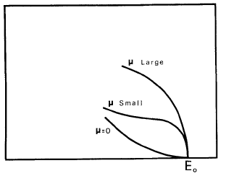
“Hence, we conclude that the rest mass of the neutrino is either zero, or, in any case, very small in comparison to the mass of the electron.”
E. Fermi
F. Wilson, Am. J. Phys. 36, 1150 (1968)
This is the “direct” method.

Slide 3
Limits on neutrino mass through the years

Slide 4
Limits on neutrino mass through the years
Lee & Yang:
P

Slide 5
Neutrino Masses and Flavor Content
e mu tau
“Normal”
“Inverted”
ν₃
ν₂
Solar
ν₁
Δm₂₃²
2 x 10⁻³ eV²
Atmospheric
Atmospheric
ν₂
Δm₁₂²
Solar
8 x 10⁻⁵ eV²
ν₁
ν₃
?
?

Slide 6
v₁, v₂, v₃

Slide 7
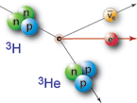

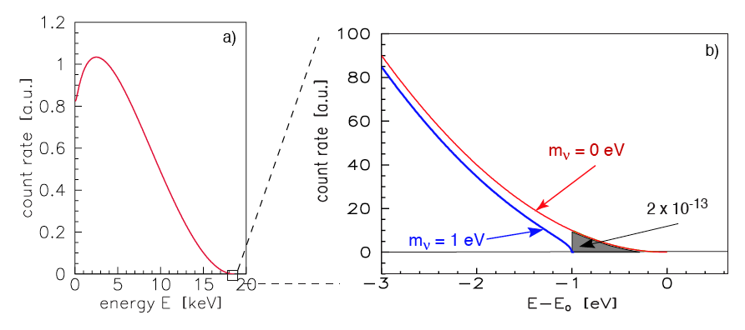
Neutrino mass from Beta Spectra
With flavor mixing:
mixing
neutrino masses
from oscillations
mass scale

Slide 8
Mass Range Accessible
Present
Lab Limit
2 eV

Slide 9
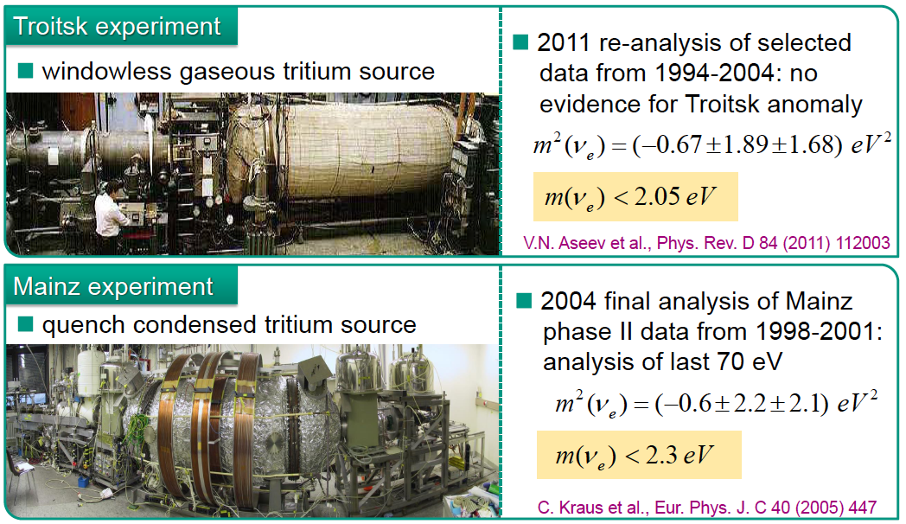
Present Laboratory Limit from 2 tritium experiments:
m_{v} < 2 eV

Slide 10

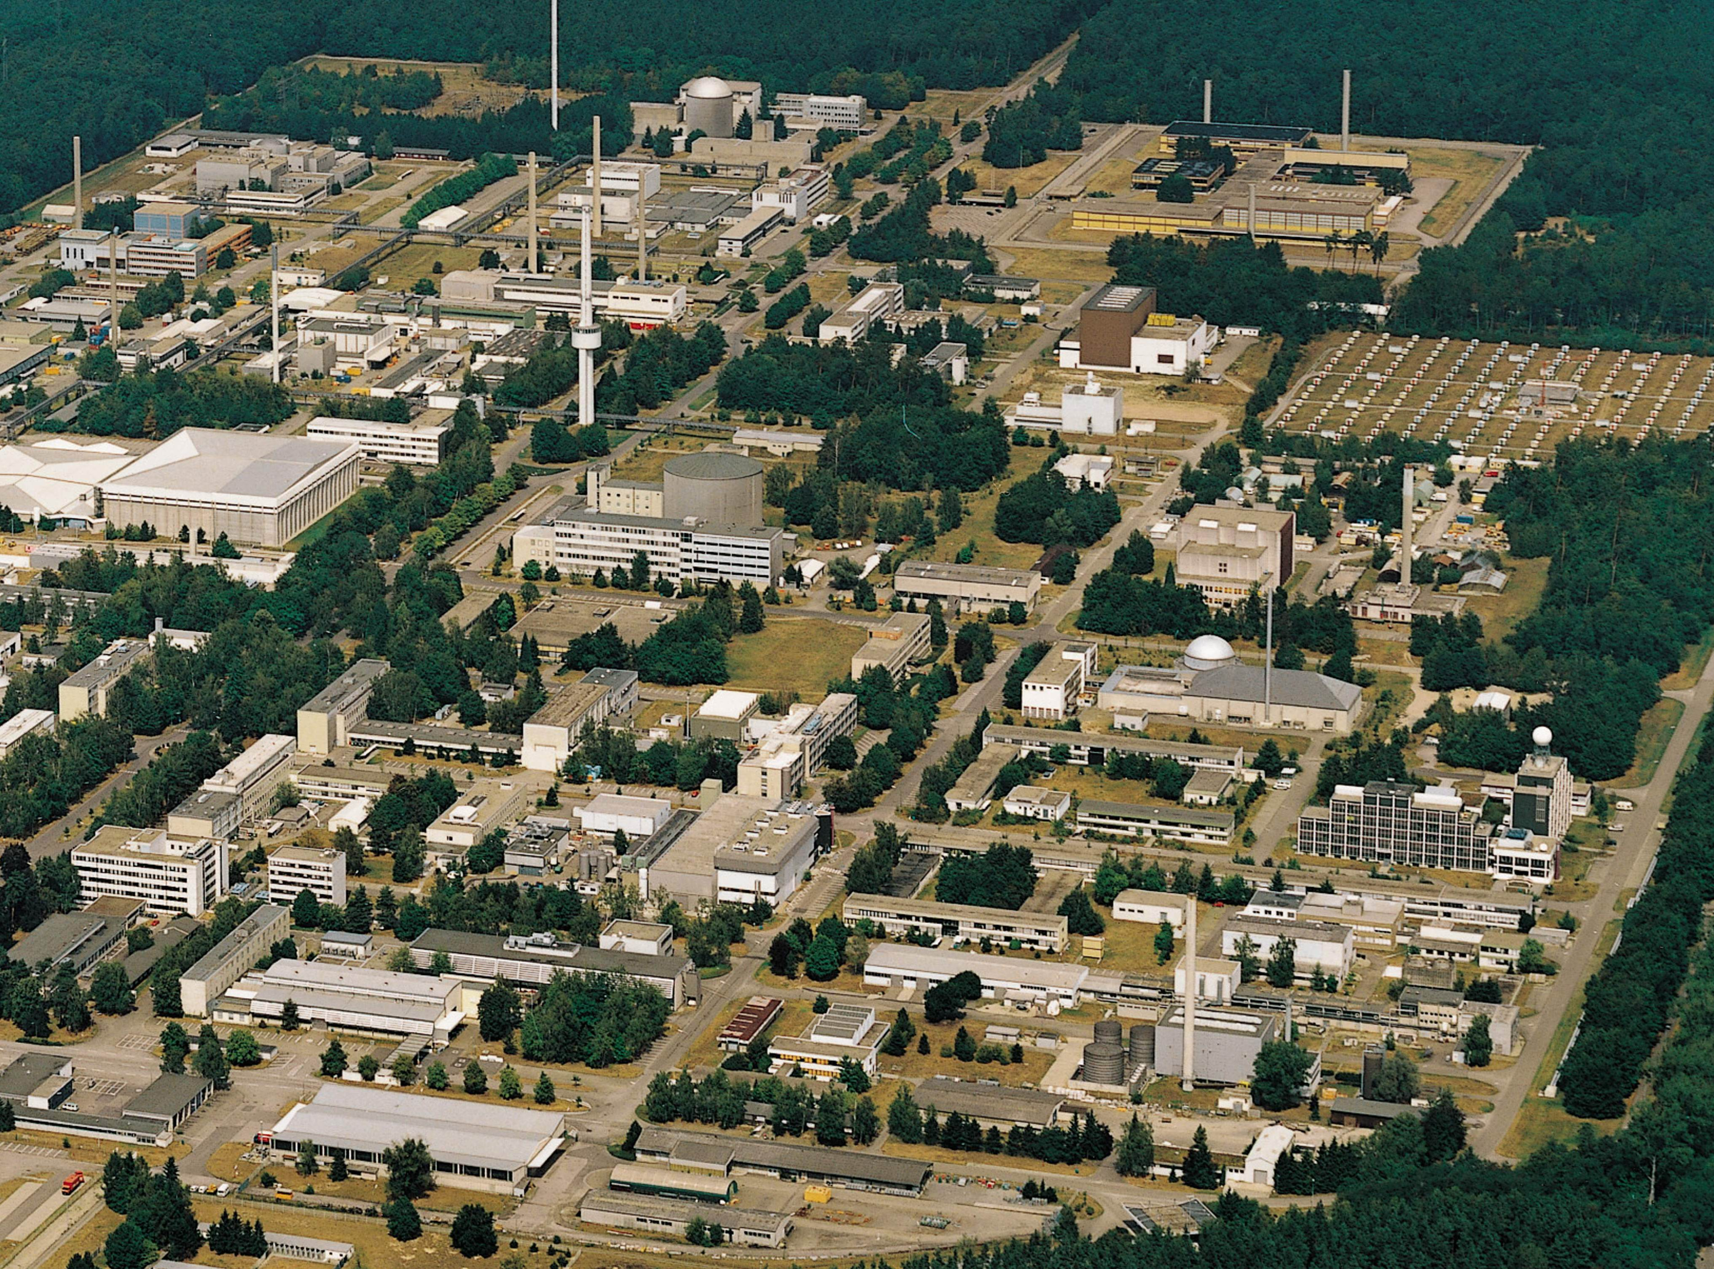
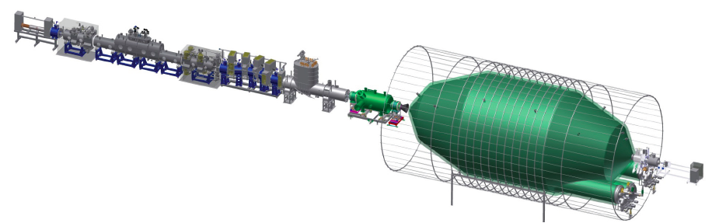
KATRIN
At Karlsruhe Institute of Technology
unique facility for closed T₂ cycle:
Tritium Laboratory Karlsruhe
A direct, model-independent, kinematic method, based on β decay of tritium.
TLK
~ 75 m long with 40 s.c. solenoids

Slide 11
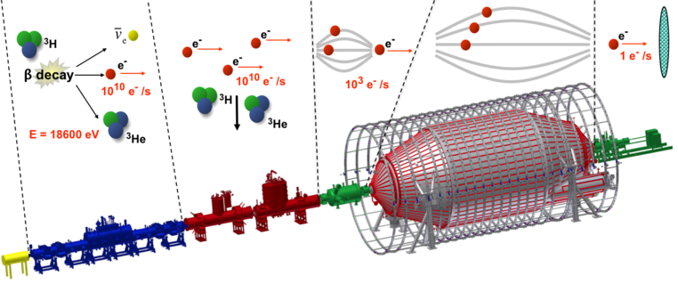
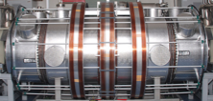
Overview of KArlsruhe TRItium Neutrino Experiment
Windowless gaseous source
Transport section
Pre-spectrometer
Main-spectrometer
Detector
10⁻³ mbar
10⁻¹¹ mbar
V
Monitor-spectrometer
70 m

Slide 12
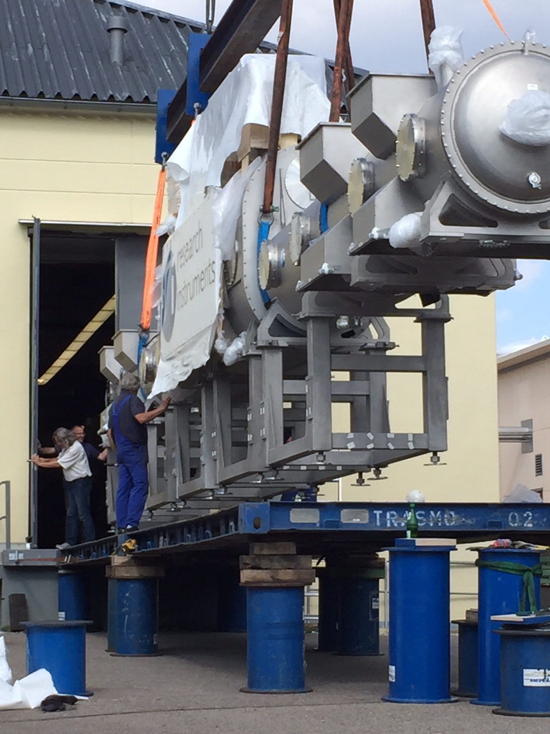
Windowless Gaseous Tritium Source

Slide 13
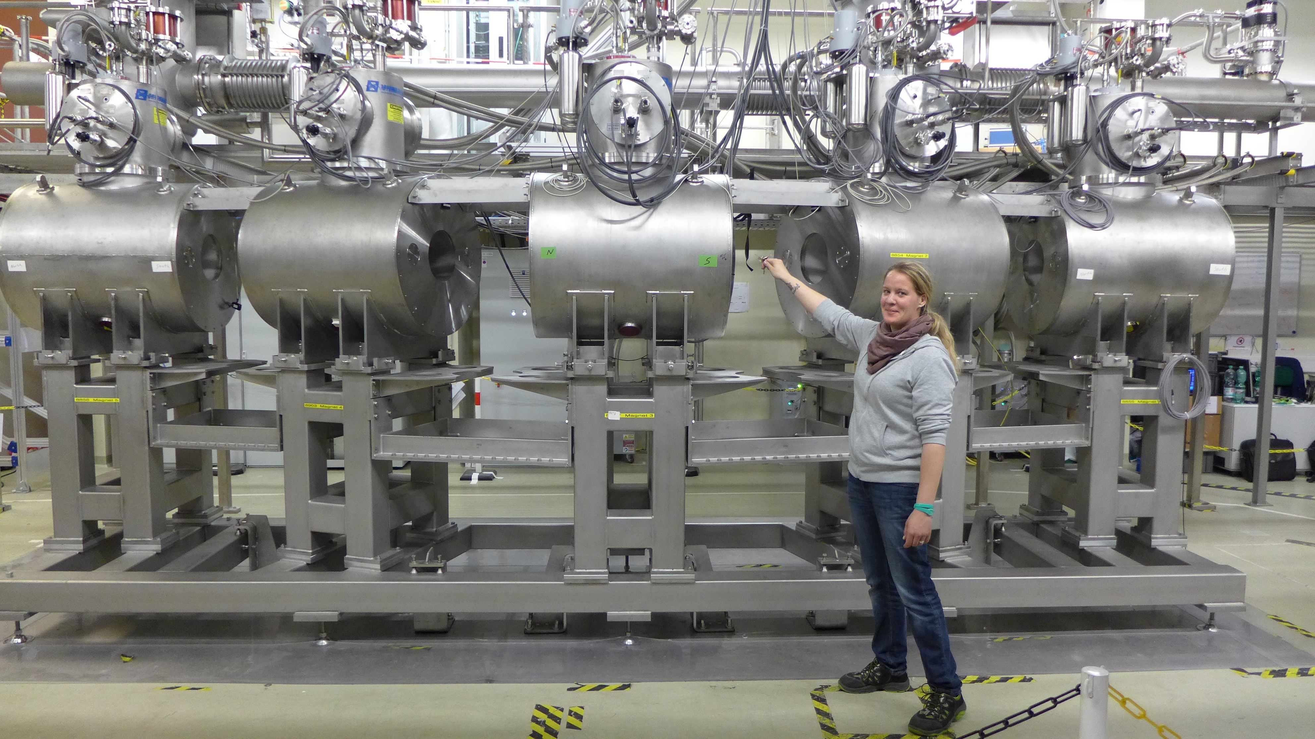
Differential Pumping System

Slide 14
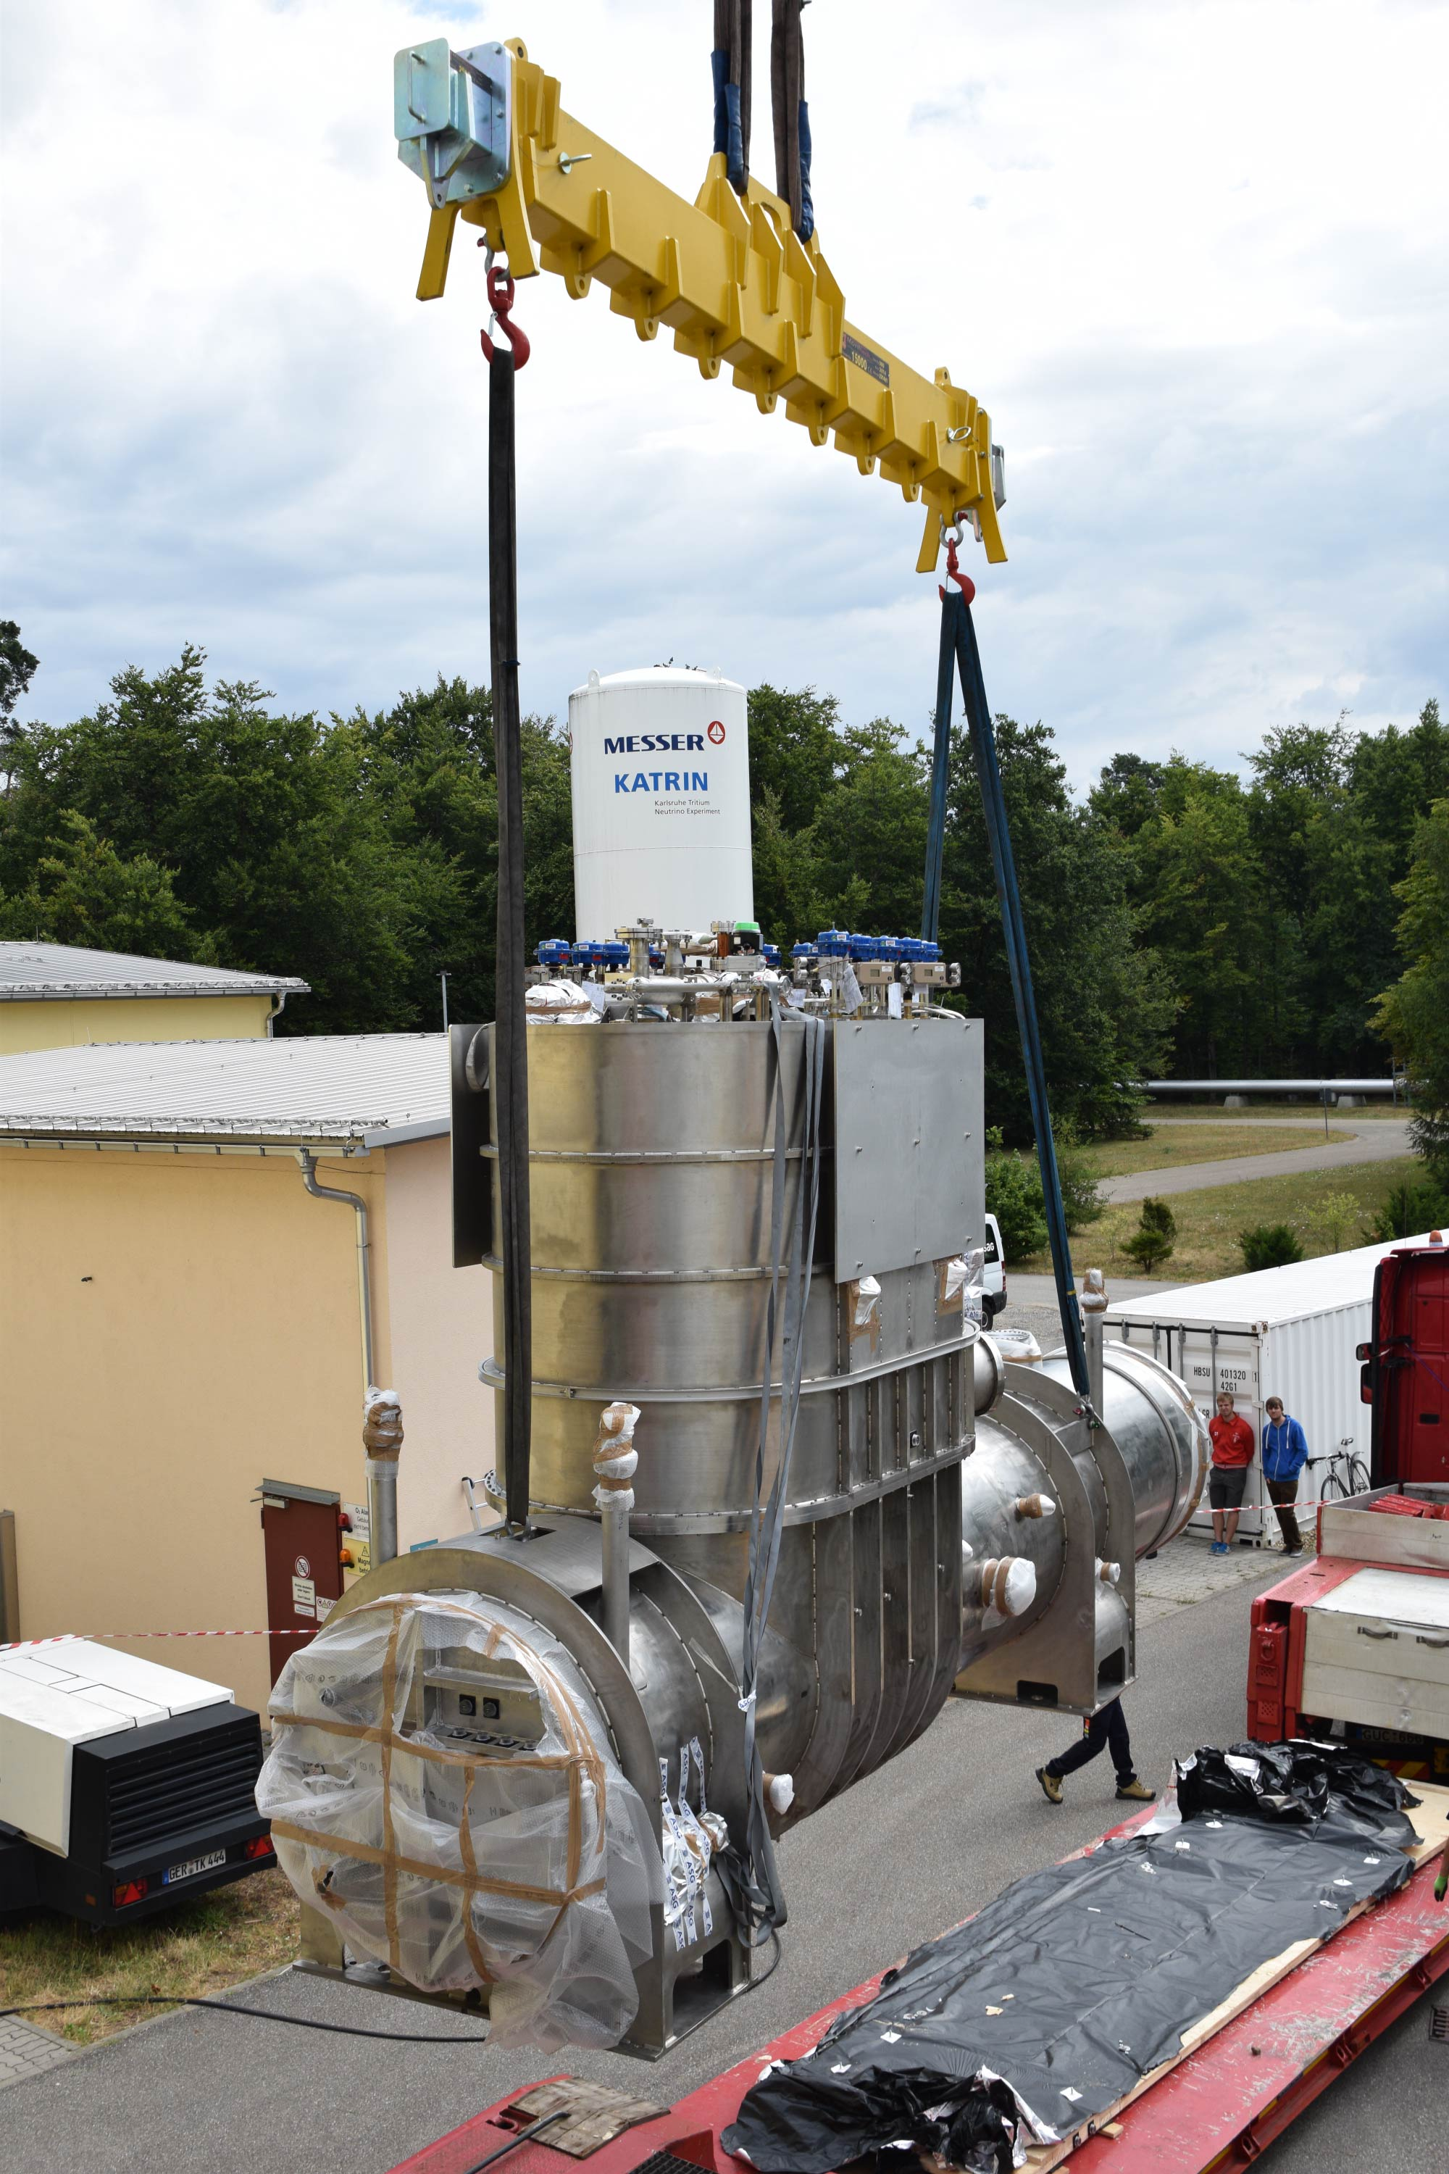
Cryogenic Pumping System

Slide 15
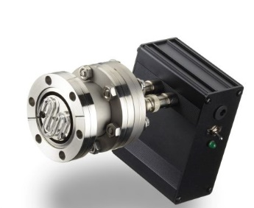
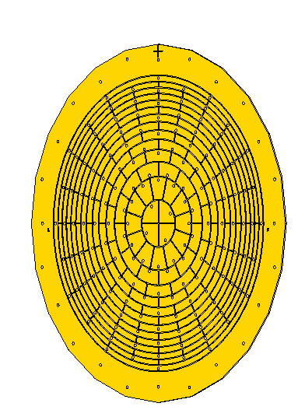
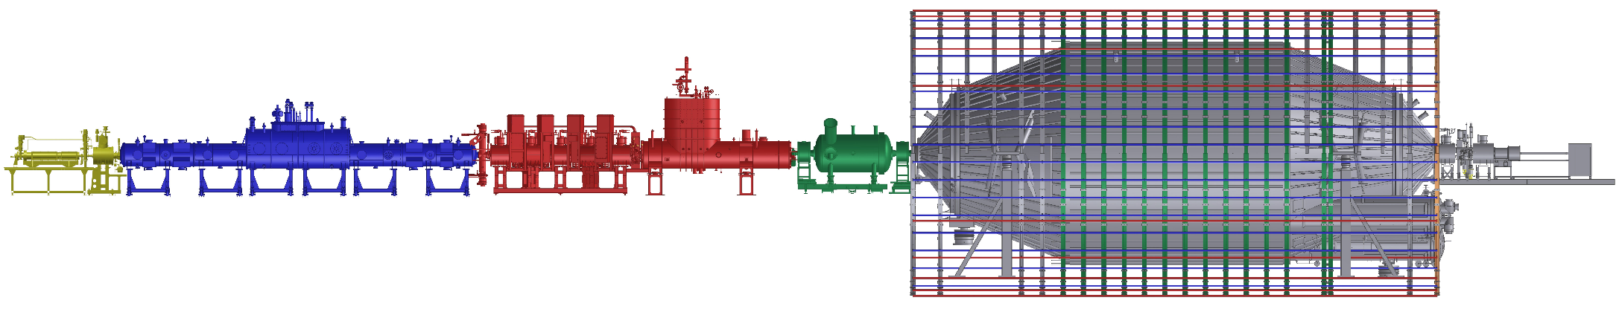
“First light”
Aligning system with photoelectrons from the rear wall.
E. L. Martin
Notes:
Electrons where sent through the entire beam line for the first time yesterday. Using a temporary version of the electron gun the rear wall is being illuminated with UV light to produce a beam of photo electrons. All magnets are running at a reduced field to allow for both raising and lowering magnetic field. The beam is being used for alignment, as well as some other tests.

Slide 16
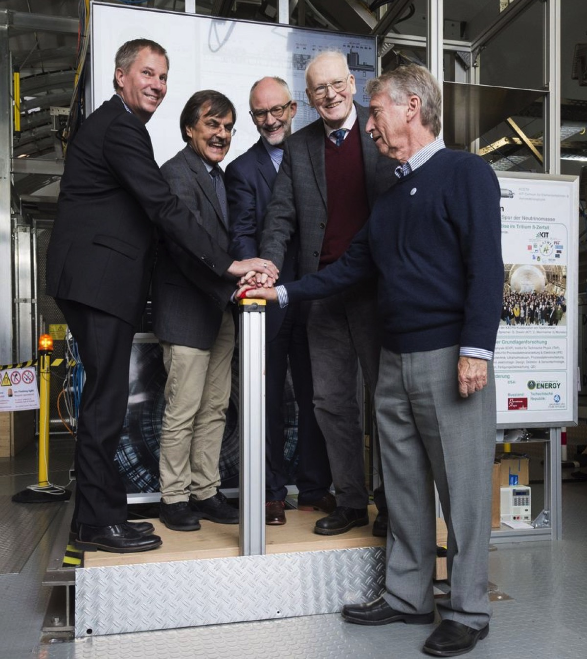
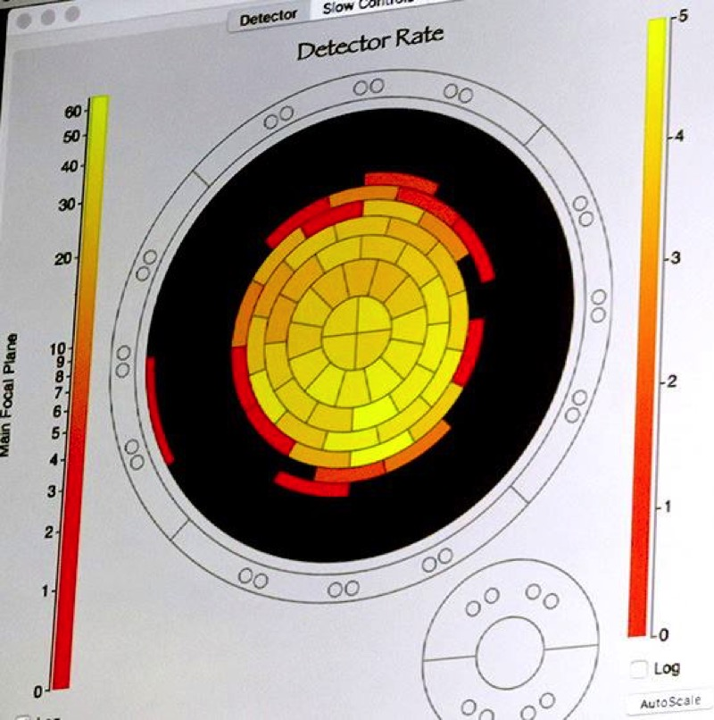
“first Light” at Katrin – Oct. 14, 2016
Photoelectrons transmitted through the entire 75-m KATRIN system

Slide 17


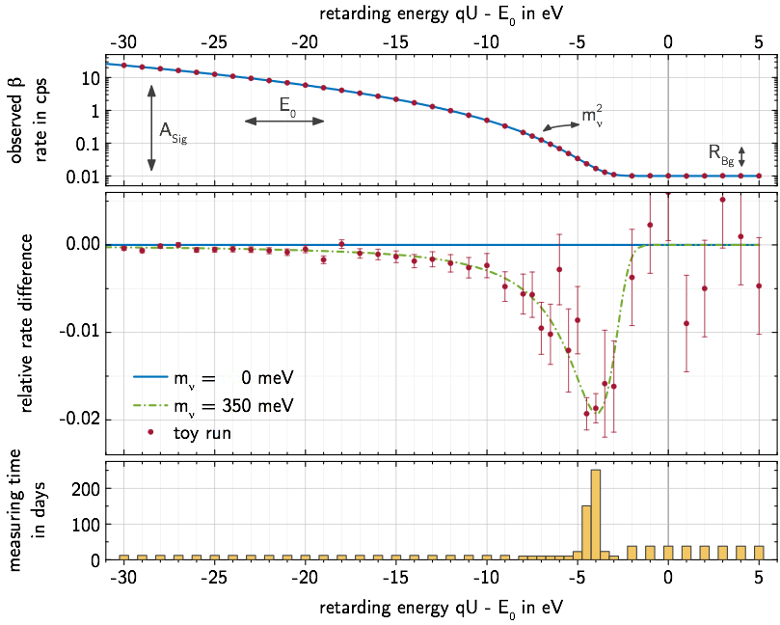

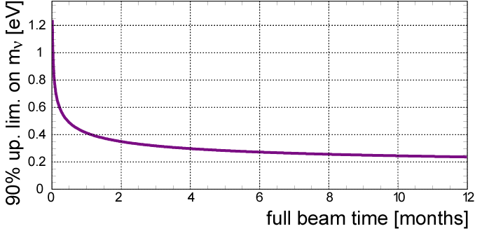

KATRIN: neutrino mass analysis & sensitivity
Relative shape measurement
of integrated β spectrum
4 fit parameters:
m²_{ν} , E₀ , A_{S} , R_{Bg}
count rate (s⁻¹)
3 yrs (5 cal. yrs) to balance statistics and systematics
rel. difference
_{at design parameters:}
1200
1000
800
600
400
200
200 meV: 90% CL
300 meV: 3σ
350 meV: 5σ
sensitivity 90% CL [meV]
meas. time (d)
optimal m²_{ν} sensitivity at S/B ≈ 2 [E. Otten, 1994]
0 2 4 6 8 10 12
full beam time [months]
K. Valerius, M. Kleesiek

Slide 18
Mass Range Accessible
starting
2017
KATRIN
Present
Lab Limit
2 eV

Slide 19
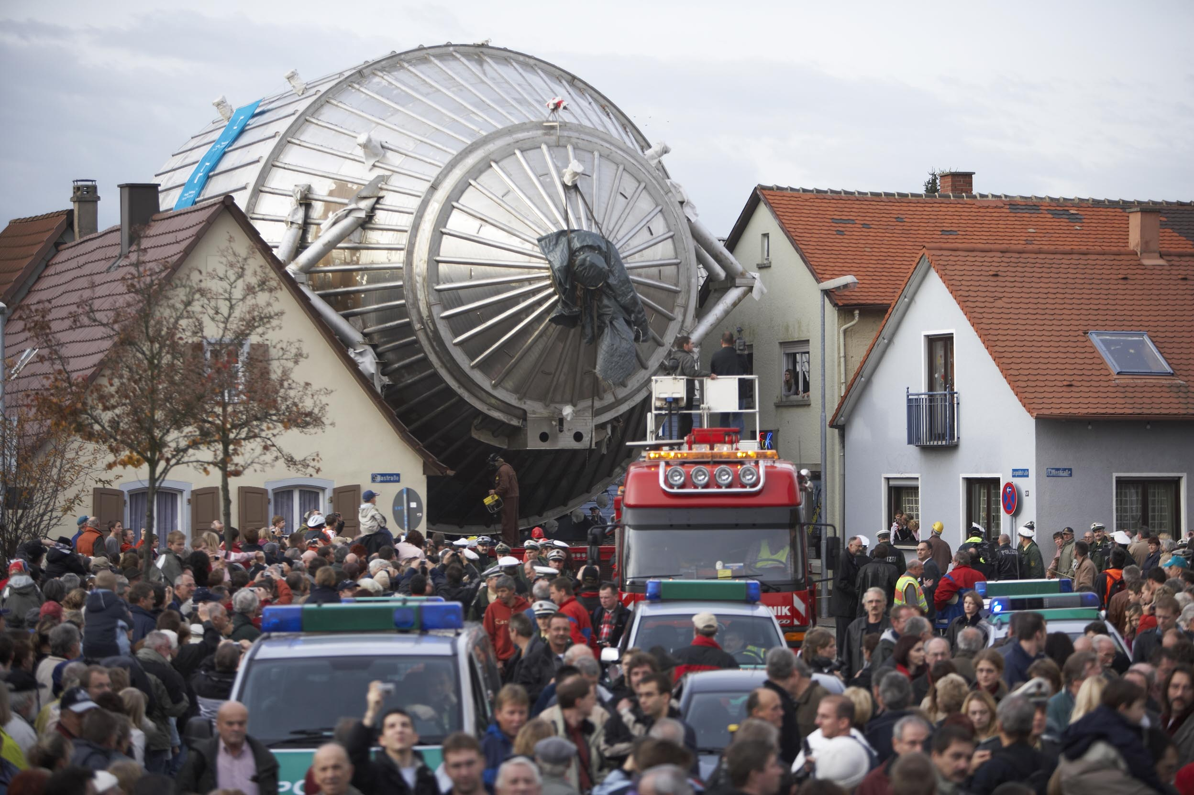
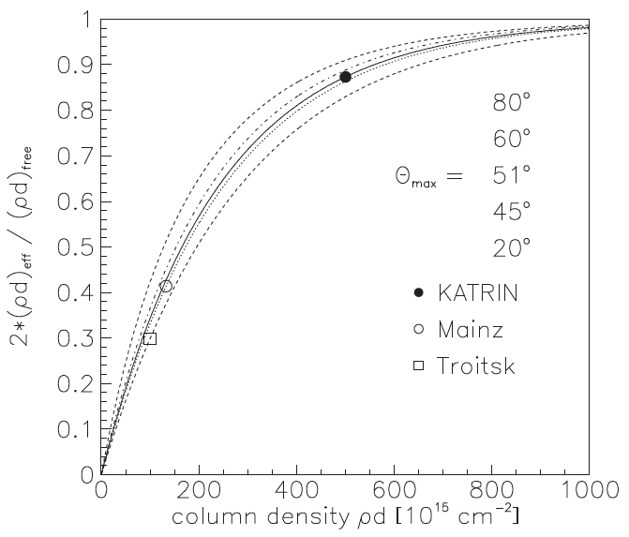
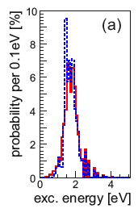

The Last Order of Magnitude
If the mass is below 0.2 eV, how can we measure it?
KATRIN may be the largest such experiment possible.
σ(m_{v})² ~ 0.38 eV²
Size of experiment now:
Diameter 10 m.
Source T₂ column density near max
Rovibrational states of THe⁺, HHe⁺ molecule
Next diameter: 300 m!

Slide 20
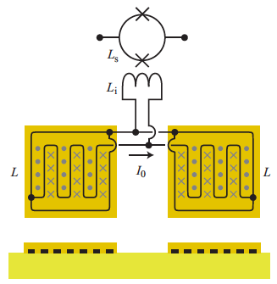
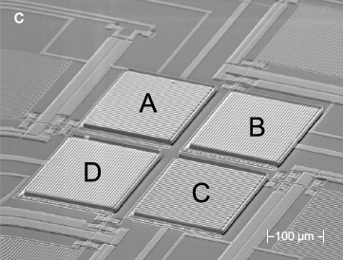
Electron Capture Holmium Expt (ECHo)
Gastaldo et al. NIM A711, 150 (2013)
¹⁶³Ho implanted in Metallic Magnetic Calorimeters
Au:Er paramagnetic sensors

Slide 21
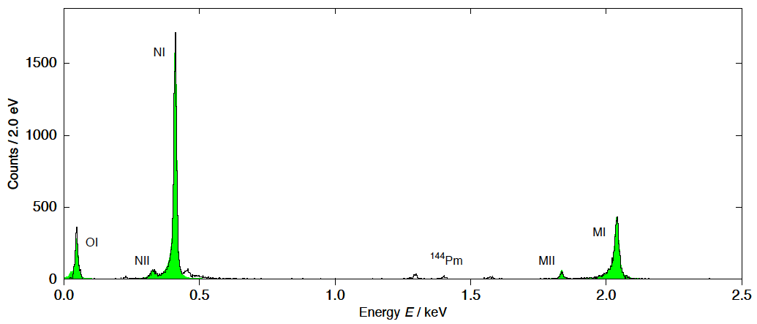
Ranitzsch et al. 1409.0071
Energy resolution 8.3 eV

Slide 22
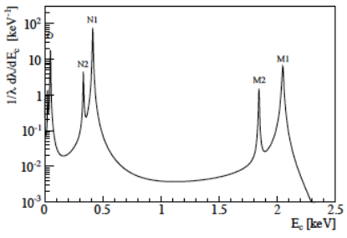
Ranitzsch et al. 1409.0071
Energy resolution 8.3 eV
De Rujula & Lusignoli PL 118B 429 (1982)

Slide 23
Spectrum with both single and double vacancies in the ¹⁶³Dy daughter.
HR 2014
1411.2906

Slide 24
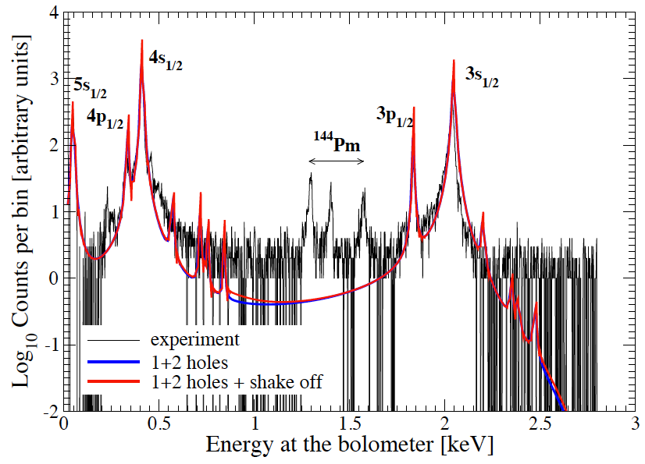
Power Radiated
Data: ECHo. Theory:
Faessler et al. 1611.0325
Endpoint from SHIPTRAP

Slide 25
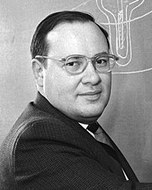
(B. Monreal and J. Formaggio, PRD 80:051301, 2009)
A new idea : Cyclotron Radiation Emission Spectroscopy (CRES).
If you are going to measure anything with precision, measure frequency.
-- Arthur Schawlow

Slide 26
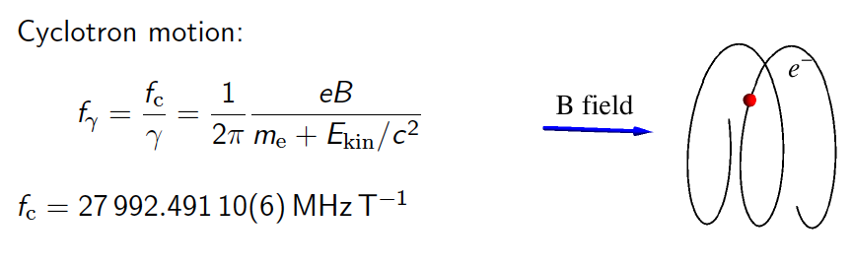
Cyclotron radiation from tritium beta decay
Surprisingly, this had never been observed for a single electron.

Slide 27
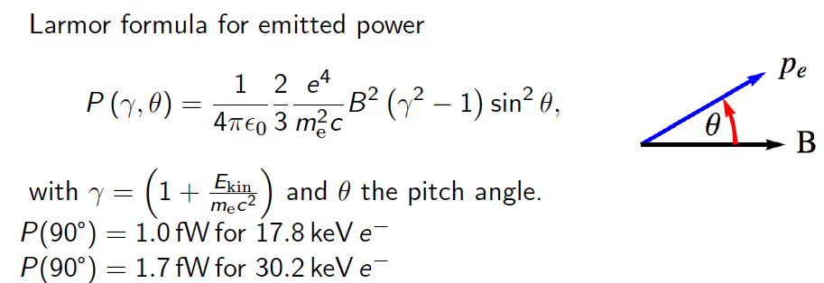
Power Radiated

Slide 28
Energy rEsolution
~30
For 1 eV energy resolution, you need about 2 ppm frequency.
For 2 ppm frequency, you need 500,000 cycles, or 15 μs.
Electron travels 2 km.
You need a trap!

Slide 29
^{83m}Kr: Nice TEST source
86.2 d
⁸³Rb
E_{γ} = 32152 eV
Conversion e⁻
K: 17824.3 eV
L₂: 30424.4 eV
L₃: 30477.2 eV
…
41 keV
1.83 h
9 keV
⁸³Kr

Slide 30
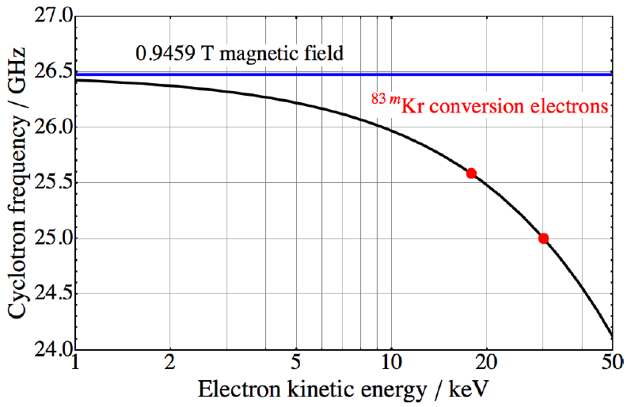
The energy is measured as a frequency
Tritium endpoint

Slide 31
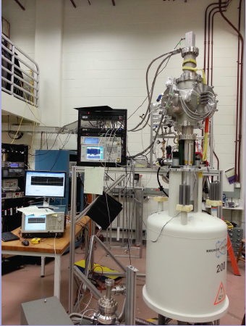
G-M cooler (35K)
26-GHz amplifiers
^{83m}Kr source (behind)
SC Magnet (0.95 T)
Prototype at University of Washington

Slide 32
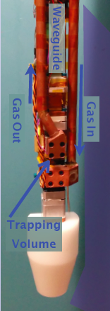
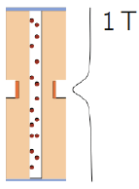
Gas cell is a small section of WR-42 waveguide

Slide 33
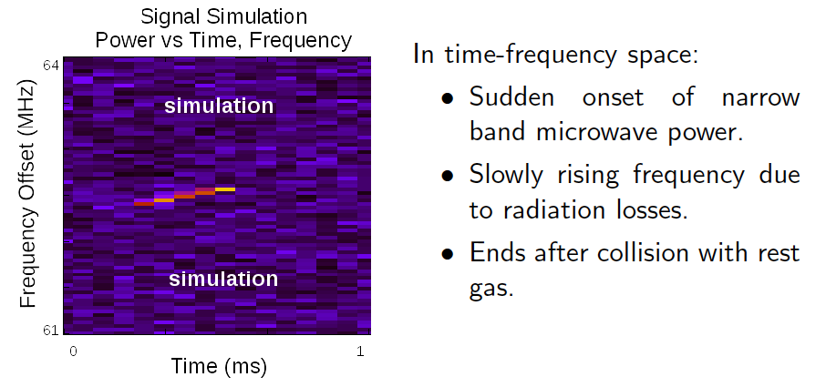
What would a signal from an electron look like?
Digitize the amplifier output. Make short-time Fourier transforms. Plot the spectra sequentially (a “spectrogram”).
Simulation: M. Leber

Slide 34
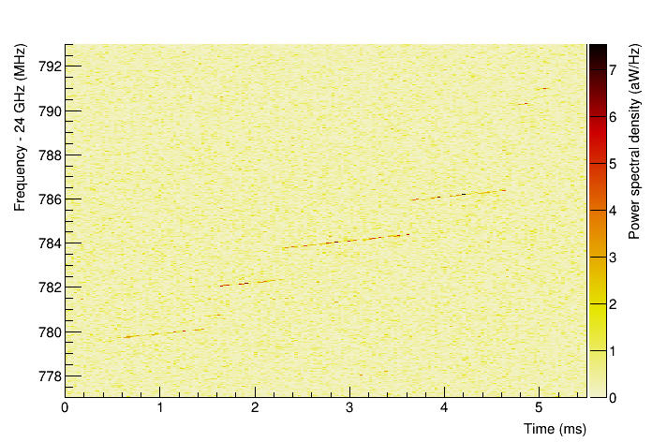
First observation of single-electron cyclotron radiation
Project 8, PRL 114, 162501 (2015)
June 6, 2014

Slide 35
Unexpected Detail!
June 6, 2014
Electron scatters off gas molecules, losing energy, possibly changing pitch angle
Electron slowly loses energy
from cyclotron emission
~ 1 fW radiative loss
Track start gives initial electron kinetic energy

Slide 36
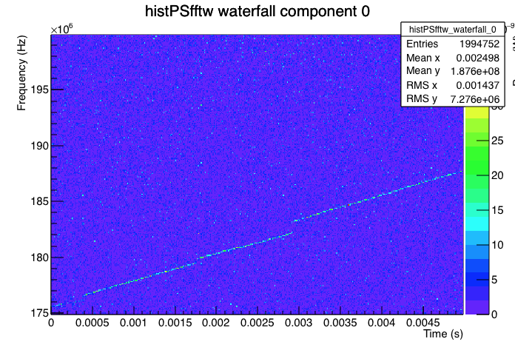

Slide 37
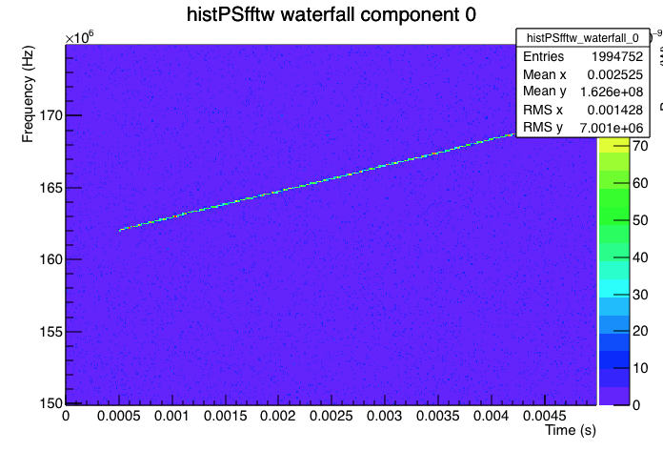

Slide 38
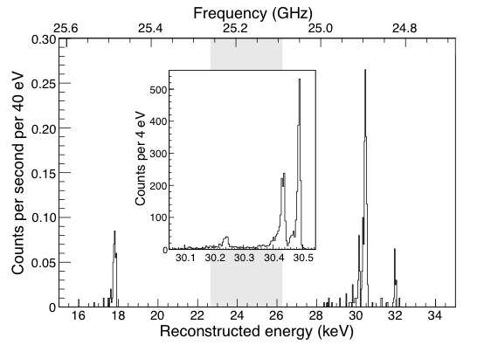
Energy spectrum
^{83m}Kr

Slide 39
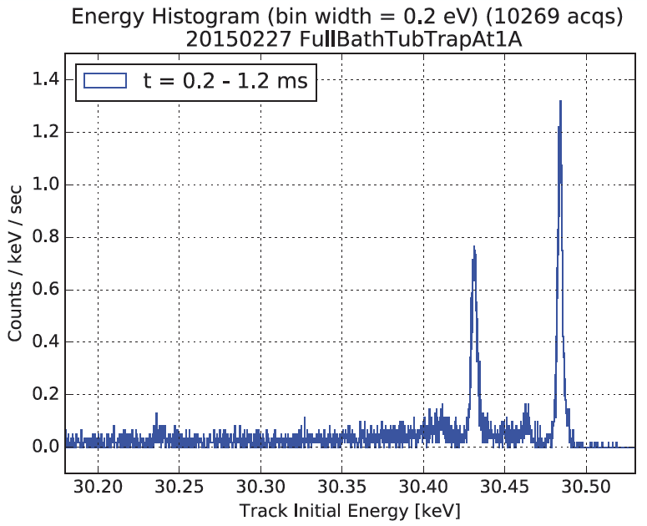
Higher resolution
L₃
53 eV
L₂
3.6 eV
L₁

Slide 40
Why is this important?
Source is transparent to microwaves: can make it as big as necessary.
Whole spectrum is recorded at once, not point-by-point.
Excellent resolution should be obtainable.
An atomic source of T (rather than molecular T₂) may be possible. Eliminates the final-state theory input.

Slide 41
Project 8 sensitivity
and OPTIMISTIC

Slide 42
Project 8 sensitivity
Existing mass limit
Normal vs inverted hierarchy
Current system volume

Slide 43
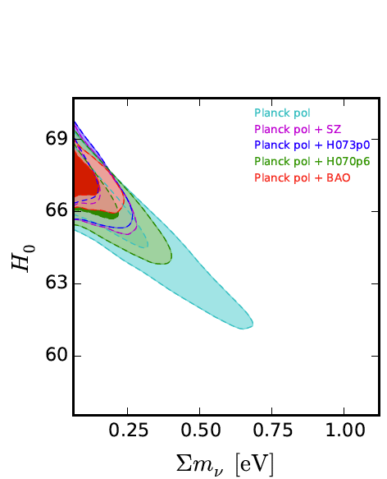

Cosmological sensitivity
Within the ΛCDM model, constraints are now quite tight. Planck + BAO gives
< 0.17 eV
Di Valentino et al. PRD 93, 083527 (2016)

Slide 44
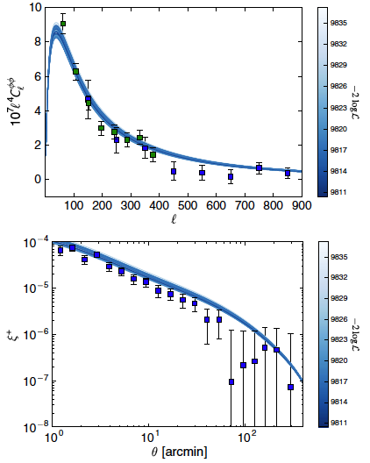
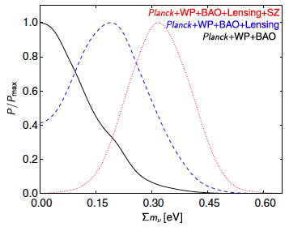
But some tensions …
Battye and Moss, PRL 112, 051303 (2014)
Lensing power spectrum
Planck
SPT
Some tensions in ΛCDM resolved with neutrino mass:
Shear correlation spectrum
CFHTLenS

Slide 45


Hubble tension…
Tension with the HST galaxy low-z data can be resolved by relaxing w:
75
73.00(175) – HST
72
w ~
~
eV
Di Valentino et al. PLB 761, 242 (2016)

Slide 46
Neutrino Mass Limits from Beta decay

Slide 47
Neutrino Mass Limits from Beta decay
KATRIN

Slide 48
summary
Direct mass measurements are largely model independent:
  Majorana or Dirac
  No nuclear matrix elements
  No complex phases
  No cosmological degrees of freedom
One experiment in construction (KATRIN); 2017 start.
Five experiments in R&D (Project 8, ECHo, HOLMES, NuMECS, PTOLEMY)
Success of Project 8 proof-of-concept.
  New spectroscopy based on frequency
  First step toward new determination of neutrino mass

Slide 49
Fin

Slide 50
Mass and mixing parameters
Oscillation
Kinematic
Δm₂₁² | 7.54^{+0.21}_{-0.21} x 10⁻⁵ eV²
|Δm₃₂²| | 2.42^{+0.12}_{-0.11} x 10⁻³ eV²
Σm_{i} | > 0.055 eV (90% CL) | < 5.4 eV (95% CL)*
θ₁₂ | 34.1^{+0.9}_{-0.9} deg
θ₂₃ | 39.2^{+1.8}_{-1.8} deg
θ₁₃ | 9.1^{+0.6}_{-0.7} deg
sin²θ₁₃ | 0.025^{+.003}_{-.003}
Marginalized 1-D 1-σ uncertainties.
*C. Kraus et al., Eur. Phys. J. C40, 447 (2005); V. Aseev et al. PRD 84 (2011) 112003.
Other refs, see Fogli et al. 1205.5254

Slide 51
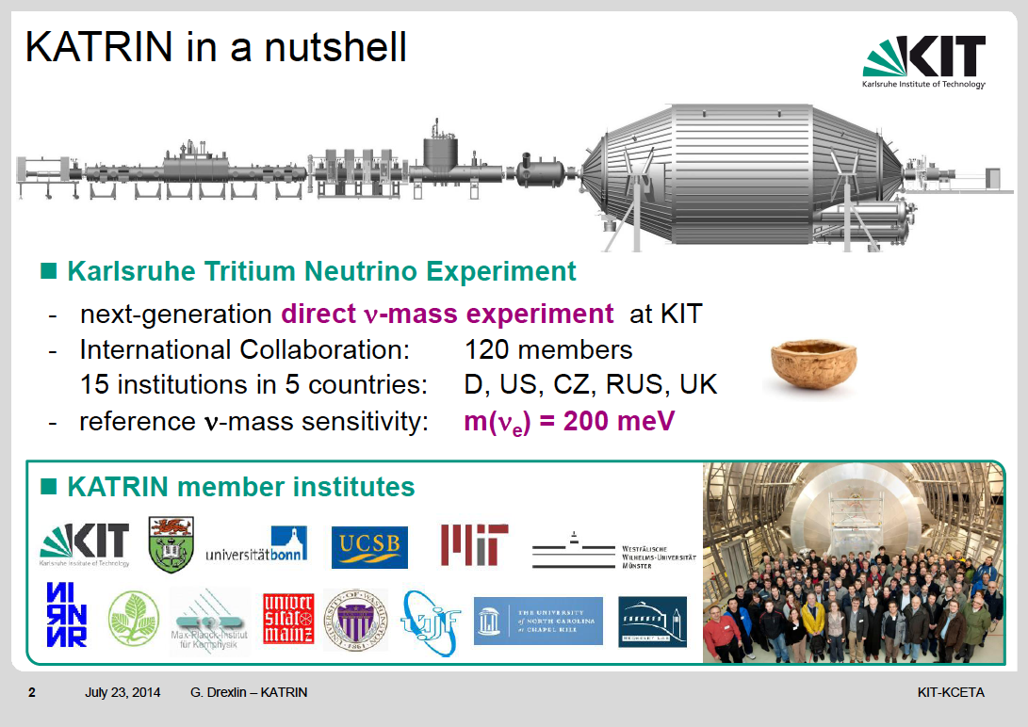
ES

Slide 52
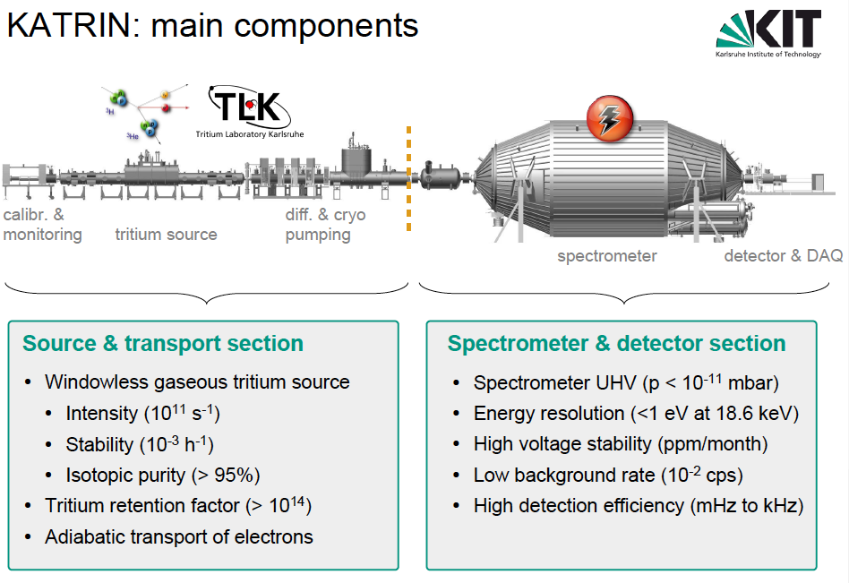
K. Valerius

Slide 53
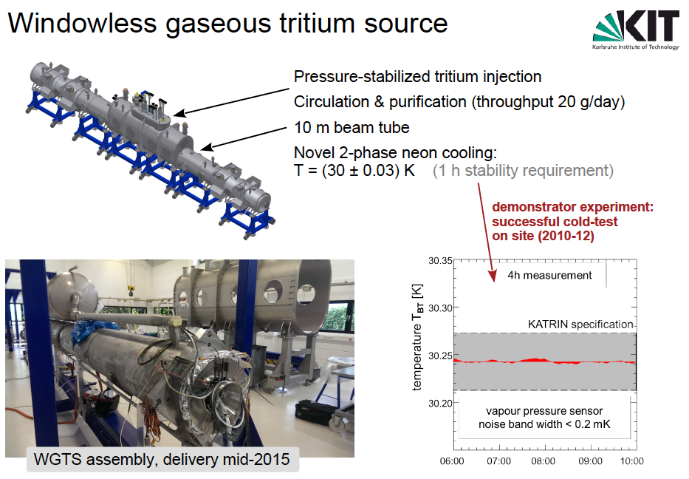
K. Valerius

Slide 54
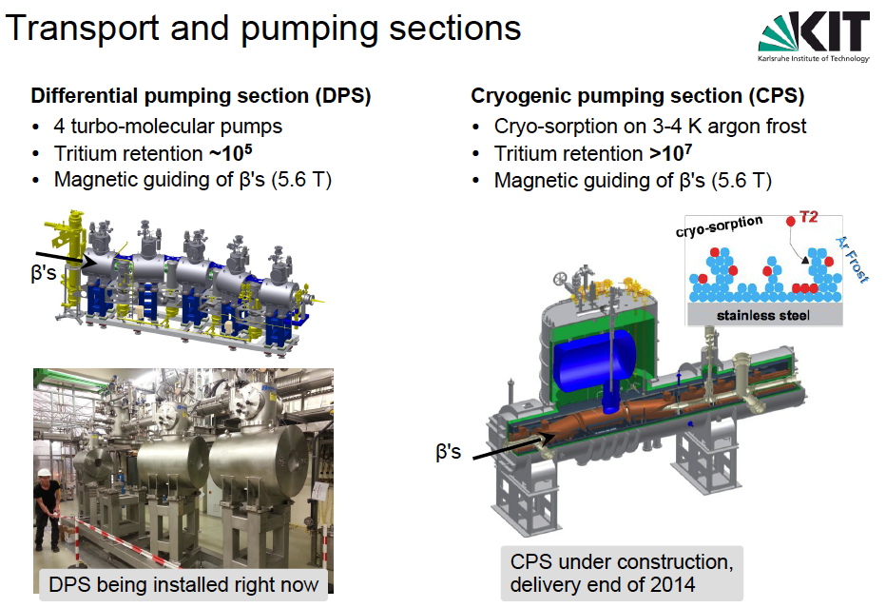
K. Valerius

Slide 55
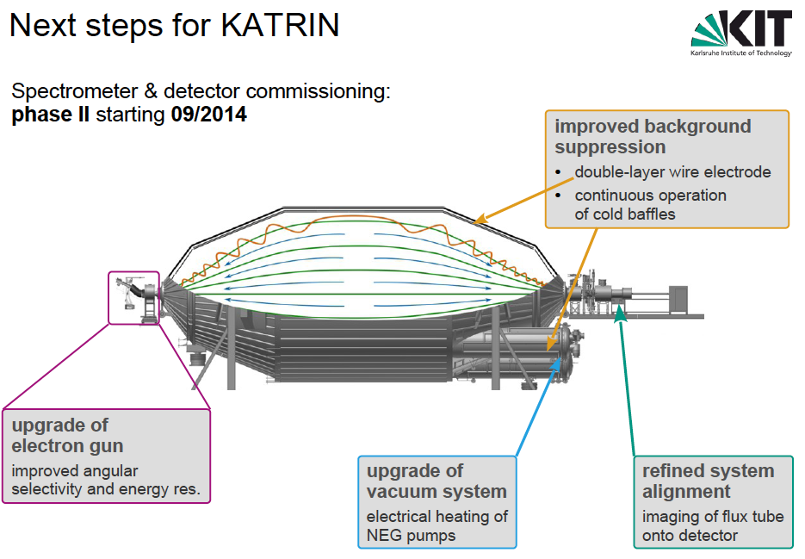
K. Valerius

Slide 56
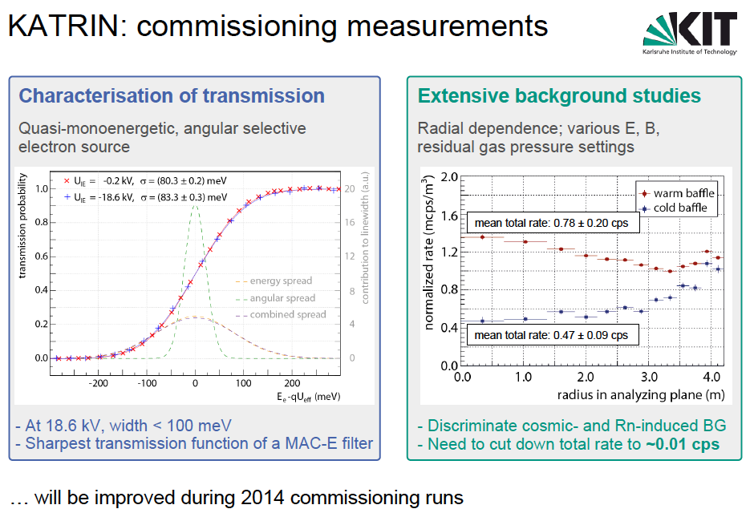
K. Valerius

Slide 57
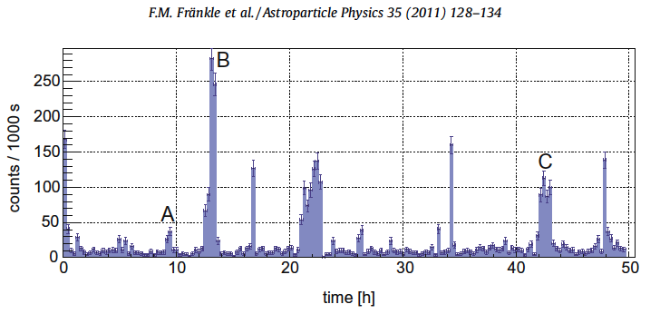
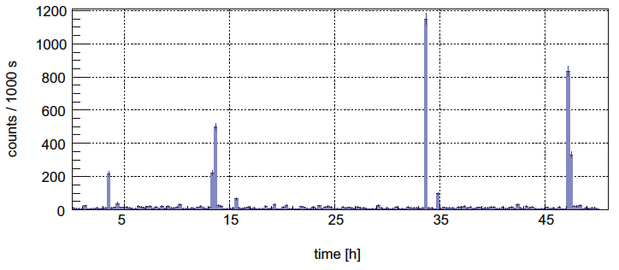
Radon!
10⁻¹⁰ mbar
10⁻⁹ mbar

Slide 58

Sensitivity and background
Background 50 X higher than assumed. What is this background?
~1/3 is ²¹⁹Rn
~2/3 is H* Rydberg atoms photoionizing in the BB radiation (!)
²¹⁰Pb-²¹⁰Po on walls ejects Rydberg atoms into the volume, where they are ionized by BBR (Drexlin mechanism).
Measured (8/15) 558 mcps
TDR 2004
optimized for
10 mcps
Limit on m_{v} ~ b^{1/6}

Slide 59



Sensitivity and background optimized
Further background reduction measures being studied
In addition: several mitigation strategies currently under investigation:
558 mcps
non-optimized
558 mcps
non-optimized
~290 meV
optimized scanning
range of spectral analysis
~240 meV
ΔE ~ 2.5 eV
flux tube compression by increasing B
TDR 2004
optimized for
10 mcps
TDR 2004
optimized for
10 mcps
0.38 mT
0.50 mT
0.80 mT

Slide 60
KATRIN’s uncertainty budget
σ(m_{v}²)
0
0.01 eV²
Statistical
Final-state spectrum
T⁻ ions in T₂ gas
Unfolding energy loss
Column density
Background slope
HV variation
Potential variation in source
B-field variation in source
Elastic scattering in T₂ gas
σ(m_{v}²)_{total}= 0.025 eV²
m_{v}< 0.2 eV (90 % CL)

Slide 61


Slide 62

Sensitivity with Time

Slide 63


Slide 64



Short-time Fourier transform spectrogram
Find tracks
Join segments vertically to map complete electron event

Slide 65
“jump” spectrum
^{83m}Kr 30.4 keV line
Most probable jump is 14 eV.

Slide 66


Slide 67

Neutrino mass Physics Impact

Slide 68

Molecular final-state spectrum
Saenz et al. PRL 84 (2000)
T₂ → ³HeT⁺
rotation
e⁻
vibration
translation
T₂ molecule
Q_{A} = 18.6 keV

Slide 69
Molecular final-state spectrum
Saenz et al. PRL 84 (2000)
Fackler et al. PRL 55 (1985)
694 eV²
LANL 1991, LLNL 1995

Slide 70

An old problem solved
Bodine, Parno, HR; PRC 91 035505 (2015)

Slide 71
Molecular final-state spectrum
Saenz et al. PRL 84 (2000)
0.2 eV²
Fackler et al. PRL 55 (1985)
694 eV²
KATRIN
LANL 1991, LLNL 1995

Slide 72


Microcalorimeters for ¹⁸⁷Re ß-decay
MIBETA: Kurie plot of 6.2 ×10⁶ ¹⁸⁷Re ß-decay events (E > 700 eV)
MANU2 (Genoa)
metallic Rhenium
m(ν) < 26 eV
Nucl. Phys. B (Proc.Suppl.) 91 (2001) 293
MIBETA (Milano)
AgReO₄
m(ν) < 15 eV
10 crystals:
8751 hours x mg (AgReO₄)
Nucl. Instr. Meth. 125 (2004) 125
MARE (Milano, Como,
Genoa, Trento, US, D)
Phase I : m(ν) < 2.5 eV
E₀ = (2465.3 ± 0.5_{stat} ± 1.6_{syst}) eV
m_{ν}² = (-112 ± 207 ± 90) eV²
hep-ex/0509038

Slide 73


Slide 74


Slide 75

M₃
M₂
8 eV
M₁

Slide 76
Magnetic configuration of trap
Solenoidal uniform field for electron cyclotron motion
Pinch coils to reflect electrons
Ioffe conductors (multipole magnetic field) to reflect radially moving atoms.
The ALPHA antihydrogen trap parameters:
Magnetic well depth 0.54 K (50 μeV)
Trap density initially ~10⁷ cm⁻³
Trap lifetime ~ 1000 s

Slide 77


An early H trap (AT&T, MIT)
6 x 10¹² cm⁻³
40 mK
400 s
Effect of dipolar spin flips
Hess et al. PRL 59, 672 [1987]

Slide 78

ALPHA’s antihydrogen trap
ALPHA Collaboration: Nature Phys.7:558-564,2011; arXiv 1104.4982

Slide 79


A window to work in
Molecular excitations
Energy loss

Slide 80
Mass Range Accessible
starting
2017
KATRIN
Present
Lab Limit
2 eV

