Slide 1
Rethink the Food Label Entries

Slide 2
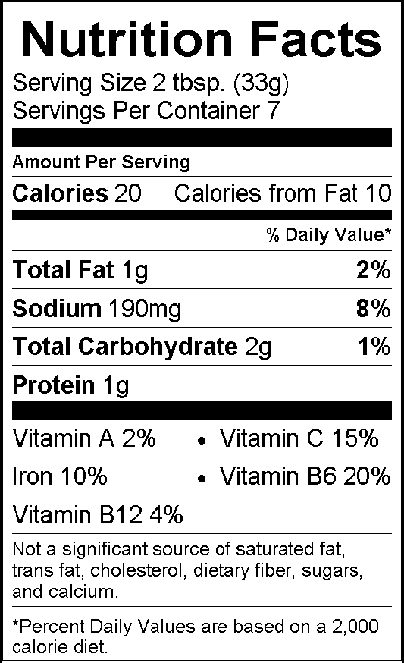
U.S. Food and Drug Administration Label Design

Slide 3
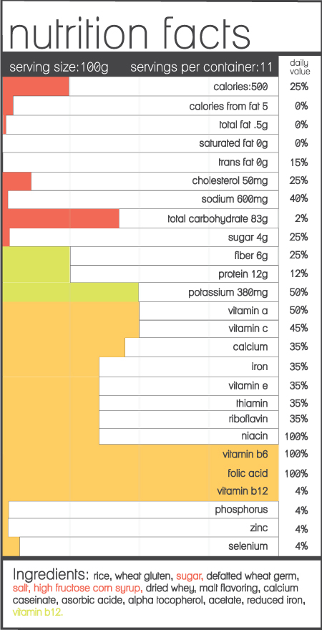
Ackerman

Slide 4
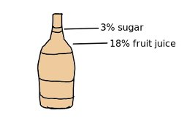
Andrews

Slide 5
Bai

Slide 6
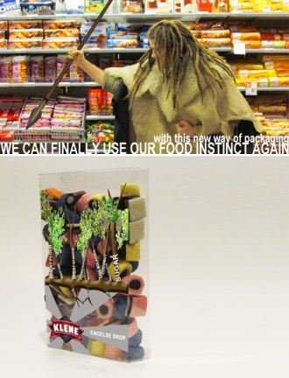
Bardoel

Slide 7
Becker

Slide 8
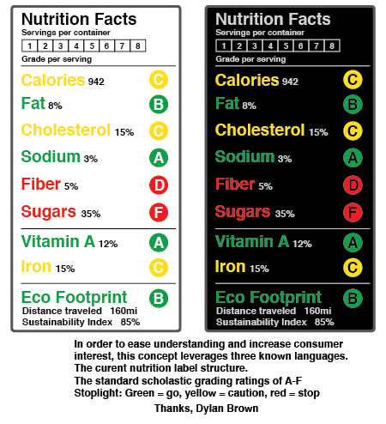
Brown
3rd Prize

Slide 9
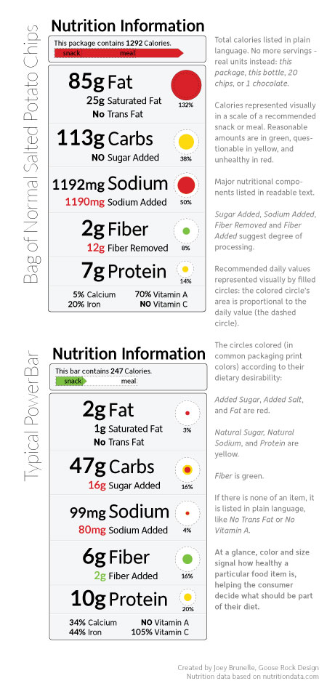
Brunelle
2nd Prize

Slide 10
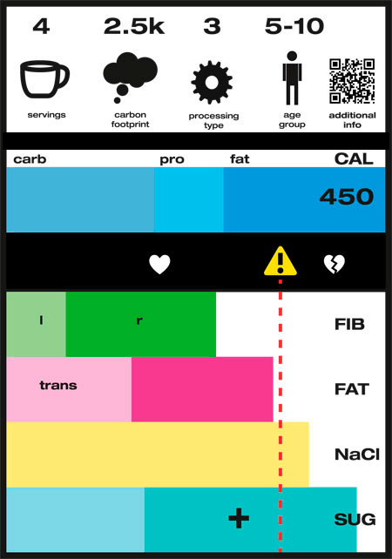
Campuzano

Slide 11
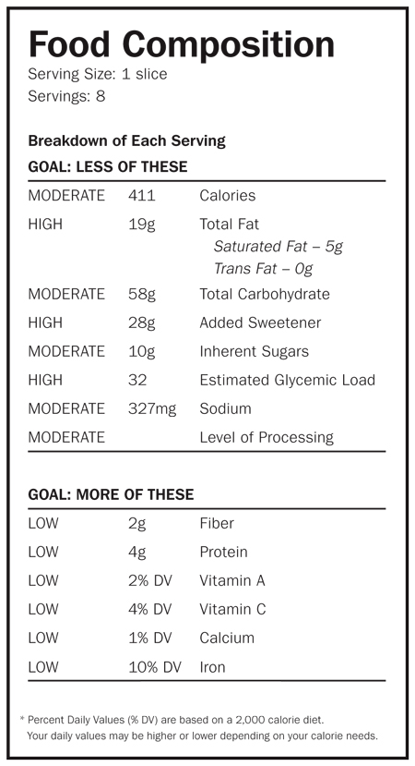
Chu

Slide 12
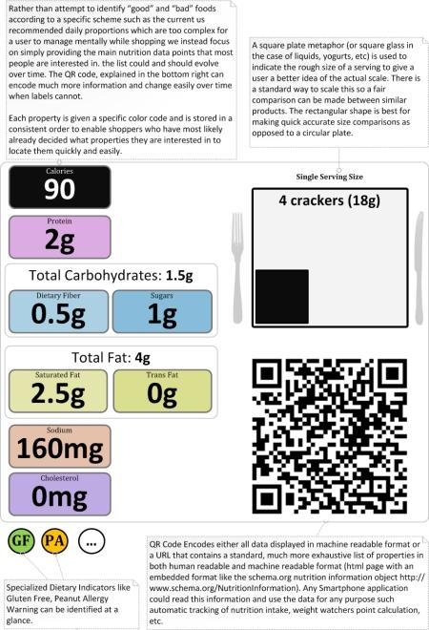
Conner

Slide 13
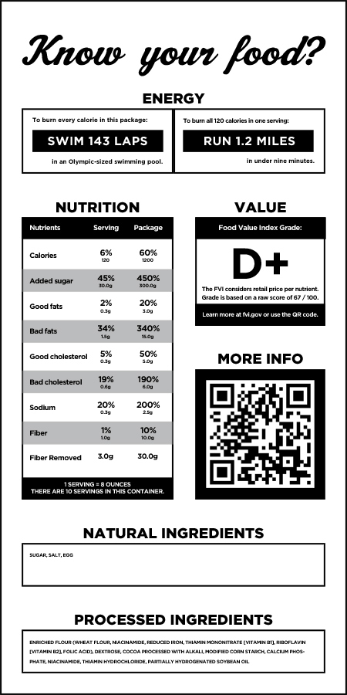
Cook

Slide 14
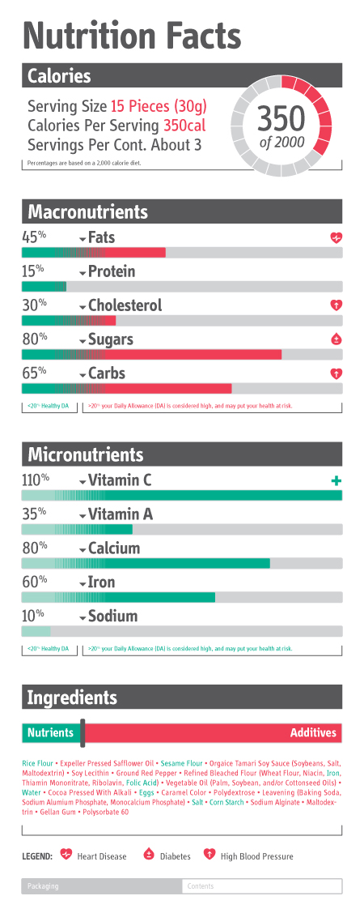
Corpuz

Slide 15
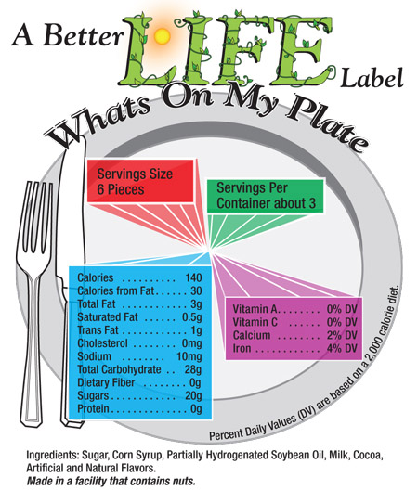
Dichard

Slide 16
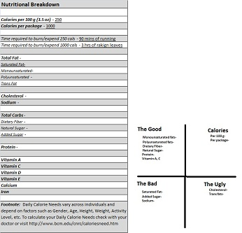
Dievski

Slide 17
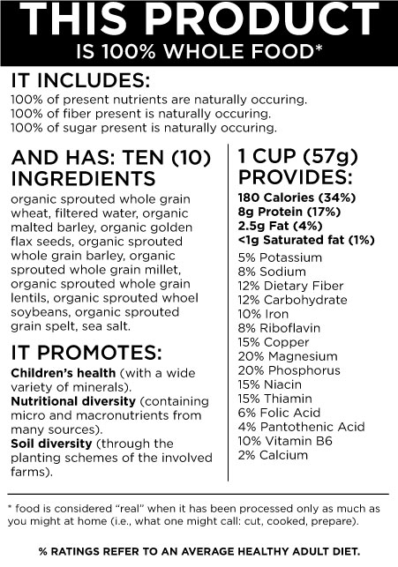
Esparza

Slide 18
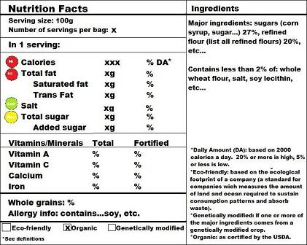
Frank

Slide 19
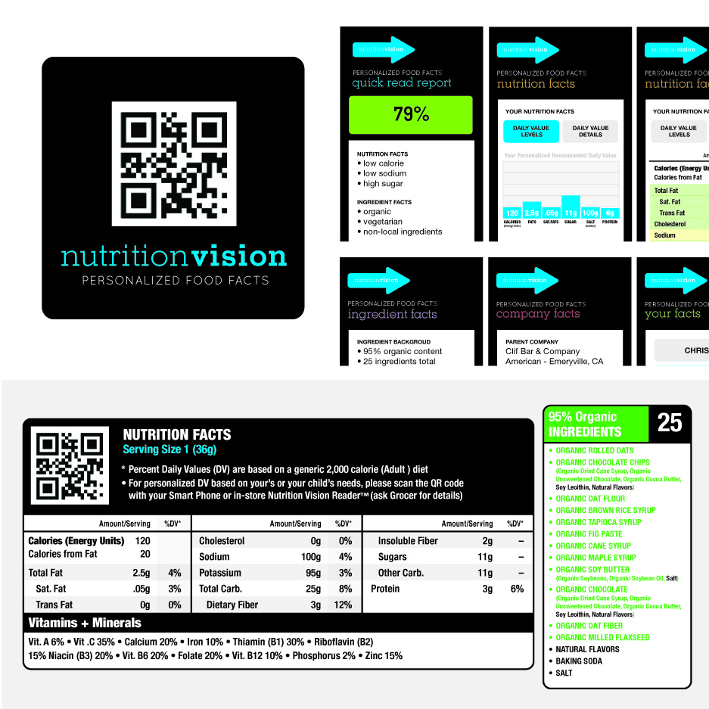
Frayne

Slide 20
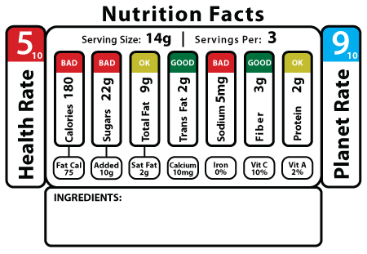
Frantellizzi

Slide 21
Frederick

Slide 22
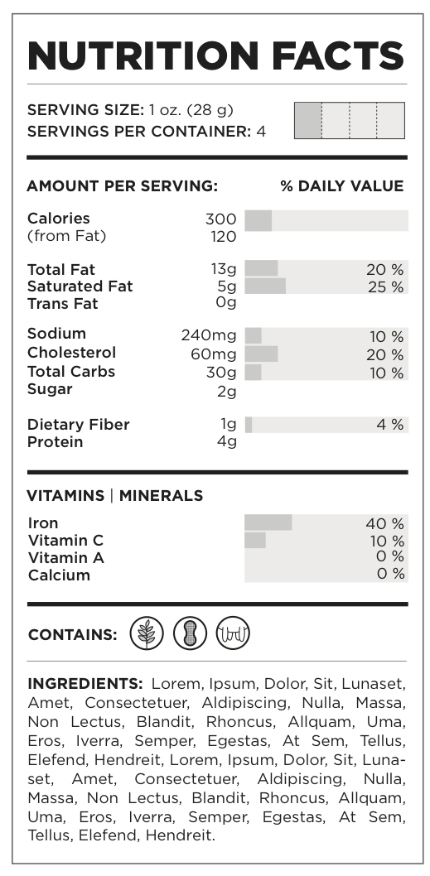
Gaw

Slide 23
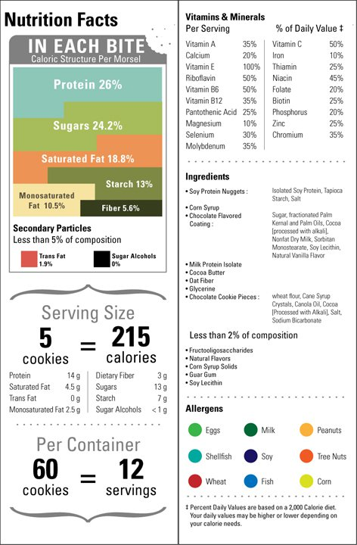
Griego

Slide 24
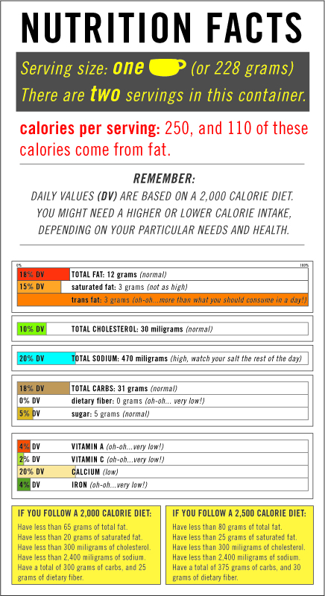
Hernandez

Slide 25
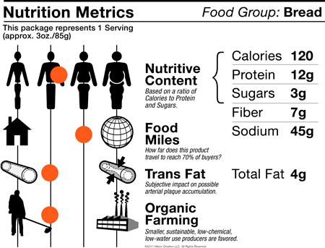
Hilson

Slide 26
Holmes

Slide 27
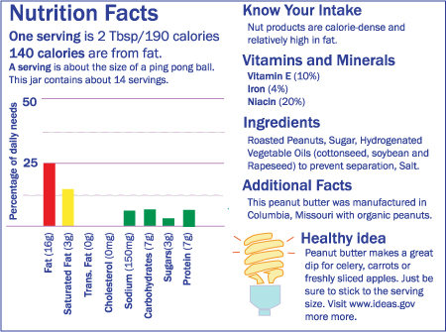
Hubbard

Slide 28
Huard

Slide 29
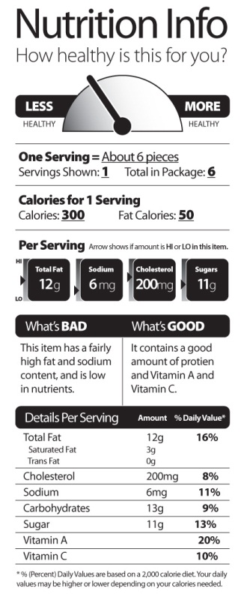
Jeffrey

Slide 30
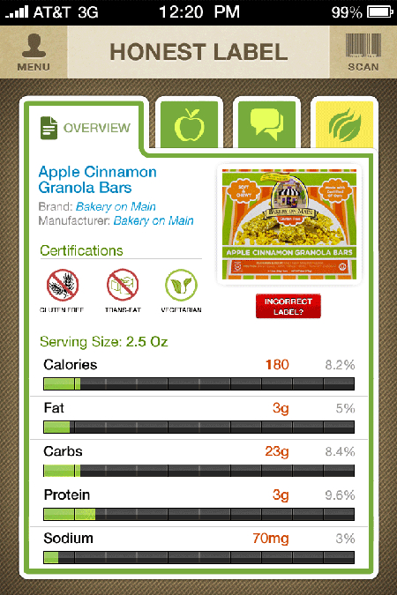
Johnson

Slide 31
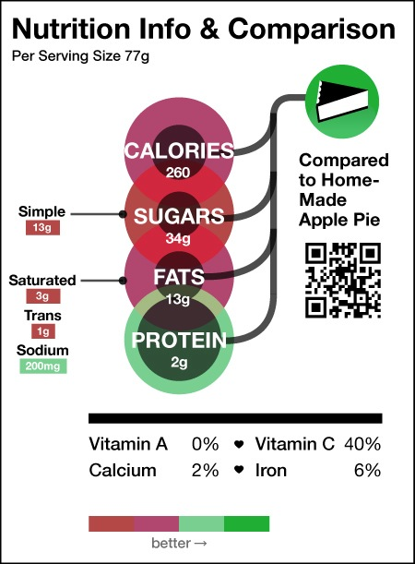
Ketheswaran

Slide 32
Klockenbrink

Slide 33
Kraemer

Slide 34
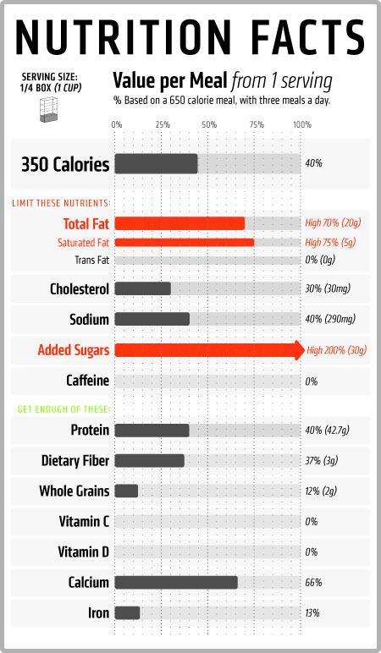
Kokkinidis

Slide 35
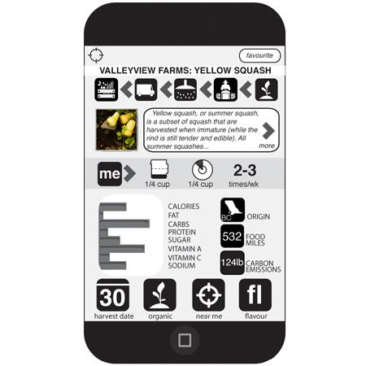
Lefort

Slide 36
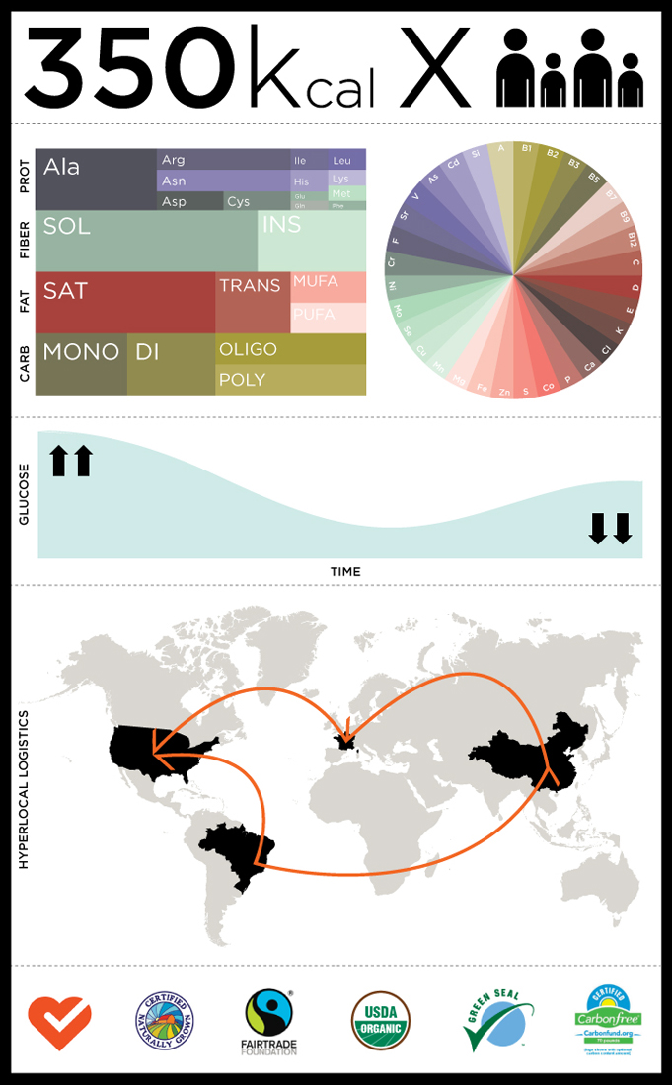
Leineweber

Slide 37
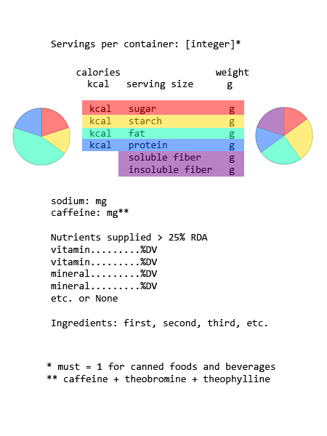
Lumma

Slide 38
McBride

Slide 39
McCall

Slide 40
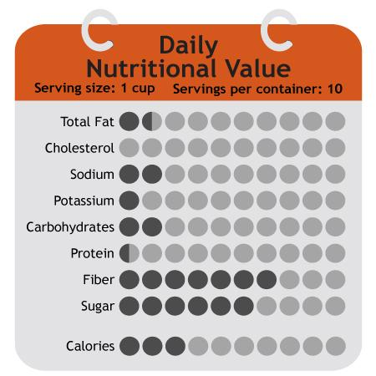
Messer

Slide 41
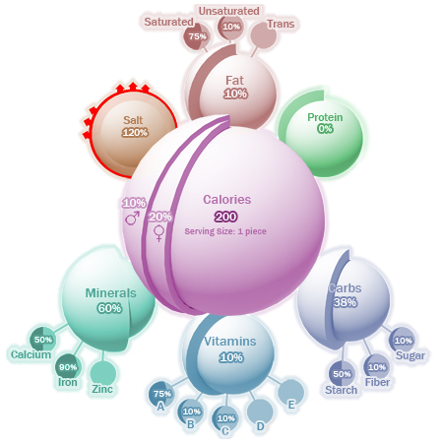
Mikulecky, Paul

Slide 42
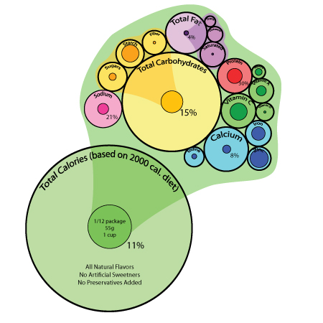
Milulecky, Stephanie

Slide 43
Miller

Slide 44
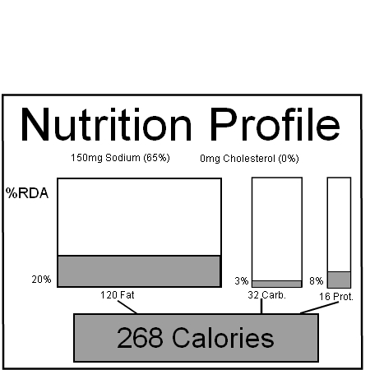
Mink

Slide 45
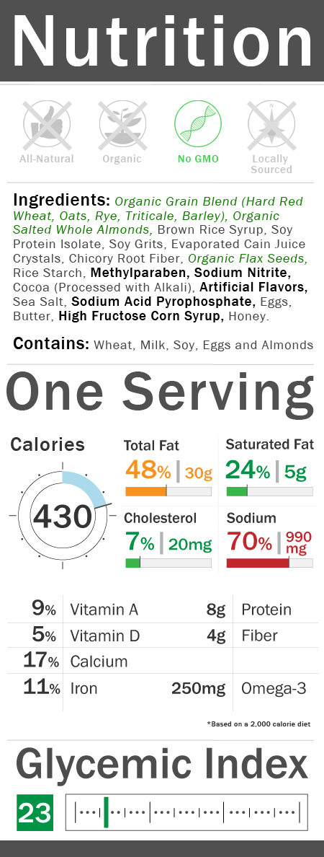
Mu

Slide 46
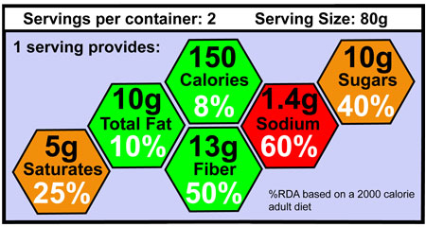
O’Reilly

Slide 47
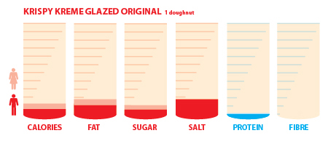
Pritchard

Slide 48
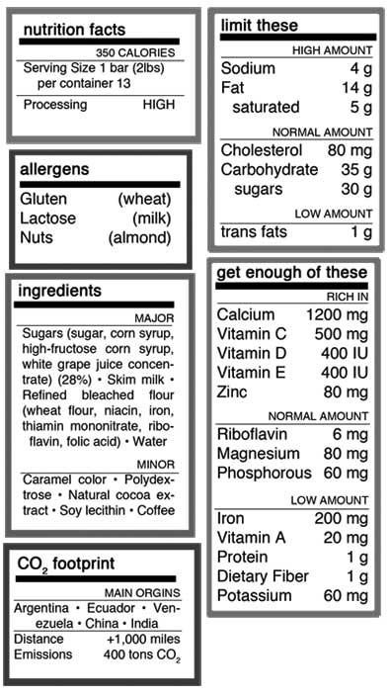
Seyfert

Slide 49
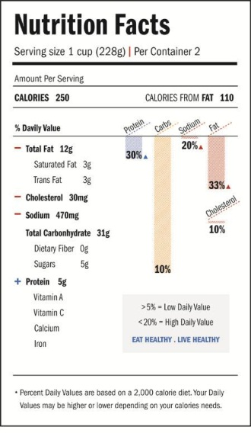
Shim

Slide 50
Ackerman
Sepidehalavi

Slide 51
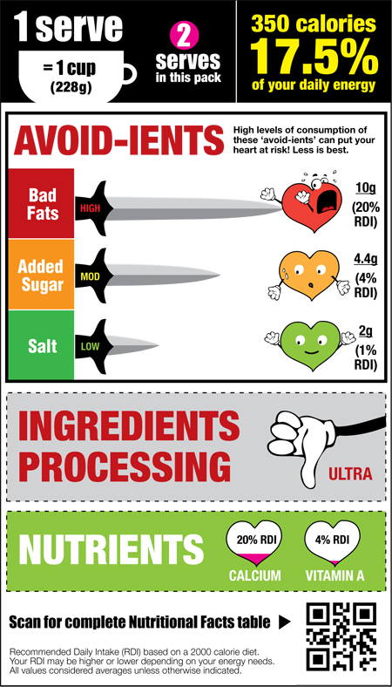
Tam

Slide 52
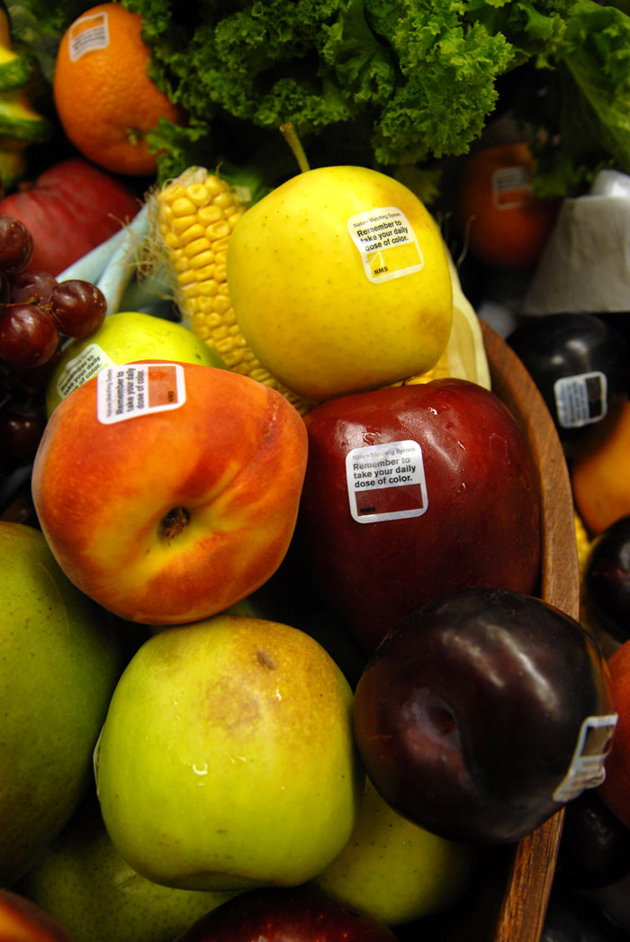
Tan

Slide 53
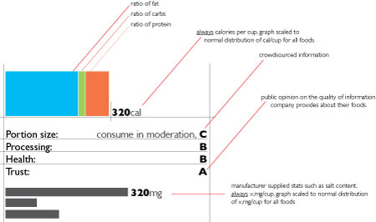
Thomson

Slide 54
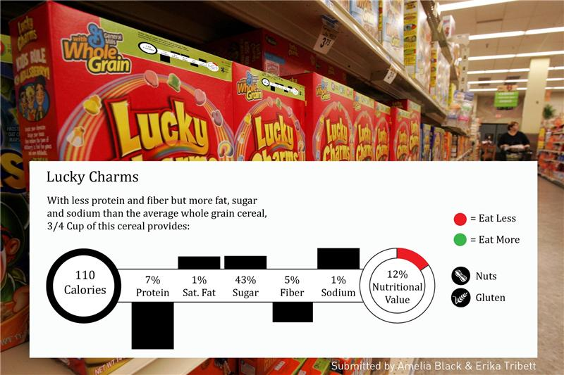
Tribett

Slide 55
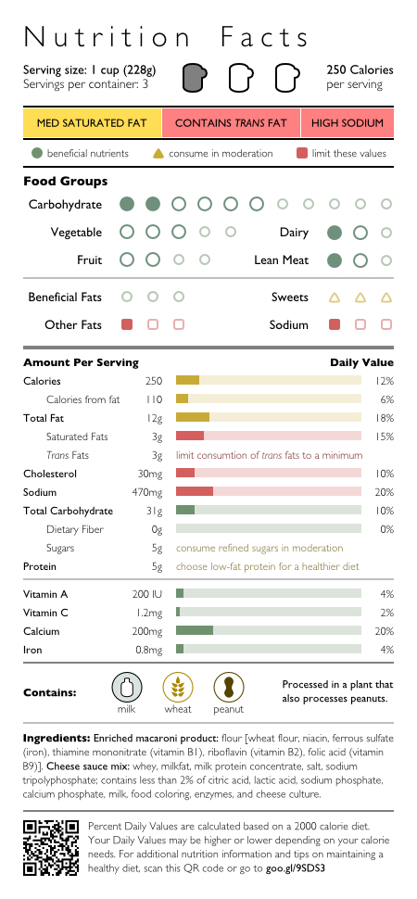
Phan-Ba

Slide 56
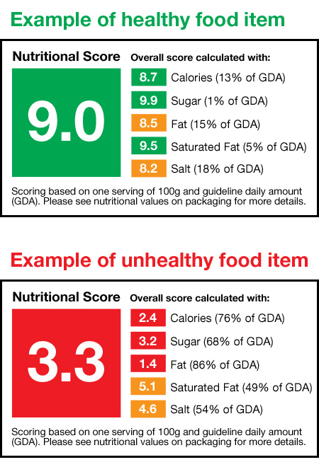
Tong

Slide 57
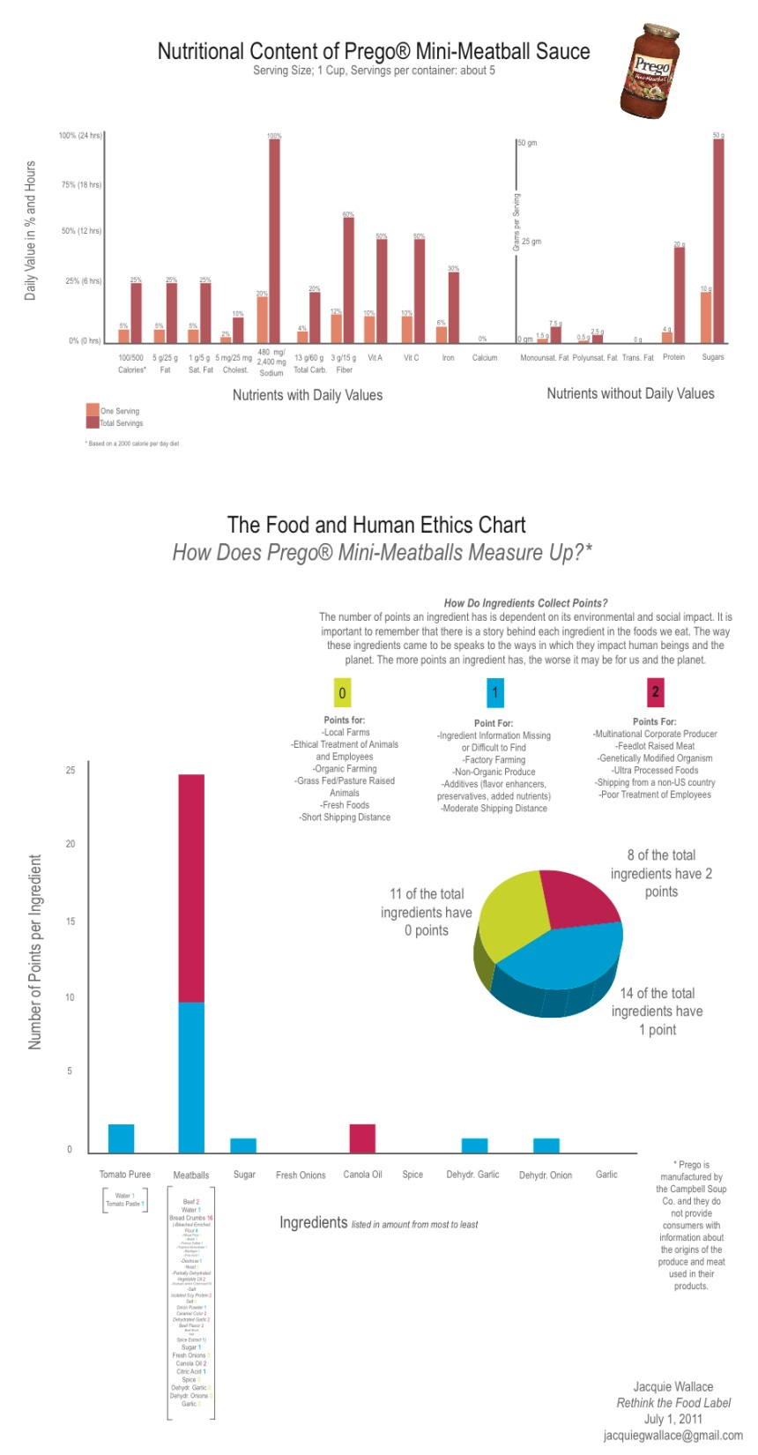
Wallace

Slide 58
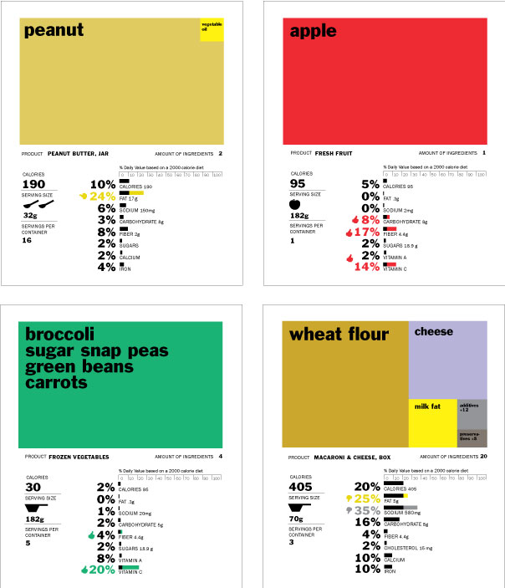
Walker
1st Prize

Slide 59
Weingarten

Slide 60
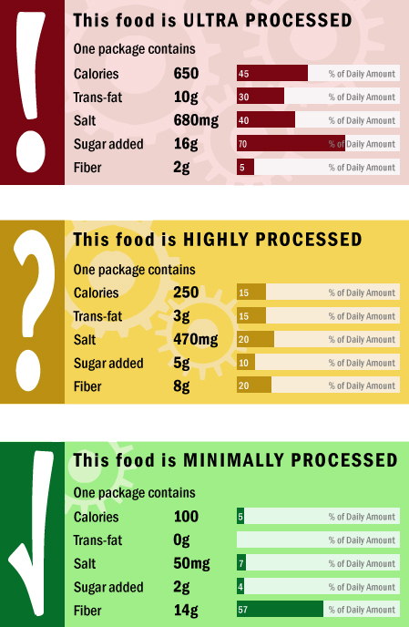
Wilkes

Slide 61
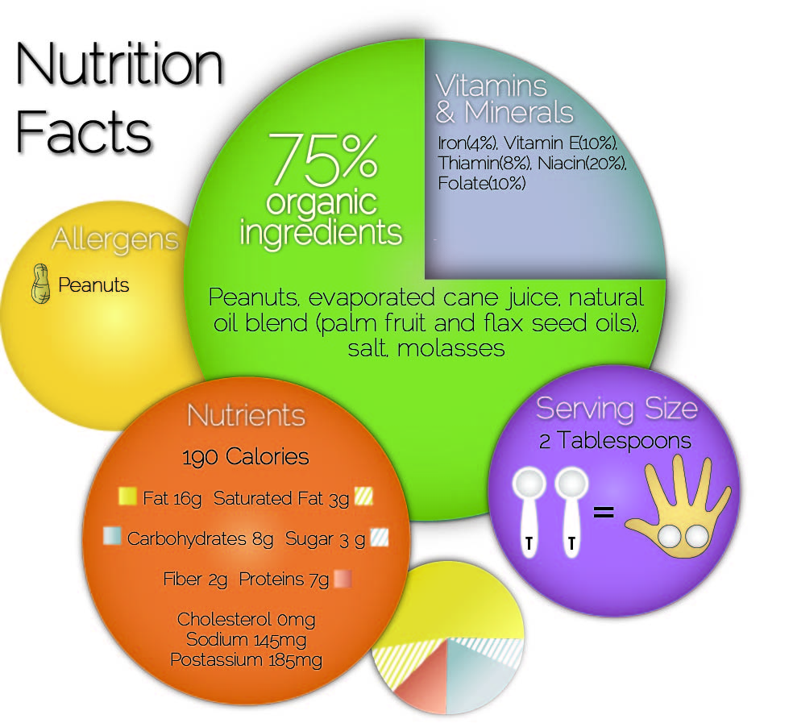
Wilson

Slide 62
Winter

