Slide 1
Concepts for Information Design: Medium and Genre

Slide 2
HCDE 510 Information Design, Fall 2012
Department of Human Centered Design &
Engineering, University of Washington
David K. Farkas

Slide 3
Concepts
Media/Medium
Mediation/Mediation effects
Genre
Rhetorical moves
Standard Expository Model (SEM)
Genre bending

Slide 4
Media
Communication technologies that transcend time and space
Classifying media is difficult
Is the newspaper a single medium?
PowerPoint a medium?
Is Flash a medium or a application/tool used in other media?
Media space (convenient umbrella term)

Slide 5
Media
Media evolve, compete and (very slowly) die out

Slide 6
Mediation/Mediation effects
Any aspect of a medium that influences communication—font choices, authoring tool, speaker’s voice
Cultural influences on communication. Cultural forces mediate.
Mediation is a much broader concept than medium

Slide 7
Web
The web is an exceptionally broad medium (or
media space) that encompasses almost all other
modalities, media, and genres.
In addition, it does not fully constrain the
presentation of its content. The experience differs
by platform, browser, setting, etc.

Slide 8
Genre
A genre is a recognized category of document (or other communication event).
A genre is (1) recognizable as an instance of a genre and (2) fulfills a recognized social role (purpose).
“Social roles” are easier to articulate for functional documents than in literary and entertainment genres.

Slide 9
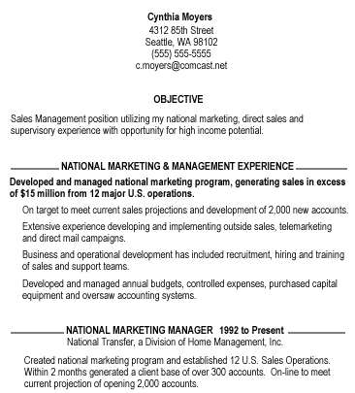
Identifying genres: How do we know what genre this is?

Slide 10
What are the “moves” for an email canceling a lunch meeting/date?
What happens if you handle these moves clumsily?
What happens if you diverge from the expected moves in an extreme way?
How might cancelling a first date with a prospective romantic partner differ from cancelling a lunch meeting with a friend or business associate?

Slide 11
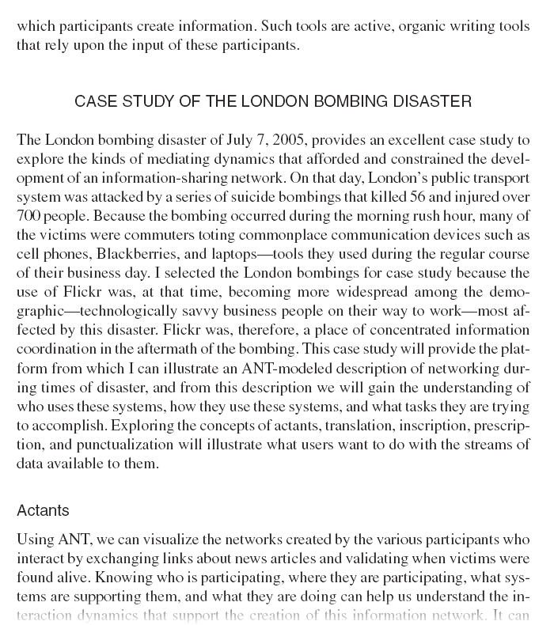
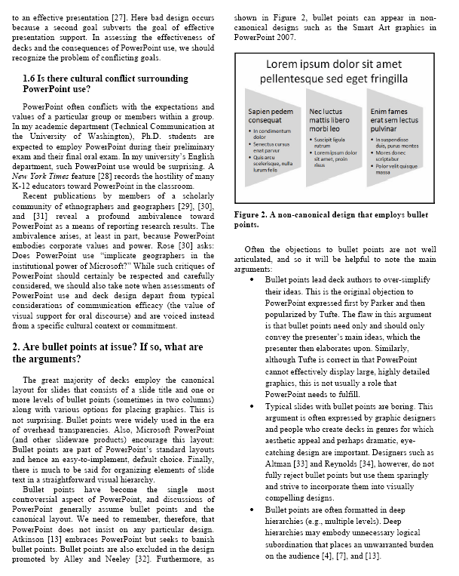
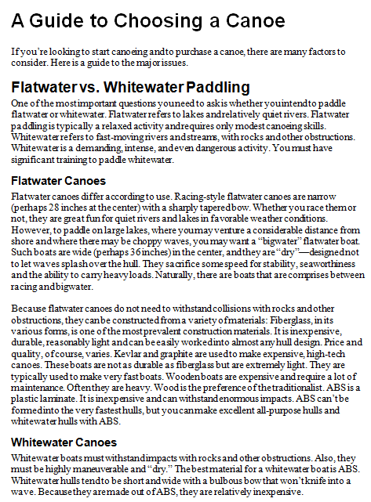
The standard expository model (SEM): A format for many genres

Slide 12
The centrality of genre
Every document belongs to one or more genres.
We cannot create or intelligently comprehend documents independent of their genres
Genres evolve, blend, are spoofed, and (slowly) fade away

Slide 13
How do we define a genre?
Is a business card a genre?
Is PowerPoint a genre?
Is a business letter a genre?
Is a technical briefing a genre?
Are tabs on a website a genre?
Is an web-based store a genre?

Slide 14
Many genres can cross media
But not all media
Examples?

Slide 15
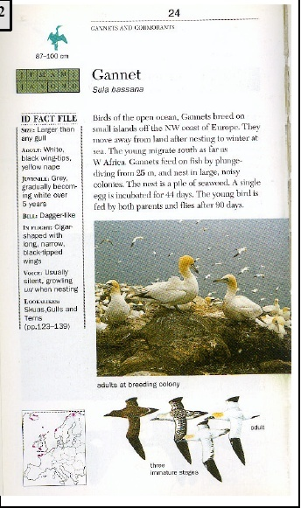
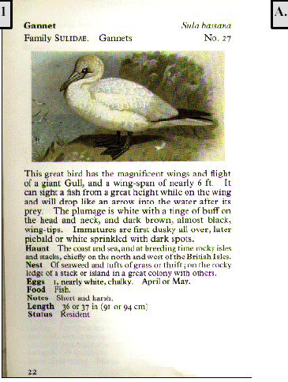
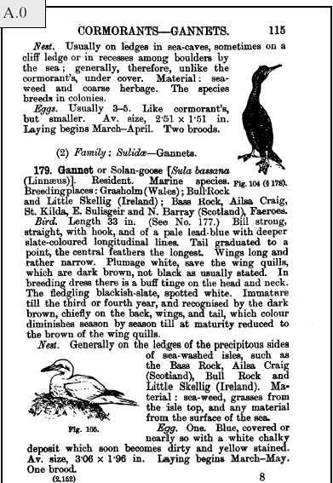
Genres evolve

Slide 16
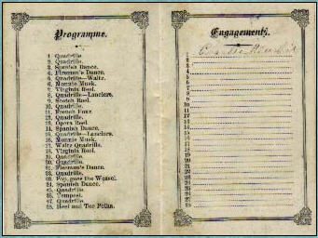
Genres sometimes die out

Slide 17
Genre bending-1
There is much “genre bending”—but will the audience “get it”

Slide 18
Genre bending-2

Slide 19
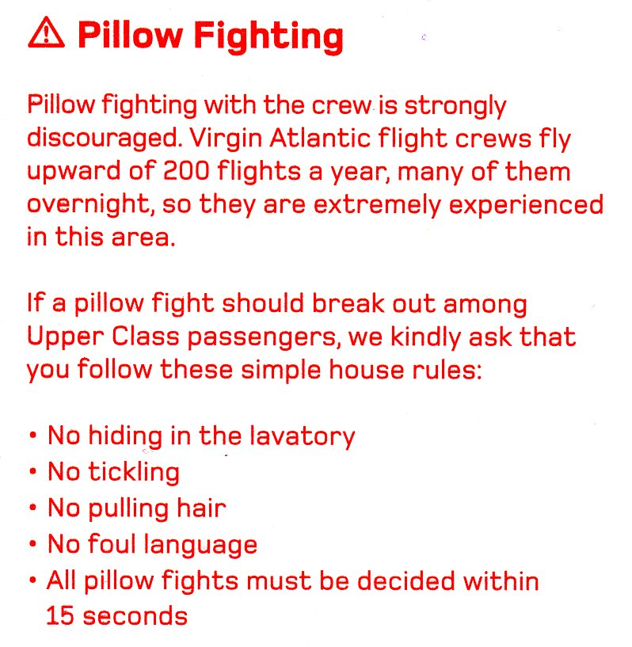
Genre bending-3

Slide 20
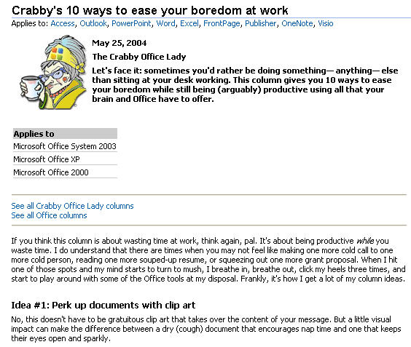
Genre bending-4

Slide 21
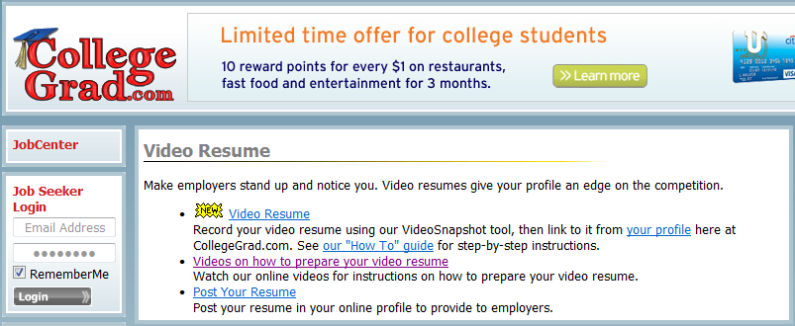
Genre bending-5

