Slide 1
Concepts for Information Design: Format and Behaviors

Slide 2
HCDE 510 Information Design, Fall 2012
Department of Human Centered Design &
Engineering, University of Washington
David K. Farkas

Slide 3
Concepts
Format (macro and micro)
Standard Expository Model (SEM)
Display unit boundaries
Chunking and Modularity
Structure
Behaviors (macro and micro)

Slide 4
Format (in information design)
The placement of pigment or pixels to show relationships and emphasize meaning.
There is micro-format and macro-format.

Slide 5
Format-2
Format helps to constitute genres.
Some formats are genre specific.
Formats can cross media.

Slide 6
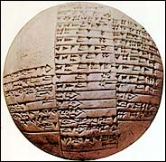
Sumerian formatting

Slide 7
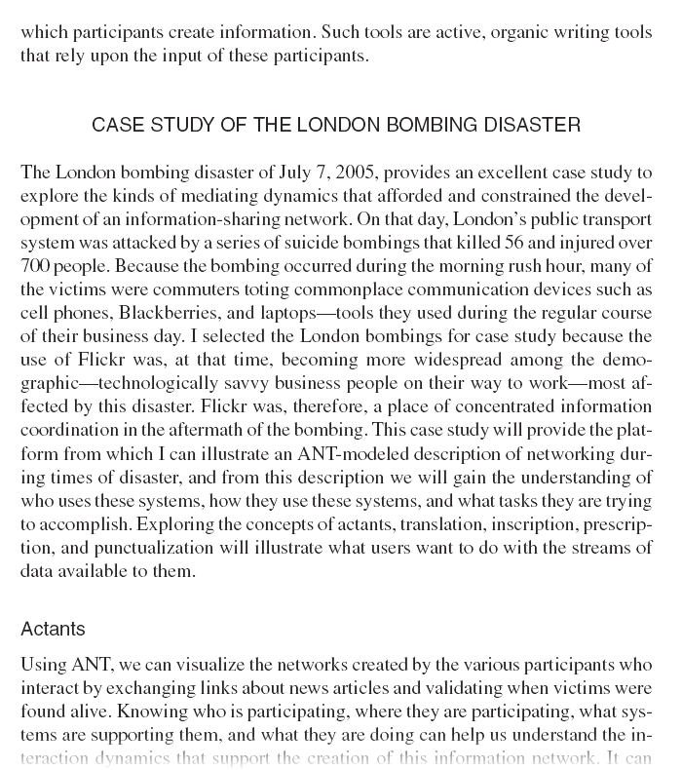
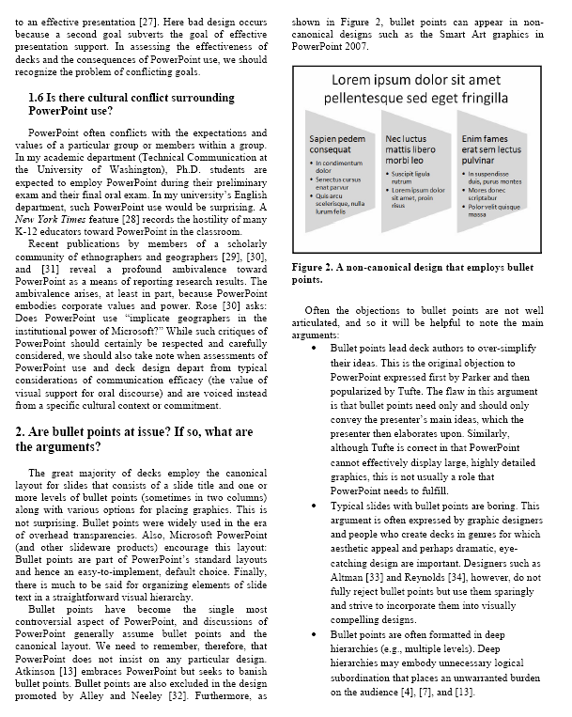
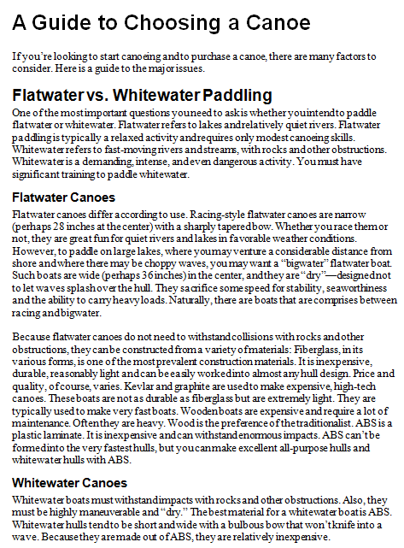
The standard expository model (SEM): A format for many genres

Slide 8
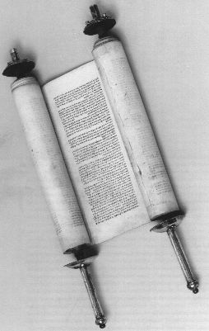
Codex (bound book)
A great many medium-to-long print documents are codexes (codices).
Codexes have supplanted the scroll.

Slide 9
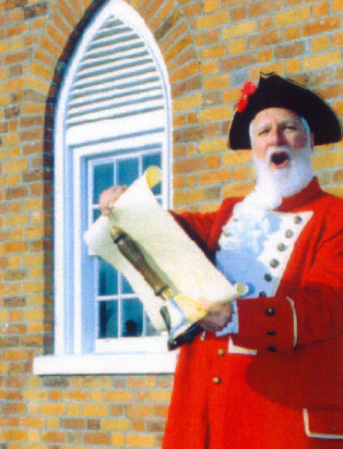
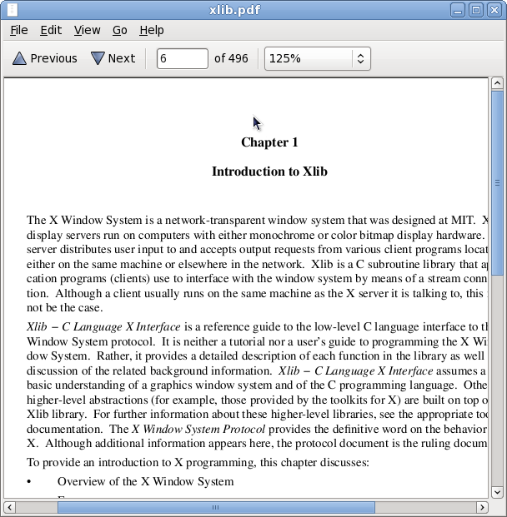
Scrolling direction

Slide 10
Standard expository model (SEM, SE Model)
A very general (macro) format for extended text
The SEM is the default format for many workplace genres.
Employs hierarchical system of headings and subheadings.
Broadly speaking intended for linear reading.
Spans print and online media, various artifacts, and many genres.

Slide 11
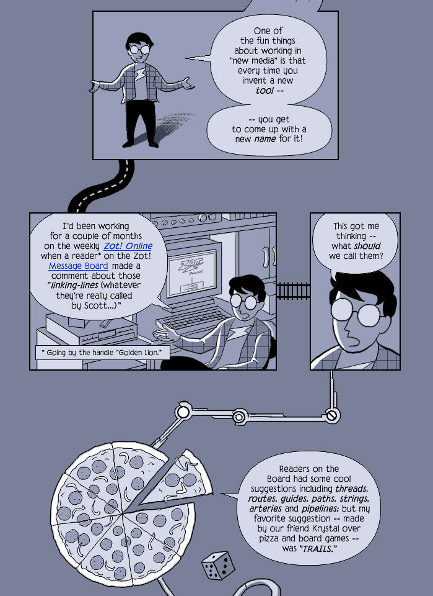
How a new medium can change traditional formatting

Slide 12
Display unit
The physical unit of content of a particular medium (also referred to as the “canvas”).
Business card
Slide
Mural
Printed page
HTML page

Slide 13
Display unit boundaries
Display unit boundaries can be strong (e.g.,
PowerPoint slides) or weak (the pages of most
books), or non-existent (immersive VR).
HTML pages have strong display unit boundaries, but users may or may not reach the bottom boundary of a scrolling page.

Slide 14
Chunking and Modularity
Chunking (“weak modularity”) refers to distinct units of content (strong display unit boundaries).
Modularity refers to free-standing units with no necessary sequence among them.

Slide 15
Chunking and Modularity
PowerPoint slides are “chunks” of content.
Is a PowerPoint presentation typically modular?
Encyclopedia articles are “chunks” of content
Are encyclopedias typically modular?

Slide 16
Text structure
Text structure comprises the recognizable shifts in discourse.
Much text structure is implicit, but formatting helps to express structure explicitly.
Text structure is very often hierarchical.
Headings are an important form of “explicit” structure.

Slide 17
Structure of graphics

Slide 18
Document behaviors
Operations (usually digital) that a document can perform.
Often analogous in function to formatting (cross reference vs. hyperlink).
Document behaviors include hyperlinks, ALT tags, multimedia, Search, etc.

Slide 19
Document behaviors-2
There are microbehaviors (hyperlinking) and macrobehaviors (expanding TOC, Adobe Acrobat or Flash).
Behaviors help constitute genres. How do we know we are looking at a Help system? An eCard?

Slide 20
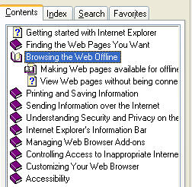
A macrobehavior

Slide 21
Behaviors of a special codex

Slide 22
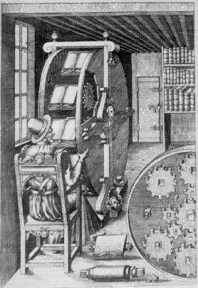
A vision of the codex with special behaviors
The Various and Ingenious Machines of Agostino Ramelli,
Paris, 1588

Slide 23
Do We Need This Behavior? Many PowerPoint Decks Are Overpowered

Slide 24
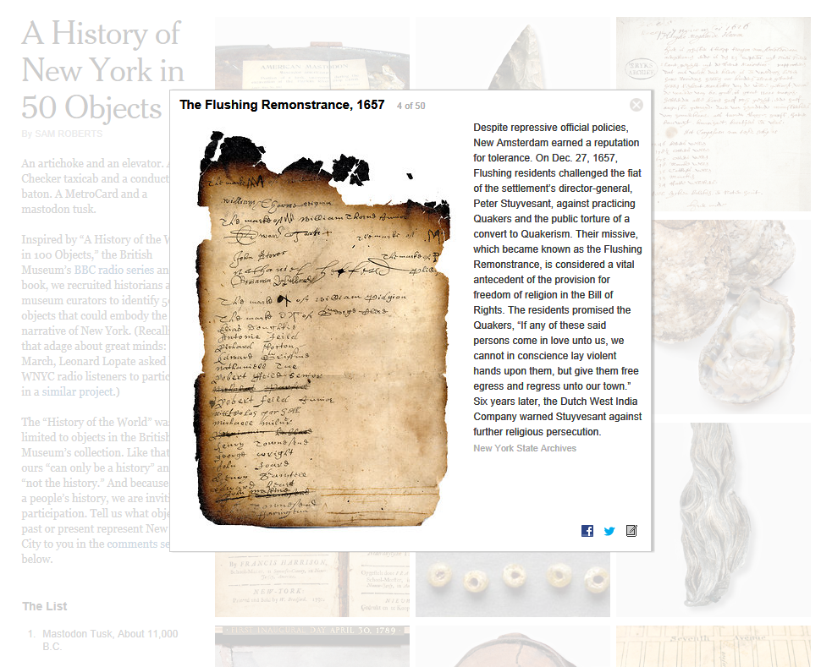
New digital formats

