Slide 1
LSST: Cosmology and Galaxies
Andrew Connolly
DiRAC Institute
University of Washington

Slide 2
We will draw from several sources
Rubin/LSST Science Book
https://www.lsst.org/scientists/scibook
591 pages ~190 on extra galactic and cosmology
DESC Science Roadmap
https://lsstdesc.org/assets/pdf/docs/DESC_SRM_latest.pdf
Reviews of galaxy formation
https://www.annualreviews.org/doi/pdf/10.1146/annurev-astro-081913-040037
https://www.annualreviews.org/doi/abs/10.1146/annurev-astro-032620-021910
DESC Science Requirements Document
https://arxiv.org/pdf/1809.01669.pdf

Slide 3
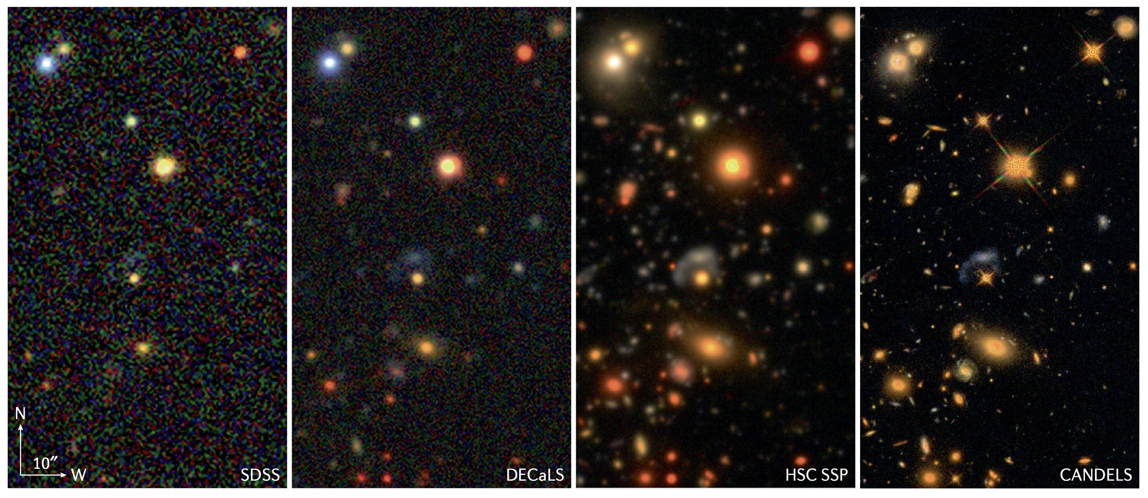
Rubin compared to the rest

Slide 4
What do we want to measure?
Notes:
Photometry, shapes, sizes, position, classifications, density, star/galaxy, psf
Photometry, shapes, star/gal, psf

Slide 5
What do we want to measure?
Which parameters need high precision ?
Notes:
Photometry, shapes, sizes, position, classifications, density, star/galaxy, psf
Photometry, shapes, star/gal, psf

Slide 6
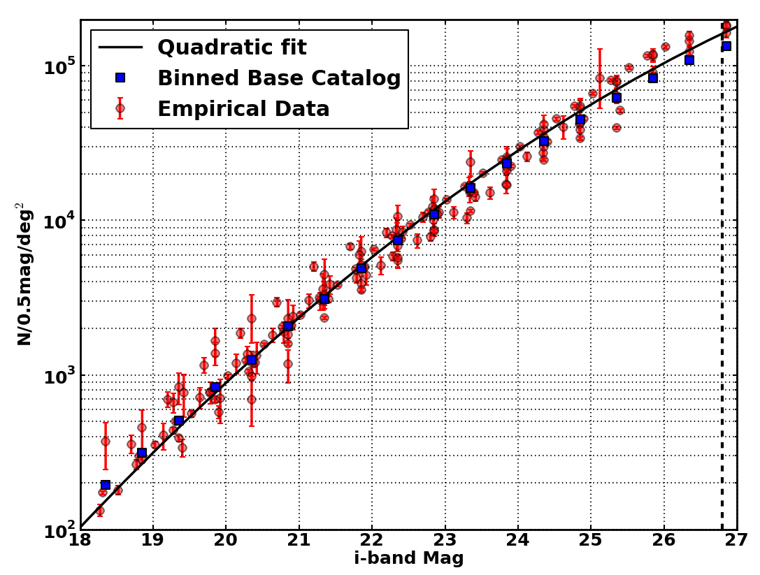
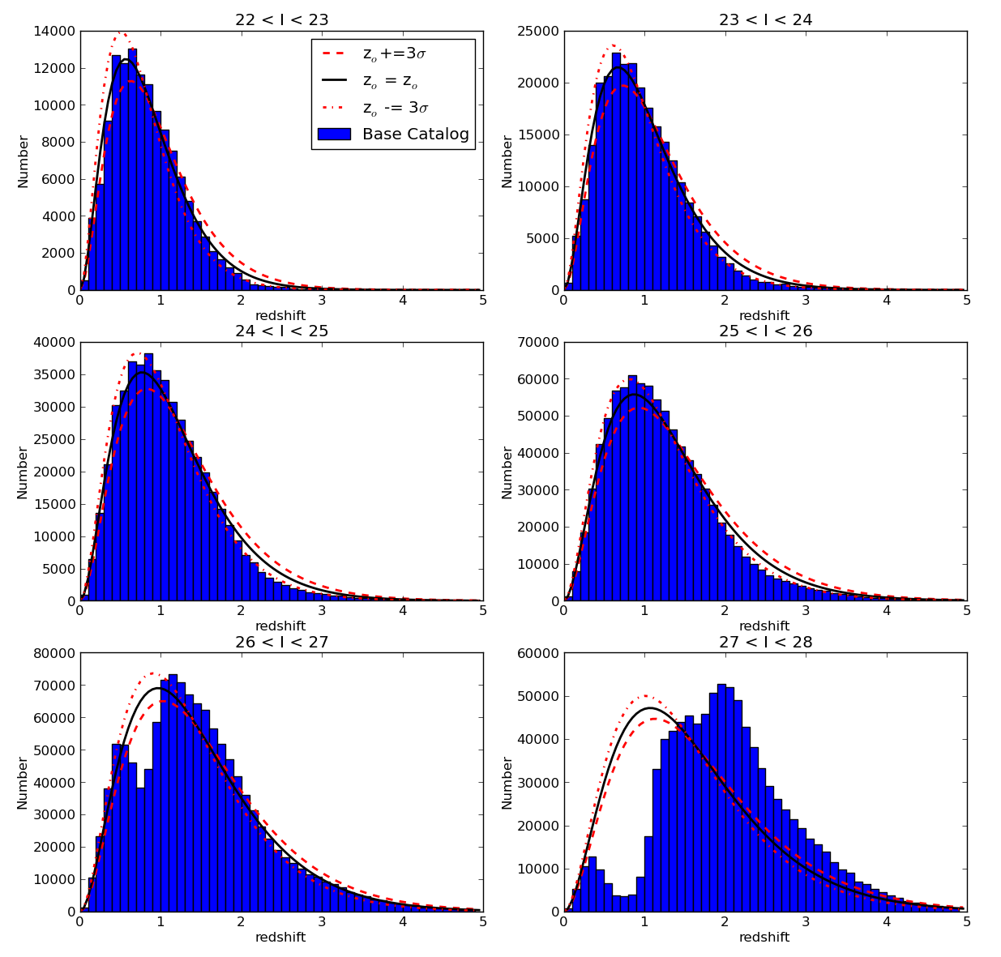
Galaxy properties: counts and redshift

Slide 7
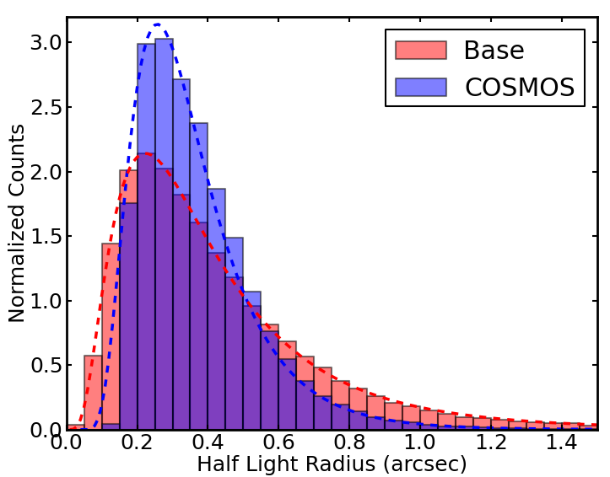
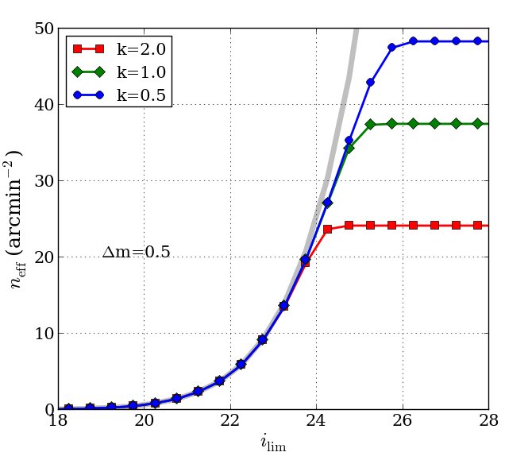
Galaxy properties: size and n_{eff}
Number of galaxies useful for weak lensing, k reflects efficiency of the shear measurement algorithms
Notes:
Chang et al: https://academic.oup.com/mnras/article/434/3/2121/1033585

Slide 8
What makes it hard?
Notes:
Blending, variable psf, DCR, variability in shapes, sky background, variability in galaxy properties…
Why not just aperture fluxes

Slide 9
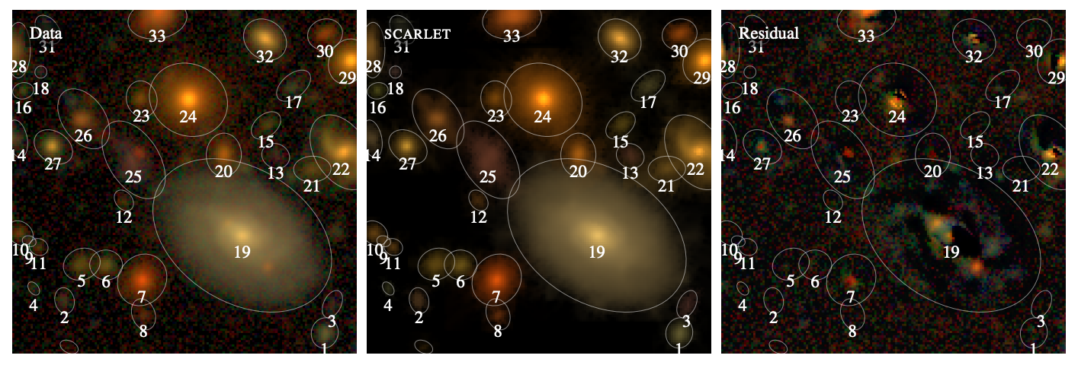
Deblending
Scarlet (Melchior et al)
M: model
S_{k}: spatial component,
A_{k}: weights (across all bands)
Requires incorporating PSF in the model
(as it is wavelength and time dependent)
Techniques include constrained NMF with sparsity and monotonicity, symmetric reflections,
https://github.com/pmelchior/scarlet
Notes:
Solve for A then solve for S can be a function (Gaussian) or “free form” a voxel
Not a solved problem – lots of interesting approaches
https://www.osti.gov/pages/servlets/purl/1833317
RNN: https://journals.aps.org/prd/pdf/10.1103/PhysRevD.106.063023

Slide 10
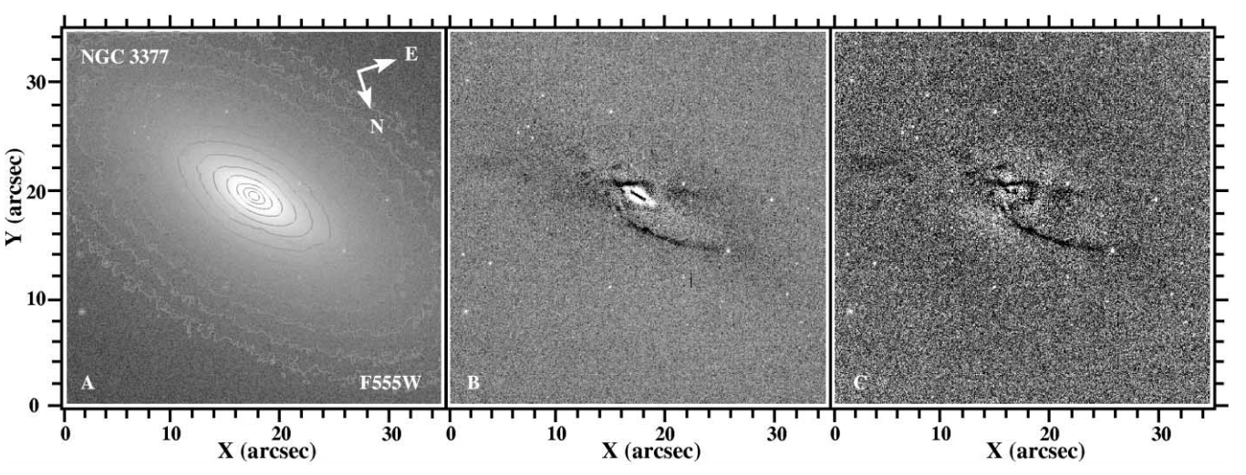
Measuring Galaxy Shapes (Moments, Parametric, CNN)
KSB (Kaiser, Squires, Broadhurst 1995)
GALFIT (Peng et al 2002)
CNNs (Sanchez et al 2018)
Neural networks trained from Galaxy Zoo classifications with 90% recall for disk, edge, bar, merger, roundness predictions
Q_{xy}: quadrupole moments
Sersic profile fitting
Notes:
KSB: https://articles.adsabs.harvard.edu/full/1995ApJ...449..460K
GALFIT: https://iopscience.iop.org/article/10.1086/340952/pdf
PETROFIT: https://petrofit.readthedocs.io/en/latest/fitting.html
CNN:https://academic.oup.com/mnras/article/476/3/3661/4848300
Nonparametric : asymmetry, gini, etc

Slide 11
Photometric redshifts
Johnson-Cousins
SDSS
LSST
Choice of filters is somewhat adhoc (not quite)

Slide 12
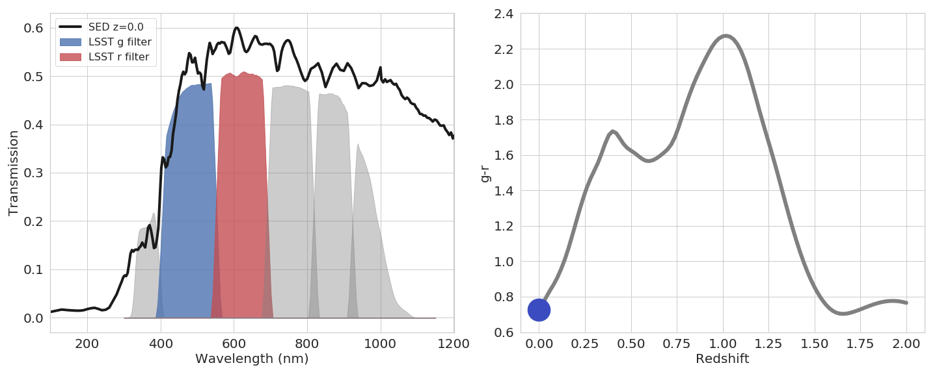
Photometric Redshifts (photo-z)
Photo-Z relies upon features of spectral energy distribution (SED) moving through different photometric filters
Notes:
So the focus…

Slide 13
Photometric Redshifts (photo-z)
Photo-Z relies upon features of spectral energy distribution (SED) moving through different photometric filters

Slide 14
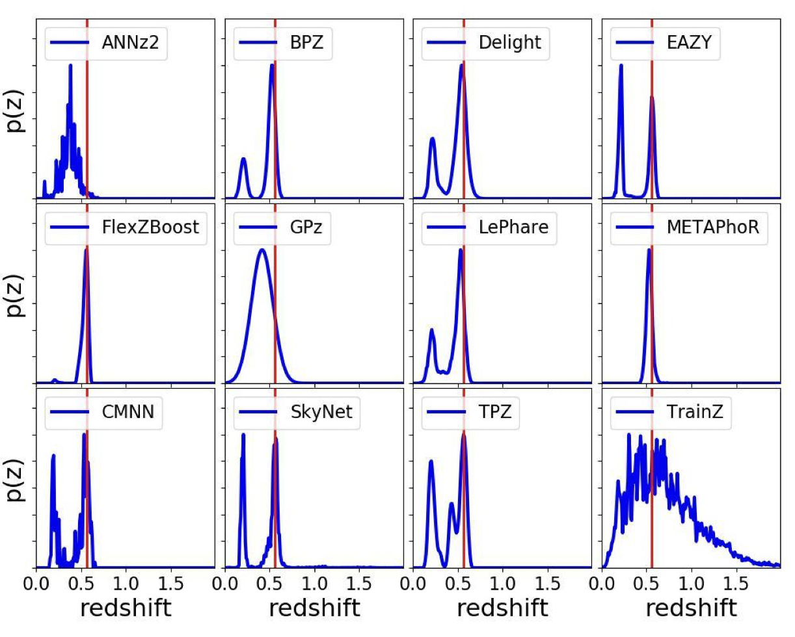
Photo-z estimators
Multiple estimators including model fitting, empirical methods, ML
Key takeaway; given a region in color space (u-g, g-r…) galaxies have a distribution of redshifts
Degeneracies occur because Balmer break has the same shape as the Lyman break

Slide 15
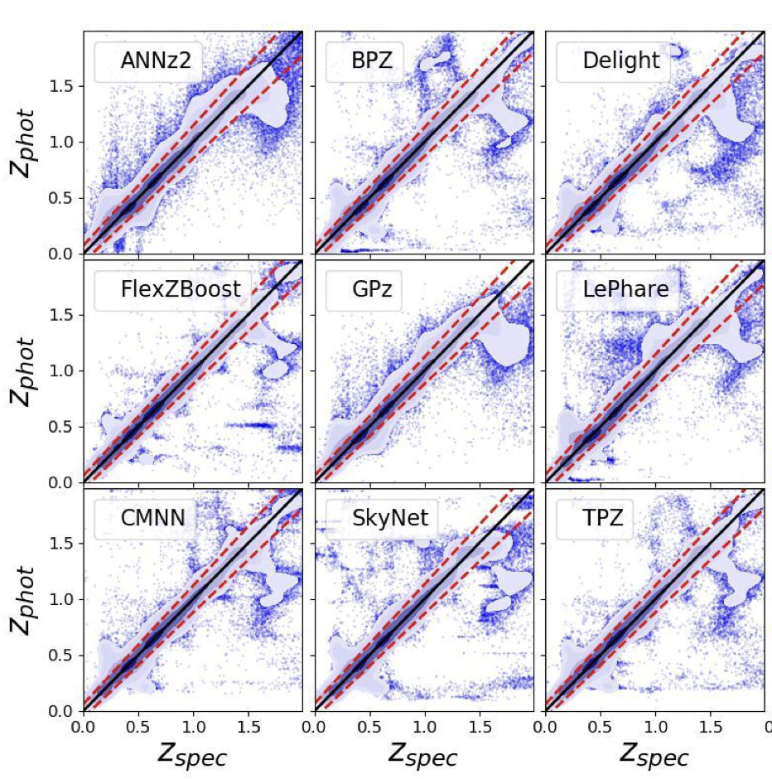
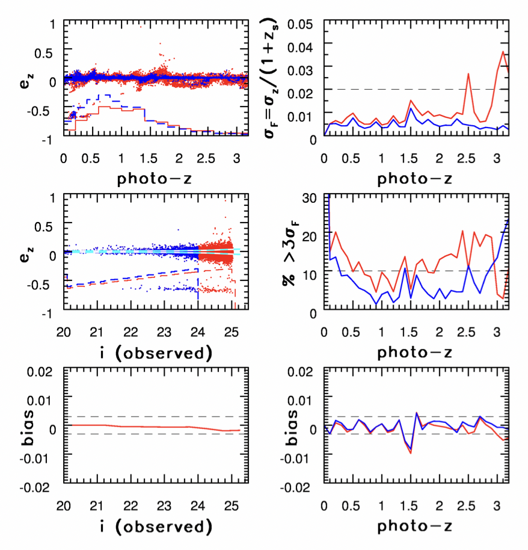
Photo-z performance (requirements for science)

Slide 16
What about the science?
Notes:
Technical work is very publishable

Slide 17
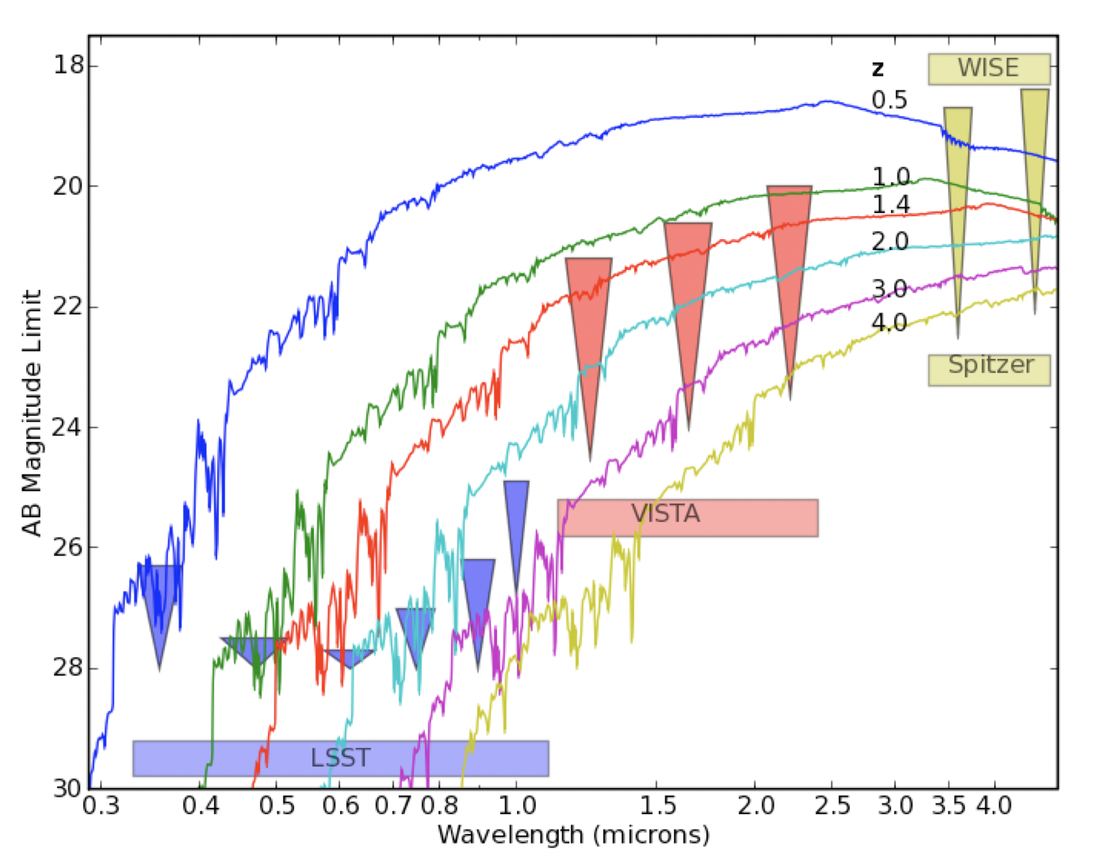
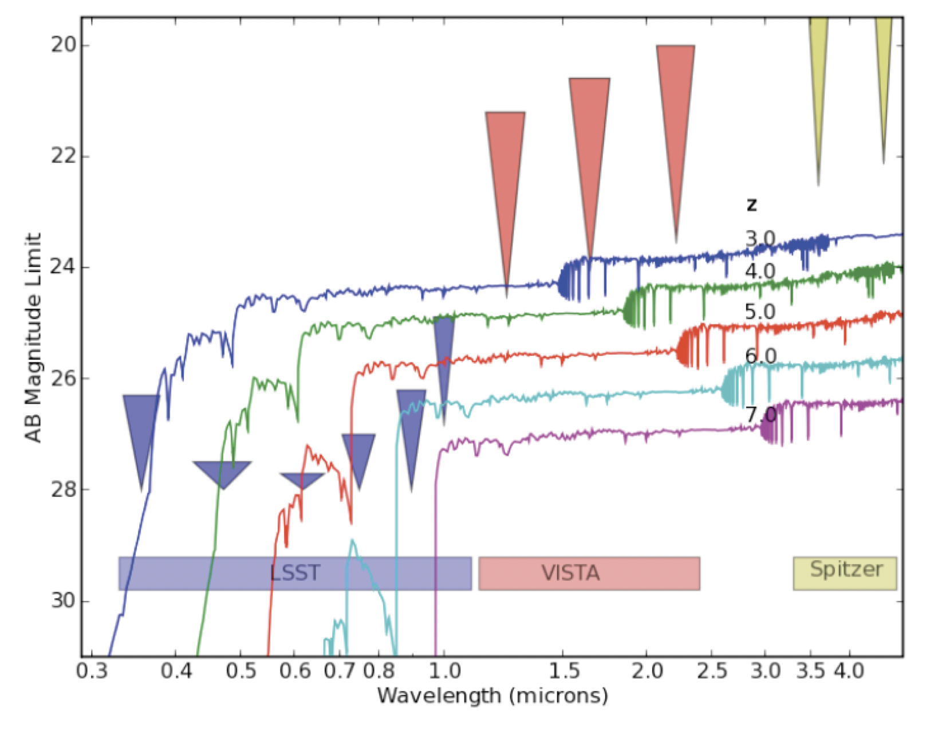
Galaxy Science (a subset)
LSST will provide data for roughly 10⁹ galaxies at z > 2, of which ∼ 10⁷ will be at z > 4.5.

Slide 18
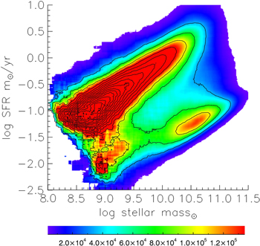
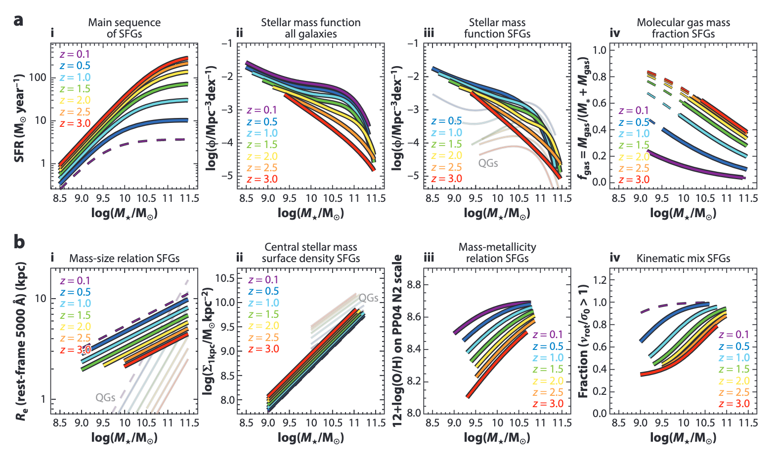
Key science areas: cosmic noon
Optical data probes stellar populations (>100Myr). From this we can define the “star-forming main sequence” for galaxies
Cosmic noon is the build up of galaxy populations through to the peak in the SFR history around z~2
Galaxies of the same stellar mass have similar star formation rates (two populations – star forming, quenched)
Gravitational instabilities and secular evolution are important for the build up of galactic structure
Rubin can contribute volume (some depth and less detail in wavelength or image quality). Volume means we can search for outliers from the “main sequence”
Connections with other wavelengths, higher image resolution, and spectral properties will be critical
Notes:
Main sequence https://iopscience.iop.org/article/10.1088/2041-8205/801/2/L29/meta
Annual reviews: https://www.annualreviews.org/doi/abs/10.1146/annurev-astro-032620-021910

Slide 19
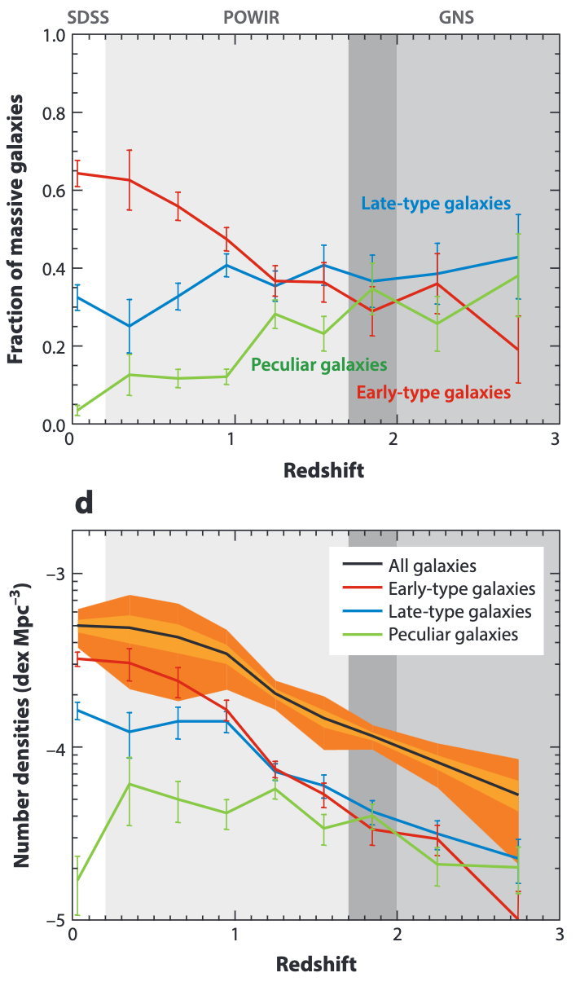
Key science areas: structure evolution
Morphological studies (structural properties of galaxies) and change as a function of environment, and redshift.
Goal is to understand how in situ star formation, major and minor mergers, and gas accretion from the IGM impacts the formation of galaxies.
Visual morphologies play a major role (e.g. Galaxy Zoo). Parametric models (e.g. Sersic) enable characterization of how structure evolves (modulo SNR, k-corrections and PSFs). Nonparametric statistics (concentration, asymmetry, clumpiness) are often used to characterize morphology a high redshift
Applications include tracing the merger rate with redshift, evolution of stellar populations of bulges, regulation of star formation with structural properties
Techniques robust to observational constraints (e.g. PSF) are still in development
Notes:
Annual reviews: https://www.annualreviews.org/doi/pdf/10.1146/annurev-astro-081913-040037

Slide 20
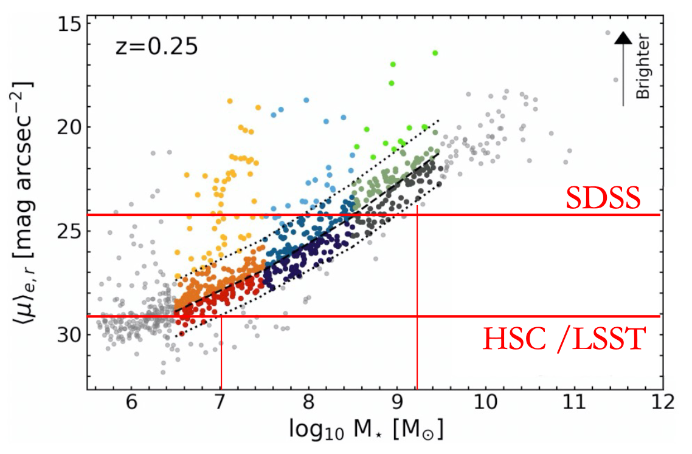
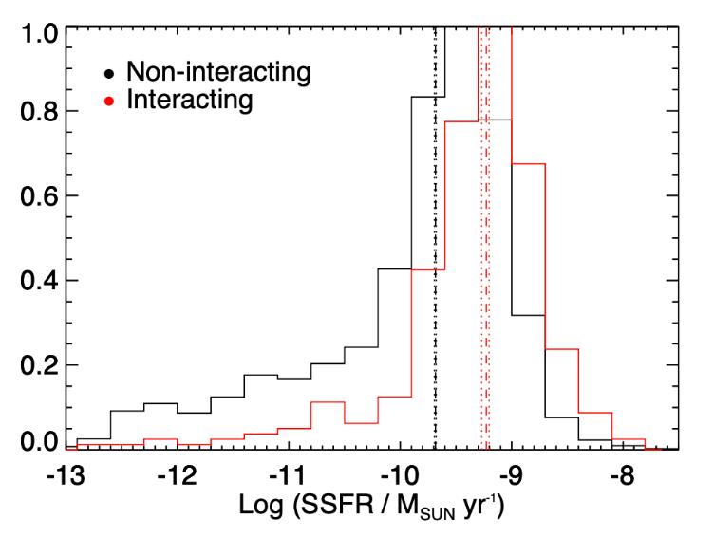
Key science areas: low surface brightness
The role of mergers in driving star formation, black hole growth and morphological evolution remains an open question
Low Surface Brightness (LSB) galaxies as a test of hierarchical galaxy formation (LSBs outnumber massive galaxies and minor mergers dominate the assembly history)
Spectroscopic survey have biases where photometric redshift samples may not (or have less).
Interactions enhance SFR in dwarfs (Kaviraj 2022)
Requires identification of LSBs and tidal features around merging galaxies which is possible with LSST data
Jackson +21, MN, 402, 4262
Notes:
Annual reviews: https://www.annualreviews.org/doi/pdf/10.1146/annurev-astro-081913-040037
Kaviraj: https://project.lsst.org/meetings/rubin2022/sites/default/files/Dwarf%20galaxies.pdf

Slide 21
Cosmology
Y1
Y10
https://arxiv.org/pdf/1809.01669.pdf
Notes:
DESC Science Requirements Document: https://arxiv.org/pdf/1809.01669.pdf

Slide 22
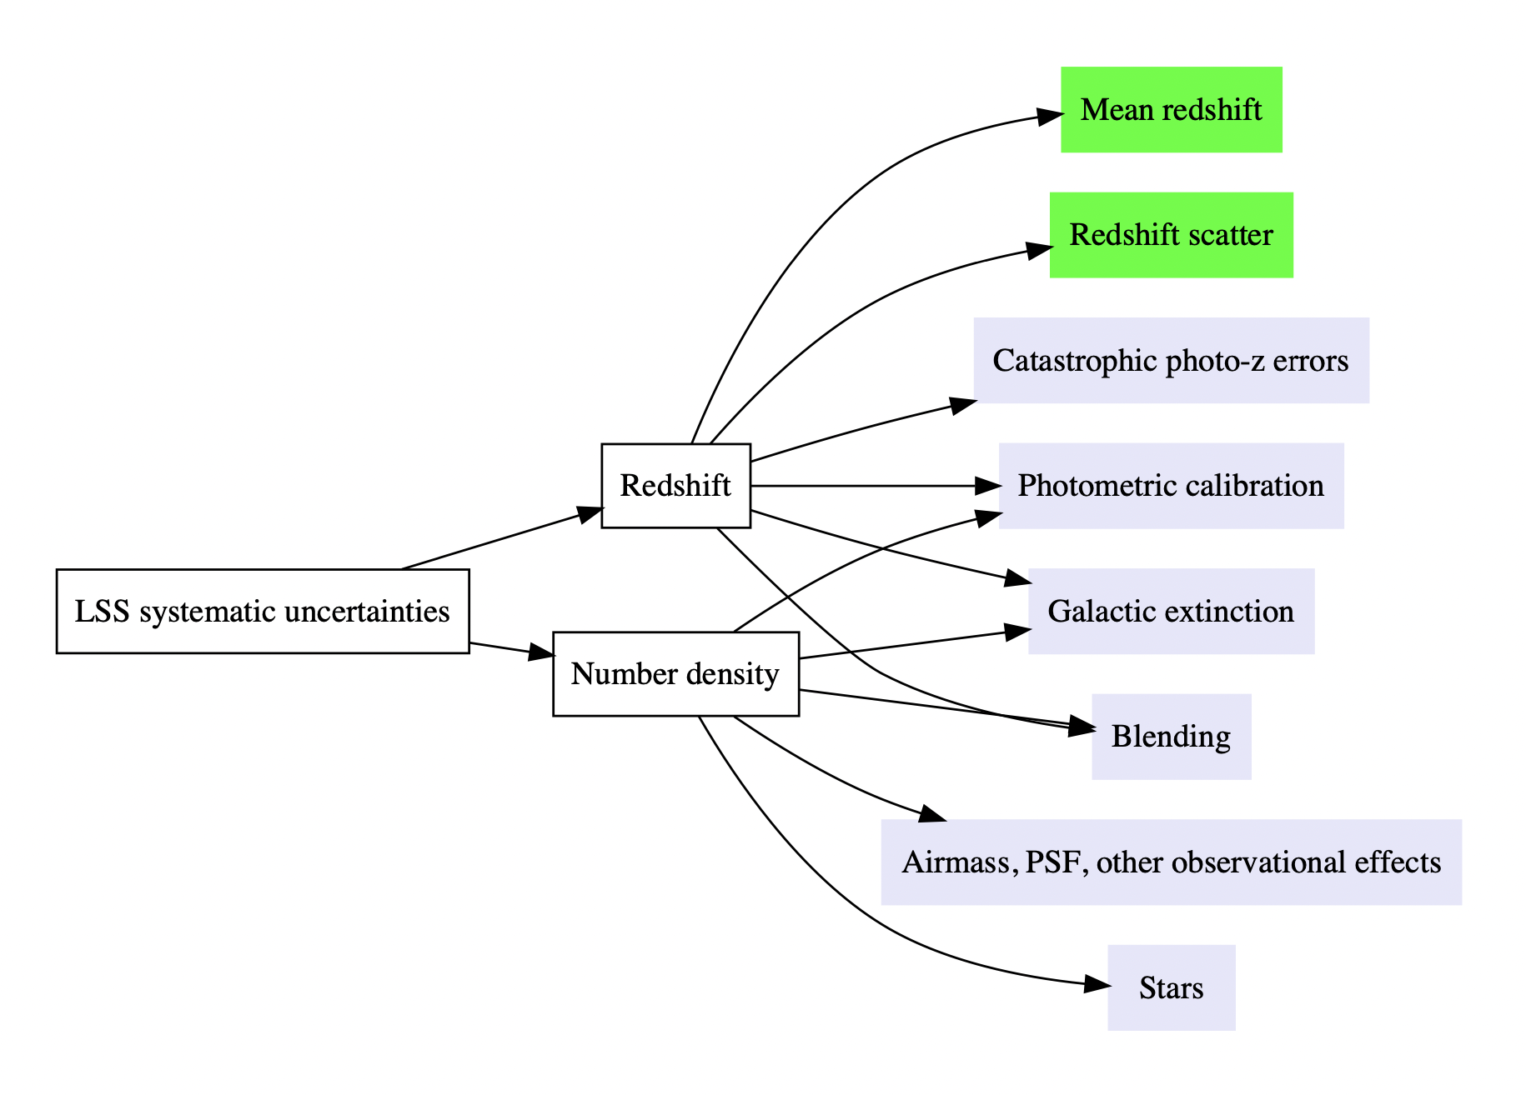
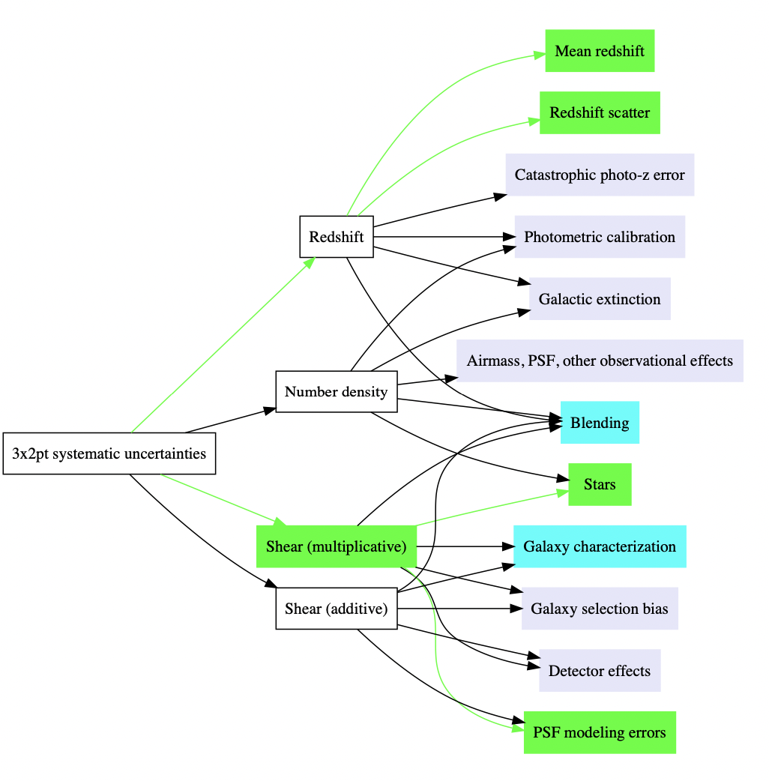
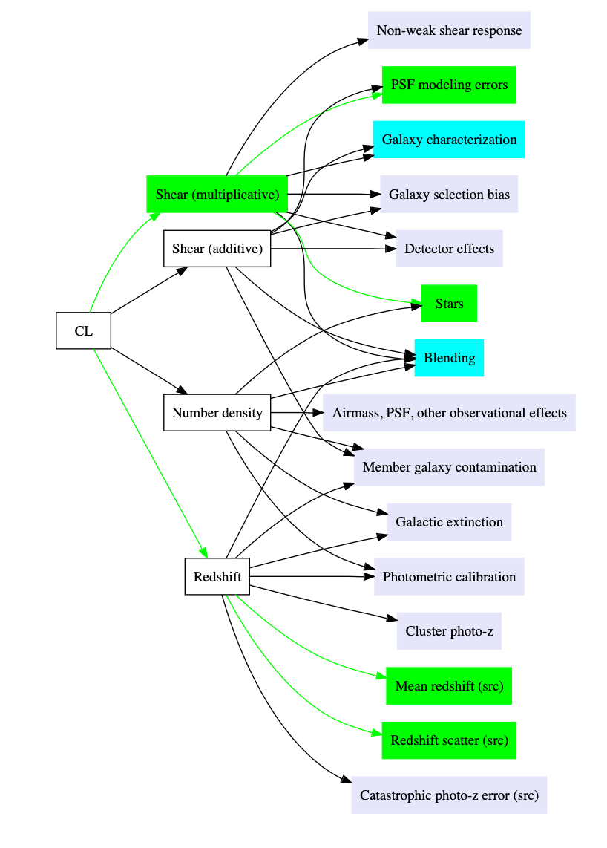
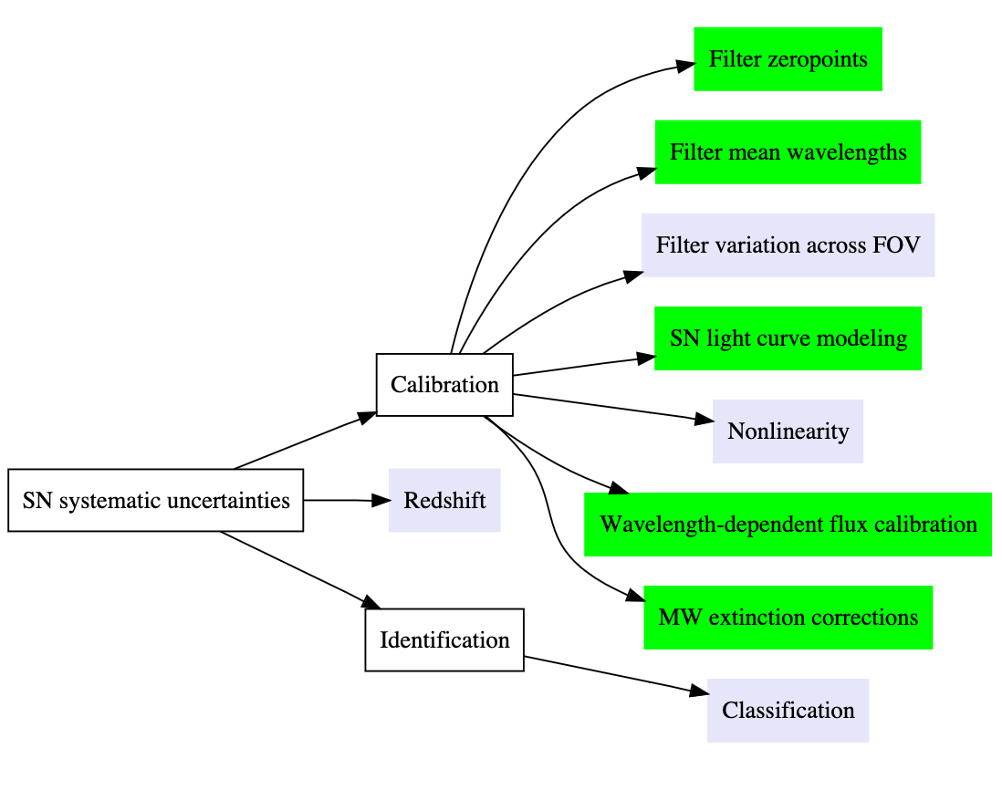
Impact of Systematics
LSS (BAOs)
Weak Lensing
Clusters
SN

Slide 23
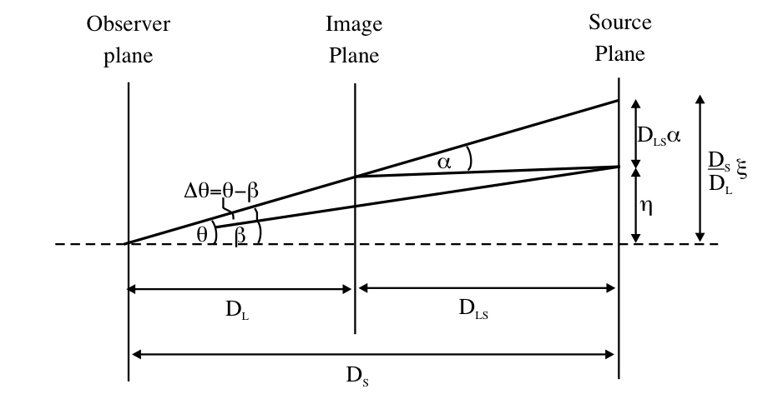
Gravitational Lensing
From the small angle formula
$θ=β+\frac{4GM}{θc^{2}}$ $\frac{D_{ds}}{D_{d}D_{s}}$
$$α=\frac{4GM}{c^{2}b}$$
If β=0 (source is behind the lens)
$$θ=θ_{E}={\left(\frac{4GM}{c^{2}}\frac{D_{ds}}{D_{d}D_{s}}\right)}^{1/2}$$
θ_{E}: Einstein radius
$$θ_{E}=0.9 arcsec {\left(\frac{M}{{{10}^{11}M}_{0}}\right)}^{1/2}{\left(\frac{D}{1Gpc}\right)}^{−1/2}$$
The solution is a ring of angular radius θ_{E}

Slide 24
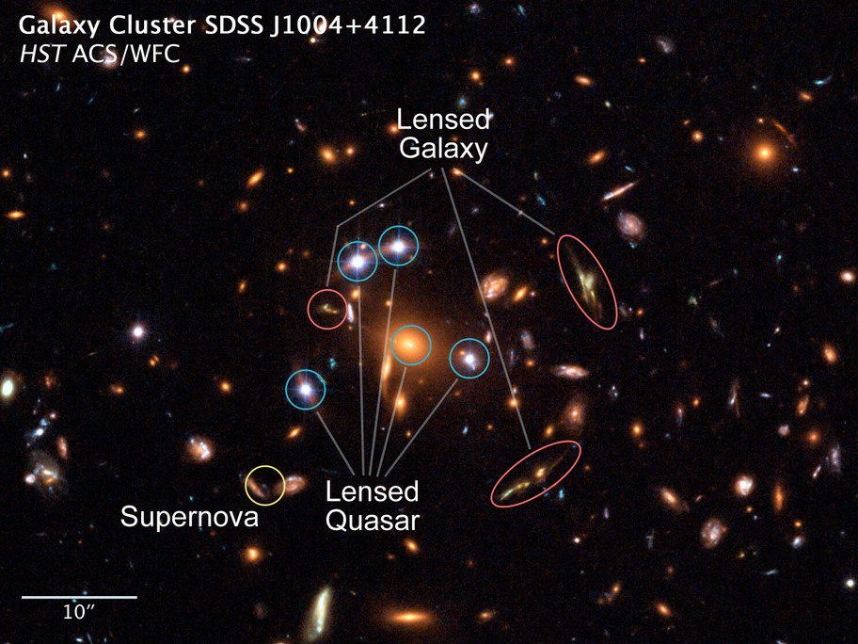
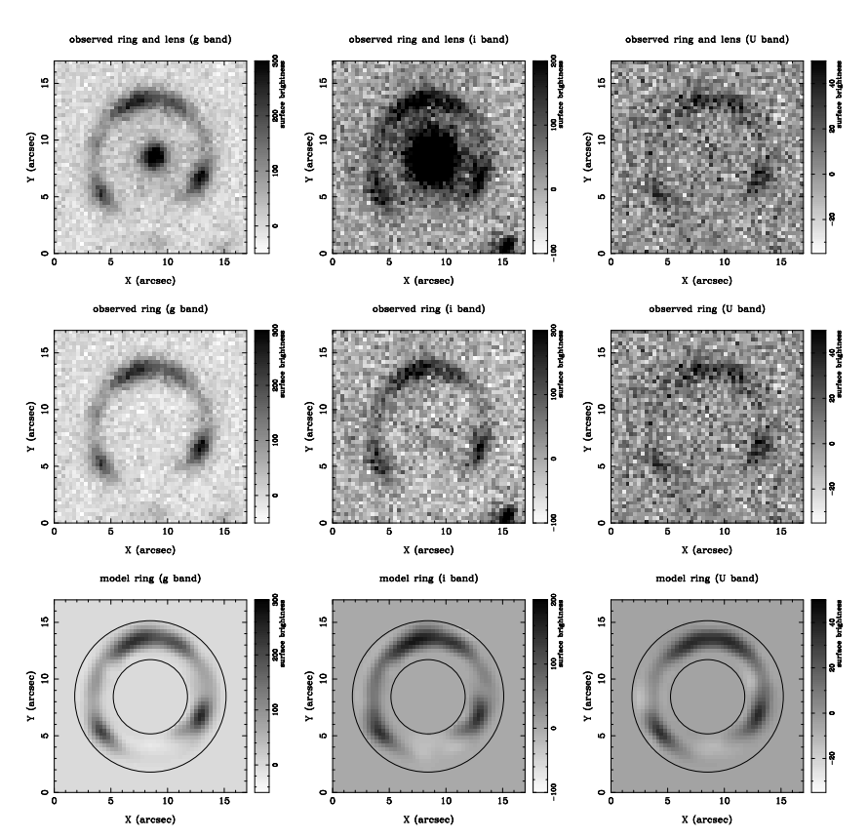
Strong Lensing
For a lens that isn’t a point source (e.g. a galaxy) the Einstein radius gives an estimate of the mass within the Einstein radius

Slide 25
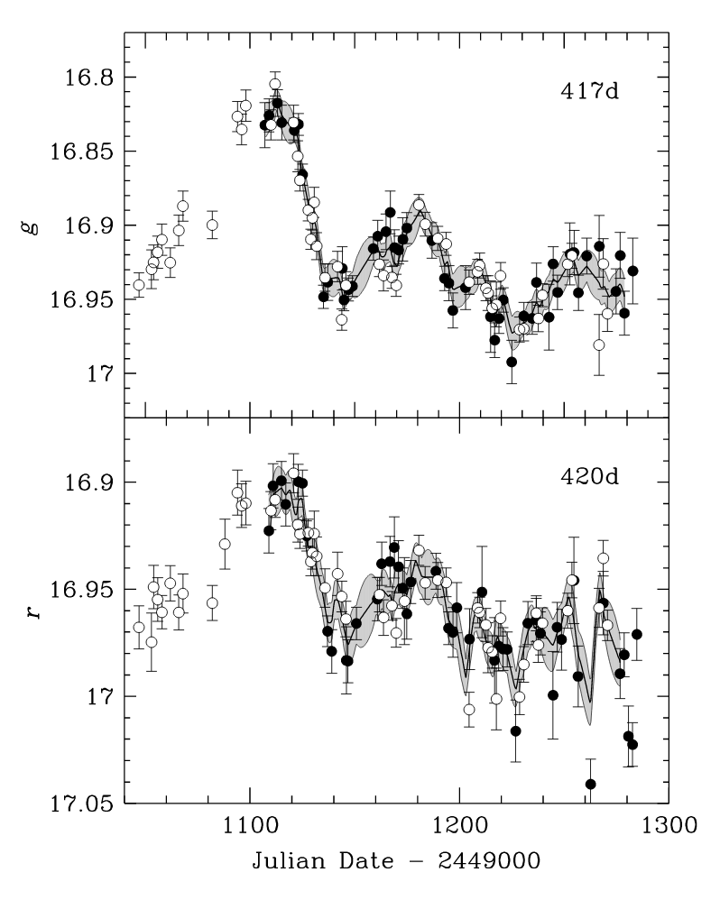
Time delays and measuring the Hubble constant
$$t\left(θ\right)=\frac{1+z}{c}\frac{D_{d}D_{s}}{D_{ds}}\left[\frac{1}{2}{\left(θ−β\right)}^{2}−ψ\right]$$
t_{geometry}
t_{gravitation}
If we have a model for the lens mass we can estimate H₀Δt. If we measure Δt then we can measure H₀
For Rubin
10,000’s strong (arc) lenses
1000’s quasar lenses
Modeling requires follow-up resources (spectra, high resolution images)
Expect ~25 strongly lensed Sne
Address the Hubble tension (with follow-up 1-2% precision on H0), depends on cadence (needs colors)
QSO 0957+561AB

Slide 26
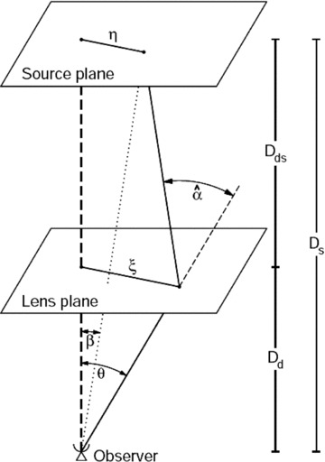
Weak Lensing
$$α=\frac{4GM}{c^{2}b}$$
$\sum{\left(ξ\right)}$: mass surface density
𝜚: 3D mass density
z: direction along line of sight
ξ: distance vector along plane of the lens
$$\sum{\left(ξ\right)=\int{ρ\left(ξ, z\right)dz}}$$
Weak deflections add linearly (so we can think of a mass being made up of a lot of point masses). This means the deflection of ray due to all of these masses as
$$α(ξ)=\sum_{i}{α_{i}\left(ξ−ξ_{i}\right)= }\frac{4G}{c^{2}}\sum_{i}{M_{i}\frac{(ξ−ξ^{′}) }{{\left|ξ−ξ^{′}\right|}^{2}}}$$
$$α(ξ)=\frac{4G}{c^{2}}\int{\frac{(ξ−ξ^{′})\sum{\left(ξ^{′}\right)d^{2}ξ′}}{{\left|ξ−ξ^{′}\right|}^{2}}}$$
For a continuous distribution of mass

Slide 27
Lensing Potential
$$α=\frac{2}{c^{2}} \int{∇_{⊥}φ}ds$$
$$\hat{α\left(θ\right)}=\frac{D_{ds}}{D_{s}}α(θ)$$
We can introduce the idea of an effective lensing potential where we project the Newtonian potential onto a plane and scale (by the distance)
$$ψ\left(θ\right)= \frac{D_{ds}}{D_{d}D_{s}}\frac{2}{c^{2}}\int{φ\left(D_{d}θ, z\right)dz}$$
$$∇_{θ}ψ=\frac{2}{c^{2}}\frac{D_{ds}}{D_{s}}\int{∇_{⊥}φdz=\hat{α}}$$
$$∇_{θ}^{2}ψ=\frac{2Σ(θ)}{Σ_{CR}}≡2κ\left(θ\right)$$

Slide 28
Mapping from the source to the image plane
We can now write down a shear matrix A
$$A=\frac{dβ}{dθ}=\left(δ_{ij}−ψ_{ij}\right)$$
$$A_{11}$$
$$A_{12}$$
$$γ_{1}(θ)=\frac{1}{2}\left(ψ_{11}−ψ_{22}\right)=γcos(2φ\left(θ\right))$$
$$A=\left(\begin{matrix}1−κ−γ_{1} & −γ_{2} \\ −γ_{2} & 1−κ+γ_{1}\end{matrix}\right)$$
$$γ_{2}\left(θ\right)=ψ_{12}=ψ_{21}=γsin(2φ\left(θ\right))$$
$$A_{21}$$
$$A_{22}$$
$$κ=\frac{1}{2}\left(ψ_{11}+ψ_{22}\right)=\frac{Σ(θ)}{Σ_{CR}}$$
$$A=(1−κ)\left(\begin{matrix}1 & 0 \\ 0 & 1\end{matrix}\right)− γ\left(\begin{matrix}cos(2φ) & sin(2φ) \\ sin(2φ) & −cos(2φ)\end{matrix}\right)$$
Increase in size of an image due to magnification
Change in size and shape (shear) of an image

Slide 29
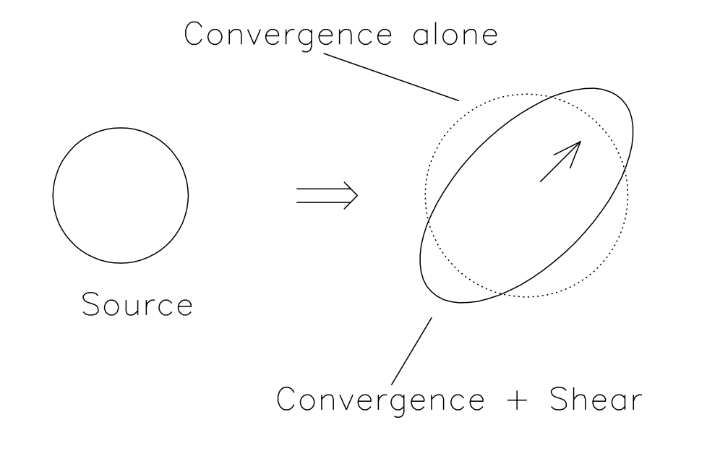
Magnification and shear
Semi major axis ${\left(1−k−γ\right)}^{−1}=a$
Semi minor axis ${\left(1−k+γ\right)}^{−1}=b$
$$A=(1−κ)\left(\begin{matrix}1 & 0 \\ 0 & 1\end{matrix}\right)− γ\left(\begin{matrix}cos(2φ) & sin(2φ) \\ sin(2φ) & −cos(2φ)\end{matrix}\right)$$

Slide 30
Measuring the shape of the galaxy
If we measure the shape of a galaxy (its ellipticity or semi major and semi minor axes) and we assume on average that all galaxies are circular we can measure ɣ
$$γ→ ψ_{ij}→ α →∇_{⊥}φ$$
Shear gives a measure of the gradient of the potential from which we can infer the mass surface density. This assume no preferred alignment in the shapes of galaxies and we must average over many galaxies (because the signal is so small)

Slide 31
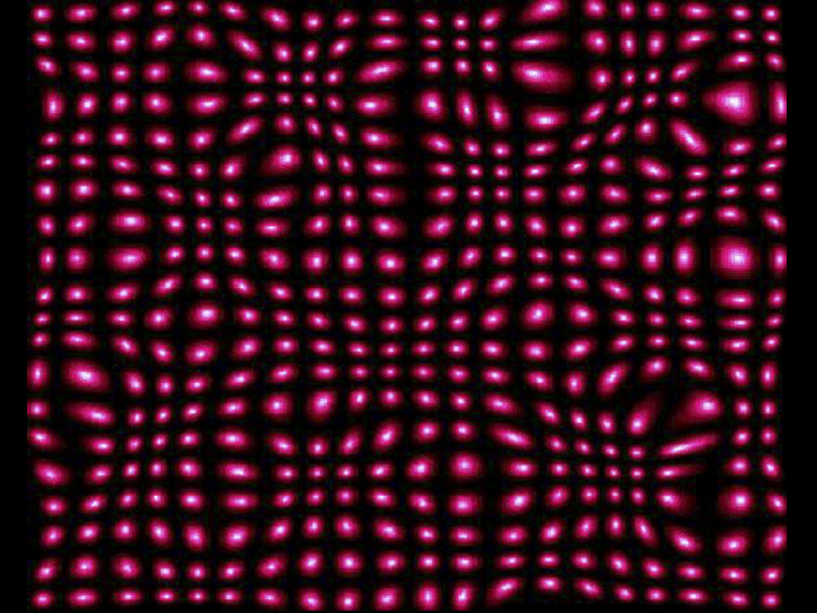
Measuring mass distribution with weak lensing
Credit: Sarah Bridle

Slide 32
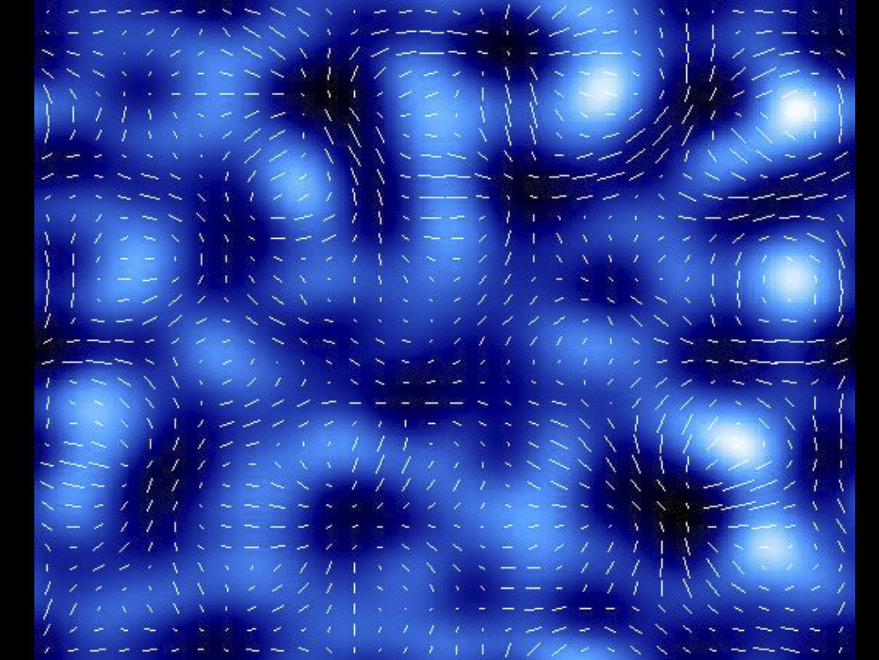
Measuring mass distribution with weak lensing
Credit: Sarah Bridle

Slide 33
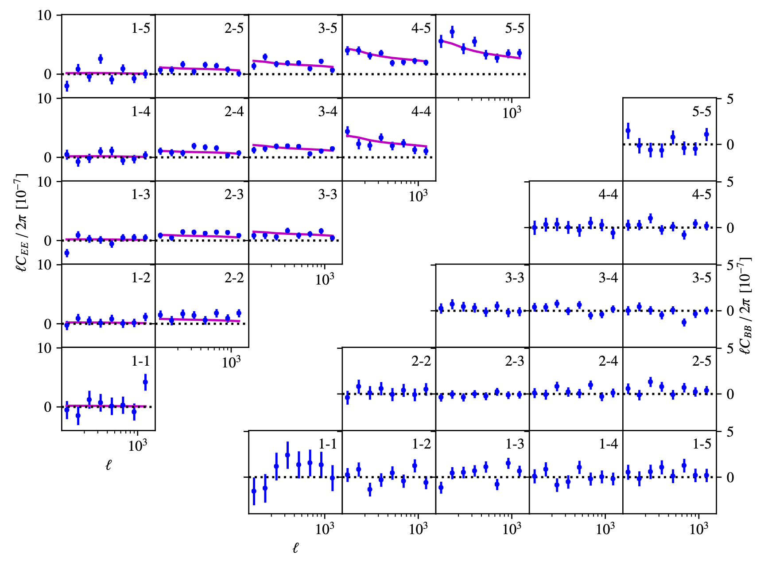
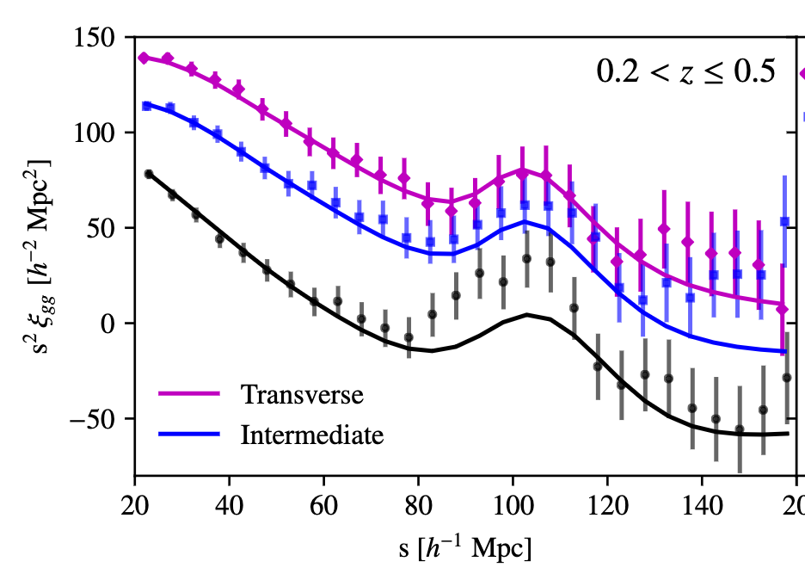
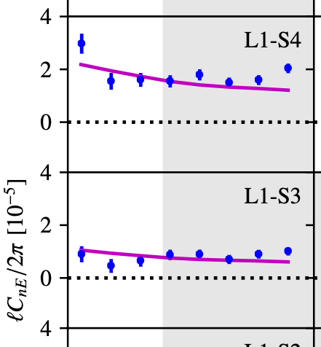
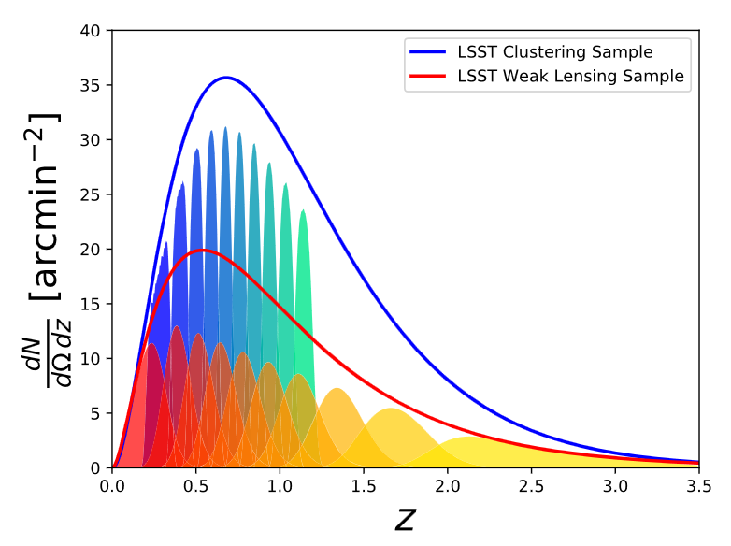
Joint Probes: bringing it together 3x2pt function
Cosmic shear power spectrum
LSS or BAOs
Galaxy-galaxy lensing
3x2pt function: galaxy clusters, WL shear, galaxy-galaxy lensing
Notes:
Eifler: https://academic.oup.com/mnras/article/507/1/1514/6155044
Cid: https://moriond.in2p3.fr/2022/Cosmology/transparencies/06_saturday/01_morning/02_sanchez_cid.pdf
Heymans: https://kids.strw.leidenuniv.nl/k1000cs/KiDS1000_3x2pt_Cosmology_-_Heymans_et_al.pdf

Slide 34
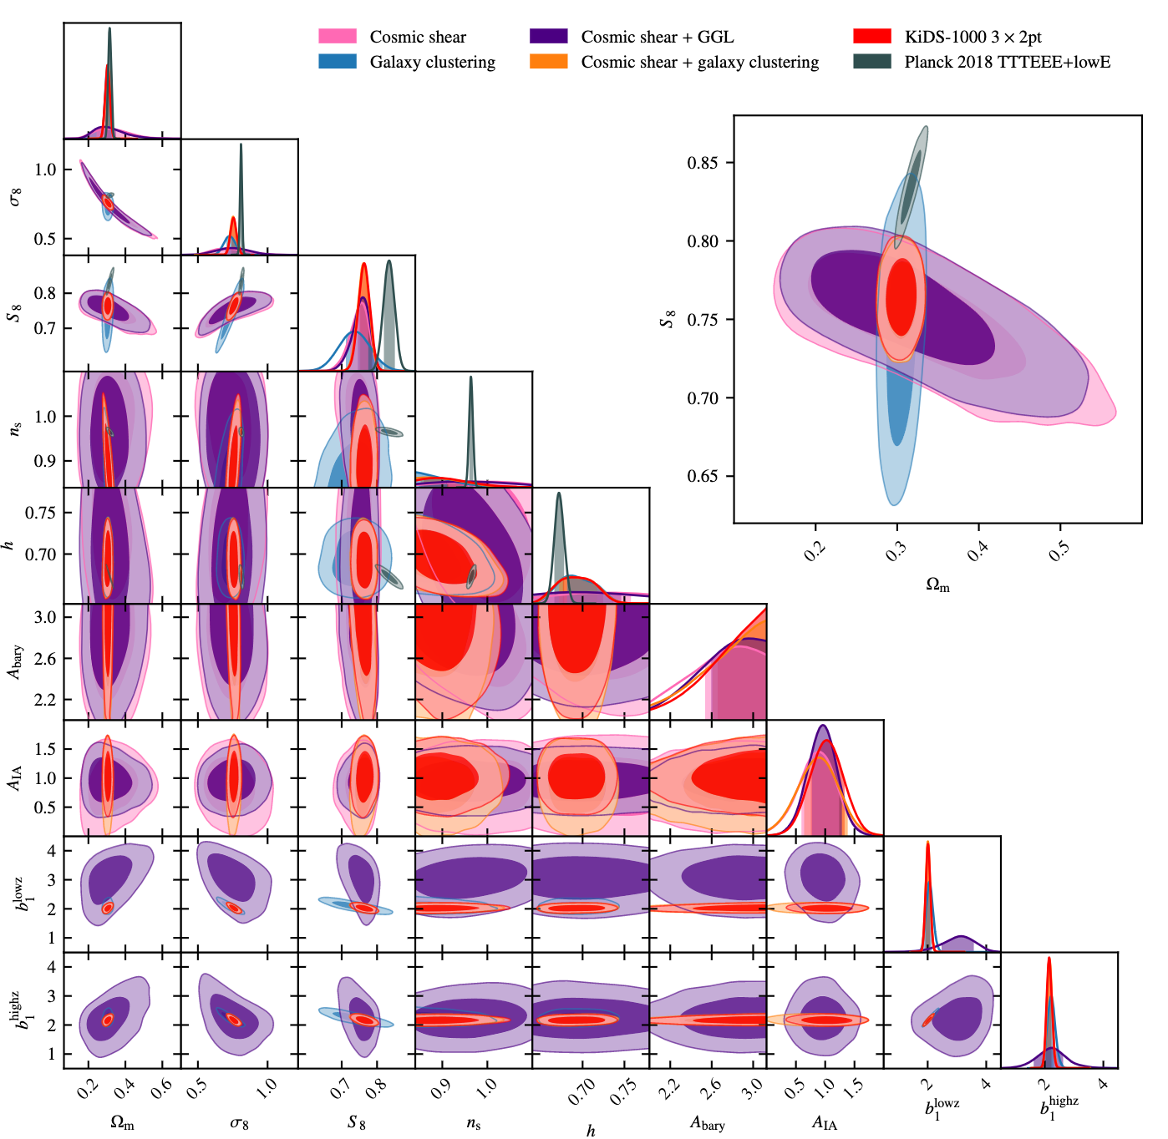
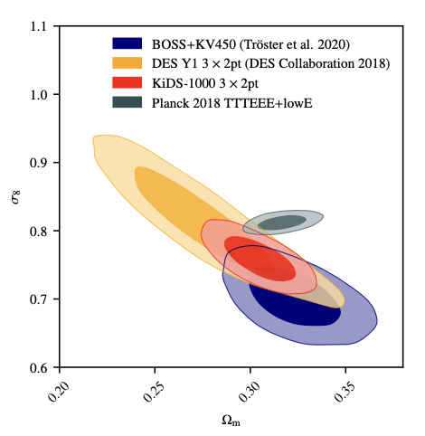

Slide 35
We will draw from several sources
Rubin/LSST Science Book
https://www.lsst.org/scientists/scibook
591 pages ~190 on extra galactic and cosmology
DESC Science Roadmap
https://lsstdesc.org/assets/pdf/docs/DESC_SRM_latest.pdf
Reviews of galaxy formation
https://www.annualreviews.org/doi/pdf/10.1146/annurev-astro-081913-040037
https://www.annualreviews.org/doi/abs/10.1146/annurev-astro-032620-021910
DESC Science Requirements Document
https://arxiv.org/pdf/1809.01669.pdf

