Slide 1
Worksheet: journey along the nephron
Note to instructors: This worksheet represents a way that I have taught this material, which incorporates figures/tables created by others. I have cited my sources, but I have not obtained formal permission to use the figures/tables. As far as I’m concerned, you’re welcome to use this worksheet as is or modify it. If you do the latter, please continue to cite the sources – and be aware that their inclusion here may or may not be permissible under “fair use” doctrine.
--Greg Crowther, Everett Community College (gcrowther@everettcc.edu)
Goals:
(A) Review anatomy and terminology pertaining to nephrons.
(B) Master the concepts of filtration, reabsorption, and secretion by drawing graphs of how various substances are processed by nephrons.

Slide 2
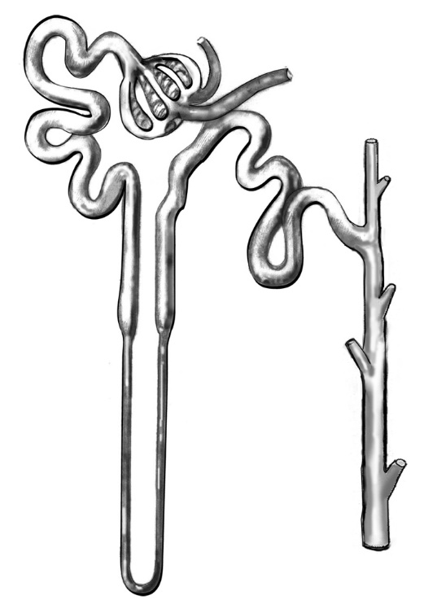
(A) Background anatomy and terminology
A1. Label the diagram with the following terms:
a. Bowman’s capsule (glomerular capsule)
b. collecting duct
c. distal tubule
d. glomerulus
e. loop of Henle (nephron loop)
f. proximal tubule
g. renal corpuscle
A2. Which of these structures carries blood?
Figure: catalog.niddk.nih.gov

Slide 3
A3. Define each of the following terms as they apply to the nephron. (You may do sketches if that’s helpful.)
a. filtration
b. secretion
c. reabsorption
A4. The 3 types of transfers above generally apply to substances of a certain size range. Which entities are normally TOO BIG to be filtered, secreted, or reabsorbed?

Slide 4
(B) Nephron graphs
For any substance that is present in the blood, we can make a graph of the amount of it passing through the sections of a nephron, with this set-up:
In this type of graph, we will focus on relative trends. That is, as pre-pee moves along the nephron, does the amount of the substance in the nephron go up, hold steady, or decrease? We will NOT worry about specific numerical values.

Slide 5
A simple case is for the molecule inulin (NOT insulin), which is small enough to be filtered into Bowman’s capsule, but is neither secreted nor reabsorbed by any subsequent part of the nephron. Thus, its graph would look about like this.
B1. Would this graph look the same if the rates of secretion and reabsorption were not zero, but equal to each other at each part of the nephron?

Slide 6
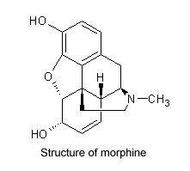
Now consider the drug morphine (image at right), which is actively secreted into the proximal and distal tubules, but not reabsorbed.
B2. Is morphine small enough to be filtered from the glomerulus into Bowman’s capsule?
(Hint: how does the size of morphine compare to the size of proteins?)
B3. Based on the information you have, draw the graph for morphine.
image: sciencebase.com

Slide 7
Albumin is the most abundant protein in the plasma. It is ~580 amino acids long and has a molecular weight of ~60,000.
B4. Draw a graph for albumen in a healthy person.
B5. In some types of kidney disease, more albumen than usual is able to escape the glomeruli. Add a 2nd curve, labeled “Disease,” to the graph above.
B6. Based on the above, is protein in the urine normal, or a symptom of disease?

Slide 8
Sodium (Na⁺) is reabsorbed along most of the nephron, including the ascending limb of the loop of Henle (but not the descending limb). It is not actively secreted. Aldosterone enhances reabsorption in the distal tubule and collecting duct, but, either way, at least a bit of Na⁺ is lost in the urine.
B7. Draw the graph for Na⁺ in the absence and in the presence of aldosterone. (Label your two lines “NO ALD” and “WITH ALD.”)
B8. Despite the changes in Na⁺ amount graphed above, the Na⁺ concentration does not change that much between the Bowman’s capsule and the collecting duct. Why not?
Finally, let’s consider glucose in normal and diabetic people (next slide)….

Slide 9
B9. Is glucose small enough to be filtered into Bowman’s capsule?
B10. Would it be advantageous for the body to secrete glucose? Why or why not?
B11. Glucose reabsorption through membrane proteins occurs along the proximal tubule. Draw the curve for glucose during euglycemia (normal blood glucose levels) and hyperglycemia (as occurs in diabetes mellitus). Is glucose in the urine a sign of disease? Explain.
B12. By the end of the collecting duct, the “pre-pee” has become urine. Through which structures does it pass on its way out of the body?
B13. Based on all of the above, describe the contents of a healthy person’s urine in terms of its contents of morphine, albumen, sodium, and glucose.

