Slide 1
Ancient Greek View of Cosmology
James J. Clauss
Department of Classics

Slide 2
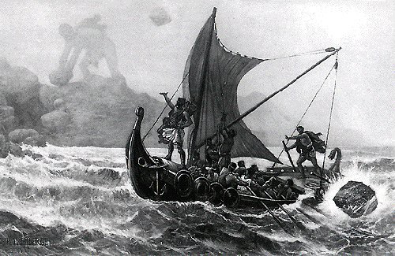
In Ancient Greek, mythos (μῦθος) = story.
Most of the stories that comprise the body of tales we know as Greek Mythology, especially the oldest ones, contain important insights into how our cultural ancestors explained the world in which they lived.
The stories were based on observations and experiences

Slide 3
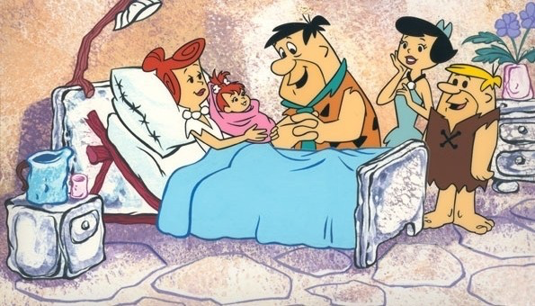
Fred and Wilma Flintstone’s scientific questions and observations of the origin of the world in 10,000 BCE: Where did their daughter Pebbles come from, why do plants grow after it rains, why are families so dysfunctional?
Three models for Greek cosmology:
Creation as birth (biological)
Creation as vegetal growth (agricultural)
Familial Behaviors (psychological): fear of replacement

Slide 4
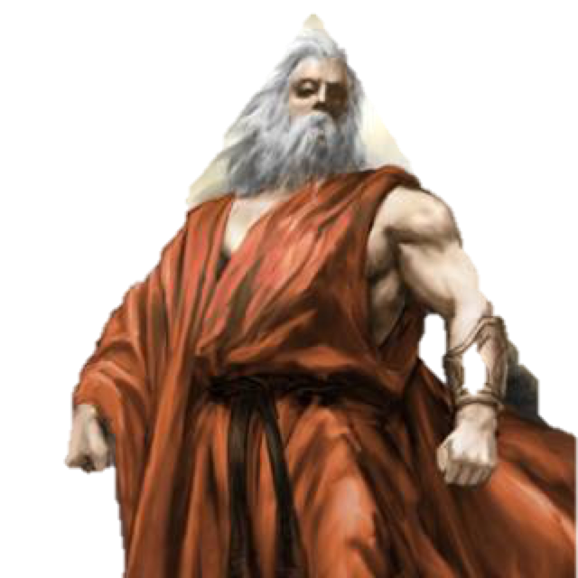
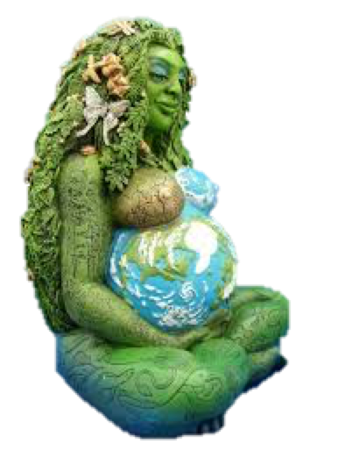
Hesiod’s Theogony (8th century BCE) offers the earliest Greek thinking on cosmology. In the beginning there was
Chaos (= empty space, the “abyss” in genesis)
Gaia emerges within space (earth, female)
Parthenogenesis (virgin birth)
Ouranos (sky, male)

Slide 5
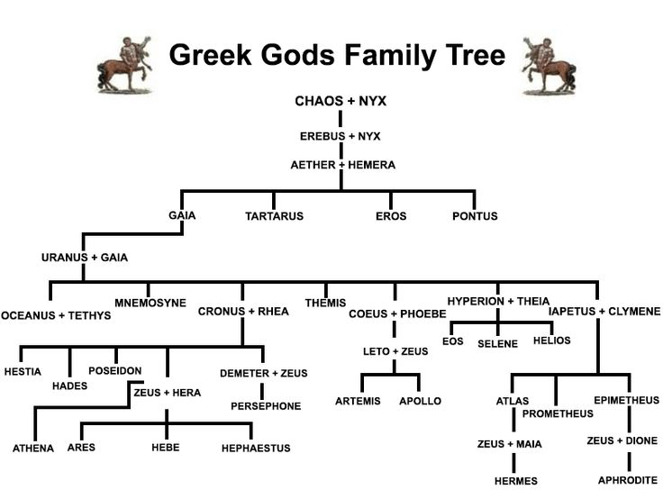
Gaia and Ouranos* (= cosmic Eve and Adam) mate and create the second generation of beings (more below). Thus sexual intercourse (biological model) provides an understanding of how creation can happen. Doesn’t this model come from the observation that men and women procreate?
* aka Uranus

Slide 6
When it rains (from Father Sky), plants grow (in Mother Earth), which provides an agricultural model for creation. Doesn’t this model come from the observation that crops will only grow when it rains, a parallel to intercourse?

Slide 7
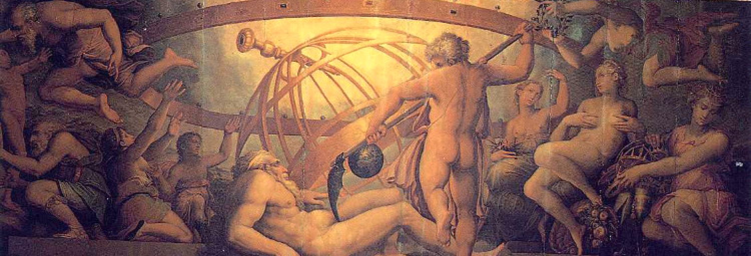
Back to Earth and Sky, they needed to be separated before the next generation could emerge from the womb.
Ouranos prevented his children from being born by staying on top of Gaia, not allowing birth to happen because of fear of replacement. Thus embedded in the story of human creation as model for cosmic birth is psychological anxiety.
Youngest son Kronos castrates his father and creates the separation of Sky and Earth that allows for further creations.

Slide 8
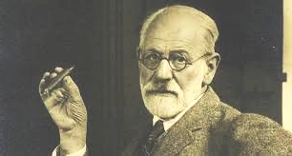
Heavens to Sigmund Freud!

Slide 9
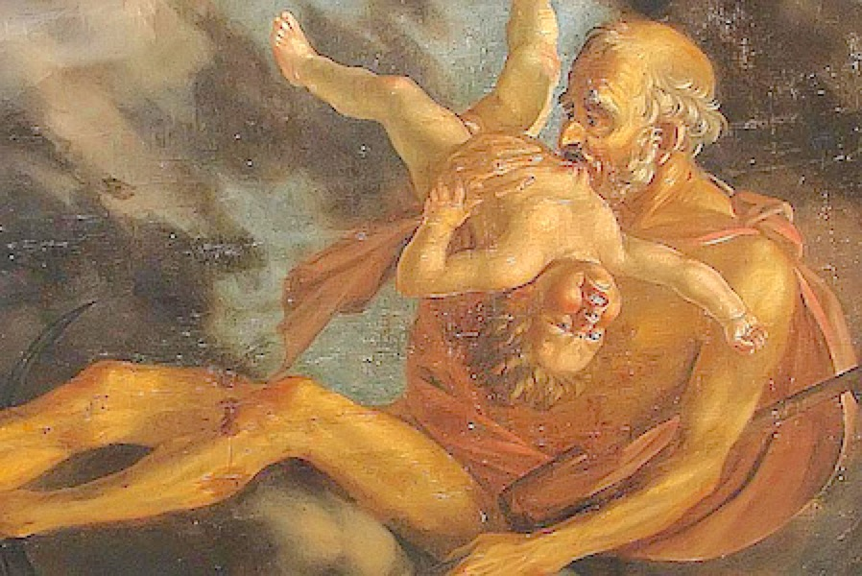
The psychological model of familial dysfunctionality continues:
Kronos allows his children to be born, but swallows them = fear of replacement
• Kronos’ youngest son, Zeus, forces Kronos to regurgitate his siblings, becomes new king and swallows his first wife, destined to give birth to the one who would replace him. Further divine births lead to the status of the world at the time Hesiod composed.

Slide 10
In sum, behind the fantastic stories of the Greek creation myth lie biological, agricultural and psychological observations that reveal the logic behind western narratives about the origin of the cosmos. But note well: the Greeks, who came into the Balkan Peninsula ca. 2000 imported many of their stories from pre-existing Near Eastern and Egyptian that were in their times based on observation!

Slide 11
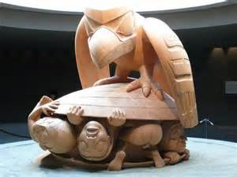
But where did people come from???
Humanity emerges from a clamshell
Ancient mythological cosmologies typically include the creation of humans (often from the earth) and an account of the human condition, which is typically grim.
Museum of Anthropology. Vancouver BC
In post-Hesiodic accounts, Prometheus created humans from clay. In the Theogony, we learn that humans (only men) and gods got together to determine who got what during the first sacrifice of an animal.

Slide 12
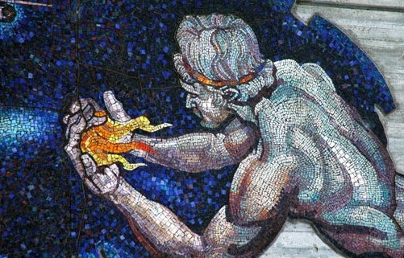
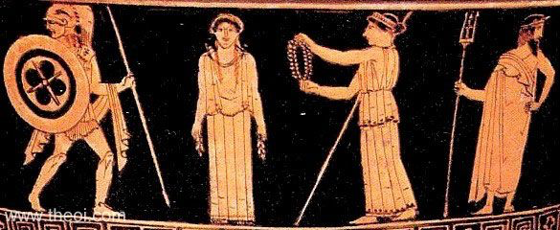
Favoring his new creation, Prometheus tricked Zeus into taking the skin and bones, while humans consumed the meat.
Zeus withdraws fire, which Prometheus steals.
Zeus has all of the gods create Pandora (= gifts from all) to punish men.

Slide 13
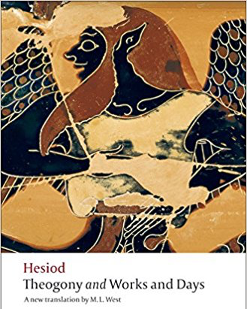
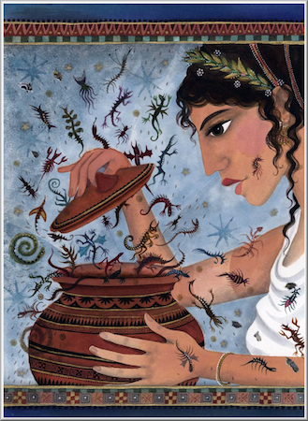
• In the Theogony, women are the source of suffering qua women*.
* Genesis. Like Eve’s fruit from the snake?
Together, both poems account for both the origin of the universe but also humans place within and the reason why life is difficult. But at the heart of this is observation:
life is difficult and we die.
• In the Works and Days, Hesiod’s other surviving poem, Pandora opens a jar (not box) full of evils, including death*.
* Genesis. Death is God’s punishment on humankind for Eve’s behavior.

