Slide 1
Applying Library of Congress Faceted Vocabularies
Adam L. Schiff
Principal Cataloger, University of Washington Libraries
aschiff@uw.edu
OLAC 2017 Conference
Richmond, Virginia
October 28, 2017

Slide 2
Outline
LCGFT
“General” Terms
Moving Image Terms
Music Terms
Cartographic Terms
LCDGT
Other Facets
Time Period of Creation
Language
Place of Creation
Country of Producing Entity
Music Medium of Performance
Facets and Your Discovery System

Slide 3
Background
LCSH for many decades included headings and subdivisions that were used to describe what a resource is rather than what it is about. Headings can describe numerous non-subject aspects, including:
Genre/form Symphonies World maps Comedy films Sports posters
Creator info Canadian fiction Film posters, Swiss American poetry--
Women authors African American children's writings
Music by Jewish composers
Place of origin Almanacs, Argentinian Folk music--Appalachian Region
Language Inuktitut poetry Short stories, Zambian (English)
Audience Young adult fiction Teen films Music--Dictionaries, Juvenile
Time period of creation Rock music--1961-1970 Tales, Medieval
Music medium of performance Piano quintets Concertos (Bassoon, flute, oboe)
Flutes (3) with orchestra
Notes:
I’ve used different colors to show the different aspects that are mixed in many LCSH terms and subject strings. Red indicates the genre/form aspect.

Slide 4
Background
Starting with genre/form in 2007, LC has been developing new controlled vocabularies to describe some of these aspects, with the long-term goal of limiting LCSH to describe what a resource is about and using the new vocabularies to describe what it is
LCGFT (2007- ): genre/form
LCMPT (2014- ): music medium of performance
LCDGT (2015- ): demographic groups (audience and creator/contributor
characteristics)
New MARC fields/subfields were created to record form of work (380), medium of performance (382), demographic group characteristics (385, 386), place of origin (370), and time period of creation (046 $k/$l and $o/$p, 388)
Existing MARC fields already existed for genre/form (655), language (008/35-37, 041), and country of production (257)

Slide 5
LCGFT
Library of Congress Genre/Form Terms

Slide 6
LC Genre/Form Terms
Draft LCGFT Manual is available at http://www.loc.gov/aba/publications/FreeLCGFT/freelcgft.html
Terms so far for: cartographic materials, “general” materials (e.g., dictionaries, encyclopedias), law materials, literature, moving images (films and television programs), music, radio programs and other non-musical sound recordings, and religious materials
SACO proposals for additional terms and revisions to existing terms may be made for all of the areas listed above
Upcoming project: ARLIS/NA Cataloging Advisory Committee is preparing an initial group of art terms (to appear late 2017 or 2018)
Potential addition for video game genres through a vocabulary being developed by ALA Subject Analysis Committee Subcommittee on Genre/Form Implementation Working Group on Genre/Form of Videogames. If not added to LCGFT, OLAC may sponsor it as a stand-alone list of terms.
Notes:
General terms were developed with the ALA Subject Access Committee Subcommittee on Genre/Form Implementation General Terms Working Group
Law terms were developed with the American Association of Law Libraries’ Classification and Subject Cataloging Policy Advisory Working Group
Literature terms were developed with the ALA Subject Access Committee Subcommittee on Genre/Form Implementation Working Group on LCGFT Literature Terms
Music terms were developed with the Music Library Association Bibliographic Control Committee Form/Genre Task Force
Religion terms were developed with the American Theological Library Association, coordinating with members of the Association of Jewish Libraries, the Catholic Library Association, and the Council on East Asian Libraries
From ALA/ALCTS/CaMMS Subject Analysis Committee Annual Conference, Chicago, Illinois June 24, 2017 Report from the Subcommittee on Genre/Form Implementation (http://connect.ala.org/files/ALA%20Annual%202017%20%20SAC%20GFIS%20Report.docx): “The Working Group (WG) on Genre/Form of Videogames selected 75 terms from an initial list of hundreds. The WG proceeded to create authority records, and by the time of ALA Annual they had already created records for 55 of the 75 terms. By ALA Midwinter 2018 the WG plans to add scope notes to authority records for all 75 genre terms. Conceivably the specialists at PSD will not be ready to incorporate the production of this new vocabulary to their current list of priorities in the near future. However the WG on Genre/Form of Videogames has been offered the option of adding the vocabulary to the Open Data Registry under the sponsorship of Online Audiovisual Catalogers (OLAC). In that case the G/F of Videogames would be published under the patronage of the Subject Analysis Committee (SAC) and the sponsorship of OLAC. The source code that would be used in bibliographic records would then be $2 olac. There might still be a chance that PSD will make a favorable decision by the time ALA Midwinter 2018 opens.”

Slide 7
Where Can You Find LCGFT Terms?
OCLC and SkyRiver Authority Records
Classification Web
Catalogers Desktop (if you have a Classification Web subscription too)
Library of Congress Genre/Form Terms PDF Files (https://www.loc.gov/aba/publications/FreeLCGFT/GENRE.pdf)
LC Linked Data Service (http://id.loc.gov/authorities/genreForms.html)
Library of Congress Authorities (http://authorities.loc.gov)

Slide 8
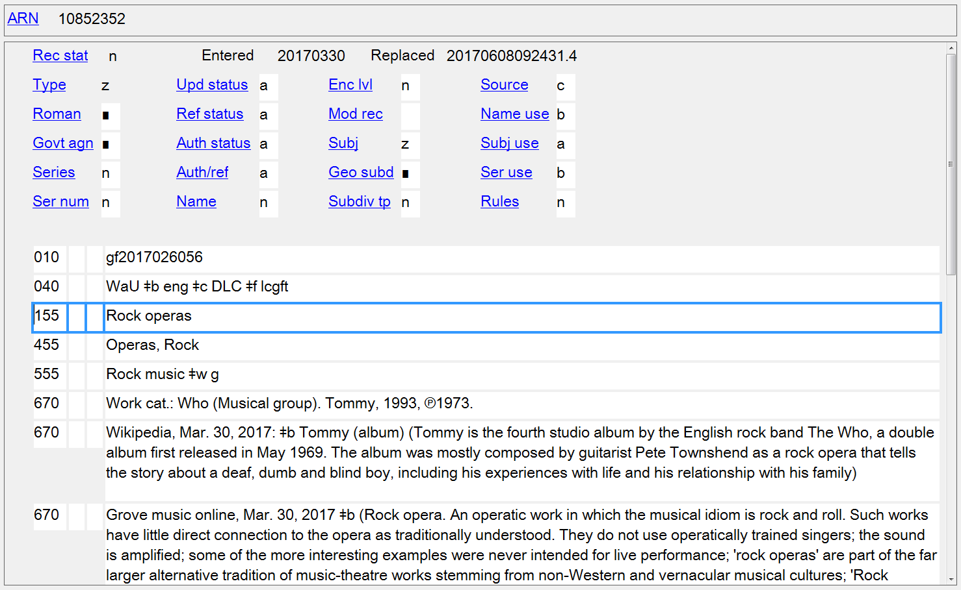
Notes:
LCGFT authority record in OCLC Connexion Client

Slide 9
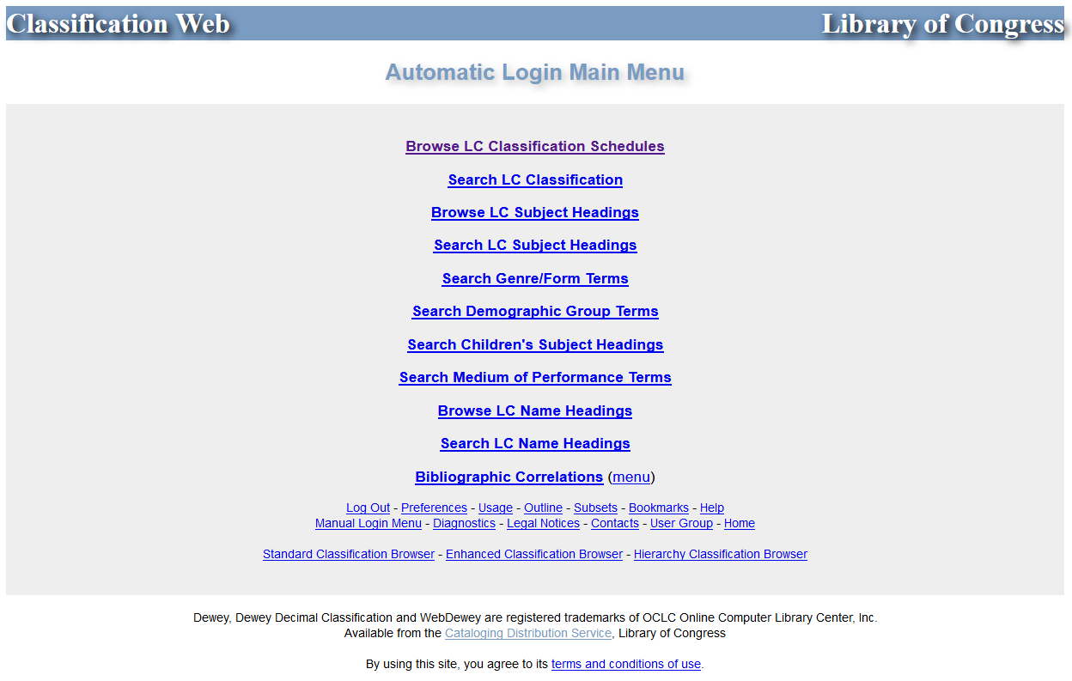
Notes:
Classification Web

Slide 10
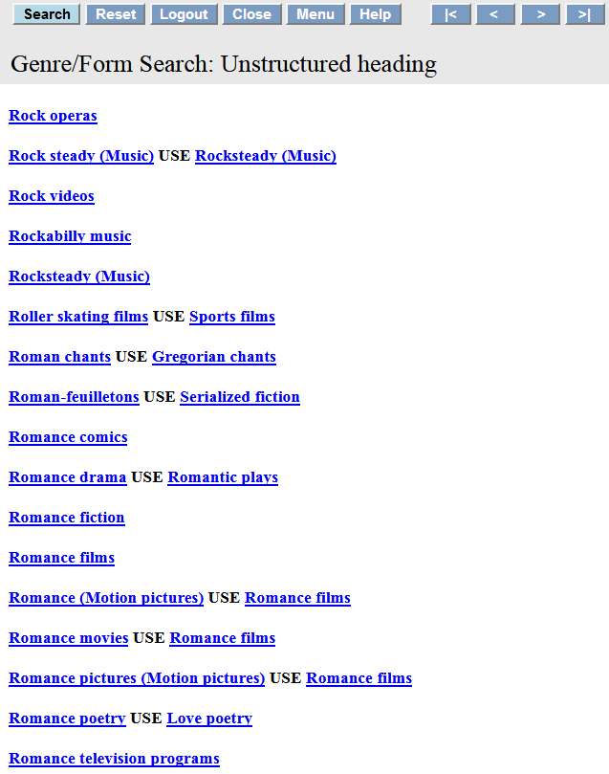
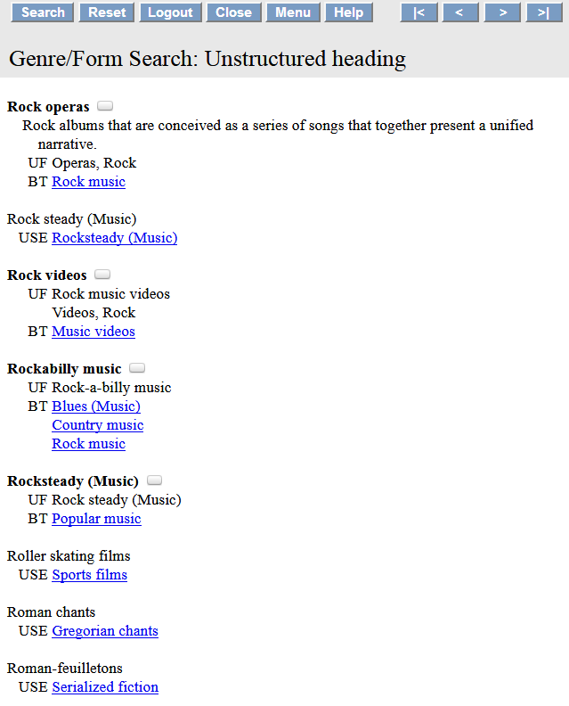
Scope note
Notes:
Classification Web search results for “Rock operas”. It’s important to check if there is a scope note to help guide you in the assignment of the term in question.

Slide 11
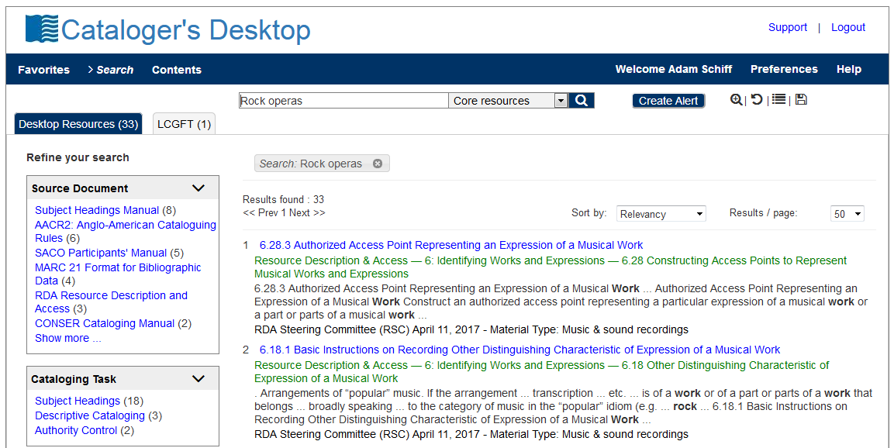
Notes:
Cataloger’s Desktop now includes searching of Classification Web, provided that you have a Class Web subscription.

Slide 12
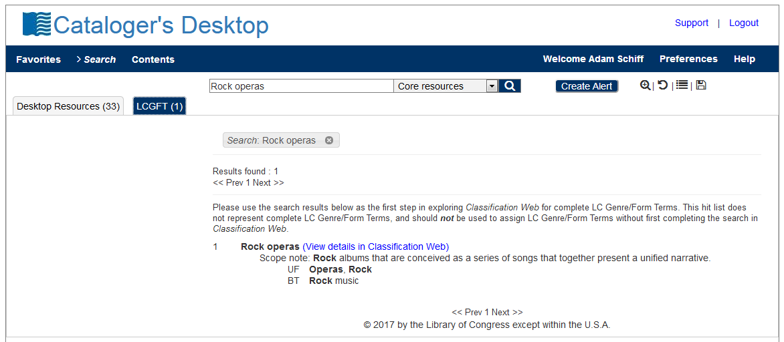

Slide 13
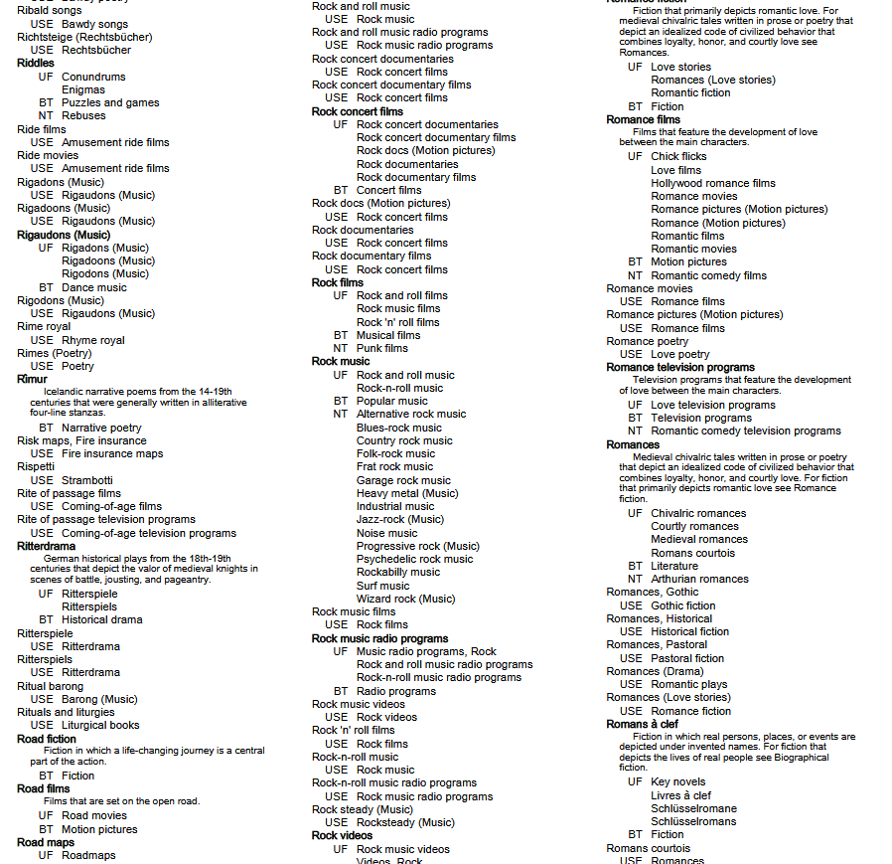
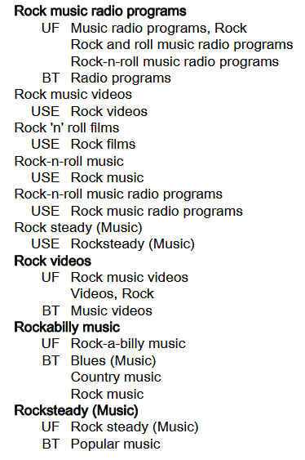
Notes:
ANIMATED SLIDE
This is a screenshot from PDF file of the 2017 Edition of the Library of Congress Genre/Form Terms for Library and Archival Materials (LCGFT). You will notice that our example, “Rock operas,” is not here. This illustrates the drawback of using the PDF file, as it is only compiled once a year, at the beginning of the year. Any terms added after will not be found in the PDF list until the following year.

Slide 14
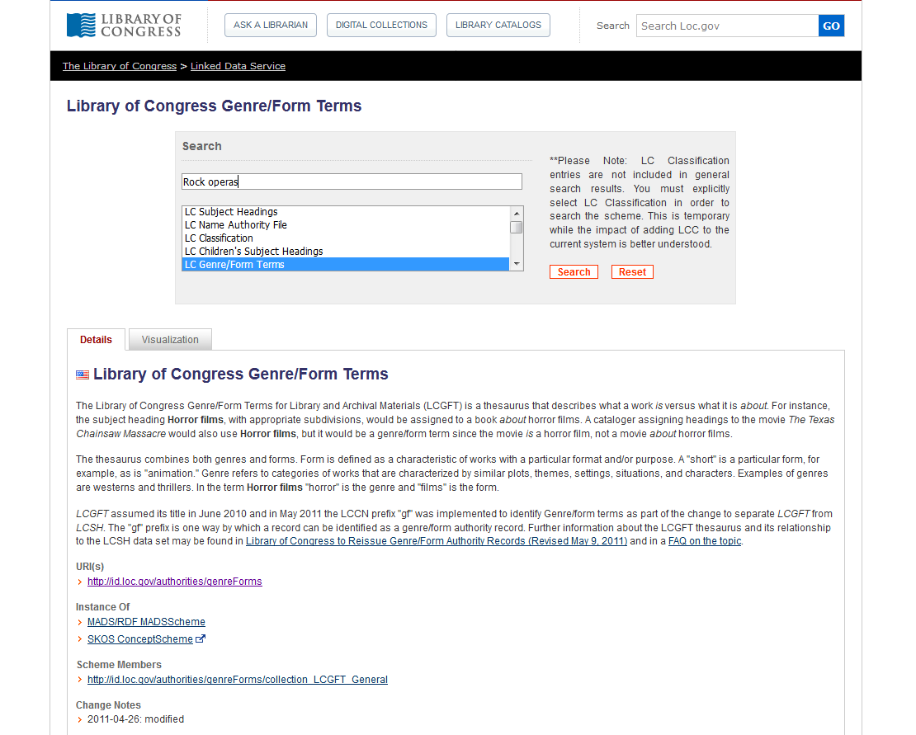
Notes:
LC Linked Data Service

Slide 15
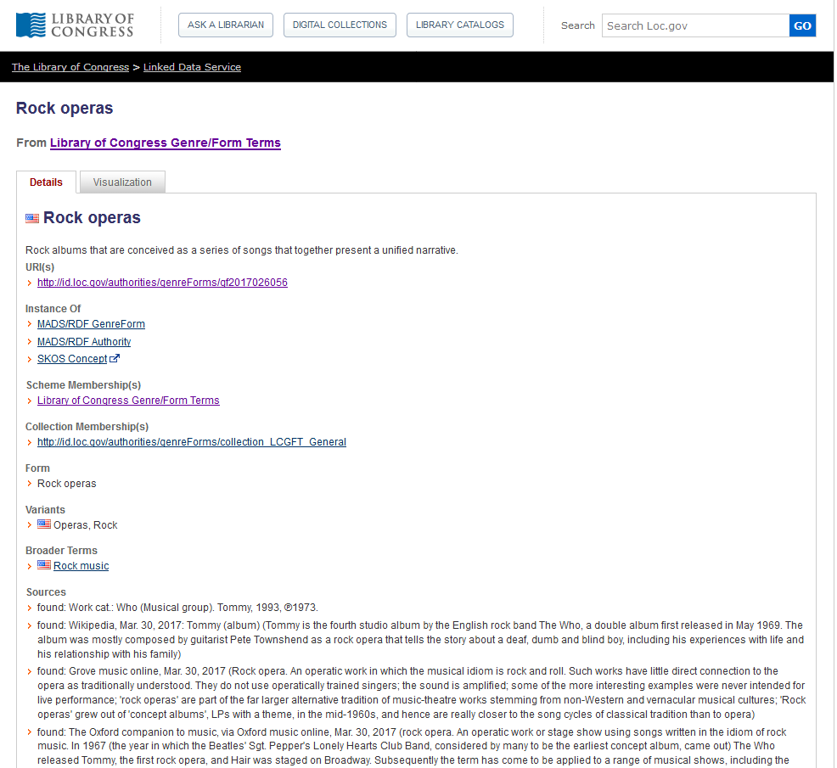
Notes:
LC Linked Data Service

Slide 16
Notes:
Library of Congress Authorities also includes authority records for LCGFT as well as LCSH.

Slide 18
LC Genre/Form Terms
General principles
Consult Introduction to Library of Congress Genre/Form Terms for Library and Archival Materials and the Library of Congress Genre/Form Terms Manual (http://www.loc.gov/aba/publications/FreeLCGFT/freelcgft.html)
Assigned both to individual works and to compilations
Terms that describe works and expressions are eligible: terms for the intellectual or artistic expression of the work and also the original mode of issuance, where applicable
Terms that describe manifestation attributes generally are ineligible (e.g., DVDs; Large print books; Paperbacks)
A few exceptional manifestation-level terms are in LCGFT (e.g., Internet videos; Video recordings for the hearing impaired), but they should not be considered precedents

Slide 19
LC Genre/Form Terms
General principles
Definition: “Genres and forms may be broadly defined as categories of resources that share known conventions. More specifically, genre/form terms may describe the purpose, structure, content, and/or themes of resources. Genre/form terms describing content and themes most frequently refer to creative works and denote common rhetorical devices that usually combine elements such as plot and setting, character types, etc. Such terms may be closely related to the subjects of the creative works, but are distinct from them.”

Slide 20
LC Genre/Form Terms
General principles
Exclusions: Several other characteristics of works and expressions are closely related to genres and forms, but are not eligible for explicit inclusion in LCGFT:
ethnicity, nationality, or other characteristics of creators (e.g., Korean drama; Uighur folk songs; Artists' writings; Films by children; Music by women composers; Shinto poetry; Taoist music; Mexican American posters)
intended audience (e.g., Children’s stories; Young adult drama; Music for the hearing impaired)
time period of creation (e.g., Medieval music; Han poetry; 19th century maps)
language (e.g., Urdu wit and humor; Arabic films)
place of creation (e.g., East Asian periodicals; Southern African newspapers)
country of production (e.g., Canadian films; Mexican television programs)
geographic location (e.g., works set in Berlin)

Slide 21
LC Genre/Form Terms
General principles
Exclusions: Several other characteristics of works and expressions are closely related to genres and forms, but are not eligible for explicit inclusion in LCGFT:
the popularity of the work (e.g., blockbusters)
medium of performance (e.g., trumpet music)
terms that by their nature require a value judgment on the part of catalogers and users (e.g., racist films)
Excluded characteristics may be implicit within a genre or form (e.g., Fu is a Chinese poetic form from the Han Dynasty; Silent films generally come from a particular time period of the 20th century; Rubble films are set in the rubble of bombed-out European cities)
LCGFT has a few exceptional terms indicative of audience which should not be considered precedents (e.g., Children's films; Law for laypersons; Television programs for people with visual disabilities)

Slide 22
LC Genre/Form Terms
MARC coding
Use MARC 655 (Index Term--Genre/Form) and 380 (Form of Work) in bibliographic records
Use MARC 380 (Form of Work) and perhaps 372 (Field of Activity) in authority records
Include $2 lcgft in MARC fields when LCGFT terms are used
100 1_ Copland, Aaron, $d 1900-1990, $e composer.
240 10 Billy the Kid. $p Suite
245 10 Billy the Kid : $b ballet-suite / $c Aaron
Copland.
250 __ Orchestral score.
655 _7 Suites. $2 lcgft
655 _7 Ballets (Music) $2 lcgft
655 _7 Excerpts. $2 lcgft
655 _7 Scores. $2 lcgft
130 _0 Wo hu cang long (Motion picture)
380 __ Motion pictures $a Action and adventure
films $a Martial arts films $a Romance films
$a Film adaptations $a Fiction films $a
Feature films $2 lcgft
430 _0 Crouching tiger, hidden dragon (Motion
picture)
Notes:
The RDA element “Form of work” can be recorded in bibliographic records, but is much more likely to be used in authority records. If 655 is used in bib records, the use of 380 is probably redundant.
OLAC’s Best Practices for Cataloging DVD-Video and Blu-ray Discs using RDA and MARC21, version 1.0 (January 2015) does give a recommendation to include 380 in video records:
Best Practice Recommendation: Provide the form of work if readily ascertainable. Take terms from a controlled vocabulary (e.g., LCGFT, LCSH, etc.) and capitalize the first word to provide
consistency.
380 __ $a Television program.
380 __ $a Motion picture.
The examples given in the guideline, however, don’t follow the recommendation to take terms from a controlled vocabulary. If they did, they would be:
380 __ $a Television programs $2 lcgft
380 __ $a Motion pictures $2 lcgft

Slide 23
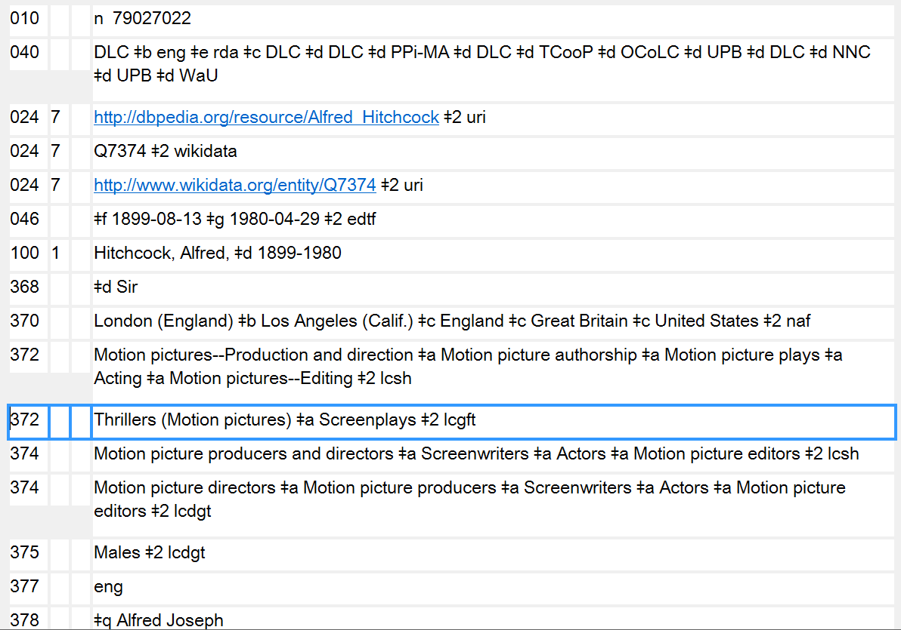
Notes:
Here’s an example of LCGFT terms used for Field of Activity (MARC 372). Alfred Hitchcock is well known as a director of suspense films and as a screenwriter.

Slide 24
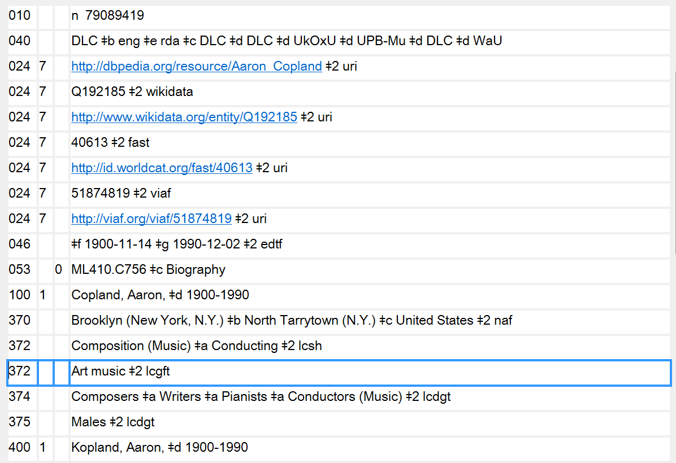
372 - Field of Activity in authority records may also contain genre/form terms
Notes:
Here’s another example of LCGFT terms used for Field of Activity (MARC 372). Aaron Copland was a composer of classical music, “Art music” in LCGFT.

Slide 25
LC Genre/Form Terms
General principles
May use subfield $3 when a term only applies to a part of a resource
245 04 The gold rush ; $b plus, Pay day / $c Film de Dam ; written and directed by Charlie Chaplin.
655 _7 Comedy films. $2 lcgft
655 _7 Silent films. $2 lcgft
655 _7 Fiction films. $2 lcgft
655 _7 $3 Gold rush: $a Feature films. $2 lcgft
655 _7 $3 Pay day: $a Short films. $2 lcgft
Notes:
The slide shows an example of using $3 in the 655 field. The DVD being cataloged contains two films. Both of the films are comedy films, silent films, and fiction films, so the first three 655s in the record apply to all the works. However, one of the works is a feature film and the other is a short film. In this example, the titles of the works that the genre/form term applies to have been used in the $3. But anything appropriate can go into the subfield, e.g. volume numbers, “1st work”, “2nd work”, accompanying disc, and so on. Use whatever is appropriate and makes the most sense.

Slide 26
LC Genre/Form Terms
General principles
May use subfield $3 when a term only applies to a part of a resource
245 02 A German requiem : $b op. 45 / $c Brahms. Bartered bride overture / Smetana. Rhapsodie espagnole / Ravel.
655 _7 Art music. $2 lcgft
655 _7 $3 A German requiem: $a Requiems. $2 lcgft
655 _7 $3 Bartered bride overture: $a Overtures. $2 lcgft
655 _7 $3 Rhapsodie espagnole: $a Rhapsodies (Music) $2 lcgft
Notes:
An example of a sound recording with three different genre/forms of works. $3 may be used to identify the work to which the genre/form term applies. The first term, “Art music,” applies to the compilation as a whole.

Slide 27
LC Genre/Form Terms
General principles
May use subfield $3 when a term only applies to a part of a resource
245 00 Tennessee River Civil War driving tour.
300 __ 1 audio disc (approximately 18 min.) : $b digital ; $c 4 3/4 in. + $e 1 videodisc (approximately
23 min. : sound, color ; 4 3/4 in.) + 1 color map (27 x 19 cm, on sheet 44 x 28 cm, folded to 14
x 11 cm)
520 __ Driving tour of Civil War sites in Tennessee, specifically along the Tennessee River and
surrounding area. Includes audio tour CD with accompanying map. The map includes an
audio CD legend of attractions and GPS coordinates, and URLs to local area tourist websites.
The accompanying DVD covers the same sites referenced on both the audio CD and map.
655 _7 $3 CD: $a Audiobooks. $2 lcgft
655 _7 $3 CD: $a Guidebooks. $2 lcgft
655 _7 $3 Accompanying DVD: $a Travelogues (Motion pictures) $2 lcgft
655 _7 $3 Accompanying DVD: $a Nonfiction films. $2 lcgft
655 _7 $3 Accompanying DVD: $a Short films. $2 lcgft
655 _7 $3 Accompanying map: $a Tourist maps. $2 lcgft
Notes:
Here’s a multipart monograph consisting of an audio disc, videodisc, and map. The use of $3 in 655 helps to identify what LCGFT terms apply to what part of the resource.

Slide 28
LC Genre/Form Terms
General principles
Specificity applies to genre/form the same as it does to subjects. Assign LCGFT terms that are specific to the resource being cataloged. A seemingly broad term like Poetry is specific when you’re cataloging a collection of poems in many different forms
Assign genre/form terms only as they come readily to mind after a superficial review of the resource being cataloged
Assign genre/form terms that correspond to the cataloging treatment of the resource. If cataloging a continuing resource such as a periodical, a monographic series, or a collected set, assign terms that characterize the resource as a whole. If cataloging a work as an analytic, assign terms that characterize the analytic

Slide 29
LC Genre/Form Terms
General principles
Assign terms based on analysis of the resource being cataloged. Genre/form terms do not need to be justified by descriptive cataloging elements
Assign to the resource being cataloged genre/form terms that describe the resource as a whole. Sometimes one term is sufficient, while at other times a complement of terms is necessary
Assign broader or more general terms when it’s not possible to establish a more specific term, when an array of terms is needed (e.g., for an animated science fiction romance film, three terms are needed: Animated films, Science fiction films, Romance films), or when the LCGFT Manual includes special instructions to do this

Slide 30
LC Genre/Form Terms
General principles
It is permissible to assign both a broader and a narrower term (for a compilation that consists of a predominant genre or form but includes a “significant proportion” of works that would be assigned another term in the hierarchy)
Example: anthology of oi music that also includes a significant proportion of other types of punk rock: assign both Oi music and Punk rock music
If there is a predominant genre/form, assign that term first; if predominant genre/form needs two terms to express it, assign them first
Notes:
First bullet:
GFTM J 110 says “Note: The use of the phrase ‘significant proportion’ is deliberate. Catalogers should take the intent of the resource into account and display good judgment when assigning terms from
multiple levels of the hierarchy in this manner.”

Slide 31
LC Genre/Form Terms
General principles
Don’t assign genre/form terms to works that have no discernible genre/form (e.g., a history of U.S. foreign relations in the 20th century)
For resources with separate parts (e.g., text plus an extensive bibliography or a section of maps; book with accompanying disc) also assign separate terms for the individual parts or materials if they are judged to be significant. May use $3 to identify the part to which a term applies
Notes:
LCGFT Manual J 110

Slide 32
LC Genre/Form Terms
General principles
Number of terms
If a resource consists of two or three genres that make up a broader genre, and that broader genre includes no other than those two or three genres within its scope, assign the broader genre instead of the two or three narrower genres
Title: The best Rosh ha-Shanah and Yom Kippur music: music of the High
Holidays
Term assigned: High Holiday music (rather than Rosh ha-Shanah music and Yom Kippur music)
Notes:
LCGFT Manual J 110
6. Two or three related terms. If a term exists, or can be established (see J 120), that (1) represents the two or three genres or forms displayed by a resource, and (2) includes no other genres or forms within its scope, assign one term instead of two or three narrower terms.

Slide 33
LC Genre/Form Terms
General principles
Number of terms - Rule of Three
If a genre/form term includes in its scope more than three sub-genres or forms, but the resource being cataloged consists of only two or three of those sub-genres or forms, assign the appropriate two or three terms instead of the broader term
Title: Time machine: the history of Canadian 60’s garage, punk, and surf, 1985-95
Terms assigned: Garage rock music
Punk rock music
Surf music
not Rock music, the broader term, because it has more than three NTs
Notes:
LCGFT Manual J 110
7. Rule of three. If a genre/form term includes in its scope more than three sub-genres or forms, but the resource being cataloged consists of only two or three of those sub-genres or forms, assign the appropriate two or three terms instead of the broader term.
If a resource displays more than three of the narrower terms of a single broader term, assign the broader term unless the rule of four, described below, applies.

Slide 34
LC Genre/Form Terms
General principles
Number of terms - Rule of Three
If a resource displays more than three of the narrower terms of a single broader term, assign the broader term unless the rule of four applies
Number of terms - Rule of Four
For resources that display four sub-genres or forms of a broader term, if the four sub-genres or forms comprise only a small portion of the scope of the broader term (i.e., the broader term has many narrower terms in addition to the four in question), assign the four sub-genres or forms instead of the broader term.
Example: poetry anthology that consists of four Japanese forms: Haiku, Senryu, Tanka, and Kyōka. Assign the four specific terms rather than Poetry
Notes:
LCGFT Manual J 110
7. Rule of three. If a genre/form term includes in its scope more than three sub-genres or forms, but the resource being cataloged consists of only two or three of those sub-genres or forms, assign the appropriate two or three terms instead of the broader term.
If a resource displays more than three of the narrower terms of a single broader term, assign the broader term unless the rule of four, described below, applies.
8. Rule of four. In certain circumstances it may be preferable to assign terms for four sub-genres or forms of a broad term. If a term covers a broad range and each sub-genre or form comprises only a small portion of that whole range, assign the four sub-genres or forms. For example, a poetry anthology that consists of haiku, senryu, tanka, and kyōka may be assigned terms for those
four genres instead of the broad term Poetry.
LC practice: Do not exceed four sub-genres or forms under any circumstances.

Slide 35
LC Genre/Form Terms
General principles
Bring out or account for each genre or form in the title and subtitle if they accurately represent the genre(s) and/or form(s) of the resource and if they are useful for retrieval
If the title is general but the work is actually of a more specific genre and/or form, assign terms for the specific genre or form
If many genres and/or forms are listed on the title page in the manner of a table of contents, treat them as a table of contents
Follow additional instructions in the manual for kinds of resources and disciplines (e.g., moving images; radio programs)
Notes:
LCGFT Manual J 110

Slide 36
LC Genre/Form Terms
General principles
Objectivity: Avoid assigning terms that express personal value judgments and opinions about resources being cataloged. Consider the intent of the author or publisher, and if possible assign terms for this orientation without being judgmental (e.g., if collection says it’s humorous poetry, assign the appropriate term even if you don’t find the poems funny)
LCGFT terms are not authorized for any type of subdivision (no $x, $y, $z, or $v)
Not valid: 655 _7 Rock music $z Germany. $2 lcgft
655 _7 Rock music $y 2001-2010. $2 lcgft
Valid: 655 _7 Rock music. $2 lcgft
655 _4 Rock music $z Germany.
655 _4 Rock music $y 2001-2010.
Notes:
LCGFT Manual J 110
The last two valid examples are uncontrolled genre/form access points. They could be added in addition to the controlled form, but they may not be coded as being LCGFT.

Slide 37
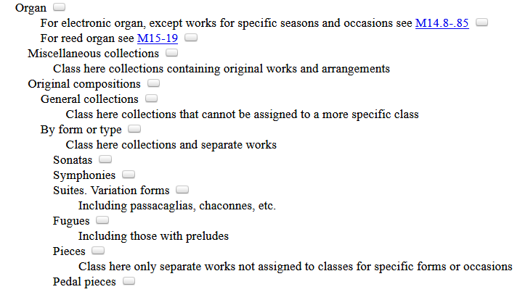
LC Genre/Form Terms
General principles
If the classification number reflects the genre/form of the resource, record that genre/form term first
050 _4 M10 $b .T289 2016
245 00 Ten preludes and fugues from the 19th and 20th centuries : $b for organ / $c compiled by
Esther Criscuola de Laix.
655 _7 Fugues. $2 lcgft
655 _7 Preludes (Music) $2 lcgft
655 _7 Scores. $2 lcgft
Notes:
Since this work has been classed in a number for fugues, the LCGFT term “Fugues” is given as the first 655 field.
"This volume features ten preludes, fugues, and prelude-fugue pairs from the early nineteenth through mid-twentieth centuries, by Charles Zeuner, Carl Czerny, Joseph Sulzer, and others. Included are pieces of a range of difficulties and lengths, with and without pedals, that are suitable for both service playing and concert use"--Back cover.

Slide 38
LC Genre/Form Terms
General principles
If no predominant genre/form and not classified in a number that reflects genre/form, then assign terms in any order considered to be most useful
If terms are assigned for the whole resource and for parts of the resource, assign terms for the whole before terms for the parts
245 10 Orchestral works / $c Henri Dutilleux.
505 0_ Symphony no. 1 -- Tout un monde lointain -- The shadows of time : for 3
children's voices and orchestra -- Métaboles -- Violin concerto : L'arbre des
songes -- Symphony no. 2 : Le double -- Sur le même accord : nocturne for
violin and orchestra -- Les citations : diptych for oboe, harpsichord, bass and
percussion -- Mystère de l'instant -- Timbres, espace, mouvement.
655 _7 Art music. $2 lcgft
655 _7 Symphonies. $2 lcgft
655 _7 Concertos. $2 lcgft
655 _7 Chamber music. $2 lcgft
Notes:
A sound recording of a number of kinds of orchestral works.

Slide 39
LCGFT Exercise 1
These are all valid LCGFT terms:
Animated films BT Motion pictures
Car-chase films BT Motion pictures
Circus films BT Motion pictures
Documentary films BT Nonfiction
films
Ethnographic films BT Documentary
films
Feature films BT Motion pictures
Fiction films BT Motion pictures
Nonfiction films BT Motion pictures
Short films BT Motion pictures
Stop-motion animation films BT
Animated films
You are cataloging a DVD compilation containing three feature films, and short animated film. Title A is a feature fiction car-chase film, Title B is a feature fiction circus film, Title C is a feature documentary about an indigenous Amazonian tribe. Title D is the short animated film fiction produced using stop-motion technique. Assign appropriate LCGFT terms in MARC for this compilation. Hint: consider using $3.
Notes:
Answer:
655 _7 Feature films. $2 lcgft
655 _7 Fiction films. $2 lcgft
655 _7 Car-chase films. $2 lcgft
655 _7 Circus films. $2 lcgft
655 _7 Ethnographic films. $2 lcgft
655 _7 Documentary films. $2 lcgft
655 _7 Nonfiction films. $2 lcgft
655 _7 Stop-motion animation films. $2 lcgft
655 _7 Animated films. $2 lcgft
655 _7 Short films. $2 lcgft
or
655 _7 $3 Title A ; Title B ; Title C: $a Feature films. $2 lcgft
655 _7 $3 Title A ; Title B ; Title D: $a Fiction films. $2 lcgft
655 _7 $3 Title A: $a Car-chase films. $2 lcgft
655 _7 $3 Title B: $a Circus films. $2 lcgft
655 _7 $3 Title C: $a Ethnographic films. $2 lcgft
655 _7 $3 Title C: $a Documentary films. $2 lcgft
655 _7 $3 Title C: $a Nonfiction films. $2 lcgft
655 _7 $3 Title D: $a Stop-motion animation films. $2 lcgft
655 _7 $3 Title D: $a Animated films. $2 lcgft
655 _7 $3 Title D: $a Short films. $2 lcgft
Note: OLAC best practices for moving images allows the assignment for terms from different levels of the same hierarchy. This is why Ethnographic films, Documentary films, and Nonfiction films and why Stop-motion animation films and Animated films can all be assigned.

Slide 40
LCGFT Exercise 2
You are cataloging the compilation Bred Any Good Rooks Lately?: A Collection of Puns, Shaggy Dogs, Spoonerisms, Feghoots & Malappropriate Stories. Assign LCGFT for this collection using MARC coding. Use these screenshots from Classification Web to choose the appropriate term(s). Consider whether the rule of three or rule of four applies.
Notes:
Answer:
655 _7 Puns. $2 lcgft
655 _7 Shaggy dog stories. $2 lcgft
655 _7 Spoonerisms. $2 lcgft
655 _7 Humorous fiction. $2 lcgft
In LCGFT, Feghoots is a UF for Shaggy dog stories.
The rule of three does not apply, because there are more than three sub-genres of humor here.
“If a resource displays more than three of the narrower terms of a single broader term, assign the broader term unless the rule of four, described below, applies.”
The rule of four applies in this case, because the broader term Humor has many additional narrower terms besides the four above.

Slide 41
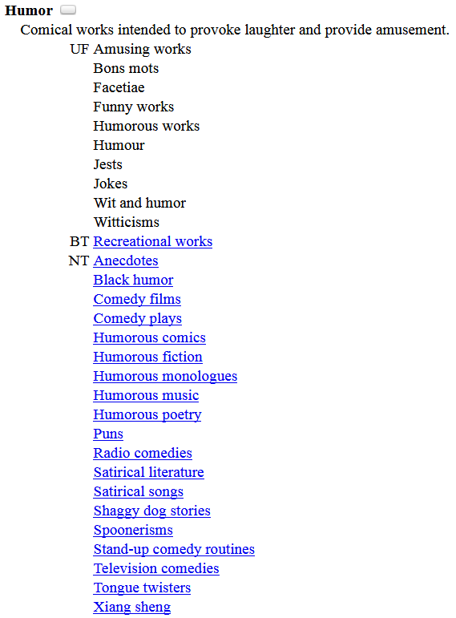
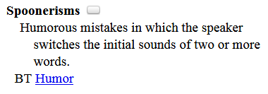
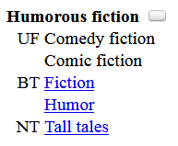
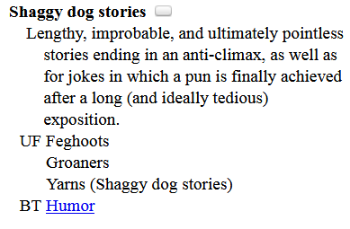
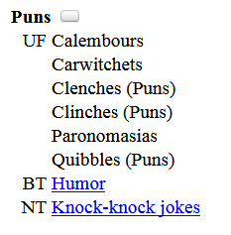
Notes:
Answer:
655 _7 Puns. $2 lcgft
655 _7 Shaggy dog stories. $2 lcgft
655 _7 Spoonerisms. $2 lcgft
655 _7 Humorous fiction. $2 lcgft
In LCGFT, Feghoots is a UF for Shaggy dog stories.
The rule of three does not apply, because there are more than three sub-genres of humor here.
“If a resource displays more than three of the narrower terms of a single broader term, assign the broader term unless the rule of four, described below, applies.”
The rule of four applies in this case, because the broader term Humor has many additional narrower terms besides the four above.

Slide 42
“General” Terms
Terms which are not specific to a particular discipline
Abridgments Almanacs Bibliographies Blogs
Conference papers and proceedings Diaries Dictionaries
FAQs Guidebooks Newsletters Picture books
Sayings Textbooks Yearbooks Zines
Terms for ephemera Calendars Menus Theater programs
Terms for some graphic materials Posters Postcards Paper dolls
Terms for puzzles and games KenKen puzzles Sudoku puzzles
Terms for types of toy and movable books Flip books Pop-up books
Some nonfiction terms Autobiographies Biographies Diaries
Essays Travel writing True crime stories

Slide 43
“General” Terms
Many have corresponding headings or form subdivisions in LCSH, but the LCGFT headings may not be identical. For example:
LCSH: $v Biography LCSH: $v Congresses
LCGFT: Biographies LCGFT: Conference papers and proceedings
LCSH: $v Handbooks, manuals, etc. LCSH: Imaginary histories
LCGFT: Handbooks and manuals LCGFT: Counterfactual histories
LCSH: Playbills LCSH: Sound effects books
LCGFT: Playbills (Posters) LCGFT: Sound books
LCSH: $v Tables LCSH: $v Exhibitions
LCGFT: Tables (Data) LCGFT: Exhibition catalogs
Notes:
All LCGFT terms are in the plural form, unlike some LCSH headings. Terms in LCSH with “etc.” were deemed undesirable, so you won’t find them in LCGFT. All terms were reevaluated to be sure that they reflected current and common usage and made sense as stand-alone genre/form terms.

Slide 44
“General” Terms
Divided into 10 “top” terms: Commemorative works; Creative nonfiction; Derivative works; Discursive works; Ephemera; Illustrated works; Informational works; Instructional and educational works; Recreational works; Tactile works
These are mainly for gathering the general terms into broad categories; they will rarely be assigned in a bibliographic record because more specific terms are available
Some of the more specific terms may be in the hierarchies of multiple top terms. For example, Handbooks and manuals has two BTs, Instructional and educational works and Reference works, which is an NT of Informational works

Slide 45
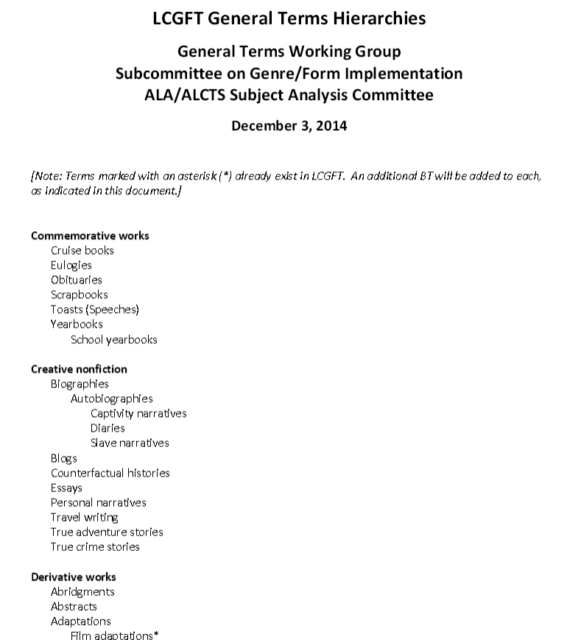
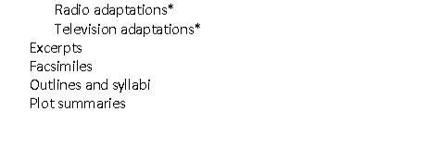
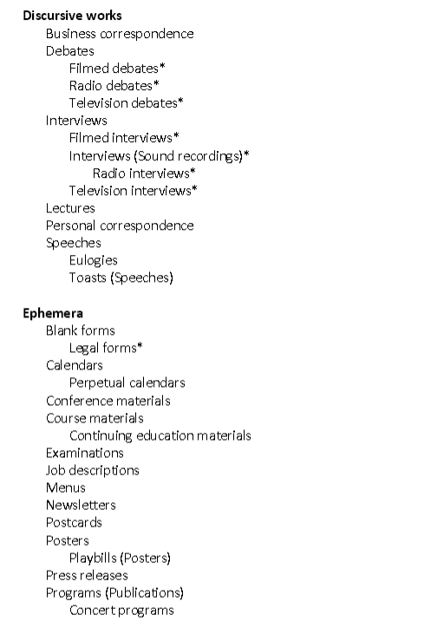
Notes:
LC has posted a hierarchical arrangement of the general terms that the GFIS Working Group created. Note that the current version online, dated December 3, 2014, does not reflect any changes that LC may have made to the records during the editorial process.

Slide 46
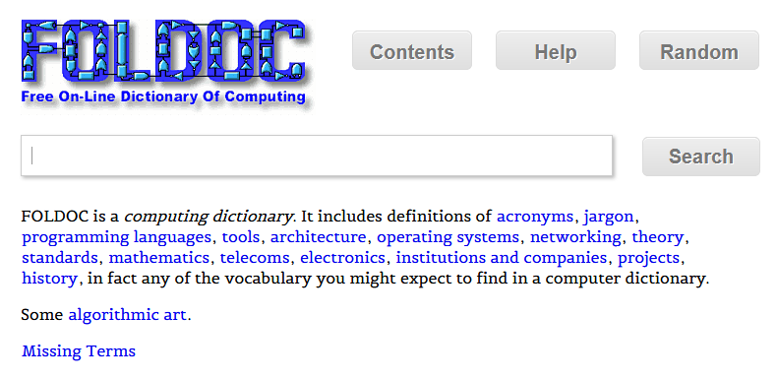
General Term Examples
245 00 FOLDOC : $b free on-line dictionary of computing / $c editor, Denis
Howe.
650 _0 Computer science $v Dictionaries.
650 _0 Computers $v Dictionaries.
650 _0 Microcomputers $v Dictionaries.
655 _7 Dictionaries. $2 lcgft
Notes:
Another very simple case where the LCGFT term is identical to the LCSH form subdivision.

Slide 47
General Term Examples
100 1_ King, Coretta Scott, $d 1927-2006, $e author.
245 10 My life, my love, my legacy / $c Coretta Scott King as told to the
Rev. Dr. Barbara Reynolds.
250 __ Unabridged.
300 __ 1 online resource (1 sound file (14 hr., 30 min.)) : $b digital
655 _7 Autobiographies. $2 lcgft
655 _7 Audiobooks. $2 lcgft

Slide 48
General Term Examples
245 00 Stink bugs of Oregon.
264 1_ Salem, OR : $b Oregon Department of Agriculture, Plant Protection and Conservation Program, Insect Pest Prevention and Management, $c [2017]
300 __ 1 poster ; $b color ; $c 46 x 31 cm
650 _0 Stinkbugs $z Oregon $v Posters.
655 _7 Wildlife posters. $2 lcgft
Notes:
LCGFT has the general term Posters, but also a number of more specific terms for kinds of posters. Other examples include: Environmental posters, Geological posters, Political posters, Propaganda posters, Travel posters.

Slide 49
General Term Examples
245 00 Travel writers / $c compilation, Steve Cleary.
300 __ 2 audio discs (150 min.) : $b digital, CD audio ; $c 4 3/4 in. + $e 1 booklet (13 unnumbered
pages : illustrations ; 12 cm).
500 __ "A mixture of radio broadcasts and live talks and readings"--Accompanying booklet.
505 0_ disc 1. Marooned on Elephant Island / Leonard D.A. Hussey (3:04). Speaking personally /
Rosita Forbes (7:48). The philosophy of exploration / Freya Stark (17:35). Nuptials of the
East and West / Sacheverell Sitwell (12:46). Interview at her home in Chandolin / Ella
Maillant ; interviewer, Bridget Carter (17:21). On the Bushmen of the Kalahari / Laurens
van der Post (19:10) -- disc 2. The time of my life / Peter Fleming (20:49). The empty
quarter / Wilfred Thesiger (16:02). The last fiesta / Laurie Lee (13:57). Turning points / Eric
Newby (11.28). Trieste and the meaning of nowhere / Jan Morris (6:02). By camel across
Sahara / Geoffrey Moorhouse ; interviewer, Robert Williams (4:55)..
655 _7 Travel writing. $2 lcgft
655 _7 Literary readings (Radio programs) $2 lcgft
655 _7 Interviews. $2 lcgft

Slide 50
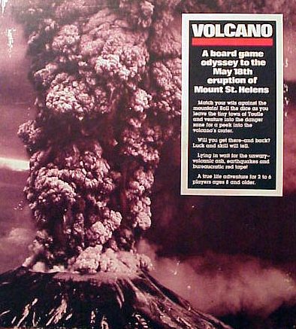
General Term Examples
245 00 Volcano : $b a board game odyssey to the May 18th eruption of Mount
St. Helens.
300 __ 1 game (1 board, 1 rules sheet, 6 colored move markers, 1 dice, 31
blue cards, 37 red cards, and 34 grey cards) : $b paper, cardboard, and
plastic ; $c 34 x 30 x 5 cm
655 _7 Board games. $2 lcgft

Slide 51
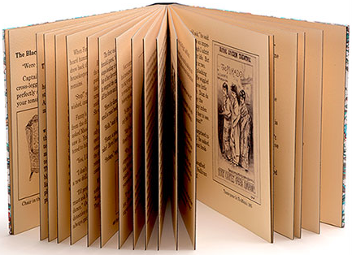
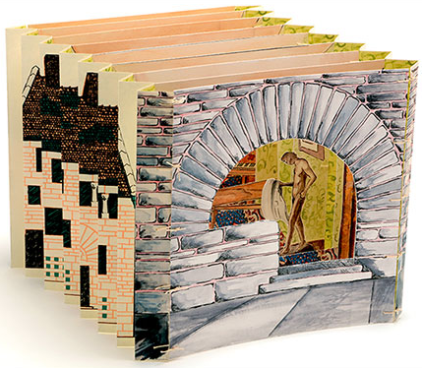
General Term Examples
100 1_ Widmer, Don, $e book artist.
245 10 Fanny and the doll corpse / $c by Don Widmer.
300 __ 2 volumes : $b color illustrations ; $c 21 x 25 cm,
in box 23 x 26 x 6 cm
500 __ Consists of two artist book structures housed in
a drop-spine box. One is in codex format; the other is a tunnel book.
655 _7 Picture books. $2 lcgft
655 _7 Tunnel books. $2 lcgft
655 _7 Historical fiction. $2 lcgft
655 _7 Detective and mystery fiction. $2 lcgft
655 _0 Artists' books.
Notes:
Artists’ books is not yet in LCGFT, so the term is coded here with a second indicator value of 0, meaning that the term is from LCSH. However, this term will be coming into LCGFT through the upcoming project to add art terms.

Slide 52
Moving Image Terms
Top terms: Motion pictures and Television programs. Only used for collections composed of multiple genres and/or forms
LCGFT Manual Instruction Sheet J 240:
The word films refers to resources that are originally recorded and released on motion picture film, on video, or digitally. The phrase television programs refers to those resources that were intended to be telecast.
Assign one of these terms: Fiction films; Nonfiction films; Fiction television programs; Nonfiction television programs
For films, assign either Short films (< 40 min.) or Feature films (40 min. or longer) as appropriate

Slide 53
Moving Image Terms
LCGFT Manual Instruction Sheet J 240:
For moving image resources produced with captions or sign language for viewing by the hearing impaired assign: Films for the hearing impaired or Television programs for the hearing impaired
For moving image resources with additional audio description provided for people with visual disabilities assign: Films for people with visual disabilities or Television programs for people with visual disabilities.
Local policy decision: instead of or in addition to above, may assign Video recordings for the hearing impaired and/or Video recordings for people with visual disabilities
Notes:
First and second subbullets: Note: The terms describe audiences, not genres or forms, and are provided in LCGFT as exceptions.
The terms Video recordings for the hearing impaired and Video recordings for people with visual disabilities, which likewise refer to audiences, are also provided as exceptions. Individual libraries may choose to develop local policies to assign them instead of, or in addition to, the above required terms.

Slide 54
Moving Image Terms
OLAC’s Library of Congress Genre-Form Thesaurus (LCGFT) for Moving Images: Best Practices (http://www.olacinc.org/sites/capc_files/LCGFTbestpractices.pdf)
Terms may be assigned from different levels of the same hierarchy if desired (e.g., Slasher films as well as Horror films; Sex comedy films as well as Comedy films)
Fiction vs. nonfiction: useful for limiting/faceting; guidelines for borderline cases
When to assign Short films and Feature films: films or videos that have been or are likely to have been originally exhibited theatrically or otherwise shown publicly and for films and videos similar in structure and style to films shown in theatrical venues where users may find these categories useful
Accessibility terms: base accessibility form terms on the format in hand, normally video recordings, rather than the original format. Films for the hearing impaired and Films for people with visual disabilities should thus only be used when cataloging moving images in film format. Television programs for [. . .] terms would not be used at all
Notes:
OLAC’s Library of Congress Genre-Form Thesaurus (LCGFT) for Moving Images: Best Practices (December 13, 2011)
Terms may be assigned from the same hierarchy: “First, OPACs, generally, neither do a good job of guiding the user through the syndetic structure nor make it easy to search both the larger category (e.g., Comedy films) and all
of its subcategories (e.g., Screwball comedy films, Parody films) at one time. Assigning terms at different levels would make it easier for users to do comprehensive searches.”
“Secondly, with topical headings, some specificity is lost by using broader headings in addition to headings that are specific to the item because it becomes impossible to retrieve items solely on the general, broader topic (e.g., if a library used Psychology as a subject heading on all psychology-related works as opposed to only general overviews). Genre terms are not specific in this same way. Specialized types of comedies are not lesser members of the general category of comedy.”
Fiction films/Nonfiction films and Fiction television programs/Nonfiction television programs: Though these terms may not seem useful for direct searching, they have great potential as search limits or in faceted interfaces, particularly when combined with genres that are not inherently either fiction or nonfiction, such as Biographical films.
Filmed or televised performances are considered recordings of events, and, therefore, nonfiction. For unclear cases, use cataloger judgment, taking into consideration the intent of the filmmakers and the likely perception of the audience.
Short films vs. Feature films: Do not apply to film serials, materials that were originally made for television, recordings of events such as lectures or conferences, instructional materials, live performances, unedited footage, or materials intended primarily as visual or conceptual art. When in doubt, apply the term.

Slide 55
Moving Image Terms
OLAC’s Library of Congress Genre-Form Thesaurus (LCGFT) for Moving Images: Best Practices (http://www.olacinc.org/sites/capc_files/LCGFTbestpractices.pdf)
Recommends order of genre/form terms: from specific terms to broader terms, followed by terms relating to intended audience, technique, derivation, duration, fiction/nonfiction element, form of distribution, and accessibility. Any local terms should follow the authorized LCGFT terms
Guidance on when to use Internet videos, Podcasts, and Webisodes
Internet videos: only when the piece in hand is on the Internet
Podcasts and Webisodes: for resources in their original format online as well as for DVDs containing them

Slide 56
Moving Image Examples
245 00 Monsters, Inc. / $c Walt Disney Pictures presents ; Pixar Animation Studios film ; producer, Darla K.
Anderson ; written by Andrew Stanton, Daniel Gerson ; directors, Pete Docter, David Silverman, Lee Unkrich.
650 _0 Monsters $v Juvenile drama.
650 _0 Factories $v Juvenile drama.
650 _0 Monsters, Inc. (Imaginary organization) $v Juvenile drama.
650 _0 Girls $v Juvenile drama.
650 _0 Toddlers $v Juvenile drama.
650 _0 Male friendship $v Juvenile drama.
650 _0 Nightmares $v Juvenile drama.
655 _7 Comedy films. $2 lcgft
655 _7 Monster films. $2 lcgft
655 _7 Children's films. $2 lcgft
655 _7 Computer animation films. $2 lcgft
655 _7 Animated films. $2 lcgft
655 _7 Feature films. $2 lcgft
655 _7 Fiction films. $2 lcgft
655 _7 Video recordings for the hearing impaired. $2 lcgft
655 _7 Video recordings for people with visual disabilities. $2 lcgft

Slide 57
Moving Image Examples
130 0_ Modern family (Television program). $n Season 6.
245 10 Modern family. $n The complete sixth season / $c Levitan Lloyd ; 20th Century Fox
Television ; created by Christopher Lloyd & Steven Levitan.
650 _0 Families $z United States $v Drama.
650 _0 Man-woman relationships $z United States $v Drama.
650 _0 Stepfamilies $v Drama.
650 _0 Gay fathers $v Drama.
650 _0 Adopted children $v Drama.
650 _0 Suburban life $v Drama.
651 _0 Los Angeles (Calif.) $v Drama.
655 _7 Television comedies. $2 lcgft
655 _7 Documentary-style television programs. $2 lcgft
655 _7 Fiction television programs. $2 lcgft
655 _7 Television series. $2 lcgft
655 _7 Video recordings for the hearing impaired. $2 lcgft

Slide 58
Music Terms
Use for both sound recordings and notated music
For notated music, there are additional terms that are assigned to bring out the notated aspect (e.g., Chorus scores; Fakebooks (Music); Musical sketches; Parts (Music); Piano scores; Scores; Songbooks; Vocal scores)
LCGFT Manual J 250 Music – “coming soon”
Until J 250 comes out, use: Music Library Association’s Best Practices for Using LCGFT for Music Resources

Slide 59
Music Terms
Music Library Association’s Best Practices for Using LCGFT for Music Resources (http://c.ymcdn.com/sites/www.musiclibraryassoc.org/resource/resmgr/BCC_Genre_Form_Task_Force/BestPractices160621.pdf)
Generally choose the most specific appropriate term available (e.g., Rock music instead of Popular music)
If work combines aspects of two genres/forms that are in different hierarchies, or exemplifies more than one genre/form, give multiple terms (e.g., for an art song, assign both Songs and Art music)
For notated music, give terms for the notated format in addition to any genre/form terms describing the musical work (e.g., for the score and set of parts for a string quartet, assign Chamber music, Scores, and Parts (Music))

Slide 60
Music Terms
Music Library Association’s Best Practices for Using LCGFT for Music Resources
For sound recordings, do not assign Sound recordings, but assign terms for particular types of sound recordings if appropriate (e.g., Film soundtracks, Live sound recordings, Original cast recordings, Remixes (Music), Visual albums)
Guidance on some specific terms (Art music and Folk music; Chamber music; Arrangements (Music); Excerpts)
LCGFT terms should be used in conjunction with LCMPT terms
For now, continue to use LCSH in field 650 according to the guidelines in the Subject Headings Manual

Slide 61
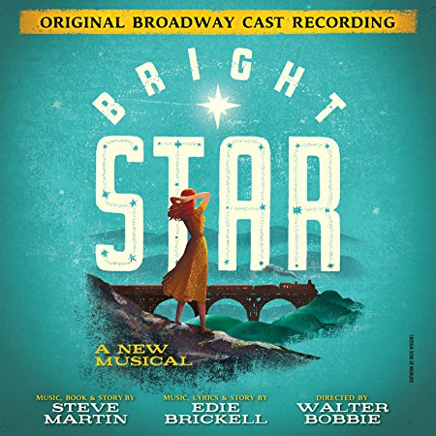
Music Examples
100 1_ Martin, Steve, $d 1945- $e composer, $e librettist.
245 10 Bright star : $b a new musical : original Broadway cast recording / $c
music, book & story by Steve Martin ; music, lyrics & story by Edie
Brickell.
300 __ 1 audio disc (61 min.) : $b digital ; $c 4 3/4 in.
650 _0 Musicals.
655 _7 Musicals. $2 lcgft
655 _7 Original cast recordings. $2 lcgft

Slide 62
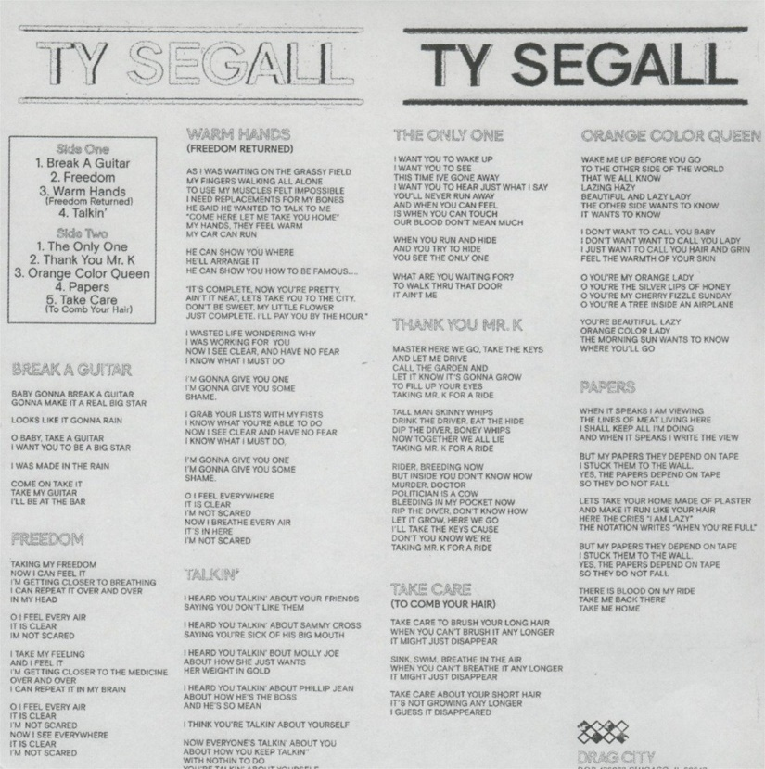
Music Examples
100 1_ Segall, Ty, $e composer, $e performer.
245 10 Ty Segall / $c Ty Segall.
264 _1 Chicago, IL : $b Drag City, $c [2017]
264 _4 $c ℗2017
300 __ 1 audio disc : $b analog, 33 1/3 rpm, stereo ; $c 12 in.
340 __ vinyl $2 rdamat
344 __ analog $2 rdatr
344 __ $c 33 1/3 rpm
344 __ $d microgroove $2 rdagw
344 __ $g stereo $2 rdacpc
511 0_ Ty Segall, guitar, vocals ; Emmett Kelly, guitar, vocals ; Mikal Cronin, bass, vocals on "Take
care" ; Charles Moothart, drums, percussion ; Ben Boye, piano, Wurlitzer.
650 _0 Garage rock music.
650 _0 Alternative rock music.
650 _0 Rock music $y 2011-2020.
655 _7 Garage rock music. $2 lcgft
655 _7 Alternative rock music. $2 lcgft
655 _7 Songs. $2 lcgft
Notes:
This is an example of a brand new recording issued on vinyl, which is still very popular and even growing in popularity again.

Slide 63
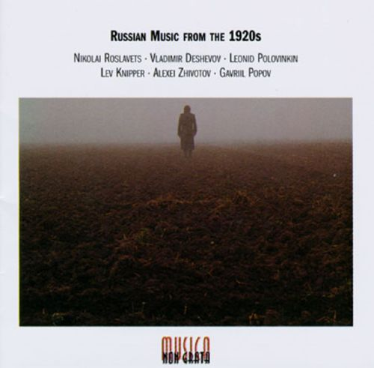
Music Examples
245 00 Russian music from the 1920s.
505 0_ Nocturne / Nikolai Roslavets (7:18) -- Rails : op. 16 / Vladimir Deshevov (1:05) -- Suite for 2 pianos. March ; Waltz ;
Humoresque / Leonid Polovinkin (9:58) -- Concerto for bassoon and strings / Lev Knipper (17:47) -- Fragments : for
nonet, op. 2 / Alexei Zhivotov (7:43) – Chamber symphony in C major, op. 2 / Gavril Popov (32:32).
650 _0 Quintets (Harp, oboe, violas (2), cello)
650 _0 Piano music.
650 _0 Piano music (Pianos (2))
650 _0 Suites (Pianos (2))
650 _0 Concertos (Bassoon with string orchestra)
650 _0 Nonets (Piano, bassoon, clarinet, flute, trombone, violins (2), viola, cello)
650 _0 Symphonies (Instrumental ensemble)
650 _0 Septets (Bassoon, clarinet, flute, trumpet, violin, cello, double bass)
650 _0 Music $z Russia $y 20th century.
655 _7 Art music. $2 lcgft
655 _7 Chamber music. $2 lcgft
655 _7 Suites. $2 lcgft
655 _7 Concertos. $2 lcgft
655 _7 Symphonies. $2 lcgft
Notes:
Note: one could use $3 in the 655s to specify which pieces are which genre/form.

Slide 64
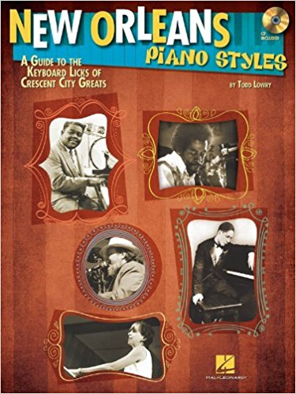
Music Examples
100 1_ Lowry, Todd, $e composer, $e author.
245 10 New Orleans piano styles : $b a guide to the keyboard licks of Crescent City
greats / $c by Todd Lowry.
__ 1 score (77 pages) : $b illustrations ; $c 31 cm + $e 1 audio disc (4 3/4 in.)
348 __ score $2 rdafnm
500 __ Accompanying CD contains demonstrations of all the musical examples in the book
as recorded by Brent Edstrom.
500 __ "Learn to play the piano styles of Jelly Roll Morton, James Booker, Fats Domino,
Professor Longhair, Allen Toussaint, Harry Connick Jr., Dr. John, and more"--Page 4
of cover.
650 _0 Piano $v Methods (Jazz)
650 _0 Piano $v Methods (Jazz) $v Self-instruction.
650 _0 Jazz $z Louisiana $z New Orleans.
655 _7 Jazz. $2 lcgft
655 _7 Methods (Music) $2 lcgft
655 _7 Scores. $2 lcgft

Slide 65
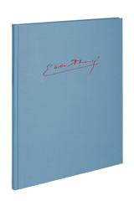
Music Examples
100 1_ Fauré, Gabriel, $d 1845-1924, $e composer.
240 10 Instrumental music. $k Selections
245 10 Berceuse pour violon et orchestre, op. 16, N 50b ; $b Ballade pour piano et orchestre, op. 19, N 56b ;
Élégie pour violoncelle et orchestre, op 24, N 66b ; Romance pour violon et orchestre, op. 28, N 71b ;
Fantaisie pour piano et orchestre, op. 111, N 184b ; Concerto pour violon et orchestre, op. 14, N 47 /
$c Gabriel Fauré ; éditées par Peter Jost.
300 __ 1 score (lxii, 278 pages) : facsimiles ; $c 33 cm.
500 __ The 1st and 4th works originally for violin and piano; the 3rd work originally for cello and piano.
650 _0 Violin with orchestra, Arranged $v Scores.
650 _0 Ballades (Instrumental music) $v Scores.
650 _0 Piano with orchestra $v Scores.
650 _0 Cello with orchestra, Arranged $v Scores.
650 _0 Concertos (Violin) $v Scores.
655 _7 Art music. $2 lcgft
655 _7 $3 1st, 3rd-4th works: $a Arrangements (Music) $2 lcgft
655 _7 $3 2nd work: $a Ballades (Instrumental music) $2 lcgft
655 _7 $3 6th work: $a Concertos. $2 lcgft
655 _7 Scores. $2 lcgft

Slide 66
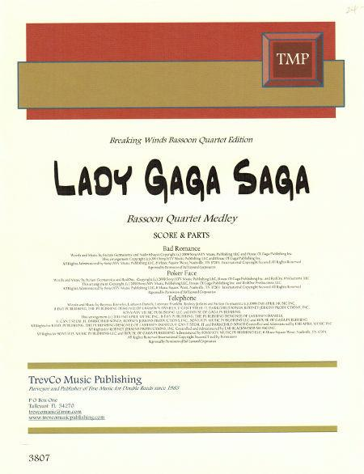
Music Examples
245 00 Lady Gaga saga : $b bassoon quartet medley.
300 __ 1 score (8 pages) + 4 parts ; $c 28 cm.
348 __ score $a part $2 rdafnm
500 __ A medley of songs made famous by Lady Gaga, including "Telephone,“
"Poker face," and "Bad romance," arranged for bassoon quartet.
650 _0 Woodwind quartets (Bassoons (4)), Arranged $v Scores and parts.
655 _7 Popular music. $2 lcgft
655 _7 Chamber music. $2 lcgft
655 _7 Medleys (Music) $2 lcgft
655 _7 Arrangements (Music) $2 lcgft
655 _7 Scores. $2 lcgft
655 _7 Parts (Music) $2 lcgft

Slide 67
Cartographic Materials
LCGFT Manual: No separate instruction sheet for these materials
Cartographic Resources Manual (2016) available through Cataloger’s Desktop
Replaces LC’s Map Cataloging Manual
Chapter 4. Subject Access:
Assign at least one genre form heading for all cartographic materials. Assign a more specific applicable heading or headings in preference to a general one, that is, Road maps rather than Maps.
There is no set order for genre form headings for maps.
However, for other cartographic materials, the first heading should be specific to the medium, such as Atlases, World atlases, Globes, or Relief models. This heading can then be followed, in no set order, by any another headings that apply, such as Physical maps or Road maps.

Slide 68
Cartographic Materials
Cartographic Resources Manual (2016) available through Cataloger’s Desktop
Chapter 4. Subject Access:
A subsidiary map mentioned in a title, subtitle, or cover, even if not indexed, frequently receives a subject or genre/form tracing depending on prominence, detail, typography, or other factors.
Subsidiary maps, especially insets, which portray a specific subject frequently receive subject or genre/form tracings, whether or not they are indexed.
The genre/form headings Maps, Tourist maps, and Road maps are all considered general headings, and the maps to which they apply are considered general maps. The use of two of the three general headings on the same work should be explained by the title, alternate title, series, or overall publishers’ intent, often clarified by a shows note.
Title: Tourist map of Britain. Title: Tourist road map of Britain.
Subject heading: Great Britain--Maps. Subject headings: Great Britain--Maps.
Genre/form heading: Tourist maps. Roads--Great Britain--Maps.
Genre/form headings: Tourist maps; Road maps
Notes:
See the Special Applications and Instructions section of chapter 4 of Cartographic Resources Manual for additional instructions on special kinds of cartographic resources.

Slide 69
Cartographic Examples
110 2_ Replogle Globes, $e cartographer.
245 10 Replogle world nation series 12 inch diameter globe / $c LeRoy
M. Tolman, chief cartographer ; Terrence E. Donovan, cartographer.
255 __ Scale 1:41,849,600. 660 miles per in. $c (W 180°--E 180°/N 90°--S
90°).
__ 1 globe : $b color, plastic coated paper gores over plastic core,
mounted on spindle crowned by a plastic clockface, in a metal
meridian half circle, on metal base ; $c 31 cm in diameter
500 __ Raised relief globe.
651 _0 Earth (Planet) $v Maps.
655 _7 Globes. $2 lcgft
655 _7 Relief models. $2 lcgft
655 _7 World maps. $2 lcgft

Slide 70
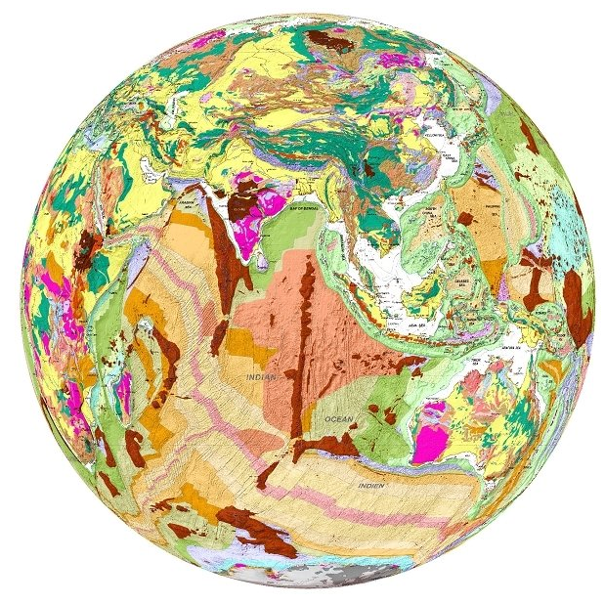
Cartographic Examples
110 2_ Real World Globes, $e cartographer.
245 10 Geological globe of the world = $b Globe géologique du monde / $c Real
World Globes.
246 31 Globe géologique du monde
255 __ Scale 1:27,900,000. 1 cm to 279 km.
300 __ 1 globe : $b color plastic-coated paper over foam core, mounted on
separate ring stand ; $c 46 cm in diameter + $e legend sheet (31 x 61 cm)
and measuring tape
650 _0 Geology $v Maps.
651 _0 Earth (Planet) $v Maps.
655 _7 Globes. $2 lcgft
655 _7 Geological maps. $2 lcgft
655 _7 World maps. $2 lcgft

Slide 71
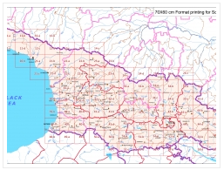
Cartographic Examples
110 2_ GeoLand Ltd., $e cartographer.
245 10 Georgia--topographical map 1:50 000 / $c GeoLand.
255 __ Scale 1:50,000 $c (E 39°52ʹ--E 46°45ʹ/N 43°51ʹ--N 41°17ʹ).
300 __ 100 maps : $b color ; $c 58 x 69 cm
500 __ General-content topographic quadrangle maps of the Republic of
Georgia also showing points-of-interest and foreign occupation zones.
__ Relief shown by contours and spot heights; relief shown by contours,
shading, spot heights, and rock drawings on some sheets.
651 _0 Georgia (Republic) $v Maps.
650 _0 Military occupation $v Maps.
655 _7 Topographic maps. $2 lcgft
655 _7 Quadrangle maps. $2 lcgft

Slide 72
Cartographic Examples
110 2_ Oxford University Press. $b Cartographic
Department, $e cartographer.
245 10 Oxford school atlas for Pakistan / $c all maps
drawn by the Cartographic Unit, Oxford University
Press, UK ; editorial advisor, Dr. Fazle Karim Khan.
__ Scales differ.
264 _1 Karachi, Pakistan : $b Oxford University Press, $c [2013]
300 __ 1 atlas (112 pages) : $b color illustrations, color maps ; $c 29 cm
651 _0 Pakistan $v Maps.
650 _0 Atlases $z Pakistan.
655 _7 Children's atlases. $2 lcgft
655 _7 World atlases. $2 lcgft

Slide 73
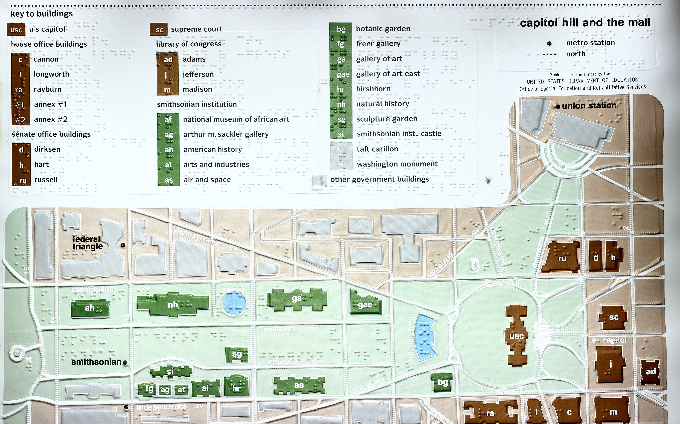
100 1_ Wiedel, Joseph W., $e cartographer.
245 10 Capitol Hill and the Mall / $c J.W.
Wiedel, Univ. of Md. ; produced for and
funded by the United States Department
of Education, Office of Special Education
and Rehabilitative Services.
500 __ Tactile map for the blind.
500 __ Covers the Mall west of the
Washington Monument.
500 __ Place-names in braille and lower-
case type.
500 __ Streets and government buildings in
raised relief.
651 _0 Capitol Hill (Washington, D.C.) $v
Maps.
651 _0 Mall, The (Washington, D.C.) $v
Maps.
650 _0 Public buildings $z Washington
(D.C.) $v Maps.
655 _7 Maps. $2 lcgft
655 _7 Cartographic materials for people
with visual disabilities. $2 lcgft
Cartographic Examples
Notes:
The LCGFT term Cartographic materials for people with visual disabilities is one of those exceptional terms that includes an audience. It’s possible that in the future these will be cancelled or changed to some other form, such as Tactile cartographic materials.

Slide 74
LCDGT
Library of Congress Demographic Group Terms

Slide 75
Audience and Creator/Contributor Characteristics
Explicit indications of audience and creators/contributors of works and expressions are out of scope for LCGFT (although currently there are a few exceptions)
If we stop using LCSH to describe what resources are, this information needs to be retained somewhere
LCSH: Almanacs, Children's LCSH: Young adult fiction, Korean
LCGFT: Almanacs LCGFT: Fiction (or Novels, Short stories, etc.)
LCSH: Jazz $z Lithuania LCSH: Music by African American composers
LCGFT: Jazz LCGFT: Music (or more specific terms)
LCSH: Music for the blind LCSH: Japanese essays $x Women authors
LCGFT: Music (or more specific terms) LCGFT: Essays
Notes:
From the Introduction to Library of Congress Demographic Group Terms:
“When LCGFT is fully implemented, LCSH form headings – including those that include both form and audience, or form and creator/contributor characteristics – will no longer be assigned to resources that are
for particular audiences, or by members of a particular demographic group. Those headings will be reserved for topical resources about those resources.”

Slide 76
Audience and Creator/Contributor Characteristics
MARC fields 385 and 386 were developed to have a place to record audience and creator/contributor characteristics
Library of Congress Demographic Group Terms (LCDGT) is a controlled vocabulary specific to demographic groups and was developed for use in 385 and 386 fields
Initial group of 387 terms were approved in 2015, and there were 1,090 approved terms as of April 2017
SACO proposals may be made for additional needed terms
LCDGT should be used with the Demographic Group Terms Manual (https://www.loc.gov/aba/publications/FreeLCDGT/freelcdgt.html)

Slide 77
MARC 385 – Audience Characteristics
Indicators both blank
Subfields:
$a – Audience term (R)
$b – Audience code (R)
$m – Demographic group term (NR)
$n – Demographic group code (NR)
$0 – Authority record control number or standard number (R)
$2 – Source (NR)
$3 – Materials specified (NR)
Notes:
Field Definition and Scope
A category of persons for which a resource is intended or a category of persons representing the intellectual level for which the content of a resource is considered appropriate.
If a demographic group is not specified then multiple audience characteristics from the same source vocabulary or code list may be recorded in the same field in separate occurrences of subfield $a and subfield $b. If a demographic group is specified then the characteristics in the field must all come from the same group. Terms from different source vocabularies are recorded in separate occurrences of the field.

Slide 78
MARC 386 – Creator/Contributor Characteristics
Indicators both blank
Subfields:
$a – Creator/contributor term (R)
$b – Creator/contributor term code (R)
$i – Relationship information (R)
$m – Demographic group term (NR)
$n – Demographic group code (NR)
$0 – Authority record control number or standard number (R)
$2 – Source (NR)
$3 – Materials specified (NR)
$4 – Relationship (R)
Notes:
Field Definition and Scope
A group category to which the creator(s) of a work or compilation of works, or the contributor(s) to an expression or compilation of expressions, belongs.
If a demographic group is not specified then multiple creator/contributor group categories from the same source vocabulary or code list may be recorded in the same field in separate occurrences of subfield $a and subfield $b. If a demographic group is specified then the categories in the field must all come from the same group. Terms from different source vocabularies are recorded in separate occurrences of the field.

Slide 79
MARC 385/386 $m and $n
$m – Demographic group term (NR)
$n – Demographic group code (NR)
During the development of the 385 and 386 fields, some commented that many class of persons headings belong to broader group categories that users might want to search or limit by. For example, children, tweens, teenagers, young adults, middle-aged persons, and senior citizens are all examples of age groups. Catholics, Baptists, Jews, Buddhists, Mormons, Muslims, Hindus, and Wiccans are all examples of religious groups.
LC PSD maintains the list of group terms and codes: http://www.loc.gov/standards/valuelist/lcdgt.html

Slide 80
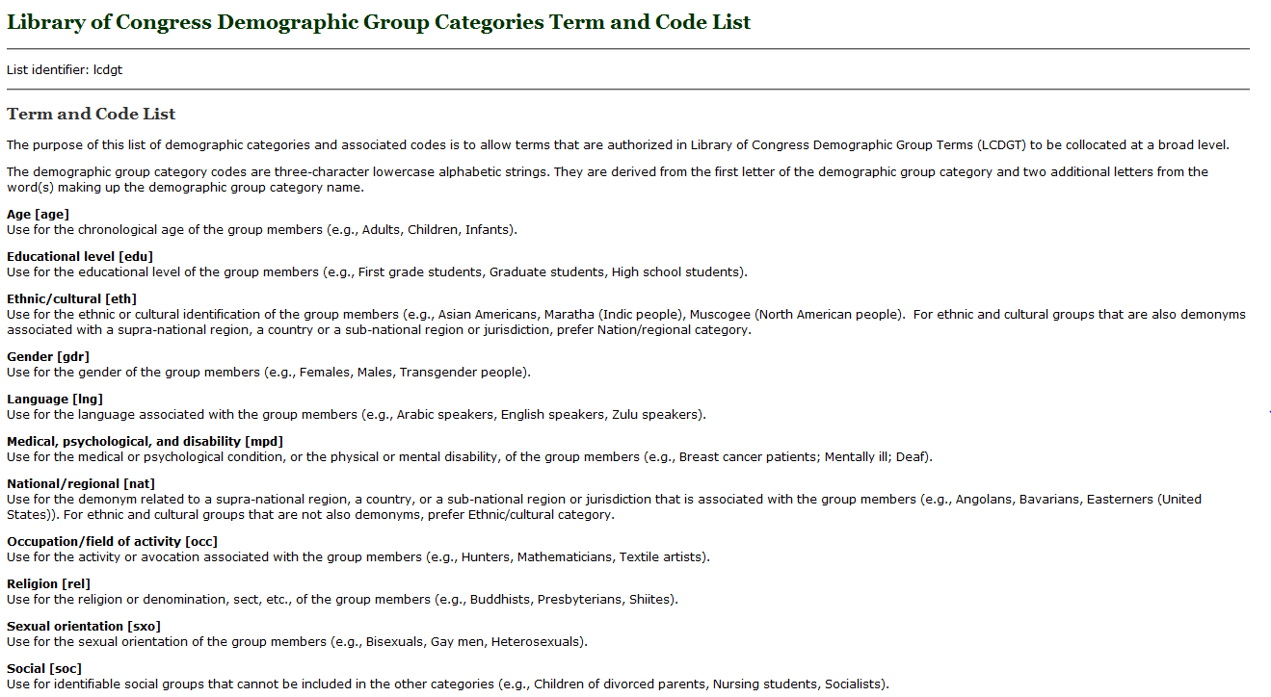
http://www.loc.gov/standards/valuelist/lcdgt.html

Slide 81
385/386 Fields
$m and $n are optional
$2 is optional, but recommended if terms recorded are from a controlled vocabulary. Use lcdgt for terms from LCDGT
May repeat $a when terms are from the same vocabulary:
386 __ Catholics $a Canadians $a Librarians $2 lcdgt
A work or works created by Catholic Canadian librarians
Must repeat the field if $m or $n is used and terms belong to different demographic categories:
386 __ $n rel $a Catholics $2 lcdgt
386 __ $n nat $a Canadians $2 lcdgt
386 __ $n occ $a Librarians $2 lcdgt

Slide 82
385/386 Fields
Must repeat field if terms are from different controlled vocabularies:
385 __ Teenagers $2 lcdgt
385 __ Adolescents $2 ericd
A work or works for teenagers
386 __ Indians, North American $2 mesh
386 __ American Indians $2 ericd
386 __ Indians of North America $2 lcsh
A work or works created by Native Americans
Notes:
Note: There currently is no collective term in LCDGT for Native Americans

Slide 83
385/386 Fields
Generally, break up compound terms into their components. For example:
386 __ Japanese American women teachers $2 lcsh
use instead:
386 __ Japanese Americans $a Women $a Teachers $2 lcdgt
or
386 __ Japanese Americans $2 lcdgt
386 __ Women $2 lcdgt
386 __ Teachers $2 lcdgt
A work or works created by Japanese American women teachers

Slide 84
386 Field
New $i (Relationship information) and $4 (Relationship) can be used to record relationship of the term(s) recorded and the resource described
100 1_ Messiaen, Olivier, $d 1908-1992, $e composer.
245 10 Turangalîla-symphonie / $c Messiaen.
511 0_ Pierre-Laurent Aimard, piano ; Dominique Kim, ondes Martenot ;
Berliner Philharmoniker ; Kent Nagano, conductor.
386 __ $i Composer: $a French $2 lcdgt
386 __ $i Instrumentalist (piano): $a French $2 lcdgt
386 __ $i Instrumentalist (ondes Martenot): $a South Koreans $2 lcdgt
386 __ $i Performer: $a Germans $2 lcdgt
386 __ $i Conductor: $a Americans $a Japanese Americans $a Sanseis $2 lcdgt
Notes:
$i - Relationship information
Designation of a relationship between one or more members of the demographic group recorded in the 386 field and the resource described in the 1XX/245 of the record. This may be an uncontrolled textual phrase or a controlled textual value from a list of relationships between bibliographic resources.
If gender was important, it could be included as another subfield $a in the 386 fields, the 386 fields could be doubled, or the $i could be repeated:
386 __ $i Composer $i Instrumentalist (piano) $i Conductor: $a Men $2 lcdgt
386 __ $i Instrumentalist (ondes Martenot): $a Women $2 lcdgt
Sanseis: third generation Japanese-Americans
OCLC will fix a validation error with $i in its December 3 validation install. You will be able to use $i in the 386 field after then.

Slide 85
386 Field
New $i (Relationship information) and $4 (Relationship) can be used to record relationship of the term(s) recorded and the resource described
130 0_ Gravity (Motion picture : 2013)
245 10 Gravity / $c directed by Alfonso Cuarón ; written by Alfonso
Cuarón & Jonás Cuarón ; produced by Alfonso Cuarón ; produced
by David Heyman ; executive producers, Nikki Penny, Chris
DeFaria, Stephen Jones ; a Warner Bros. Pictures presentation ; an
Esperanto Filmoj produktado ; a Heyday Films production ; an
Alfonso Cuarón film.
257 __ United States $a Great Britain $2 naf
386 __ $4 http://id.loc.gov/vocabulary/relators/fmd $i Film director: $a
Mexicans $a Men $2 lcdgt
Notes:
$4 - Relationship
Code or URI that specifies the relationship from the entity described in the record to the entity referenced in the field.

Slide 86
Which Vocabularies to Use?
Any vocabularies that are on the Subject Heading and Term Source Codes list or other appropriate specialized lists such as Occupation Term Source Codes
LCDGT is being developed as a preferred vocabulary to use in these fields
My advice:
1) use LCDGT as first choice
2) propose needed new terms through SACO whenever possible
3) use other vocabularies (LCSH, MeSH, AAT, etc.) as third resort
4) use uncontrolled or locally maintained terms as last resort
http://www.loc.gov/standards/sourcelist/subject.html

Slide 87
Where Can You Find LCDGT Terms?
Available in Classification Web and through LC’s Linked Data Service (id.loc.gov)
Now also searchable through Cataloger’s Desktop (if you have a Class Web subscription)
Annually created PDF file at https://www.loc.gov/aba/publications/FreeLCDGT/DEMOGRAPHIC.pdf
Netanel Ganin’s list at http://www.netanelganin.com/projects/lcdgt/lcdgt.html
New and changed terms are posted in the monthly lists at http://www.loc.gov/aba/cataloging/subject/weeklylists; free subscriptions to the monthly lists, via e-mail or RSS feed, can be arranged at http://www.loc.gov/rss
Full MARC 21 authority records in MARC UTF-8 format are free to download from http://classificationweb.net/LCDGT/ and in a variety of formats from the Linked Data Service
Authority records not available in OCLC Connexion or SkyRiver
Notes:
The primary source for access to the approved LCDGT terms is Classification Web. The terms can now also be searched in Cataloger’s Desktop if you also have a Classification Web subscription. There is a PDF file compiled annually posted on the LCDGT Manual web page. Authority records in MARC UTF-8 format may be freely downloaded from http://classificationweb.net/LCDGT/, and they are also available for download in a variety of formats from LC’s Linked Data Service, http://id.loc.gov. Hopefully, with enough interest, people will convince OCLC to make the terms available through Connexion, so you can search the authorities there.

Slide 88
LCDGT Authority Record
Authorized terms are tagged 150 even though they are used in 3XX fields
010 has prefix “dg” and 040 $f “lcdgt”
072 field contains code(s) for the demographic group categories a term falls into
072 code “eth” indicates that the established term Bosnian Swedes is an ethnic/cultural group

Slide 89
Why Use LCDGT?
LCDGT includes many terms that are not in LCSH:
language speakers Chinese speakers Korean speakers
demonyms for persons from states, provinces, regions, etc.
Wisconsinites Newfoundlanders Tuscans
non-U.S. ethnic groups formed as compound terms
Japanese Canadians Asian Australians Bosnian Swedes
members of named religious denominations and political parties
Church of Scotland members Fianna Fáil members (Ireland)
LCDGT terms may be different from LCSH:
phrase headings instead of [Main heading]--[Subdivision] strings
Breast cancer patients Bookstore employees
Native American tribal groups formed differently
Cherokee (North American people) vs. Cherokee Indians
new authority research might lead to choice of different authorized form
Notes:
In LCSH some class of persons headings are formed by adding subdivisions to a main heading:
Breast $x Cancer $x Patients
Bookstores $x Employees
There are no subdivided terms in LCDGT. All terms are formed in direct order as plural nouns.
Terms for Native American tribes are formed the same way in LCDGT as they are for other groups around the world. The term for the tribe or ethnic group is qualified by a qualifier in the form “([demonym] people)”. Hence “Cherokee (North American people)” and “Basques (European people)” and “Bengali (South Asian people)”. This provides consistency throughout the vocabulary and is less North American-centric.

Slide 90
Notes:
LCDGT via Classification Web

Slide 91
Searching by “Subject heading” will result in a browsable list beginning with the term searched
Use the established demographic group codes in the “Subject category code” search and you will get a list of all of the established terms that are members of that demographic group
Notes:
LCDGT via Classification Web

Slide 92
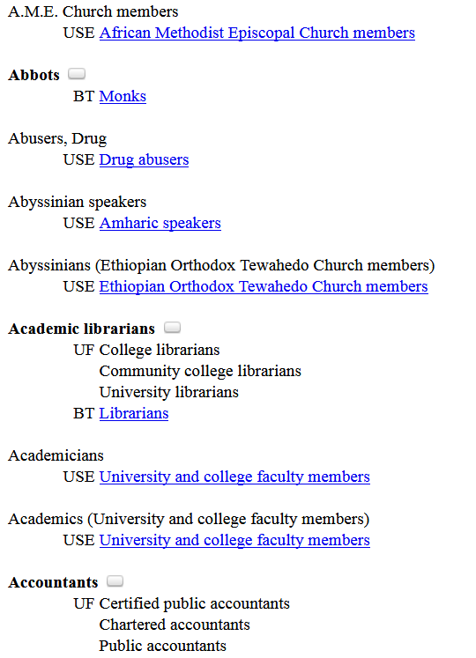
Click on bubble to view MARC record

Slide 93
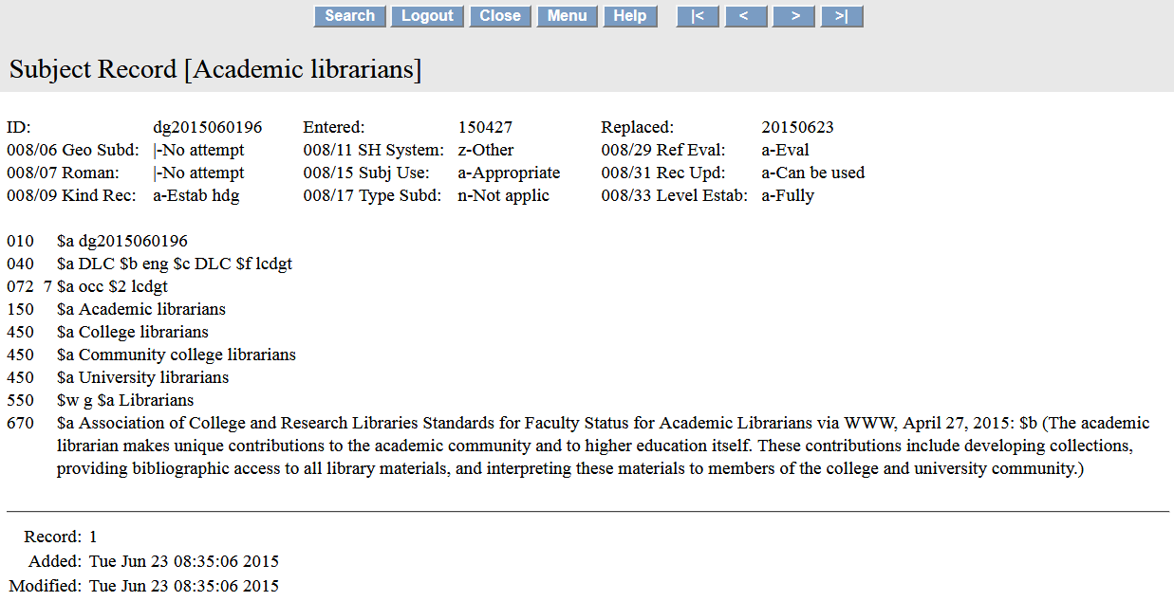
072 code indicates that the established term Academic librarians is an occupational group
Notes:
Authority record for LCDGT term Academic librarians viewed in Classification Web

Slide 94
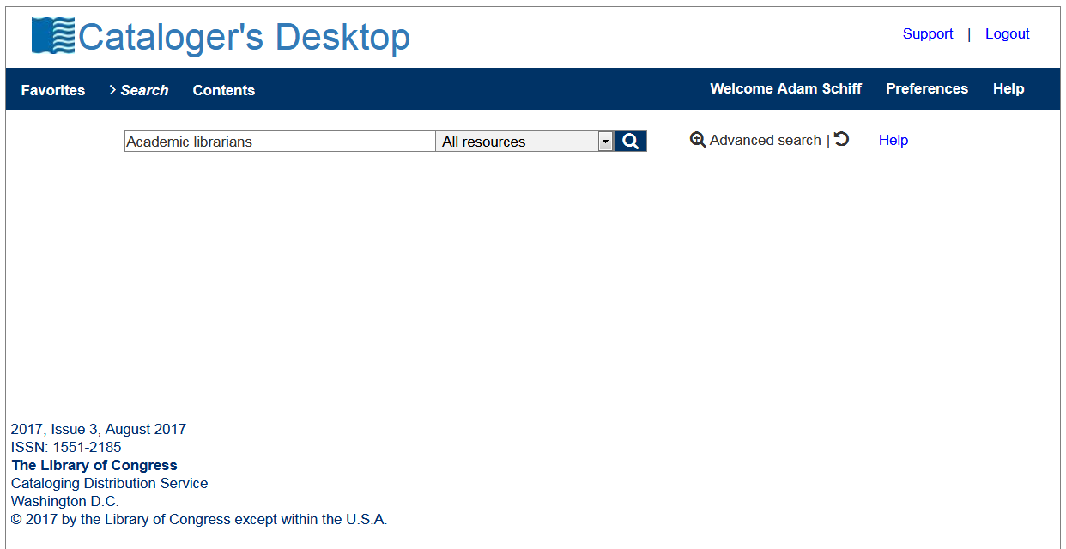
Notes:
If you have a subscription to both Classification Web and Cataloger’s Desktop, you can now search LCDGT terms through Cataloger’s Desktop.

Slide 95
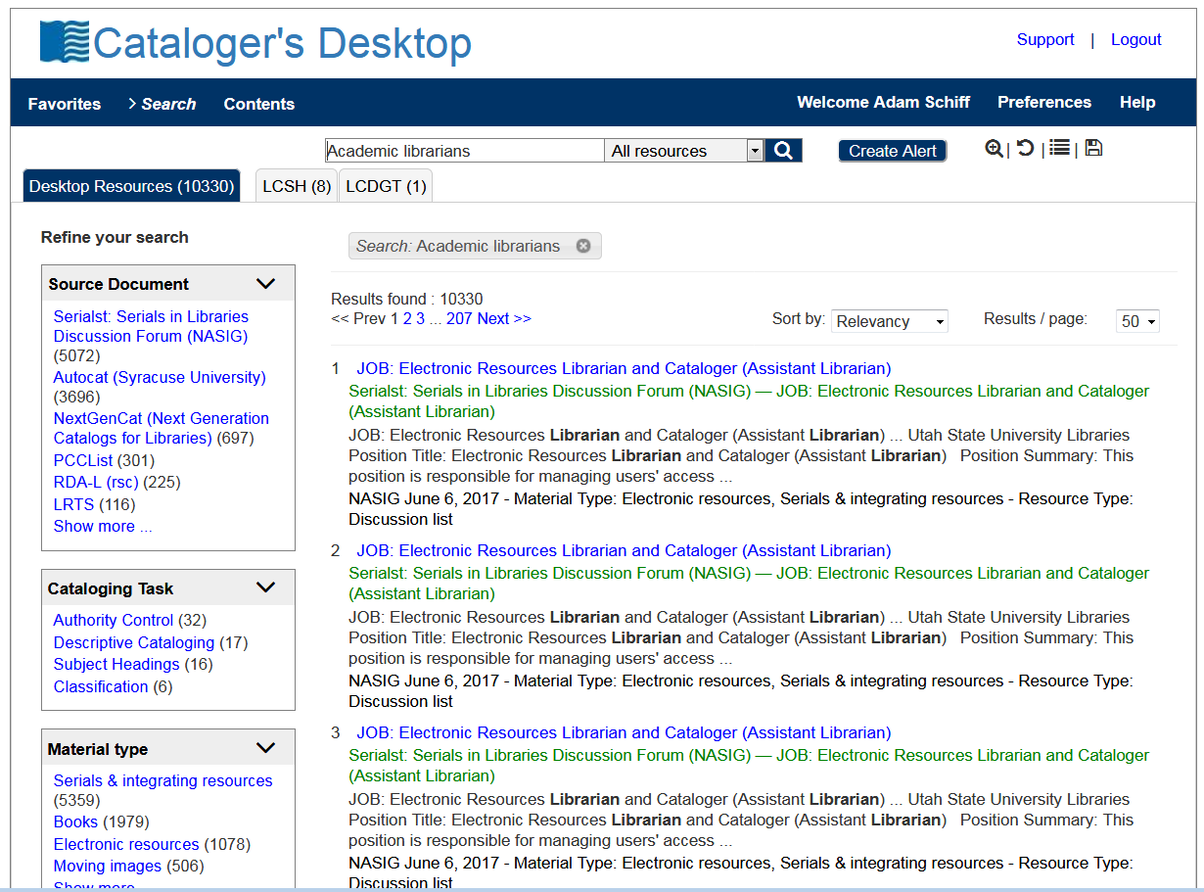
Notes:
If you have a subscription to both Classification Web and Cataloger’s Desktop, you can now search LCDGT terms through Cataloger’s Desktop.

Slide 96
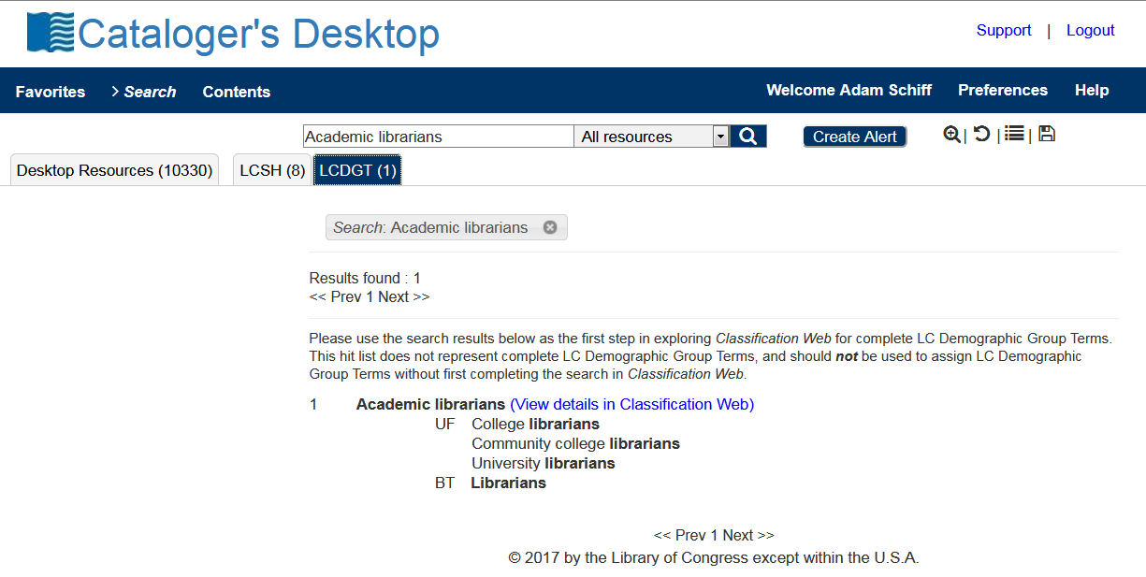

Slide 97
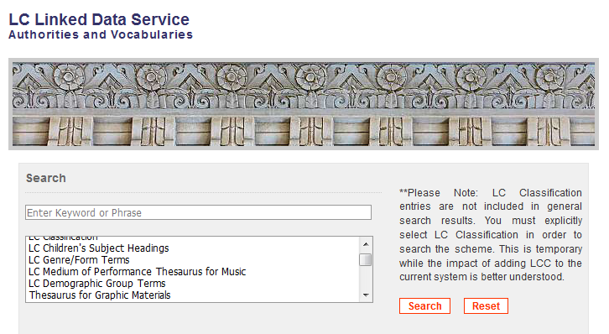
id.loc.gov
Notes:
LCDGT via the LC Linked Data Service

Slide 98
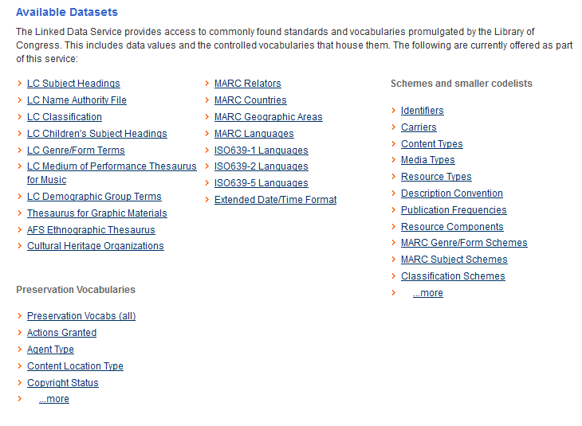

Slide 100
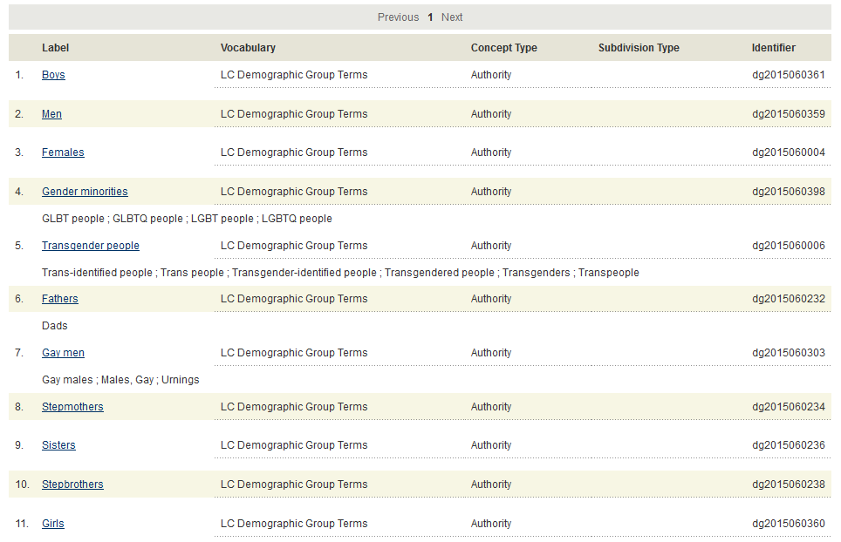
Notes:
Screen display after clicking on the Gender Group link

Slide 101
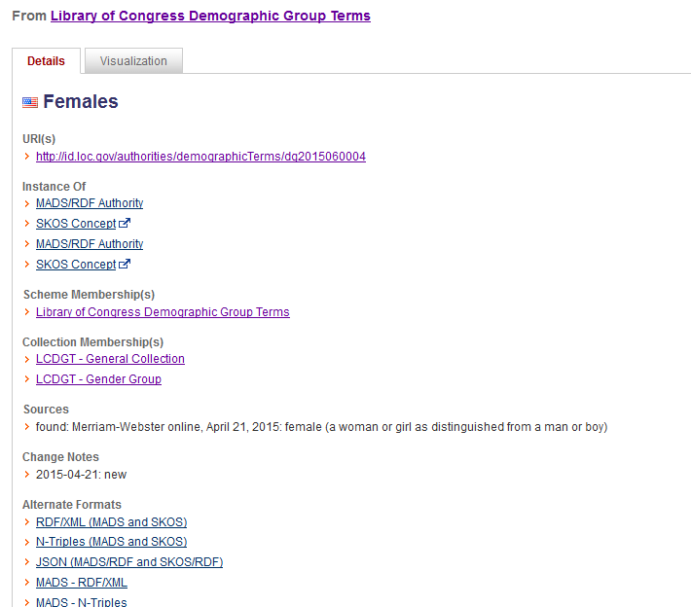

Slide 102
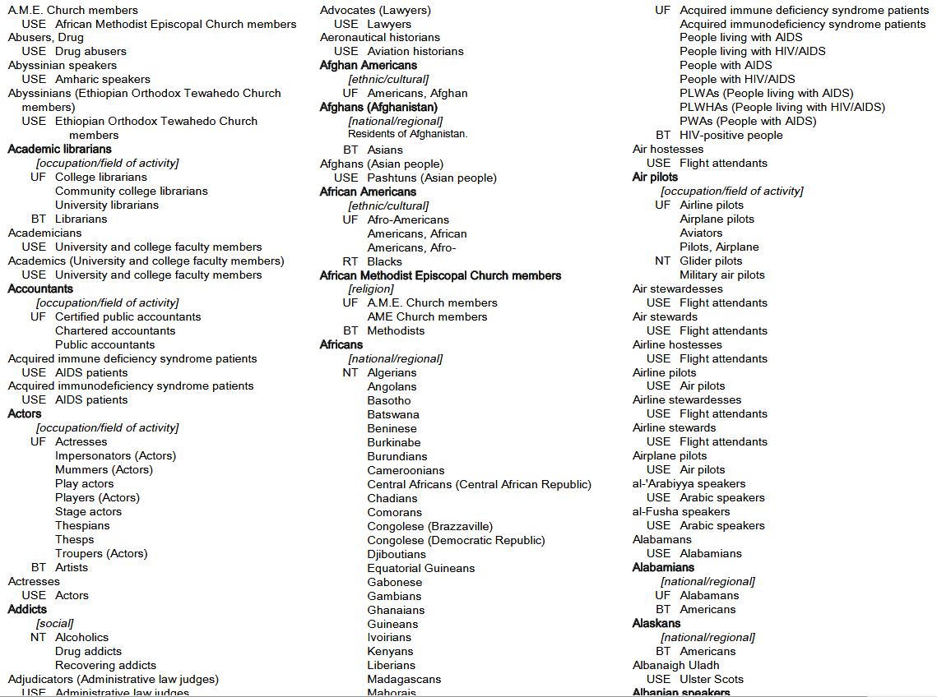
PDF file of terms on the LCDGT web page:
https://www.loc.gov/aba/publications/FreeLCDGT/freelcdgt.html
Caution: only updated annually
Notes:
PDF file of LCDGT on the LCDGT Manual website. This is only updated annually.

Slide 103
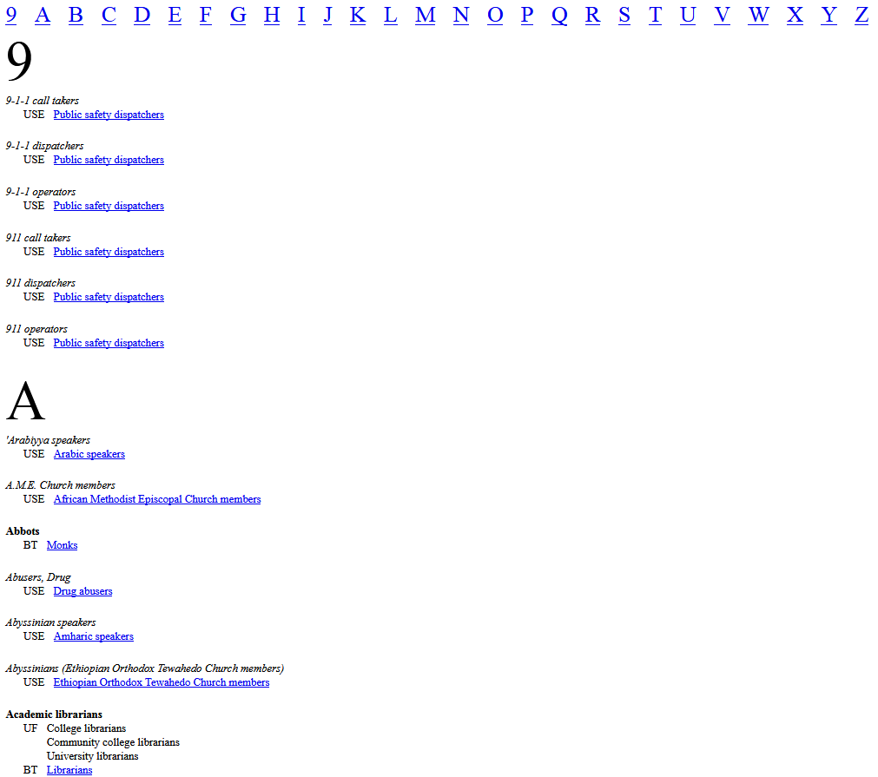
Netanel Ganin generates an up-to-date list of LCDGT monthly:
http://www.netanelganin.com/projects/lcdgt/lcdgt.html
Notes:
Netanel Ganin (former of Brandeis University, now at Library of Congress National Audio-Visual Conservation Center) is generating an alphabetical list of the terms for those who don’t have access to Classification Web.

Slide 104
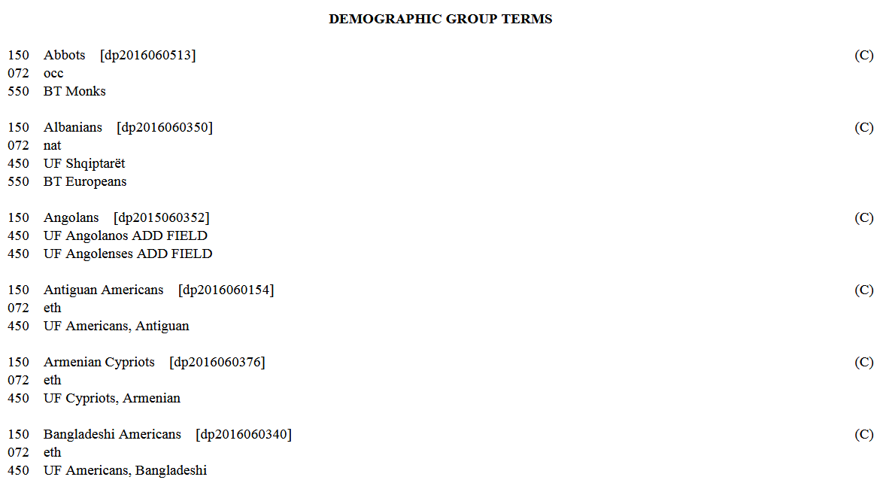
Notes:
New and changed demographic terms are published on the LC Subject Headings Monthly Lists at http://www.loc.gov/aba/cataloging/subject/weeklylists/ or https://classificationweb.net/approved-subjects/

Slide 105
Assigning LCDGT
https://www.loc.gov/aba/publications/FreeLCDGT/freelcdgt.html
Notes:
The LCDGT Manual, currently in a draft edition, is the source for guidelines and principles for assigning and establishing LCDGT terms. The manual is available in PDF form online. The final version, expected some time in 2018, will probably also be available through Cataloger’s Desktop.

Slide 106
Assigning LCDGT - Key Points
May add Audience Characteristics (field 385) and Creator/Contributor Characteristics (field 386) to bibliographic and authority records
LC practice: one term per field. Repeat field if recording multiple terms. Optionally include $n code.
385 __ Lawyers $2 lcdgt
385 __ Japanese speakers $2 lcdgt
or
385 __ $n occ $a Lawyers $2 lcdgt
385 __ $n lng $a Japanese speakers $2 lcdgt
Notes:
The Program for Cooperative Cataloging has not yet announced a particular practice or best practice.

Slide 107
Assigning LCDGT - Key Points
LCDGT Manual L 480 (Audience) and L 485 (Creators/Contributors)
Audience may be explicitly stated or implicit. Infer audience through examination of the resource (subject matter, format, etc.).
Liberally assign inferred audiences for juvenile resources, both fiction and nonfiction. Not restricted to age and educational level terms. For example, for a picture book on intercountry adoption for ages 5-9, you could assign both School children and Adoptees, if considered useful for those wishing to find a resource to help explain adoption to young children
No limit to number of terms that can be assigned
Notes:
L 480
1. b. Implicit indication of intended Audience.
Assign one or more terms that describe the intended audience and that come readily to mind from a superficial review of the resource, including the subject matter, format, etc. Assign such terms with caution, since even resources that seem to have a relatively narrow inferred audience may be useful to a wide variety of readers, depending on the viewpoints of the readers. In case of doubt, do not include terms for audiences that are only inferred.

Slide 108
Assigning LCDGT - Key Points
LCDGT Manual L 480 (Audience) and L 485 (Creators/Contributors)
Generally, all editions of a resource should get the same audience terms assigned, unless the audience has changed significantly. Generally, all editions of a resource by the same creator should get the same creator terms.
You may assign terms that overlap in meaning if they are in different group categories (e.g., Teenagers and High school students; Asian Americans and Americans)
Creator/contributor terms should be based on self-identification as a member of a particular demographic group
Avoid assigning terms based solely on a photograph or a person’s name. Gendered titles (Ms., Mr., Madame, contessa) and pronouns (he, she, elle, er, etc.) may be used, with caution, to choose terms describing a person’s gender
Notes:
Avoid assigning terms based on a photograph or picture of the creator, or based on the creator’s name, because they can be misleading regarding age, ethnicity, gender, etc. Gendered titles such as Ms., Mr., or Dottoressa (i.e., an Italian title for a female university graduate) may be useful in assigning terms describing gender, but they must be used with caution, as must pronouns such as he, she, and their equivalents in other languages.

Slide 109
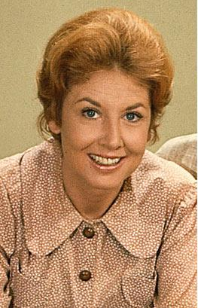
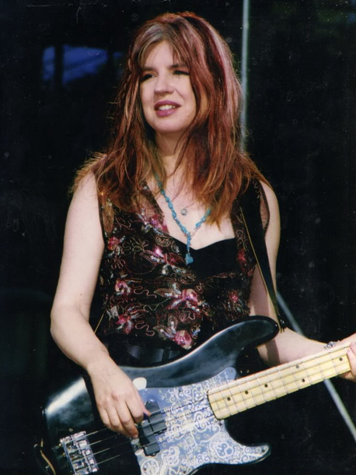
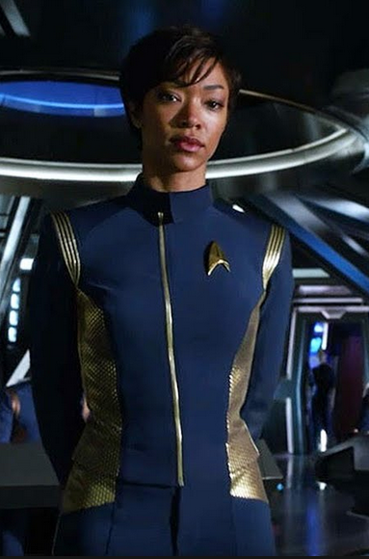
What do each of these people have in common?
Notes:
They are all named Michael.
Michael Learned, actress from the TV show The Waltons
Michael Steele, bassist and guitarist in bands such as The Bangles and The Runaways
Michael Burnham, fictional character on Star Trek: Discovery, portrayed by American actress Sonequa Martin-Green

Slide 110
Assigning LCDGT - Key Points
LCDGT Manual L 480 (Audience) and L 485 (Creators/Contributors)
Demographic terms assigned to one of a creator’s resources generally can be used on other resources created by the same person
Assign a term that is broader or more general than the group it is intended to cover only when it is not possible to establish a precise term, or when an array of terms is needed
Assign a separate term for each discrete element rather than compound terms (e.g., Japanese Americans and Women and Teachers, rather than the LCSH term Japanese American women teachers)
L 487 gives guidance on the order of the terms
If classification number does not reflect either the audience or creator/contributor characteristics, the order doesn’t matter

Slide 111
Assigning LCDGT - Key Points
Follow special instructions in L 510-L 560 if there are any
Age level and Educational level terms can both be assigned
385 __ Teenagers $2 lcdgt
385 __ Junior high school students $2 lcdgt
385 __ High school students $2 lcdgt
Assign Adults only when resource specifically states that as the audience. This can include statements found on a resource such as “Ages 10 and up”:
385 __ Preteens $2 lcdgt
385 __ Teenagers $2 lcdgt
385 __ Adults $2 lcdgt
Many resources may not have a specific audience and that’s OK. Resources with a general audience do not get any audience terms assigned.

Slide 112
Assigning LCDGT - Key Points
Follow special instructions in L 510-L 560 if there are any
Ethnic/cultural terms and nationality/regional terms may both be assigned, even if they share wording (e.g., Korean Americans and Americans)
Assign demonyms based on statements that indicate current or former residence in a place
Do not attempt to distinguish between people who were born and/or grew up in a place and those who moved to that place later in their lives. Do not attempt to discern immigration and naturalization status, except as explicitly indicated on the resource itself.
“… was born and raised in Australia and currently lives in Spain”
386 __ Australians $a Spaniards $2 lcdgt

Slide 113
Assigning LCDGT - Key Points
Follow special instructions in L 510-L 560 if there are any
When the audience or creator/contributor resides below the first-level administrative subdivisions of countries (e.g., a state, a province), assign terms for the first-level administrative subdivision (e.g., for a resident of San Francisco or someone who grew up in San Francisco, assign Californians)
Note: LC is still deciding whether and how to establish demonyms for places below the first-level administrative subdivision of a country
Possible interim practice:
If there is an well known demonym for the local place, assign it without a subfield $2 or with $2 local if you keep your own list of locally assigned terms
For creator/contributors, could also add 370 $g for the place of origin of work
For example: A collection of poetry written by people from Richmond, Virginia
370 __ $g Richmond (Va.) $2 naf
386 __ Richmonders or Richmonders $2 local
386 __ Virginians $2 lcdgt

Slide 114
Assigning LCDGT - Key Points
Follow special instructions in L 510-L 560 if there are any
Do not assign language terms just to reflect the language of a resource (e.g., don’t assign audience German speakers to every resource in German). Language terms for audience are usually assigned for resources that instruct speakers of one language who are learning another language.
Bilingual dictionaries may have two audience speaker terms assigned if speakers of both languages would find it useful
245 00 Collins English-Italian, Italian-English dictionary …
385 __ English speakers $2 lcdgt
385 __ Italian speakers $2 lcdgt
Monolingual language dictionaries would not be assigned a language audience term, e.g., don’t assign English speakers to the OED or to A Dictionary of Economics

Slide 115
Assigning LCDGT - Key Points
Do not assign a term from the Occupation/Field of Activity category when the term is redundant with the format of resource being cataloged. That is, don’t assign Composers as a creator characteristic of a score. It’s a score, so its creator must be a composer! Similarly, don’t assign Poets to every book of poetry. However, if you have a novel or non-fiction work written by a composer, then assigning Composers as a creator characteristic is useful.
Consider SACO proposals for new LCDGT terms needed in new cataloging
Continue to follow current subject cataloging policies and procedures as found the Subject Headings Manual. That is, assignment of LCDGT in fields 385 and 386 is in addition to what you assign in 6XX fields.
Notes:
It is highly unlikely that someone will come to the reference/information desk with a question such as: “do you have any music by composers?” or “I’d like to find all of the novels you have by authors.” Therefore it is unnecessary and redundant to record a creator term that corresponds to the format of the resource being cataloged. On the other hand, users might want to know if you have any novels written by composers, or music written by poets.

Slide 116
Examples - Audience
245 00 Monsters, Inc. / $c Walt Disney Pictures presents ; Pixar Animation
Studios film ; producer, Darla K. Anderson ; written by Andrew
Stanton, Daniel Gerson ; directors, Pete Docter, David Silverman,
Lee Unkrich.
385 __ Children $2 lcdgt
650 _0 Monsters $v Juvenile drama.
650 _0 Factories $v Juvenile drama.
650 _0 Monsters, Inc. (Imaginary organization)
$v Juvenile drama.
650 _0 Girls $v Juvenile drama.
650 _0 Toddlers $v Juvenile drama.
650 _0 Male friendship $v Juvenile drama.
650 _0 Nightmares $v Juvenile drama.
Notes:
Another possible 385 that could be useful here, especially since LCGFT does not have the term Family films:
385 Families $2 lcdgt

Slide 117
Examples - Audience
100 1_ Lowry, Todd, $e composer, $e author.
245 10 New Orleans piano styles : $b a guide to the keyboard licks of Crescent City
greats / $c by Todd Lowry.
__ 1 score (77 pages) : $b illustrations ; $c 31 cm + $e 1 audio disc (4 3/4 in.)
385 __ Piano students $2 lcdgt
500 __ Accompanying CD contains demonstrations of all the musical examples in the book
as recorded by Brent Edstrom.
500 __ "Learn to play the piano styles of Jelly Roll Morton, James Booker, Fats Domino,
Professor Longhair, Allen Toussaint, Harry Connick Jr., Dr. John, and more"--Page 4
of cover.
650 _0 Piano $v Methods (Jazz)
650 _0 Piano $v Methods (Jazz) $v Self-instruction.
650 _0 Jazz $z Louisiana $z New Orleans.
655 _7 Jazz. $2 lcgft
655 _7 Methods (Music) $2 lcgft
655 _7 Scores. $2 lcgft

Slide 118
Examples - Audience
110 2_ Oxford University Press. $b Cartographic
Department, $e cartographer.
245 10 Oxford school atlas for Pakistan / $c all maps
drawn by the Cartographic Unit, Oxford University
Press, UK ; editorial advisor, Dr. Fazle Karim Khan.
__ Scales differ.
264 _1 Karachi, Pakistan : $b Oxford University Press, $c [2013]
300 __ 1 atlas (112 pages) : $b color illustrations, color maps ; $c 29 cm
385 __ High school students $2 lcdgt
651 _0 Pakistan $v Maps.
650 _0 Atlases $z Pakistan.
655 _7 Children's atlases. $2 lcgft
655 _7 World atlases. $2 lcgft

Slide 119
Examples - Audience
245 00 Conozca Andalucia.
264 1_ San Antonio, TX : $b Babbitt Instructional Resources, $c [2013]
300 __ 1 videodisc (31 min.) : $b sound, color ; $c 4 3/4 in. + $e 1 computer disc (4 3/4 in.)
385 __ Spanish students [Term not yet in LCDGT – could be proposed]
385 __ English speakers $2 lcdgt
__ "This DVD is for advanced beginning and intermediate students. It is composed of five lessons
devoted to the history and folklore of the old province of Andalucia. The goal of this program is to
help students beginning the study of Spanish to learn about the history, art and folklore of
Andalucia while, at the same time, gain skills in the language itself"--Container.
650 _0 Spanish language $v Films for English speakers.
650 _0 Spanish language $x Study and teaching $x English speakers.
651 _0 Andalusia (Spain) $x Civilization.
651 _0 Andalusia (Spain) $x History.
650 _0 Folklore $z Spain $z Andalusia.
655 _7 Instructional films. $2 lcgft
655 _7 Nonfiction films. $2 lcgft
Notes:
Note: Spanish students is not yet established in LCDGT. If a library were cataloging this resource, they would probably want to propose this term through SACO. The omission of $2 in the first 385 field shows that the term is currently uncontrolled.

Slide 120
Examples - Audience
100 1_ Wiedel, Joseph W., $e cartographer.
245 14 The tactile and large print atlas of the state of Maryland / $c editor,
Margaret Rockwell Pfanstiehl, Ed.D. ; cartographers, Joseph W. Wiedel
and Mary L. Helmsen.
340 __ $n large print $2 rdafs
346 __ $b Braille code.
385 __ Blind $2 lcdgt
385 __ People with visual disabilities $2 lcsh
651 _0 Maryland $v Maps.
655 _7 Atlases. $2 lcgft
655 _7 Braille books. $2 lcgft
655 _7 Cartographic materials for people with visual disabilities. $2 lcgft
655 _0 Large type books.
Notes:
The second 385 field contains a term taken from LCSH, because the needed term was not found in LCDGT. It could be proposed for LCDGT through SACO. This atlas contains both large print and braille, so its audience is both blind persons and people with limited sight.

Slide 121
Examples - Audience
100 1_ Bruce, Hank, $e author.
245 10 Florida gardening for seniors / $c by Hank Bruce.
385 __ Gardeners $2 lcdgt
385 __ Older people $2 lcdgt
385 __ Floridians $2 lcdgt
500 __ A booklet providing gardening advice for
senior Florida gardeners.
650 _0 Gardening for older people $z Florida.

Slide 122
Examples – Creator/Contributor Characteristics
245 00 Women on the edge : $b writing from Los Angeles / $c edited by
Samantha Dunn and Julianne Ortale ; foreword by Janet Fitch.
386 __ Californians $2 lcdgt
386 __ Women $2 lcdgt
650 _0 Short stories, American $z California $z Los Angeles.
650 _0 American fiction $x Women authors.
651 _0 Los Angeles (Calif.) $v Fiction.
655 _7 Short stories. $2 lcgft
Also consider including:
386 __ Angelenos [without $2 or with $2 local]
370 __ $g Los Angeles (Calif.) $2 naf
Notes:
This is a compilation of short stories by Californian women. Currently, LC does not accept proposals for demonyms below the level of a state or province, that is, demonyms for local places like cities. There’s nothing that prevents you, however, from recording an uncontrolled term, should you decide that is important for access. Simply record the term without a subfield $2. Another option is to record the local place in the 370 subfield $g (place of origin of work or expression).
Since users looking for American short stories would probably also want to retrieve this collection, it might also be beneficial to include a 386 for Americans as well.

Slide 123
Examples – Creator/Contributor Characteristics
100 1_ King, Coretta Scott, $d 1927-2006, $e author.
245 10 My life, my love, my legacy / $c Coretta Scott King as told to the
Rev. Dr. Barbara Reynolds.
386 __ African Americans $2 lcdgt
386 __ Americans $2 lcdgt
386 __ Civil rights workers $2 lcsh
386 __ Activists $2 lcdgt
386 __ Baptists $2 lcdgt
386 __ Widows $2 lcdgt
__ Women $2 lcdgt
655 _7 Autobiographies. $2 lcgft
655 _7 Audiobooks. $2 lcgft
Notes:
An individual work.
Note: the third 386, Civil rights workers, is not yet in LCDGT. The LCSH term has been recorded, but it could be proposed through SACO to be added to LCDGT.

Slide 124
Examples – Creator/Contributor Characteristics
100 1_ Anusauskas, Artūras, $e composer.
245 10 Tylos puota / $c Artūras Anusauskas Jazz Quartet.
386 __ Lithuanians $2 lcdgt
511 0_ Artūras Anusauskas Jazz Quartet (Artūras Anusauskas, piano ;
Aleksandras Fedotovas, alto saxophone ; Eugenijus Kanevičius,
double bass ; Darius Rudis, drums).
650 _0 Jazz $z Lithuania.
650 _0 Jazz $y 2001-2010.
655 _7 Jazz. $2 lcgft
710 2_ Artūras Anusauskas Jazz Quartet, $e performer.
Notes:
A sound recording of jazz by a Lithuanian composer, performed by a Lithuanian jazz quartet.
Another way to do this:
386 __ $i Composer: $a Lithuanians $2 lcdgt
386 __ $i Performer: $a Lithuanians $2 lcdgt
or even
386 __ $i Composer, $i Performer: $a Lithuanians $2 lcdgt

Slide 125
Examples – Creator/Contributor Characteristics
100 1_ Higdon, Jennifer, $d 1962- $e composer.
240 10 Concertos, $m viola, orchestra
245 10 Viola concerto / $c Jennifer Higdon.
300 __ 1 score (75 pages) ; $c 44 cm
348 __ score $2 rdafnm
382 01 $b viola $n 1 $a orchestra $e 1 $r 1 $t 1 $2 lcmpt
386 __ Americans $2 lcdgt
386 __ Women $2 lcdgt
386 __ Lesbians $2 lcdgt
650 _0 Concertos (Viola) $v Scores.
655 _7 Concertos. $2 lcgft
655 _7 Scores. $2 lcgft

Slide 126
Examples – Creator/Contributor Characteristics
100 1_ Segall, Ty, $e composer, $e performer.
245 10 Ty Segall / $c Ty Segall.
264 _1 Chicago, IL : $b Drag City, $c [2017]
264 _4 $c ℗2017
300 __ 1 audio disc : $b analog, 33 1/3 rpm, stereo ; $c 12 in.
386 __ Californians $a Americans $2 lcdgt
386 __ Men $2 lcdgt
511 0_ Ty Segall, guitar, vocals ; Emmett Kelly, guitar, vocals ; Mikal Cronin,
bass, vocals on "Take care" ; Charles Moothart, drums, percussion ; Ben
Boye, piano, Wurlitzer.
650 _0 Garage rock music.
650 _0 Alternative rock music.
650 _0 Rock music $y 2011-2020.
655 _7 Garage rock music. $2 lcgft
655 _7 Alternative rock music. $2 lcgft
655 _7 Songs. $2 lcgft
Notes:
According to AllMusic, Ty Segall was born June 8, 1987 in Laguna Beach, California, and he is a California-based garage rock revivalist and lo-fi musician.
I’ve included Americans in addition to Californians, in contradiction to the draft LCDGT Manual, because users might want to facet on the national group rather than the regional group.

Slide 127
Examples – Creator/Contributor Characteristics
245 00 Russian music from the 1920s.
505 0_ Nocturne / Nikolai Roslavets (7:18) -- Rails : op. 16 / Vladimir Deshevov (1:05) -- Suite for 2
pianos. March ; Waltz ; Humoresque / Leonid Polovinkin (9:58) -- Concerto for bassoon and
strings / Lev Knipper (17:47) -- Fragments : for nonet, op. 2 / Alexei Zhivotov (7:43) –
Chamber symphony in C major, op. 2 / Gavril Popov (32:32).
386 __ $i Composer: $a Russians $2 lcdgt
386 __ $i Composer: $a Men $2 lcdgt
650 _0 Music $z Russia $y 20th century.
655 _7 Art music. $2 lcgft
655 _7 Chamber music. $2 lcgft
655 _7 Suites. $2 lcgft
655 _7 Concertos. $2 lcgft
655 _7 Symphonies. $2 lcgft
Notes:
A collection of Russian music by different male composers. The slide illustrates the use of subfield $i.

Slide 128
Examples – Creator/Contributor Characteristics
100 1_ Greenberg, Jay, $d 1991- $e composer.
240 10 Symphonies, $n no. 5
245 10 Symphony no. 5 ; $b Quintet for strings / $c Jay Greenberg.
__ New York, N.Y. : $b Sony Classical, $c ℗2006.
300 __ 1 audio disc : $b digital, SACD ; $c 4 3/4 in.
386 __ $3 Symphony no. 5 $i Composer: $a Teenagers $2 lcdgt
386 __ $3 Quintet for strings $i Composer: $a Preteens $2 lcdgt
386 __ $i Composer: $a Boys $2 lcdgt
__ $i Composer: $a Americans $2 lcdgt
650 _0 Symphonies.
650 _0 String quintets (Violins (2), viola, cellos (2))
650 _0 Music by child composers.
655 _7 Symphonies. $2 lcgft
655 _7 Chamber music. $2 lcgft
700 12 Greenberg, Jay, $d 1991- $t Quintets, $m violins (2), viola, cellos (2)
Notes:
The symphony was written when the composer was 13. The quintet when he was 12. The slide illustrates the use of subfields $3 and $i

Slide 129
Examples - Creator/Contributor Characteristics
245 00 Sonata no. 4 / $c Eugene Ysaÿe. Prelude and fugue in B minor / Max Reger.
Recitativo and scherzo / Fritz Kreisler. Sonata no. 3, BWV 1005 / Johann
Sebastian Bach. Tango etudes / Astor Piazzolla.
246 1_ Title from container: $a Violin solo
386 __ $3 Sonata no. 4 $i Composer: $a Belgians $2 lcdgt
386 __ $3 Prelude and fugue in B minor ; Sonata no. 3, BWV 1005 $i Composer: $a Germans
$2 lcdgt
386 __ $3 Recitativo and scherzo $i Composer: $a Austrian Americans $a Americans $2 lcdgt
386 __ $3 Tango etudes $i Composer: $a Argentines $2 lcdgt
386 __ $i Composer: $a Men $2 lcdgt
386 __ $i Instrumentalist: $a Coloradans $a Chinese Americans $a Americans $a Women $a
University and college faculty members $a Violin teachers $2 lcdgt
511 0_ Linda Wang, violin.
700 1_ Wang, Linda $c (Violinist), $e instrumentalist, $e audio producer.
Notes:
Another slide showing how $i and $3 may be combined if necessary.
Linda Wang is String Chair and Professor of Violin at University of Denver's Lamont School of Music
I’ve included both Coloradans and Americans in the last 386 because users might just be looking for any American regardless of state.

Slide 130
Examples - Audience and Creator
100 1_ Lindgren, Astrid, $d 1907-2002, $e author.
240 10 Pippi Långstrump i Humlegården. $l English
245 10 Pippi Longstocking in the park / $c by Astrid Lindgren ;
with pictures by Ingrid Nyman.
385 __ Children $2 lcdgt
386 __ Swedes $2 lcdgt
386 __ Women $2 lcdgt
600 10 Longstocking, Pippi $v Juvenile fiction.
650 _0 Parks $v Juvenile fiction.
650 _0 Criminals $z Sweden $v Juvenile fiction.
650 _0 Girls $z Sweden $v Juvenile fiction.
651 _0 Sweden $v Juvenile fiction.
655 _7 Fiction. $2 lcgft
Notes:
Another individual work. In this example, the cataloger has chose to record the demographic group codes in subfield $n in addition to the LCDGT terms. Both audience (385) and creator/contributor characteristics (386) have been recorded. In this example the creator (Lindgren) and the contributor (Nyman) are both Swedish women. The translator (another contributor) is unnamed.

Slide 131
Examples – Audience and Creator
100 1_ Labrecque, Ellen, $e author.
245 14 The science of a triple axel / $c Ellen Labrecque.
385 __ Preteens $2 lcdgt
385 __ Fourth grade students $2 lcdgt
385 __ Fifth grade students $2 lcdgt
__ Sixth grade students $2 lcdgt
386 __ Pennsylvanians $2 lcdgt
386 __ Women $2 lcdgt
521 1_ 8-12.
521 2_ 4-6.
650 _0 Axel jump $v Juvenile literature.
650 _0 Figure skating $v Juvenile literature.
650 _0 Physics $v Juvenile literature.
650 _0 Sports sciences $v Juvenile literature.
Notes:
Although there is some meaning in overlap between the age group “Preteens” and the educational level groups recorded here, because the terms are from different categories, they can all be recorded.

Slide 132
Examples – Audience and Creator
130 0_ Young American (New York, N.Y.)
245 14 The young American.
__ New York : $b Frank Leslie, $c 1874-1876.
385 __ Teenagers $2 lcdgt
__ Americans $2 lcdgt
650 _0 Adventure stories, American $v Periodicals.
650 _0 American fiction $y 19th century $v Periodicals.
650 _0 Young adult fiction, American $v Periodicals.
655 _7 Action and adventure fiction. $2 lcgft
655 _7 Short stories. $2 lcgft
655 _7 Periodicals. $2 lcgft
Notes:
A serial for teenagers, written by Americans.

Slide 133
Examples - Authority Records
100 1_ Collins, Suzanne. $t Hunger Games (Novel)
370 __ $g United States $2 naf
380 __ Novels $a Dystopian fiction $a Apocalyptic fiction $a Science
fiction $a Action and adventure fiction $2 lcgft
380 __ Young adult fiction $2 lcsh
385 __ Teenagers $2 lcdgt
386 __ Americans $2 lcdgt
386 __ Women $2 lcdgt
530 _0 $i Adapted as motion picture (work): $a Hunger Games (Motion
picture) $w r
500 1_ $i Sequel: $a Collins, Suzanne. $t Catching fire $w r
Notes:
Fields 385 and 386 are also authorized in work and expression authority records.

Slide 134
Examples - Authority Records
100 1_ Higdon, Jennifer, $d 1962- $t Concertos, $m viola, orchestra
380 __ Concertos $2 lcgft
382 0_ $b viola $n 1 $a orchestra $n 1 $2 lcmpt
386 __ Americans $a Women $a Lesbians $2 lcdgt
400 1_ Higdon, Jennifer, $d 1962- $t Viola concerto
500 1_ $i Composer: $a Higdon, Jennifer, $d 1962- $w r
500 1_ $i Dedicatee: $a Díaz, Roberto $c (Violist) $w r
500 1_ $i Honouree: $a Coolidge, Elizabeth Sprague, $d 1864-1953 $w r
510 2_ $i Commissioning body: $a Library of Congress $w r
670 __ Higdon, Jennifer. Viola concerto, 2015.
670 __ Theodore Front Musical Literature website, September 9, 2017 $b (under
Lawdon Press: Viola Concerto; Higdon, Jennifer; A concerto in three movements
for viola and mid-sized orchestra. Dedicated to Roberto Diaz. Commissioned by
the Library of Congress in honor of Elizabeth Sprague Coolidge on the occasion
of the 90th anniversary of the Library's concert series. Premiered by Roberto Diaz and
the Curtis Chamber Orchestra in Washington, DC, March 2015. Higdon composed this
work for Diaz to perform on the Library of Congress's Tuscan-Medici viola. Duration ca. 22
minutes) $u http://www.tfront.com/p-398730-viola-concerto.aspx
Notes:
We saw this example earlier for bibliographic records. The same characteristics ideally could be recorded just once, in the work authority record, or in the personal name authority record, and perhaps future systems could take advantage of this instead of putting it in every manifestation record.

Slide 135
Examples - Authority Records
100 1_ Mao, Zedong, $d 1893-1976. $t Mao zhu xi yu lu
380 __ Quotations $2 lcgft
386 __ Chinese $2 lcdgt
386 __ Communists $2 lcdgt
386 __ Statesmen $2 lcdgt
386 __ Rulers $2 lcdgt
386 __ Revolutionaries $2 lcsh
386 __ Zhongguo gong chan dang members (China) $2 lcdgt
386 __ Men $2 lcdgt
400 1_ Mao, Zedong, $d 1893-1976. $t 毛主席语录
400 1_ Mao, Zedong, $d 1893-1976. $t 毛主席語錄
Notes:
Note that the term Revolutionaries is not yet found in LCDGT. A SACO library could propose it, but the slide shows the term taken from LCSH. The term Zhongguo gong chan dang members is not yet established but has been proposed through SACO.

Slide 136
Examples - Authority Records
100 1_ Benjamin, Martin, $d 1968- $t Swahili phrasebook
380 __ Phrase books $a Dictionaries $2 lcgft
385 __ English speakers $2 lcdgt
400 1_ Benjamin, Martin, $d 1968- $t Swahili phrasebook & dictionary
400 1_ Benjamin, Martin, $d 1968- $t Swahili phrasebook and dictionary
500 1_ $i Author: $a Benjamin, Martin, $d 1968- $w r
Notes:
First subject heading assigned to this work:
650 _0 Swahili language $v Conversation and phrase books $x English.

Slide 137
Examples - Authority Records
130 _0 Anthology of North American Indian and Eskimo music
380 __ Folk dance music $a Folk songs $2 lcgft
386 __ Indians of North America $a Eskimos $2 lcsh
400 1_ Asch, Michael. $t Anthology of North American Indian and
Eskimo music
430 _0 Musica degli Indiani e degli Eschimesi dell'America del Nord
670 __ An anthology of North American Indian and Eskimo music [SR]
1973: $b label (An anthology of North American Indian and Eskimo
music / compiled and edited by Michael I. Asch)
670 __ Musica degli Indiani e degli Eschimesi dell'America del Nord [SR] p1974: $b label (Musica degli Indiani e degli Eschimesi dell'America del Nord)
Notes:
The authority record shown in this slide is for an anthology of music by North American Indians and Eskimos. Again, SACO proposals should be made for ethnic groups not yet in LCDGT.
The slide shows the use of repeatable subfield $a. However, LC policy is to repeat the field.

Slide 138
Examples - Authority Records
130 _0 World's best plays by celebrated European authors
370 __ $g New York (N.Y.) $2 naf
380 __ Monographic series $a Series (Publications) $2 lcsh
380 __ Drama $2 lcgft
386 __ Europeans $2 lcdgt
643 __ New York $a London $b S. French
644 __ f $5 ICU
645 __ t $5 DPCC $5 ICU
646 __ s $5 ICU
670 __ Everyman, a morality play, ©1925: $b series title page (The
world's best plays by celebrated European authors)
Notes:
Example of a series authority record with a creator characteristic added

Slide 139
Examples - Authority Records
Potential use of $4 and $i. Neither has yet to be implemented in NACO authority records.
100 1_ Fauré, Gabriel, $d 1845-1924. $t Après un rêve; $o arranged $s
(Casals)
381 __ arranged
381 __ Casals
382 __ cello $n 1 $a piano $n 1 $2 lcmpt
386 __ $4 http://id.loc.gov/vocabulary/relators/arr $i Arranger: $a Catalans
$a Cellists $a Men $2 lcdgt
500 1_ $i Arranger of music: $a Casals, Pablo, $d 1876-1973 $w r
670 __ Fauré, G. Après un rêve, after 1910: $b title page (Après un rêve / G.
Fauré ; transcripción para cello y piano de Pablo Casals)
Notes:
Example showing the use of $i and $4 (not yet implemented by NACO) to indicate the nationality, occupation, and gender of the arranger.

Slide 140
LCDGT in Other Authority Fields
LCDGT also authorized for use in some other authority fields: 368 $c, 374, 375
Notes:
Note: 385 and 386 are only valid in work and expression authority records. For attributes of persons that don’t fit in any of the other MARC 3XX fields in the authority format, field 368 $c (Other Attributes of Person or Corporate Body) can be used in a personal name authority record. In the example shown in the slide, this person’s nationality has been recorded in 368 $c.
374 - Profession/Occupation
375 - Gender

Slide 141
LCDGT Exercise 1
Here are some established terms found in LCDGT:
Americans | High school students | Library employees
British Columbians | Hotel employees | Librarians
Buddhists | Japanese | Males
Calligraphers | Japanese Canadians | Men
Children | Japanese speakers | Monks
Chinese | Journalists | Restaurant employees
Chinese Americans | Junior high school students | Teenagers
Chinese speakers | Korean speakers | Travelers
Chosŏnjok | Koreans | Tourism industry employees
English speakers | Lamas | Women
Females | Lawyers | Zen Buddhists

Slide 142
LCDGT Exercise 1
Assign audience and creator/contributor characteristics for the following resources based on these subject headings assigned:
Children’s poetry, Chinese.
Korean language $v Textbooks for foreign speakers $x Japanese.
Japanese language $v Conversation and phrase books (for restaurant and hotel personnel)
Japanese language $v Conversation and phrase books $x Korean.
4. Sermons, Korean $x Women authors.
5. Whitman, Walt, $d 1819-1892 $v Translations into Chinese.
6. American drama $x Chinese American authors.
American drama $x Buddhist authors.
Young adult drama, American.
7. Monks’ writings, Japanese $z British Columbia $z Vancouver.
Zen literature, Japanese $z British Columbia $z Vancouver.
Gautama Buddha $v Juvenile literature.
Notes:
1. 385 Children $2 lcdgt
386 Chinese $2 lcdgt
2. 385 Japanese speakers $2 lcdgt
3. 385 Restaurant employees $2 lcdgt
385 Hotel employees $2 lcdgt
385 Korean speakers $2 lcdgt
4. 386 Koreans $2 lcdgt
386 Women $2 lcdgt
5. 386 Americans $2 lcdgt
386 Men $2 lcdgt
6. 385 Teenagers $2 lcdgt
386 Americans $2 lcdgt
386 Chinese Americans $2 lcdgt
386 Buddhists $2 lcdgt
7. 385 Children $2 lcdgt
386 Monks $2 lcdgt
386 Zen Buddhists $2 lcdgt
386 Japanese Canadians $2 lcdgt
386 British Columbians $2 lcdgt

Slide 143
LCDGT Exercise 2
Based on the information found in the resources shown on the following slides, what audience and/or creator/contributor characteristics would you want to assign? (Don’t worry about the exact authorized terms.)

Slide 145
Notes:
ANSWER:
Creator:
Jews
Americans / Coloradans
Israeli Americans
Men
Music teachers College professors

Slide 147
Notes:
ANSWER:
Creator:
African Americans
Americans / Illinoisians / Chicagoans
Women
Pianists / Organists
Piano teachers

Slide 149
Notes:
ANSWER:
Audience:
Guitarists
Guitar students
Jazz musicians
Creator:
Guitarists
Norwegians
New Yorkers (New York State)
Jazz musicians
Men

Slide 150
Notes:
ANSWER:
Audience:
Blind / People with visual disabilities
Middle school students / High school students
Geography students / History students / Social studies students
Preteens / Teenagers / Adults
Americans / Canadians ?

Slide 151
Other Facets
Time Period of Creation
Language
Place of Creation
Country of Producing Entity
Music Medium of Performance

Slide 152
Time Period of Creation
If we stop using LCSH terms to describe what something is, we now know where to put genre/form, audience, and creator characteristics. But what about LCSH strings that include chronological information?
Rock music $y 1971-1980
Orchestral music $y 18th century
American poetry $y 20th century
European drama $y Renaissance, 1450-1600
Poetry, Medieval
Notes:
LCSH strings describing what something is may include a chronological aspect, either as part of a main heading (Poetry, Medieval) or as a chronological subdivision. If we limit LCSH to works about something, we know how to deal with the genre/form, audience, and creator/contributor characteristics, but what about the chronological aspect? For that, we have two options in MARC.

Slide 153
MARC 046 - Special Coded Dates (R)
$k - Beginning or single date created (NR)
$l - Ending date created (NR)
$o - Single or starting date for aggregated content (NR)
$p - Ending date for aggregated content (NR)
046 __ $k 2017 $o 1800 $p 1899 $2 edtf
Anthology of 19th century poetry published in 2017
046 __ $k 2006 $o 1932 $p 1940 $2 edtf
DVD set of films originally released 1932-1940 and issued as a collection in 2006
Notes:
$o - Single or starting date of original release of the contents of a collection/aggregation.
$p - Ending date of original release of the contents of a collection/aggregation.
MARC 045 - Time Period of Content (NR) has also been used to record creation dates for some types of resources, specifically, for printed music and sound recordings.
For books and continuing resources, this field indicates the period depicted by the content of the item (e.g., history of the 16th century would be coded as 045 ##$at-t- or 045 2#$bd1500$bd1599).
For collections of mixed materials, this field indicates the time period covered by the collection.
For computer files, this field indicates the period covered by the data in the file (e.g., a data file containing statistics for the period 1950-1960 would be coded 045 ##$ax5x6).
For cartographic material, this field indicates the date portrayed on the item, that is, the situation date. A currently prepared map of Rome in 50 B.C. would be coded for the B.C. date. A remote-sensing map which depicts the time the satellite recorded the image would be coded for that time.
For printed music and sound recordings, this field indicates the period of the composition, and will usually relate to the date of the composition. If the precise date of composition cannot be determined, an approximate date (or range of dates) or the dates of the composer are used.
For motion pictures and videorecordings, this field indicates the time period depicted in the film (e.g., a videorecording documentary of the history of the brewing industry in Wisconsin for the period 1900-1986 would be coded 045 2#$bd1900$bd1986).
For two-dimensional nonprojectable graphic representations, this field indicates the time period depicted in the graphic (e.g., a collection of photographs from 1870 to 1930 would be coded 045 ##$aw7x3).
For artifacts, this field indicates the time period covered by the content of the artifact (e.g., a model of an automobile repair shop of the 1920-1930 period would be coded 045 ##$ax2x3).
For naturally occurring objects, this field indicates the time period of the content, that is, the time period that the item originated (e.g., a geode would be coded for the time period when it was formed).

Slide 154
MARC 388 - Time Period of Creation (R)
First indicator - Type of time period Second indicator - Undefined
# - No information provided
1 - Creation of work
2 - Creation of aggregate work
Subfields: $a - Time period of creation term
$0 - Authority record control number or standard number (R)
$2 - Source of term
$3 - Materials specified
Notes:
While 046 is used for coded dates of creation, field 388 was created to record controlled vocabulary for time period of creation.
First indicator:
1 - The time period of creation or origin of the work/expression, or of the components of an aggregate work/expression considered collectively.
2 - The time period of creation or origin of an aggregate work/expression.
First indicator value 1 is probably what will be used most of the time, unless you consider it important to bring out the time of creation of an aggregate (e.g. a compilation created in the 21st century of 19th century poetry).

Slide 155
What Vocabulary To Use in 388
LC maintains a list called Temporal Term Source Codes (https://www.loc.gov/standards/sourcelist/temporal.html). But there is nothing currently on the list!
“Many general subject lists and thesauri also contain controlled vocabularies for specifying time periods. Thus those general sources may also be used in usage elements identified for temporal terms, with the appropriate source code (see Subject Heading and Term Source Codes)”
Maybe some day LC will decide it needs to create the LCTTT (LC Temporal Terms Thesaurus)
For now, use terms from other general lists, e.g., LCSH, FAST
Notes:
First bullet: in other words, LC has not yet identified any sources for terms that are limited to just time periods.
“Temporal Term Sources contains a list of sources of terms used to record time periods in bibliographic records and assigns a code to each source. The purpose of this list is to identify the vocabulary used in records. For code assignment, general structure, usage, and maintenance guidelines see Source Codes for Vocabularies, Rules, and Schemes. Many general subject lists and thesauri also contain controlled vocabularies for specifying time periods. Thus those general sources may also be used in usage elements identified for temporal terms, with the appropriate source code (see Subject Heading and Term Source Codes). Only sources that are specific for time periods are listed here.”

Slide 156
Rock music $y 1971-1980
046 __ $k 1969 $2 edtf
110 2_ Moody Blues (Musical group), $e performer. $4 prf
245 10 To our children's children's children / $c the Moody Blues.
260 __ New York, NY : $b Threshold, $c ℗2008.
300 __ 1 audio disc : $b digital ; $c 4 3/4 in.
388 1_ Nineteen sixties $2 lcsh
and/or
388 1_ Nineteen sixty-nine, A.D. $2 lcsh
and/or
388 1_ 1961-1970 $2 fast
and/or
388 1_ 1969 $2 fast
500 __ Originally released November 1969.
650 _0 Rock music $y 1961-1970.
650 _0 Progressive rock music.
655 _7 Progressive rock (Music) $2 lcgft
Notes:
As you can see from this slide, there are a variety of possibilities that could be used to record time period of creation. As far as I am aware, there are no best practices yet developed for this. There is also no purpose-built controlled vocabulary for time periods. LCSH and FAST are typically being used at this time. Perhaps at some point LC will decide it needs to create the LCTTT - LC Temporal Terms Thesaurus.

Slide 157
European drama $y Renaissance, 1450-1600
046 __ $k 2012 $o 1450~ $p 1560 $2 edtf
245 00 Comic drama in the Low Countries, c.1450-1560 : $b a critical
anthology / $c edited and translated by Ben Parsons and Bas Jongenelen.
__ Cambridge ; $a New York : $b D.S. Brewer, $c 2012.
386 __ Dutch $a Flemings $2 lcdgt
388 1_ Renaissance $2 lcsh
388 1_ 1450-1560 $2 fast
650 _0 Dutch drama (Comedy)
650 _0 Dutch drama (Comedy) $v Translations into English.
650 _0 Dutch drama $y Early modern, 1500-1700.
650 _0 Dutch drama $y Early modern, 1500-1700 $v Translations into English.
650 _0 European drama $y Renaissance, 1450-1600.
650 _0 European drama $y Renaissance, 1450-1600 $v Translations into English.
655 _7 Farces. $2 lcgft
655 _7 Humorous monologues. $2 lcgft

Slide 158
Orchestral music $y 18th century Orchestral music $y 19th century
045 1_ $b d1786 $b d1775 $b d1864 $b d1899
046 __ $o 1775 $p 1899 $2 edtf
245 00 Violin concertos by Black composers of the 18th & 19th centuries.
386 __ Blacks $2 lcdgt
386 __ Men $2 lcdgt
388 1_ Eighteenth century $a Nineteenth century $2 lcsh
505 0_ Violin concerto no. 4 in D major (1786) / Chevalier J.J.O. de Meude-Monpas (16:56) --
Violin concerto in A major, op. 5 no. 2 (1775) / Chevalier de Saint-Georges (23:43) --
Violin concerto in F-sharp minor (1864) / Joseph White (21:34) -- Romance in G major
for violin and orchestra (1899) / Samuel Coleridge-Taylor (12:33).
650 _0 Concertos (Violin)
650 _0 Concertos (Violin with string orchestra)
650 _0 Violin with orchestra.
650 _0 Orchestral music $y 18th century.
650 _0 Orchestral music $y 19th century.
655 _7 Concertos. $2 lcgft
Notes:
Two 388 fields could be used instead of a single one with repeated subfield $a’s.
Note: subsequent research has determined that Meude-Monpas had no African ancestry. Historical references had named him a “Black Musketeer”, but research disclosed that “Black” referred to the color of the horses used by the members of his unit, not to the composer's race. Cf. http://africlassical.blogspot.com/2007/09/violin-concertos-by-black-composers-of.html
Additional 386s on the bibliographic record:
386 $3 Violin concerto no. 4 in D major ; Violin concerto in A major $a French $2 lcdgt
386 $3 Violin concerto in F-sharp minor $a Cubans $2 lcdgt
386 $3 Romance in G major for violin and orchestra $a English $a Britons $2 lcdgt
386 $3 Violin concerto in A major ; Violin concerto in F-sharp minor ; Romance in G major for violin and orchestra $a Racially mixed people $2 lcsh [not yet in LCDGT]
Additional 6XXs:
650 _0 Concertos (Violin)
650 _0 Concertos (Violin with string orchestra)
650 _0 Violin with orchestra.
650 _0 Music by Black composers.
655 _7 Concertos. $2 lcgft

Slide 159
Language
Code language in 008/35-37 and 041 and record notes in 546
Give nationality/demonym for place of residence and other creator characteristics in 386
008/35-37 fre 008/35-37 fre
650 _0 French poetry. 650 _0 French poetry $z Brazil.
386 __ French $2 lcdgt 386 __ Brazilians $2 lcdgt
008/35-37 fre
650 _0 Short stories, French $z Ghana.
386 __ Ghanaians $2 lcdgt
Notes:
First example: the 386 refers to the nationality or residence of the creators, not the language.
Second example: title of book: Poèmes français d'écrivains brésiliens.
Third example: title of book: La belle Fleure et d'autres histoires = "Beautiful Fleure" and other stories : 20 stories for your reading pleasure, with comprehension texts / J.N.D. Dodoo. J.N.D. Dodoo is a professor at the University of Ghana.

Slide 160
Place of Creation
In addition to recording demonyms for the place where a creator is from in 386, consider giving place of creation in 370 $g. It’s possible they might not be the same place, however (e.g., a musical work created by an American composer while living in Italy).
245 00 Short stories from Mozambique / $c edited by Richard Bartlett.
370 __ $g Mozambique $2 naf
386 __ Mozambicans $2 lcdgt
546 __ Translated from the Portuguese.
650 _0 Short stories, Mozambican (Portuguese) $v Translations into English.
655 _7 Short stories. $2 lcgft

Slide 161
Country (Area) of Producing Entity
Field 257 in bibliographic records
Field 370 $c or $g in bibliographic and authority records
New subfield $i in 370 and/or 386 could be used to explain the relationship
245 00 Monsters, Inc. / $c Walt Disney Pictures presents ; Pixar Animation
Studios film ; producer, Darla K. Anderson ; written by Andrew
Stanton, Daniel Gerson ; directors, Pete Docter, David Silverman, Lee
Unkrich.
257 __ United States $2 naf
370 __ $i Production company: $c United States $2 naf
386 __ $i Production company: $a Americans $2 lcdgt
Notes:
MARC 257 - At the June 2017 ALA conference, a proposal was approved to rename the field from Country of Producing Entity to Area of Producing Entity, so that jurisdictions that have strong film cultures and are often treated as countries can be used in this field, even if they are not legally recognized as countries. Examples: Palestine, Hong Kong, Taiwan, Quebec.
MARC 370 Bibliographic
$c - Associated country
A country with which the work is identified. Dates that pertain to the country are recorded in subfields $s (Start period) and $t (End period).
$g - Place of origin of work or expression
The place(s) from which a work or expression originated. Dates associated with place of origin of work or expression are recorded in subfields $s (Start period) and $t (End period).
$i - Relationship information
Designation of a relationship between the associated place recorded in the 370 field and the resource described in the 1XX/245 of the record. This may be an uncontrolled textual phrase or a controlled textual value from a list of relationships between bibliographic resources.
MARC 370 Authority
$c - Associated country
A country with which the person, corporate body, family, or work is identified. Dates that pertain to the country are recorded in subfields $s (Start period) and $t (End period).
$g - Place of origin of work or expression
The place(s) from which a work or expression originated. Dates associated with place of origin of work or expression are recorded in subfields $s (Start period) and $t (End period).
$i - Relationship information
Designation of a relationship between the associated place recorded in the 370 field and the 1XX entity in the record. This may be an uncontrolled textual phrase or a controlled textual value from a list of relationships.
The 370 field shown in the slide is redundant with the 257 field. In the authority format however, there is no field specifically for country of production. The use of the subfield $i could help explain the relationship. OCLC will fix a validation error with $i in bib fields 370 and 386 in its December 3 validation install. For authorities, NACO and OCLC have not yet implemented this subfield.

Slide 162
LCMPT
Library of Congress Medium of Performance Thesaurus for Music

Slide 163
Music Medium of Performance
Instruments, ensembles, voices, and other things (e.g., armpit squeezing; baby rattle; flowerpot; foot tapping) needed to perform a piece of music
LCSH has many headings that describe medium of performance
Entirely medium: Piano music; Violin and cello music; Bassoon, clarinet, trumpet with orchestra
Medium combined with genre/form: Concertos (Viola); Sonatas (Cellos (2)); Suites (Clarinet, English horn, flute, oboe with string orchestra); Symphonies (Band)
Once we limit LCSH to describing what a work is about, these LCSH strings will only be used for works about these kinds of musical works
The genre/form part goes in fields 380 and 655
Field 382 was created for the medium of performance part; 382 also holds RDA element 6.15 Medium of Performance

Slide 164
Music Medium of Performance
RDA 6.15.1.3: Record a medium of performance using a term from a standard list, if available.
MLA and LC collaborated to create a standard list that was extensive enough to support the needs of music libraries: LCMPT (2014- )
LC-PCC Policy Statement for 6.15.1.3: LC practice/PCC practice: Use terms from LCMPT when possible. Exception: use string orchestra for an orchestra consisting primarily of string instruments and no wind instruments (even when it may include continuo, keyboard instruments, plucked instruments, or percussion). Use orchestra for an orchestra that has both string and wind instruments.
842 terms established through April 2017

Slide 165
Music Medium of Performance
Draft LCMPT Manual was released in June 2017 https://www.loc.gov/aba/publications/FreeLCMPT/freelcmpt.html
Currently limits itself to discussion of authority records and how to formulate them
No instructions on assigning terms in the 382 field
MLA released Best Practices for Using LCMPT (A Manual for Use with MARC Field 382) in February 2017 http://c.ymcdn.com/sites/www.musiclibraryassoc.org/resource/resmgr/BCC_Resources/BPsForUsingLCMPT_14022017.pdf
For NACO authority records, the Descriptive Cataloging Manual Z1: Name and Series Authority Records, has additional guidance on field 382 https://www.loc.gov/catdir/cpso/dcmz1.pdf

Slide 166
Where Can You Find LCMPT Terms?
Available in Classification Web and through LC’s Linked Data Service (id.loc.gov)
Now also searchable through Cataloger’s Desktop (if you have a Class Web subscription)
Annually created PDF file at https://www.loc.gov/aba/publications/FreeLCMPT/MEDIUM.pdf
Netanel Ganin’s list at http://www.netanelganin.com/projects/lcmpt/lcmpt.html
New and changed terms are posted in the monthly lists at http://www.loc.gov/aba/cataloging/subject/weeklylists; free subscriptions to the monthly lists, via e-mail or RSS feed, can be arranged at http://www.loc.gov/rss
Full MARC 21 authority records in MARC UTF-8 format are free to download from http://classificationweb.net/LCMPT and in a variety of formats from the Linked Data Service
Authority records not available in OCLC Connexion or SkyRiver
Notes:
The primary source for access to the approved LCDGT terms is Classification Web. The terms can now also be searched in Cataloger’s Desktop if you also have a Classification Web subscription. There is a PDF file compiled annually posted on the LCMPT Manual web page. Authority records in MARC UTF-8 format may be freely downloaded from http://classificationweb.net/LCMPT/, and they are also available for download in a variety of formats from LC’s Linked Data Service, http://id.loc.gov. Hopefully, with enough interest, people will convince OCLC to make the terms available through Connexion, so you can search the authorities there.

Slide 167
LCMPT Example - Bibliographic Record
100 1_ Groslot, Robert, $e composer.
240 10 Suites, $m flute, piano
245 10 Suite for flute and piano / $c Robert Groslot.
300 __ 1 score (26 pages) + 1 part (10 pages) ; $c 30 cm
382 01 flute $n 1 $a piano $n 1 $s 2 $2 lcmpt
386 __ Belgians $a Men $2 lcdgt
650 _0 Suites (Flute and piano) $v Scores and parts.
655 _7 Suites. $2 lcgft
655 _7 Scores. $2 lcgft
655 _7 Parts (Music) $2 lcgft

Slide 168
LCMPT Example - Authority Record
046 __ $k 1964 $2 edtf
100 1_ Adler, Samuel, $d 1928- $t Music for eleven
380 __ Suites $2 lcgft
382 0_ flute $n 1 $d piccolo $n 1 $a oboe $n 1 $a clarinet $n 1 $a bass clarinet $n 1
$a bassoon $n 1 $a timpani $n 1 $a xylophone $n 1 $a glockenspiel $n 1 $a
percussion $n 3 $s 11 $2 lcmpt
386 __ Americans $a German Americans $a Jews $a Men $2 lcdgt
400 1_ Adler, Samuel, $d 1928- $t Music for 11
670 __ NEC Wind Ensemble student conductors, 2013: $b program (Music for
eleven : suite for woodwinds and percussion (1964))
670 __ Adler, S. Music for eleven, c1968: $b t.p. (Music for eleven : suite for
woodwinds and percussion; for flute (piccolo), oboe, clarinet, bass clarinet,
bassoon, timpani, xylophone and glockenspiel, and percussion (3 players))

Slide 169
Facets and Your Discovery System
We have deconstructed LCSH into a number of facets, and we have other additional facets that describe works. Now what does your ILS do with all of it?
Possibilities:
Index everything for keyword
Provide facets for limiting
Provide browse searches

Slide 170
Notes:
A few examples of what is possible in discovery systems. Here we are in the University of Oregon Primo online catalog, and we start with a keyword search for the word “films”.

Slide 171
Notes:
ANIMATED SLIDE
On the left side of the screen, there is a genre/form facet that enables you to include or exclude particular genres.

Slide 172
Notes:
Another keyword search for “films,” this time in the University of Washington Primo discovery system (sandbox version; you won’t yet see this in the publicly available catalog). There are facets for Country of Production, Creator Demographic Group, Original Language, Original Date, and Audience, among others.

Slide 173
Notes:
A keyword search for “scores.” For music, there are facets for Number of Parts, Medium of Performance, Medium of Performance Statement, Musical Key, and Numeric Designation.
Medium of Performance facet lists each medium separately, while Medium of Performance Statement represents the complete list of all the instruments, voices, etc. found in a single 382 field.

Slide 174
Notes:
ANIMATED SLIDE
Note under Work Information that we have the demographic terms from the 386 field, and the creation date from the 046 $k and $l.

Slide 175
Notes:
ANIMATED SLIDE
At the bottom of the slide you can see the medium of performance information and work information, including Time Period of Creation, taken from the 388 field.

Slide 176
Notes:
ANIMATED SLIDE
Brigham Young University is the only other library that I’m aware of that is displaying LCDGT audience and creator/contributor terms. The terms are also keyword indexed for searching. No limiting facets yet, however.

Slide 177
Notes:
Screenshot from Indiana University Libraries catalog. There are no facets available for limiting by genre/form or medium of performance, but these are labeled clearly in the full display of the record.

Slide 179
Notes:
Los Angeles Public Library has a Genre face and a Primary Audience facet.

Slide 180
Notes:
Stanford University Libraries - nicely done display of medium of performance information

Slide 181
Notes:
University of North Texas Libraries displays performance medium, but the display could be clearer. The total number of performers isn’t clear, and there’s no reason to display “lcmpt”.

Slide 182
Finally - What About All Our Old Records?
In order for faceted vocabularies to work best, we will need to figure out how to add facets to legacy records. Think about how many literature and music records don’t have any genre/form terms in them. Audience and creator/contributor terms would also be helpful.
ALCTS CaMMS Subject Analysis Committee has issued a white paper: A Brave New (Faceted) World: Towards Full Implementation of Library of Congress Faceted Vocabularies (http://hdl.handle.net/11213/8146)

Slide 183
A Brave New (Faceted) World
Key Points:
need critical mass of bibliographic metadata that includes these faceted attributes
full-scale implementation requires a combination of broad and comprehensive training of catalogers (“current implementation”) and retrospective implementation through the development of nuanced and powerful machine algorithms
requires buy-in and support of national and international entities like PCC, LC, OCLC and library systems vendors
addition of genre/form terms should be a core requirement for PCC records
strongly encourage the addition of 382 fields, using LCMPT terms whenever appropriate
add LCDGT to both bibliographic and authority records, until authority records are created for all personal names and works and expressions; then just add to authority records
shows how retrospective enhancement of records could be achieved based on fixed field values and codes, LCSH and classification numbers, and other data already in records

Slide 184
Thank you!

