Slide 1
OCLC Member Forum June 3, 2014 Seattle Public Library
Adam L. Schiff
Principal Cataloger
University of Washington Libraries
aschiff@uw.edu
Presentation available at http://faculty.washington.edu/aschiff/

Slide 2
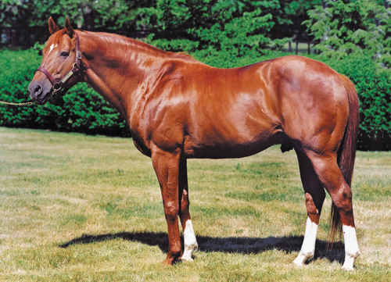
Three Topics
Relationship designators
Fictitious characters (and real non-human ones too!)
Genre/form, LCGFT, and the future
Kermit
Secretariat

Slide 3
Relationship Designators
author editor composer interviewer film director
host institution issuing body illustrator actor conductor
motion picture adaptation of (work) novelization (work)
musical setting of (work) container of (work) music for (work)
translation of contained in (expression) continuation of (expression)
alternate identity member founded corporate body predecessor

Slide 4
Relationship Designators in RDA
A designator that indicates the nature of the relationship between entities represented by authorized access points, descriptions, and/or identifiers
RDA 18.1.6, 18.4.1, 18.5, Appendix I (relationships between works, expressions, manifestations, and items and persons, families, and corporate bodies)
RDA 24.1.5, 24.4, 24.5, Appendix J (relationships between works, expressions, manifestations, and items)
RDA 29.1.5, 29.4, 29.5, Appendix K (relationships between persons, families, and corporate bodies)
Not core in RDA, but PCC has developed best practice guidelines for bibs and authorities, and has made its use mandatory in some cases
Notes:
18.1.6 The term relationship designator▼ refers to a designator that indicates the nature of the relationship between a resource and a person, family, or corporate body associated with that resource.
A relationship designator is recorded with the authorized access point and/or identifier representing the associated person, family, or corporate body.
18.4.1 Record a relationship designator to indicate the specific function performed by a person, family, or corporate body in relation to the resource (see 18.5).
Record the appropriate relationship designator with the identifier and/or the authorized access point representing that person, family, or corporate body.
24.1.5 The term relationship designator▼ refers to a designator that indicates the nature of the relationship between works, expressions, manifestations, or items. A relationship designator is recorded with the authorized access point, identifier, and/or description representing the related work, expression, manifestation, or item.
24.4 Record an appropriate relationship designator to specify the nature of the relationship (see 24.5).
29.1.5 The term relationship designator▼ refers to a designator that indicates the nature of the relationship between persons, families, or corporate bodies. A relationship designator is recorded with the authorized access point and/or identifier representing the related person, family, or corporate body.
29.4 Record an appropriate relationship designator to specify the nature of the relationship (see 29.5).

Slide 5
PCC Guidelines on Relationship Designators in Bib Records
http://www.loc.gov/aba/pcc/rda/PCC%20RDA%20guidelines/Relat-Desig-Guidelines.docx
Include a relationship designator for all creators (whether 1XX or 7XX)
Highly encouraged to include Appendix I relationship designators for all access points whenever it is clear what the relationship is
Prefer terms from RDA appendices; propose new terms when needed; however, terms from other lists may also be used
Notes:
Key points of the PCC Guidelines on Relationship Designators

Slide 6
PCC Guidelines on Relationship Designators in Bib Records
Prefer a specific term to a more general one (e.g., librettist instead of author for the creator of a libretto)
May use RDA element name as a relationship designator if nothing else more specific expresses the relationship, e.g.
creator
contributor
publisher
distributor
Notes:
Key points of the PCC Guidelines on Relationship Designators

Slide 7
PCC Guidelines on Relationship Designators in Bib Records
If nature of relationship cannot be ascertained even at a general level, don’t use a designator
Follow the definitions and FRBR level used in RDA for designators, e.g.
artist (work level designator for a creator)
vs.
illustrator (expression level designator for a contributor)
Notes:
Key points of the PCC Guidelines on Relationship Designators

Slide 8
PCC Guidelines on Relationship Designators in Bib Records
Preferably, use repeatable $e (or $j in 111/711) when entity has multiple roles; add the designators in WEMI order
100 1_ Sendak, Maurice, $e author, $e illustrator.
700 1_ Allen, Woody, $d 1935- $e screenwriter, $e film director, $e actor, $e composer (expression)
Note: no comma used after the access point when $e follows a hyphen
Notes:
Key points of the PCC Guidelines on Relationship Designators

Slide 9
PCC Guidelines on Relationship Designators in Bib Records
If necessary, multiple fields with same access point may be used instead
100 1_ Roethke, Theodore, $d 1908-1963, $e author.
700 1_ Roethke, Theodore, $d 1908-1963, $e former owner. $5 WaU
Relationship of author applicable universally; relationship of former owner only applicable to an item owned by UW Libraries
Notes:
Key points of the PCC Guidelines on Relationship Designators

Slide 10
PCC Guidelines on Relationship Designators in Bib Records
Do not include Appendix I designators in name/title access points tagged MARC 700-711 or 800-811, or in a name/title linking field tagged MARC 76X-78X
700 02 $i Container of (work): $a Aristotle. $t Metaphysics.
700 02 $i Container of (work): $a Aristotle, $e author. $t Metaphysics
not
Notes:
Key points of the PCC Guidelines on Relationship Designators

Slide 11
PCC Guidelines on Relationship Designators in Bib Records
Use of relationship designators from Appendix J for resource-to-resource relationships is encouraged
700 1_ $i Sequel to: $a Rowling, J. K. $t Harry Potter and the Chamber of Secrets.
700 1_ $i Motion picture adaptation of (work): $a O'Hara, Mary. $t My friend Flicka.
700 1_ $i Translation of: $a Frank, Anne, $d 1929-1945. $t Achterhuis.
LC-PCC PS for J.1: Give $i as first subfield, capitalize the first word in the designator, and end the subfield with a colon.
Notes:
Key points of the PCC Guidelines on Relationship Designators
When MARC subfield $i for a relationship designator is used in a bibliographic record, give it as the first subfield, capitalize the first word in the designator, and end the subfield with a colon.

Slide 12
PCC Guidelines on Relationship Designators in Bib Records
If MARC 7XX field being used has the subfield $i defined, provide a relationship designator even if the MARC field coding otherwise already expresses a relationship
700 12 $i Container of (work): $a Diemer, Emma Lou. $t Toccatas, $m piano.
700 12 $i Container of (work): $a Zwilich, Ellen Taaffe, $d 1939- $t Lament.
700 12 $i Container of (work): $a Larsen, Libby. $t Mephisto rag.
Notes:
Key points of the PCC Guidelines on Relationship Designators

Slide 13
Which direction?
Definitions in Appendix J describe what the designator points to, not what the record describes:
100 $a Author’s name, $e screenwriter.
245 $a Script for a TV show
730 $i Screenplay for the television program (work): $a TV show
Definition: A work that uses the text as a screenplay for a television program.

Slide 14
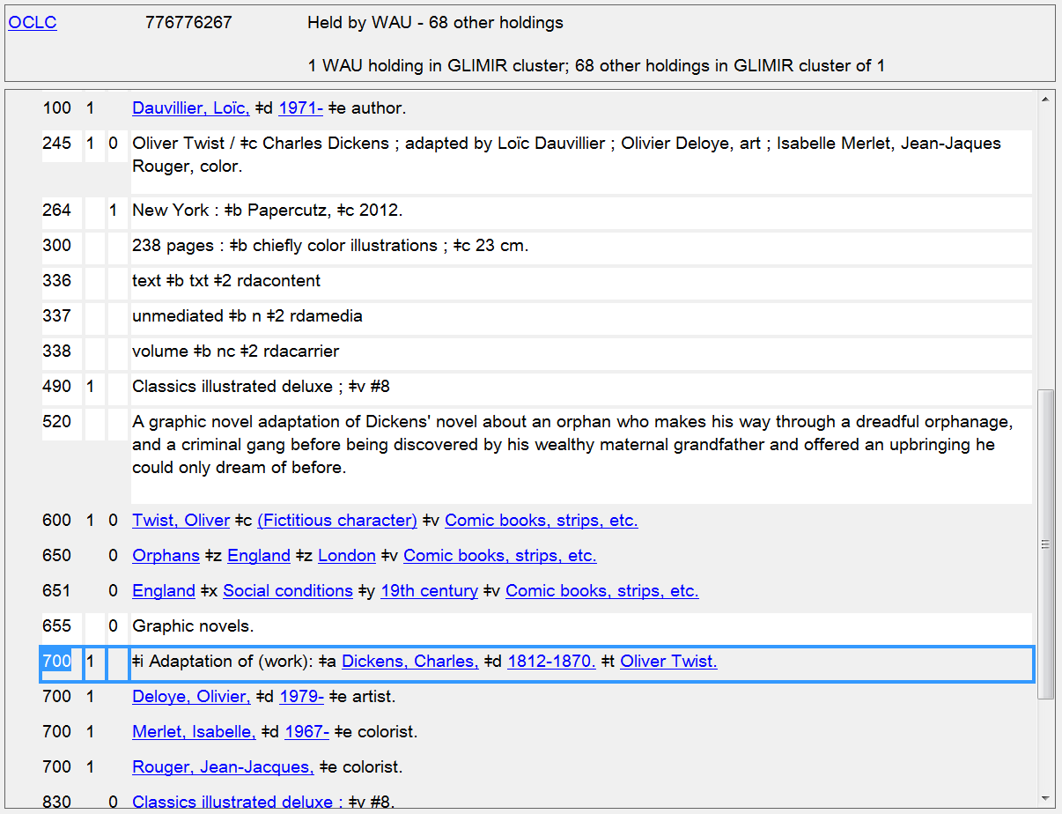
Notes:
The resource being described in this record is the graphic novelization of Oliver Twist. The relationship designator in the 700 added entry points to the original work by Dickens.

Slide 15
Many designators changed in April 2014
In the April 2014 update to RDA, numerous changes were made to existing designators, and many new ones were added. Be sure to check the current lists in RDA Appendixes I-K
Change examples:
editor of compilation → editor
contains (work) → container of (work)
continues (work) → continuation of (work)
supersedes (work) → replacement of (work)
adapted as a motion picture (work) → adapted as motion picture (work)
group member → member
group member of → corporate body

Slide 16
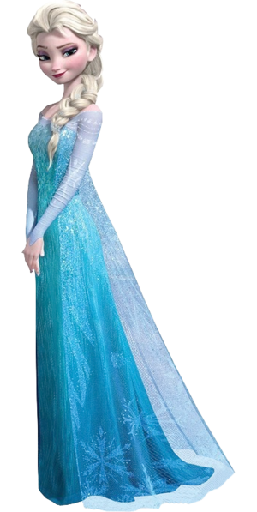
Fictitious Characters

Slide 17
Creators/Contributors can be fictitious, legendary, and real or fictitious non-humans!
RDA 9.0. Persons include persons named in religious works,
fictitious and legendary persons, and real or fictitious
non-human entities.
If a resource represents itself as having been created or
contributed to by any of these kinds of persons, then they
can be given access points (and name authority records).
Name authority records and subject access points may
also be created for persons who are only the subjects of
works. (Cf. LC-PCC PS for 9.0)
Notes:
LC-PCC PS for 9.0
Create a name authority record for the entity following RDA instructions and NACO guidelines, whether needed as a creator, contributor, etc., under RDA, or needed only for subject access. Do not create a subject proposal for LCSH.

Slide 18
Creators/Contributors can be fictitious, legendary, and real or fictitious non-humans!
If an LCSH subject heading exists for one of these entities,
when the name authority is created, the subject is reported
for cancellation.
LCSH subject authorities for these persons are tagged 150
and coded as 650 in bibliographic records. RDA name
authorities are tagged as 100 and coded as 600 in
bibliographic records when used as a subject.
LC will undertake a project to cancel existing LCSH
authority records for these entities and establish them as
RDA name authorities, but only as resources permit.
Notes:
LC-PCC PS for 9.0
Fictitious Entities and Real Non-Human Entities
LC practice/PCC practice: Apply this chapter to fictitious entities and real non-human entities following the guidelines below:
No LCSH Authority Record Exists
Create a name authority record for the entity following RDA instructions and NACO guidelines, whether needed as a creator, contributor, etc., under RDA, or needed only for subject access. Do not create a subject proposal for LCSH.
LCSH Authority Record Exists
If needed as a creator, contributor, etc., under RDA, create a new name authority record and notify the Policy & Standards Division (policy@loc.gov) to cancel the existing subject authority record.
Optionally, a new name authority record may be created for such an entity if needed only for subject access. If a name authority record is created, notify the Policy & Standards Division (policy@loc.gov) to cancel the existing subject authority record.
Future activity: A project to transition all fictitious and real non-human entities from LCSH will be conducted as resources are available.

Slide 19
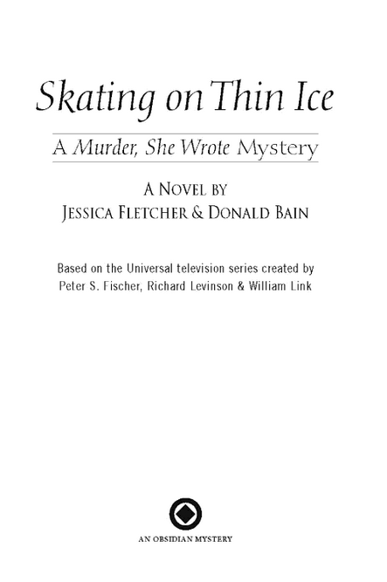
Notes:
An example of a resource that presents a fictitious character as a creator.

Slide 20
100 1_ $a Fletcher, Jessica, $e author.
245 10 $a Skating on thin ice : $b a Murder, she wrote mystery / $c a novel by Jessica Fletcher & Donald Bain.
700 1_ $a Bain, Donald, $d 1935- $e author.

Slide 21
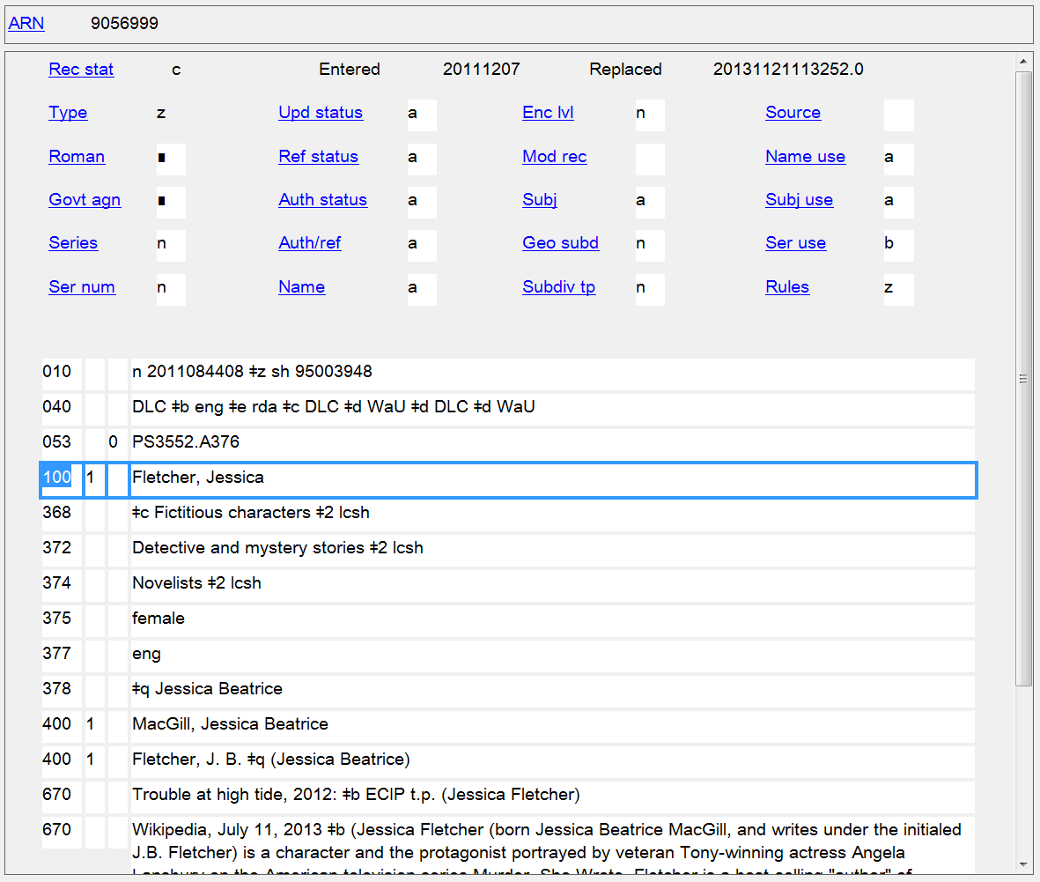
Notes:
Here’s her authority record. Since there is no conflict with any other person with the same name, RDA does not require the addition of the qualifier “(Fictitious character)” to the authorized access point. However, the other designation associated with the person is a core element for fictitious persons, so it is recorded as a separate element in MARC 368 subfield $c. Note that just like any other persons, other attributes and variant access points may be recorded as well.

Slide 22
Notes:
Here are some works created or contributed to by another fictitious character.

Slide 23
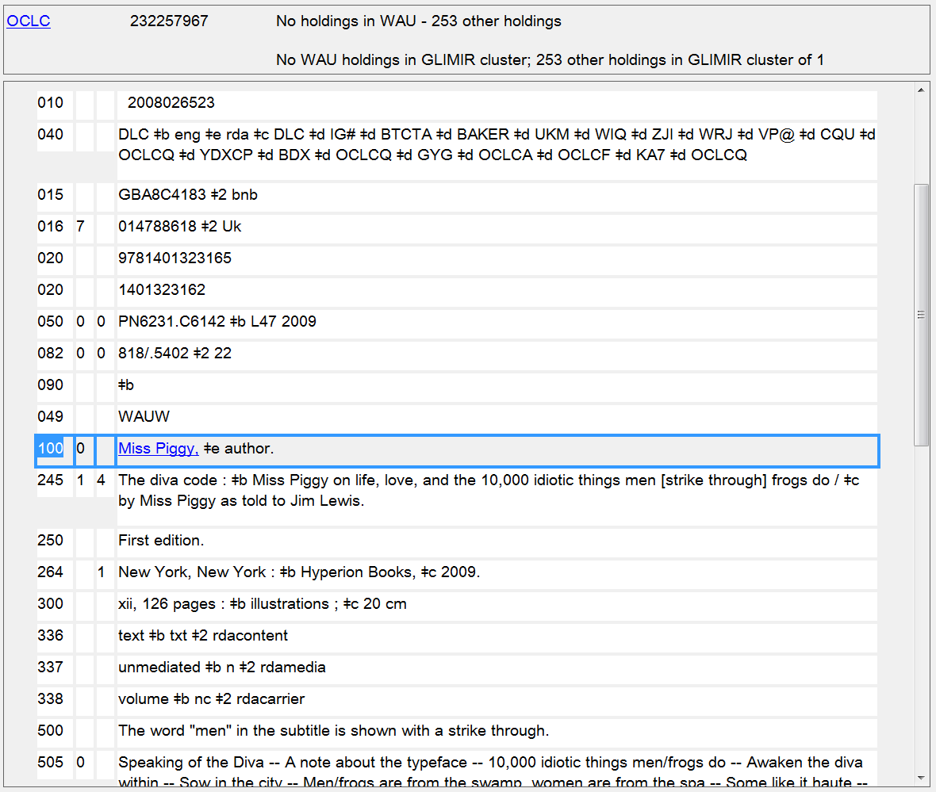
Notes:
And here is the bibliographic record in OCLC for the book by Miss Piggy.

Slide 24
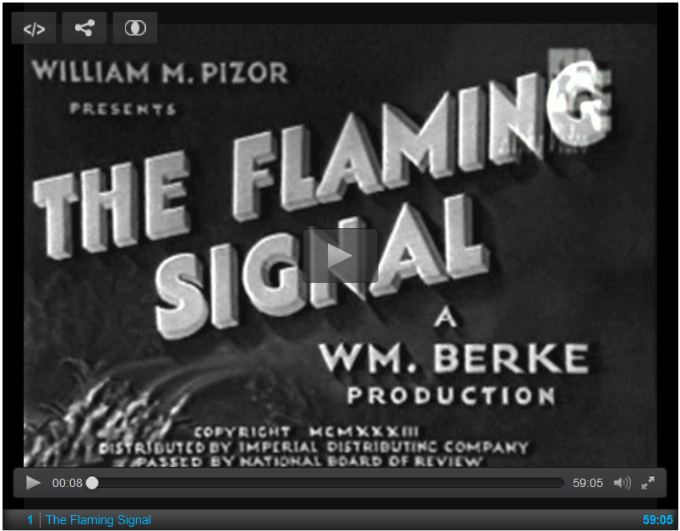
Notes:
Here is a motion picture. CLICK ON HYPERLINK TO OPEN A NEW WINDOW AND VIEW THE OPENING CREDITS

Slide 25
Notes:
Opening credits for the film include this real non-human entity.

Slide 26
245 04 $a The flaming signal / $c William M. Pizor presents ; a Wm. Berke production ; directed by George Jeske and C. Edward Roberts ; screenplay and adaptation by C. Edward Roberts.
511 ## $a John David Horsley, Marceline Day, Carmelita Geraghty, Noah Beery, Henry B. Walthall, Mischa Auer, Flash.
700 1_ $a Pizor, William M., $e film producer.
700 1_ $a Berke, Wm. $q (William), $d 1903-1958, $e film producer.
700 1_ $a Roberts, C. Edward $q (Charles Edward), $d 1894-1951, $e film director, $e screenwriter.
700 1_ $a Jeske, George, $d 1891-1951, $e film director.
700 1_ $a Horsley, John, $e actor.
700 1_ $a Day, Marceline, $e actor.
700 1_ $a Beery, Noah, $d 1882-1946, $e actor.
700 1_ $a Walthall, Henry B. $q (Henry Brazeale), $d 1878- 1936, $e actor.
700 1_ $a Auer, Mischa, $d 1905-1967, $e actor.
700 0_ $a Flash $c (Dog), $e actor.

Slide 27
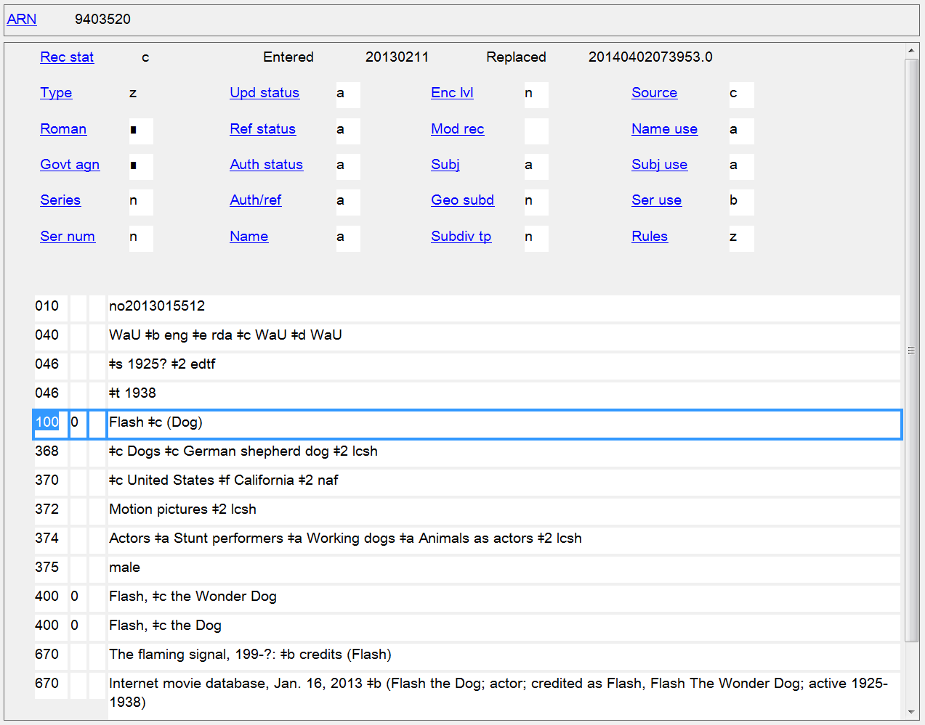
Notes:
Here is Flash’s name authority record.

Slide 28
245 00 $a Dear Socks, dear Buddy : $b kids’ letters to the first pets / $c [compiled, with a foreword, by] Hillary Rodham Clinton.
520 1_ $a Letters written by children to the Clintons’ White House pets ... Socks, a black-and-white cat; and Buddy, a Labrador retriever.
700 1_ $a Clinton, Hillary Rodham, $e editor, $e writer of supplementary textual content.
700 0_ $a Socks $c (Cat), $d 1989- 2009, $e addressee.
700 0_ $a Buddy $c (Dog), $d 1997- 2002, $e addressee.
Notes:
Here access points have been made for two real non-human persons associated with a work, but not considered creators, in this case the addressees of correspondence.
addressee A person, family, or corporate body to whom a work or part of a work is addressed.

Slide 29
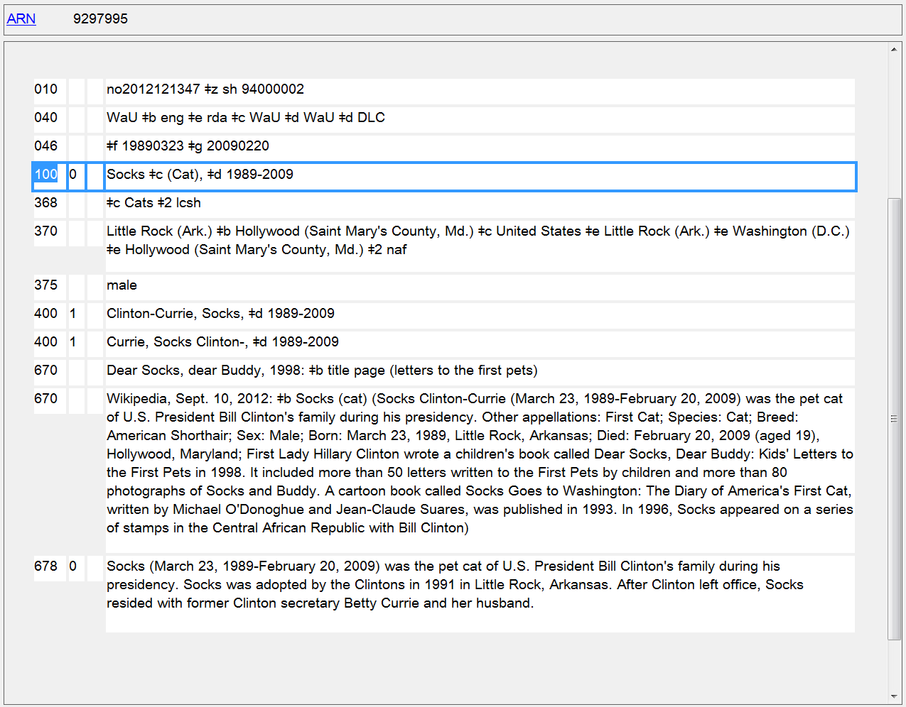
Cancelled subject authority record number in 010 $z
Notes:
Authority record for Socks. You can see from the subfield $z in the 010 that the subject authority record for him was cancelled after the name authority was created. LCSH subject authority record control numbers begin with the prefix “sh”.

Slide 30
100 1_ $a Dalby, Andrew, $d 1947- $e author.
245 10 $a Venus : $b a biography / $c Andrew Dalby.
505 0_ $a The birth of Venus -- Marriage and adultery -- The children of Venus -- The story of Adonis -- The events on Mount Ida -- The fall of Troy and the origin of Rome -- The goddess of love.
600 00 $a Venus $c (Roman deity)
Notes:
Fictitious and legendary characters and real non-human entities can also more commonly be the subjects of works, as seen in this and the next two slides.

Slide 31
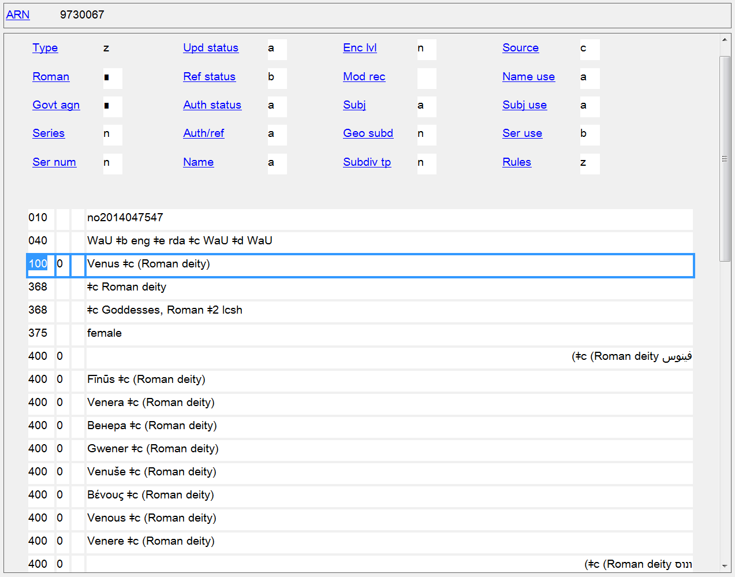

Slide 32
130 0_ $a Oliver Twist (Motion picture : 2005)
245 10 $a Oliver Twist / $c Tristar Pictures and R.P. Productions present ; Oliver Twist Productions, LLP ; a Roman Polanski film ; screenplay, Ronald Harwood ; produced by Robert Benmussa, Alain Sarde, Roman Polanski ; directed by Roman Polanski.
600 10 $a Twist, Oliver $c (Fictitious character) $v Drama.
700 1_ $i Motion picture adaptation of (work): $a Dickens, Charles, $d 1812- 1870. $t Oliver Twist.

Slide 33
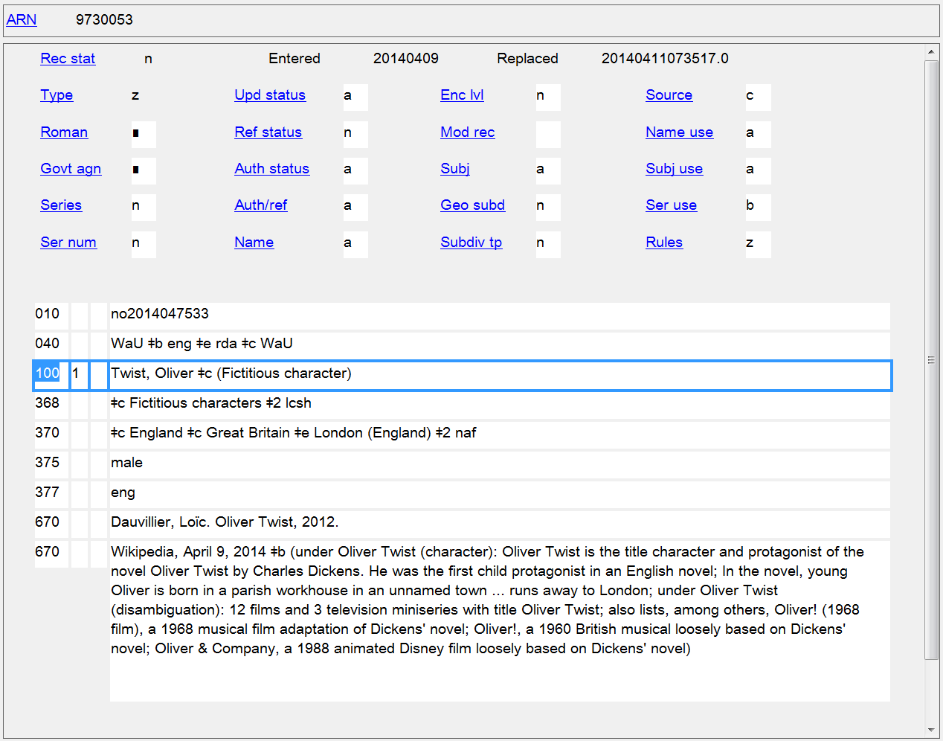
Notes:
“(Fictitious character)” was added to the authorized access point in this case because there was another person with the same name already established.

Slide 34
245 00 $a Keiko : $b the untold story / $c Joshua Records, LLC presents a film by Theresa Demarest ; produced and directed by Theresa Demerest.
520 $a Keiko (star of the film "Free Willy") journeys from captivity to release in his home waters of the North Atlantic. Footage includes his life in the wild with day-to-day accounts by his last two caretakers, Colin Baird and Thorbjorg (Tobba) Valdis Kristjansdottir.
600 00 $a Keiko, $d approximately 1976-2003.

Slide 35
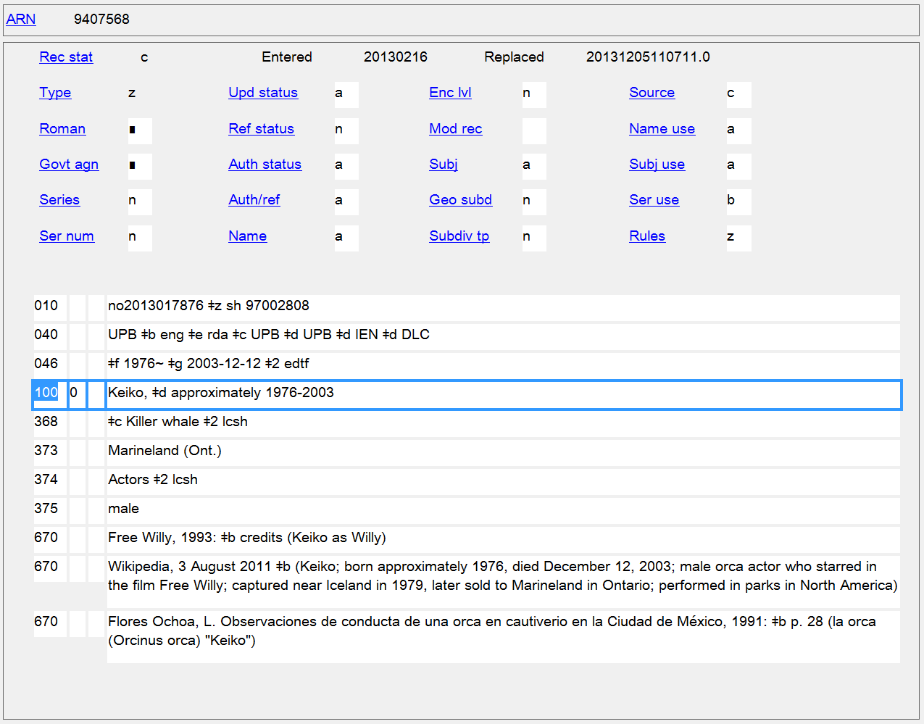

Slide 36
How can you tell if an NAR exists for a fictitious character, real non-human entity, etc.?
Search OCLC name authority records
Search for the name as a personal name (rather than as a subject)
Search by entity attribute for the type of entity (RDA 9.6 Other Designation Associated with the Person)
9.6.1.7: “For a fictitious or legendary person, record Fictitious character, Legendary character, or another appropriate designation.” Greek deity Mythological character Vampire
9.6.1.8: For a real non-human entity, record a designation for type, species, or breed. Horses Cats Dogs Labrador retriever
Remember that PCC policy is to prefer controlled vocabulary when this attribute is recorded. LCSH is the most commonly used controlled vocabulary for these terms. Search by both singular and plural forms for best results.
Notes:
9.6.1.7 For a fictitious or legendary person, record Fictitious character, Legendary character, or another appropriate designation.
9.6.1.8 For a real non-human entity, record a designation for type, species, or breed.

Slide 37
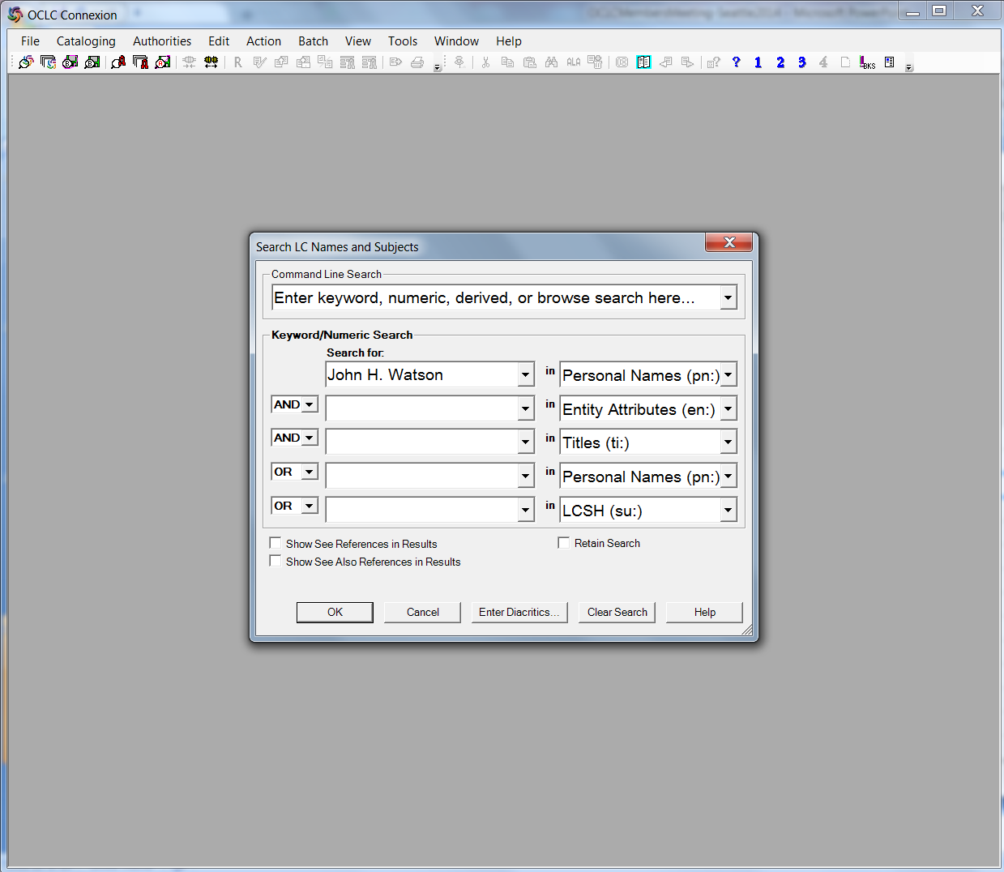
Method 1: Keyword search of the authority file
Notes:
Searching for a particular name: Here’s a personal name keyword search in the name authority file for the fictitious character from Arthur Conan Doyle, John H. Watson.

Slide 38
Results of personal name keyword search of the authority file for John H. Watson
Reminder: If there is no conflict with another person with the same name, there may not be a qualifier added to the name.
Notes:
Results of personal name keyword search of the authority file for John H. Watson

Slide 39
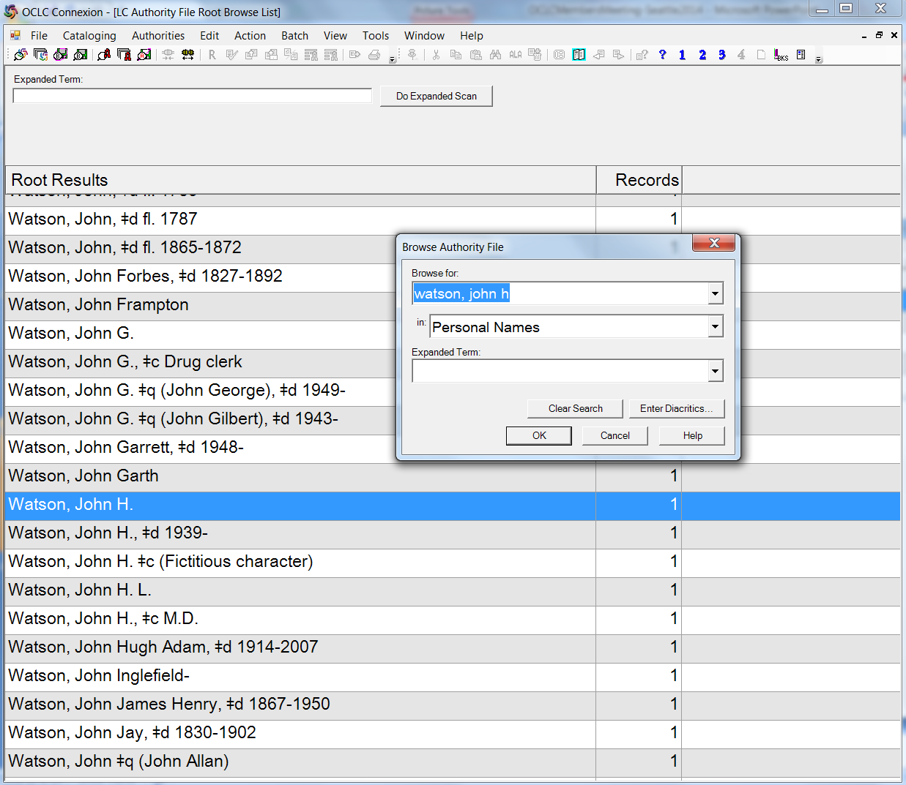
Method 2: Browse search of the authority file
Notes:
Searching for a particular name: Here’s a personal name browse search in the name authority file for John H. Watson.

Slide 40
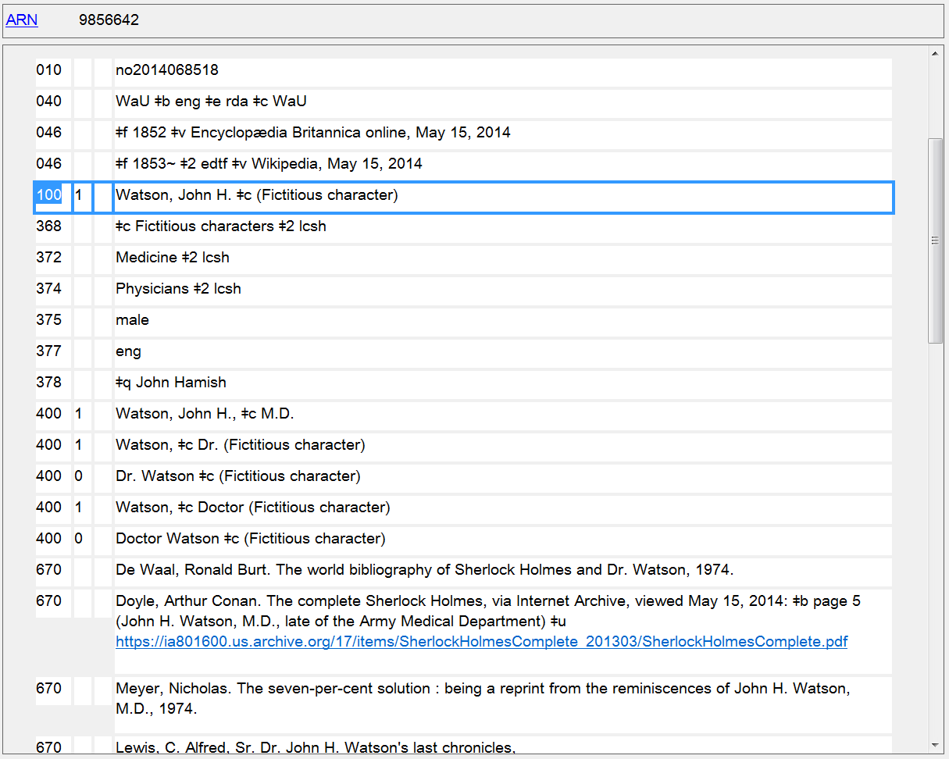
Notes:
Here’s his name authority record.

Slide 41
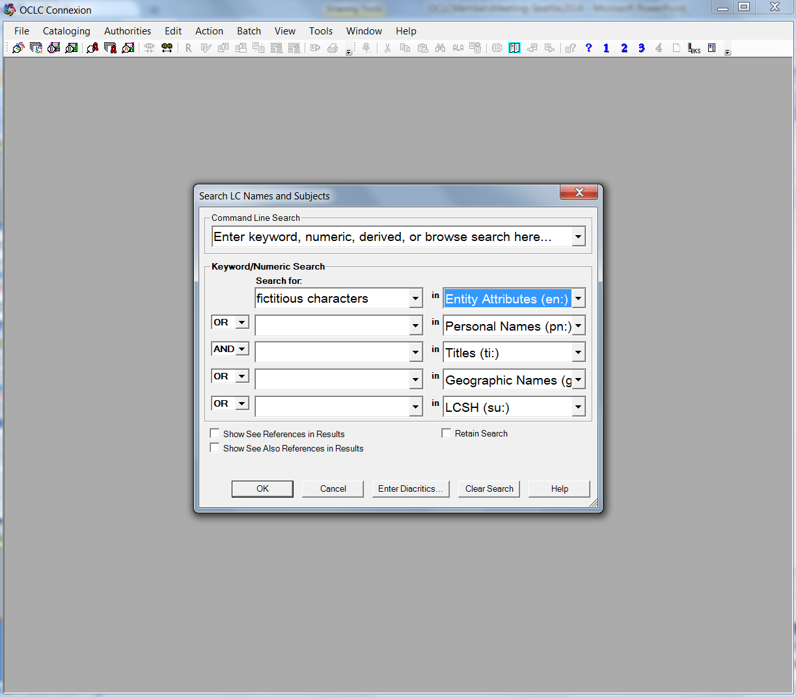
Method 3: Keyword search of entity attributes
Notes:
Searching by entity attributes: Here is a search for the entity attribute that would be recorded in the 368 $c of the name authority record for a fictitious character. The keyword used here is the LCSH term “Fictitious characters” rather than the singular form that might be added as a qualifier to a name. The RDA element Other Designation Associated with the Person is a core element for fictitious characters, but it is not automatically included in authorized access points for the person. Therefore it’s better to search it as an entity attribute rather than as part of the name itself.

Slide 42
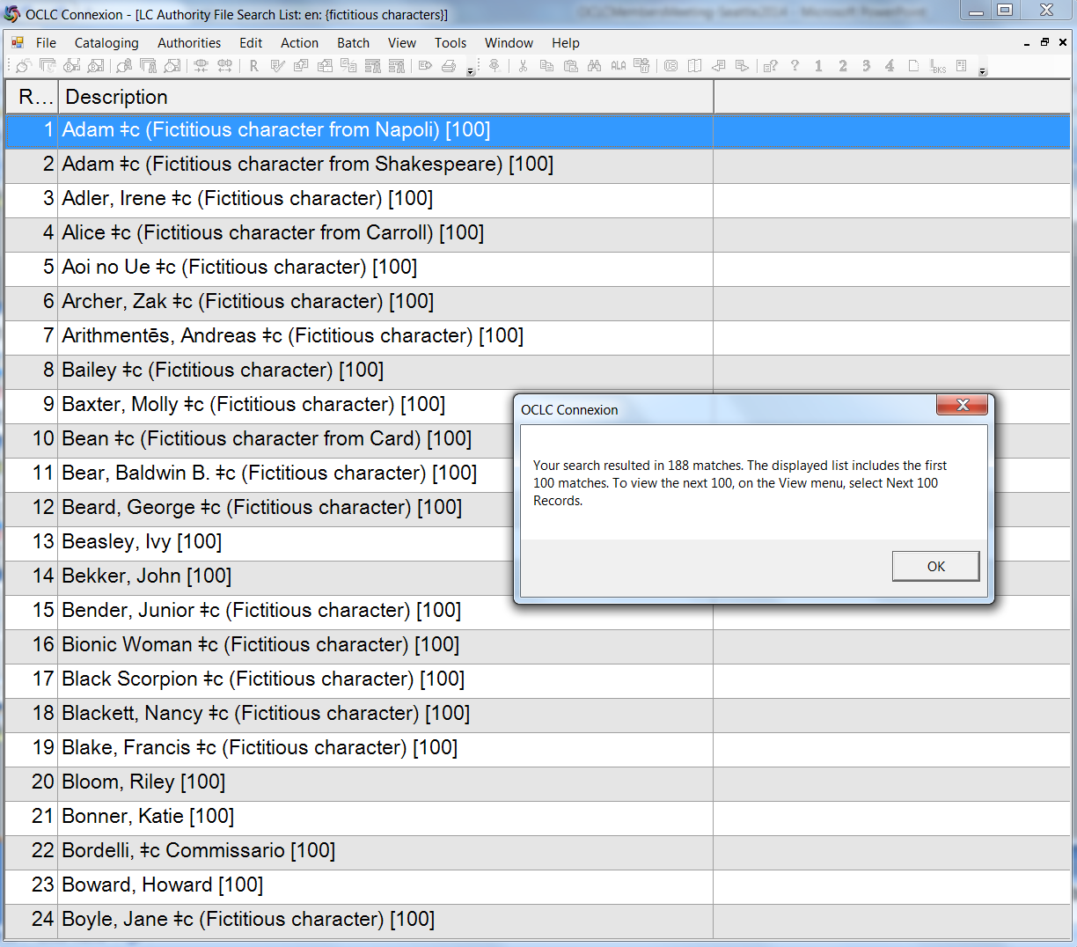
Notes:
Results of the keyword search “fictitious characters” as an entity attribute. As can be seen from the first screen of results, not all of the names have the qualifier “(Fictitious character)”.

Slide 43
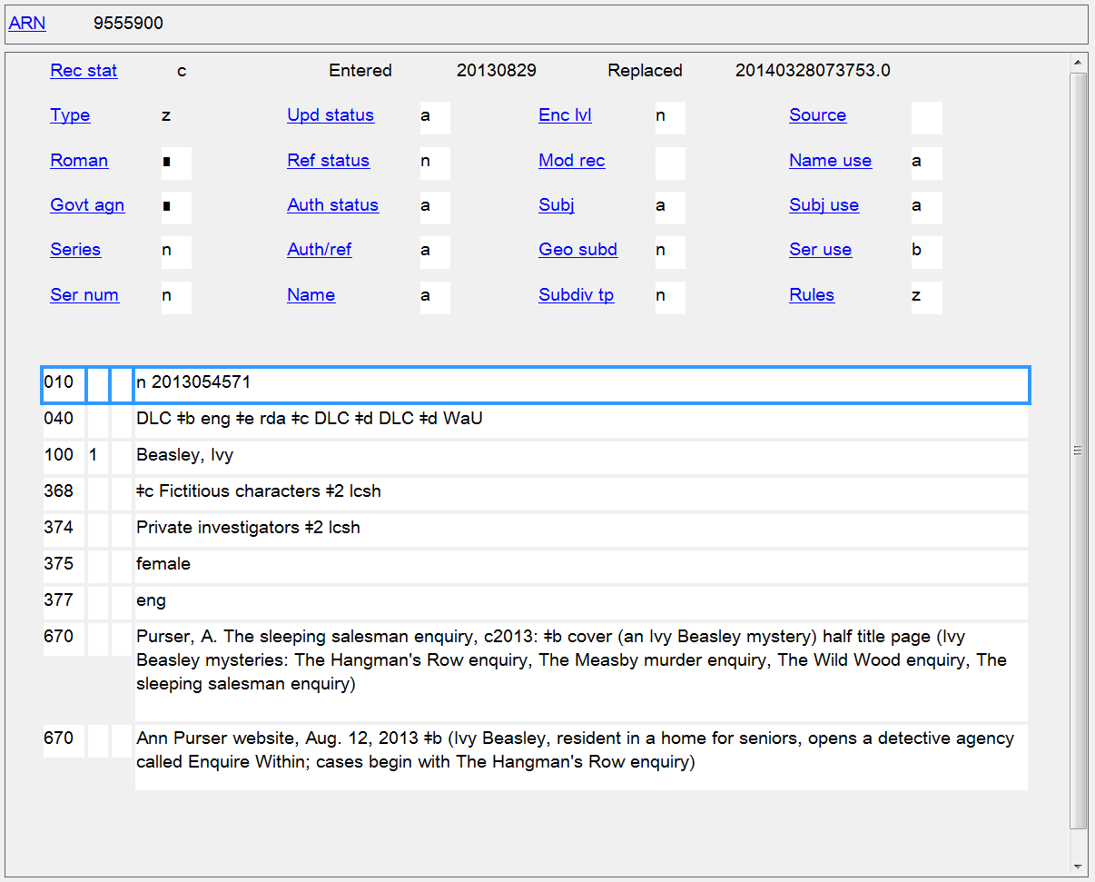
Notes:
Here’s one of the authority records for a name that doesn’t have a qualifier, showing that records for fictitious characters can still be found by searching for the entity attribute Other Designation Associated with the Person.

Slide 44
How can you tell if an NAR exists for a fictitious character, real non-human entity, etc.?
Follow LCSH Monthly Lists for Cancellations
Approved Monthly Lists
http://classificationweb.net/approved-subjects/
http://www.loc.gov/aba/cataloging/subject/weeklylists/
Tentative Monthly Lists
http://classificationweb.net/tentative-subjects/

Slide 45
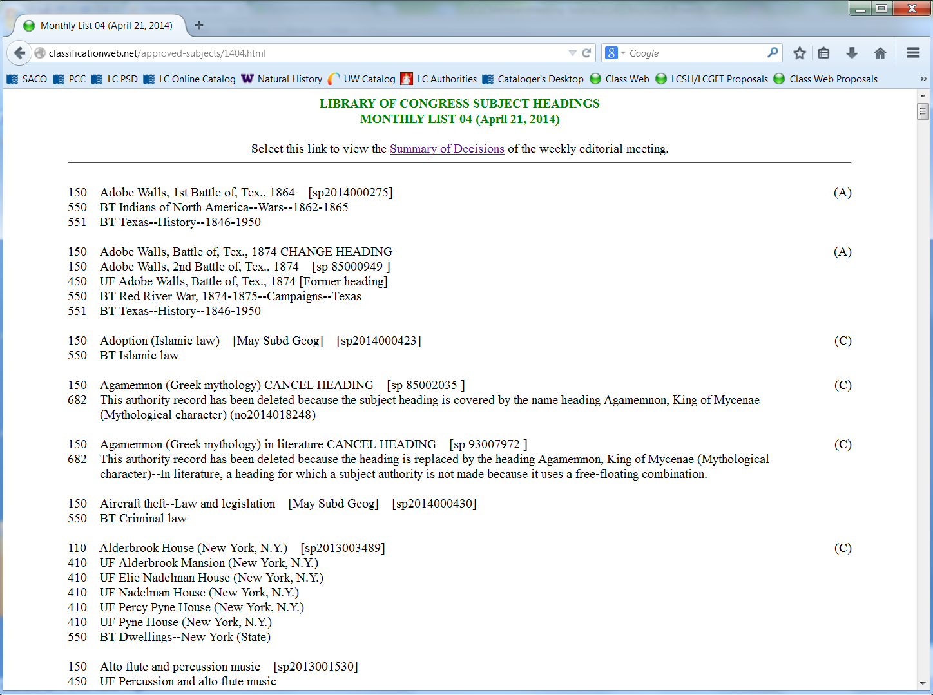
Notes:
Approved monthly list (April 2014) showing an example of a cancelled subject replaced by a name authority. The authorized access point for the name is not always the same as the LCSH, as can be seen in this example.

Slide 46
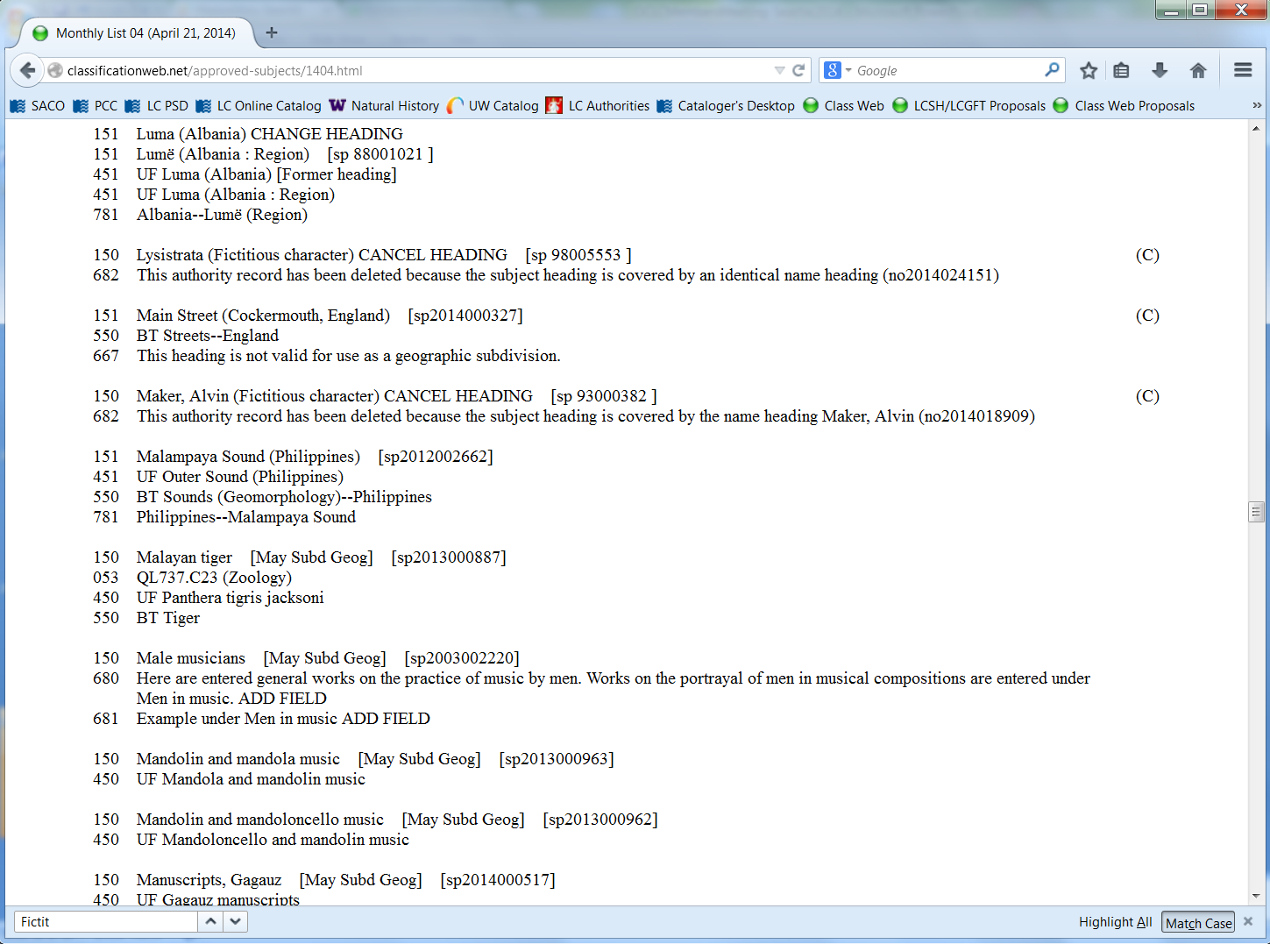
Notes:
Examples of fictitious character headings being cancelled from LCSH. The first is replaced by an identical RDA name access point, but the RDA form of the authorized access point for the second is different from the LCSH form.

Slide 47
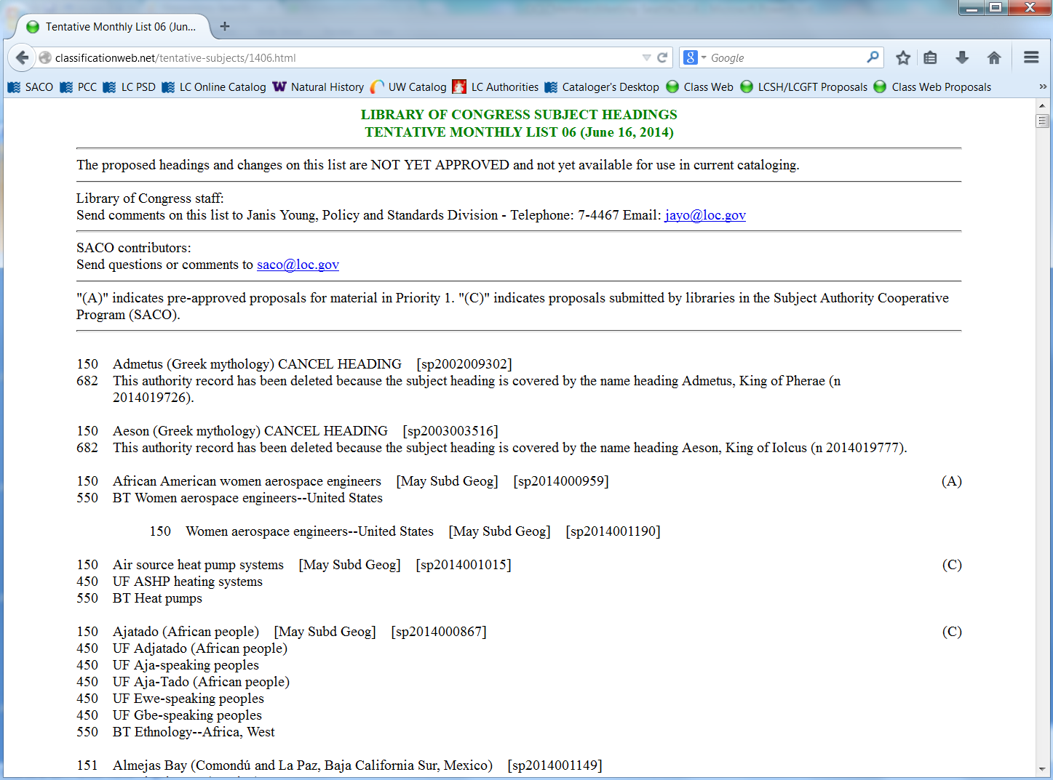
Notes:
In addition to following the approved monthly lists, catalogers can also look at proposed LCSH changes, through monthly tentative lists of new and changed headings. The latest tentative list that is available online is the one for June 2014. This contains proposals for new LCSH, changes to LCSH, and cancellations. Note that these proposals are NOT YET APPROVED and so the subject authority file in OCLC will not yet reflect any of the proposals. However, the presence of the cancellation proposals such as the ones shown in this slide indicate that you can already start using the RDA name authorities for these entities as subjects in bibliographic records.

Slide 48
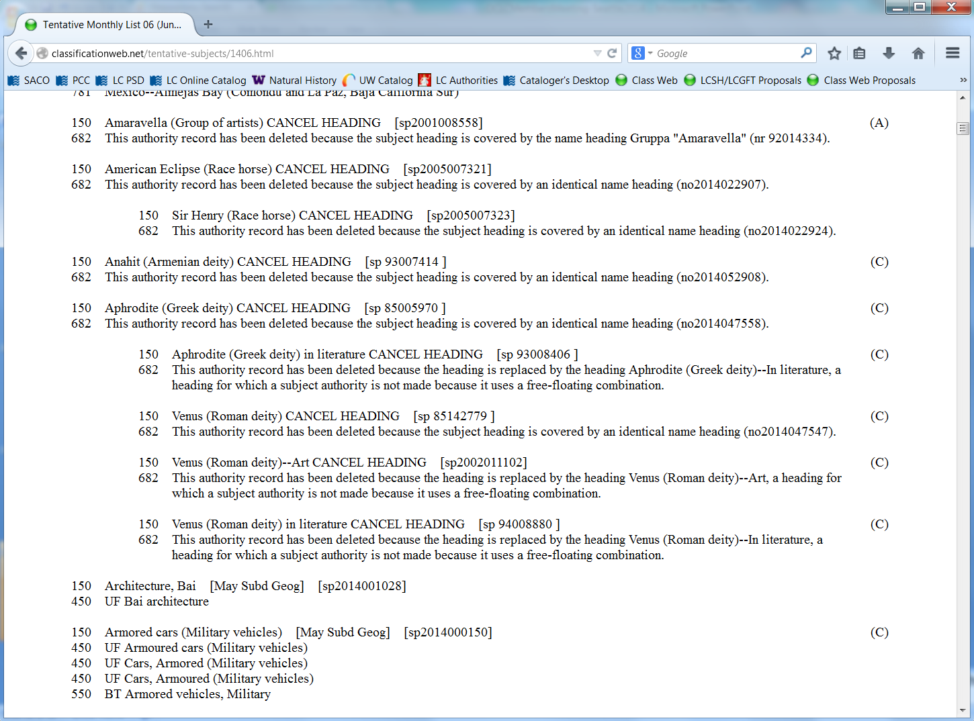
Notes:
Additional cancellation proposals on the June 2014 tentative list.

Slide 49
Some tips and reminders
Control LCSH headings in OCLC so when a subject is cancelled and replaced by an RDA name authority the heading in the OCLC record will flip to the new form

Slide 50
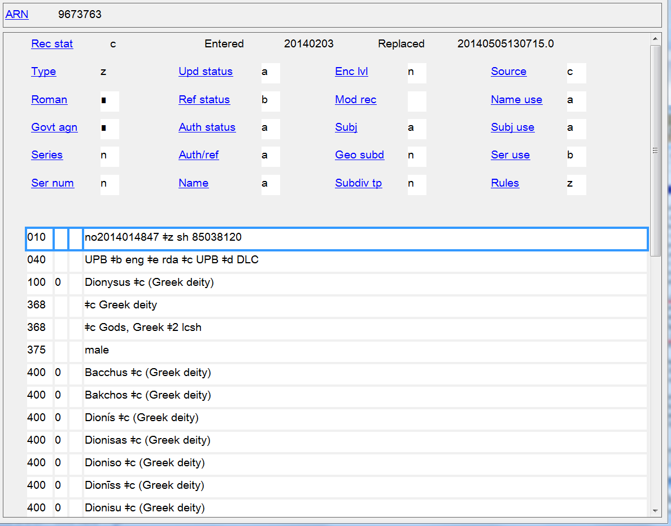
When an LCSH heading is cancelled, the cancelled LCCN of that subject authority record is added to the RDA name authority. Controlled subjects in OCLC bib records will automatically be flipped to the correct RDA form and tagging.

Slide 51
Some tips and reminders
Free-floating subdivisions under names of persons (SHM H 1110) do not apply to names of fictitious, legendary, and mythological characters nor names of deities. Use free-floating subdivisions listed in H 1095 (form and topical subdivisions of general application) instead.
Check scope notes for the free-floating subdivisions to be sure what categories they can be used with.

Slide 52
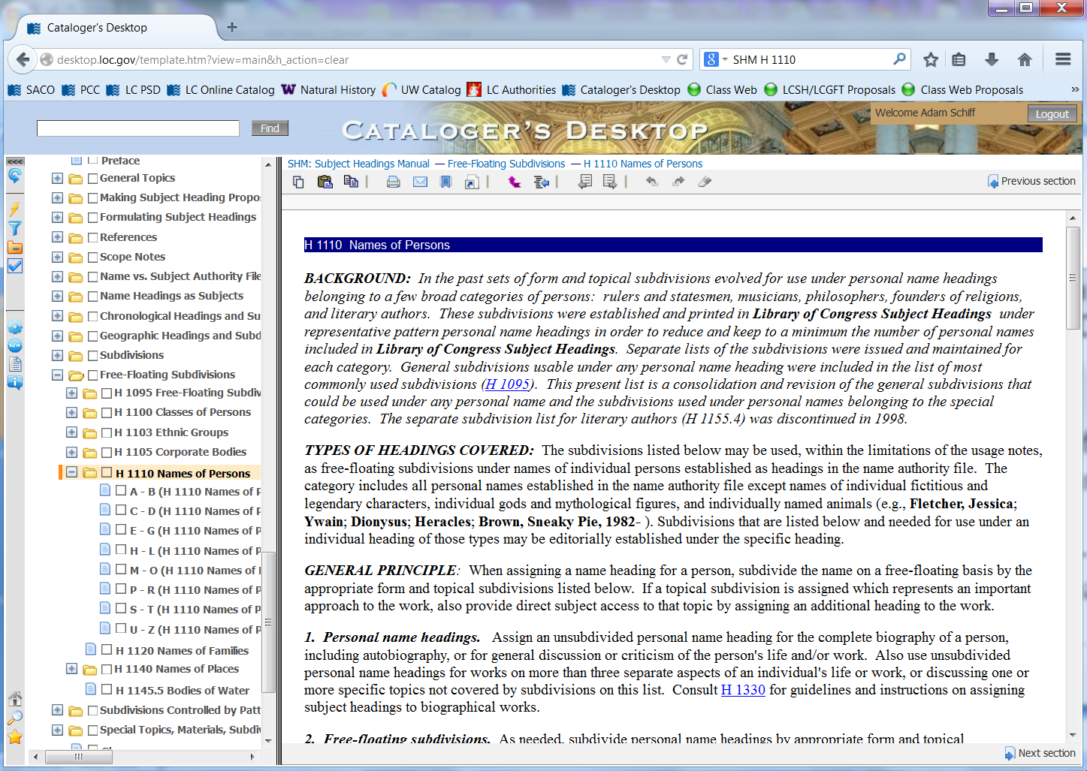
Notes:
In LCSH, free-floating subdivisions established under Names of Persons are not applicable to individual fictitious and legendary characters, individual gods and mythological figures, and individual named animals. Use the list of free-floating subdivisions of general application in H 1095 instead.

Slide 53
LCSH:
650 _0 $a Bond, James (Fictitious character) in art.
After RDA name authority established:
600 10 $a Bond, James $c (Fictitious character) $x Art.
600 10 $a Bond, James $c (Fictitious character) $x In art.
not
Notes:
The free-floating general subdivision --Art may be used under names of individual persons who lived before 1400, names of deities and mythological or legendary figures, individual fictitious characters and groups of fictitious characters, and under headings of the type [topic]–[subdivision].
The free-floating general subdivision --In art may be used under names of countries, cities, etc., and individual corporate bodies, and individual Christian denominations, and under uniform titles, for their representation as physical objects in artistic works. Use as a form subdivision for works consisting of reproductions of artistic works that depict the place, body, etc. Use as a topical subdivision for works that discuss the place, body, etc., as a theme in art.

Slide 54
Genre/Form Developments
Notes:
The slide shows two proposed literature terms to be added to LCGFT. The literature terms have been developed by the ALA ALCTS Subject Analysis Committee Subcommittee on Genre/Form Implementation.

Slide 55
LCGFT
Library of Congress Genre/Form Terms for Library and Archival Materials
Projects already “completed”
Moving images (film and television)
Radio programs
Cartographic resources
Law
Cookbooks

Slide 56
LCGFT
Projects underway
Religion
Literature (Comics, Drama, Fiction, Poetry, etc.)
Music
General terms (e.g., Dictionaries, Diaries, Exhibition catalogs, Obituaries, Periodicals, Pop-up books, Sayings, Teachers’ guides)
Terms for above areas should be available by end of 2014 or early in 2015
New MARC fields 382, 385, 386, 388 will be used in conjunction with genre/form terms in field 655
Notes:
LC is working with the American Theological Library Association on religion terms, with the Music Library Association on music terms, and with the ALA ALCTS Subject Analysis Committee Subcommittee on Genre/Form Implementation on literature and general terms. New MARC fields have been created or proposed to accommodate aspects/characteristics of works and expressions that are not specifically genre/form but were treated with genre/form in LCSH.

Slide 57
LCGFT
LCSH form headings will no longer be assigned to works of literature and music when LCGFT terms for literature and music are implemented. Aspects found in LCSH strings that are not strictly genre/form will be coded in the new MARC fields 382, 385, 386, 388
382 - Medium of performance
385 - Audience characteristics
386 - Creator/contributor characteristics
388 - Time period of creation term
proposal at ALA Annual 2014

Slide 58
LCGFT
Example: Anthology of poetry for children by American women.
LCSH: Children’s poetry, American.
American poetry—Women authors.
LCGFT: Poetry.
Where will we record the information about the audience (children) and the creators of the poetry (American women)?

Slide 59
MARC 385 - Audience Characteristics (R)
Indicators both blank
Subfields
$a - Audience term (R)
$b - Audience code (R)
$m - Demographic group term (NR)
$n - Demographic group code (NR)
$2 - Source (NR)
Notes:
Field Definition: A group category to which the creator(s) of a work or compilation of works, or the contributor(s) to an expression or compilation of expressions, belongs.
If a demographic group is not specified then multiple creator/contributor group categories from the same source vocabulary or code list may be recorded in the same field in separate occurrences of subfield $a and subfield $b. If a demographic group is specified then the categories in the field must all come from the same group. Terms from different source vocabularies are recorded in separate occurrences of the field.
$2 - Source
MARC code that identifies the source of the term or code used to record the creator/contributor information.
Code from: Subject Heading and Term Source Codes.

Slide 60
MARC 386 - Creator/Contributor Characteristics (R)
Indicators both blank
Subfields
$a - Creator/contributor term (R)
$b - Creator/contributor code (R)
$m - Demographic group term (NR)
$n - Demographic group code (NR)
$2 - Source (NR)
Notes:
Field Definition: A category of persons for which a resource is intended or a category of persons representing the intellectual level for which the content of a resource is considered appropriate.
If a demographic group is not specified then multiple audience characteristics from the same source vocabulary or code list may be recorded in the same field in separate occurrences of subfield $a and subfield $b. If a demographic group is specified then the characteristics in the field must all come from the same group. Terms from different source vocabularies are recorded in separate occurrences of the field.
$2 - Source
MARC code that identifies the source of the term or code used to record intended audience information.
Code from: Subject Heading and Term Source Codes or Target Audience Code and Term Source Codes.

Slide 61
Old vs. New Coding
Example: Anthology of poetry for children by American women.
650 _0 $a Children’s poetry, American.
650 _0 $a American poetry $x Women authors.
385 __ $m age group $n age $a Children $2 [source code]
386 __ $m gender group $n gdr $a Women $2 [source code]
386 __ $m nationality group $n nat $a Americans $2 [source code]
655 _7 $a Poetry. $2 lcgft
OLD
NEW
Notes:
In fields 385 and 386, subfield $m denotes a particular category that the term in subfield $a falls into. Subfield $n is a code for that category.

Slide 62
LCDGT
LC is developing a new controlled vocabulary to use in 385 and 386 fields: LCDGT: Library of Congress Demographic Group Terms
One element per term: Women and Physicians rather than Women physicians
Limited hierarchy will be provided (Physicians is a narrower term to Medical personnel)
Each term will have a category code in its authority record (in field 072) to specify the demographic group the term belongs to (e.g., age group; ethnic/cultural group; gender group; nationality/regional group; occupational/field of activity group; religious group)
Terms will be available through Classification Web. Other distribution means (e.g., authorities available in OCLC; free on the LC website) are still being discussed

Slide 63
LCDGT
Sample authority record
010 __ $a dg2014000100
040 __ $a DLC $b eng $c DLC $e lcdgt
072 _7 $a gdr $2 lcdgt
150 __ $a Women
450 __ $a Females

Slide 64
LCDGT and LCGFT used together
Bibliographic record
Currently:
650 _0 $a Children’s poetry, American.
650 _0 $a American poetry $x Women authors.
After implementation:
385 __ $a Children $2 lcdgt
386 __ $a Women $a Americans $2 lcdgt
655 _7 $a Poetry. $2 lcgft
Notes:
Because the authority records for Women and Americans will include an 072 code for the demographic group category that the terms fall into, it won’t be necessary to use subfields $m or $n with terms from LCDGT.

Slide 65
MARC 388 - Time Period of Creation (R)
First indicator - Type of time period
# - No information provided
1 - Creation
2 - Creation of aggregation
Second indicator not defined
Subfields
$a - Time period of creation term (R)
$2 - Source of term (NR)
Notes:
This new proposed field will be discussed later this month at the MARC Advisory Committee meetings held during ALA Annual in Las Vegas. The field would be used to record chronological terms representing the time period of creation or origin of works and expressions.
Field definition: The time period of creation or origin of the work or expression (including aggregate works), or of the works or expressions contained in an aggregation.
Coded dates or time periods of creation are recorded in field 046.
First Indicator – Type of time period # - No information provided 1 – Creation The time period of creation or origin of the work/expression, or, of the components of an aggregate work considered collectively. 2 – Creation of aggregation The time period of creation or origin of an aggregate work
$2 - Source of term (NR) Specifies a code that identifies the source of a controlled vocabulary used in $a.
LC has not yet indicated if it will be creating a new vocabulary for time period of creation terms.

Slide 66
LCGFT
LCSH terms that include chronological aspects will not be valid in LCGFT
Examples:
Operas $y 18th century
English drama $y 19th century
Rock music $y 2011-2020
Literature, Medieval
When LCGFT for literature and music is implemented, the chronological aspect will be recorded in coded form in field 046 and/or with a controlled term in field 388

Slide 67
LCGFT in conjunction with LCDGT, 388, etc.
Bibliographic record
Currently:
245 00 $a Violin concertos by Black composers of the 18th & 19th centuries.
650 _0 $a Concertos (Violin)
650 _0 $a Concertos (Violin with string orchestra)
650 _0 $a Violin with orchestra.
650 _0 $a Composers, Black.
650 _0 $a Orchestral music $y 18th century.
650 _0 $a Orchestral music $y 19th century.
Notes:
Recording performed by Rachel Burton and the Encore Chamber Orchestra, published in 1997. Individual concertos dates range from 1775 to 1899.

Slide 68
LCGFT in conjunction with LCDGT, 388, etc.
Bibliographic record
After implementation:
046 __ $k 1997 $o 1775 $p 1899
245 00 $a Violin concertos by Black composers of the 18th & 19th centuries.
382 0_ $b violin $a orchestra $2 lcmpt
382 0_ $b violin $a string orchestra $2 lcmpt
386 __ $a Composers $a Blacks $2 lcdgt
388 1_ $a 18th century $a 19th century $2 [source code for controlled vocabulary]
655 _7 $a Concertos. $2 lcgft
Notes:
Recording performed by Rachel Burton and the Encore Chamber Orchestra, published in 1997. Individual concertos dates range from 1775 to 1899.

