Slide 1




Performance Modeling to Support Multi-Tier Application Deployment to
Infrastructure-as-a-Service Clouds
Wes Lloyd, Shrideep Pallickara, Olaf David,
James Lyon, Mazdak Arabi, Ken Rojas
November 6, 2012
Colorado State University, Fort Collins, Colorado USA
UCC 2012: 5th IEEE/ACM International Conference on Utility and Cloud Computing

Slide 2
Outline
Background
Research Problem
Research Questions
Experimental Setup
Experimental Results
Conclusions

Slide 3
Background

Slide 4
Traditional Application Deployment
Data
Spatial DB
rDBMS
Business
Services
Logging
Tracking DB
DODB / NOSQL
App Server
Apache Tomcat
Services
Services
Object Store
Single Server

Slide 5
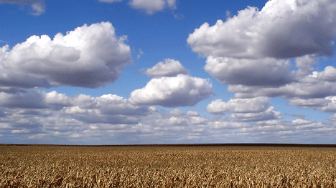
rDBMS
Logging
Server
Geospatial DB
Services
File Server
Apache Tomcat
Object Store
Distributed
Cache
NOSQL DB
IaaS cloud
Application Deployment

Slide 6
Application Component Deployment
Application
Components
Virtual Machine (VM) Images
App Server
Image 1
Image 2
App Server
rDBMS write
rDBMS r/o
Component
Deployment
File Server
File Server
Log Server
Log Server
Load Balancer
Image n
rDBMS r/o
rDBMS write
Load Balancer
Dist. cache
Application “Stack”
. . .
PERFORMANCE

Slide 7


Application Deployments
n=# components; k=# components per set
Permutations
Combinations
But neither describes partitions of a set!

Slide 8


Bell’s Number
Number of ways a set of n elements can be partitioned into non-empty subsets
n | k
4 | 15
5 | 52
6 | 203
7 | 877
8 | 4,140
9 | 21,147
n | . . .
n = #components
VM deployments
config 1
config 2
Model
1 VM : 1..n components
M
D
M
D
F
Database
Component
Deployment
F
L
L
File Server
config n
Log Server
M
L
D
Application “Stack”
F
. . .
k= #configs
# of Configurations

Slide 9
Research Problem

Slide 10
Problem Statement
How should application components be deployed to ?
  → Provide high throughput (requests/sec)
  → With low resource costs (# of VMs)
  To guide VM image composition
  Avoid resource contention from interfering components

Slide 11

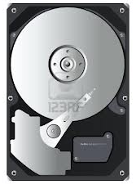
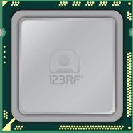


Physical Machine (PM) Resources
VM
VM
VM
VM
VM
VM
VM
VM
VM
Resource
Contention
Resource
Surplus
PERFORMANCE

Slide 12
Resource Utilization Statistics
CPU
- CPU time
- CPU time in user mode
- CPU time in kernel mode
- CPU idle time
- # of context switches
- CPU time waiting for I/O
- CPU time serving soft interrupts
- Load average (# proc / 60 secs)
Disk
- Disk sector reads
- Disk sector reads completed
- Merged adjacent disk reads
- Time spent reading from disk
- Disk sector writes
- Disk sector writes completed
- Merged adjacent disk writes
- Time spent writing to disk
c
Network
- Network bytes sent
- Network bytes received
PM
PM
VM
VM
VM
VM
VM

Slide 13

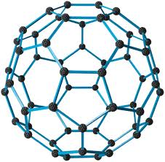
Can Resource Utilization Statistics
Model Application Performance?

Slide 14
Research Questions

Slide 15
Research Questions
RQ1)
RQ2)
RQ3)
Which resource utilization statistics are the best predictors?
How should resource utilization data be treated for use in models?
Which modeling techniques are best for predicting application performance and ranking performance of service compositions?

Slide 16
Experimental Setup

Slide 17
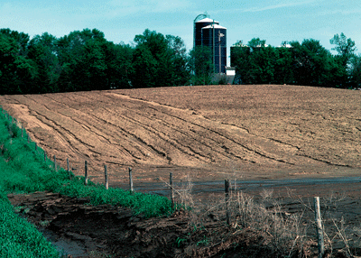
RUSLE2 Model
“Revised Universal Soil Loss Equation”
Combines empirical and process-based science
Prediction of rill and interrill soil erosion resulting from rainfall and runoff
USDA-NRCS agency standard model
  Used by 3,000+ field offices
  Helps inventory erosion rates
  Sediment delivery estimation
  Conservation planning tool

Slide 18
RUSLE2 Web Service
Multi-tier client/server application
  RESTful, JAX-RS/Java using JSON objects
  Surrogate for common architectures
App Server
Apache Tomcat
Geospatial rDBMS
File Server
nginx
Logging
Codebeamer
1.7+ million shapes
57k XML files, 305Mb
POSTGRESQL
OMS3
RUSLE2
POSTGIS

Slide 19
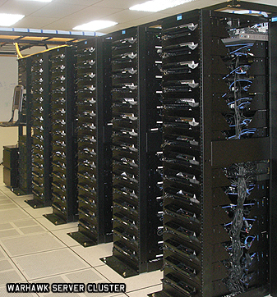
Eucalyptus 2.0 Private Cloud
(9) Sun X6270 blade servers
  Dual Intel Xeon 4-core 2.8 GHz CPUs
  24 GB ram, 146 GB 15k rpm HDDs
  CentOS 5.6 x86_64 (host OS)
  Ubuntu 9.10 x86_64 (guest OS)
Eucalytpus 2.0
  Amazon EC2 API support
  8 Nodes (NC), 1 Cloud Controller (CLC, CC, SC)
  Managed mode networking with private VLANs
  XEN hypervisor v 3.4.3, paravirtualization

Slide 20
RUSLE2 Components
Virtual Machine |  | Description
M | Model | Apache Tomcat 6.0.20, Wine 1.0.1, RUSLE2 Model, Object Modeling System (OMS 3.0)
D | Database | Postgresql-8.4, and PostGIS 1.4.0-2. soil data: 1.7 million shapes, 167 million points management data: 98 shapes, 489k points climate data: 31k shapes, 3 million points 4.6 GB for the state of TN
F | File Server | nginx http server 0.7.62 57,185 XML files consisting of 305MB.
L | Logger | Codebeamer 5.5 running 32-bit ApacheTomcat 6.0 Custom REST/JSON logging service as wrapper.

Slide 21
SC1
SC2
SC3
SC4
M D
F L
M D
F
L
M D
F L
M D
F
L
SC5
SC6
SC7
(15) Tested Component Deployments
  Each VM deployed to separate physical machine
  All components installed on composite image
  Script enabled/disabled components to achieve configs
M
D
F L
M
D F
L
M
D
F
L
SC8
SC9
SC10
M
D
F L
M
D L
F
M F
D L
SC11
SC12
SC13
M F
D
L
M L
D F
M L
D
F
SC14
SC15
M D
L
F
M L
F
D

Slide 22
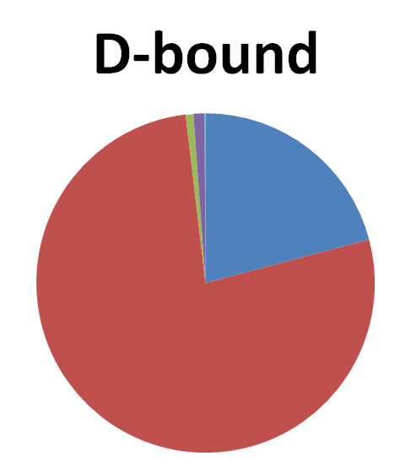
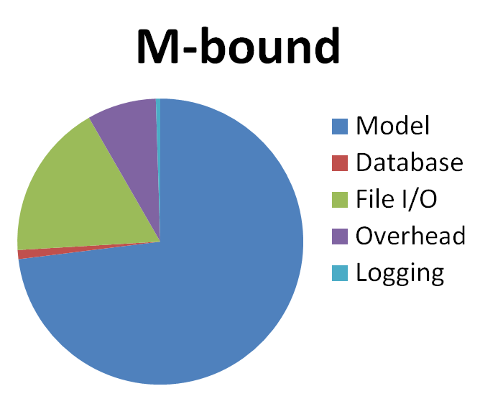
RUSLE2 Application Variants
D-bound
Model 21%
Database 77%
File I/O .75%
Overhead 1%
Logging .1%
M-bound
Model 73%
Database 1%
File I/O 18%
Overhead 8%
Logging 1%
D-bound: join w/ a nested query
M-bound: standard model

Slide 23
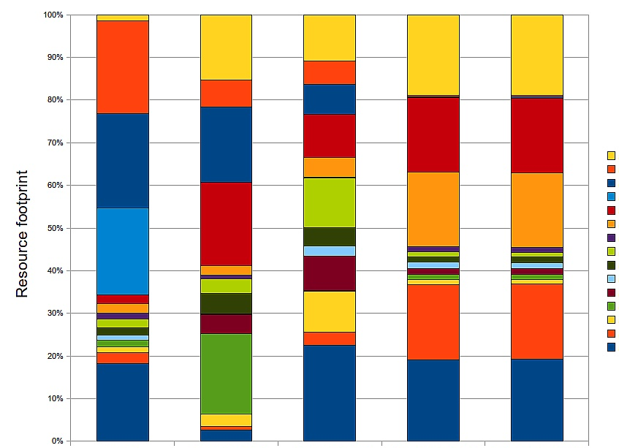
SC15
SC14
SC13
SC12
SC11
SC10
SC9
SC8
SC7
SC6
SC5
SC4
SC3
SC2
SC1
Resource Utilization Variance
for Component Deployments
  Boxes represent absolute deviation from mean
  Magnitude of variance for deployments
CPU time disk sector reads disk sector writes net bytes rcv’d net bytes sent

Slide 24
Tested Resource Utilization Variables
CPU
- CPU time
- CPU time in user mode (cpu usr)
- CPU time in kernel mode (cpu krn)
- CPU idle time (cpu_idle)
- # of context switches (contextsw)
- CPU time waiting for I/O (cpu_io_wait)
- CPU time serving soft interrupts (cpu_sint_time)
- (loadavg) (# proc / 60 secs)
c
Disk
- Disk sector reads (dsr)
- Disk sector reads completed (dsreads)
- Merged adjacent disk reads (drm)
- Time spent reading from disk (readtime)
- Disk sector writes (dsw)
- Disk sector writes completed (dswrites)
- Merged adjacent disk writes (dwm)
- Time spent writing to disk (writetime)
Network
- Network bytes sent (nbr)
- Network bytes received (nbs)

Slide 25


(15) RUSLE2
deployments
Resource
Utilization
Data
SC1
20x Ensembles
M D
F L
100 random runs
SC5
100 random runs
script
capture
M
D
F L
100 random runs
100 random runs
SC8
100 random runs
M
D
F L
100 random runs
100 random runs
Experimental Data Collection
  1st run → training dataset
  2nd run → test dataset
SC11
100 random runs
M F
D
L
100 random runs
JSON object
SC14
M D
L
F

Slide 26
Experimental Results

Slide 27
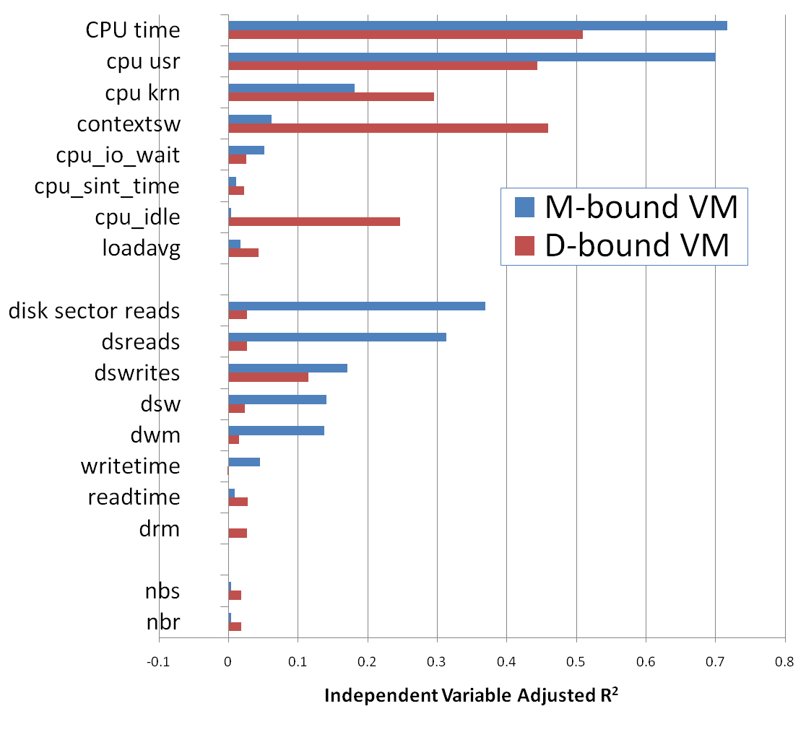
RQ1 – Which are the best predictors? VM Variables
CPU
Disk I/O
Network I/O

Slide 28
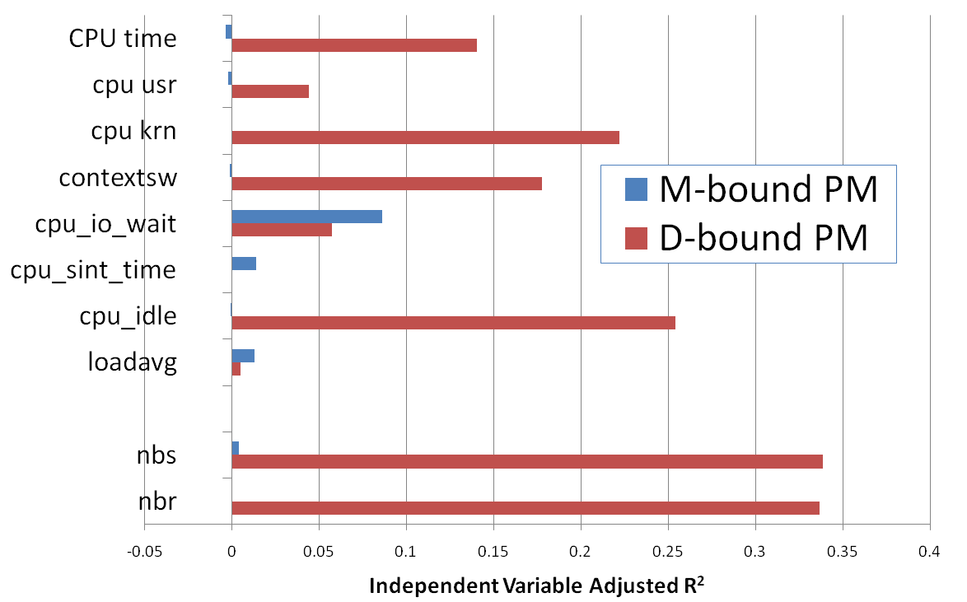
RQ1 – Which are the best predictors? PM Variables
CPU
Network I/O

Slide 29
RQ2 – How should VM resource utilization data be used by performance models?
Combination:
  RU_{data}=RU_{M}+RU_{D}+RU_{F}+RU_{L}
Used Individually:
  RU_{data}={RU_{M}; RU_{D}; RU_{F}; RU_{L};}

Slide 30
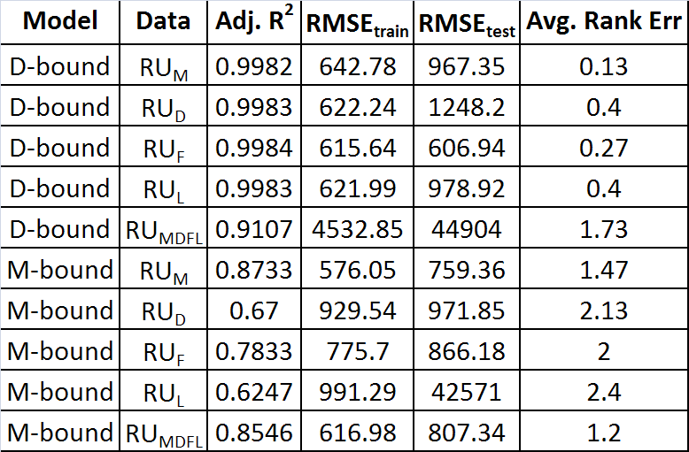
RQ2 – How should VM resource utilization data be used by performance models?
D-bound separate
RU_{M} or RU_{MDFL}
for M-bound was better !
D-bound combined
M-bound separate
Treating VM data separately
for D-bound was better !
Note the larger RMSE
for D-bound RU_{MDFL}!
M-bound combined

Slide 31
RQ3 – Which modeling techniques were best?
Multiple Linear Regression (MLR)
Stepwise Multiple Linear Regression (MLR-step)
Multivariate Adaptive Regression Splines (MARS)
Artificial Neural Network (ANNs)

Slide 32
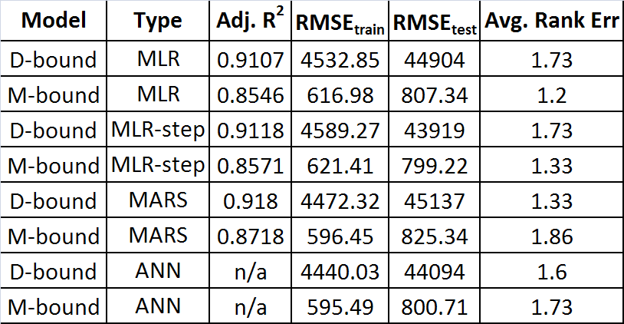
RQ3 – Which modeling techniques were best?
Model performance did not vary much
Best vs. Worst
D-Bound M-Bound
.11% RMSE_{train} .08%
.89% RMSE_{test} .08%
.40 rank err .66
Multiple
Linear
Regression
Stepwise
MLR
Multivariate
Adaptive
Regresion
Splines
RU_{MDFL} data used to
compare models.
Had high RMSE_{test} error
for D-Bound (32% avg)
Artifical
Neural
Network

Slide 33
Conclusions

Slide 34
Conclusions
RQ1)
RQ2)
RQ3)
CPU statistics were the best predictors
The best treatment of resource utilization statistics was model specific.
- (RU_{MDFL}) best for M-Bound RUSLE2 (more I/O)
- Individual VM stats (e.g. RU_{M}) best for D-Bound RUSLE2 (more CPU)
ANN and MARS provided lower RMS_{error}.
All models adequately predicted performance and ranks

Slide 35
Questions

Slide 36
Extra Slides

Slide 37

Gaps in Related Work
Existing approaches do not consider
  VM image composition
  Complementary component placements
  Interference among components
  Minimization of resources (# VMs)
  Load balancing of physical resources
Performance models ignore
  Disk I/O
  Network I/O
  VM and component location

Slide 38
Infrastructure Management
Service Requests
  Scale Services
  Tune Application Parameters
  Tune Virtualization Parameters
Application
Servers
Load Balancer
Load Balancer
distributed cache
noSQL data stores
rDBMS

Slide 39
Provisioning Variation
Request(s) to
launch VMs
VMs Share PM
CPU / Disk / Network
VM
Physical Host
Physical Host
Physical Host
VM
VM
VM
VM
VM
VM
Ambiguous
Mapping
VM
VM
VM
VM
VM
Physical Host
Physical Host
Physical Host
VM
VM
VM
VM
VM
VM
VMs Reserve
PM Memory Blocks
PERFORMANCE

Slide 40
Application Profiling Variables
Predictive Power

Slide 41

Application Deployment Challenges
VM image composition
Service isolation vs. scalability
Resource contention among components
Provisioning variation
  Across physical hardware

Slide 42
Resource Utilization Statistics
VMs
  Reserve PM memory
  Share CPU, disk, and network I/O resources
VM application performance
  Reflects quality of load balancing of shared resources
    Resource contention → performance degradation
    Resource surplus → good performance, higher costs

Slide 43
Resource Utilization Variables
Statistic |  | Description
P/V | CPU time | CPU time in ms
P/V | cpu usr | CPU time in user mode in ms
P/V | cpu krn | CPU time in kernel mode in ms
P/V | cpu_idle | CPU idle time in ms
P/V | contextsw | Number of context switches
P/V | cpu_io_wait | CPU time waiting for I/O to complete
P/V | cpu_sint_time | CPU time servicing soft interrupts
V | dsr | Disk sector reads (1 sector = 512 bytes)
V | dsreads | Number of completed disk reads
V | drm | Number of adjacent disk reads merged
V | readtime | Time in ms spent reading from disk
V | dsw | Disk sector writes (1 sector = 512 bytes)
V | dswrites | Number of completed disk writes
V | dwm | Number of adjacent disk writes merged
V | writetime | Time in ms spent writing to disk
P/V | nbr | Network bytes sent
P/V | nbs | Network bytes received
P/V | loadavg | Avg # of running processes in last 60 sec

Slide 44
Experimental Data
Script captured resource utilization stats
  Virtual machines
  Physical Machines
Training data: first complete run
  20 different ensembles of 100 model runs
  15 component configurations
  30,000 model runs
Test data: second complete run
  30,000 model runs

