Slide 1




Service Isolation vs. Consolidation:
Implications for IaaS
Cloud Application Deployment
Wes Lloyd, Shrideep Pallickara, Olaf David,
James Lyon, Mazdak Arabi, Ken Rojas
March 26, 2013
Colorado State University, Fort Collins, Colorado USA
IC2E 2013: IEEE International Conference on Cloud Engineering

Slide 2
Outline
Background
Research Problem
Research Questions
Experimental Setup
Experimental Results
Conclusions

Slide 3
Background

Slide 4
Traditional Application Deployment
Data
Spatial DB
rDBMS
Business
Services
Logging
Tracking DB
DODB / NOSQL
App Server
Apache Tomcat
Services
Services
Object Store
Physical Server(s)

Slide 5
IaaS Component Deployment
Application
Components
Virtual Machine (VM) Images
App Server
Image 1
Image 2
App Server
rDBMS write
rDBMS r/o
Component
Deployment
File Server
File Server
Log Server
Log Server
Load Balancer
Image n
rDBMS r/o
rDBMS write
Load Balancer
Dist. cache
Application “Stack”
. . .
PERFORMANCE

Slide 6
Research Problem

Slide 7
Amazon Web Services:
White Paper on Application Deployment
Amazon white paper suggests:
  “bundling the logical construct of a component into an Amazon Machine Image so that it can be deployed more often.”
  J. Varia, Architecting for the Cloud: Best Practices, Amazon Web Services White Paper, 2010, https://jineshvaria.s3.amazonaws.com/public/ cloudbestpractices-jvaria.pdf
To support application scaling

Slide 8
Service Isolation Advantages
MongoDB
Enables
  Horizontal scaling
  Fault tolerance
tomcat7
nginx
MongoDB
MongoDB
PostgreSQL
MySQL
MongoDB
MongoDB
MemcacheDB
MongoDB
SCALE
MongoDB

Slide 9

Service Isolation Overhead
Isolation requires
  Separate operating system instances
  More network traffic
PostgreSQL
tomcat7
nginx

Slide 10
Provisioning Variation
Request(s) to
launch VMs
VMs Share PM
CPU / Disk / Network
VM
Physical Host
Physical Host
Physical Host
VM
VM
VM
VM
VM
VM
Ambiguous
Mapping
VM
VM
VM
VM
VM
Physical Host
Physical Host
Physical Host
VM
VM
VM
VM
VM
VM
VMs Reserve
PM Memory Blocks
PERFORMANCE

Slide 11
Research Questions

Slide 12
Research Questions
RQ1:
RQ2:
RQ3:
What performance and resource utilization implications result based on how application components are deployed?
  How does increasing VM memory impact performance?
How much overhead results from VM service isolation?
Can resource utilization data be used to build models to predict performance of component deployments?

Slide 13

Gaps in Related Work
Prior work investigates:
  Virtualization performance
  Isolation properties of hypervisors
  Autonomic scaling of application infrastructure
  Performance variation from
    Provisioning variation
    Shared cluster/cloud loads
No studies have investigated implications of how the application stack is deployed…

Slide 14
Experimental Setup

Slide 15
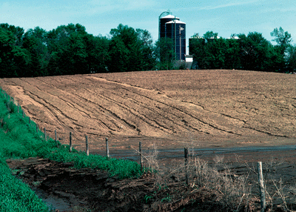
RUSLE2 Model
“Revised Universal Soil Loss Equation”
Combines empirical and process-based science
Prediction of rill and interrill soil erosion resulting from rainfall and runoff
USDA-NRCS agency standard model
  Used by 3,000+ field offices
  Helps inventory erosion rates
  Sediment delivery estimation
  Conservation planning tool

Slide 16
RUSLE2 Web Service
Multi-tier client/server application
  RESTful, JAX-RS/Java using JSON objects
  Surrogate for common architectures
App Server
Apache Tomcat
Geospatial rDBMS
File Server
nginx
Logging
Codebeamer
1.7+ million shapes
57k XML files, 305Mb
POSTGRESQL
OMS3
RUSLE2
POSTGIS

Slide 17
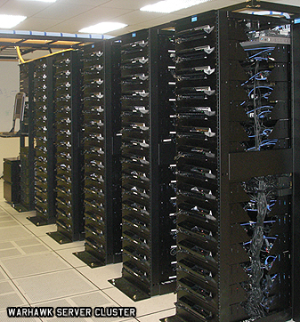
Eucalyptus 2.0 Private Cloud
(9) Sun X6270 blade servers
  Dual Intel Xeon 4-core 2.8 GHz CPUs
  24 GB ram, 146 GB 15k rpm HDDs
  CentOS 5.6 x86_64 (host OS)
  Ubuntu 9.10 x86_64 (guest OS)
Eucalytpus 2.0
  Amazon EC2 API support
  8 Nodes (NC), 1 Cloud Controller (CLC, CC, SC)
  Managed mode networking with private VLANs
  XEN hypervisor v 3.4.3, paravirtualization

Slide 18
RUSLE2 Components
Virtual Machine |  | Description
M | Model | Apache Tomcat 6.0.20, Wine 1.0.1, RUSLE2 Model, Object Modeling System (OMS 3.0)
D | Database | Postgresql-8.4, and PostGIS 1.4.0-2. soil data: 1.7 million shapes, 167 million points management data: 98 shapes, 489k points climate data: 31k shapes, 3 million points 4.6 GB for the state of TN
F | File Server | nginx http server 0.7.62 57,185 XML files consisting of 305MB.
L | Logger | Codebeamer 5.5 running 32-bit ApacheTomcat 6.0 Custom REST/JSON logging service as wrapper.

Slide 19
SC1
SC2
SC3
SC4
M D
F L
M D
F
L
M D
F L
M D
F
L
SC5
SC6
SC7
M
D
F L
M
D F
L
M
D
F
L
(15) Tested Component Deployments
  Each VM deployed to separate physical machines
  All components installed on composite image
  Script enabled/disabled components to achieve configs
SC8
SC9
SC10
M
D
F L
M
D L
F
M F
D L
SC11
SC12
SC13
M F
D
L
M L
D F
M L
D
F
SC14
SC15
M D
L
F
M L
F
D

Slide 20
Tested Resource Utilization Variables
CPU
CPU time
c
Disk
- Disk sector reads (dsr)
- Disk sector reads completed (dsreads)
Network
- Network bytes sent (nbr)
- Network bytes received (nbs)

Slide 21
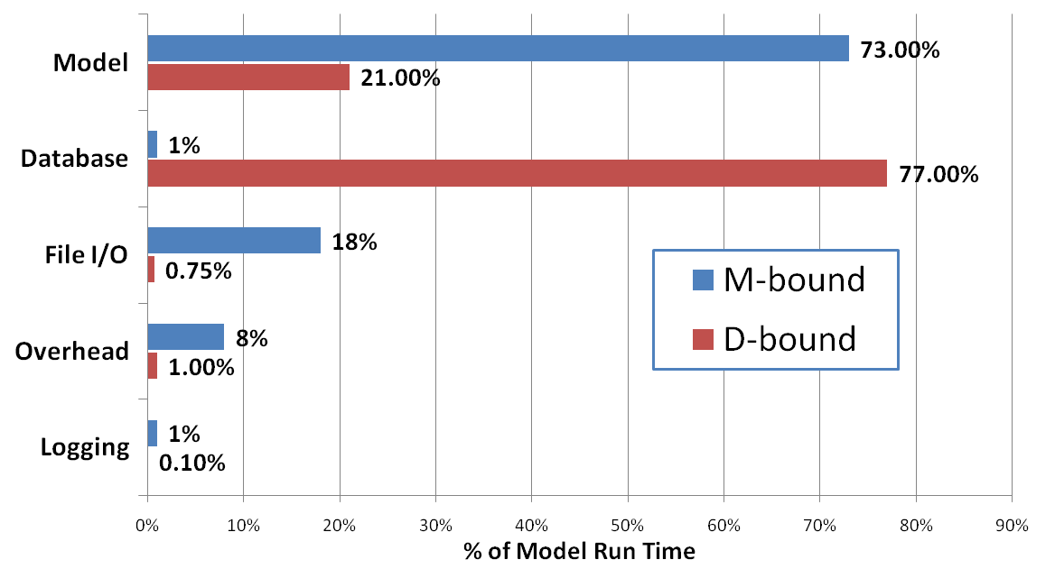
RUSLE2 Application Profiles
D-bound: join w/ a nested query
M-bound: standard model

Slide 22
Experimental Results

Slide 23
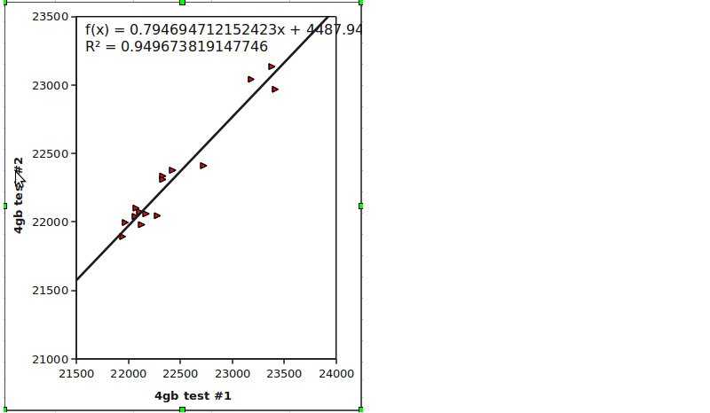
Reproducibility of tests
Slow group:
ah3, ah5, ah8*
Middle group:
ah4, ah9*, ah10*, ah13
Conclusion:
Service Composition of VMs mattered.
Performance is different and can be
measured with reproducible results.
Fast group:
ah1, ah2*, ah6*, ah7, ah11, ah12*, ah14, ah15
Test: 2 identical runs, 4GB VMs, 15 component deployments, 10 ensemble runs of 100 model runs each…
Performance was reproduced.
Strong correlation
p=0.000000000809050298
* - indicates same group membership as DBound

Slide 24
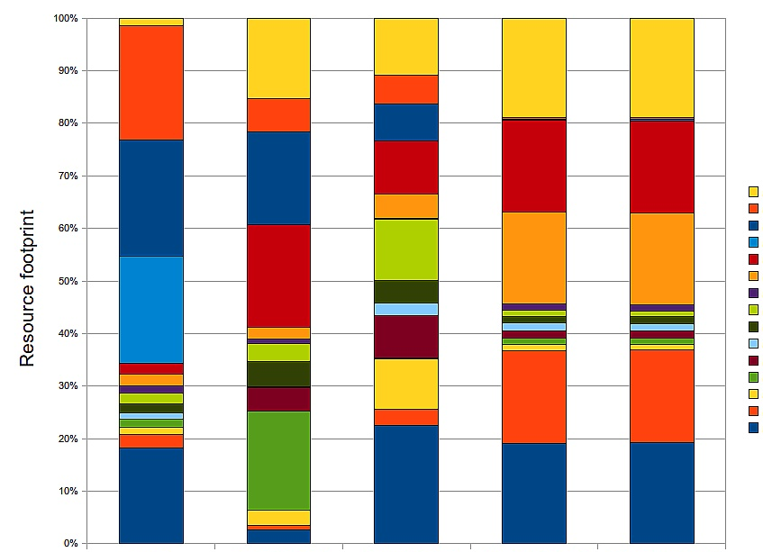
RQ1: Resource utilization implications from component deployments
  Boxes represent absolute deviation from mean (m-bound)
  Magnitude of variance for deployments
  ∆ Resource Utilization Change
  Min to Max Utilization
  m-bound d-bound
  CPU time: 6.5% 5.5%
  Disk sector reads: 14.8% 819.6%
  Disk sector writes: 21.8% 111.1%
  Network bytes received: 144.9% 145%
  Network bytes sent: 143.7% 143.9%
SC15
SC14
SC13
SC12
SC11
SC10
SC9
SC8
SC7
SC6
SC5
SC4
SC3
SC2
SC1
CPU time disk sector reads disk sector writes net bytes rcv’d net bytes sent

Slide 25
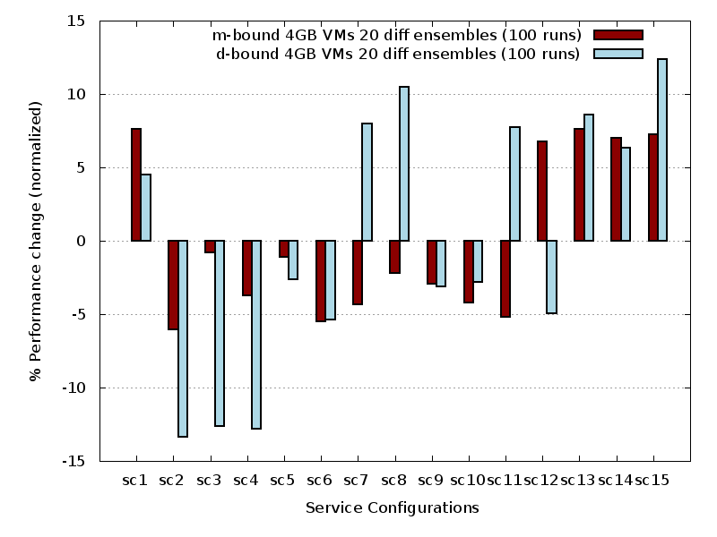
RQ1: Performance implications from component deployments
∆ Performance Change:
Min to max performance
M-bound: 14%
D-bound: 25.7%
Slower deployments
Faster deployments

Slide 26
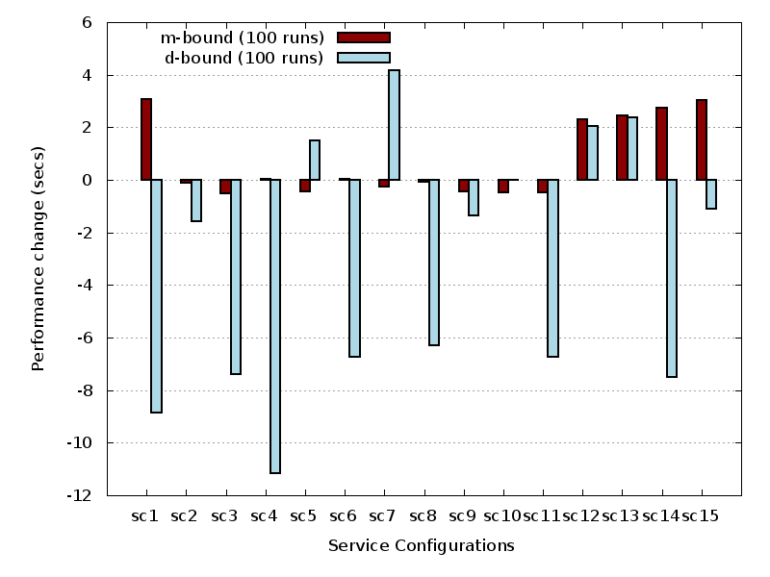
RQ1: How does increasing VM memory allocation impact performance?
In some cases…
more memory lead to
slower performance
More memory…
Faster performance

Slide 27
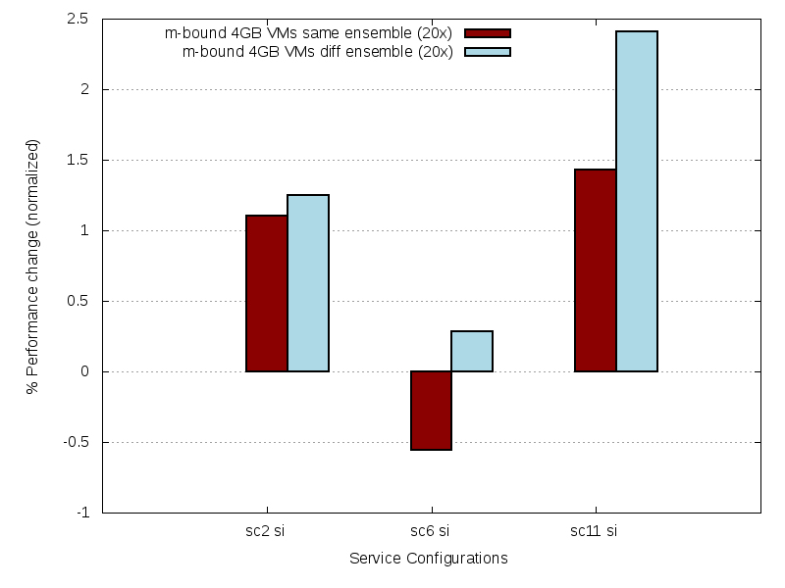
RQ2: How much overhead results from VM service isolation?
Performance Overhead
  Xen: ~1% average
  KVM: ~2.4% average
.3 %
1.2 %
2.4 %

Slide 28


(15) RUSLE2
deployments
Resource
Utilization
Data
SC1
20x Ensembles
M D
F L
100 random runs
SC5
100 random runs
script
capture
M
D
F L
100 random runs
100 random runs
SC8
100 random runs
Data used to build
multiple linear regression
performance model
  1st run → training dataset
  2nd run → test dataset
M
D
F L
100 random runs
100 random runs
SC11
100 random runs
M F
D
L
100 random runs
JSON object
SC14
M D
L
F

Slide 29
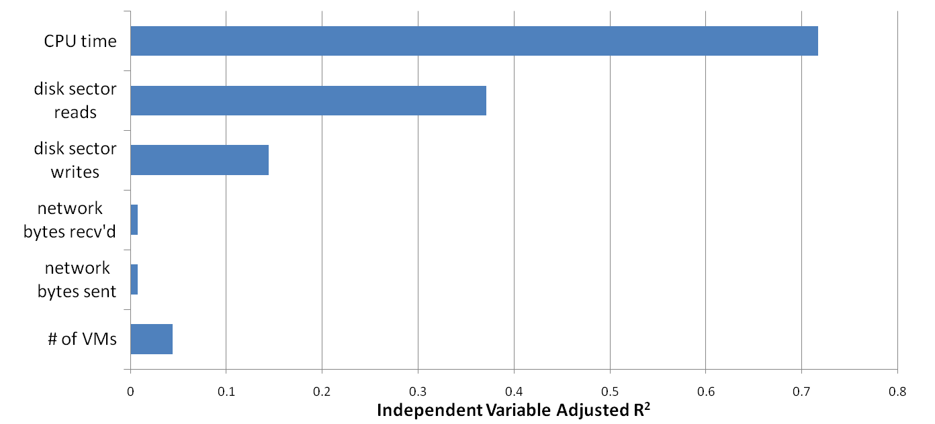
RQ3: Can resource utilization data be used to build models to predict performance of component deployments?
Multiple Linear Regression
Performance Model
For the test dataset:
  Combined R²: .8416
  Mean absolute error: 324ms (test dataset)
  Average rank error: 2 units
  Fastest deployment predicted accurately
CPU
.71
Disk I/O
.37
Network I/O
.14
Explained 84%
of the variance
.007
# VMs
.008
.04

Slide 30
Conclusions

Slide 31
Conclusions
RQ1:
RQ2:
RQ3:
Component deployments led to:
25% performance variation
Network and disk resource utilization most affected.
↑ VM memory did not always improve performance
Up to 2.4% performance overhead from service isolation
Our MLR-model accounted for 84% of the variance when predicting deployment performance

Slide 32
Questions

Slide 33
Extra Slides

Slide 34
Infrastructure Management
Service Requests
  Scale Services
  Tune Application Parameters
  Tune Virtualization Parameters
Application
Servers
Load Balancer
Load Balancer
distributed cache
noSQL data stores
rDBMS

Slide 35
Application Profiling Variables
Predictive Power

Slide 36

Application Deployment Challenges
VM image composition
Service isolation vs. scalability
Resource contention among components
Provisioning variation
  Across physical hardware

Slide 37
Resource Utilization Variables
Statistic |  | Description
P/V | CPU time | CPU time in ms
P/V | cpu usr | CPU time in user mode in ms
P/V | cpu krn | CPU time in kernel mode in ms
P/V | cpu_idle | CPU idle time in ms
P/V | contextsw | Number of context switches
P/V | cpu_io_wait | CPU time waiting for I/O to complete
P/V | cpu_sint_time | CPU time servicing soft interrupts
V | dsr | Disk sector reads (1 sector = 512 bytes)
V | dsreads | Number of completed disk reads
V | drm | Number of adjacent disk reads merged
V | readtime | Time in ms spent reading from disk
V | dsw | Disk sector writes (1 sector = 512 bytes)
V | dswrites | Number of completed disk writes
V | dwm | Number of adjacent disk writes merged
V | writetime | Time in ms spent writing to disk
P/V | nbr | Network bytes sent
P/V | nbs | Network bytes received
P/V | loadavg | Avg # of running processes in last 60 sec

Slide 38
Experimental Data
Script captured resource utilization stats
  Virtual machines
  Physical Machines
Training data: first complete run
  20 different ensembles of 100 model runs
  15 component configurations
  30,000 model runs
Test data: second complete run
  30,000 model runs

Slide 39


Application Deployments
n=# components; k=# components per set
Permutations
Combinations
But neither describes partitions of a set!

Slide 40


Bell’s Number
Number of ways a set of n elements can be partitioned into non-empty subsets
n | k
4 | 15
5 | 52
6 | 203
7 | 877
8 | 4,140
9 | 21,147
n | . . .
n = #components
VM deployments
config 1
config 2
Model
1 VM : 1..n components
M
D
M
D
F
Database
Component
Deployment
F
L
L
File Server
config n
Log Server
M
L
D
Application “Stack”
F
. . .
k= #configs
# of Configurations

Slide 41
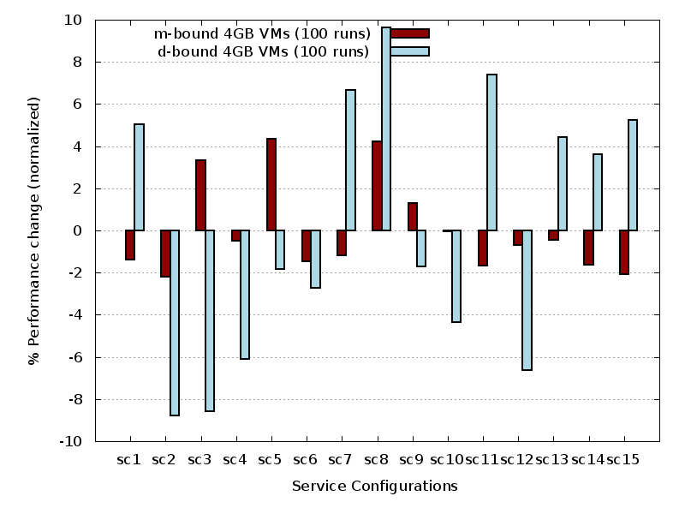
XEN Mbound vs Dbound Performance Same Ensemble

Slide 42
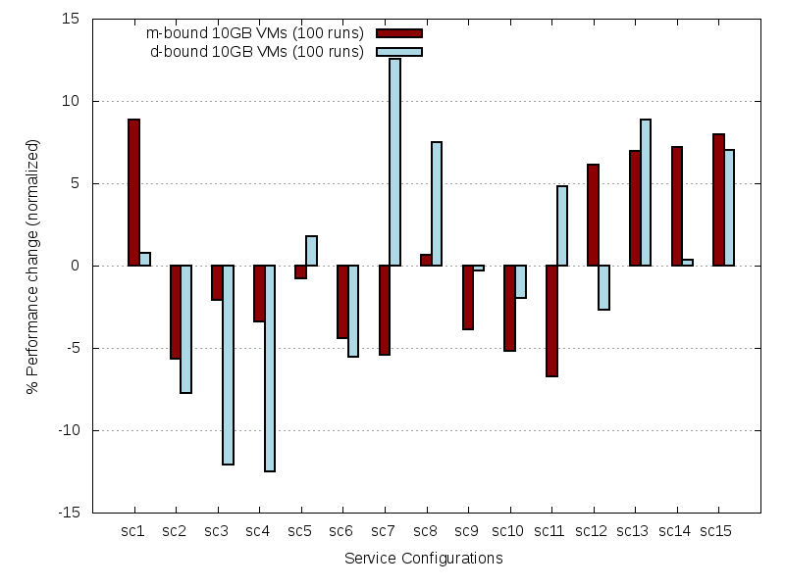
XEN 10 GB VMs

Slide 43
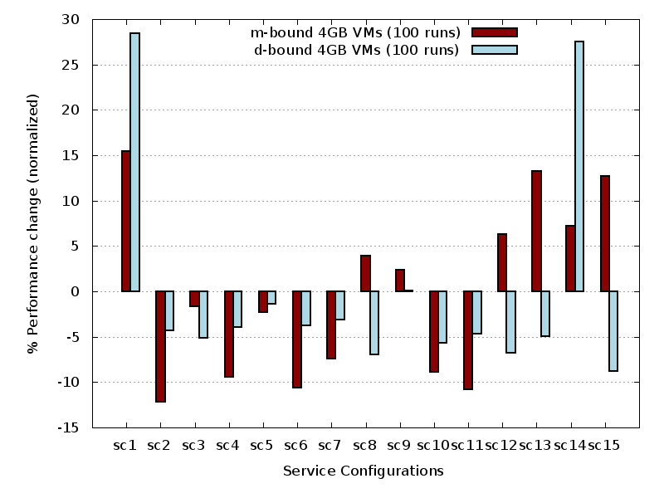
KVM Mbound vs Dbound Performance
Same Ensemble

Slide 44
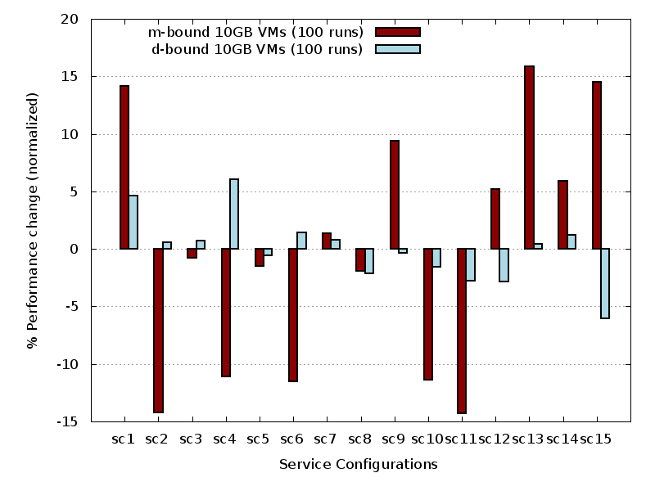
KVM 10GB Performance
Same Ensemble

Slide 45
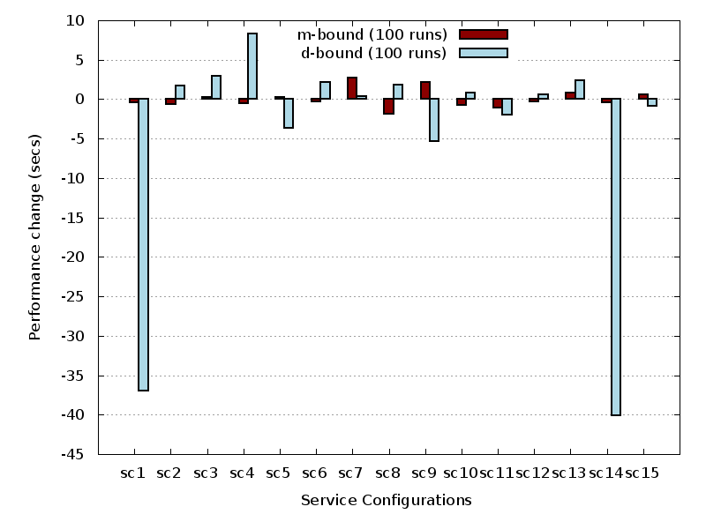
KVM 10 GB Performance Change
Same Ensemble

Slide 46
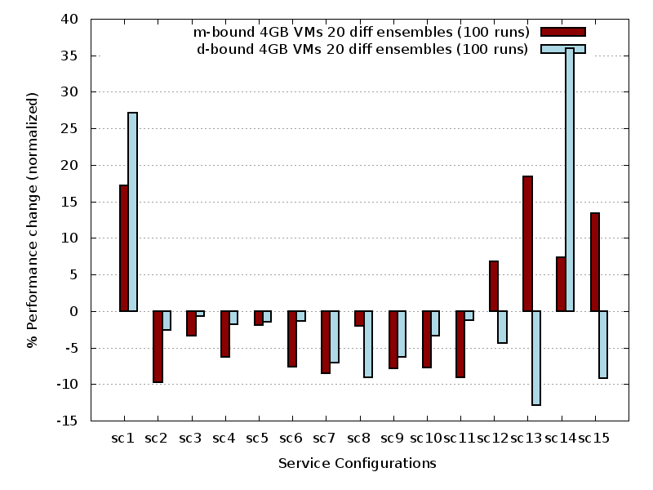
KVM Performance Comparison
Different Ensembles

Slide 47
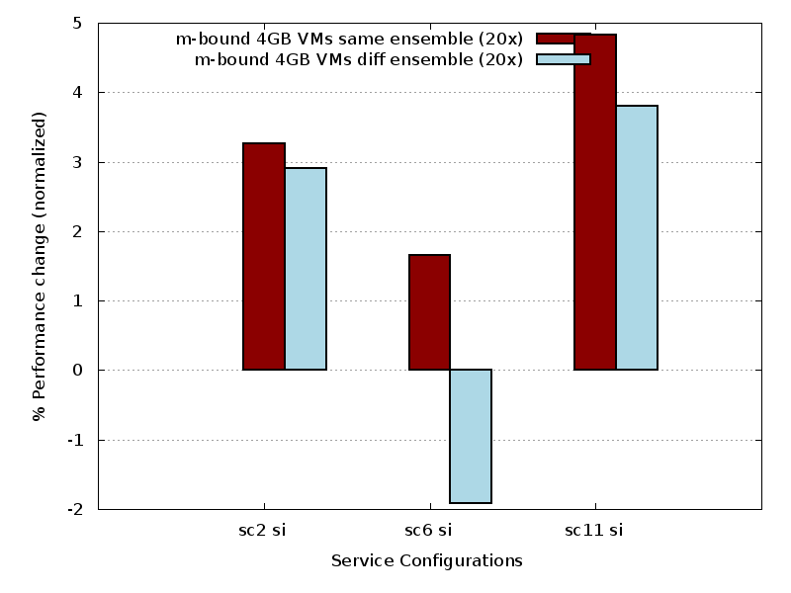
KVM Performance Change
From Service Isolation

Slide 48
Service Configuration Testing
Big VMs
  All application services installed on single VM
  Scripts enable/disable services to achieve configurations for testing
  Each VM deployed on separate host
Provisioning Variation (PV) Testing
  KVM used
  15 total service configurations
  46 possible deployments

Slide 49
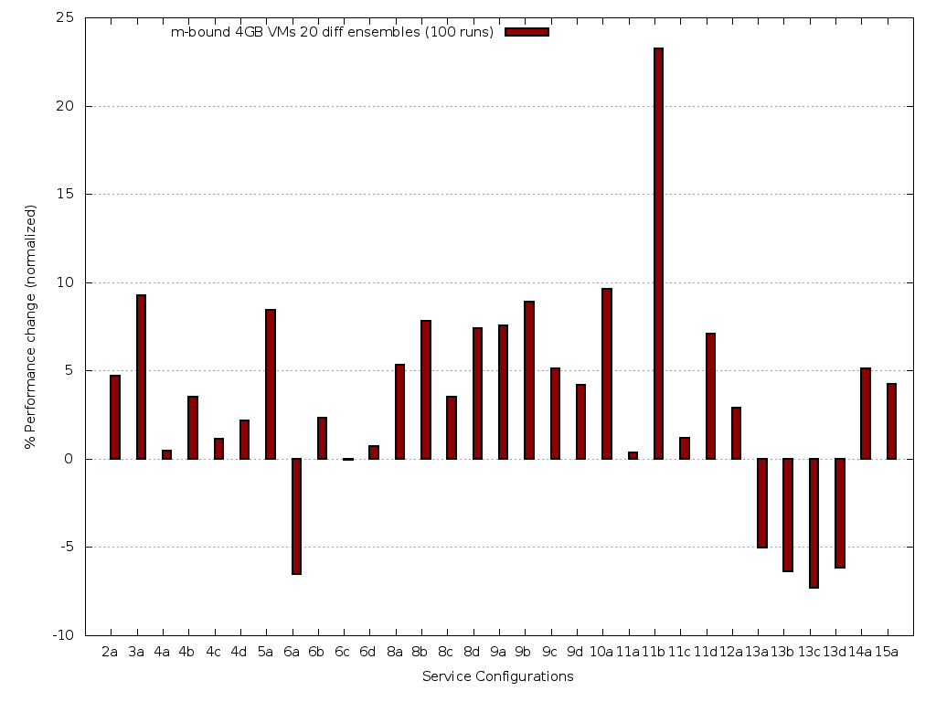
PV: Performance Difference vs. Physical Isolation

Slide 50
Service Configuration Testing - 2
Big VMs used in physical isolation were effective at identifying fastest service configurations
Fastest configurations isolate “L” service on separate physical host; and VMs
  Some provisioning variations faster
Other SC provisioning variations remained slow
  SC4A-D, SC9C-D
  Only SCs w/ avg ensemble performance < 30 seconds

Slide 51

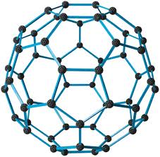

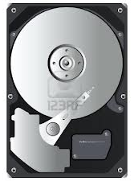


Can Resource Utilization Statistics
Model Application Performance?

Slide 52
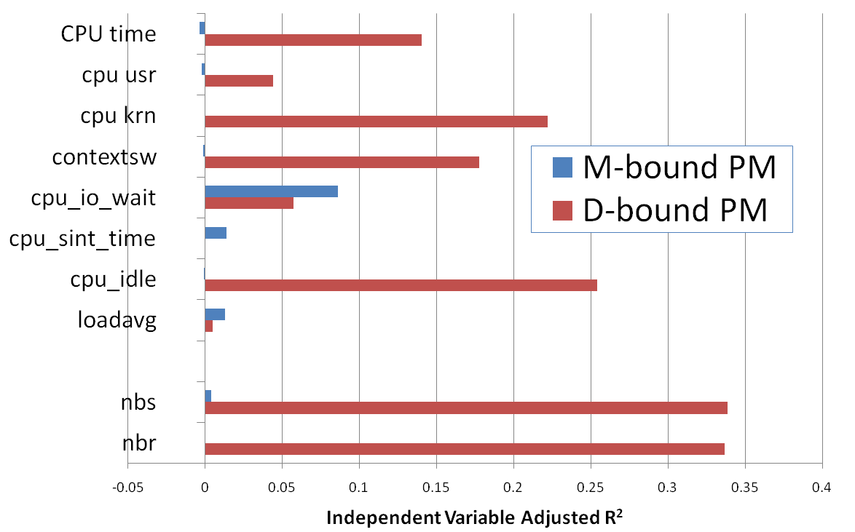
RQ1 – Which are the best predictors? PM Variables
CPU
Network I/O

Slide 53
RQ2 – How should VM resource utilization data be used by performance models?
Combination:
  RU_{data}=RU_{M}+RU_{D}+RU_{F}+RU_{L}
Used Individually:
  RU_{data}={RU_{M}; RU_{D}; RU_{F}; RU_{L};}

Slide 54
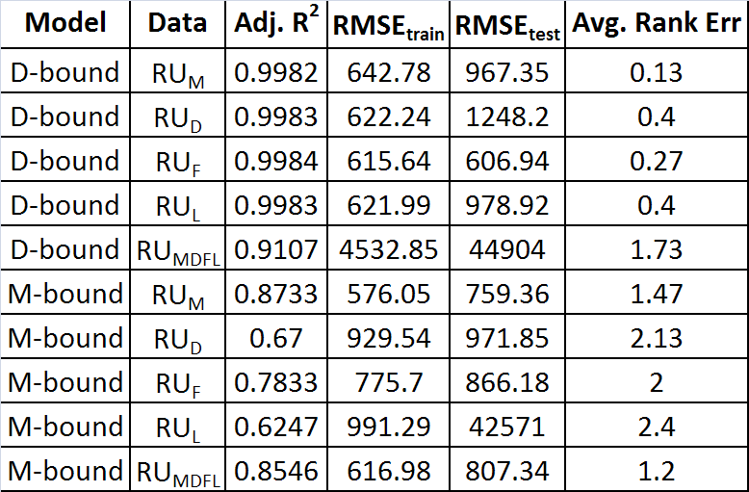
RQ2 – How should VM resource utilization data be used by performance models?
D-bound separate
RU_{M} or RU_{MDFL}
for M-bound was better !
D-bound combined
M-bound separate
Treating VM data separately
for D-bound was better !
Note the larger RMSE
for D-bound RU_{MDFL}!
M-bound combined

Slide 55
RQ3 – Which modeling techniques were best?
Multiple Linear Regression (MLR)
Stepwise Multiple Linear Regression (MLR-step)
Multivariate Adaptive Regression Splines (MARS)
Artificial Neural Network (ANNs)

Slide 56
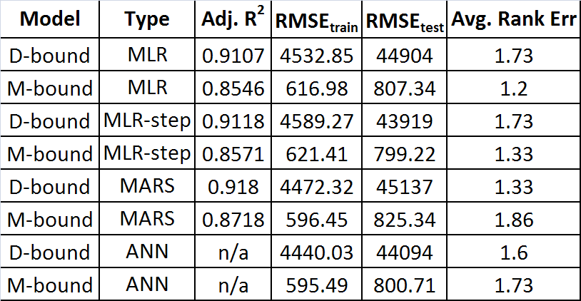
RQ3 – Which modeling techniques were best?
Multiple
Linear
Regression
Stepwise
MLR
Multivariate
Adaptive
Regresion
Splines
RU_{MDFL} data used to
compare models.
Had high RMSE_{test} error
for D-Bound (32% avg)
Artifical
Neural
Network
Model performance did not vary much
Best vs. Worst
D-Bound M-Bound
.11% RMSE_{train} .08%
.89% RMSE_{test} .08%
.40 rank err .66

Slide 57
Resource Utilization Statistics
CPU
- CPU time
- CPU time in user mode
- CPU time in kernel mode
- CPU idle time
- # of context switches
- CPU time waiting for I/O
- CPU time serving soft interrupts
- Load average (# proc / 60 secs)
Disk
- Disk sector reads
- Disk sector reads completed
- Merged adjacent disk reads
- Time spent reading from disk
- Disk sector writes
- Disk sector writes completed
- Merged adjacent disk writes
- Time spent writing to disk
c
Network
- Network bytes sent
- Network bytes received
PM
PM
VM
VM
VM
VM
VM

