Slide 1




Migration of Multi-tier Applications to
Infrastructure-as-a-Service Clouds:
An Investigation Using
Kernel-based Virtual Machines
Wes Lloyd, Shrideep Pallickara, Olaf David,
James Lyon, Mazdak Arabi, Ken Rojas
September 23, 2011
Colorado State University, Fort Collins, Colorado USA
Grid 2011: 12th IEEE/ACM International Conference on Grid Computing

Slide 2
Outline
Cloud Computing Challenges
Research Questions
RUSLE2 Model
Experimental Setup
Experimental Results
Conclusions
Future Work

Slide 3
Traditional Application Deployment
Data
Spatial DB
rDBMS
Business
Components
Logging
Tracking DB
DODB / NOSQL
App Server
Apache Tomcat
Components
Components
Object Store
Single Server

Slide 4
Cloud Application Deployment
Service Requests
Application
Servers
Load Balancer
Load Balancer
logging
noSQL datastores
rDBMS

Slide 5
Provisioning Variation
Request(s) to
launch VMs
Disk / Network
Shared
VM
Physical Host
Physical Host
Physical Host
VM
VM
VM
VM
VM
VM
Ambiguous
Mapping
VM
VM
VM
VM
VM
Physical Host
Physical Host
Physical Host
VM
VM
VM
VM
VM
VM
CPU / Memory
Reserved
PERFORMANCE

Slide 6
Virtualization Overhead
Application Profiles
Application A
Network
Disk
CPU
Memory
PERFORMANCE
Application B
Network
Disk
CPU
Memory

Slide 7
Research Questions
How should multi-tier client/server applications be deployed to IaaS clouds?
  How can we deliver optimal throughput?
How does provisioning variation impact application performance?
  Does VM co-location matter?
What overhead is incurred from using Kernel-Based virtual machines (KVM)?

Slide 8
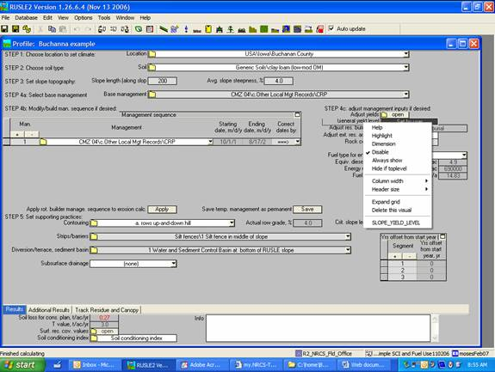
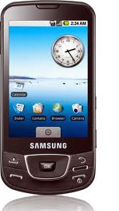
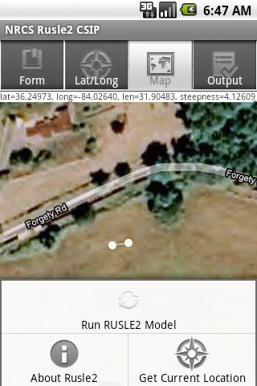
RUSLE2 Model

Slide 9
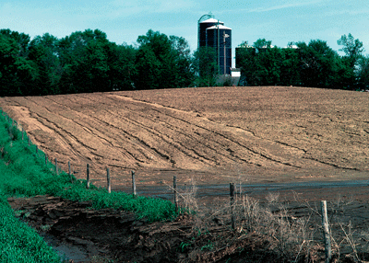
RUSLE2 Model
Revised Universal Soil Loss Equation
Combines empirical and process-based science
Prediction of rill and interrill soil erosion resulting from rainfall and runoff
USDA-NRCS agency standard model
  Used by 3,000+ field offices
  Helps inventory erosion rates
  Sediment delivery estimation
  Conservation planning tool

Slide 10
RUSLE2 Web Service
Multi-tier client/server application
  RESTful, JAX-RS/Java using JSON objects
  Surrogate for common architectures
App Server
Apache Tomcat
Geospatial rDBMS
File Server
nginx
Logging
Codebeamer
1.7+ million shapes
57k XML files, 305Mb
POSTGRESQL
OMS3
RUSLE2
POSTGIS

Slide 11
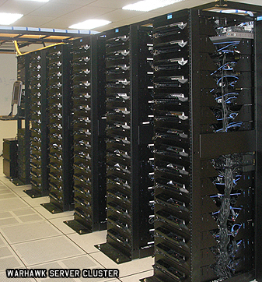
Eucalyptus 2.0 Private Cloud
(9) Sun X6270 blade servers
  Dual Intel Xeon 4-core 2.8 GHz CPUs
  24 GB ram, 146 GB 15k rpm HDDs
  Ubuntu 10.10 x86_64 (host)
  Ubuntu 9.10 x86_64 & i386 (guests)
Eucalytpus 2.0
  Amazon EC2 API support
  8 Nodes (NC), 1 Cloud Controller (CLC, CC, SC)
  Managed mode networking with private VLANs
  Kernel Based Virtual Machines, full virtualization

Slide 12
Experimental Setup
RUSLE2 modeling engine
  Configurable number of worker threads,
  1 engine per VM
  HAProxy round-robin load balancing
Model requests
  JSON object representation
  Model inputs: soil, climate, management data
Randomized ensemble tests
  Package of 25/100/1000 model requests (JSON object)
  Decomposed and resent to modeling engine (map)
  Results combined (reduce)

Slide 13
RUSLE2 Component Provisioning
P1/V1
P2/V2
Physical Host
Physical Host
Physical Host
M
D
M
D
F
F
L
L
M
Model
Database
Fileserver
Logger
P3/V3
D
Physical Host
Physical Host
Physical Host
Physical Host
M
D
F
L
F
L
P4/V4
Physical Host
Physical Host
M
F
D
L

Slide 14
RUSLE2 Test Models
d-bound
Database bound
Join on nested query
Much greater complexity
CPU bound
P1/V1
P2/V2
M
D
M
D
F
F
L
L
P3/V3
m-bound
M
D
F
L
Model bound
Standard RUSLE2 model
primarily I/O bound
P4/V4
M
L
D
F
14

Slide 15
Timing Data
All times are wall clock time
Time | Description
FileIO | XML parameterization file reads Subset of model time
Model | RUSLE2 model execution
climate/soil query | Spatial query execution
logging | Logging requests to queue
overhead | Calculated unaccounted for time
total | Complete model run

Slide 16
Experimental Results

Slide 17
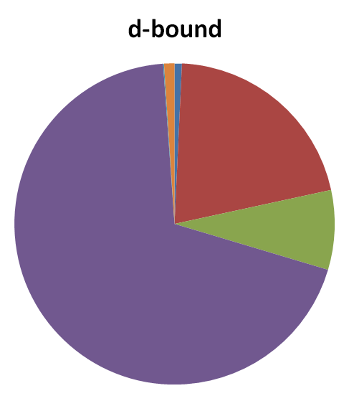
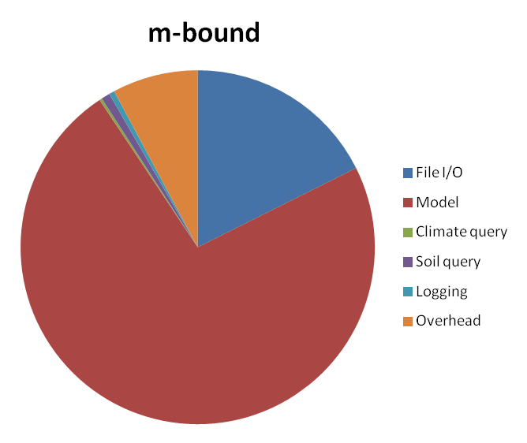
RUSLE2 Application Profile
D-bound
Database 77%
Model 21%
Overhead 1%
File I/O .75%
Logging .1%
M-bound
Model 73%
File I/O 18%
Overhead 8%
Logging 1%
Database 1%

Slide 18
Scaling RUSLE2:
Single Component Provisioning
V1 Stack
100 model run ensemble

Slide 19
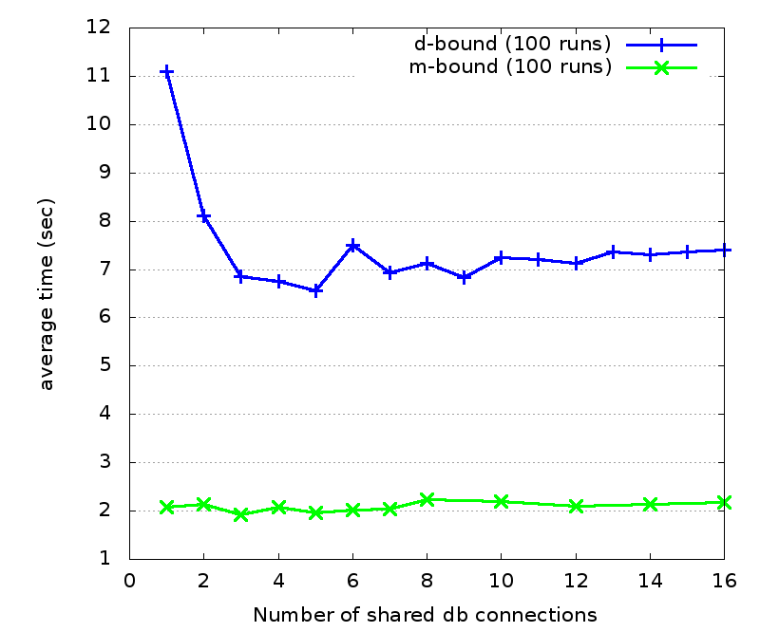
Impact of varying shared DB connections on average model execution time

Slide 20
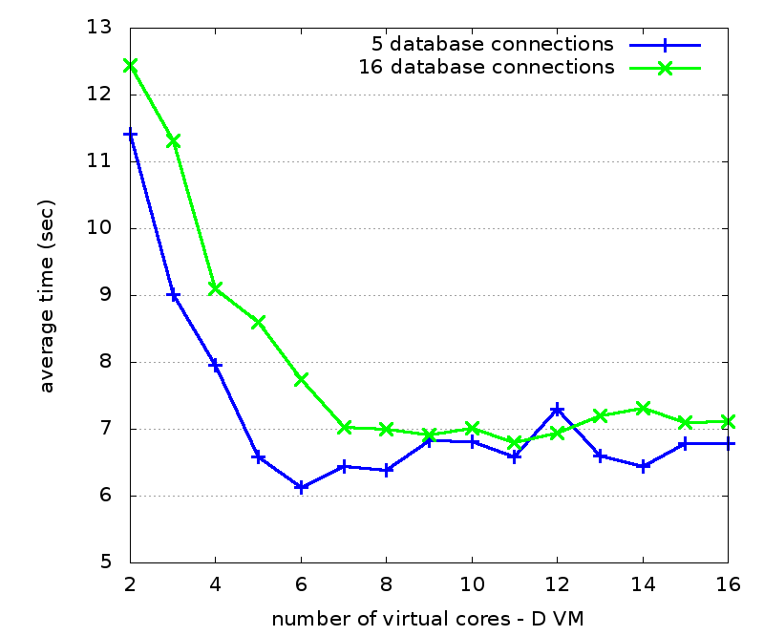
Impact of varying D VM virtual cores on average model execution time
d-bound

Slide 21
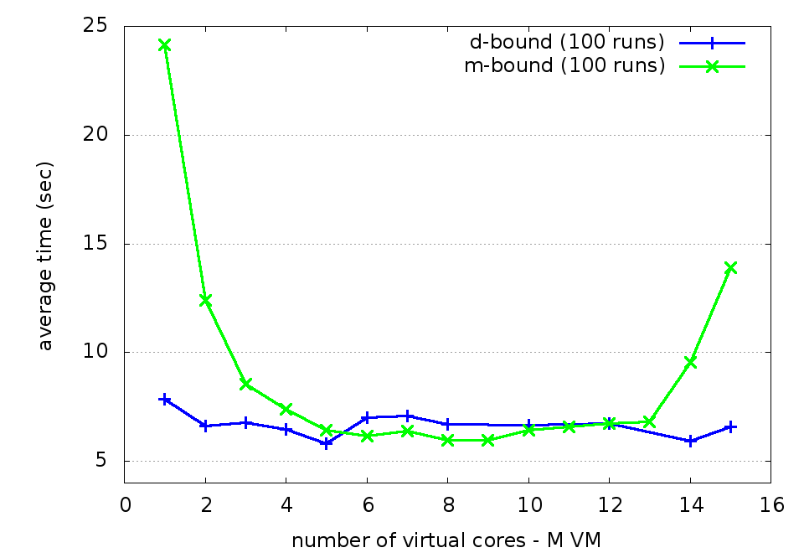
Impact of varying M VM virtual cores on average model execution time

Slide 22
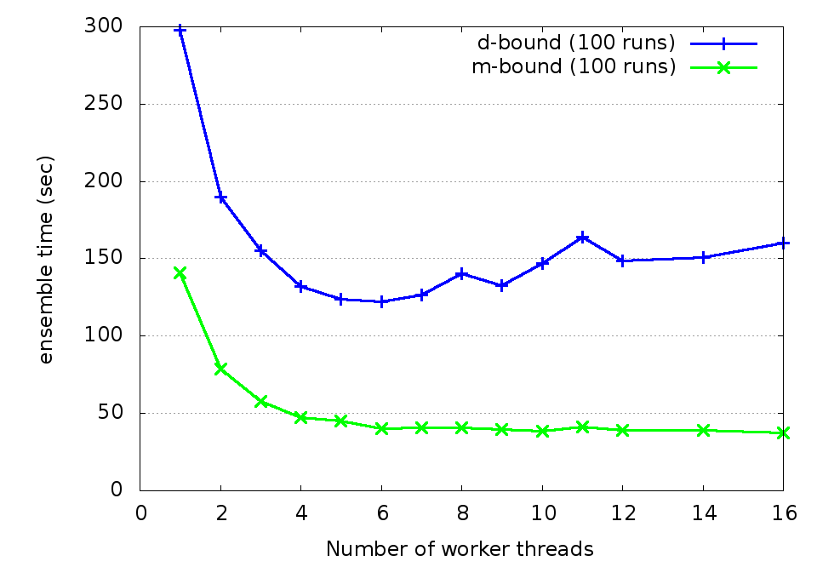
Impact of varying worker threads on ensemble execution time

Slide 23
RUSLE2 V1 Stack
d-bound
m-bound
100 model runs
100 model runs
3.75x
120 sec
32 sec
6 workers
5 dbconn /M
8 workers
8 dbconn /M
6 cores:
8 cores:
D
M
5 cores:
6 cores:
M
F
L
D
5 cores:
F
L

Slide 24
Scaling RUSLE2:
Multiple Component Provisioning
100 model run ensemble

Slide 25
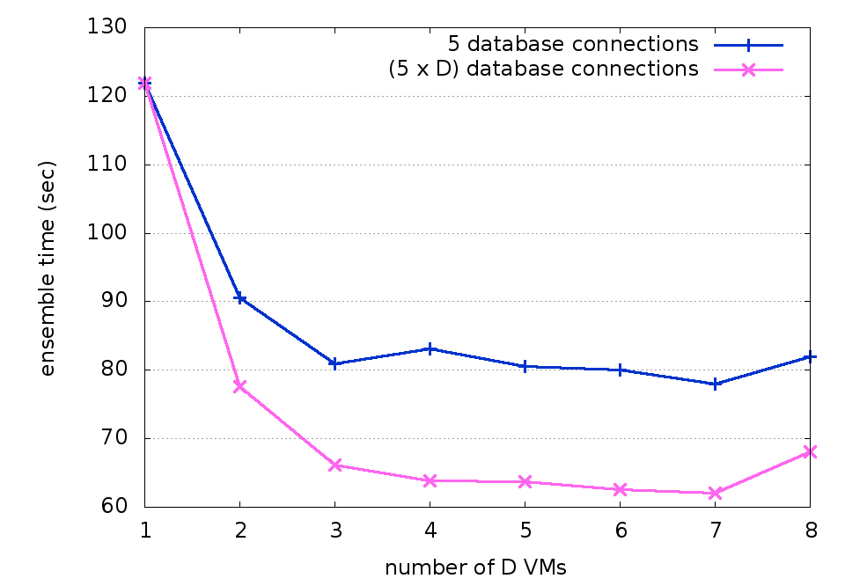
Impact of increasing D VMs and db connections on ensemble execution time
d-bound

Slide 26
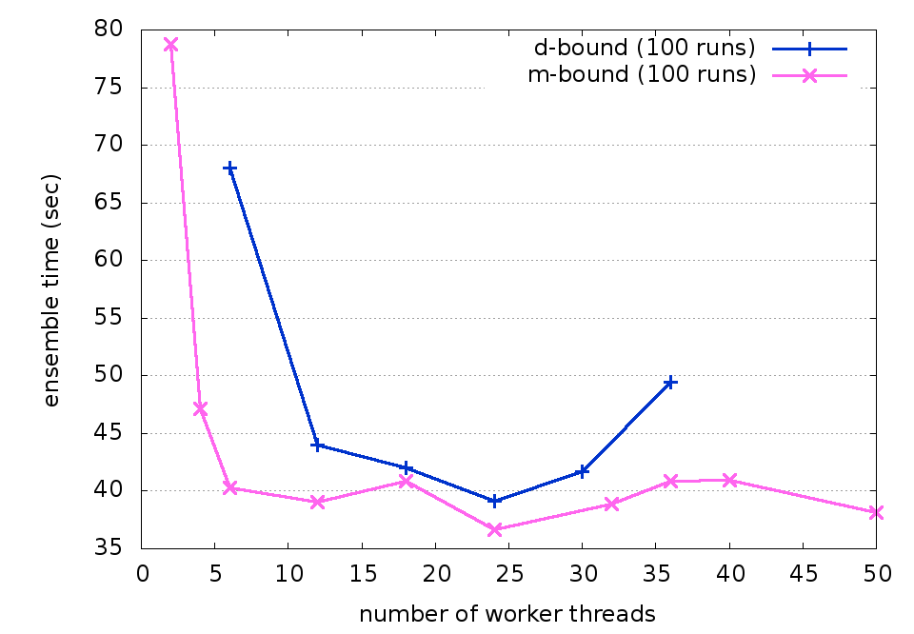
Impact of varying worker threads on ensemble execution time

Slide 27
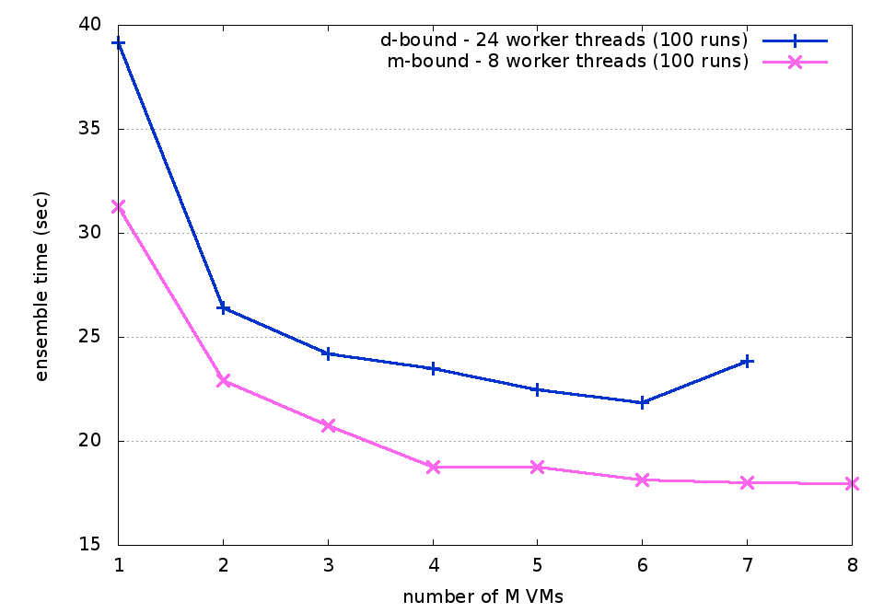
Impact of varying M VMs on ensemble execution time

Slide 28
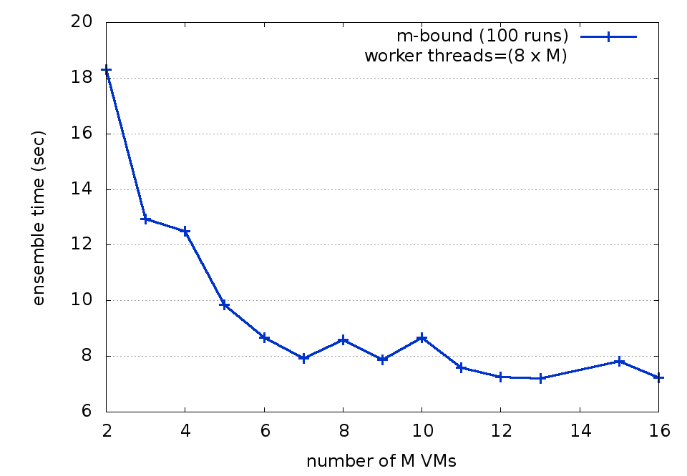
Impact of varying M VMs and worker threads on ensemble execution time
m-bound

Slide 29
RUSLE2 Scaled Up
d-bound
m-bound
100 model runs
100 model runs
5.5x
4.8x
21.8 sec
6.7 sec
24 workers
40 dbconn /M
48 workers
8 dbconn /M
6 cores:
8 cores:
D
D
D
D
D
D
D
D
M
M
M
M
M
M
M
M
M
M
M
M
M
M
M
M
5 cores:
6 cores:
M
M
M
M
M
M
F
L
D
5 cores:
F
L

Slide 30
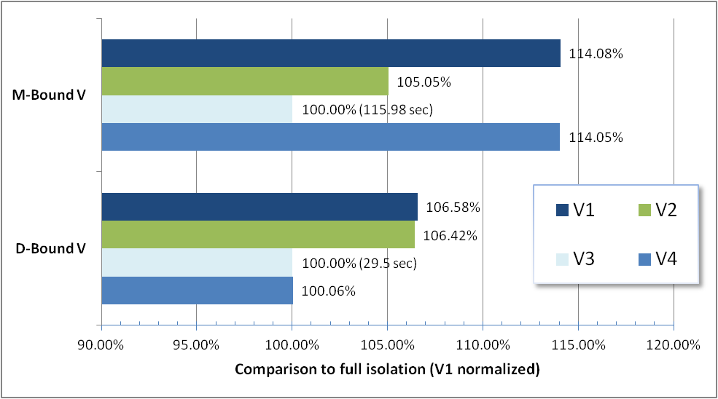
RUSLE2 - Provisioning Variation
V1
V2
V3
V4
M
D
M
D
F
M
D
F
L
M
L
D
F
L
L
F

Slide 31
KVM Virtualization Overhead
Application Profiles
D-bound
Network
Disk
CPU
Memory
10.78%
M-bound
Network
Disk
CPU
Memory
112.22%

Slide 32
Conclusions
Application scaling
  Applications with different profiles (CPU, I/O, network) present different scaling bottlenecks
  Custom tuning was required to surmount each bottleneck
  NOT as simple as increasing number of VMs
Provisioning variation
  Isolating I/O intensive components yields best performance
Virtualization Overhead
  I/O bound applications are more sensitive
  CPU bound applications are less impacted

Slide 33
Future Work
Virtualization benchmarking
  KVM paravirtualized drivers
  XEN hypervisor(s)
  Other hypervisors
Develop application profiling methods
Performance modeling based on
  Hypervisor virtualization characteristics
  Application profiles
Profiling-based approach to resource scaling

Slide 34
Questions
Application scaling
  Applications with different profiles (CPU, I/O, network) present different scaling bottlenecks
  Custom tuning was required to surmount each bottleneck
  NOT as simple as increasing number of VMs
Provisioning variation
  Isolating I/O intensive components yields best performance
Virtualization Overhead
  I/O bound applications are more sensitive
  CPU bound applications are less impacted

Slide 35
Extra Slides

Slide 36
Related Work
Provisioning Variation
  Amazon EC2 VM performance variability [Schad et al.]
  Provisioning Variation [Rehman et al.]
Scalability
  SLA-driven automatic bottleneck detection and resolution [Iqbal et al.]
  Dynamic 4-part switching architecture [Liu and Wee]
Virtualization Benchmarking
  KVM/XEN Hypervisor comparison[Camargos et al.]
  Cloud middleware and I/O paravirtualization [Armstrong and Djemame]

Slide 37
IaaS Cloud Computing
Benefits:
Multiplexing resources w/ VMs
Hybrid Clouds private→public
Elasticity, Scalability
Service Isolation
Challenges:
Virtual Resource Tuning
Virtualization Overhead
VM image composition
Resource Contention
Application Tuning

Slide 38
IaaS Cloud Benefits (1/2)
Hardware Virtualization
  Enables sharing CPU, memory, disk, and network resources of multi-core servers
  Paravirtualization: XEN
  Full Virtualization: KVM
Service Isolation
  Infrastructure components run in “isolation”
    Virtual machines (VMs) provide explicit sandboxes
  Easy to add/remove/change infrastructure components

Slide 39
IaaS Cloud Benefits (2/2)
Resource Elasticity
  Enabled by service isolation
  Dynamic scaling of multi-tier application resources
    Scale number, location, and size of VMs
  Dynamic Load Balancing
Hybrid Clouds
  Enables scaling beyond local private cloud capacity
    Augment private cloud resources using a public cloud
      e.g. Amazon EC2

Slide 40
IaaS Cloud Challenges
Application deployment
Application tuning for optimal performance
Provisioning Variation
  Ambiguity of where virtual machines are provisioned across physical cloud machines
Hardware Virtualization Overhead
  Performance degradation from using virtual machines

Slide 41
RUSLE2: Multi-tier Client/Server application
Application stack surrogate for
  Web Application Server
    Apache Tomcat – hosts RUSLE2 model
  Relational Database
    Postgresql – supports geospatial queries for determining climate, soil, and management characteristics
  File Server
    Nginx – Provides climate, soil, and management XML files used for model parameterization
  Logging Server
    Codebeamer – model logging/tracking

Slide 42
Experimental Setup (1/2)
RESTful webservice
  Java implementation using JAX-RS
  JSON objects
Object Modeling System 3.0
  Java Framework supporting component oriented modeling
  Interfaces with RUSLE2 Legacy Visual C++ implementation using RomeShell and WINE
Hosted by Apache Tomcat

Slide 43
RUSLE2 Components
Virtual Machine |  | Description
M | Model | 64-bit Ubuntu 9.10 server w/ Apache Tomcat 6.0.20, Wine 1.0.1, RUSLE2, Object Modeling System (OMS 3.0)
D | Database | 64-bit Ubuntu 9.10 server w/ Postgresql-8.4, and PostGIS 1.4.0-2. soil data: 1.7 million shapes, 167 million points management data: 98 shapes, 489k points climate data: 31k shapes, 3 million points 4.6 GB for the state of TN and CO
F | File Server | 64-bit Ubuntu 9.10 server w/ nginx 0.7.62 Serves XML files to parameterize RUSLE2 57,185 XML files consisting of 305MB.
L | Logger | 32-bit Ubuntu 9.10 server with Codebeamer 5.5 running on Tomcat. Custom RESTful JSON-based logging web service provides a wrapper.

Slide 44
Provisioning Variation
Physical location of VMs placement is nondeterministic which may result in varying VM performance characteristics
 | Node 1 | Node 2 | Node 3 | Node 4
P1/V1 | M D F L
P2/V2 | M | D F L
P3/V3 | M | D | F | L
P4/V4 | M L F | D

Slide 45
RUSLE2 Deployment
Two versions tested
  Database bound (d-bound)
    Model throughput bounded by performance of spatial queries
      Spatial queries were more complex than required
    Primarily processor bound
  Model bound (m-bound)
    Model throughput bounded by throughput of RUSLE2 modeling engine
    Processor and File I/O bound

Slide 46
RUSLE2- Single Stack
D-bound
  100-model run ensemble ~120 seconds
  6 worker threads, 5 database connections
  D: 6 CPU cores
  M, F, L: 5 CPU cores
M-bound
  100-model run ensemble ~32 seconds
  8 worker threads, 8 database connections
  M: 8 CPU cores
  D: 6 CPU cores
  F, L: 5 CPU cores

Slide 47
RUSLE2- scaled using IaaS cloud
D-bound
  100-model run ensemble ~21.8 seconds (5.5x)
  24 worker threads, 40 database connections per M
  D: 8 VMs, 6 CPU cores
  M: 6 VMs, 5 CPU cores
  F, L: 5 CPU cores
M-bound
  100-model run ensemble ~6.7 seconds (4.8x)
  48 worker threads, 8 database connections per M
  M: 16 VMs, 8 CPU cores
  D: 6 CPU cores
  F, L: 5 CPU cores

Slide 48
KVM Virtualization Overhead
 | D-bound Virt O/H | P1 D-bound average | V1 D-bound average | M-bound Virt O/H | P1 M-bound average | V1 M-bound average
TOTAL | 10.78% | 6.046 | 6.698 | 112.22% | .845 | 1.792
model | 54.50% | .968 | 1.496 | 100.16% | .816 | 1.632
fileIO | 319.70% | .056 | .234 | 463.54% | .0566 | .319
climate query | -11.41% | .692 | .613 | 404.54% | .00128 | .00645
soil query | 3.25% | 4.371 | 4.513 | 12.04% | .0118 | .0133
logging | 1360.69% | .0003 | .0047 | 2680.58% | .00035 | .0959
overhead | 395.14% | .0143 | .0708 | 740.02% | .0155 | .130

Slide 49
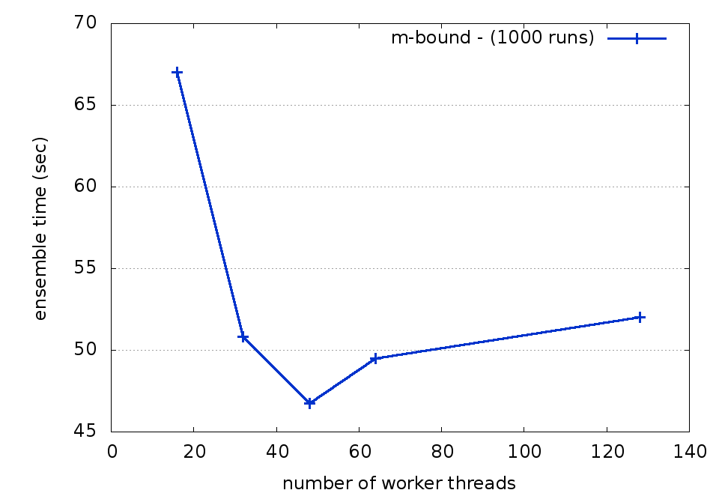
Impact of varying worker threads with 16 M VMs on ensemble execution time
m-bound
8 cores:
M
M
M
M
M
M
M
M
M
M
M
M
M
M
M
M

Slide 50
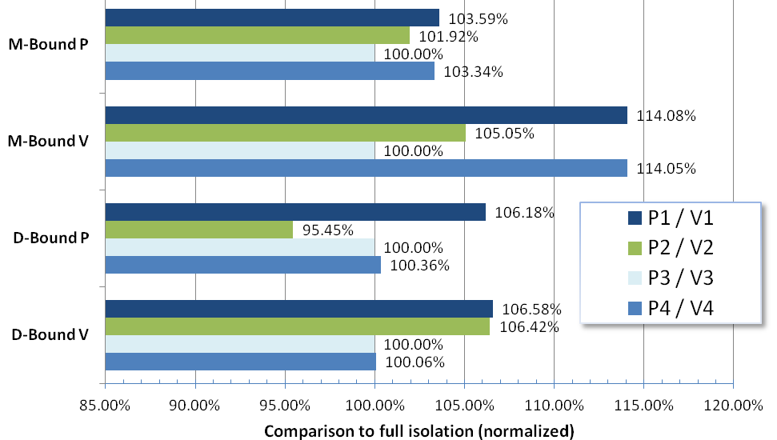
RUSLE2 - Provisioning Variation
P1/V1
P2/V2
P3/V3
P4/V4
M
D
M
D
F
M
D
F
L
M
L
D
F
L
L
F

Slide 51
Virtualization
Virtual Machines (guests)
  Software programs hosted by a physical computer
    Appear as a single “process” on the host machine
  No direct access to physical devices
    Devices are emulated
  Incurrs varying degrees of overhead
    Processor
    Device I/O

Slide 52
Types of Virtualization
Paravirtualization (XEN - Amazon)
  Device emulation provided using special Linux kernels
  Almost direct access to some physical resources → leads to faster I/O performance
Full virtualization (KVM – Eucalyptus, others)
  Device emulation provided natively with on-CPU support
  Special kernels not required
  CPU mode switching for device I/O → leads to slower I/O performance
Container based virtualization (OpenVZ, Linux-VServer)
  Not true virtualization, but operating system “containers”, where all use same kernel
  No commercial vendor support

Slide 53
Testing Infrastructure
Ensemble runs
  Groups of RUSLE2 model runs packaged together as a single JSON object
    25, 100, and 1000 model runs
  Randomized model parameterization
    Slope length, steepness, management practice, latitude, longitude
  Defeating Caching
    All services restarted prior to each test
    Eliminates “training” effect from repeat execution of model test sets

Slide 54
Questions

