Slide 1
Development Traps—and Escaping Development Traps?
Victor Menaldo Associate Professor University of Washington

Slide 2
Political Economy’s Contributions to Understanding Development
1) Property rights & institutions that reduce transaction costs are imperative
Provide incentives to save & invest
Undergird financial systems
2) This means the rule of law & widespread trust
Limits on executive authority
The government must enforce contracts fairly
3) The government should also address market failures
Provide intellectual property rights to incentivize R&D, for example
Underwrite credit bureau that discloses credit histories, for example
Notes:
1) Property Rights & institutions that reduce transaction costs imperative
Provide incentives to save & invest
Undergird financial systems (secure property rights mean collateral to back up loans/mean that govt. won’t expropriate bank from shareholders or steal deposits).

Slide 3
Puzzle of Underdevelopment: Govts. do the opposite of what they should
1) Governments in developing countries weaken property rights and increase transaction costs
Fail to codify land rights, for example
Forgive the bad loans of influential borrowers, for example
2) Violate rule of law & foment mistrust
Abuse executive authority
Use legal system/regulation to pick winners & losers
3) Let market failures fester
Fail to protect intellectual property rights, for example
Foster segmented financial markets, for example
Notes:
1) Governments in developing countries deliberately weaken property rights and increase transaction costs
Fail to codify land rights (Subsaharan Africa)
Expropriate healthy banks or forgive bad loans (India & Bangladesh)
2) Violate the rule of law & foment mistrust
Abuse executive authority (Venezuela)
Pick winners and losers (non-competitive bidding/patronage politics/crony capitalism)
3) Let market failures fester
Fail to protect intellectual property rights
Foster segmented financial markets (banks cannot hedge against localized shocks & credit fails to flow across regions)

Slide 4
Explaining the Puzzle of Deliberate Underdevelopment: 3 popular views
1) Politicians’ comparative advantage is patronage
When institutions weak, politicians compete based on clientilism, not programmatic policies
Politicians lack reputation for delivering public goods or good policies, so promises to reform not believable
2) Spoilers block reform
Losers from better policies stand to lose rents & political power
Promises to compensate them not credible
3) Rents are glue that holds society together
Developing countries fragile & combustible
Polarized btwn. rich & poor/divided along ethnic lines
The only way to tamp down conflict & violence is to create & distribute rents through powerful brokers who can keep peace
Notes:
3) Rents are glue that holds society together
Developing countries fragile & combustible
Polarized btwn. rich & poor/divided along ethnic lines
The only way to tamp down conflict & violence is to create & distribute rents through powerful brokers who can keep peace.
Corruption and clientilism is only way to create social order. Societies in developing world are powder kegs waiting to explode.

Slide 5
These are helpful explanations, but…
Fail to offer unified theory for explaining patterns endemic to underdeveloped economies.
Large, informal sectors that are unproductive
Policies explicitly aimed at suffocating innovation & entrepreneurship
Policies explicitly aimed at creating small & illiquid financial sectors (financial repression)
Endurance of state run monopolies & directed credit to state sanctioned cartels
Policies that cripple the rural sector & favor inefficient industries
Developing countries continued dependence on natural resources for employment, foreign exchange & state revenues
These are all symptoms of an underlying syndrome!

Slide 6
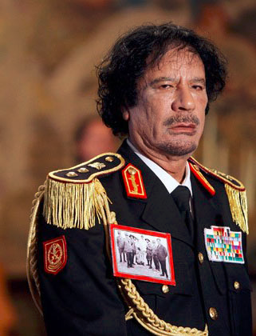
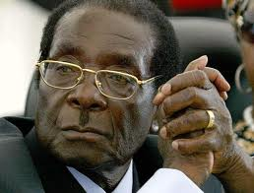
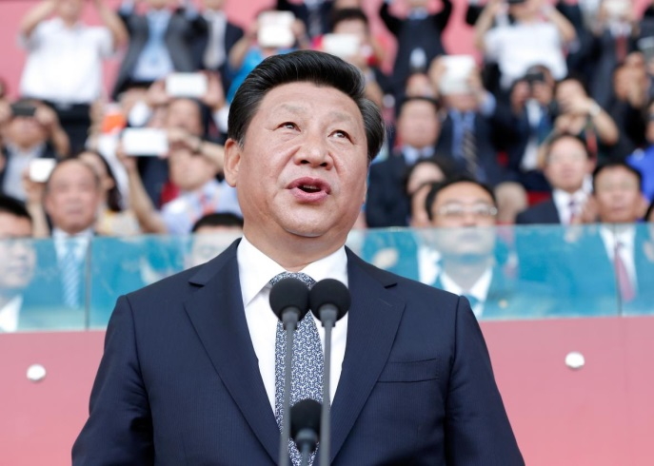
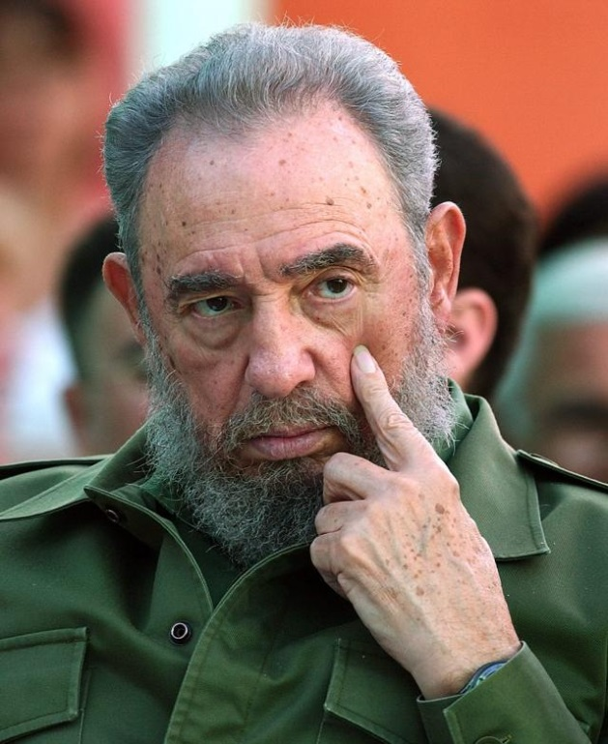
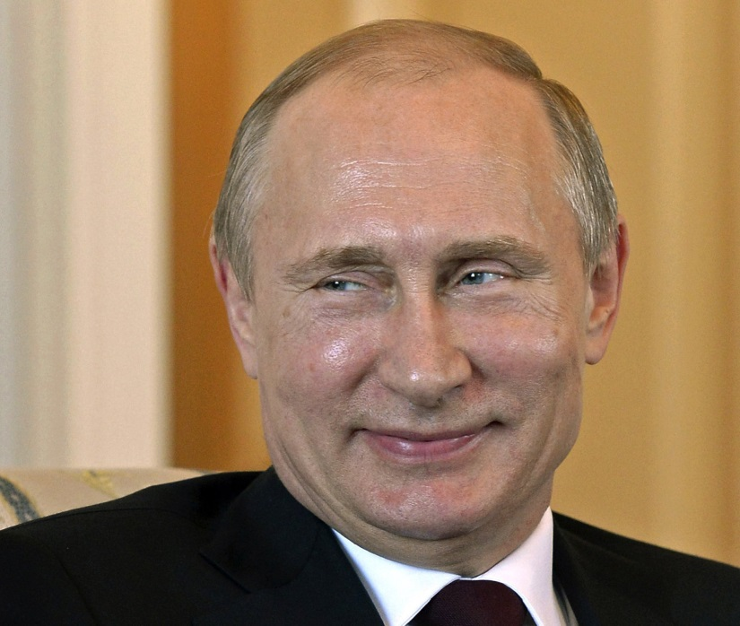
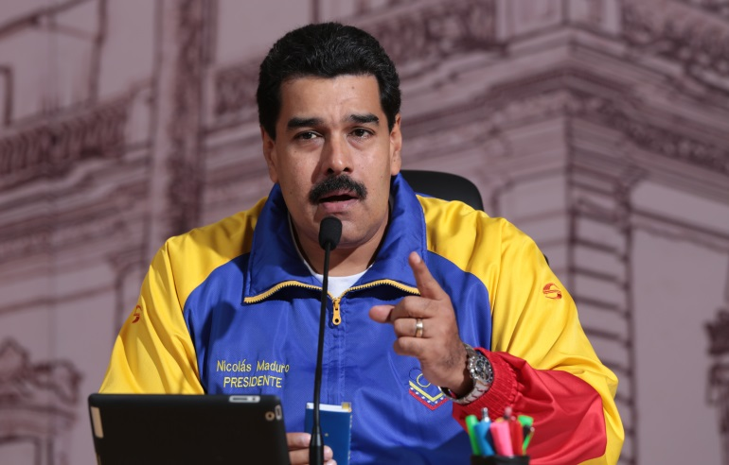
These guys were once young & rising
Notes:
Mugabe 34 years
Castro 46 years
Gaddafi 42 years
Ji Xinping

Slide 7
Consider plight of a new ruler in the developing world
Probably got to power via violence or subterfuge
Faces lack of trust about intentions & ability
Must quickly raise revenues to pay the military, reward allies & attack & deter enemies
Hard to do so when fiscal transaction costs high because of unproductive economy that is largely informal & plagued by credit market imperfections
Hard to do so when ruler inherits weak bureaucracy that cannot identify & verify tax obligations & monitor compliance, let alone punish evasion

Slide 8
Solution to this Problem: Non-tradables
Exchange monopoly rights for a share of the rents:
Cheap credit created by financial repression funneled by state to monopolies/state run firms (directed credit)
Flipside is barriers to entry in formal sector & limited investment & employment opportunities
Policies with urban bias that tax agricultural sector to subsidize labor force in cities (cheap food)
Monopolists gladly comply with taxation in exchange for government’s enforcement of their monopoly rights
Ruler can directly share some rents with supporters & tax some rents to fund the state

Slide 9
Solution to this Problem: Tradables
Court FDI in natural resource sectors to generate hard currency & revenues:
Give investors sweetheart deals
allow them to recover fixed costs at accelerated rate (Production Sharing Agreements enforced via Bilateral Investment Treaties)
allow them to exploit weak health, safety & environmental standards
FDI also enticed because of cheap labor force with no rights
Yet the state generates revenues & foreign exchange upfront
Predrilling fees & royalties
Bonuses
Acre payments/property taxes
Giving the state an equity stake
Bilateral aid given in conjunction with hydrocarbon/mining contracts

Slide 10
Directed Credit & Direct Taxation in Mexico, 1933-1974
Notes:
Directing credit to big, industrial firms:
Incubated & sheltered these firms until they produce large profits, and then swoop in and tax those profits.
Directed credit: advantage to larger firms with economies of scale that gain access to scarce capital.
These firms can be more easily monitored & taxed:
They not only produce huge profits, but represent taxable salaries of wage laborers & white collar employees.

Slide 11
Notes:
How do we know this? Nora and I put together a dataset of contracts:
31 block projects
Multiple data sources
Offshore, rehab, upfront bonuses, NOC stake, investment, profit tax
STATS:
Average year: 2001
Total projected investment: 77 billion (other source as of 2015 pegs this at 55 billion actual)
Average investment: 3 billion
Total projected up-front bonuses: $785.3 million
Average NOC stake: 32%
Acreage fees – relatively constant across all contracts, another source of upfront revenues. Most at $2,000 USD per acre, per year.

Slide 12
Implications of my View
A key cause of underdevelopment is state weakness—inability of new rulers to tax economy
Really hard to make weak states stronger because rulers care about their own survival & need to generate cash quickly; they don’t have luxury of waiting around for a broad tax base rooted in diversified economy to take hold
Interest groups endogenous & expendable. Rulers strategically create monopolists & oligarchs to help them generate rents that can be taxed; but throw them under the bus when convenient
Notes:
Interest groups are endogenous & expendable. Rulers create monopolists & oligarchs to help them generate rents that can be taxed
Russia under Putin: countless oligarchs have been expropriated or prosecuted on trumped up charges in order to destroy them.

Slide 13
EXTRAS
The following two slides were shared by Stephen Haber. This data is his and is used by him and coauthors across several of his pieces on the political economy of finance

Slide 14
Over time, Mexican government forced banks to hold more government debt
Notes:
Greater amount of deposits held with central bank.
Less credit available for private businesses and individuals.

Slide 15
Mexican banking system small even by Latin American standards
Notes:
Despite total privatization of banking system, dismantling of state run development banks in 2000s, & permission granted to foreign banks to enter Mexican market, banking system still very concentrated & small.
Result:
Bank branches are few & far between.
Interest rates are quite high.
Small businesses & middle class lack access to credit. For example, mortgage market is tiny.

Slide 16
Notes:
Sample contains 57 countries that evince positive values for data on oil endowments.
Fuel Depletion % GNP: value of oil, gas & coal, minus costs of production & opportunity cost of capital.
Oil endowments measured as ultimately recoverable reserves from Tsui 2011; do not rely on countries’ self-reporting of their proven oil reserves.
Overperformers:
Congo, Angola, Azerbaijan
Underperformers:
Germany, France, Denmark, the Netherlands. Even Great Britain, Canada, and the USA; the most underperforming country

