Slide 1
The perils of economic populism
Beatrice Magistro* and Victor Menaldo**
August 21st, 2020

Slide 2
Today we EXPLORE SEVERAL QUESTIONS
What is populism and how does it differ from liberal democracy?
What is the economic playbook used by populists from both the left and the right?
Why does the populist playbook lead to economic crises?
How do economic crises themselves foster populism?

Slide 3
outline
Populism & Populism vs. Liberal Democracy & Welfare State Capitalism
Economic Populism & Zero-Sum Thinking
Populism & Economic Crises
From populism to crises in Argentina & Spain
The new wave of populism: From crises to populism in the EU
            Eurozone crisis & Refugee crisis
            The cases of Greece & Italy: left-wing & right-wing populism
Will Covid-19 trigger a new wave of populism?

Slide 4
Populism: a definition
Populism = institutions behind liberal democracy & welfare state capitalism & experts who help them function should be ignored in favor of “will of the people”.
Usually represented by charismatic leader.
Pure people vs corrupt elites.
Against pluralism & compromise.
Current examples: Venezuela, Turkey, Hungary, Poland, USA.

Slide 5
populism and zero sum thinking
Populists do not see economic interactions as win-win situations (traditional economic perspective); obsessed with zero-sum thinking & win-lose situations.
Populists also eschew weighting tradeoffs & future consequences.
Populists stigmatize an outgroup: immigrants or foreign organizations.
Their policies harm groups they claim to champion—the poor especially.
Notes:
Exclusionary vs inclusionary populism: the latter espouses mass welfare programs to include the poor, the former protects insiders (ex. Natives) from outsiders (ex. Immigrants).
Who pure people vs evil elites are varies. Nativist form natives vs immigrants, left-wing forms, the enemies are usually US imperialism and international monetary /financial institutions.

Slide 6
Economic populism
Quick results for supporters based on distortions & redistribution:
  expropriation of wealthy, corporations & banks.
  trade protectionism & picking winners & losers.
    sharing rents with insiders @ expense of consumes & taxpayers.
    use regulation to punish outsiders.
    spend public money generously & resort to money printing to address budget deficits.
Notes:
Protectionism:
Stiff import tariffs,
quotas on finished goods,
exempting inefficient domestic manufacturers from import taxes.
governments may grant these firms special permits to import capital & intermediate goods under the auspices of cascading tariffs structures.
Picking Winners:
high barriers to entry, including subsidizing credit, land, labor & foreign exchange & restricting foreign ownership.
Exempt handpicked winners from regulations reserved for their rivals, including those intended to improve working conditions, health, safety & the environment.
Also hammer firms & business interests outside of their coalition with specious antitrust suits, irregular “windfall” taxes, fines, requirements to obtain special licenses, sky-high borrowing costs & climate of fear, intimidation & uncertainty.

Slide 7
Liberal democracy and welfare state capitalism vs populism
Political rights nourish economic rights & vice versa: both liberal democracy & capitalism depend on pluralism, competition, openness & taking calculated risks.
Both liberal democracy & capitalism rely on free speech, freedom of assembly & freedom to create long-lived organizations such as corporations, unions, political parties, etc.
Liberal democracies tend to adopt policies that benefit majority, not just elites.
Property rights, impartial contract enforcement, policies that reduce transactions costs, provision of public goods: nurture allocative & productive efficiency of capital. Also foster knowledge, education & technology that fosters innovation.
Notes:
Democratic norms must be underpinned by a broad consensus over basic rights and the rules of the game. Politicians must also share this consensus. In fact, both must police obedience to these norms: citizens and politicians must coordinate to punish those who defect from the consensus.
This entails that the key norms that undergird liberal democracy are mutual tolerance, forbearance, and viewing those who disagree as the loyal opposition, not implacable enemies that must be vanquished.
In a true liberal democracy lobbying by one special interest is checked by lobbying by other special interests

Slide 8
The Economics of Trade Protectionism
Notes:
Against populism: “emotional oratory,” “promising the impossible,” “folksy posturing” & “gross oversimplification.”
Taxes on imports allow domestic producers to raise the price of their good just short of the new price for international good.
This shifts the supply curve in, allowing higher cost domestic producers to enter the market.
The new cost curve allows these new producers to earn rents: the difference between their marginal costs & new, more expensive price.
All domestic producers below B earn rents.

Slide 9
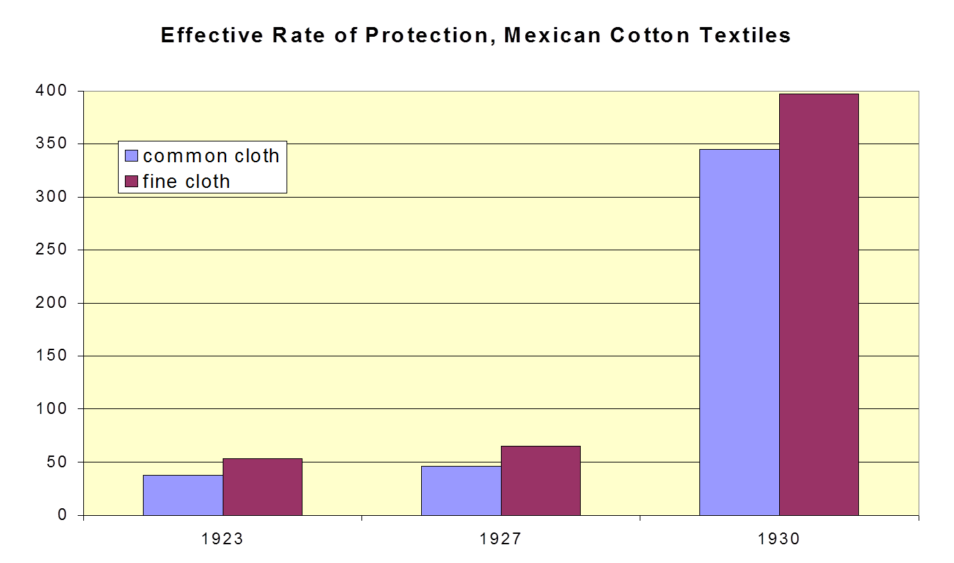
Source and graph: Haber (2006)
Notes:
Protectionism in manufacturing:
In textile industry, imported cotton was provided cheaply to textile manufacturers who were sheltered from having to compete with imported clothing.
Inefficient domestic producers with high costs were coaxed into serving the Mexican market.
Effective rate of protection: increase in domestic value added permitted by protection structure.
Value added: the cost of all manufacturing margins including labor and normal rates of return.
World value added: the cost of this stuff at world price.
When domestic value added is higher than world value added then domestic producers with higher costs can compete against imports.

Slide 10
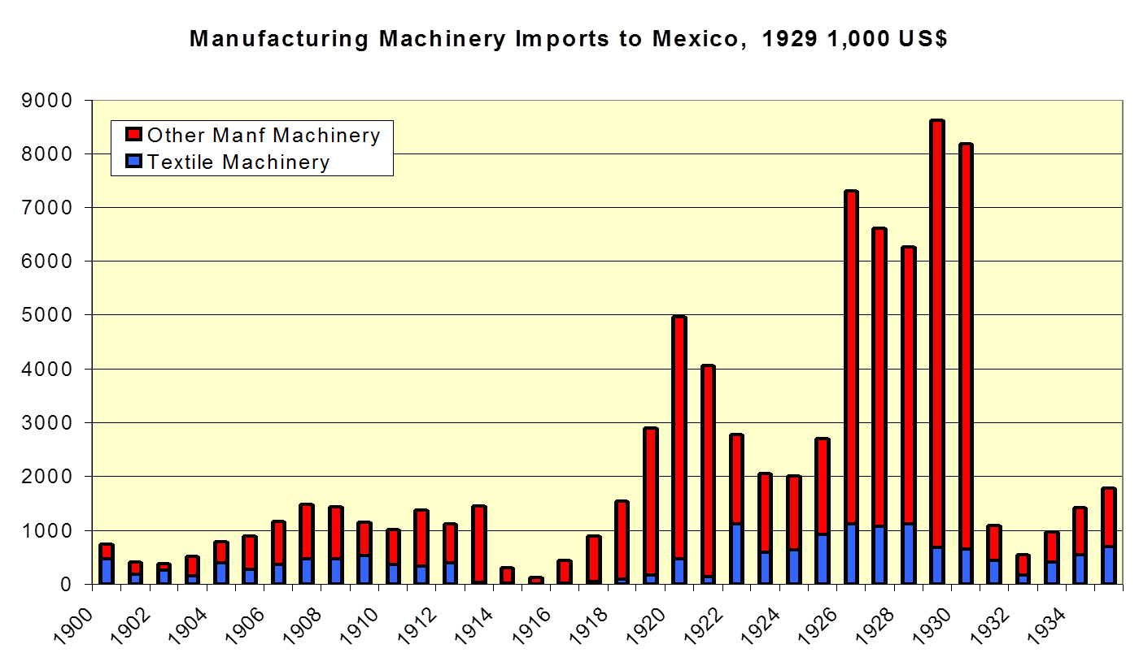
Source and graph: Haber (2006)
Notes:
Cascading tariff structure across industries: inputs to production subsidized to promote manufacturing for domestic market.

Slide 11
Industrialization Financed by Banking Oligopoly & Govt. Owned Banks

Slide 12
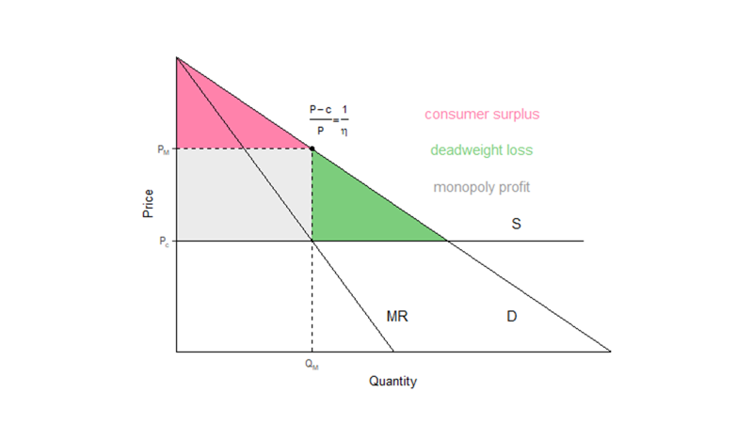
Protection from internal competition TOO

Slide 13
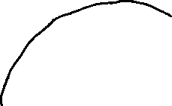


















Ration Foreign Exchange & Credit

Slide 14
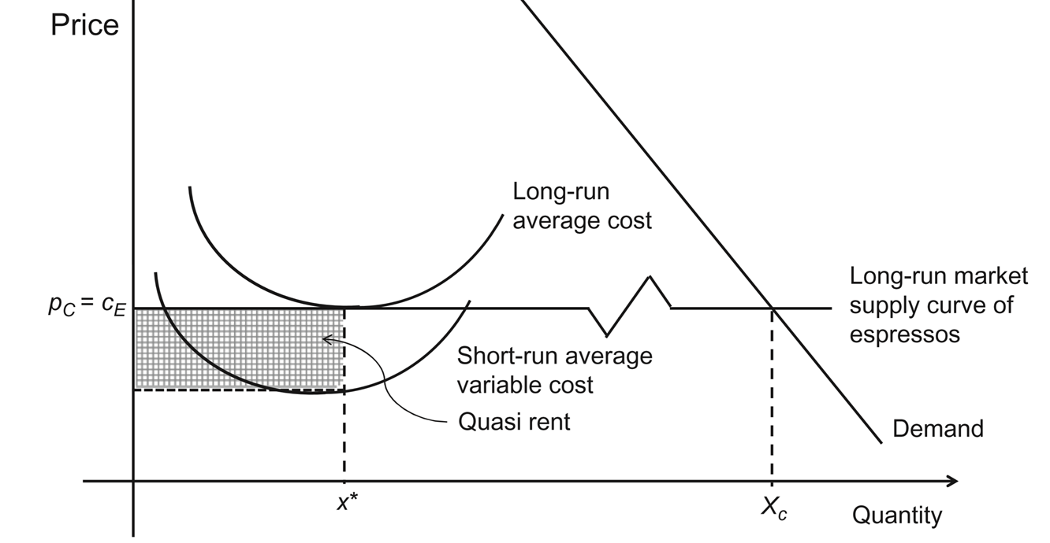
Over the long run, producers exit the market

Slide 15
CONSEQUENCES OF POPULISM
Whether right or leftwing, populism ushers in economic collapse & political instability that threatens both liberal democracy & welfare state capitalism:
Balance of payments problems
Budget deficit/debt problems
Hyperinflation
Financial Crises & Recessions
Coups

Slide 16
Populism → crises: the case of argentina
Peron rose to power during 1950s, gutted democratic institutions & put together urban coalition of domestic industrialists & unionized workers.
Peron’s policies boosted real wages for skilled & unskilled workers by 35%!
Industry subsidies, transfers to labor unions & public sector hiring = very expensive.
Foreign Direct Investment discouraged & taxes imposed on agricultural exports.
  Foreign exchange shortfall = couldn’t pay for imports.
Devaluation, default & hyperinflation.
Notes:
Coup displaced Juan Peron in 1955.
Officers grew tired of inflation, repression, demagoguery & corruption.
Was exiled to Spain.
Military re-imposed old constitution with electoral college & disproportional representation (malapportionment) that favored landowners.

Slide 17
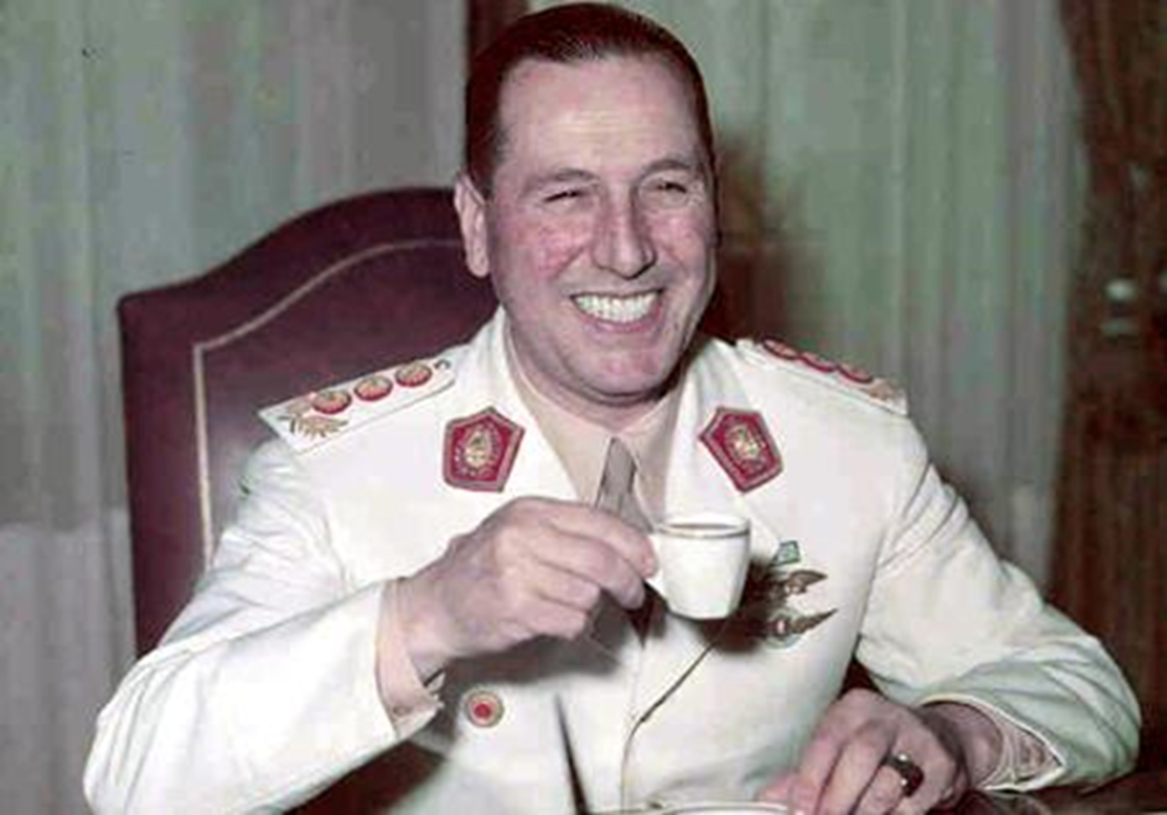

Slide 18
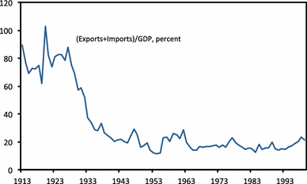
Protectionism!

Slide 19
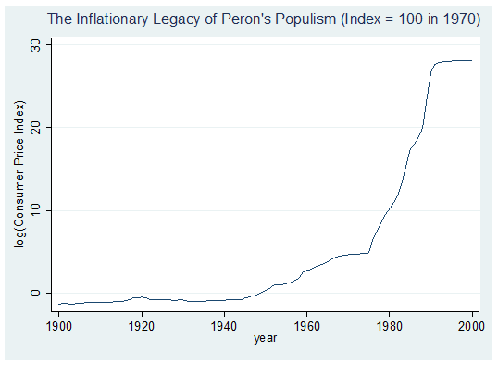
INFLATION HIGH BECAUSE GOVERNMENTS PRINT MONEY TO PAY DOWN BUDGET DEFICITS

Slide 20
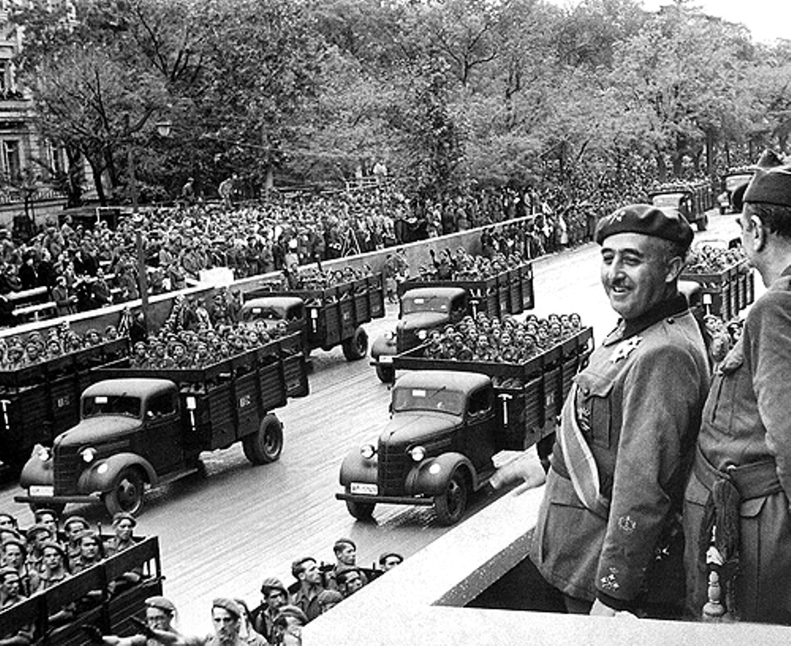
Making Spain Great Again (1939 to 1977)?
Notes:
Protectionism:
Cascading tariff structure, quantitative import restrictions via licenses & foreign exchange controls with multiple exchange rates.
Nationalization:
Franco also nationalized enterprises under the auspices of the Institute of National Industry, a state holding company.
Crony capitalism & sheltered labor unions:
boost the earnings of industrial sector wage earners.
Tax breaks & subsidies were doled out by Spanish government to a host of manufacturing industries, including textiles, domestic appliances & vehicles.

Slide 21
The new wave of populism in Europe as a result of two crises
Eurozone crisis starting in late 2009/early 2010
Migrant/refugee crisis starting in summer of 2015

Slide 22
Eurozone crisis
In 2009 Greece reveals to have lied about its public deficit for years, soon unable to service its debt: beginning of the Eurozone crisis. A result of:
  structural problems/ competitiveness differences among countries;
  fiscal misbehavior;
  2008 global financial crisis.
Southern countries (Portugal, Italy, Greece, Spain) and Ireland were especially hit. Why?

Slide 23
Eurozone crisis: causes
  Major macroeconomic divergences between Northern and Southern countries at onset of Eurozone: export-led growth vs. demand-led growth.
  Southern Europe joins Eurozone → confidence from investors → low-cost capital→ heavy borrowing → economic expansion → boom → housing market bubble → bubble burst → inability to service debt → economic and political distress.
  Only the Greek crisis was a sovereign debt crisis (and in part Italy), the others started out as private debt crises (then govts saved banks).

Slide 24
Eurozone crisis: “solutions”
In 2010 Greece, Portugal and Ireland enter bailouts from the Troika – the EU, the IMF, and the ECB - conditional on austerity measures and structural reforms.
Spain and Italy subject to more implicit conditionality from the ECB: the ECB would buy their government bonds on secondary market in exchange for package of reforms (including pension reform and labor market reform).

Slide 25
Eurozone crisis
Opened a divide between creditor member states in the north of Europe on one side, and debtor states in Southern Europe (plus Ireland) on the other.

Slide 26
Crises affect public trust in institutions
Citizens’ trust is crucial for legitimacy of institutions and for preserving their survival.
Several studies have identified the economic crisis as a major factor contributing to fall in trust in institutions.
The crisis caused economic hardship, and EU/IMF put fiscal constraints on national governments, regardless of citizens’ choices at the polls.
Studies show that illiberal cultural traits have amplified adverse macroeconomic shocks with respect to trust.

Slide 27
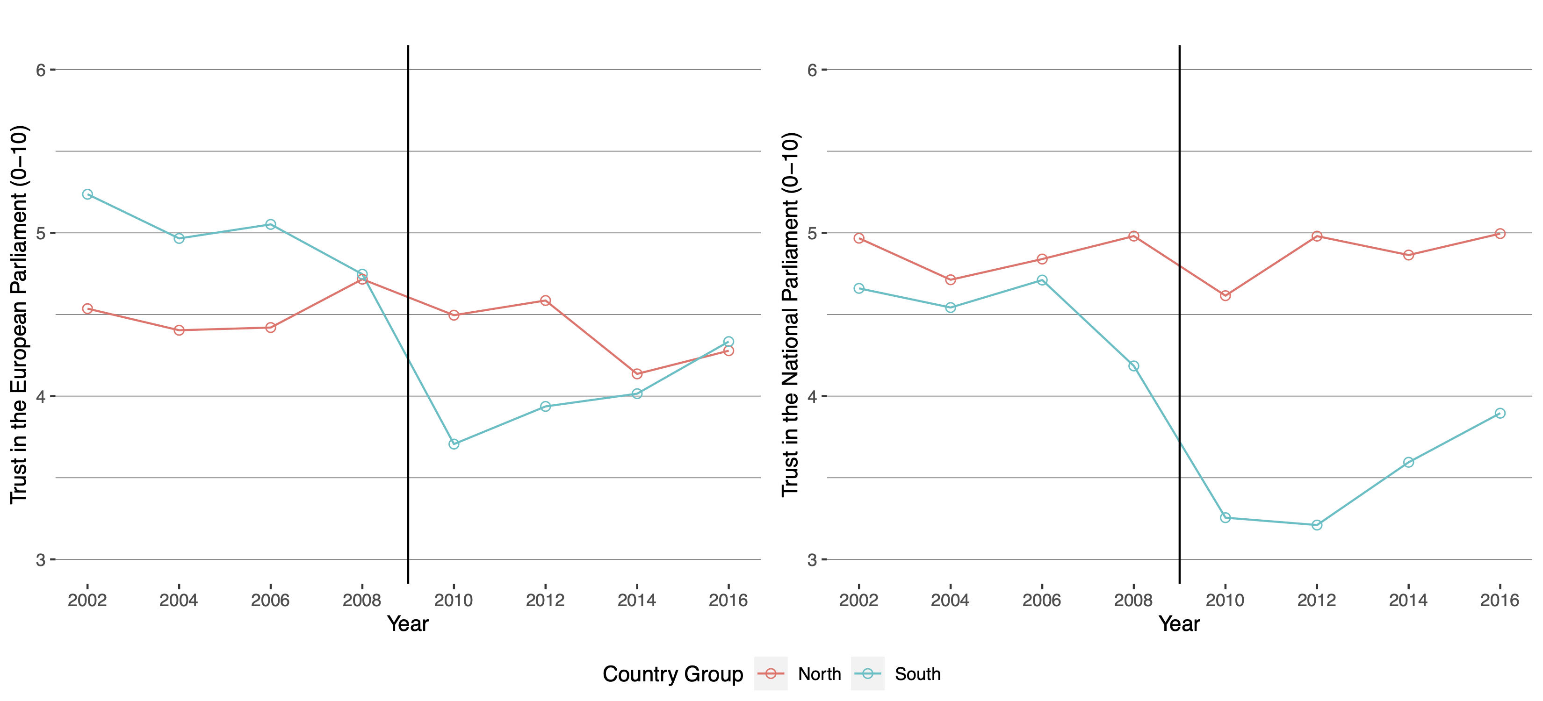
Trust in national and eu institutions after the eurozone crisis
Source: European Social Survey

Slide 28
Fall in trust and rise of populist parties
Higher distrust for European integration and political institutions → higher probability of voting for a populist party (right-wing or left-wing).
Eurozone crisis → rise of populist parties along North/South divide (e.g., Syriza and Golden Dawn in Greece, Five Star movement and Lega in Italy).

Slide 29
refugee crisis
Starts in early 2015 as war in Syria worsens.
An increasing number of asylum seekers and economic migrants arrives in EU across sea or overland (mostly Syrians, Afghans, and Iraqis).
Greece and Italy struggle to handle influx of migrants.
In 2015 EU proposes a new quota system to relocate asylum seekers among EU states.
Rifts emerge between countries.

Slide 30
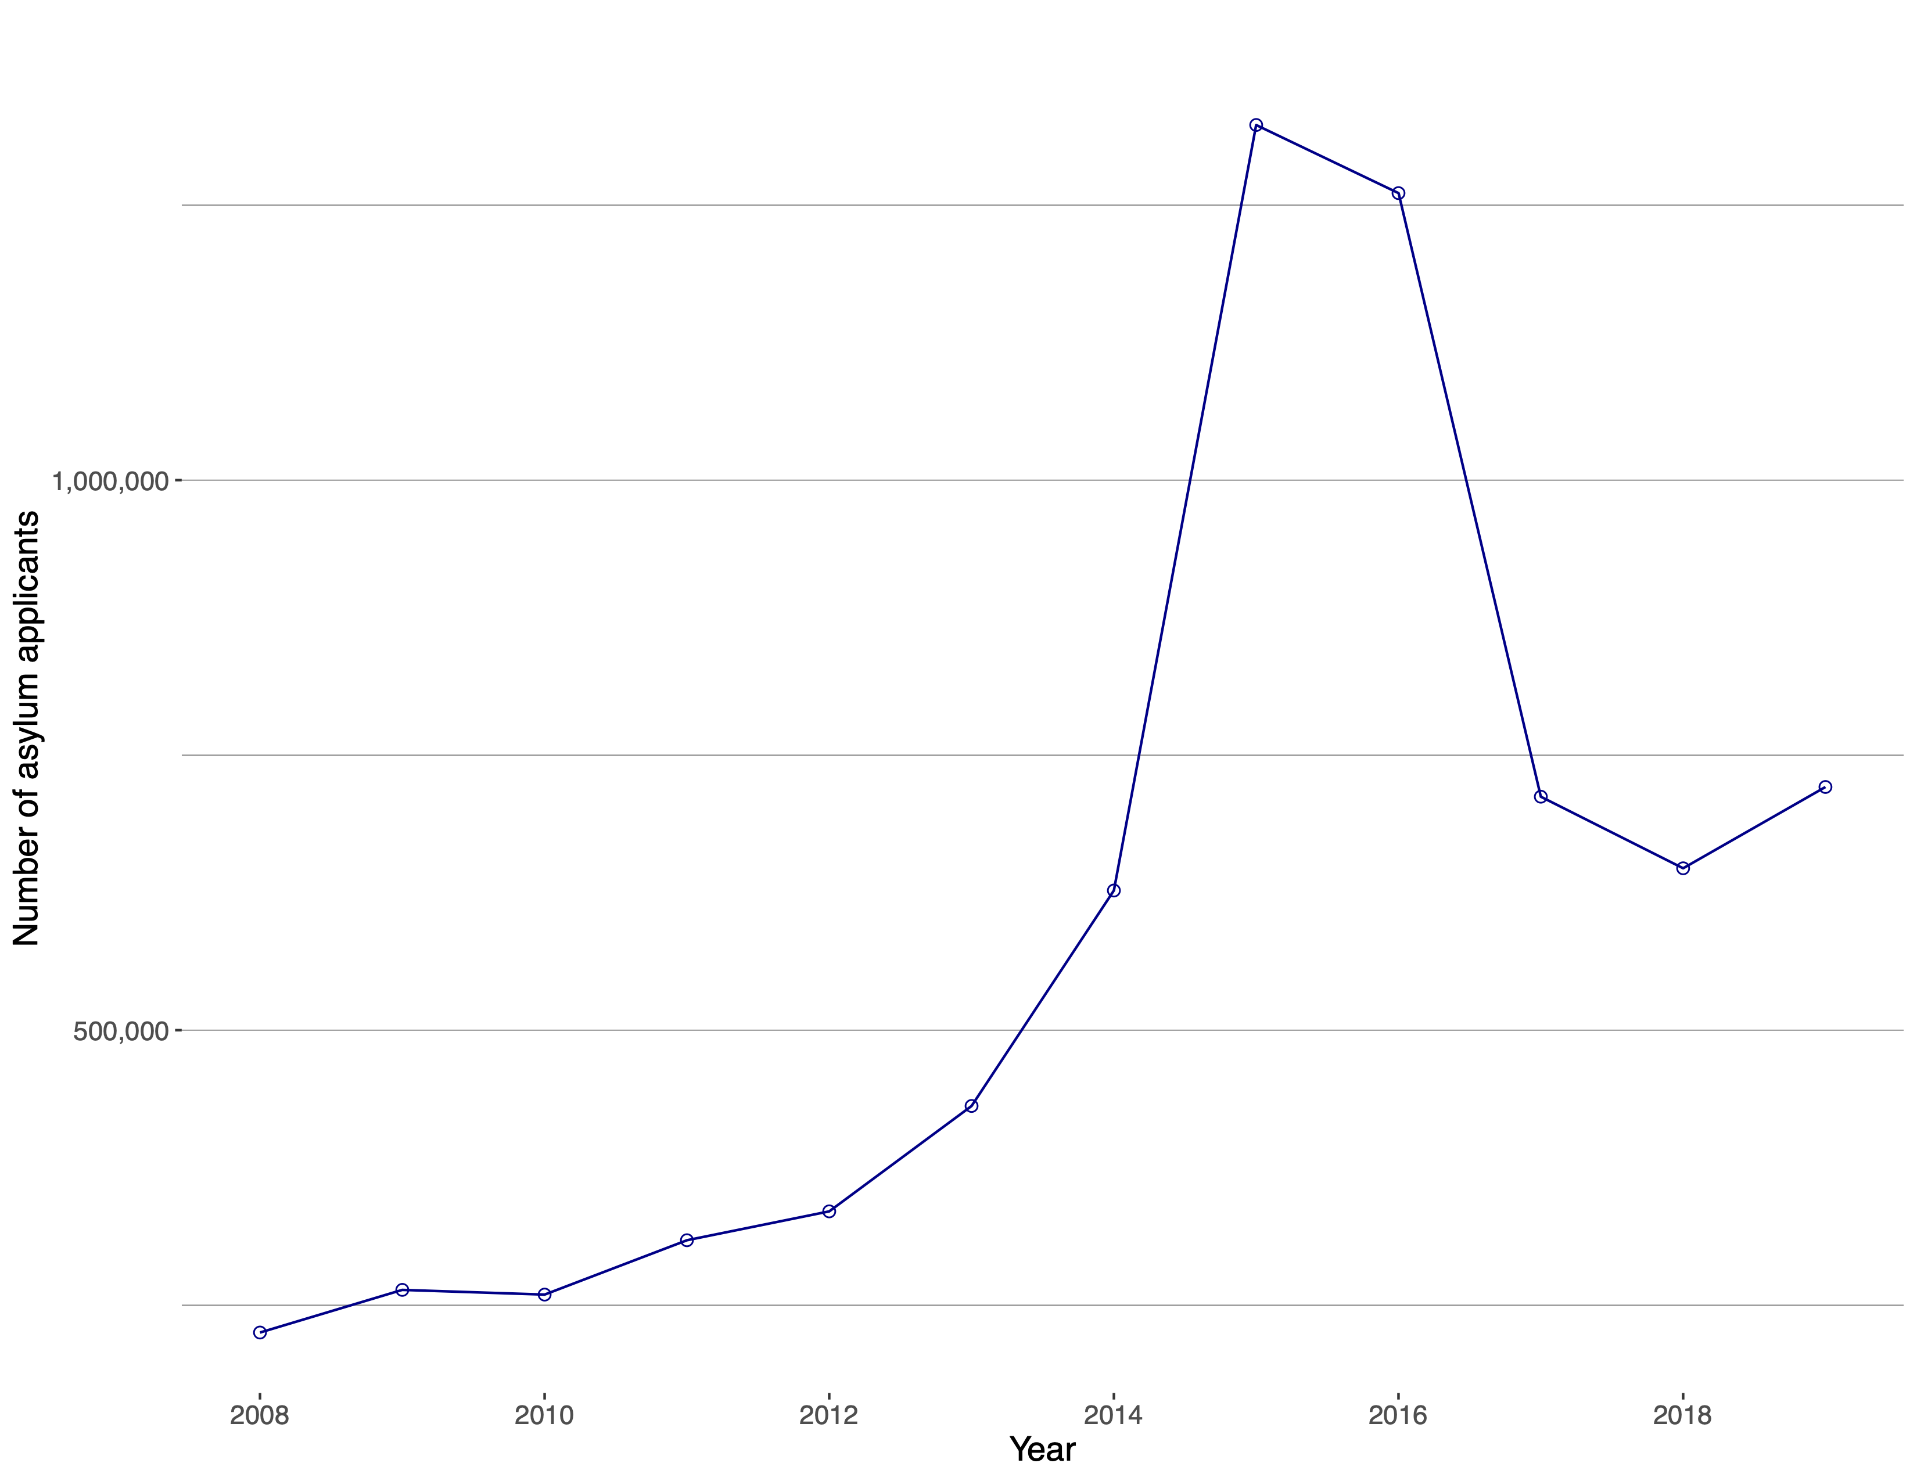
Refugee crisis (cont.)

Slide 31
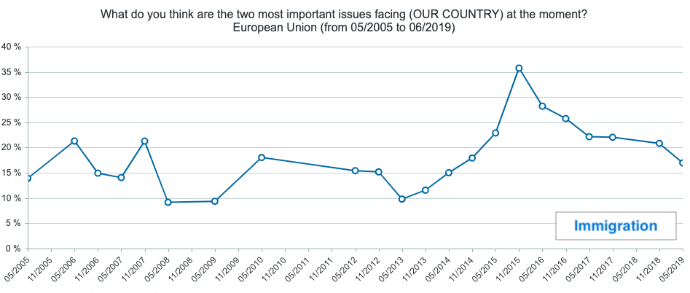
Refugee crisis (cont.)

Slide 32
refugee crisis and populism
Populists see migrants as both economic and cultural threats.
Was the refugee crisis also part of the success of far-right parties in the EU?
Recent studies suggest that refugee allocation does affect voting behavior for far-right parties.
The refugee crisis provided a powerful narrative for right-leaning populist parties to capitalize on both in Western EU (e.g., AfD in Germany, Lega in Italy, Front National in France) and Eastern EU (e.g., Fidesz in Hungary, Law and Justice in Poland).

Slide 33
Did the refugee crisis affect attitudes towards immigration?
The case of Germany:
Welcomes over 1 million refugees in 2015.
The far-right party AfD in 2017 won 17% of the national vote, running on an anti-immigrant, xenophobic platform.
Attitudes towards immigration have not changed though.
Source: German Longitudinal Electoral Study (GLES)

Slide 34
Did the refugee crisis affect attitudes towards immigration?
The case of Italy:
Experiences sudden increase in number of refugees in 2015.
The anti-immigrant Lega gets almost 20% of the votes in national elections in 2018 and 34% in EU elections in 2019.
Attitudes towards immigration actually improve over 2006-2018.
Source: Italian National Election Studies (ITANES)

Slide 35
Then what explains the rise of far-right parties after the refugee crisis? Salience!
Source: German Longitudinal Electoral Study (GLES)
Source: Italian National Election Studies (ITANES)

Slide 36
A case of left-wing populism: greece
Structural problems: large public expenditure financed with debt, corruption, large shadow economy, clientelism, excessive regulations, closed markets.
2009: budget deficit exceeds 15% of GDP financial markets reassess sovereign credit risks.
2010 and 2012: Greece enters bailouts from the Troika conditional on austerity measures and structural reforms.

Slide 37
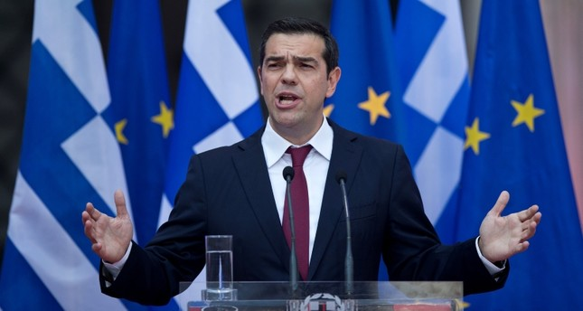
Greece starts the populist wave in the eu
2015: Alexis Tsipras (far left Syriza) is elected on an anti-austerity platform.
June 2015: Tsipras calls a referendum on bailout terms.

Slide 38
Greek Referendum: Game of chicken
EU/Greece | Swerve | Go straight
Swerve | Austerity, debt relief | Debt relief, stop austerity
Go straight | Austerity, no debt relief | Grexit
Video

Slide 39
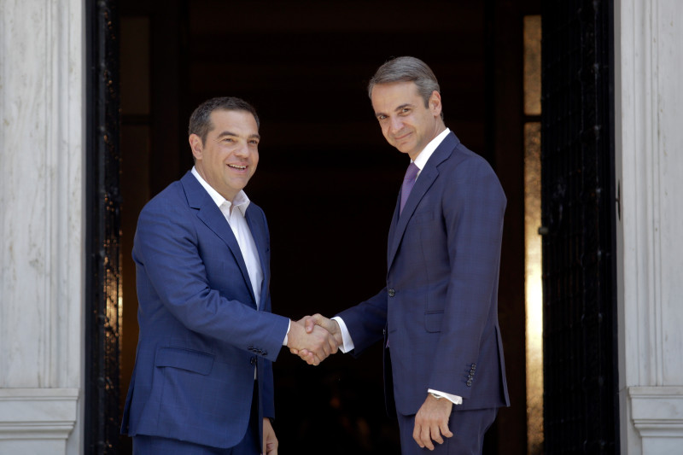
Greece ends its populist experiment
In May 2019, after defeat in EP elections, Tsipras calls general elections.
Tsipras loses elections to Mitsotakis (New Democracy center-right): end of Greece’s populist chapter.
Greece recovering, but debt still high (181% of GDP) and economic challenges remain.

Slide 40
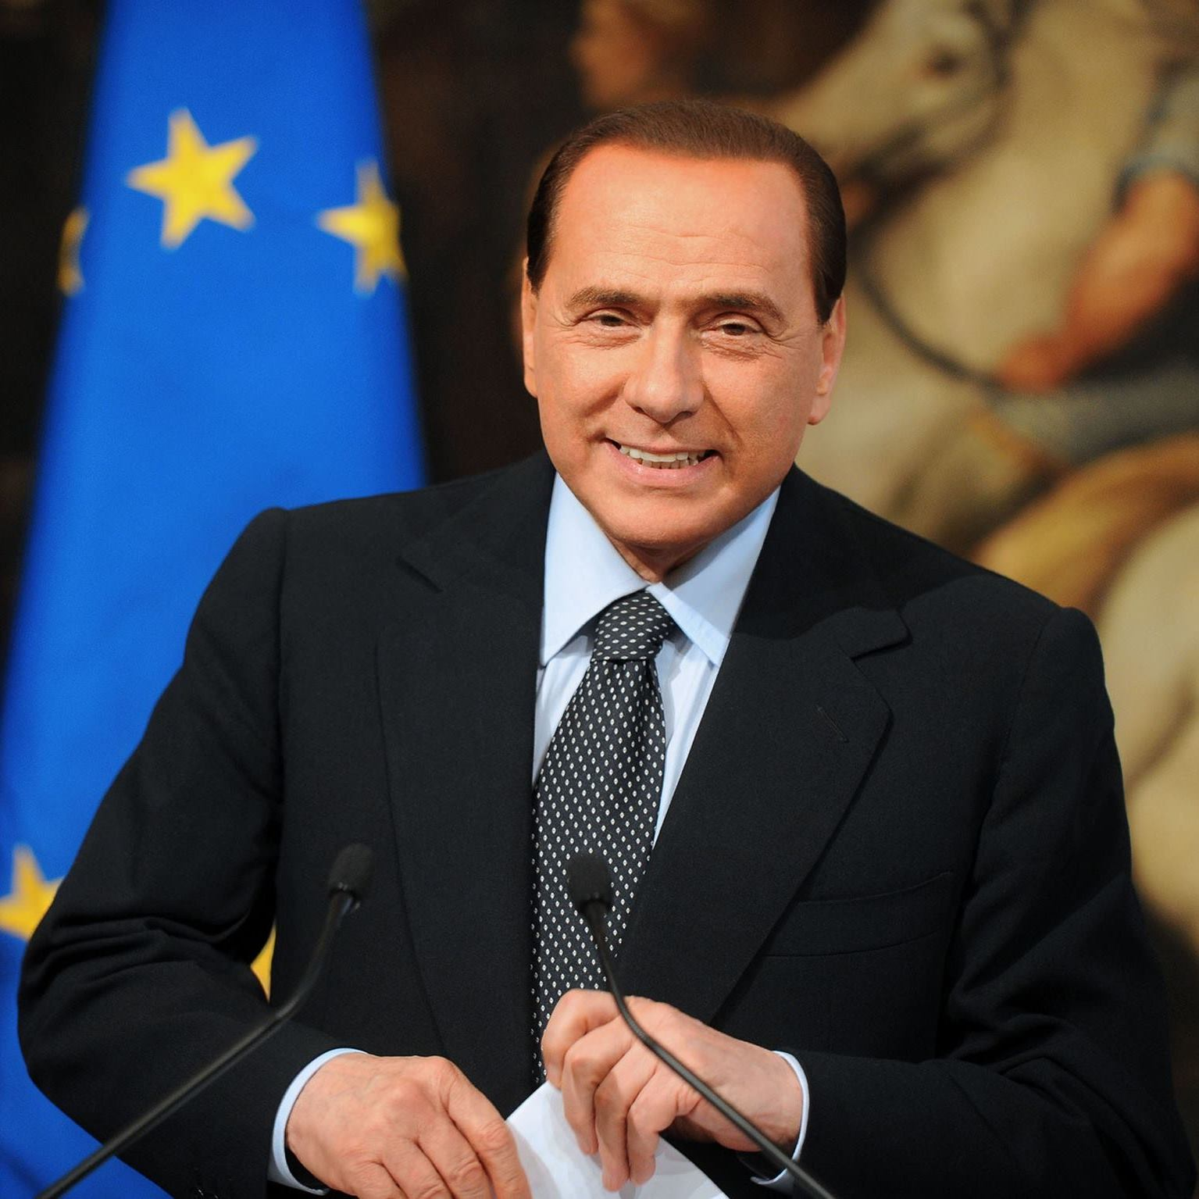
A case (or two) of right-wing populism: italy
1994-2011: Silvio Berlusconi, EU’s first populist leader, three-time prime minister.
Self-made billionaire who promised to sweep away a rotten political class and bring his business skills to running the nation.
Claimed to be the authentic voice of ordinary Italians struggling with high taxes and bureaucracy.

Slide 41
From populism to technocracy
After joining euro, low interest rates reduce the pressure for badly needed structural reforms.
Reform inertia during Berlusconi years makes Italy vulnerable to external shocks.
In 2011 the Eurozone crisis hits: Fall of sovereign debt credibility, as debt reaches 130% of GDP, very low growth prospects, and policy stalemate.
Under pressure from financial markets and the EU, Berlusconi resigns and professor Mario Monti is appointed as head of a technocratic government in Nov. 2011.

Slide 42
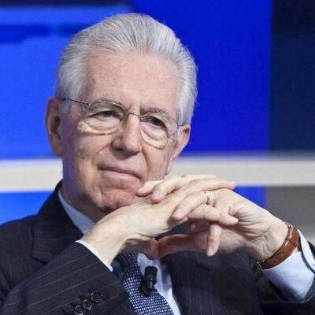
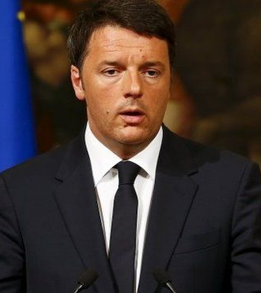
From technocracy to center-left…
2011-13: Technocratic Monti government swiftly targets pensions and compromises on labor market. Fails on service sector reform.
2013-18: Democratic Party government passes bold Jobs Act first, and then reverts back to distributive politics.
Growth does not pick up, continuing a sluggish trend of almost 30 years.
Mario Monti on the left and Matteo Renzi on the right

Slide 43
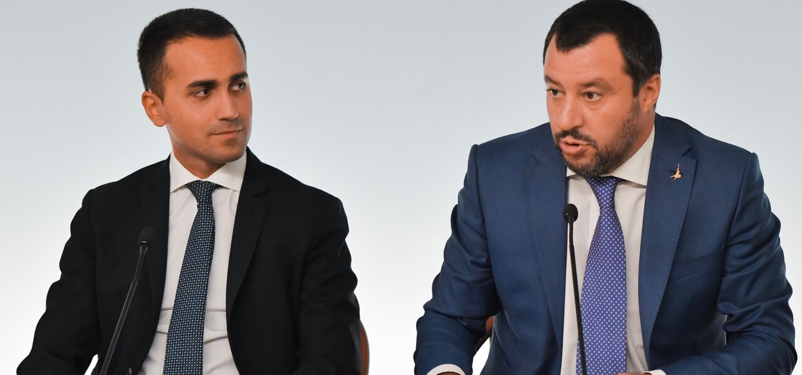
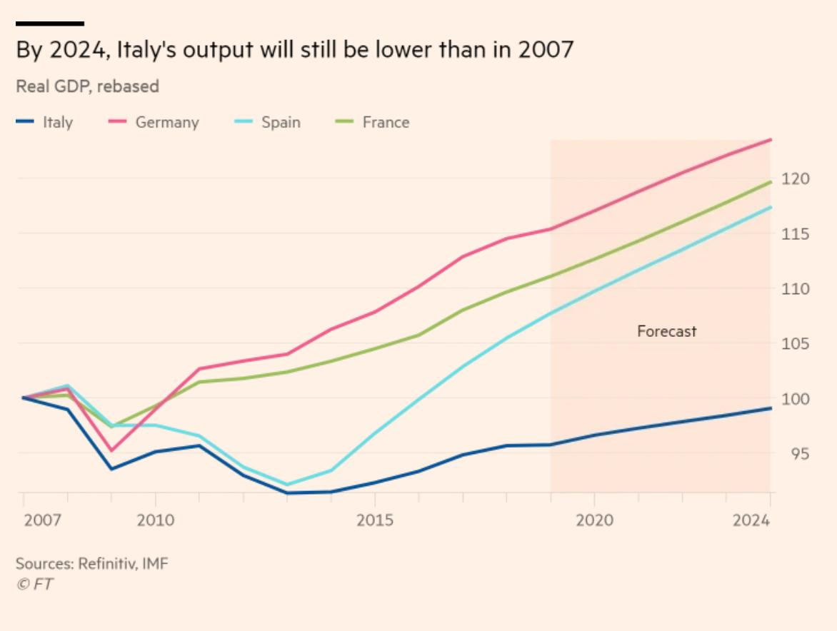
…and back to populism!
2018: Italy elects a right-wing populist government (a coalition between the Lega led by Matteo Salvini and the Five Star Movement led by Luigi Di Maio).
Populist agenda: reintroduce early retirement, deport migrants, institute a guaranteed minimum income, tax cuts, Euroscepticism.
Aug. 2019: Salvini calls for early elections.
Sep. 2019: the Five Star Movement is able to form a new coalition government with the center-left, leaving Salvini in the minority.

Slide 44
Will Covid-19 trigger a new wave of populism?
Economic activity plummeted everywhere after Covid-19 and unemployment skyrocketed.
Will the recovery be V, U or L-shaped?
Our fear is that populism, and its attendant crises, may become self-reinforcing.
Will the EU survive? Or will more exits like Britain’s be triggered by the pandemic’s continuing economic and political fallout?
What about the US? Will populists take advantage of rising fears over legitimate national security concerns?
Are Europe and the United States dangerously close to the path taken by Argentina under populist governments in the post-World War II era? Is rampant crony capitalism and protectionism masquerading as industrial policy around the corner? What about serial balance of payments crises, sovereign debt defaults, and stagflation?

Slide 45
appendix

