Slide 1
The Political Economy & Economic History of Spanish Patents
Victor Menaldo
Associate Professor
University of Washington

Slide 2
Main Questions
I. WHAT HAPPENED?
1) What’s the history of Spanish patent system?
2) How does its evolution fit in with what was happening internationally?
II. WHY DID IT HAPPEN?
3) What factors explain big changes in system over time?
4) What complementary economic reforms were coupled with these changes?
5) What exactly were Spanish policymakers trying to achieve?
III. WHAT EFFECT DID IT HAVE?
How did patents help Spanish firms acquire technology from frontier?
Notes:
Index based on papers that assess effects of patents cross-nationally. I measured patent strength by including several dimensions:
Strength of invention versus introduction patents
Cost of invention patents
Length of invention patents
Breadth of invention patents
Foreigners’ IPR
How strongly patents were enforced

Slide 3
Bottom Line Up Front
Technology transfer from frontier important for Spanish industries.
When foreign inventors had modicum of security, this meant they had framework to transfer knowhow & commercialize inventions in sectors such as iron & steel.
Patent system did trick, provided it protected foreigners’ rights.
Licensing/technical agreements underwritten by patent system.
But there were winners & losers from patent reform & complementary reforms. Losers did not go willingly into the night.
Notes:
Technology transfer: across the economy. Railroads, electricity, internal combustion engine & steel.
Homegrown technology by Spanish nationals was few & far between:
Engineer Isaac Peral (1888): the submarine
Engineer & mathematician Leonardo Torres y Quevedo (1907): cable car (1914): digital calculator
Engineer Juan de la Cierva (1922): gyroplane (precursor to helicopter).
Mop
Lollipop
Classical guitar
Foosball table
Cigarette

Slide 4
Why do patents lead to invention & innovation (Barnett; Haber; Kieff; Spulber)?
Because they’re property rights, allow inventors to capture R on I.
Because they’re property rights, underpin web of contracts behind innovation: allow ideas to be sold, licensed, separated & bundled.
Publicly recorded patent discloses info. about invention & threatens exclusion, acting as beacon.
Patents promote specialization: market participants focus on their comparative advantage.
Collateral/intermediation/new, more nimble firms/stimulates new ideas.
Notes:
Beacon: allows inventors, entrepreneurs, managers, laborers, financiers, manufacturers & distributors to coordinate & contract.
Comparative advantage: inventors invent & entrepreneurs commercialize.
Patents reduce transaction costs because they certify & standardize rights.
Evidence that strong IPR increase inventive activity & innovation: case studies of USA (Lamoreaux & Sokoloff 2003; Kahn 2014), Great Britain (Bottomley 2014) & Europe (Lerner 2000).

Slide 5
New Consensus: Gainsays IPR Importance
Strong intellectual property rights retard econ. development in late industrializing countries (Boldrin & Levine 2013):
Patents increase costs of acquiring state-of-the-art technology from countries @ innovation frontier.
Weaker IPR allows developing countries to draw freely upon best ideas & imitate most innovative practices.
Asian Tigers = imported machinery, FDI, or espionage.

Slide 6
Empirical Contributions of this Paper
1) Document long history of Spanish patent system; identify four distinct regimes:
HYBRID 1826-1877: invention & introduction patents of equal strength/foreigners’ rights somewhat curtailed.
REFORMIST 1878-1928: stronger invention patents/foreigners’ rights improved.
RENTIER 1929-1985: much stronger introduction patents/foreigners’ rights greatly curtailed.
REFORMIST 1986-today: strong invention patents/introduction patents abolished/foreigners’ rights very strong.
Notes:
Distinction btwn. Invention & introduction patents:
Invention is your plain old vanilla patent. 20 year property right to your ideas as long as they are novel & non-obvious:
Right to exclude
Right to license
Right to sell
Introduction patent: legal monopoly on introducing new process/product to Spain that had already been invented elsewhere.
Coupled with trade protectionism & compulsory working requirements. This meant that Spanish govt. made it so that you did not have to compete with imports made through the same process/competing imports.

Slide 7
Empirical Contributions
2) Identify political economy of reformist & rentier regimes:
Rentier regimes: rents via introduction patents coupled w/protectionist tariffs & cronyism. Ex. Franco: 1939-1959.
Reformists: strengthened rights of original, foreign inventors. Favored trade liberalization & other economic reforms. Reform coalition after 1868 Revolution; similarly after 1977 democratization.

Slide 8
Empirical Contributions
3) Exploit long run datasets to document technology transfer process via patents:
patent types (invention v. introduction)
real cost of obtaining patents (as ratio of avg. wages)
who obtained patents (foreigners v. Spaniards)?
what economic sector?
patent royalties/technical assistance fees
evolution of Spain’s industrial base
case study of Spain’s steelmaking industry
Notes:
Spain’s steelmaking: technology-transfer-via-patent-licensing.

Slide 9
Theoretical Contributions of this Paper
Inventions: both codifiable and non-codifiable components.
Espionage conducted by late industrializers CANNOT deliver knowhow required for inventions tied to advances in physics, chemistry, electromagnetism & organizational dynamics.
Nor can they rely on their citizens studying & working abroad, knowledge of basic science, exposure to technical literature, membership in international societies & travel to exhibitions.
Notes:
Tacit knowledge just or MORE important!

Slide 10
Theoretical Contributions
Patent licensing contracts outline how critical knowhow conveyed.
Contract → licensor gains plans/goods/services/human capital:
drawings/blueprints
machinery
on site tutorials & training
new relationships w/suppliers & distributors
continued upkeep/improvements
Notes:
Knowhow is technical, managerial & marketing
The original, foreign inventor can sell, license & monitor use of inventions.

Slide 11
Theoretical Contributions
Inventors who license patents abroad: travel to distant lands to help licensees acquire knowhow & adapt inventions to differences in raw materials/other inputs & logistical problems.
Modifications & improvements made abroad patented in both home & host.
Host country inventors come out of woodwork & also patent—both in host & home country.
Notes:
Transnational networks in textiles, pulp & paper, machinery, chemicals, electricity, telegraph, railroads & metallurgy.
Enrique Disdier Crooke, Spanish engineer who worked for Tubos Forjados, a Bilbaoan firm that manufactured metallic products such as steel pipes. Between 1890 and 1927, he obtained over 90 Spanish patents in this area, many of which were modifications of inventions patented in Spain by foreigners.

Slide 12
Spanish Steelmaking: illustrating mechanism
Notes:
Steelmaking took off in and around Bilbao (Basque country). Located in North-central Spain, on Bay of Biscay.
Due in part to proximity of iron ore & coal. Due in part to procurement policies of Spanish Navy.
Basque engineers & skilled workers employed by La Iberia, Altos Hornos de Bilbao & La Vizcaya, as well as smaller firms, took lead role in identifying foreign patents that would increase steel production or cut costs. Also hosted foreign inventors & created networks that helped transfer, adjust & improve technology.
I looked at hundreds and hundreds of patents, both by foreigners & Spaniards.
Agglomeration effects: positive impact on the emergence and consolidation of steelmaking in and around Bilbao. Co-location of several firms working on iron and steel meant a rapid and relatively frictionless spread of knowledge, technology, and innovations (see Pred 1966). Also, it meant that a relatively deep pool of skilled laborers could be drawn on by employers.

Slide 13
Political Economy of Spain’s REFORMIST Patent Regime (1878 to 1928)
Setting the Stage:
After Napoleonic occupation, surviving imperial rump = bankrupt. Spain vulnerable to invasion. Economy = agrarian & backward.
Reformers—lawyers, intellectuals, bureaucrats, upstart merchants & modernizing army officers—made inroads fixing mess.
Rent-seekers struck back: municipal government officials, Church officers, merchants involved in mercantile trade routes & provincial, landholding aristocrats w/feudal property rights.
Reformers win 1868 Liberal Revolution.
Notes:
obstacles after return of Fernando VII: absolutism, feudalism & mercantilism; Church still important.
Aristocrats: nobles (cereal & cotton) & Mesta.
Rents: high import tariffs & banning of competing goods & flag tax on merchandise delivered by foreign vessels.
too much govt. spending; violence & instability; informal economy/educational system was bad.
1814: Fernando VII rescinds 1812 liberal constitution.
Liberals again restore authority
1824: Reactionaries strike back with French help/Isabella II installed
1836: Liberals again restore authority (Carlist War snuffed out in 1939)
1850s: Reactionary backlash
1868: Liberal Revolution
1873: Spain’s First Republic
1875: Monarchy restored but with parliamentary supremacy (Alfonso XII). The so-called Restoration.

Slide 14
Spain’s REFORMIST Patent Regime (1878 to 1928)
Nuts & Bolts:
Invention patents extended from 15 to 20 years.
Original, foreigner inventors: right to re-patent their inventions.
Upfront fees reduced/payments spread out over patent life.
Working requirement weakened.
Inventors had right to patent products, not only processes.
1884: Spain joined International Union for the Protection of Industrial Property.
Notes:
Precursors:
exogenous even that precipitated patents: could not hire skilled foreign workers nor import tools & machinery from Britain.
1811-1813: Joseph Bonaparte: end feudalism, modernize commerce & promote free trade.
1826-1877 Patent Regime: foreign inventors not allowed to repatent. Invention patents expensive. Products could not be patented. Stiff working requirement.
IUPIP:
Filing of application for patent in one country gave applicant right in all other IUPIP countries.

Slide 15
Political Economy of Spain’s REFORMIST Patent Regime (1878 to 1928).
Complementary Reforms:
Stronger patents part of broader reforms that ended absolutism/feudalism/mercantilism:
market for land centered on private property rights.
free wage labor centered on modern commercial code.
more liquid & competitive financial system.
freer internal & international trade.

Slide 16
Invention Patents (mostly obtained by foreigners) explode during Second Patent Regime

Slide 17
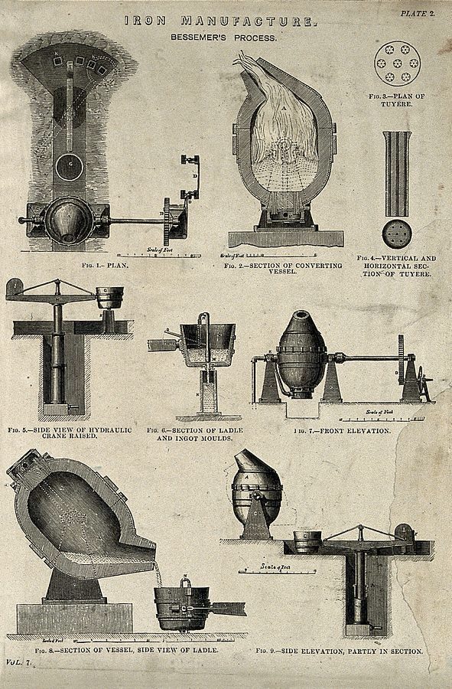
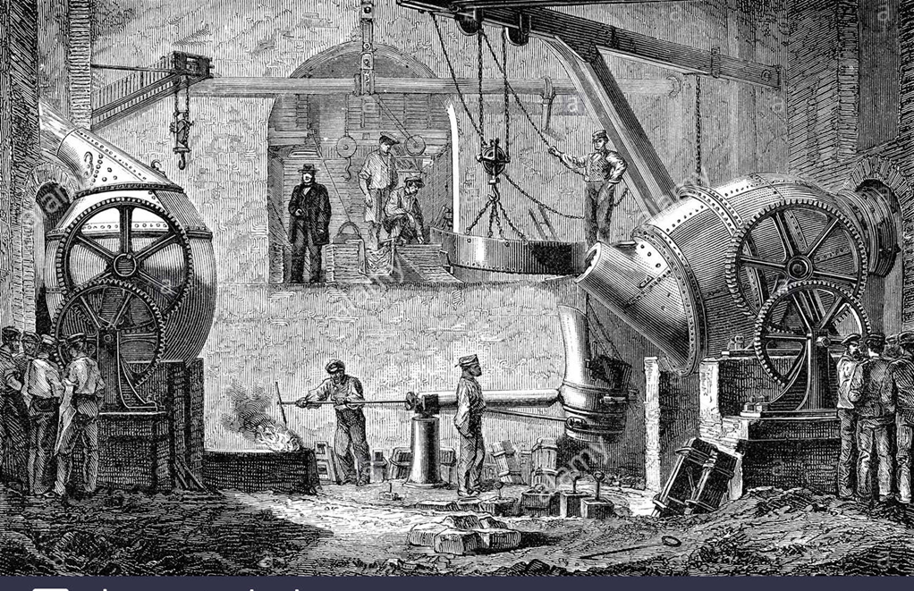
Bessemer Steel Process Introduced to Spain
Notes:
Pour molten pig iron into tilting convertor that you could blow air through to remove impurities (oxidation).
30 tons of steel produced every 30 minutes. Led to stronger & cheaper steel with no outside fuel needed.
Multistep approach:
1) Produce molten pig iron by blasting iron ore & limestone in blast furnace with coke (converted coal)
2) Control & shape flowing mass of molten pig iron via blowing process
3) Make iron into steel by adding alloys
4) Give steel its shape: becomes solid via soaking pits, rolling mills & cutting/smoothing process
Highly skilled & experienced labor for each process:
Movement control: based on blower’s experience & judgment. Knowing how to pour iron in & tilt & pour iron out.
Control temperature.
Mix with right alloys.
4) Shaping process: manipulate malleable steel to make it right size, with adequate strength & correct internal structure.

Slide 18
Notes:
Bessemer and his envoys took active role in tailoring disparate processes outlined above with whatever raw materials they found in situ.
They taught their licensees the analytic and diagnostic tools associated with each step in the process. This included not only the oxidation process, but also rolling—how to manipulate the malleable metal to make it the right size, shape, and strength—and even blast furnacing.
Henry Bessemer acquired a 15-year invention patent for his steelmaking technique in Spain—same year he was granted his first patent in England.
After acquiring Spanish patent, demonstrated his process in London to José de Vilallonga, an engineer who worked for Altos Hornos de Bilbao.
Bessemer then sold the firm his patent for Bessemer steelmaking in 1857 upon Vilallonga’s urging.
Bessemer oversaw installation of a converter in one of the Altos Hornos steelmaking facilities. Taught licensees how to heat, tilt, mix & cool molten pig iron and other additives.
British also tasked with installing & operating sophisticated hydraulic system/other supporting machinery.
Bessemer committed himself to sharing any improvements to his process with the company, Altos Hornos obligated itself to reciprocity in any advances it discovered.

Slide 19
Notes:
Siemens open hearth furnace (William Siemens):
Slowly boiling a mixture of iron ore or scrap metal into molten pig iron, thus reducing the latter’s carbon content via oxidation. Melting of these materials: dish like open bath that is heated by a regenerative gas furnace fueled by either coal or natural gas.
The open-hearth conversion process differs from Bessemer’s in four key ways. First, it uses the gases generated during the coke making process (which fuels the blast furnace that melts iron ore into pig iron) to fire the furnace, as well as reuses the escaping hot waste gases emitted during the steelmaking itself to preheat incoming fuel and air used to melt the steel and its additives. Second, the process spans hours, therefore allowing the steelmaker to repeatedly evaluate the metal’s chemical and physical features along the way, and make any needed modifications. Third, it enables the production of greater amounts of steel, albeit over a longer period of time. Fourth, it allows for the possibility of using recycled scrap metal.
Under aegis of his Spanish patents, Friedrich helped the Spaniards install and learn to use the Siemens steelmaking process in exchange for royalties.
Subsequently, inventors from Belgium, Germany, Italy, France, and the United States also patented close to twenty follow up inventions to the Siemens steelmaking process in Spain (OEPM 2017). This occurred between 1895 and 1954.
Altos Hornos de Bilbao. This firm obtained 9 invention patents between 1893 and 1900 around improvements and additions to these three processes. For its part, the Vizcaya obtained 5 patents. Desdier Crooke patented an improvement to the Siemens open-hearth steelmaking process in 1897 (OEPM 2017).

Slide 20
EXTRAS
Notes:
Other industries where technology transfer occurred on the back of patents & licensing: rubber, telephones, internal combustion engine.

Slide 21
Making Spain Great Again (1939 to 1977)

Slide 22
Political Economy of Fourth Patent Regime
Upon Franco’s death in 1975, Spain attempted to recover from deep economic crisis induced by protectionism & crony capitalism.
Spain democratized in 1977. It then joined European Union in 1986.
These developments set off cascade of economic reforms:
(Further) reducing barriers to trade, capital flows & foreign investment.
Reform of financial system to be more competitive & abide by market based allocation of credit.
And, of course, liberalizing the patent system & harmonizing it with international best practices!

Slide 23
Spain’s Fourth Patent Regime (1986 to today)
Introduction patents eliminated.
A technical examination & novelty requirement introduced.
Working requirements weakened.
Products could be patented, not only processes.
Spain signs Europe’s Patent Cooperation Treaty: Europeans receive patent in European Patent Office, which is valid across as many EU countries as inventor cares to designate.
1989: Spain joins Patent Cooperation Treaty: allows inventors to obtain a single patent with World Intellectual Property Organization and list Spain as participating country.

Slide 24
Figure 1. Patenting by Foreigners in Spain (1834-2001)

Slide 25
Figure 3. Spanish Patents by Economic Sector (1826 to 2000)

Slide 26
Figure 9. Spain’s Income from Iron Ore (1830 to 1996)

Slide 27
Figure 4. Spanish Industrialization (1830 to 2000)

Slide 28
Figure 7. Expenditures on Royalties, Copyrights and Licenses (1963 to 1973)

Slide 29
Figure 8. Technical Assistance Payments in Spanish License Contracts (1961 to 1971)

