Slide 1
Victor Menaldo Professor Political Science University of Washington
Evidence Based Policy

Slide 2
Evidence Based Policy: fluency in details, political economy, microeconomics & scientific method to adjudicate claims
1. Fluency in the Details:
Knowledge of policy debates—including assumptions made by regulation advocates & critics, their descriptive/causal claims about the world & fallacies in their logic & evidence.
2. Political Economy:
Identifying politics behind those debates & winners & losers from regulation.
3. Microeconomics:
Economic logic behind positions taken in those debates. This means understanding supply & demand curves, tradeoffs involved & behavioral adjustments made by rational actors to avoid, lessen impact of or change policy.
4. Scientific method:
Research design & data to judge how regulation/deregulation will affect economy & society: translate policy question about what govt. should do into testable research questions & strategies about real world effects of policies.

Slide 3
Understanding Policy Debate & Political Economy go hand in hand
For those stakeholders who favor regulation or deregulation:
What’s their theory of the world & ideological view?
Who are they advocating on behalf of?
What kind of economic arguments are they putting forth?
Do they claim that regulation will promote greater efficiency?
Lead to more innovation?
Create more jobs?
Improve public safety?
What kind of evidence do they put forth to defend their claims?

Slide 4
Debates about regulation often about distribution of surplus but dressed up in language of efficiency: what is best for economy & society.
Especially when players up & down vertically disintegrated supply chain fight over spoils: how to divide producer surplus.
For example, debates about intellectual property rights: those @ top of chain specialize in ideas. Those @ bottom specialize in making products.
Those @ top want royalties for their ideas & thus want stronger IPR. Those @ bottom want to pay less $$ to those at top.
To negotiate better terms, they accuse idea makers of monopolistic pricing & anticompetitive practices; frivolous lawsuits & harming innovation; or just contributing very little value added.
Those at the top of the chain may over-inflate the importance of intel. property & try to strengthen their property rights @ expense of other players in the chain.

Slide 5
My own interests: around the marketplace & in particular firm behavior & market structure
Evaluating effects of regulation on firms:
How does Policy X affect firms’ business strategy? These are things such as investment decisions & innovation policies.
How does Policy X affect firms’ revenues, budgets & profits?
Evaluating effects of regulation on market outcomes:
How does Policy X affect structure of particular market, such as how concentrated it is (how many firms compete)?
How does Policy X affect prices paid for products?
How does Policy X affect actual products & their quality?

Slide 6
My own approach: Observational Data
Choose way of measuring regulation that gives you leverage: maximizes # data points you have to work with.
Effects of a discrete, one off policy change: proxy for this change that exploits more than one data point.
Rather than evaluate the effects of a single policy change made at the federal level, you might exploit variation in similar regulations among the 50 U.S. states:
Some adopt the policy & some do not.
Variation in the timing of adoption.
Variation in the degree to which they adopt the policy.

Slide 7
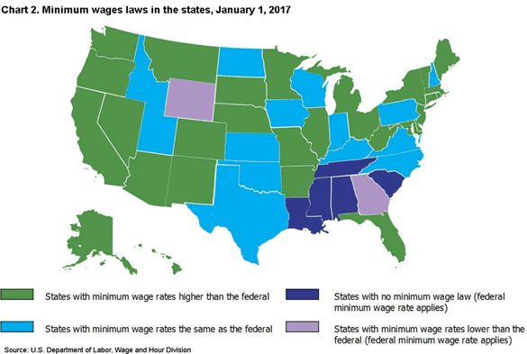

Slide 8
Best Practices for Research Strategy: Analysis
Choose research strategy centered on logic of counterfactuals.
Use observational data in way that mimics logic of experiment conducted using randomized controlled trials, where assignment to treatment is random.
In other words, think about your data in terms of treatment groups & control groups.
Notes:
Linear Regression (OLS) that controls for potential confounders.
Matching methods that use algorithms to create treatment & control groups.
Difference-in-differences techniques that segregate data into treatment & control groups & exploit time to allow a comparison in their post-treatment trends.
Regression discontinuity design that exploits arbitrary thresholds that determine assignment into a “treatment” versus “control” group.

Slide 9
Should govt. regulate student loan industry with intention of making college more affordable for greater # of people?
Translate into testable questions
What effect of federal govt.’s intervention in student loan market on?
college affordability
student educational choices
student outcomes?

Slide 10
STAKES INVOLVED & CONTEXT
Increasingly, obtaining a high paying job requires a college degree. Yet tuition is increasing at a staggering rate, much above inflation.
500% increase for private schools since early 1970s.
600% increase for public schools since early 1970s.
During that time, the student loan market exploded.
75% of students now graduate with loan debt.
Average student loan debt has more than doubled since 1993, to over $37K.
1.5 trillion in federal student loan debt.
Default rates are 10%.
Student loan market evolved from private sector centered system with federal govt. guarantees (1965) to direct loan program (1993) to one in which repayment is increasingly tied to income (2010).
Over 90% student loans owed to federal govt.

Slide 11
POLICY DEBATE
1) Arguments in favor of govt. involvement in direct lending:
Students unique set of borrowers: no credit history, no collateral & no cosigner. Few incentives for private banks to get involved (adverse selection & moral hazard).
Education public good underprovided if govt. did not get involved: society benefits from a diverse workforce that is well educated & more informed citizenry.
Govt. involvement can allow for greater flexibility, such as providing a flexible repayment schedule & loan forgiveness.

Slide 12
POLICY DEBATE
Arguments against govt. involvement in direct lending:
Creates potential harm to borrowers:
Face perverse incentives to borrow more than needed or choose low paying majors.
Incur this debt with no guaranteed income to repay.
Default & ruin their personal finances.
Creates perverse incentives for schools to increase tuition: subsidies encourage overconsumption/students willing to pile on debt.
Cream skimming: borrowers with high incomes are able to refinance debt with private lenders at lower interest rates. Those with lower incomes & higher default risk cannot & govt. system is left with only risky borrowers.

Slide 13
Deregulation may be a good idea
Perhaps private banks, which are disciplined by market forces, should take on a larger role in student loan market. This might:
Lead to fewer loans & less risky loans.
Decrease demand for education among students who are paying too much for school or who are not graduating.
Reduce tuition & increase grants.

Slide 14
Translate into several hypotheses:
What is relationship btwn. direct lending by federal govt. & college tuition prices?
What is relationship btwn. direct lending & tuition grants awarded by colleges? (crowding out effect)
What is relationship btwn. direct lending & type of major chosen?
What is relationship btwn. direct lending & retention at colleges?
What is the relationship btwn. direct lending & graduation rates?

Slide 15
Examples of Evidence Based Policy Projects Undertaken by Students (Aspiring US & International Policymakers)
The following are examples of research designs and findings from students who participated in Stanford/Hoover Institution’s IP2 from 2014 to 2018. Professor Victor Menaldo acquired permission to share these; he helped students craft & present these.

Slide 16
RESEARCH STRATEGY
Used Integrated Postsecondary Education Data System to compile data on variables that operationalized their hypotheses.
Has data on dozens of variables for 4 yr. institutions with college or university in its name & enrollment > 1,000 students.
Unit of analysis was the college/university.
7,500 data points.
Key explanatory variable that operationalizes govt.’s role on direct lending: Average Federal Student Loan Amount (key explanatory variable)
OUTCOMES OF INTEREST:
Net Tuition Price (outcome variable)
Tuition Grants Awarded (outcome variable)
Share of STEM Majors (outcome variable)
Retention Rates (outcome variable)
Graduation Rates (outcome variable)

Slide 17
Research Project Example 1: Innovation & Finance
V. RESEARCH STRATEGY
They conducted statistical analyses using OLS to evaluate the relationship btwn. Average Federal Student Loan Amount and:
Net Tuition Price
Tuition Grants Awarded
Share of STEM Majors
Retention Rates
Graduation Rates
They controlled for factors that may confound the relationship btwn. federal student loans & these outcomes, such as the cost of education & the returns to education (real wages for those with BAs).

Slide 18
Research Project Example 1: Innovation & Finance
VI. FINDINGS
They found that as the federal govt.’s lending increases:
Schools charge higher tuition
Schools reduce the amount of grant money available
Students are less likely to stay in school & less likely to graduate
They surmised that the federal govt.’s involvement in direct lending is distorting the student loan market, creating inefficiencies & inducing risky behavior.

Slide 19
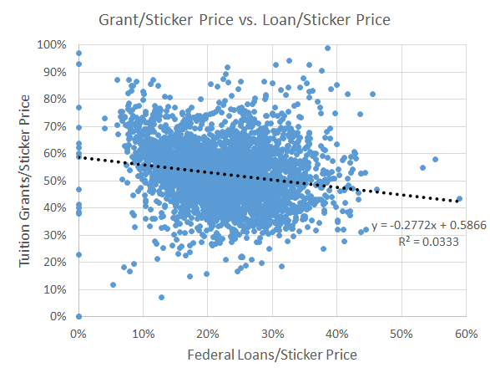
Crowding-Out of Private Aid Hypothesis
Negative relationship between federal loan aid & institutional grants provides evidence of crowding-out

Slide 20
Best Practices for Research Strategy: Measurement
If direct ways to measure your outcomes of interest (the things you believe are affected by the regulation) are not available, consider indirect ways.
For example, what if you want to evaluate the effect of a regulation on firms’ innovation policies? Hard to get records on this.
You may thus consider exploiting indirect ways of measuring innovation:
R&D spending
changes in productivity
scientific publications
participation in international expositions/fairs
patent registrations!

Slide 21
Research Project Example 2: Patents & Innovation
I. POLICY QUESTION
Should governments stop weakening intellectual property rights in the pharma industry to avoid harming drugmakers’ R&D efforts?
II. RESEARCH QUESTION
What is the effect of compulsory licensing regimes in the developing world on the R&D efforts expended by pharmaceutical firms?

Slide 22
Research Project Example 2: Patents & Innovation
III. STAKES INVOLVED & CONTEXT
Deadly diseases such as HIV/AIDS are a big problem in developing countries. Many patients go untreated, even if lifesaving drugs exist.
However, the R&D costs that go into making these drugs are huge, so prices for these drugs tend to be very high.
Many govts. thus force pharmaceutical companies to issue compulsory licenses: allows the govt. or generic drugmakers to manufacture a drug w/out obtaining approval of the patent owner & in exchange for reduced royalties.

Slide 23
Research Project Example 2: Patents & Innovation
IV. POLICY DEBATE
1) Those who support compulsory licensing claim:
In case of lifesaving drugs a patent confers an economic monopoly upon the owner & thus creates a significant deadweight loss as supply does not match demand. A compulsory license should overcome this problem.
2) Those who argue against compulsory licensing claim:
Creates gray markets due to arbitrage: some buy drugs cheaply in the developing world, in which they are manufactured via compulsory licensing, & resell them in developed world at a substantial markup.
Harms incentives to invest in R&D—especially for lifesaving drugs that affect a small portion of population & in relatively poor countries.

Slide 24
V. RESEARCH STRATEGY: Created matched comparisons—developing countries that adopted compulsory licensing versus those that didn’t. The countries that didn’t adopt compulsory licensing represent the counterfactual for those countries that did adopt.
Treatment Group (Year C.L. Issued) | Control Group
Brazil (2001) | Mexico
Argentina (2005) | Chile
Canada (2001) | Australia
Ecuador (2010) | Peru
India (2006) | China
Indonesia (2005) | Philippines
Malaysia (2003) | Philippines
Note: countries are matched by GDP per Capita.

Slide 25
Research Project Example 2: Patents & Innovation
V. RESEARCH STRATEGY
They figured out the year in which a compulsory license was imposed on each company in each country.
They collected data on patenting activity from companies directly affected by the compulsory licenses: Merck, Abbott, Gilead, etc.
Did this for each company across each of their countries (treatment & control cases) between 1996 & 2011.
They used a data source called Espacenet.
Their dataset had 520 company year observations.

Slide 26
The Dataset

Slide 27
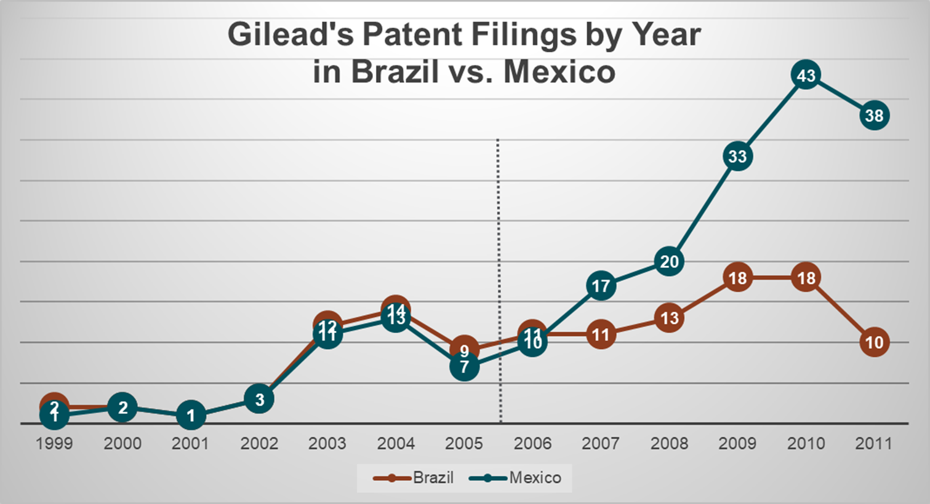
V. RESEARCH STRATEGY: Difference-in-differences design compared trends in patenting new drugs after compulsory licensing for country that enacted C.L. & matched country that did not enact.

Slide 28
Research Project Example 2: Patents & Innovation
VI. FINDINGS
On a case by case basis, they found a large, negative effect of compulsory licensing on patent registrations across their “treatment” countries & across firms such as Abbott, Gilead & Merck.
They also found this to be the case on average (pooling across countries & creating one large dataset).
Results held after controlling for potentially confounding factors, such as countries’ macro-economic characteristics.

Slide 29
Research Project Example 2: Patents & Innovation
POLICY PRESCRIPTIONS
Developing countries should be more cautious when issuing compulsory licensing if they care about future innovations in the pharmaceutical industry.
They should consider other methods for broadening the availability & reducing the price of lifesaving drugs:
Govts. themselves might finance R&D to bring more of these drugs to market.
Might reduce barriers to entry in pharmaceutical industry so that increased competition helps reduce R&D costs & prices.

