Slide 1
EDC&I 585 4/13/11
What’d We Talk About Last Week?
Organizing Our Discussions for This Week
Setting the Stage for Next Week

Slide 2
Our Reactions to Brown (2000) and Brown & Adler (2008)
Virtual vs. F2F engagement:
Virtual encounters maybe = as good as F2F, but harder to access; F2F forces attention
Open Ed Resources and TL Commons:
Trade off between quality and quantity? If a course is “free,” what are guarantees of quality?
“Passion-Based Learning”:
Shift in how individuals see selves as learners – hi-tech = easier and more widespread -> Move towards more low-tech approaches?

Slide 3
Lead-in to Cuban
Why we keep doing the same studies over and over
What we learned from 50 years of research on “teacher adoption” of ed tech
Does the current crop of ed tech differ in significant ways?
If not, does the context differ?

Slide 4
Why We Keep Doing the Same Studies Over and Over
“Teacher adoption” of ed tech ≠ a problem til there was something to adopt
Earlier waves of ed tech:
Chalkboard (blackboard): 1870s-90s
Film/filmstrips: 1940s-60s
VCR: 1970s-80s
Computers: 1980s-
We assumed they’re all fundamentally different (and fundamentally revolutionary)

Slide 5
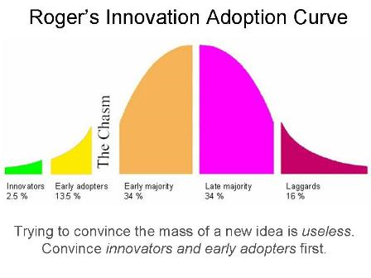
What We Learned from 50 Years of Research on “Teacher Adoption” of Ed Tech
Early assumption: “If we put it in the classroom, they’ll use it.” (But: they didn’t.)
Then: “Adoption of Innovation” model (Rogers) – based on rural ag extension work in 1950s

Slide 6
Later Adoption Research (1980s-90s)
Concerns-Based Adoption Model (CBAM)
6. Refocusing I have some ideas about something that would work even better.
5. Collaboration How can I relate what I am doing to what others are doing?
4. Consequence How is my use affecting learners? How can I refine it to have more impact?
3. Management I seem to be spending all my time getting materials ready.
2. Personal How will using it affect me?
1. Informational I would like to know more about it.
0. Awareness I am not concerned about it.
Levels of Use
VI. Renewal The user is seeking more effective alternatives to the established use of the innovation.
V. Integration The user is making deliberate efforts to coordinate with others in using the innovation.
IVB. Refinement The user is making changes to increase outcomes.
IVA. Routine The user is making few or no changes and has an established pattern of use.
III. Mechanical The user is making changes to better organize use of the innovation.
II. Preparation The user has definite plans to begin using the innovation.
0I. Orientation The user is taking the initiative to learn more about the innovation.
0 . Non-Use The user has no interest, is taking no action.

Slide 7
Most Recent (2000s- )
Move away from individual teacher as unit of analysis –> school, school culture
Cuban (1987): “What gets adopted is ed tech that reinforces teacher’s role & authority”
Lampert & Ball (1998): “Ed tech can change teachers’ real practice (and here’s how…)”
Collins & Halverson (2009): “How can we leverage ed tech in teaching to improve learning?”

Slide 8
Cuban (2001)
Do you recall a situation (from your own experience) where technology changed what happened in the classroom?
In a setting where ed tech policy was made, what arguments, assumptions were used?
Do you recall a situation where setting molded how ed tech was used?
Is there a role for ed tech in schools with very young children? (Kindergarten, etc.)
What does it mean to “integrate” technology into a classroom?

Slide 9
For next week…
NO CLASS MEETING!
Non-traditional media exercise: Fine one interesting web-based resource (video, graphic, animation) that you feel captures an important aspect of our themes in this course; post to the existing thread in GoPost
Cuban 4-6: Is ed tech being used effectively in higher ed? If there’s so little evidence of value in improving student learning, why so much emphasis? What contextual factors in schools account for slow up-take?

