Slide 1
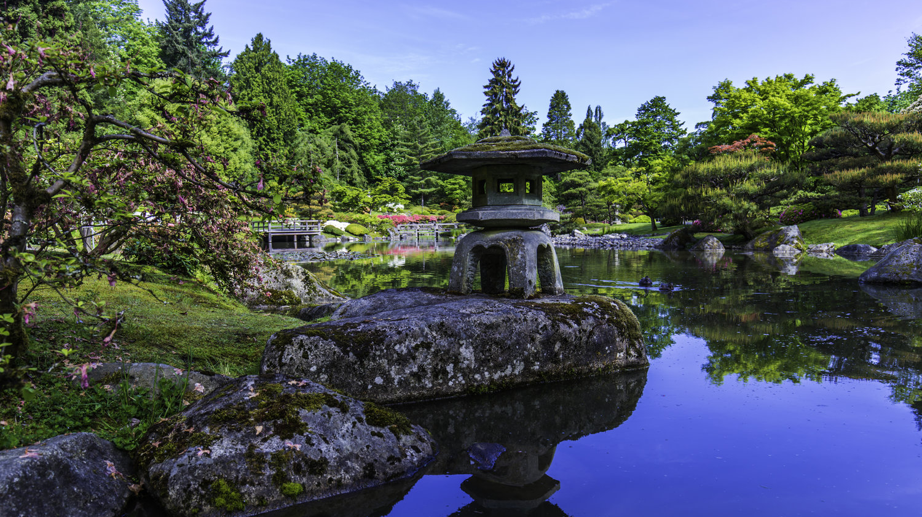
WELCOME TO THE SEATTLE JAPANESE GARDEN
OPERATIONS & SAFETY

Slide 2
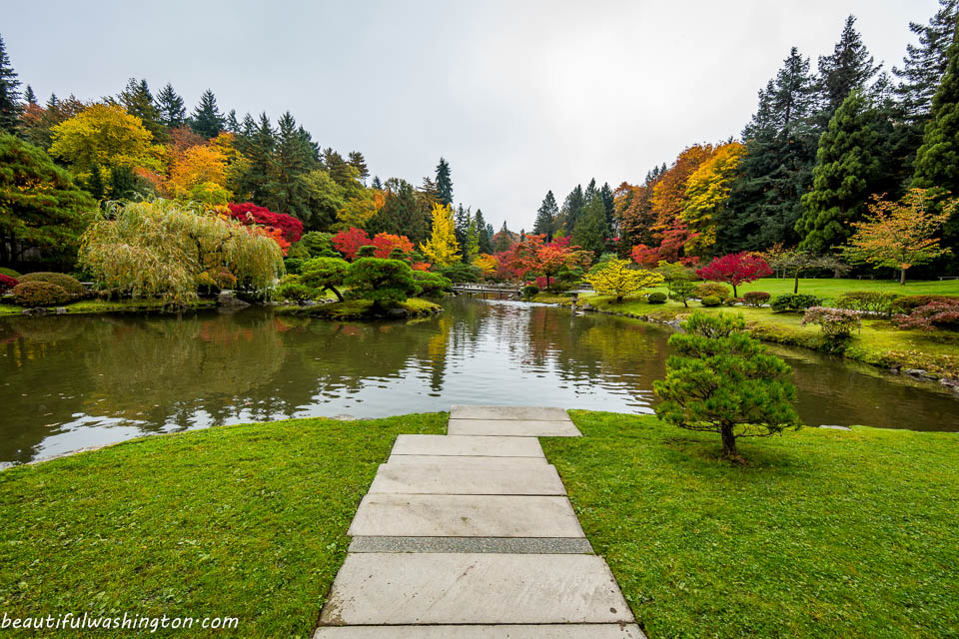
GATEHOUSE STAFF
Tashika Cormier – Senior Customer Service Representative
Johnny Townsend – Customer Service Representative
Kayleah Wheless – Customer Service Representative
Raphael Borromeo – Customer Service Representative
Elizabeth Duran – Customer Service Representative
Joshua Khan – Customer Service Representative
Andrew Pritzkau – Specialty Garden Coordinator

Slide 3
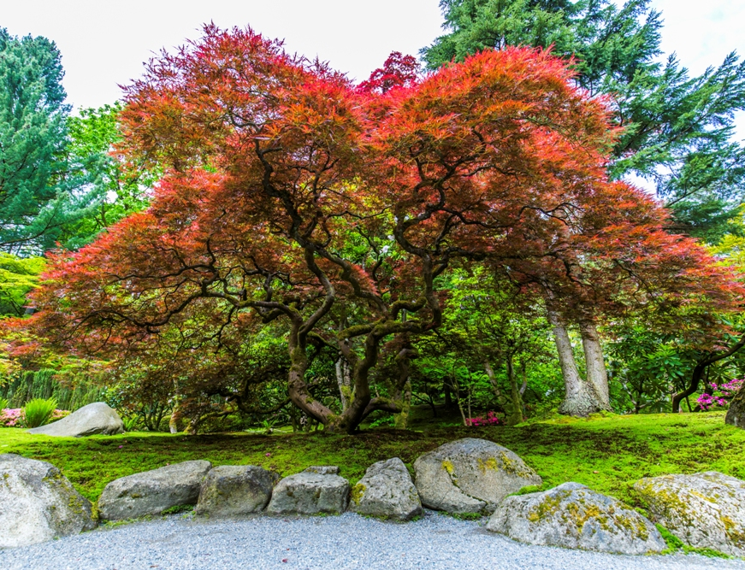
JAPANESE GARDEN CODE OF CONDUCT
No smoking or vaping
No food or drinks (water is acceptable)
No professional camera equipment or tripods
No formal photography
Including wedding, fashion, prom, etc.
No drones
Service animals only

Slide 4
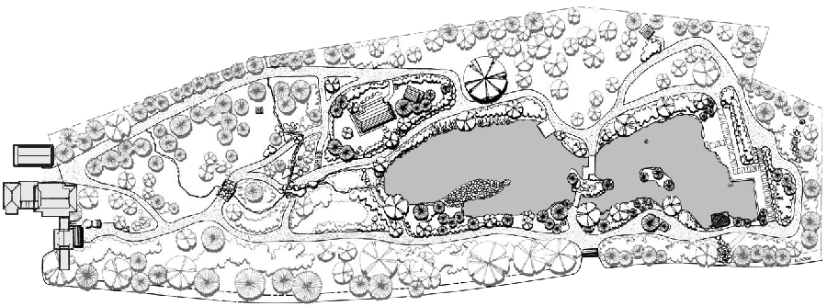
THE GARDEN PROPERTY

Slide 5
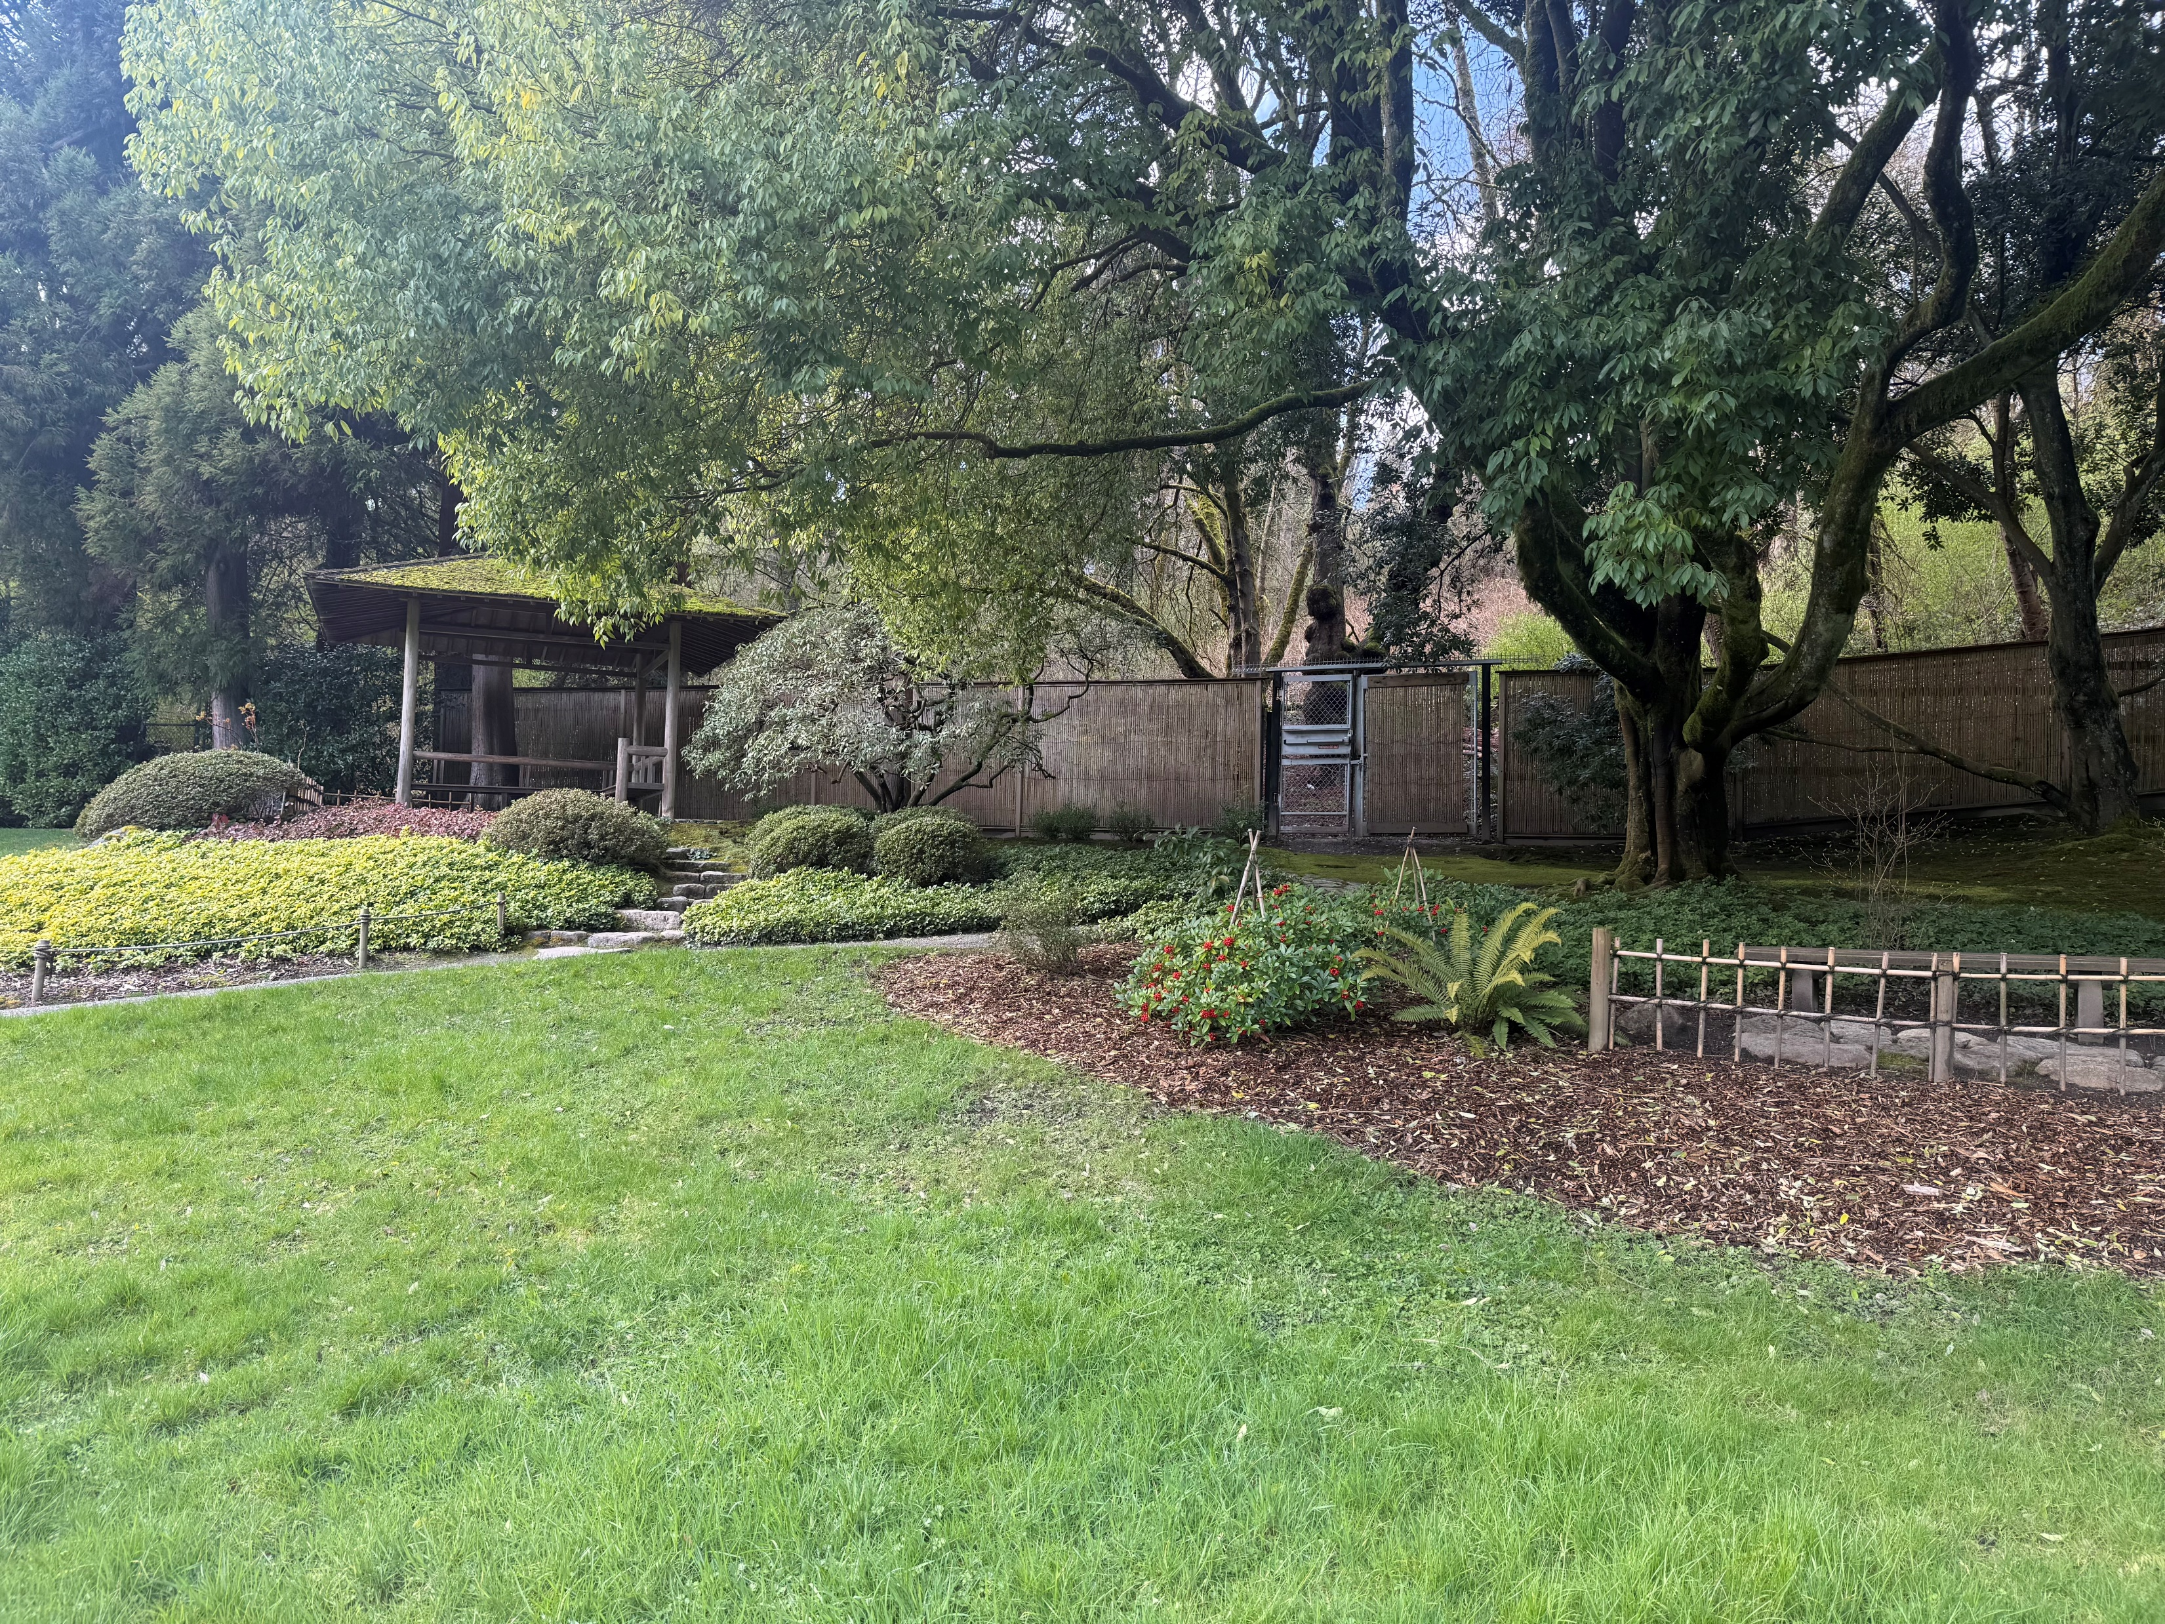
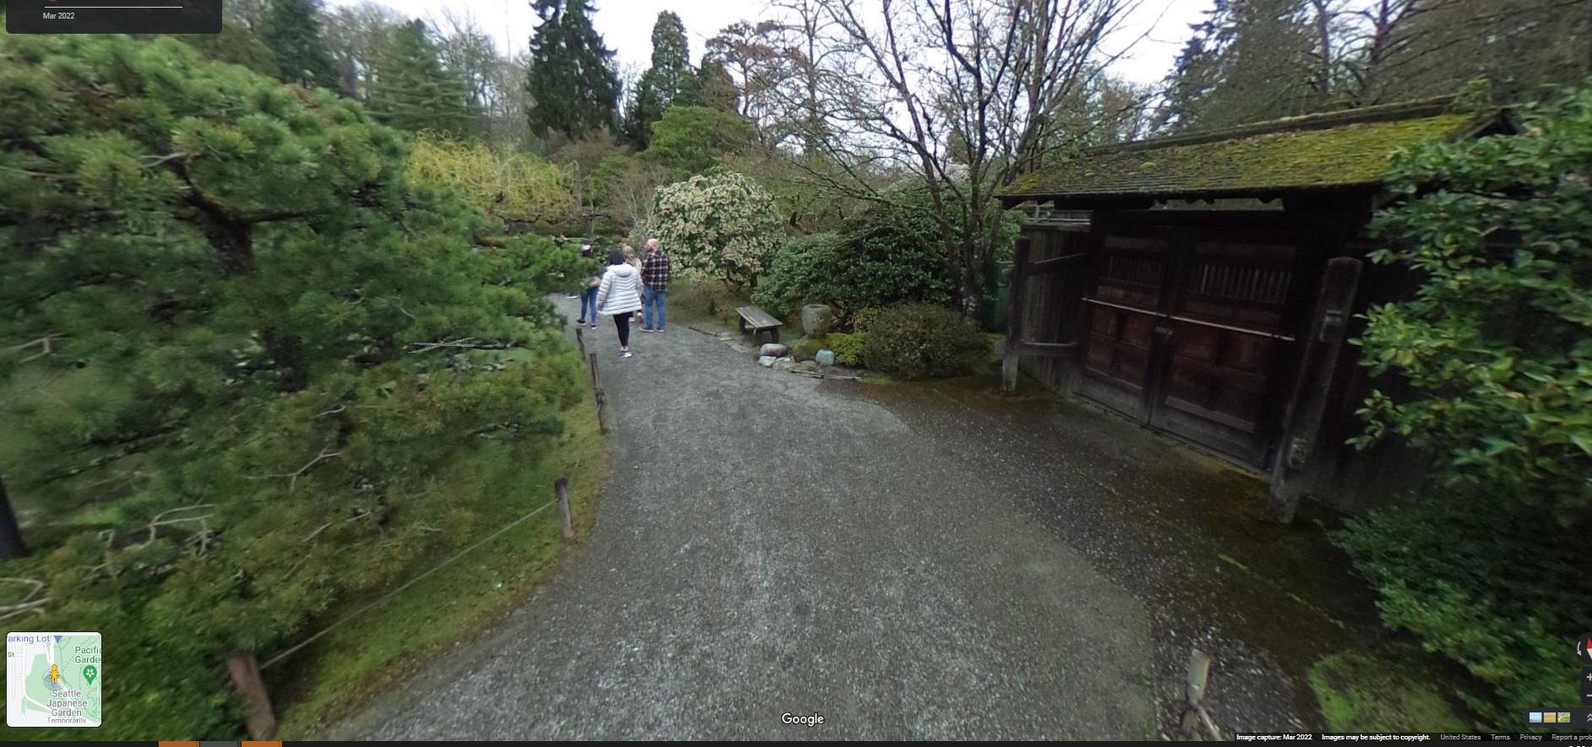
EMERGENCY EXITS

Slide 6
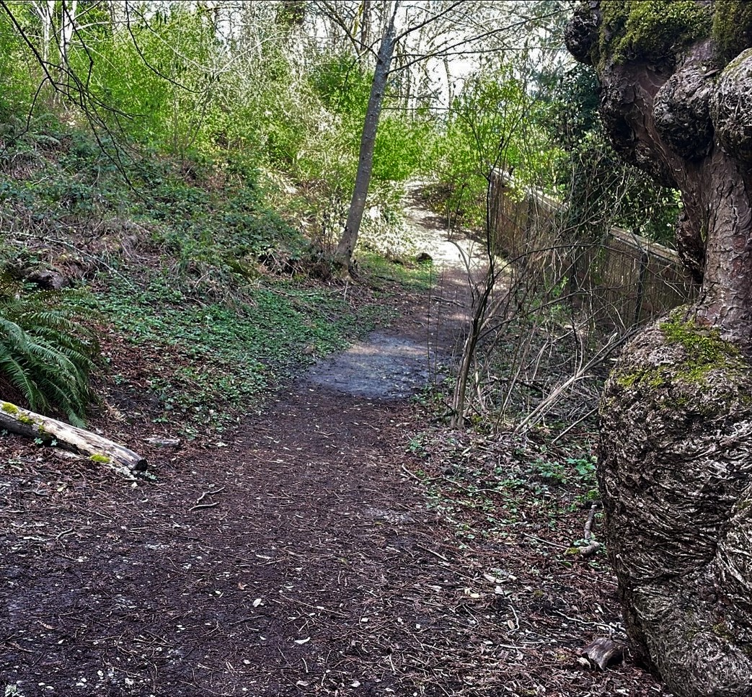
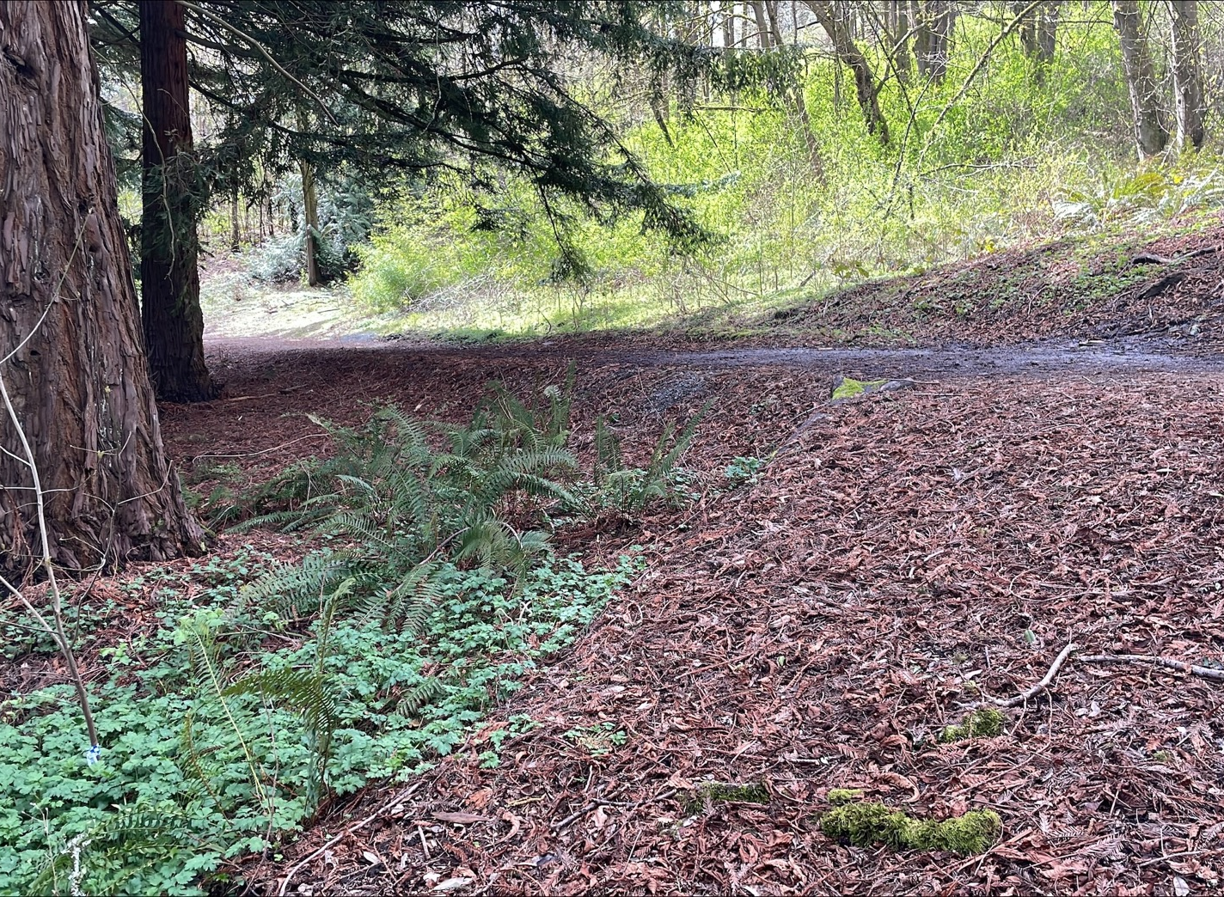
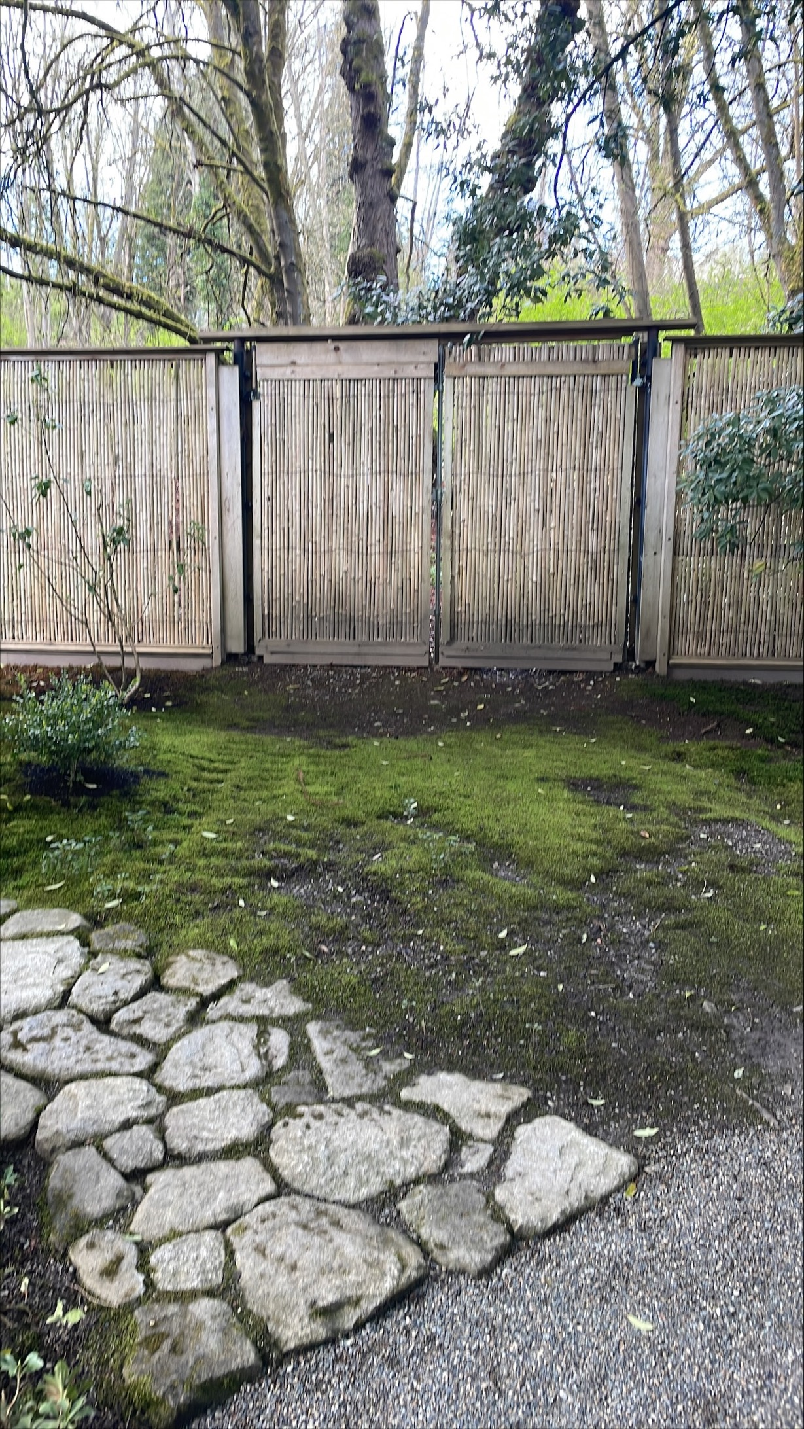
NW EMERGENCY GATE ROUTE

Slide 7
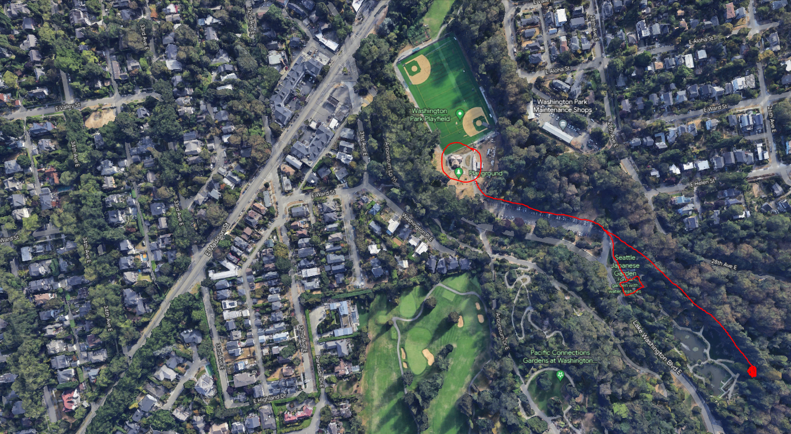
EVACUATION ROUTE & MEETING POINT
Washington Park Restrooms
Located near the Playfield
Gather information & check in with SPR staff

Slide 8
WHO TO CALL & WHEN
Situation Type | PHONE 9-1-1 | Walkie Talkie Cashiers / Gardeners
Medical/Fire/Police Emergency | Primary | Secondary
Missing Person (within the park) |  | Primary
Someone Fell into the Pond |  | Primary
Fallen Tree/Branch |  | Primary
Broken Step/Bench/Statue/etc. |  | Primary

Slide 9
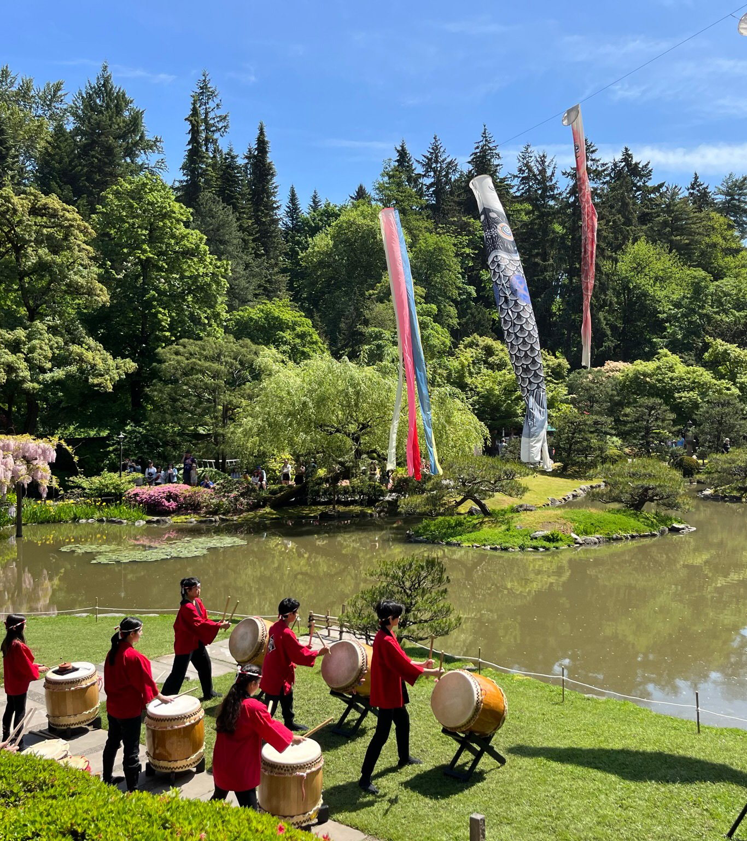
THE GO BAG
Basic First Aid
Aid for small injuries like bumps, scraps, etc.
Assess injury & contact SPR staff if need
Ice packs located in gatehouse
Walkie Talkie
Access to gatehouse staff
Emergency Numbers

Slide 10
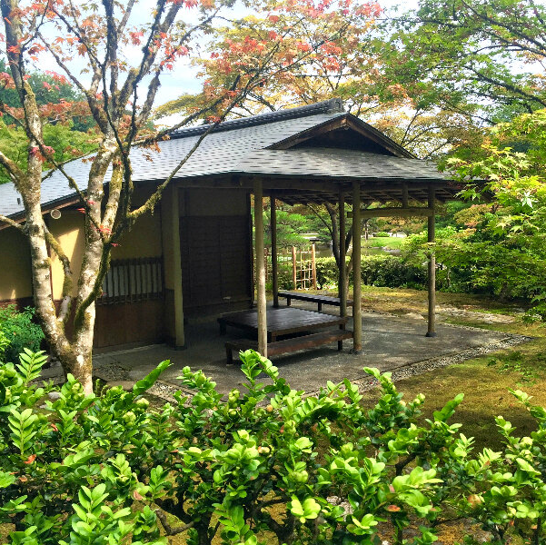
MEDICAL EMERGENCIES
Heat Stroke/Exhaustion
Difficulty Breathing/Choking
Loss of Consciousness
Sprain or break
Etc.

Slide 11
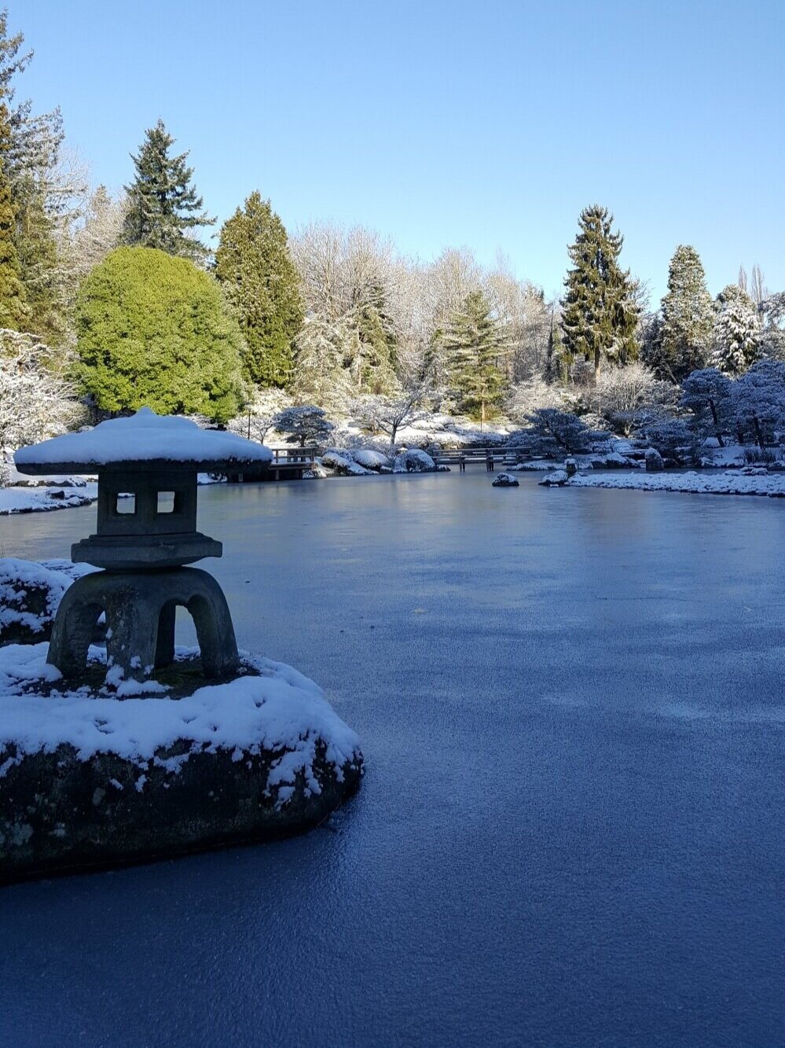
EARTHQUAKE
Remain Calm – Assess the Situation
Avoid Structures
Look out for unstable trees & sluffing (mudslides)
Drop, Cover, Hold
Proceed to Emergency Evacuation Point
Listen to instructions
Initiate your personal communication plan

Slide 12
ACTIVE ATTACKER
Run/Hide/Fight
Remain calm, call 911, run, hide, fight, move to high ground, use egress points, get far and fast away, seek cover
Active Shooters are looking for motion
Cell phone use

Slide 13
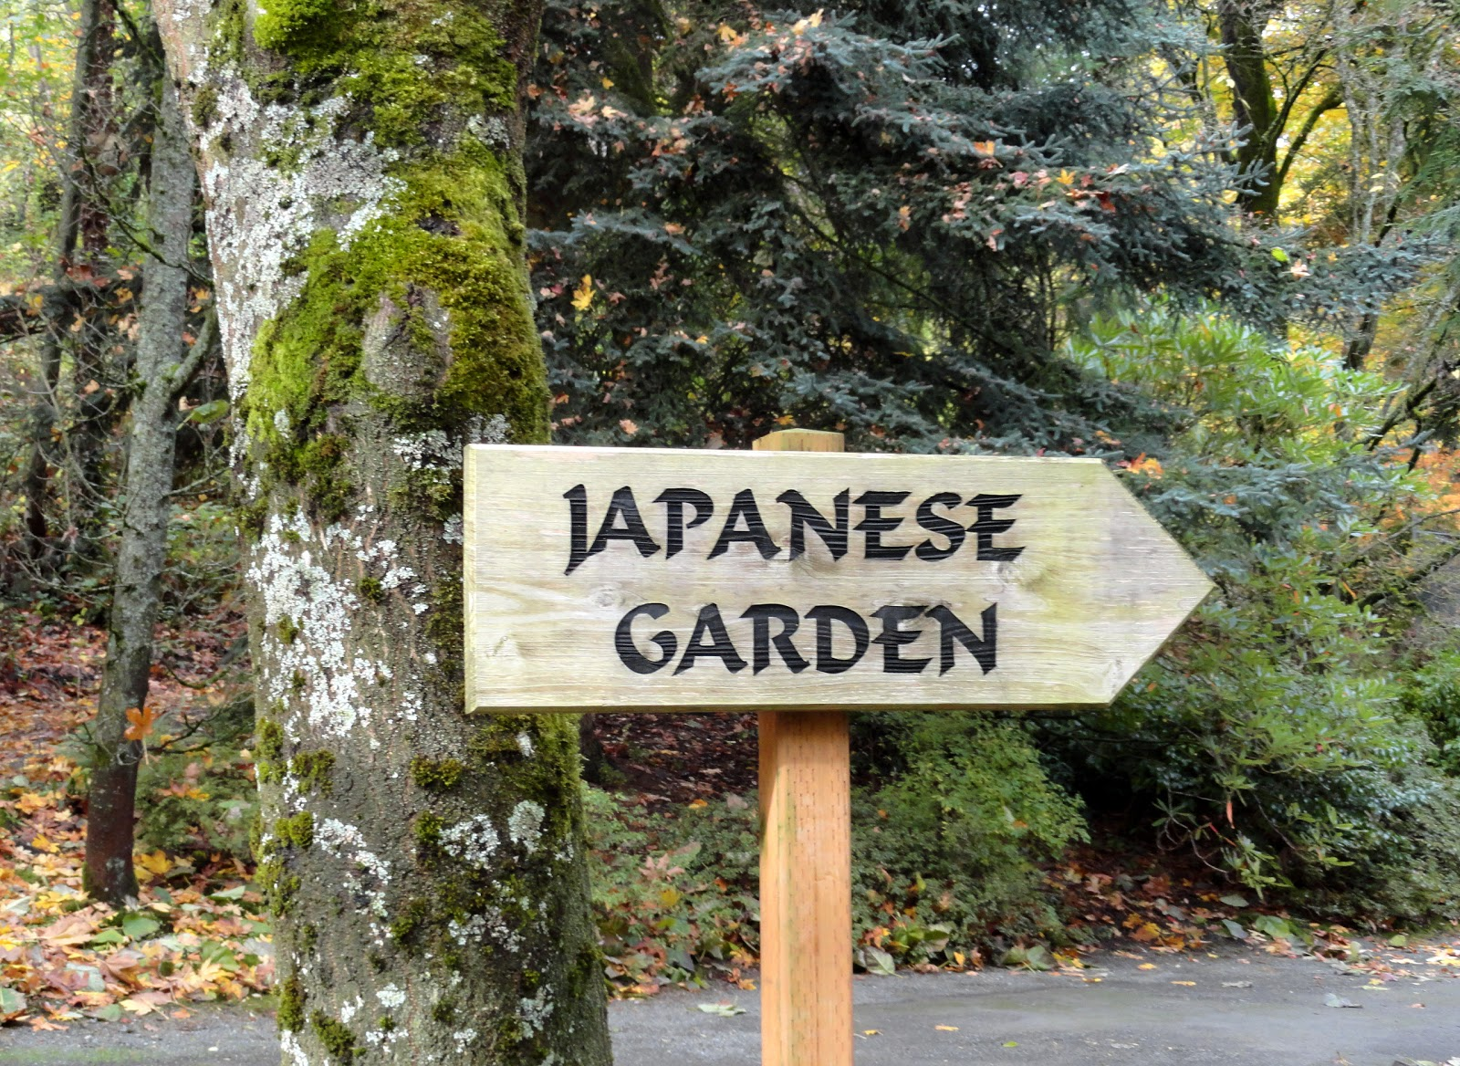
LET’S GO FOR A WALK

