Slide 1
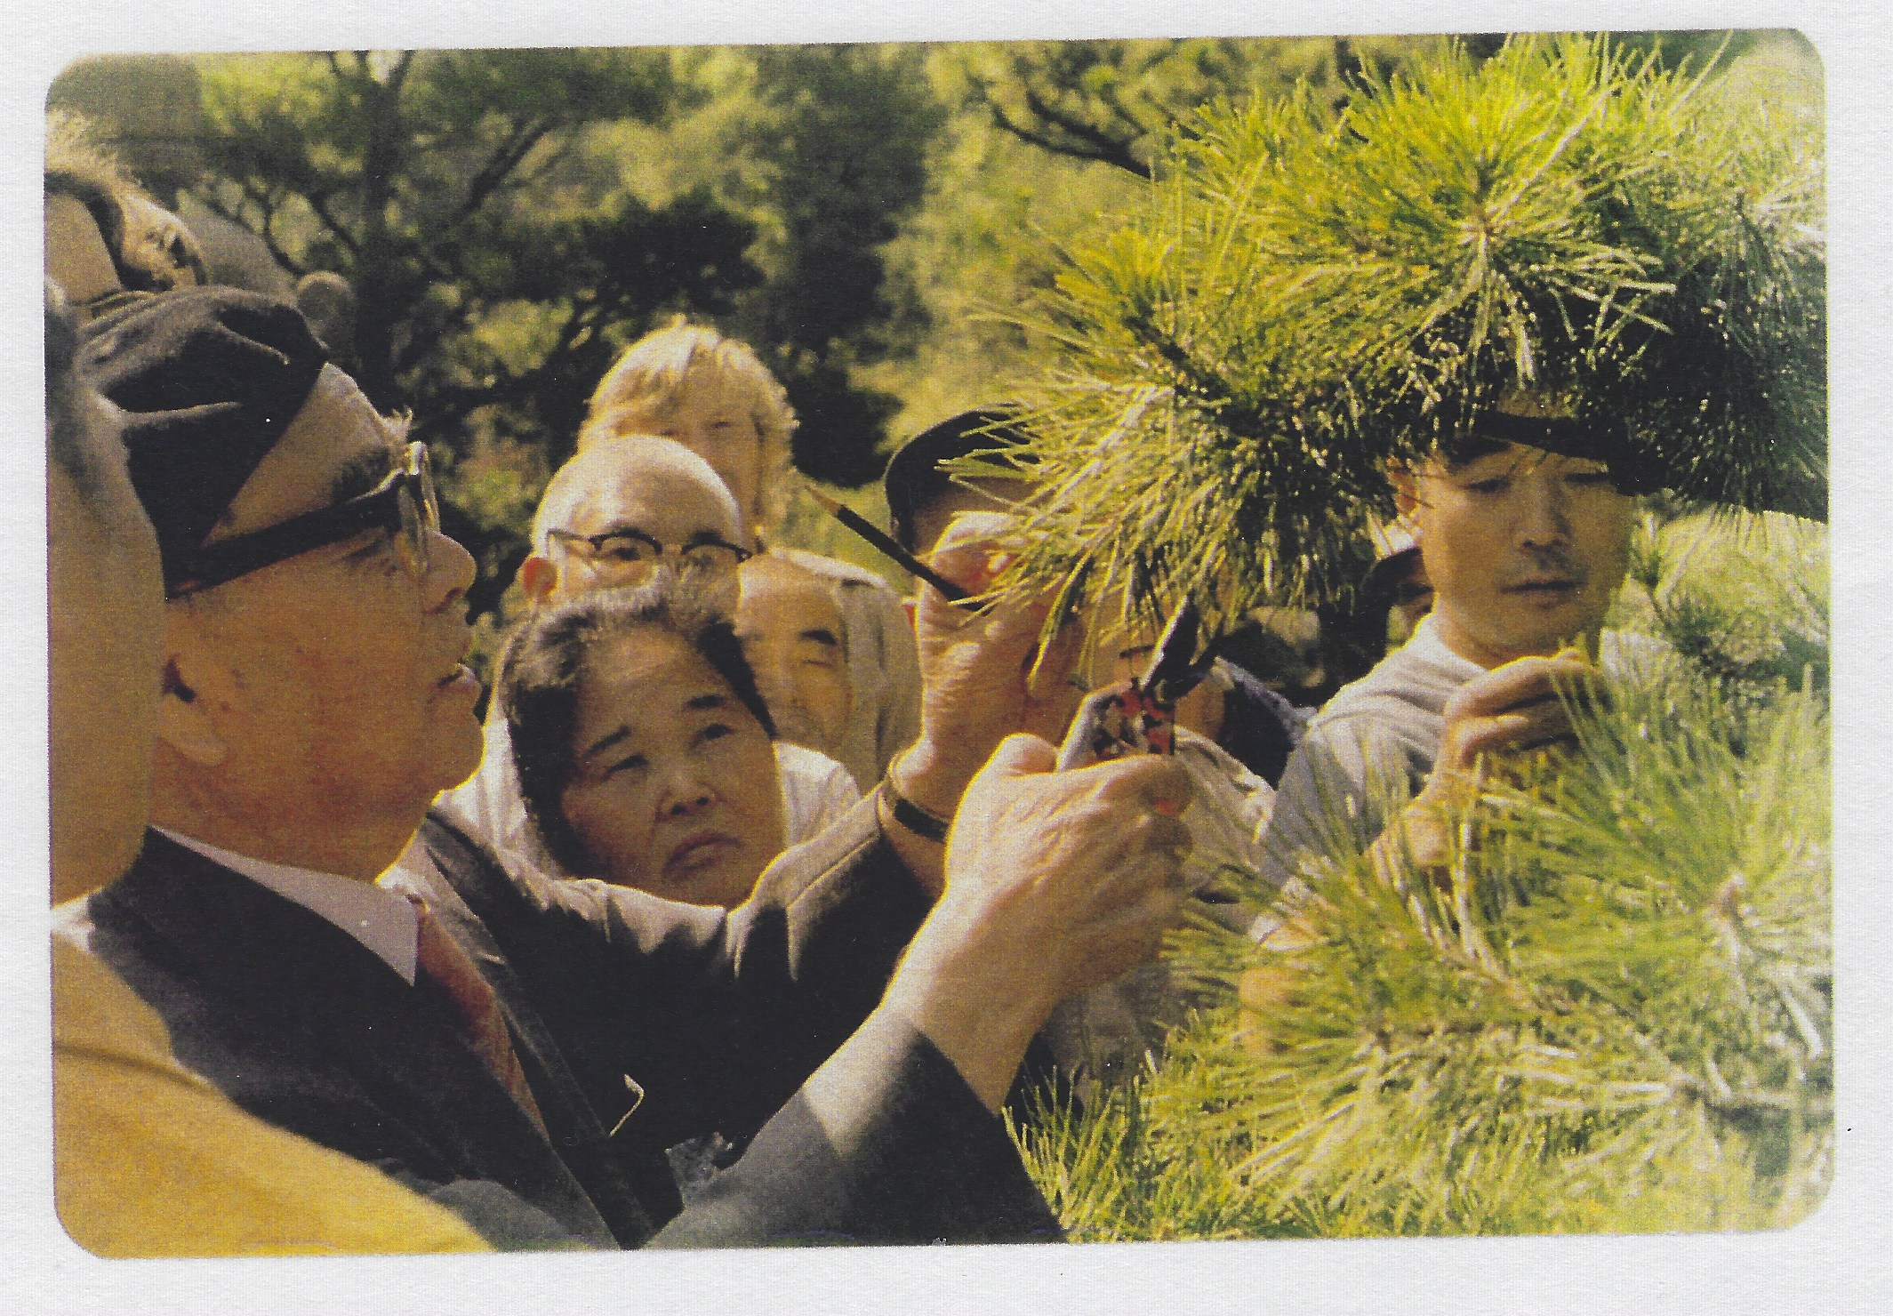
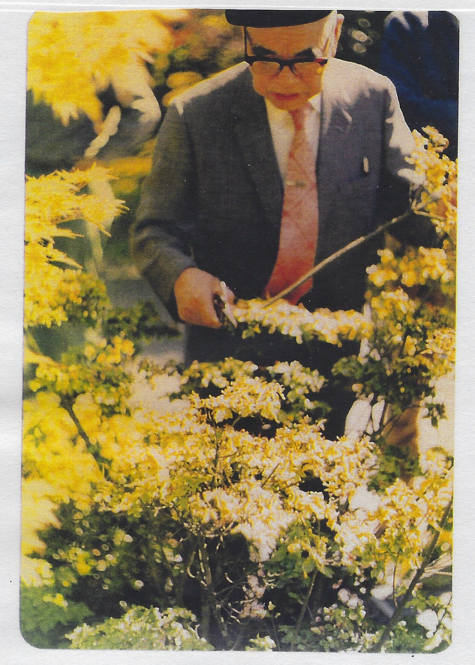
Mr Iida Prunes in July 1973
Photos by Richard Yamasaki

Slide 2
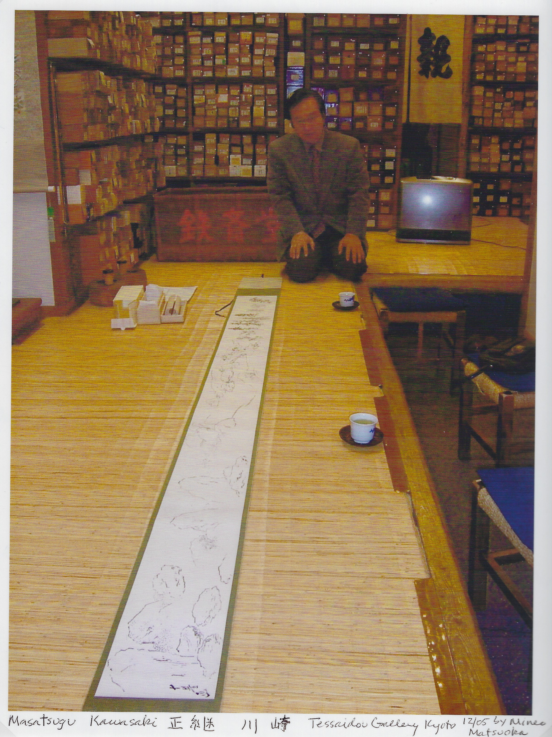
Iida Scroll Mounted at Tessaidō Gallery, Kyoto
December 2005
Dick and Fumi Yamasaki donated it to the Miller Library Center for Urban Horticulture
August 2006

Slide 3
Iida Scroll Movie Intro

