Slide 1
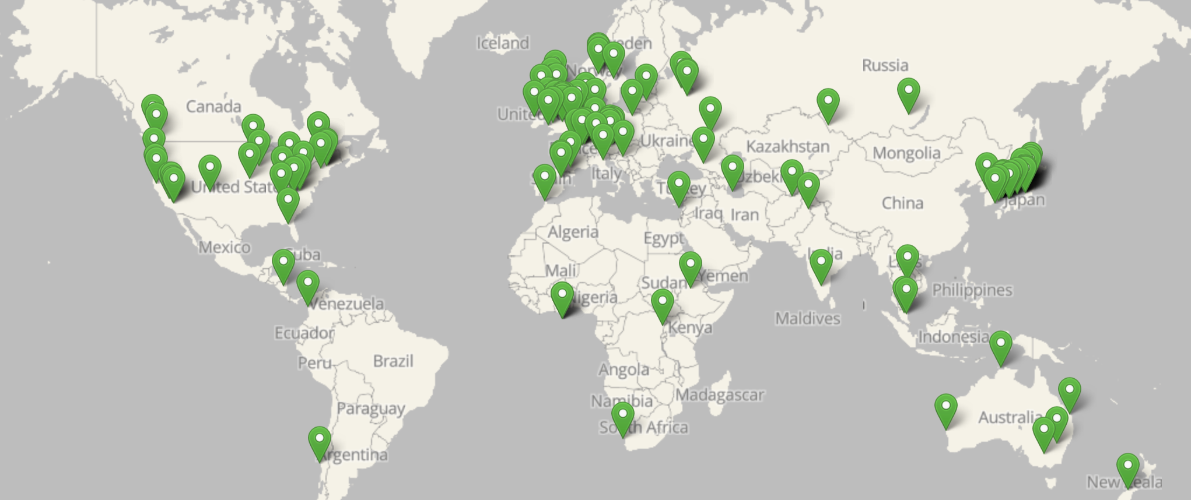

Slide 2
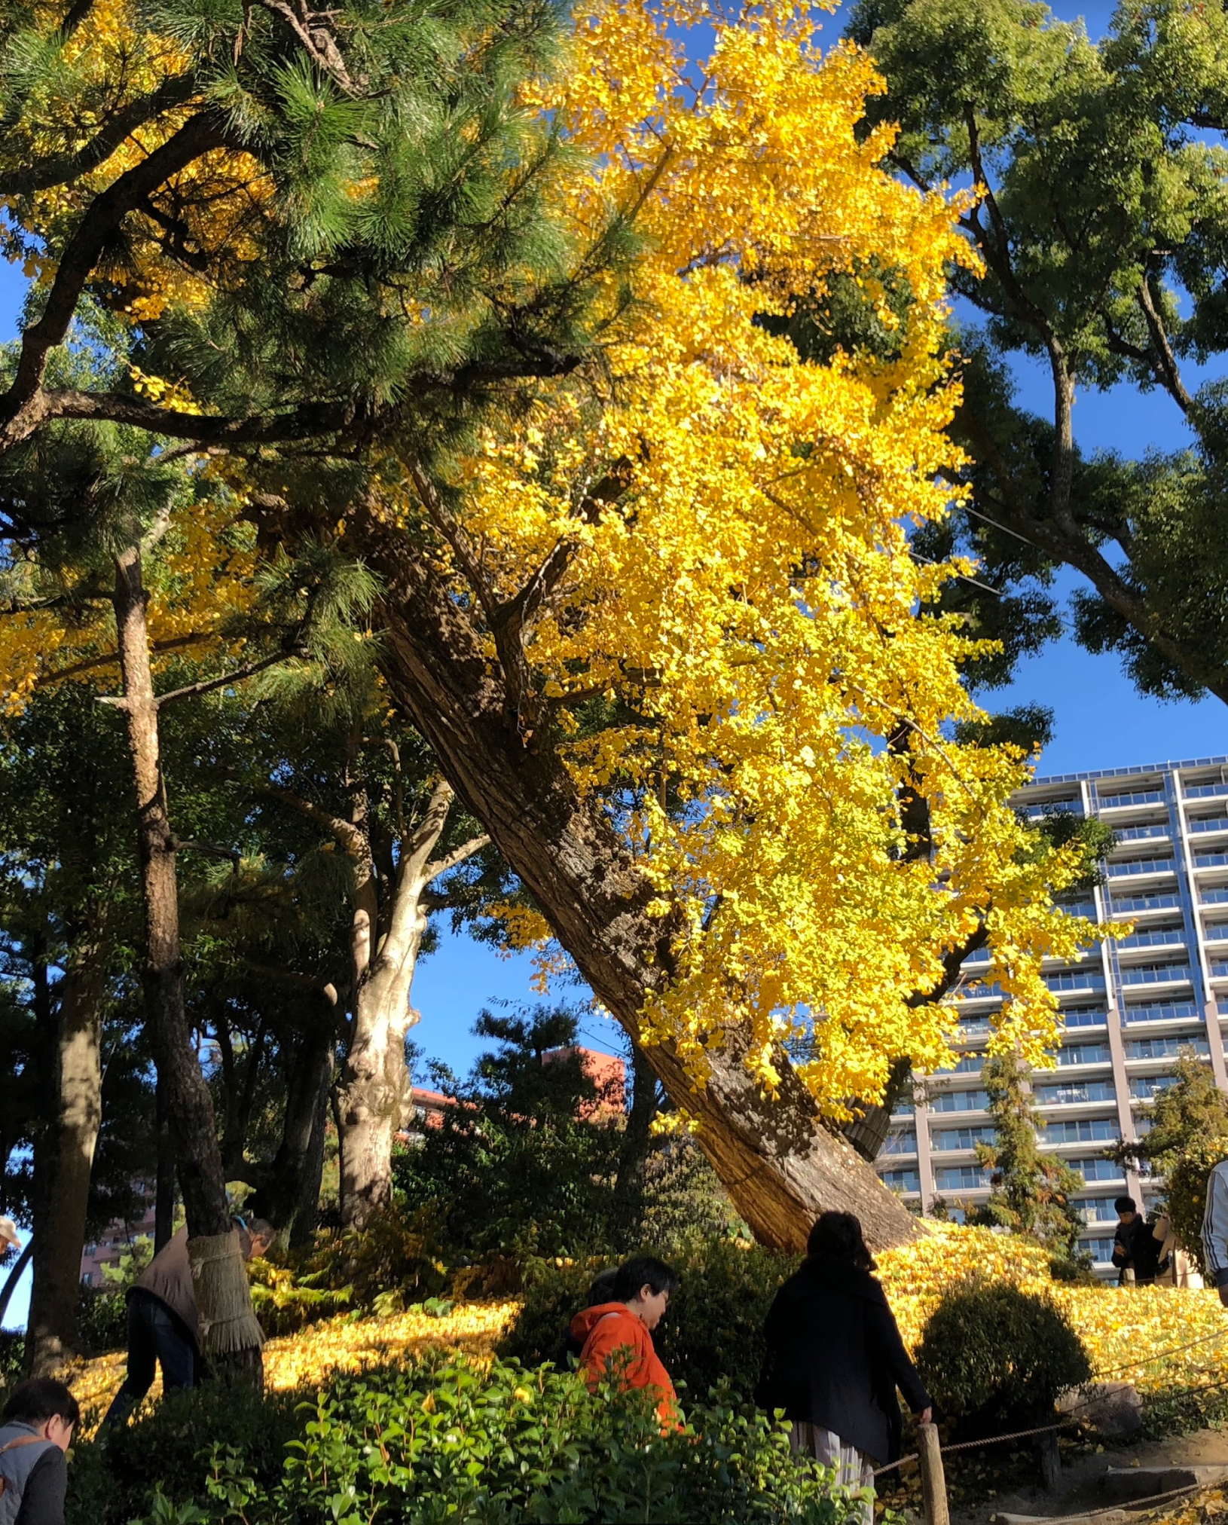
Hibaku jumoku
Shukkeien Garden was created in 1620 by Ueda Soko for the lord Asano Nagaakira.
Soko, a samurai, was one of the greatest tea masters of that time and the tea school originated by him has continued for 16 generations.
The ginkgo tree is more than 200 years old. It is slanting toward the hypocenter because after the blast moved outward from the city center, the air gushed back in. The trunk of the tree is about 4 meters in circumference and about 17 meters tall. The branches are pruned so that the tree won't fall down. After the atomic bomb, many people fled to this garden and died here.

Slide 3
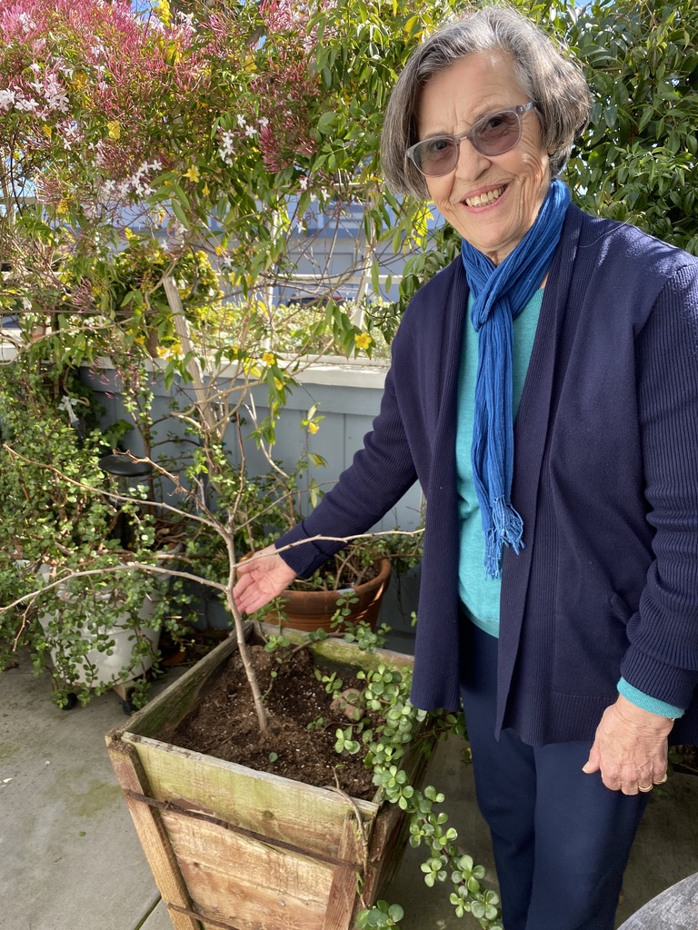
Azar Azimi,
Nassrine’s mother

Slide 4
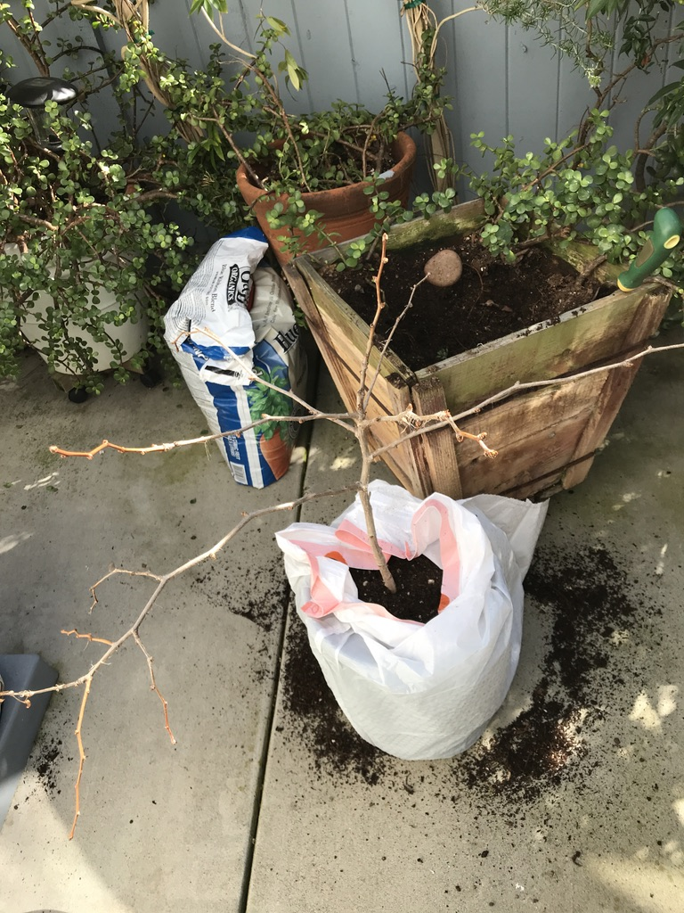

Slide 5
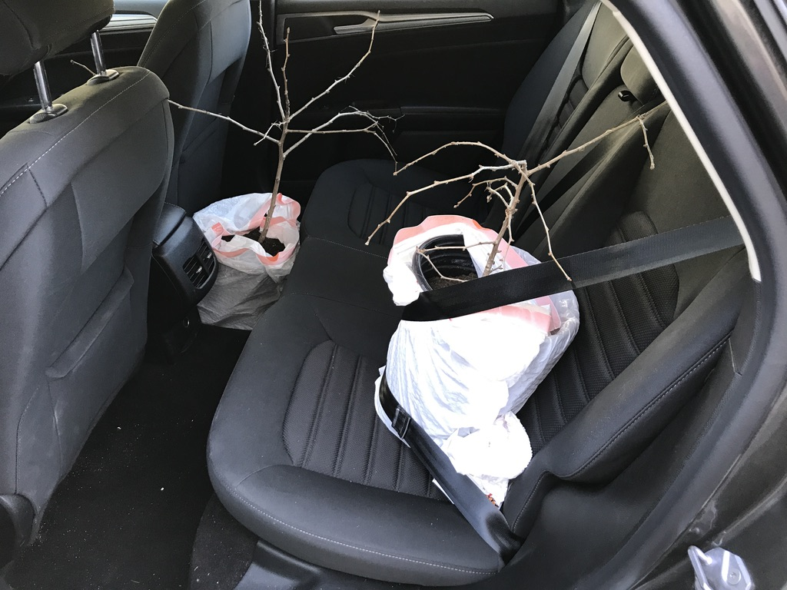

Slide 6
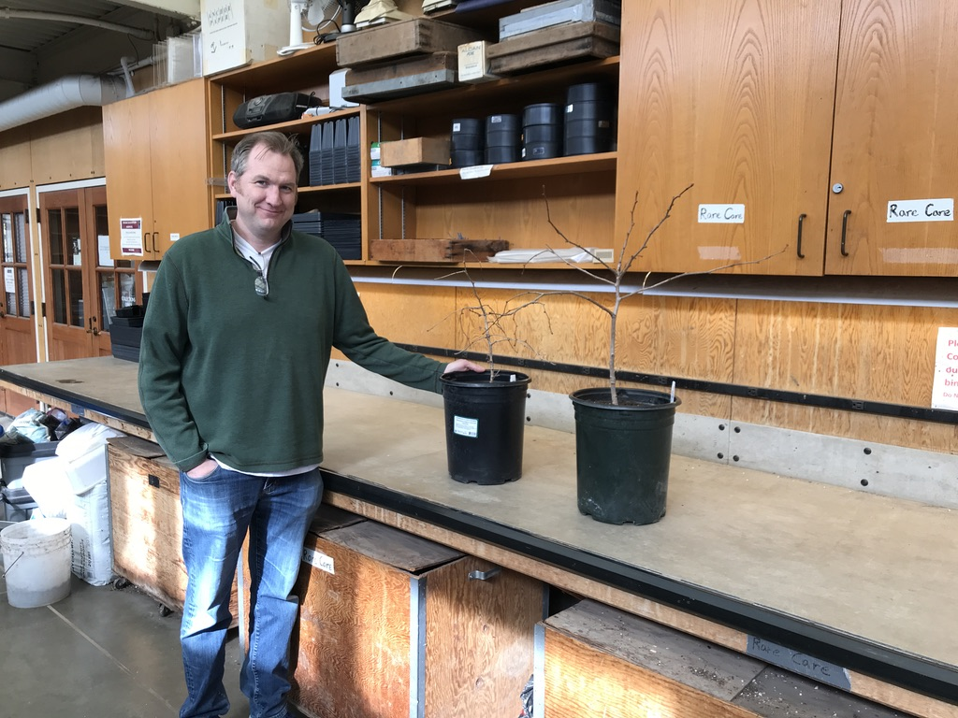
Ray Larson, Curator of Living Collections, Director of the UW Botanical Gardens

Slide 7
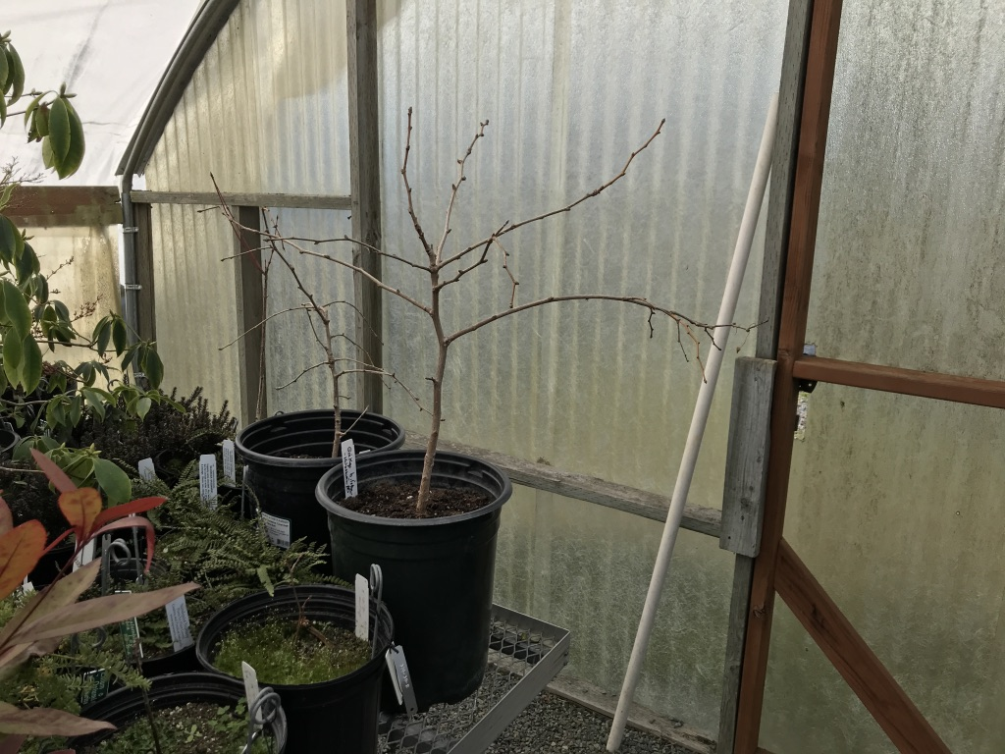
February 27, 2020

Slide 8
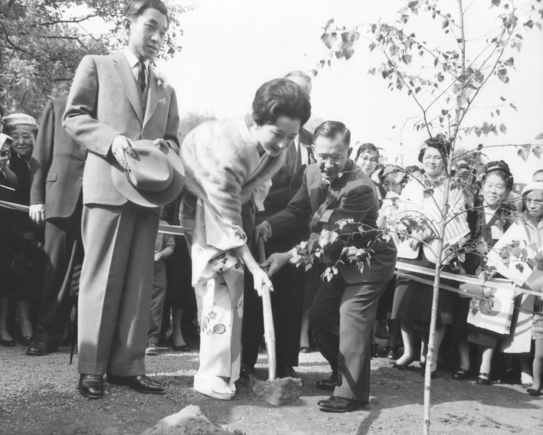
October 5, 1960
Crown Prince Akihito watches while Princess Michiko plants a birch tree

Slide 9
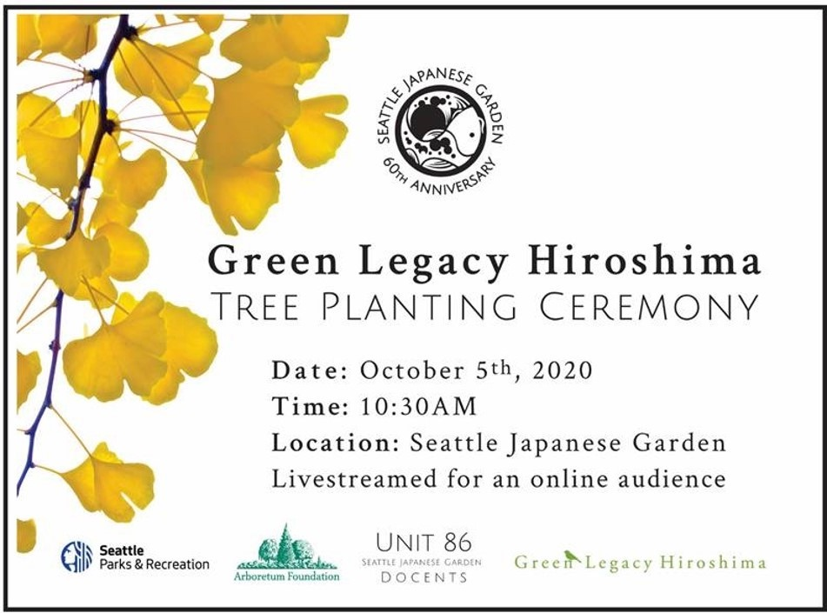

Slide 10
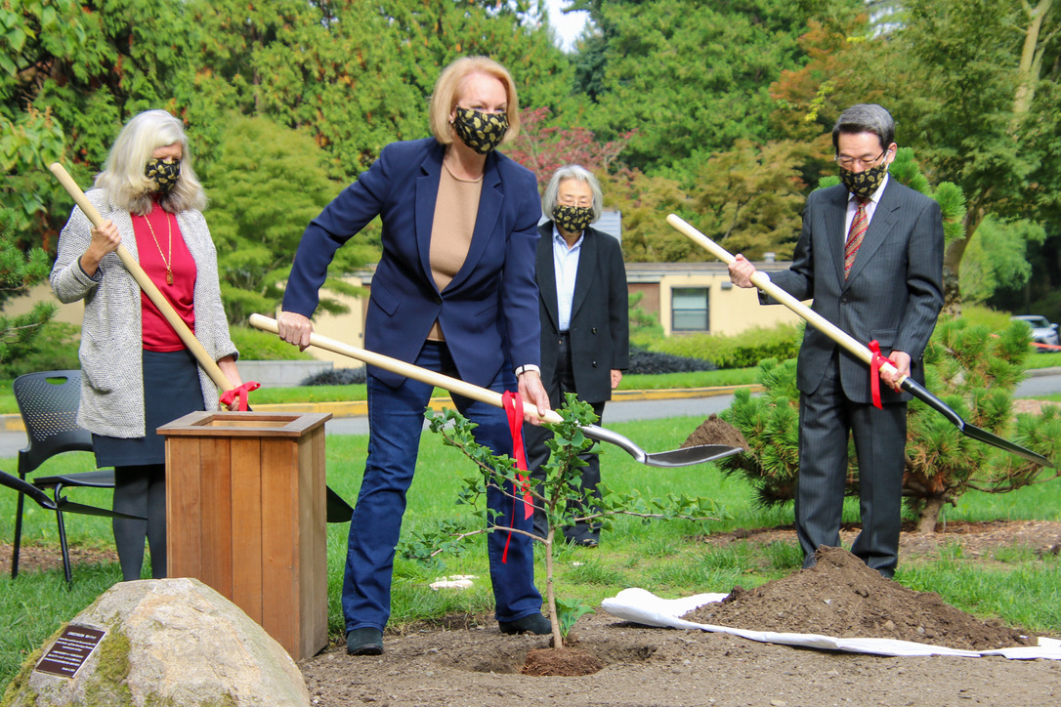

Slide 11
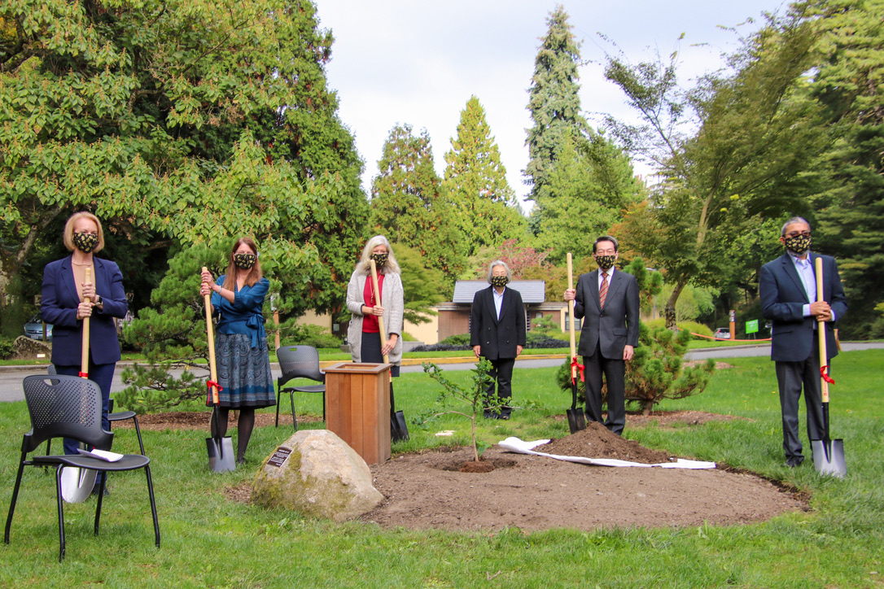

Slide 12
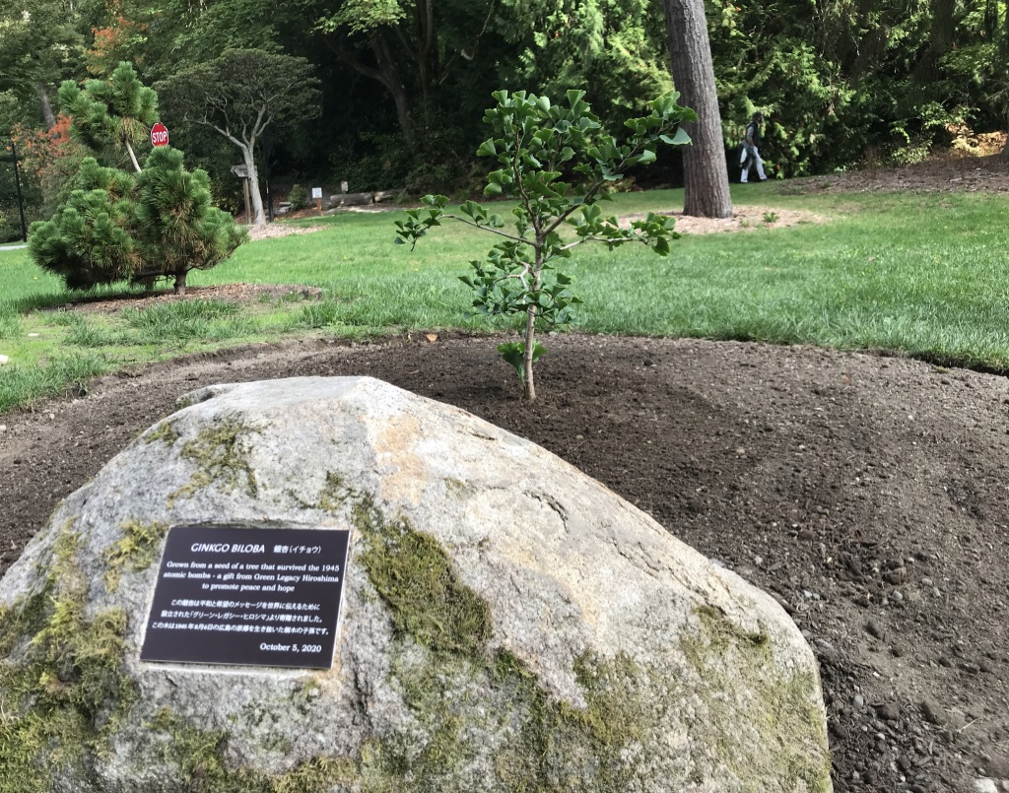

Slide 14
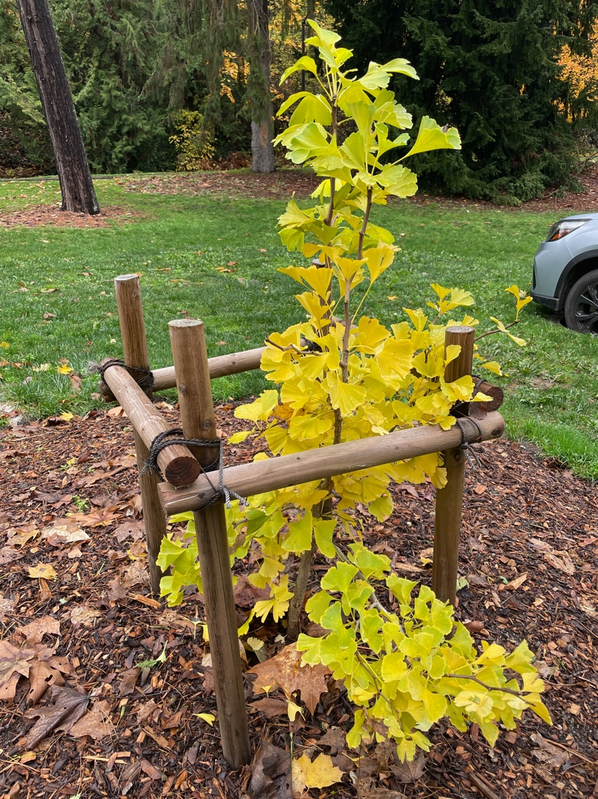
November 2021

Slide 15
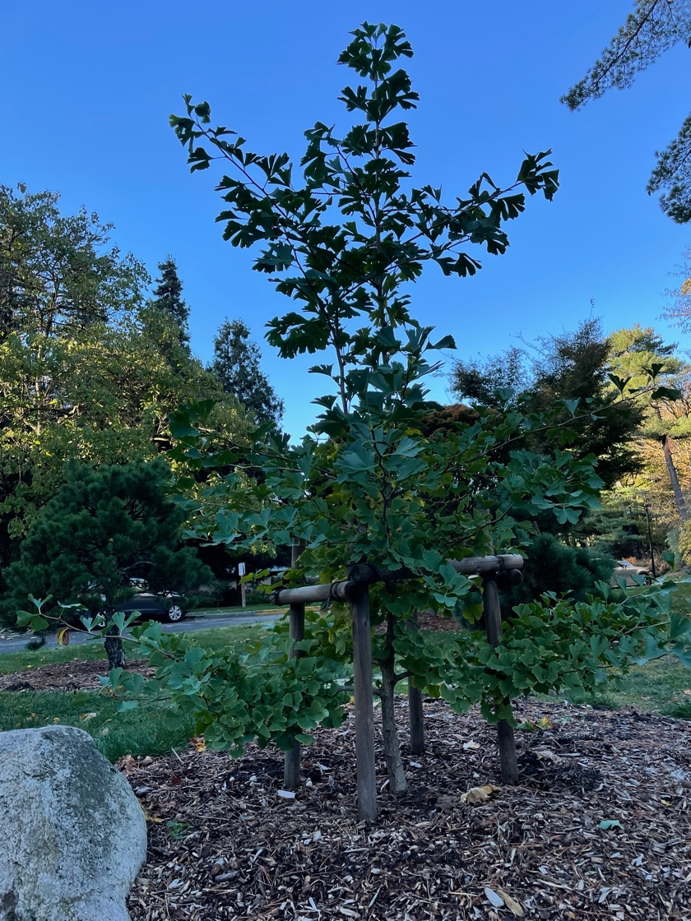
November
2022

Slide 16
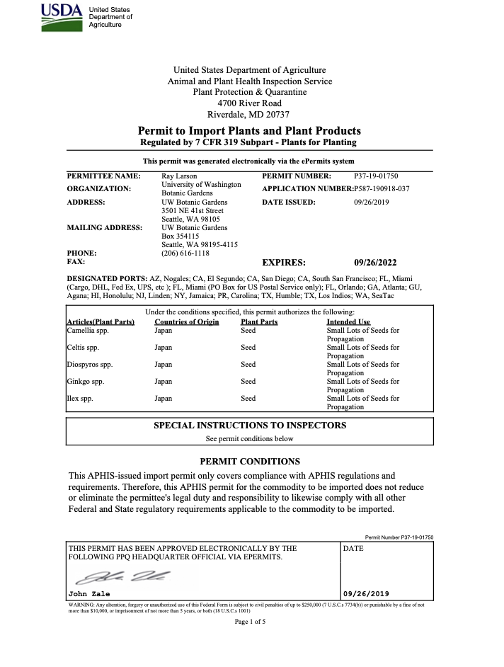
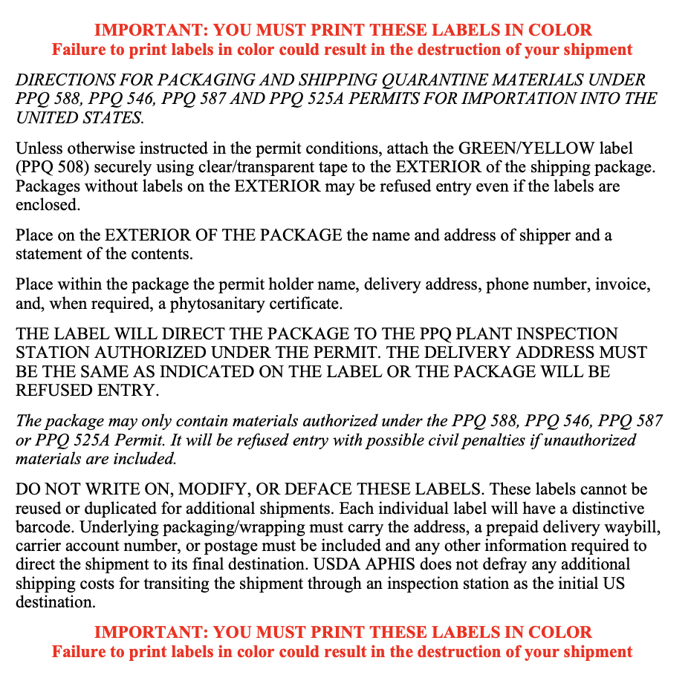
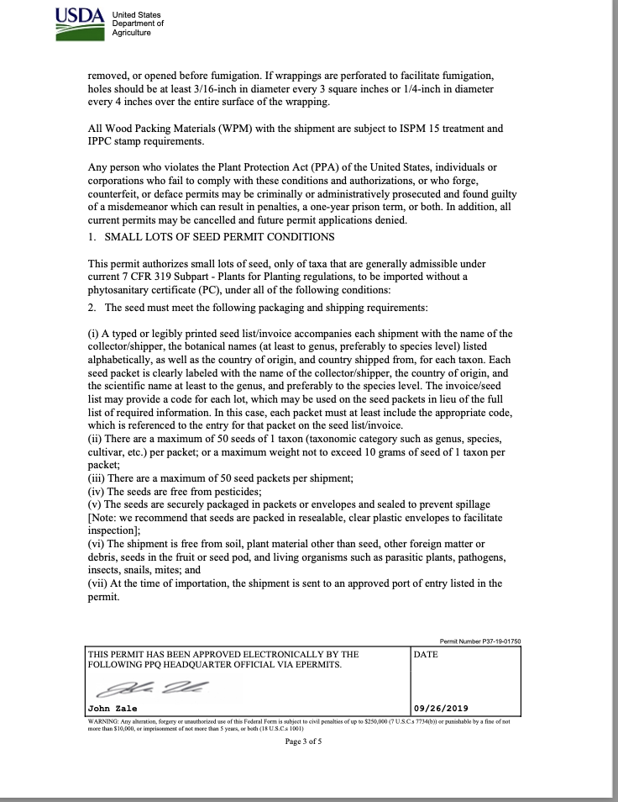
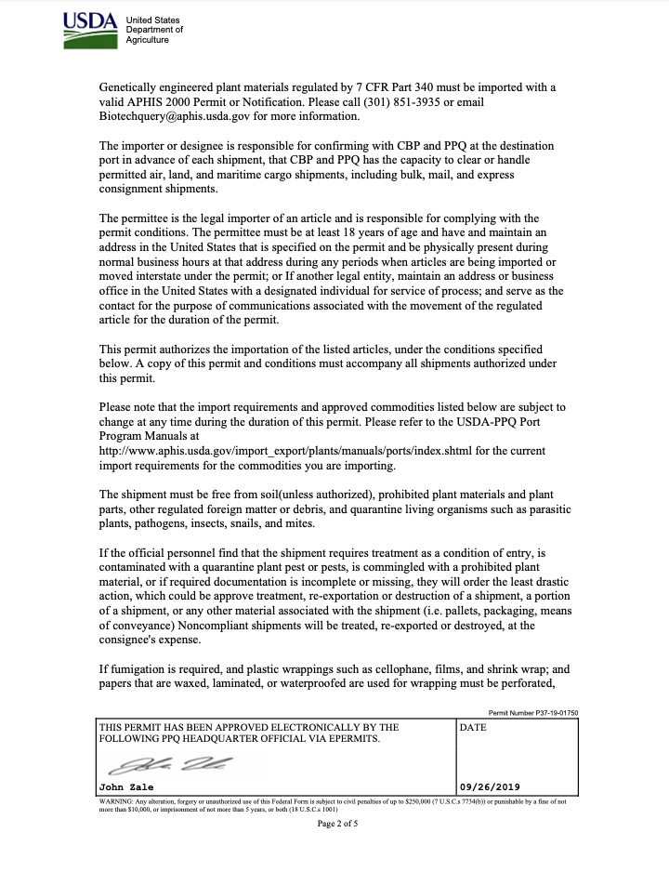
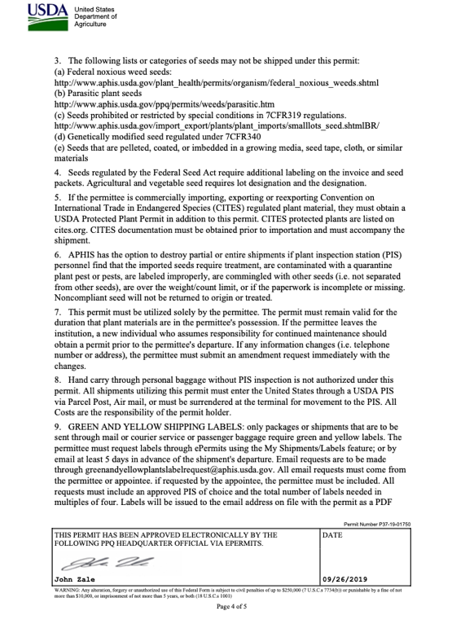
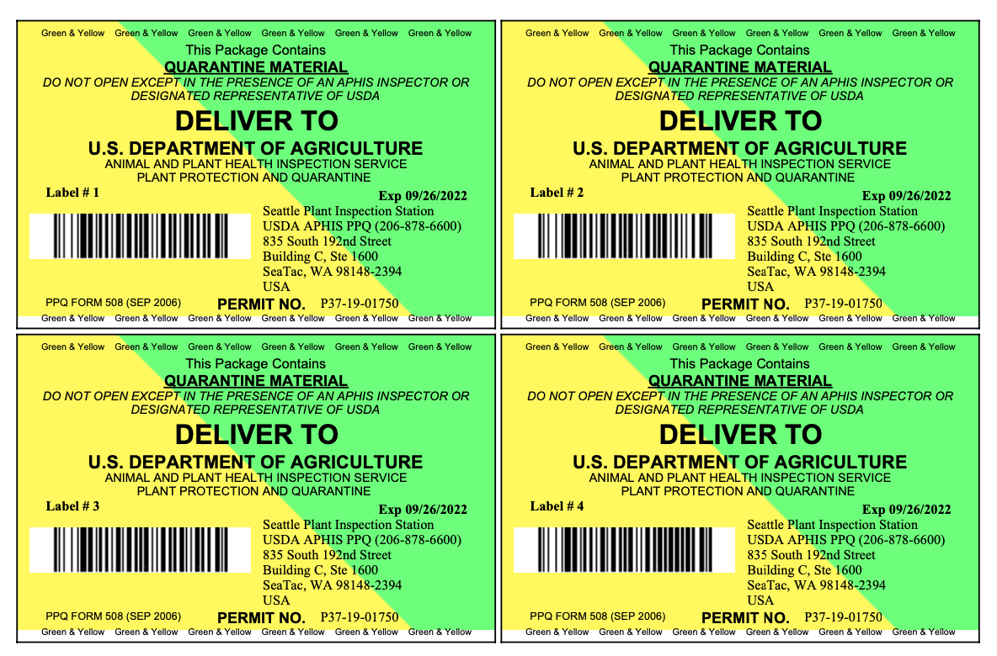
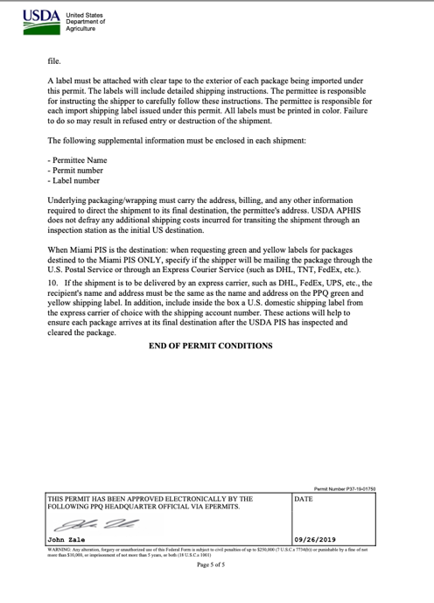

Slide 17
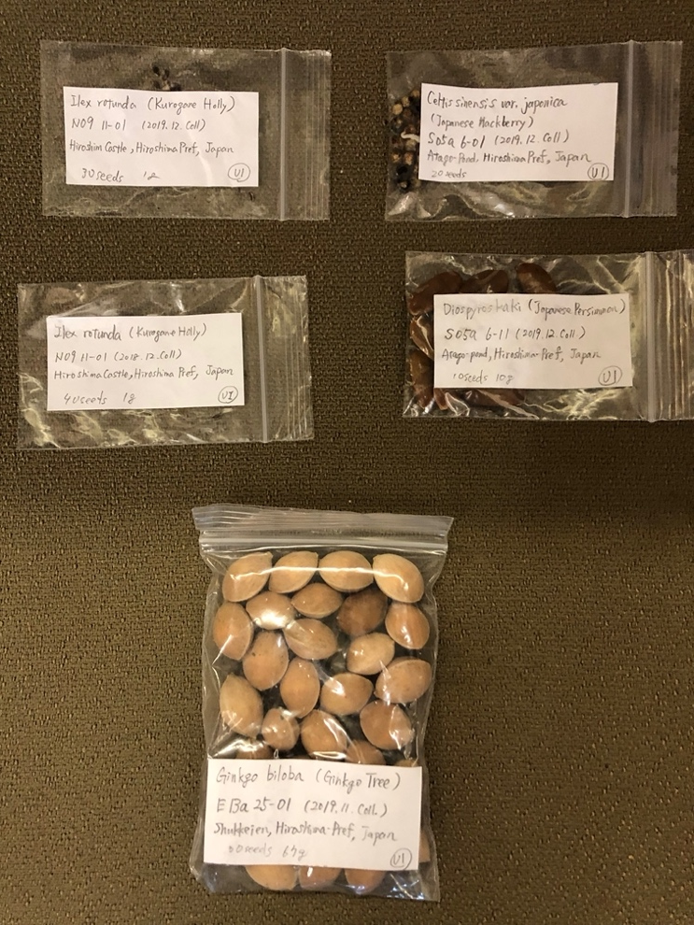

Slide 18
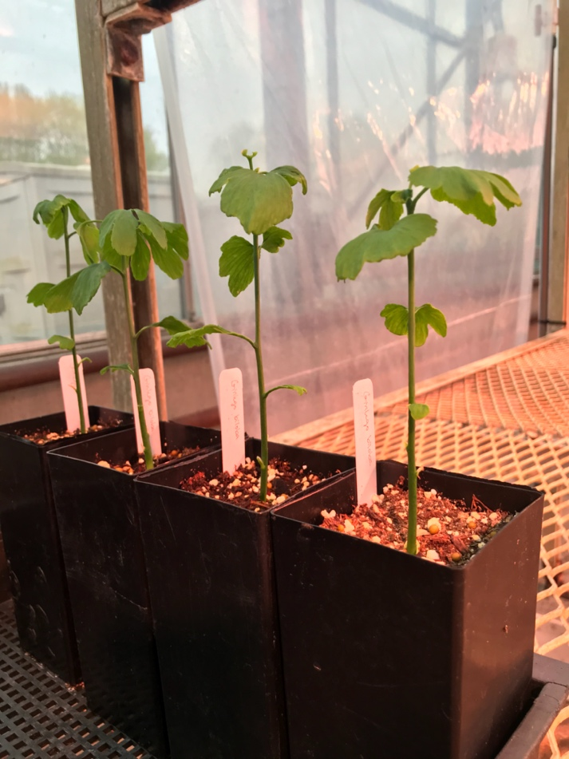
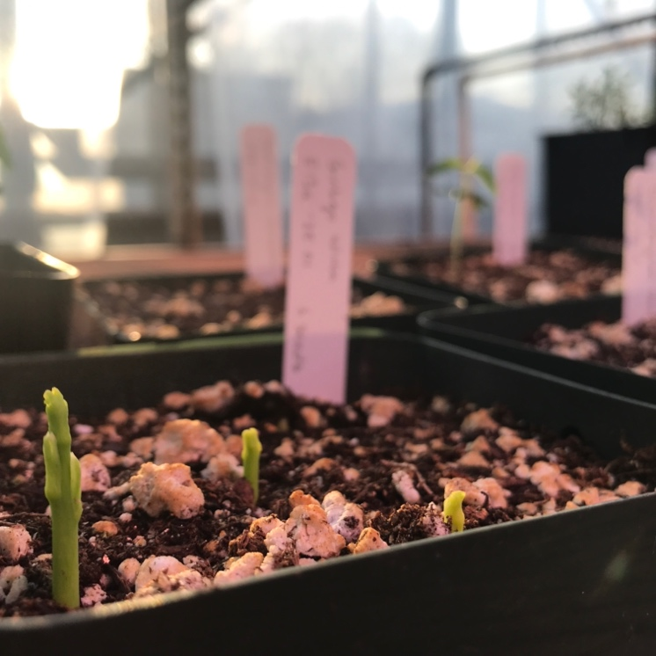
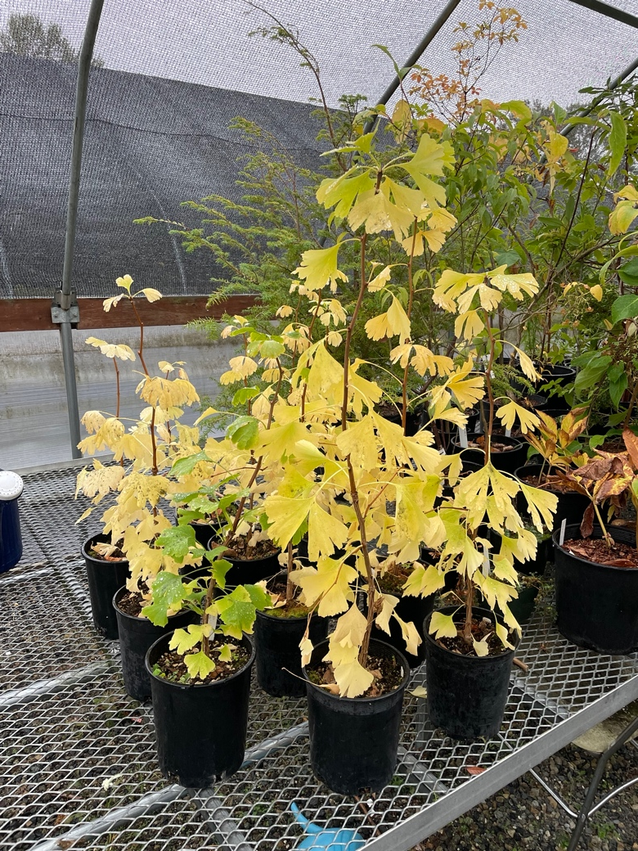

Slide 19
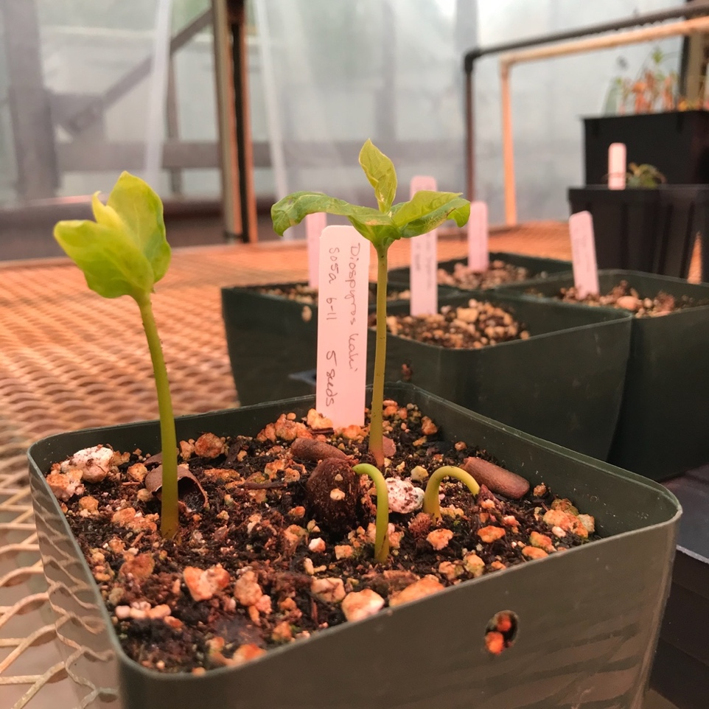
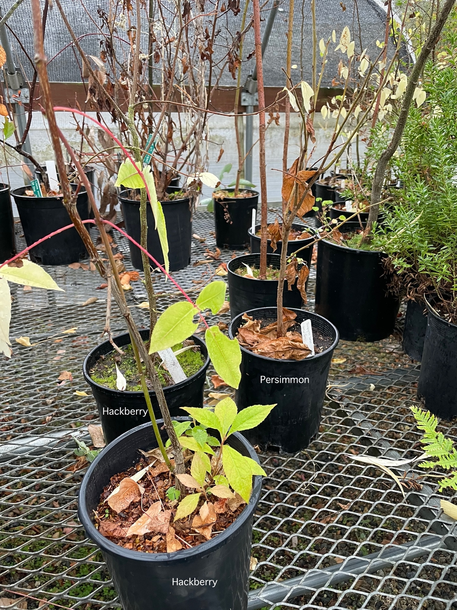
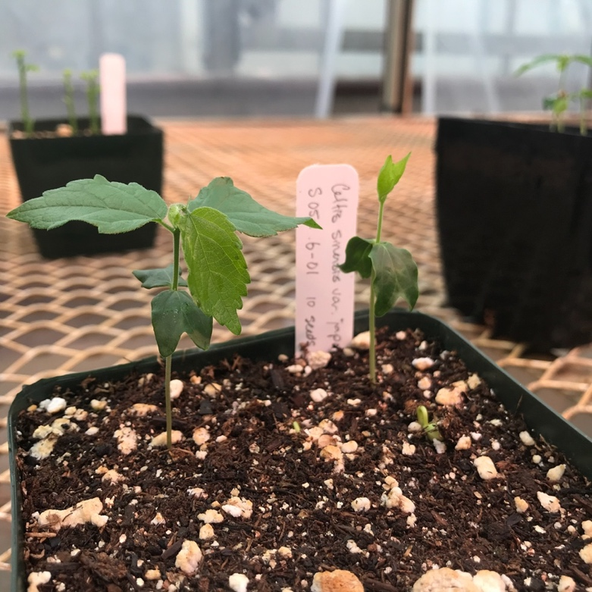

Slide 20
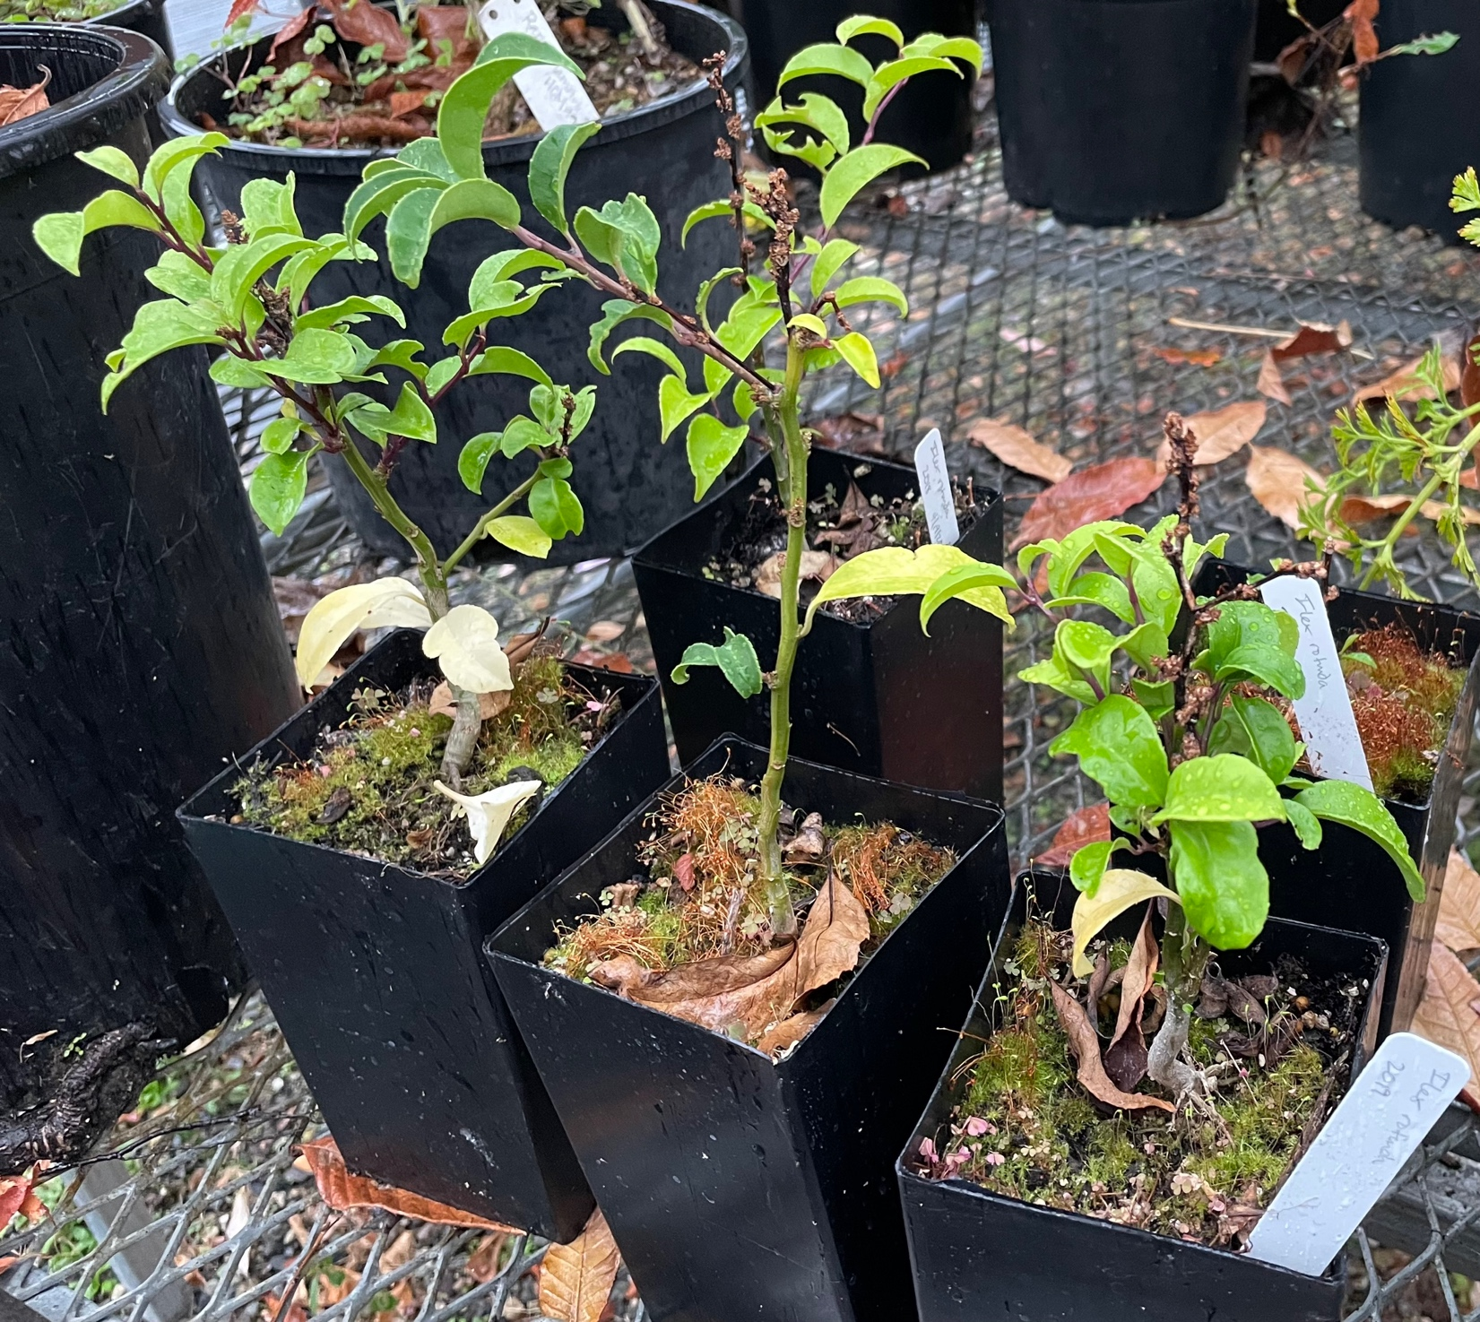
Ilex rotunda (Kurogane holly) in October 2022. These seeds took a year to germinate!

