Slide 1

Toward telelocomotion:
human sensorimotor control
of contact-rich robot dynamics
Sam Burden
Assistant Professor
Electrical & Computer Engineering
University of Washington
Seattle, WA USA
http://faculty.uw.edu/sburden
AMP Lab
http://depts.washington.edu/amplify
BioRobotics Lab
http://brl.ee.washington.edu

Slide 2
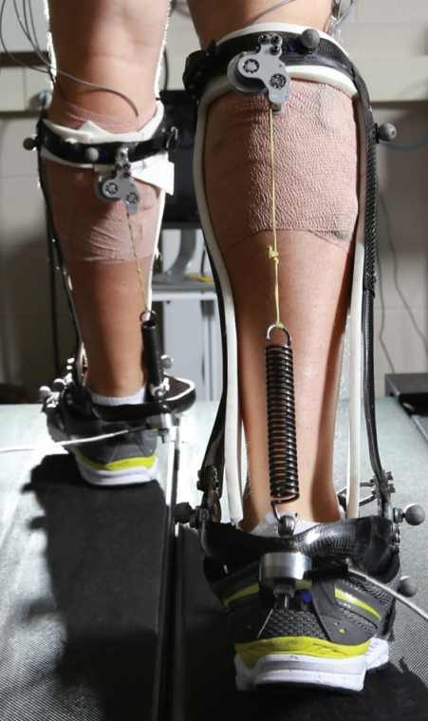
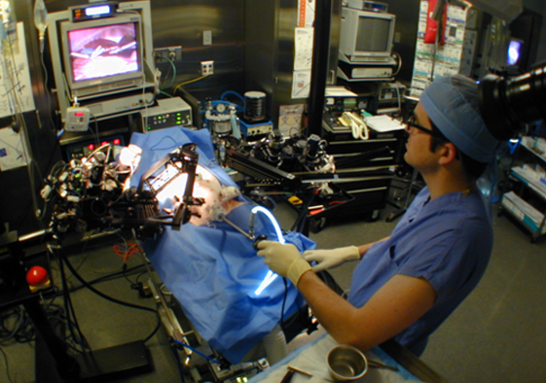
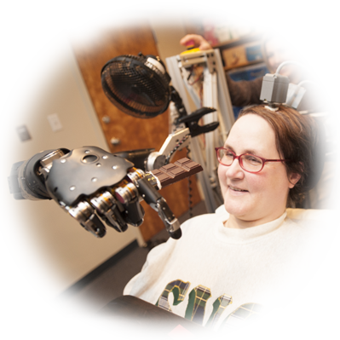
human interaction with the physical world
is increasingly mediated by machines
Hannaford, Rosen, Friedman, King, Roan, Cheng, Glozman, Ma, Kosari, White IEEE Tran Biomed Eng 2013 Raven-II: An Open Platform for Surgical Robotics Research
Wodlinger, Downey, Tyler-Kabara, Schwartz, Boninger, Collinger J Neural Eng 2015
Ten-Dimensional Anthropomorphic Arm Control in a Human Brain-Machine Interface
Collins, Wiggin, Sawicki Nature 2015
Reducing the Energy Cost of Human Walking Using an Unpowered Exoskeleton

Slide 3
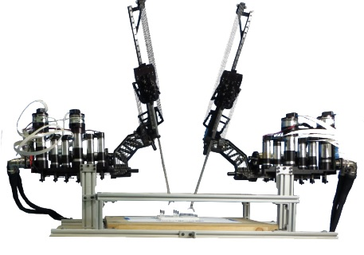
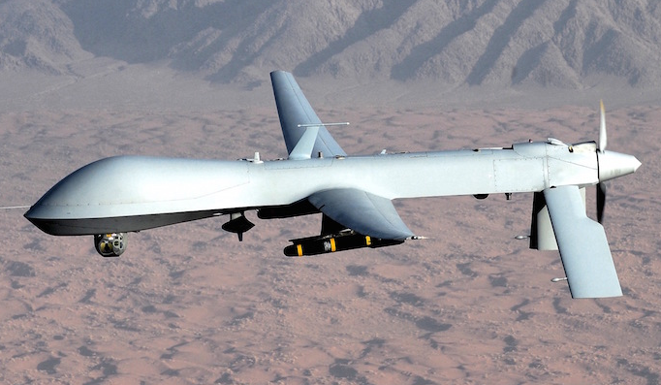
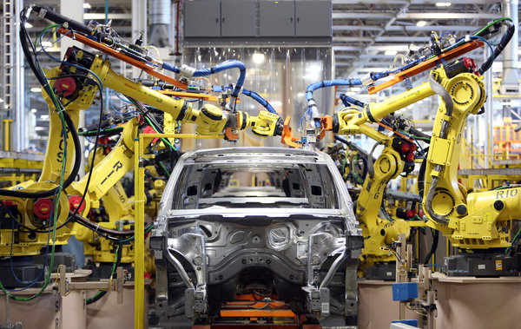
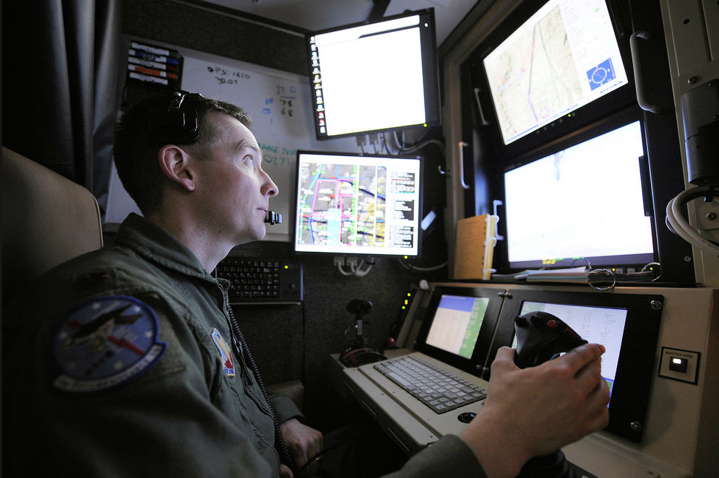
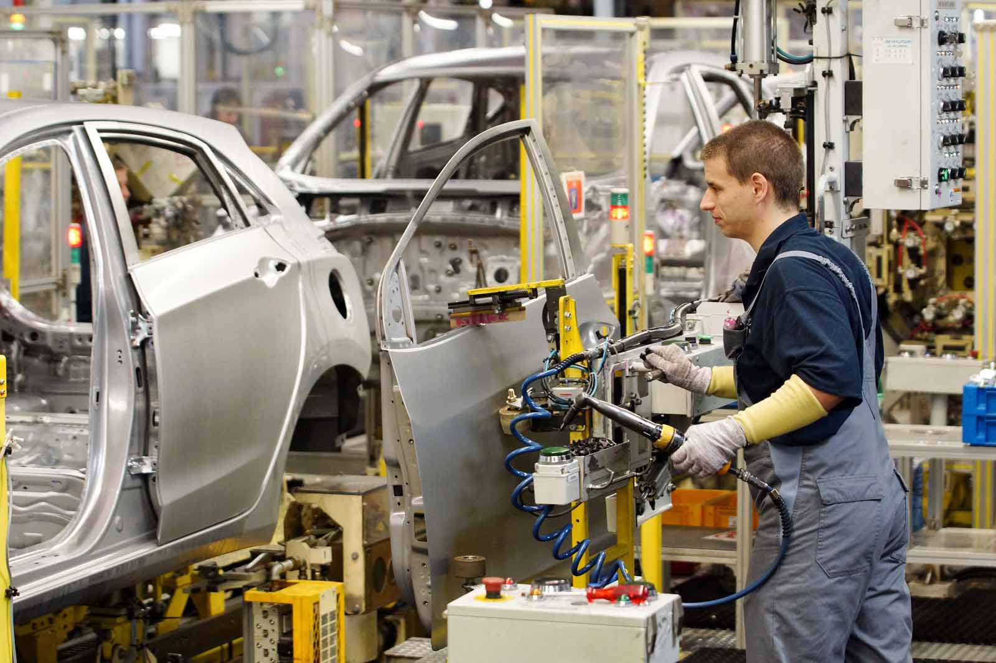



roles for humans and machines
legal, ethical, and political concerns
ensure humans will remain in-the-loop
Nothwang, Robinson, Burden, McCourt, Curtis IEEE Resilience Week 2016
The Human Should be Part of the Control Loop?

Slide 4

human/machine system:
robot teleoperation
sensory feedback
sensory feedback
motor control inputs
Chiawakum Creek Fire near Lake Wenatchee, WA © Michael Stanford 2015 http://yourshot.nationalgeographic.com/photos/4181903/

Slide 5
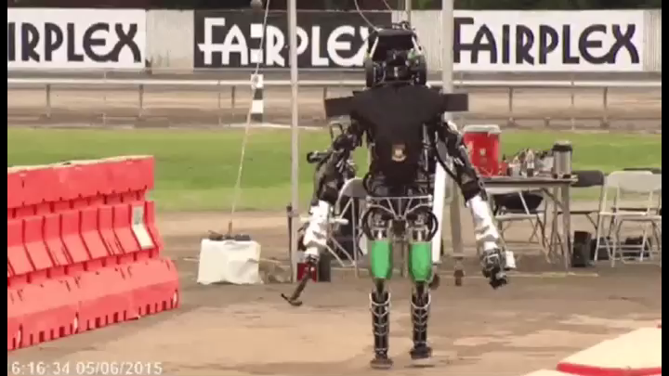
robots struggle with contact-rich dynamics

Slide 6
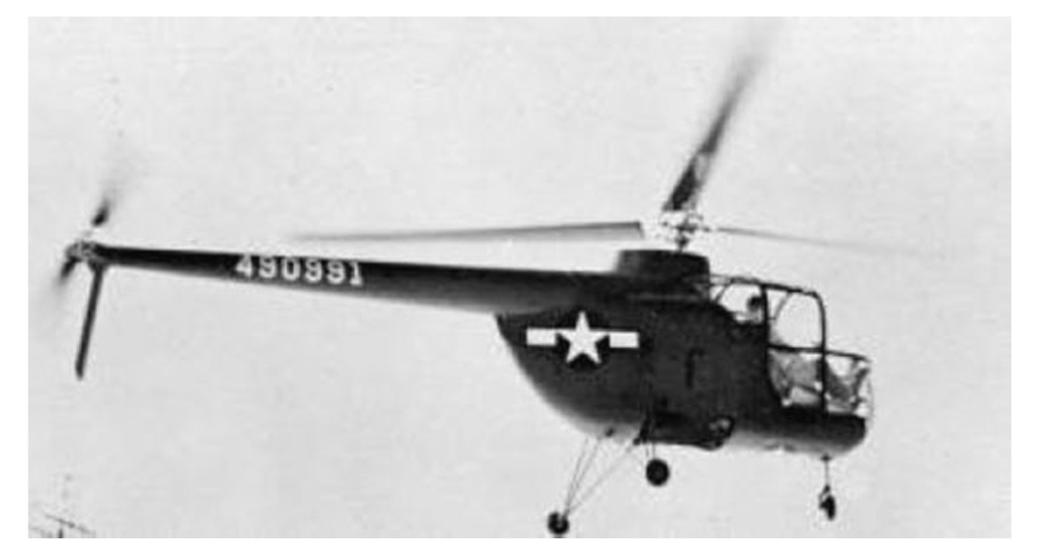
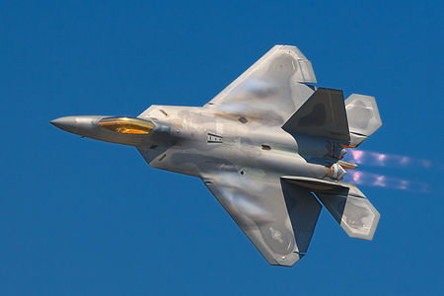
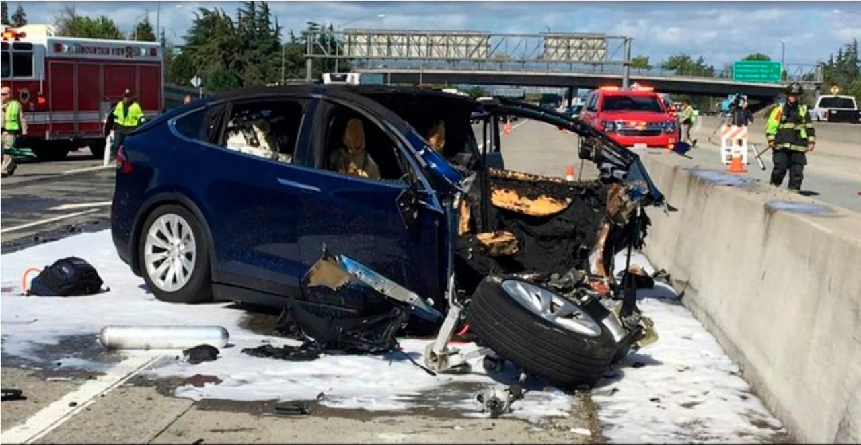
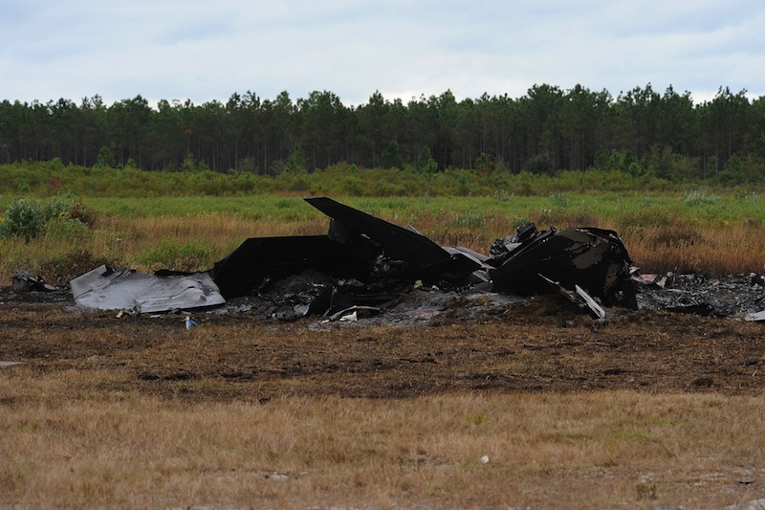
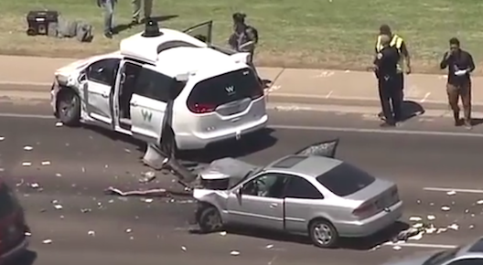
coupling humans and machines
  pilot-induced oscillations in rotory & fixed-wing aircraft
    McRuer, Krendal 1974; Hess J. Guid. Cont. Dyn. 1997
    Pavel et al. Prog. Aero. Sci. 2013
  overreliance on enhanced safety features in cars
    Rudin-Brown, Parker Traffic Psych. Behav. 2004;
    Moore, Zuby Proc. Enhanced Safety Vehicles 2013
naïve coupling can lead to performance loss
ranging from mild to catastrophic

Slide 7
teleoperation requires dynamic telemanipulation and telelocomotion
sensory feedback
sensory feedback
how do we enable humans to learn and control
contact-rich robot dynamics?
motor control inputs
Chiawakum Creek Fire near Lake Wenatchee, WA © Michael Stanford 2015 http://yourshot.nationalgeographic.com/photos/4181903/

Slide 8
today’s talk:
how do we enable humans to learn and control
contact-rich robot dynamics?
M, M⁻¹
contact-rich robot
terradynamics
human sensorimotor
learning and control

Slide 9
today’s talk:
how do we enable humans to learn and control
contact-rich robot dynamics?
M, M⁻¹
contact-rich robot
terradynamics
human sensorimotor
learning and control

Slide 10
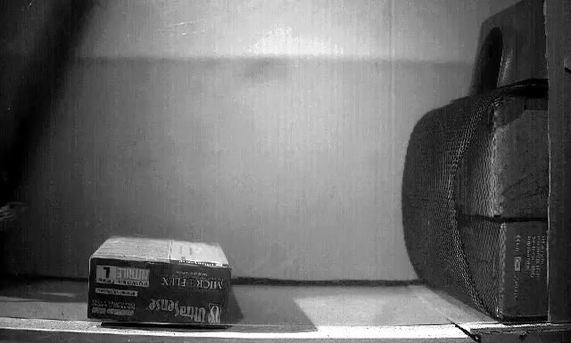
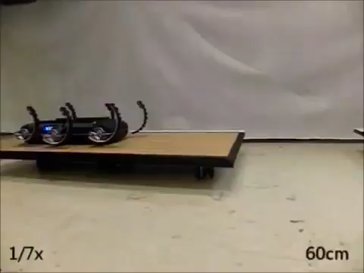
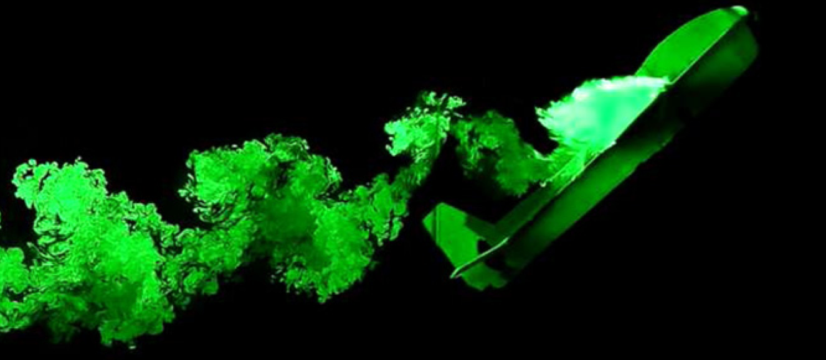
  locomotion through fluid governed by continuous hydro- and aero-dynamics
  locomotion on land governed by intermittent terra-dynamics
Vogel Life in moving fluids 1996
Li, Zhang, Goldman Science 2015
legged locomotion involves contact-rich dynamics
Tytell, Standen, Lauder JEB 2008
Cory, Moore, Tedrake B&B 2014
Libby, Moore, Chang-Siu, Cohen, Jusufi, Full Nature 2012
Johnson, Koditschek ICRA 2013

Slide 11
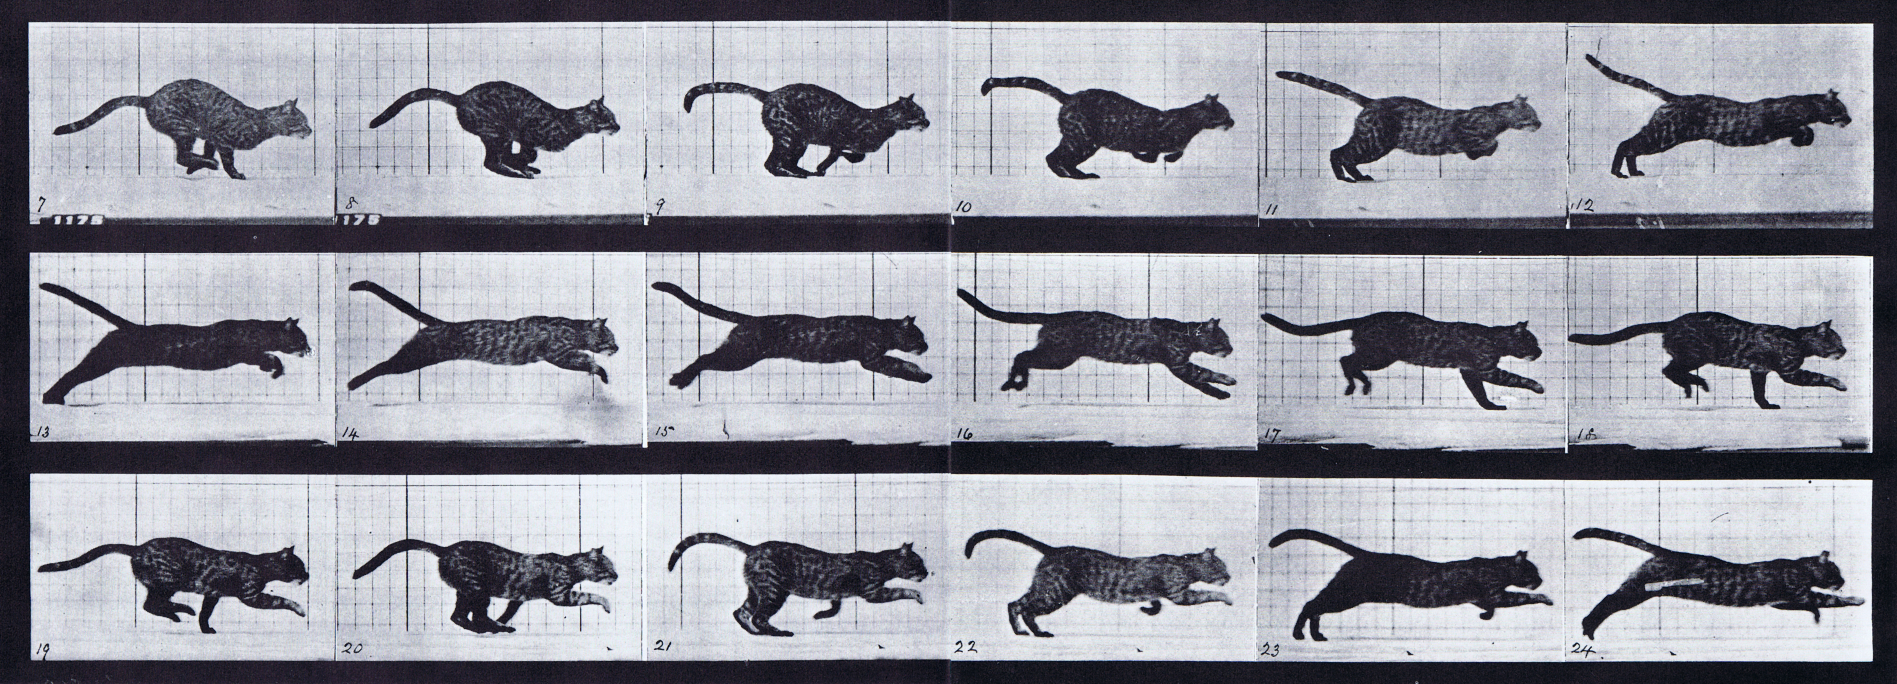

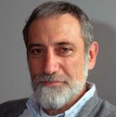
simple models are piecewise-defined (hybrid)
Muybridge 1887 (reprinted by Dover in 1957)
  limbs in contact with ground
  ground penetration constraints
  continuous dynamics
  impact dynamics
Johnson, Burden, Koditschek IJRR 2016 (arXiv:1502.01538)
A hybrid systems model for simple manipulation and self-manipulation systems

Slide 12
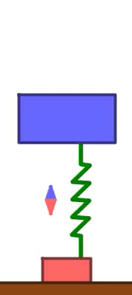

Slide 14
Theorem (Aizerman & Gantmacher et al):
if contact sequence doesn’t change,
final state varies differentiably w.r.t. initial state
Aizerman & Gantmacher 1958
Quarterly Journal of Mechanics and Applied Mathematics
Determination of Stability by Linear Approximation of a Periodic Solution of a System of Differential Equations with Discontinuous Right-Hand Sides
Grizzle, Abba, Plestan IEEE TAC 2002
Di Bernardo, Budd, Kowalczyk, Champneys Springer 2008
Burden, Revzen, Sastry IEEE TAC 2015

Slide 15
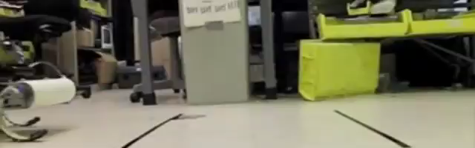
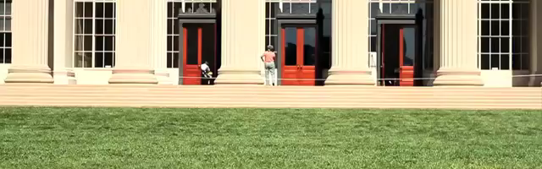
what if contact sequence can vary?
Galloway, Haynes, Ilhan, Johnson, Knopf, Lynch, Plotnick, White, Koditschek UPenn 2010
Hyun, Seok, Lee, Kim IJRR 2014

Slide 17
Theorem (Remy et al):
near simultaneous impacts, final state generally
varies discontinuously w.r.t. initial state
Hürmüzlü and Marghitu
International Journal of Robotics Research 1994
Rigid Body Collisions of Planar Kinematic Chains With Multiple Contact Points
Remy, Buffington, Siegwart
International Journal of Robotics Research 2010
Stability Analysis of Passive Dynamic Walking of Quadrupeds

Slide 18
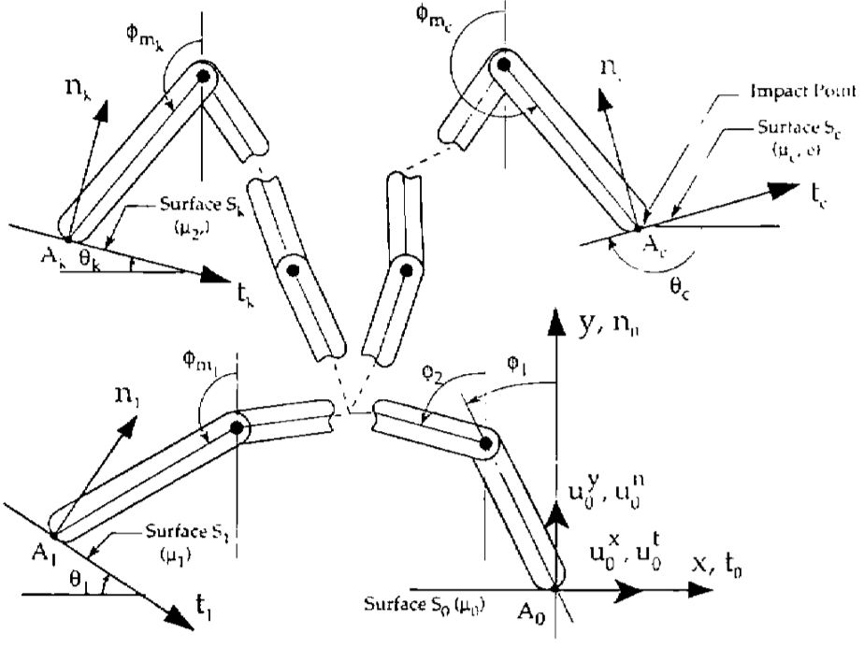
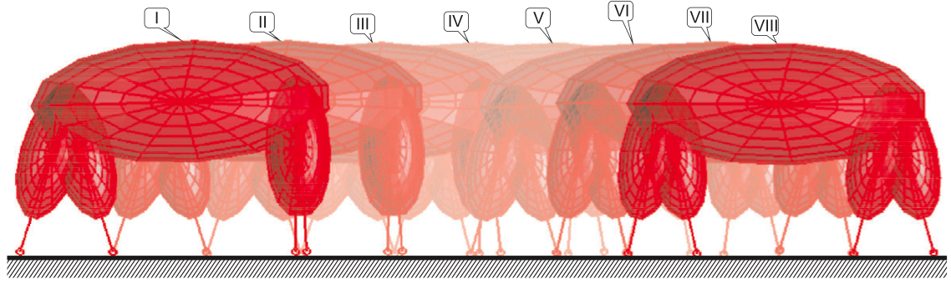
inconsistencies arise when limbs are rigid
  hand with rigid fingers exhibits 5 different post-grasp outcomes
Hürmüzlü and Marghitu IJRR 1994, JAM 1995
rigid limbs → inconsistent terra-dynamics
  quadruped with rigid legs exhibits 3 distinct (near-)trot gaits
Remy, Buffington, Siegwart IJRR 2010

Slide 19
rigid vs compliant limbs
rigid limbs
compliant limbs
compliant limbs → consistent terra-dynamics

Slide 20
rigid
limbs

Slide 21
compliant
limbs

Slide 22



Theorem (Pace & Burden):
if limbs are compliant, final state varies
piecewise-differentiably w.r.t. initial state
Pace & Burden HSCC 2017 (arXiv:1610.05645)
Piecewise-differentiable trajectory outcomes in mechanical systems subject to unilateral constraints
Pace & Burden ICRA 2017 (arXiv:1609.04056)
Decoupled limbs yield differentiable trajectory outcomes through intermittent contact
Burden, Sastry, Koditschek, Revzen SIADS 2016 (arXiv:1407.1775)
Event-Selected Vector Field Discontinuities Yield Piecewise-Differentiable Flows

Slide 23
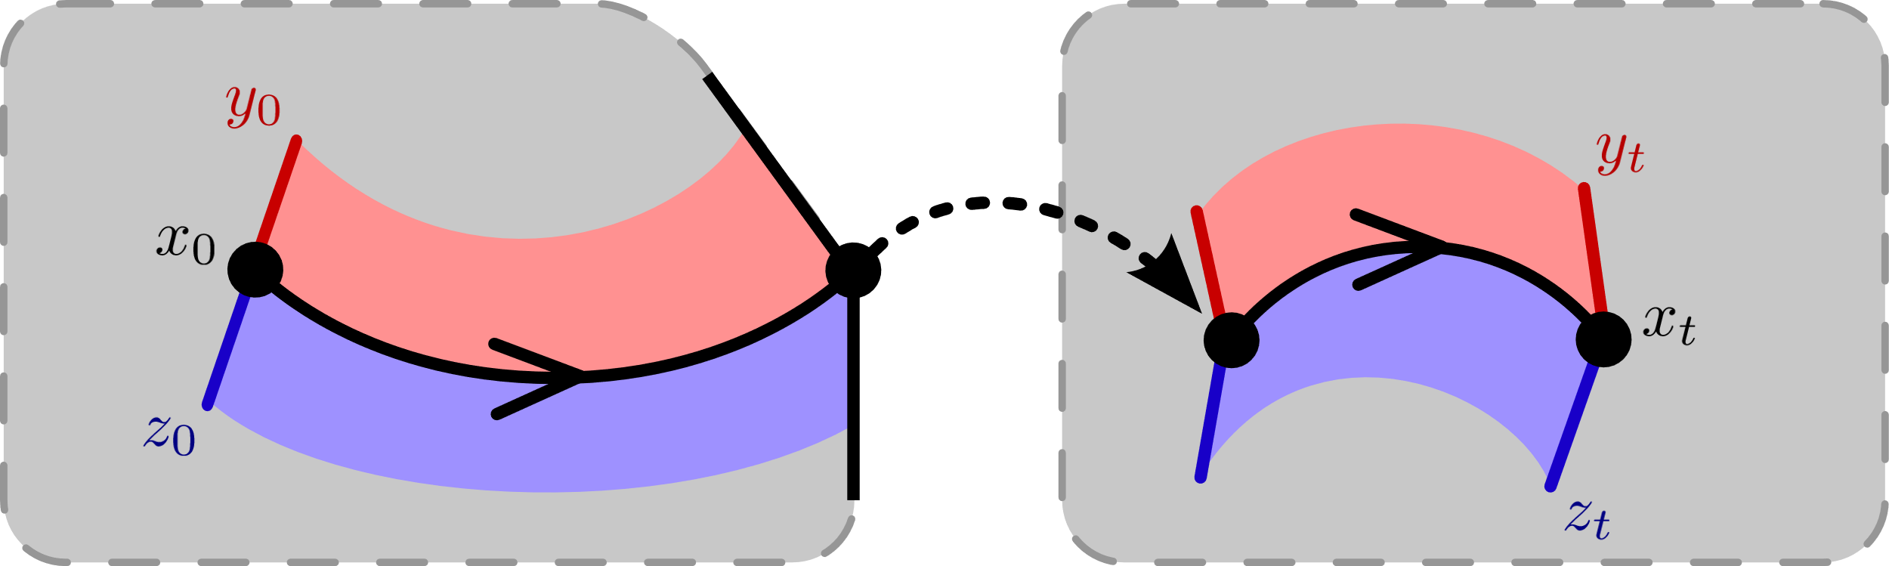
trajectories vary continuously ….

Slide 24
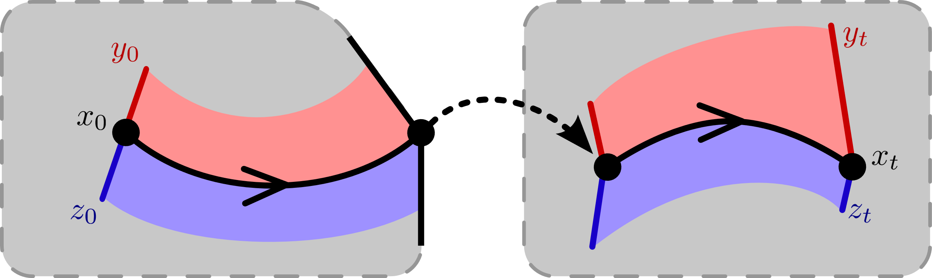
trajectories vary continuously ….
… do they
expand
or
contract?

Slide 25
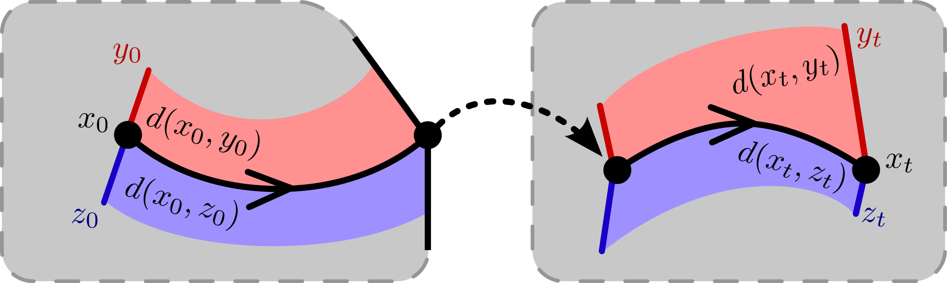


trajectories vary continuously ….
… do they
expand
or
contract?
$$d\left(x_{0},y_{0}\right)<d\left(x_{t},y_{t}\right)$$
$$d\left(x_{0},z_{0}\right)>d\left(x_{t},z_{t}\right)$$

Slide 26





aside: how to measure distance?
d(
)=0
,
Theorem (Burden, Gonzalez, Vasudevan, et al):
d(x ⁻, x ⁺) = 0 determines a distance metric
compatible with topological quotient x ⁻ ~ x ⁺
Burden, Gonzalez, Vasudevan, Bajcsy, Sastry IEEE TAC 2015
Metrization and simulation of controlled hybrid systems

Slide 27




contraction in classical dynamics
Theorem (Lohmiller & Slotine): if the
or
dynamics are infinitesimally contractive,
or
then the dynamics are globally contractive,
i.e. distances decrease at an exponential rate
continuous-time
discrete-time
Lohmiller, Slotine Automatica 1998
On contraction analysis for nonlinear systems

Slide 28
contact-rich dynamics
  limbs in contact with ground
  ground penetration constraints
  continuous-time
  discrete-time (impact)
continuous-time and discrete-time interact in contact-rich dynamics
Johnson, Burden, Koditschek IJRR 2016 (arXiv:1502.01538)
A hybrid systems model for simple manipulation and self-manipulation systems

Slide 29
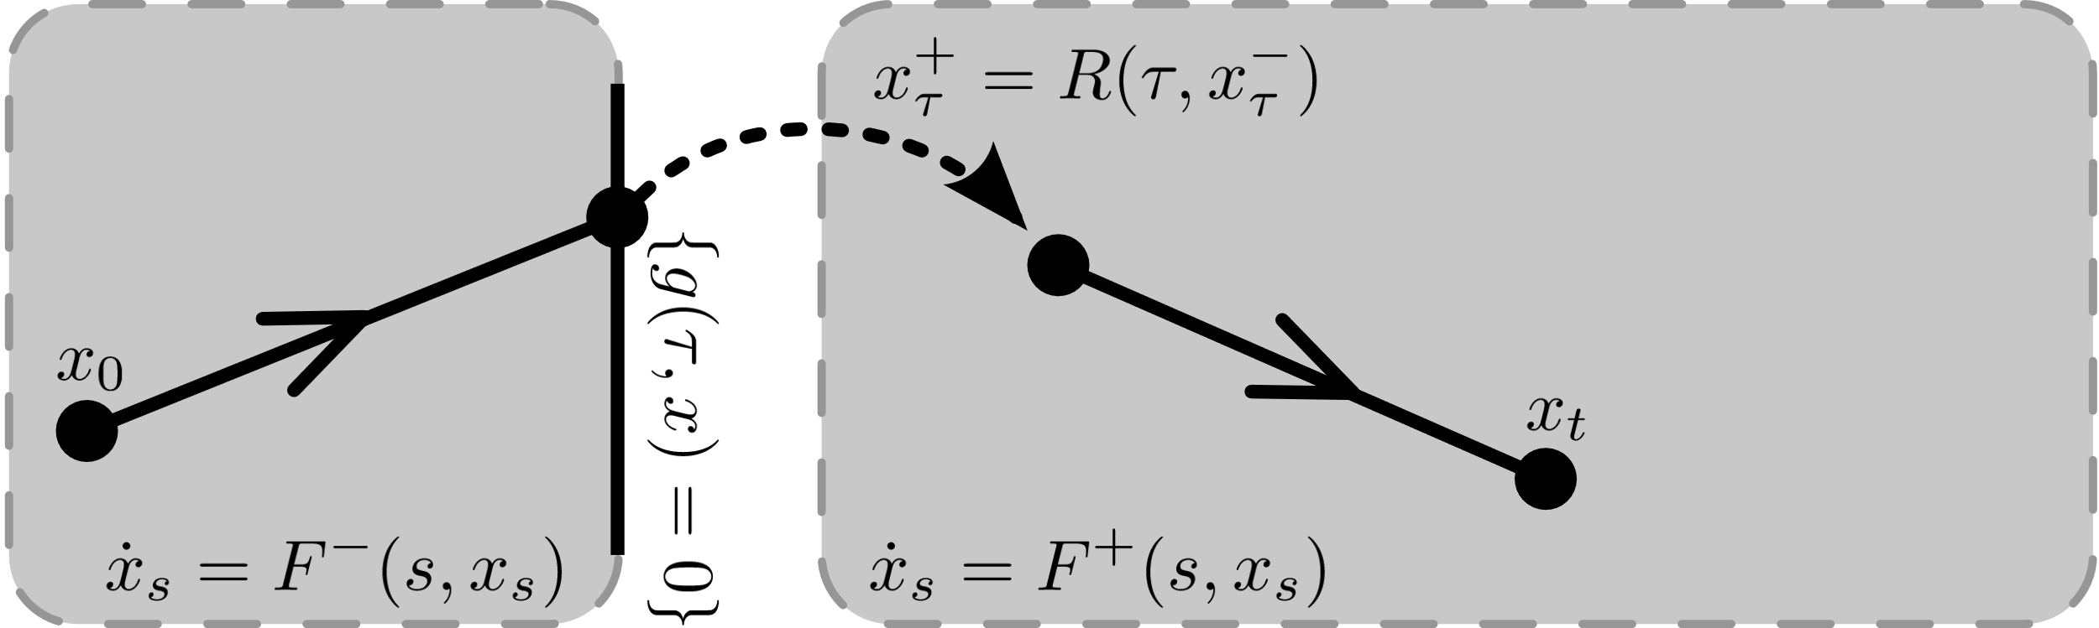

Slide 30
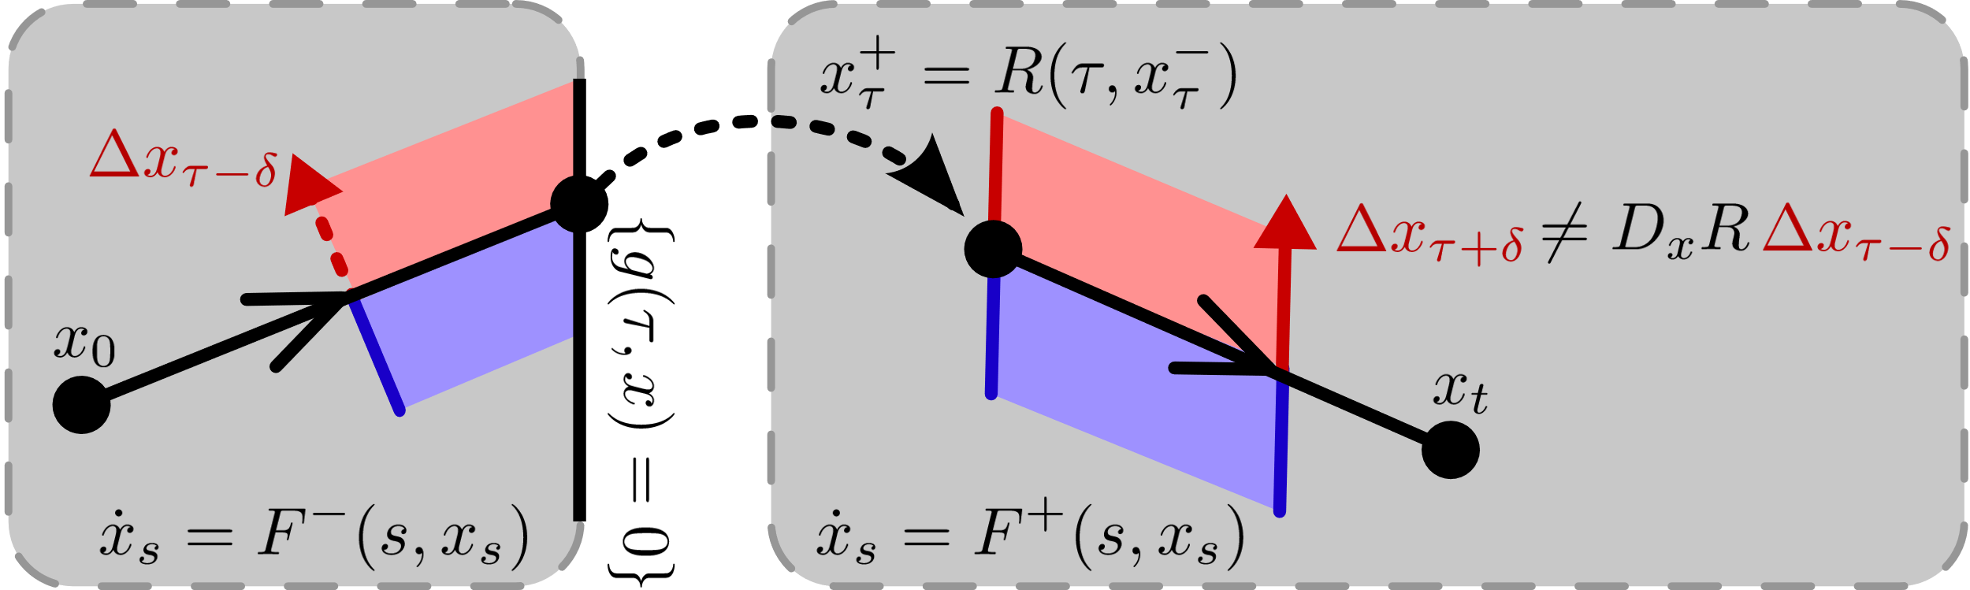
can’t look at discrete-time alone …

Slide 31
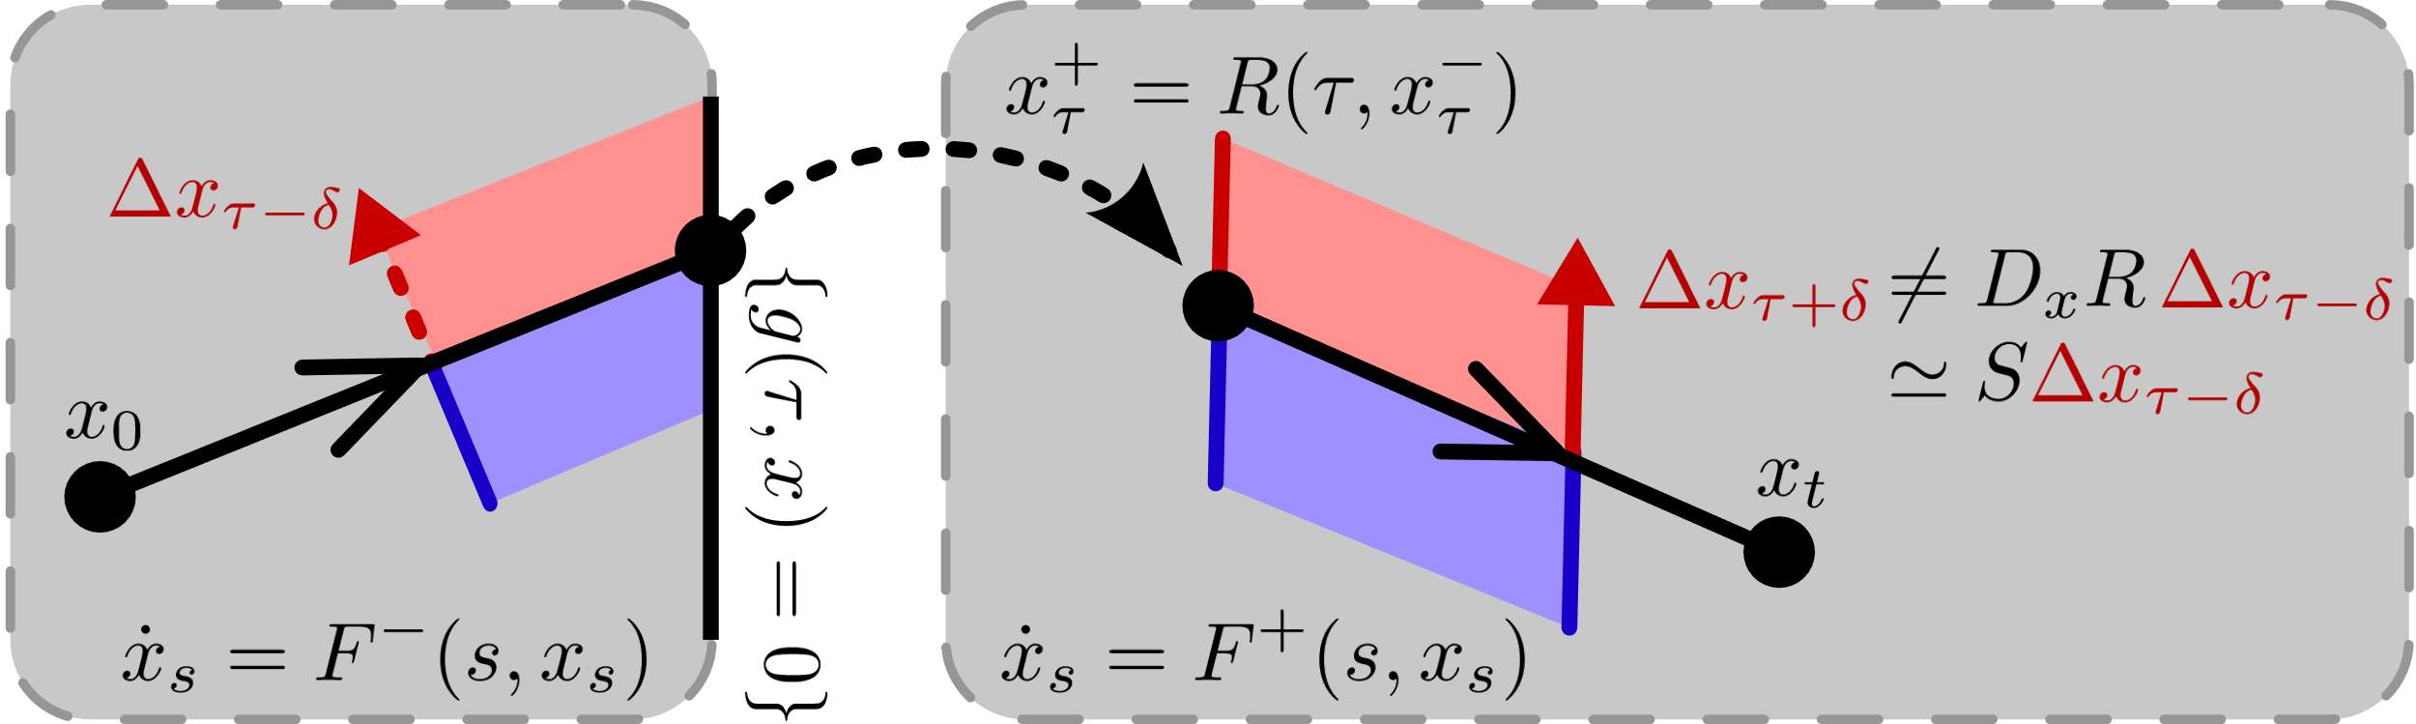
can’t look at discrete-time alone …
need interaction w/ continuous-time:
Aizerman & Gantmacher Quarterly Journal of Mechanics and Applied Mathematics 1958
Determination of Stability by Linear Approximation of a Periodic Solution of a System of Differential Equations with Discontinuous Right-Hand Sides

Slide 32




contraction in contact-rich dynamics
Theorem (Burden, Libby, Coogan): if the
and
dynamics are infinitesimally contractive,
and
then combined dynamics globally contractive,
i.e. distances decrease at an exponential rate
continuous-time
discrete-time
Burden, Libby, Coogan (arXiv: 1804.04122)
On contraction analysis for hybrid systems

Slide 33
today’s talk:
how do we enable humans to learn and control
contact-rich robot dynamics?
M, M⁻¹
takeaway:
contractive contact-rich robot dynamics
human sensorimotor
learning and control

Slide 34
today’s talk:
how do we enable humans to learn and control
contact-rich robot dynamics?
M, M⁻¹
takeaway:
contractive contact-rich robot dynamics
human sensorimotor
learning and control

Slide 35
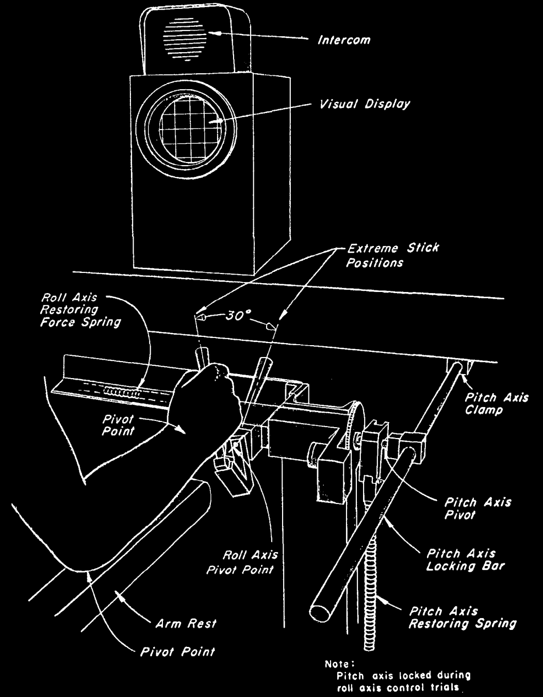
teleoperation
r
reference
y
output
disturbance
d
input
u
McRuer, Krendel J Franklin Institute 1959
The Human Operator as a Servo System Element
McRuer Automatica 1980
Human Dynamics in Man-Machine Systems

Slide 36



teleoperation
human/machine system
d
F
f
u
+
+
M
y
e
b
r
+
B
-
McRuer, Krendel J Franklin Institute 1959
The Human Operator as a Servo System Element
McRuer Automatica 1980
Human Dynamics in Man-Machine Systems
Yamagami, Howell, Roth, Burden CPHS 2018
Contributions of feedforward and feedback control in a manual trajectory-tracking task

Slide 37
teleoperation
human/machine system
feedforward
d
F
f
u
+
+
M
y
e
b
r
+
B
-
feedback
McRuer, Krendel J Franklin Institute 1959
The Human Operator as a Servo System Element
McRuer Automatica 1980
Human Dynamics in Man-Machine Systems
Yamagami, Howell, Roth, Burden CPHS 2018
Contributions of feedforward and feedback control in a manual trajectory-tracking task

Slide 38
predicting behavior using internal models
forward model
  predicts sensory effects of motor actions
    Sutton, Barto Psych Rev 1981
    Jordan, Rumelhart Cog Sci 1992
    Wolpert, Ghahramani, Jordan Science 1995
inverse model
  computes action expected to yield desired behavior
    Kawato Curr Opin Neurobio 1999
    Thoroughman, Shadmehr Nature 2000
    Conditt, Mussa-Ivaldi PNAS 1999
Notes:
replace text with cartoon

Slide 39
predicting behavior using internal models
  theoretical and empirical evidence for pairing of forward + inverse models
    Bhushan, Shadmehr Bio Cybern 1999; Sanner, Kosha Bio Cybern 1999
forward model
+
inverse model
  parallels in control theory, robotics, artificial intelligence: adaptive control, internal model principle, learning
    Francis, Wonham Automatica 1976; Sastry, Bodson Prentice Hall 1989
    Sutton, Barto, Williams IEEE CSM 1992; Atkeson, Schaal ICML 1997
    Papavassiliou, Russell IJCAI 1999
Notes:
replace text with cartoon

Slide 40
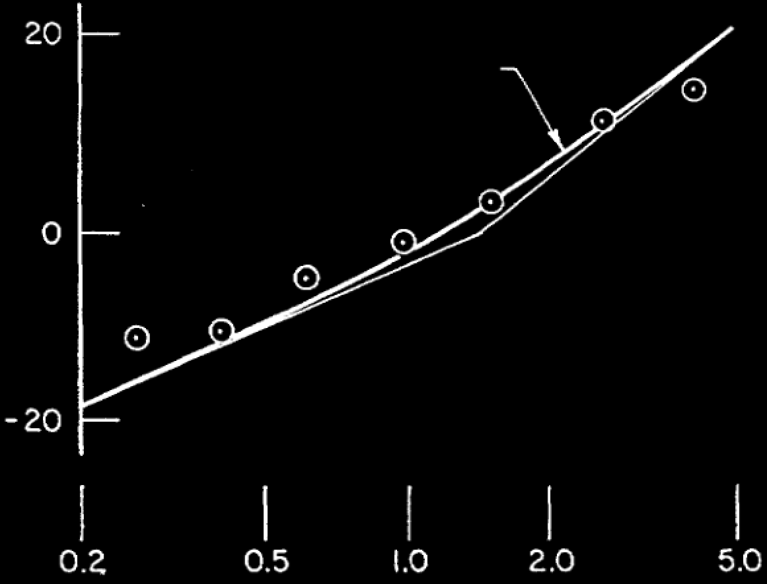
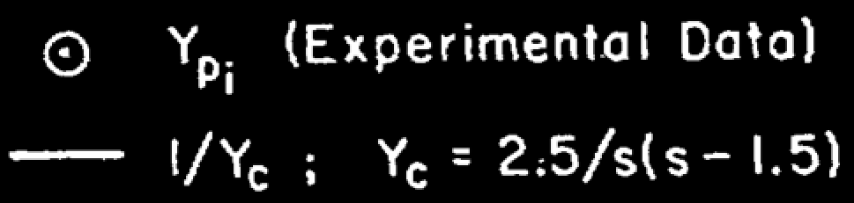
humans learn to invert linear models
|F|
gain (dB)
F
M⁻¹
M
frequency (rad/sec)
McRuer, Jex IEEE Transactions on Human Factors in Electronics 1967
A Review of Quasi-Linear Pilot Models

Slide 41
instantiating internal models
forward model ( M : U → Y ): static vs. dynamic
  static map (linear or nonlinear)
    Hanuschkin, Ganguli, Hahnloser Front. Neural Circ. 2013
    Giret, Kornfeld, Ganguli, Hahnloser PNAS 2014
  dynamic map depends on
  intermediate state
    Thoroughman, Shadmehr Science 2000
    Wolpert, Diedrichsen, Flanagan Nature Neurosci. 2011
inverse model ( M⁻¹ : Y → U ): hard to define
  dynamic or static map may not be one-to-one or onto
  dynamic map may be acausal or need state estimate

Slide 42
nonlinear forward model
  start with forward model in control-affine form
  under a technical condition* we change coordinates to
  forward model is simpler in (ξ,ζ) coordinates
*strict relative degree – easily satisfied for mechanical systems

Slide 43
nonlinear inverse model
  start with simplified forward model
  to obtain inverse model, apply input u_{d} that matches* γ—th derivative of desired output y_{d} :
*augment with feedback to correct for initial condition error

Slide 44
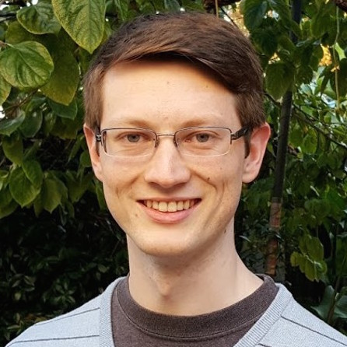
control with inverse models
  closed-loop dynamics have undesirable property:
  states in ζ are unobservable
  generally impossible to compute inverting input u_{d} using sensor data
  by restricting system dynamics, can bypass this issue:
Theorem (Robinson, Scobee, Burden, Sastry):
if forward M is infinitesimally contractive,
then feedforward input from internal model
asymptotically inverts system’s dynamics
Robinson, Scobee, Burden, Sastry SPIE-DSS 2016
Dynamic inverse models in human-cyber-physical systems

Slide 45



inversion with contractive model M
M, M⁻¹
output y
input u_{d}
Theorem implies:
  for contractive models, trajectories x₁ and x₂ converge to
  feedforward input “asymptotically inverts” dynamics
Robinson, Scobee, Burden, Sastry SPIE-DSS 2016
Dynamic inverse models in human-cyber-physical systems

Slide 46
today’s talk:
how do we enable humans to learn and control
contact-rich robot dynamics?
M, M⁻¹
takeaway:
contractive contact-rich robot dynamics
takeaway:
humans can invert contractive dynamics

Slide 47
today’s talk:
how do we enable humans to learn and control
contact-rich robot dynamics?
M, M⁻¹
takeaway:
humans can invert contractive dynamics
takeaway:
contractive contact-rich robot dynamics
takeaway:
humans can invert contractive dynamics
future work: experimental evaluation

Slide 48











sburden@uw.edu
http://faculty.uw.edu/sburden
thank you!
Darrin Howell
Sam Coogan
Tom Libby
Aaron Johnson
Andrew Pace
Dan Koditschek
Ryan Robinson
Shai Revzen
Momona Yamagami
Eatai Roth
Humberto Gonzalez
Shankar Sastry
Ruzena Bajcsy
Ram Vasudevan
ARO YIP #W911NF-16-1-0158: Predictive models for sensorimotor control of legged locomotion
NSF CPS CRII #1565529: Provably-safe interventions for human-cyber-physical systems

Slide 49
today’s talk:
how do we enable humans to learn and control
contact-rich robot dynamics?
M, M⁻¹
contact-rich robot
terradynamics
human sensorimotor
learning and control

Slide 50
parsimonious models are piecewise-defined
Muybridge 1887 (reprinted by Dover in 1957)
  limbs in contact with ground
  ground penetration constraints
  continuous dynamics
  impact dynamics
Johnson, Burden, Koditschek IJRR 2016 (arXiv:1502.01538)
A hybrid systems model for simple manipulation and self-manipulation systems

Slide 51
formal definitions
  limbs in contact with ground
  ground penetration constraints
  continuous dynamics
  impact dynamics
  state space is a complete Riemannian manifold with respect to the (nondegenerate) inertia tensor
  vector field is globally Lipschitz continuous:
  constraints are never tangent to one another:
  all the functions are sufficiently smooth:

Slide 52
formal definitions
  limbs in contact with ground
  ground penetration constraints
  continuous dynamics
  impact dynamics
  constraints are orthogonal:

Slide 53
formal definitions
  piecewise-differentiability:

Slide 54
  limbs in contact with ground
  ground penetration constraints
  continuous dynamics
  impact dynamics
  make the following assumptions:
  state space is a complete Riemannian manifold
  vector field is globally Lipschitz continuous
  constraints are never tangent to one another
  all the functions are sufficiently smooth
Theorem (Ballard):
trajectories exist and are unique in forward time
Ballard Archive for Rational Mechanics and Analysis 2000
The Dynamics of Discrete Mechanical Systems with Perfect Unilateral Constraints

Slide 55
Theorem (Ballard):
if limbs are compliant, final state varies continuously w.r.t. initial state
Ballard Archive for Rational Mechanics and Analysis 2000
The Dynamics of Discrete Mechanical Systems with Perfect Unilateral Constraints

Slide 56
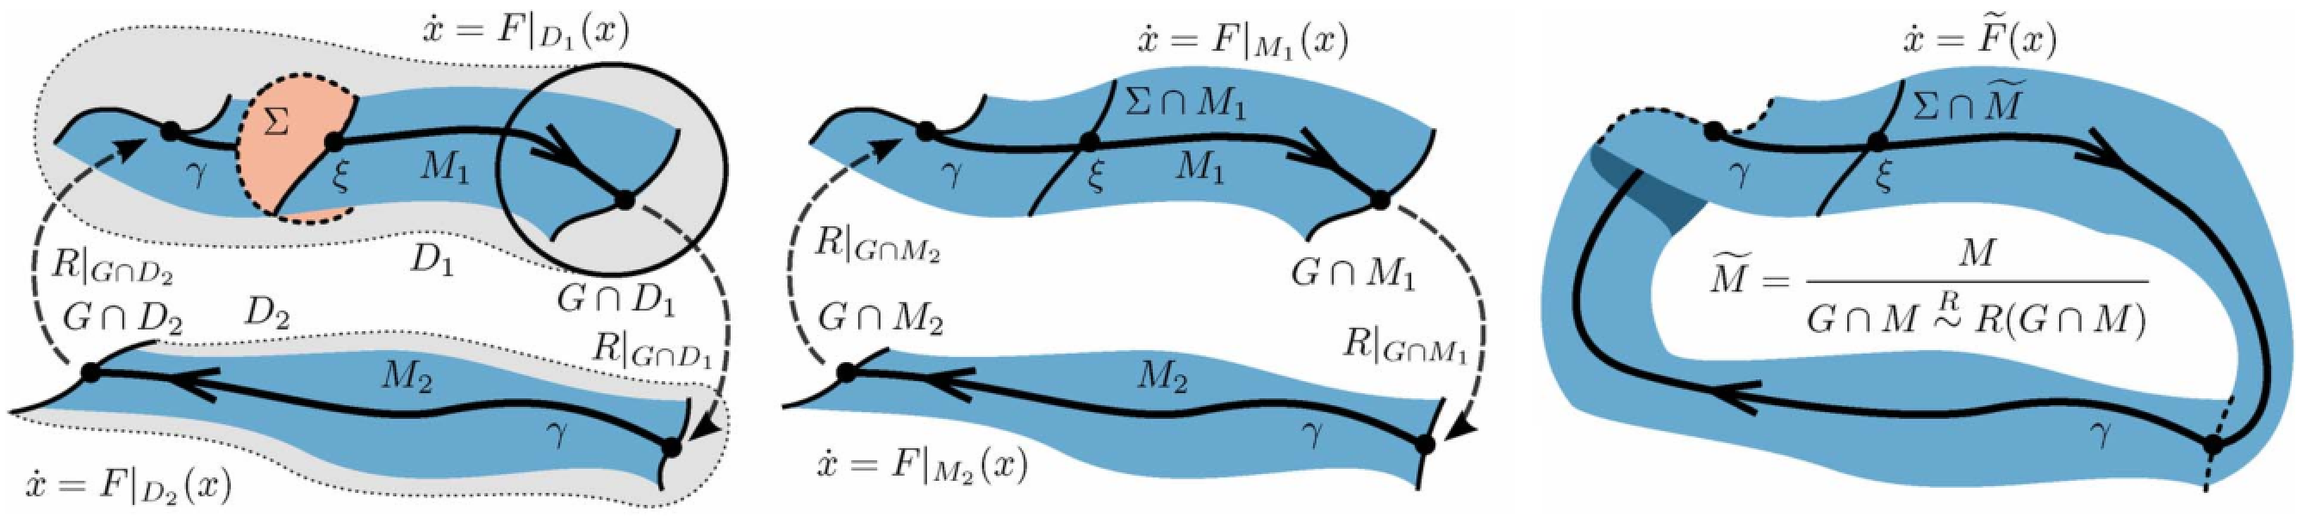
Theorem (Burden, Revzen, Sastry):
hybrid systems reduce dimension
near periodic orbits
Theorem (Burden, Revzen, Sastry): reduced dynamics can be smoothed
Burden, Revzen, Sastry IEEE TAC 2015 (arXiv:1308.4158)
Model reduction near periodic orbits of hybrid dynamical systems

Slide 57
Interpretation: ground contact performs morphological computation (reduction)
Burden, Revzen, Sastry IEEE TAC 2015 (arXiv:1308.4158)
Model reduction near periodic orbits of hybrid dynamical systems

Slide 58
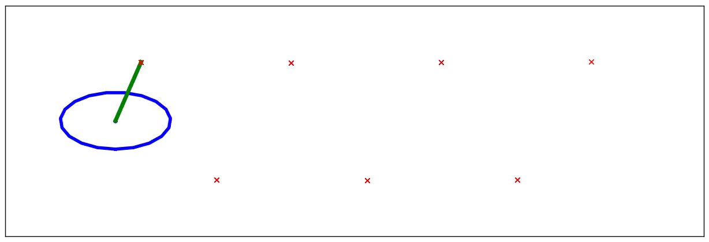
reduction
Application: n-leg polyped reduces to lateral leg-spring (LLS) after 1 stride
Burden, Revzen, Sastry IEEE TAC 2015 (arXiv:1308.4158)
Model reduction near periodic orbits of hybrid dynamical systems

Slide 59
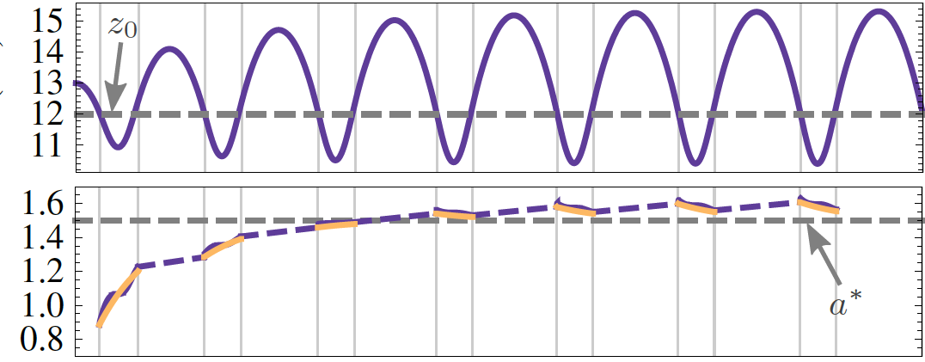
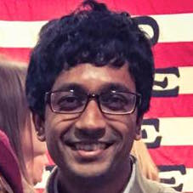
  height
  energy
Theorem: effect of many steps average to a proportional controller on total energy
De, Burden, Koditschek Submitted to IJRR (arXiv:1607.03795)
A hybrid dynamical extension of averaging

Slide 60
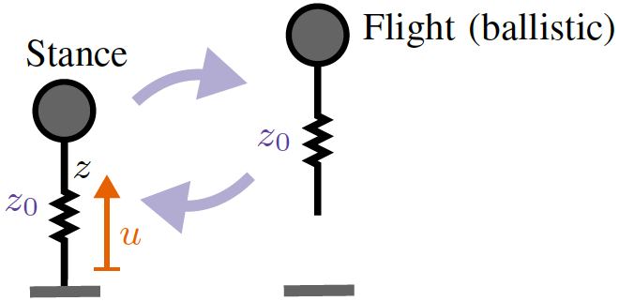
  ≈
  height
  steps
Interpretation: viscoelastic limb performs morphological computation (averaging)
De, Burden, Koditschek Submitted to IJRR (arXiv:1607.03795)
A hybrid dynamical extension of averaging

Slide 61
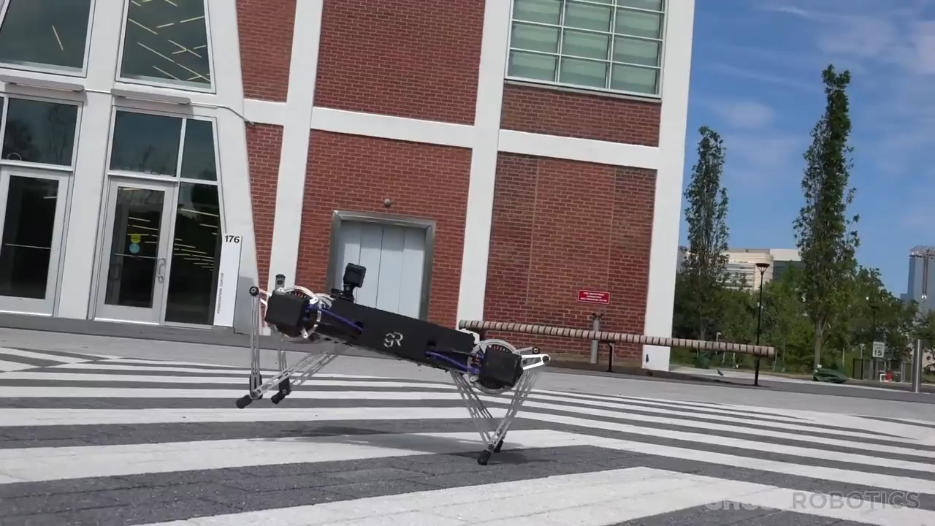

generalization of averaging to multiple limbs
Kenneally, De, Koditschek IEEE RAL 2016; http://ghostrobotics.io

Slide 62
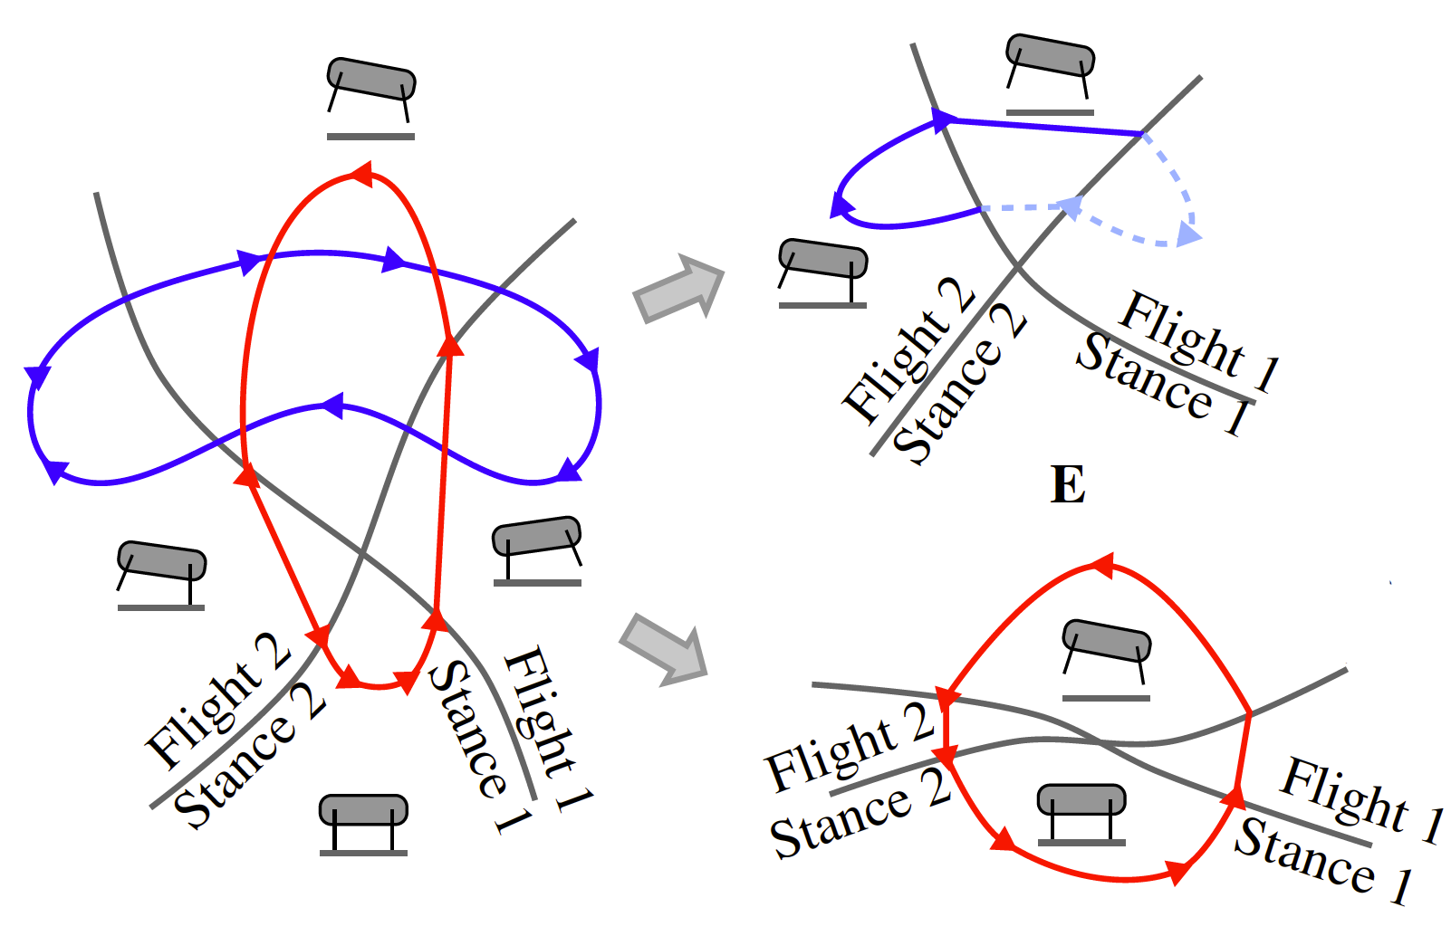
(why) does averaging generalize?
  bound
  trot
De, Burden, Koditschek Submitted to IJRR
A hybrid dynamical extension of averaging and its
application to the analysis of legged gait stability
De, Koditschek Submitted to IJRR
Vertical hopper compositions for preflexive and feedback-stabilized
quadrupedal bounding, pacing, pronking and trotting

Slide 63




  contractive
  expansive liftoff
  expansive impact
  contractive
Burden, Libby, Coogan (arXiv:1804.04122)
On contraction analysis for hybrid systems

Slide 64
today’s talk:
how do we enable humans to learn and control
contact-rich robot dynamics?
M, M⁻¹
contact-rich robot
terradynamics
human sensorimotor
learning and control

