Slide 1
21 Acres Mapping Group
Satori Johnson, Rainer Oviir, Sam Shupe
BES 318
Winter 2010
W
University of Washington Bothell

Slide 2
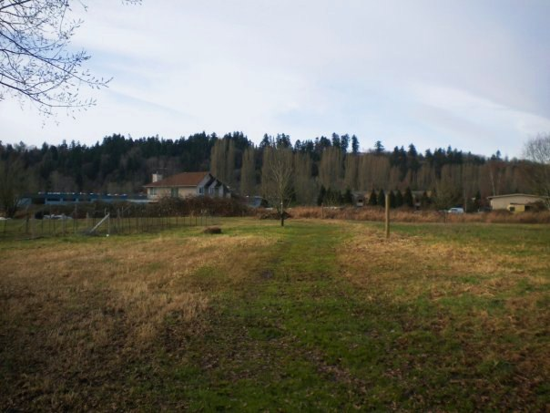
Objectives:
To measure topsoil depths for plots D, E1, E2, G, H1, and H2.
Observe differences in soil texture and color in underlying layers.

Slide 3
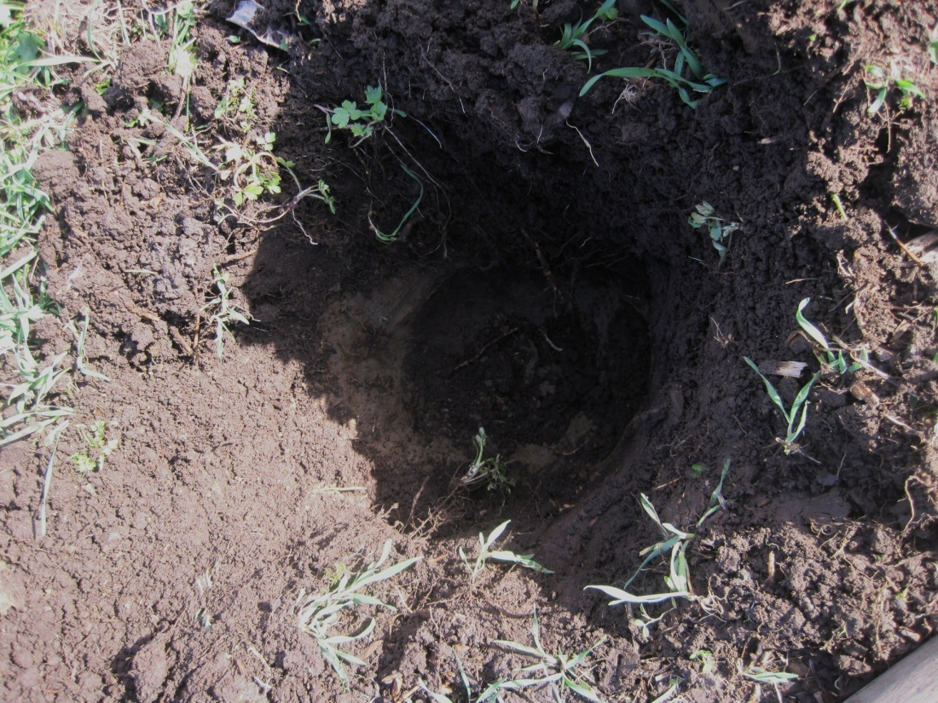
Methods & Procedures
Nine measurements collected in each plot.
Depth was measured at change of soil characteristics.

Slide 4
Results:

Slide 5
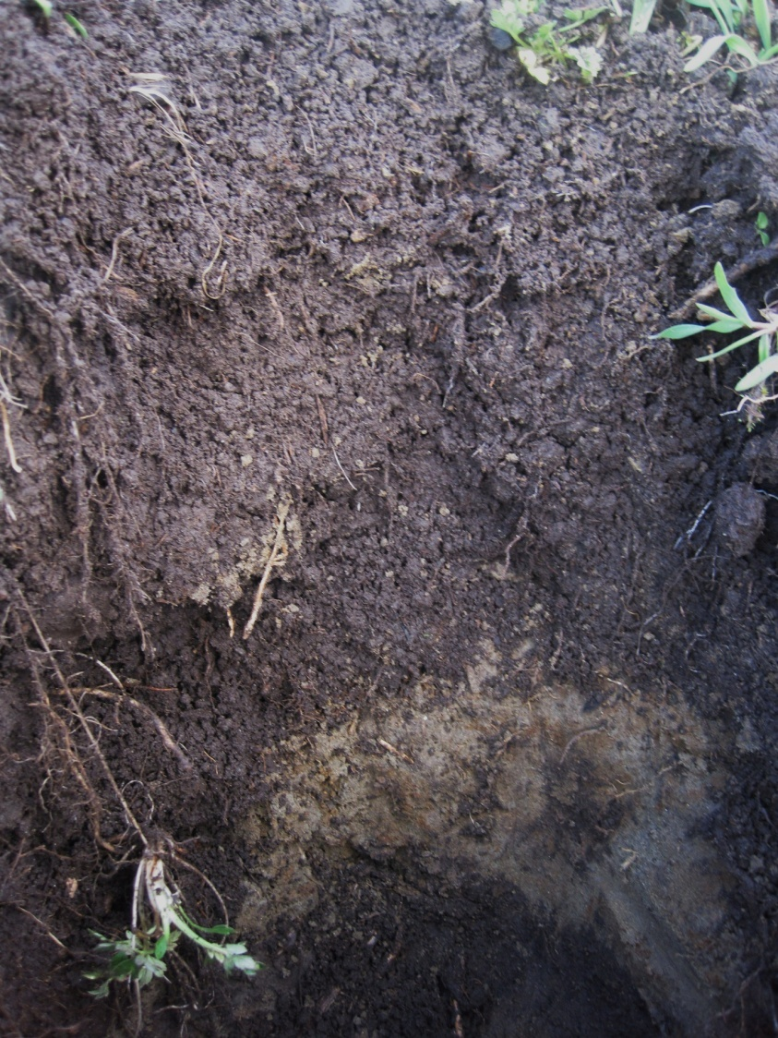
What we saw:
This photograph was taken from plot D and shows the change in soil composition.
The depth of the topsoil at this site was 15 inches.
The underlying layer was mostly clay with a low percentage of silt and almost no sand.

Slide 6
The big picture:
Topsoil depth was greater than expected
Information useful for planning crop plantings
Soil composition in layers below topsoil were diverse and
changed drastically
from one site to
the next.

Slide 7
Limitations and Future recommendations:
Limitations:
Research errors – inaccurate measurements
Measurements were taken one week apart
Future work:
Cross-reference findings with data obtained by infiltration rates group, soil hydraulic properties group, and soil nutrients and organic matter group
Conduct more comprehensive soil profile analysis.

Slide 8
21 Acres’ education director, Dave Muehleisen 21 Acres staff & Volunteers Dr. Robert Turner
Acknowledgements:

