Slide 1
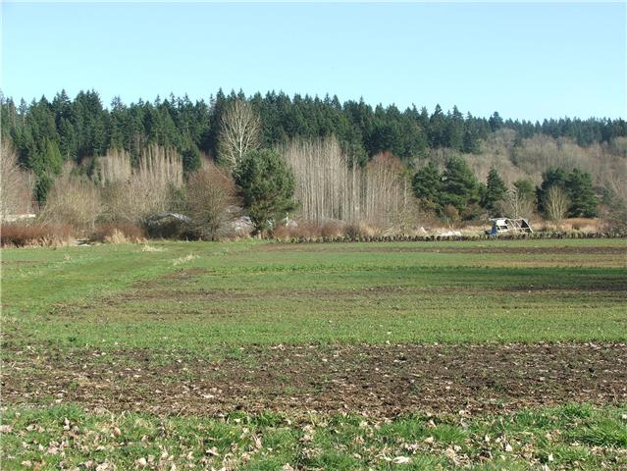
Infiltration and surface hardness at 21 Acres Farm
By Maizy B., Kevin F. ,Brian L., and Robyn M

Slide 2
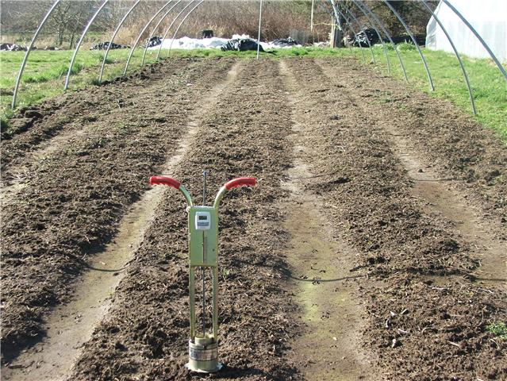
Introduction
39 infiltration readings were taken in twelve different fields.
195 surface hardness readings in the twelve fields.

Slide 3
Results

Slide 4
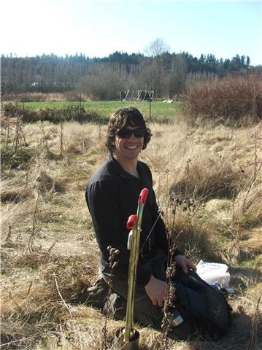
Methods and Materials
Infiltrometer
Penetrometer

Slide 5
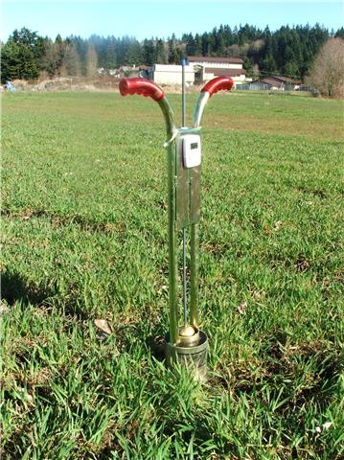
Conclusion
The readings need to be taken during the growing season for more accurate results.
Sustained infiltration rates would help the validity of the results.

