Slide 1
Assessment of the Nutrient Water Quality in the Ditch System of 21 Acres
For BCSUSP 119
By
Jan Wnek, Kelly McNemee, Winnie Kwan, Victor La and Davis Sellers-Halgren
June 2008

Slide 2
Results
Nitrate concentrations are high in the ditch water.
Standard deviations around the mean NO3⁻ values were atypically high for Site D (+/- 0.91 on 5/12/08 and +/- 0. 58 on 5/19/08) and Site A (+/- 0.48 on 5/12/08) reducing our confidence in the accuracy of the mean values on those dates.
Ammonia and phosphate levels were quite low.

Slide 3
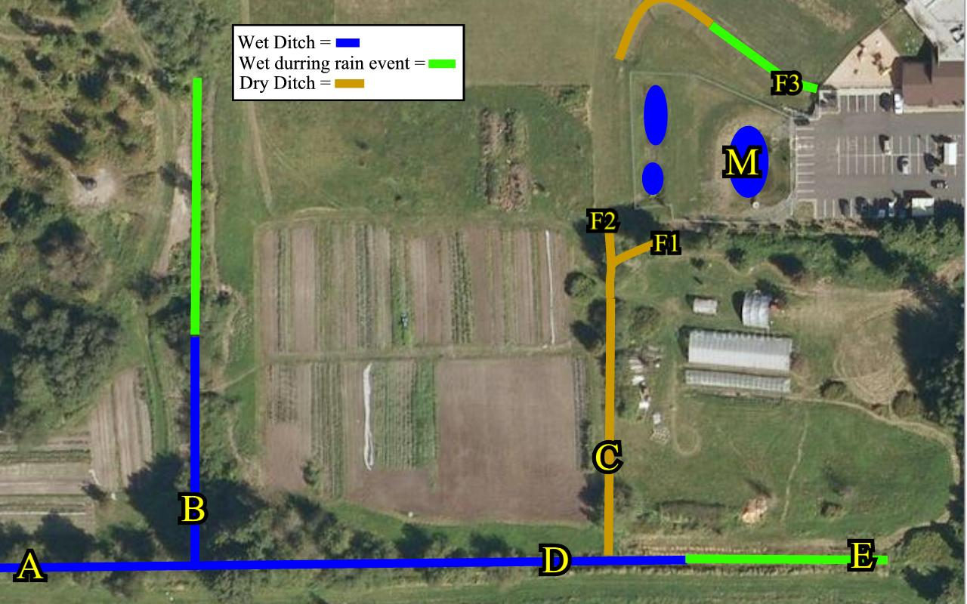
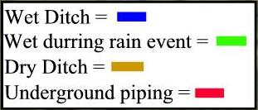
M on 5/12/08
NO₃ – 0.68 mg/l
NH₃ – 0.08 mg/l
PO₄ – 0.02 mg/l
D on 5/5/08
NO₃ – 1.01 mg/l
NH₃ – 0.07 mg/l
PO₄ – 0.02 mg/l
D on 5/12/08
NO₃ – 1.31 mg/l
NH₃ – 0.03 mg/l
PO₄ – 0.02 mg/l
D on 5/19/08
NO₃ – 1.59 mg/l
NH₃ – 0.05 mg/l
PO₄ – 0.07 mg/l
A on 5/12/08
NO₃ – 0.7 mg/l
NH₃ – 0.007 mg/l
PO₄ – 0.02 mg/l
A on 5/19/08
NH₃ – 0.004 mg/l
PO₄ – 0.02 mg/l
B on 5/12/08
NO₃ – 0.58 mg/l
NH₃ – 0.02 mg/l
PO₄ – 0.08 mg/l
B on 5/19/08
NO₃ – 0.30 mg/l
NH₃ – 0.006 mg/l
PO₄ – 0.07 mg/l
Notes:
Mean nutrient concentrations from triplicate samples collected on the dates indicated. The letters refer to the sampling site locations.

Slide 4
Conclusions
More sampling is needed to determine how representative these results are. Seasonal variations are likely to be high.
It would be interesting to see if nutrient concentrations and speciation changes along the ditch system due to phytoremediation.

Slide 5
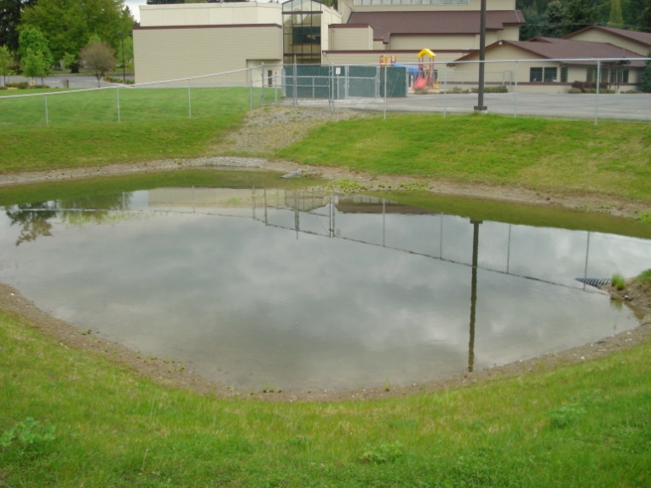
Site M
Church retention pond
All photos by Winnie Kwan

Slide 6
Sampling at Site M

Slide 7
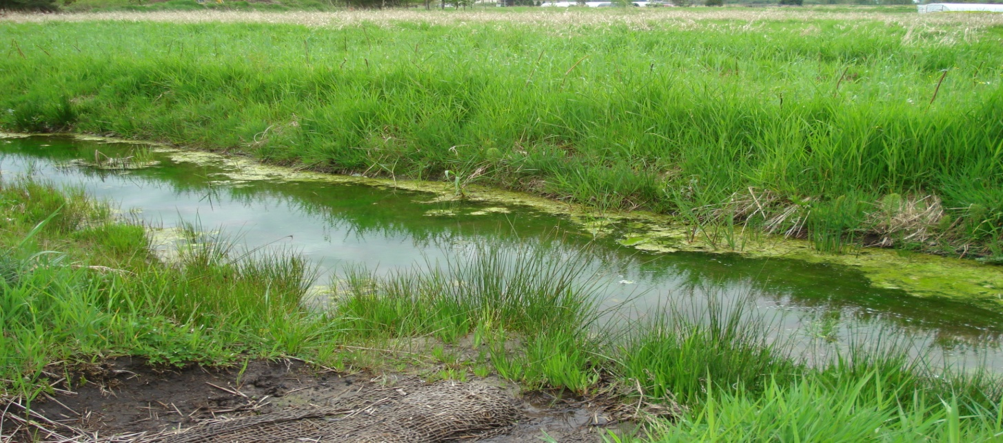
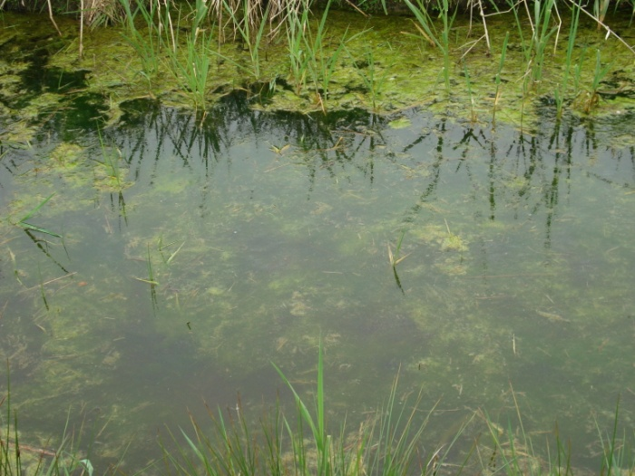
Site D
Drainage ditch.
Note the algal growth.

Slide 8
Jan, Kelly and Victor at Site D

Slide 9
Preserving Samples

Slide 10
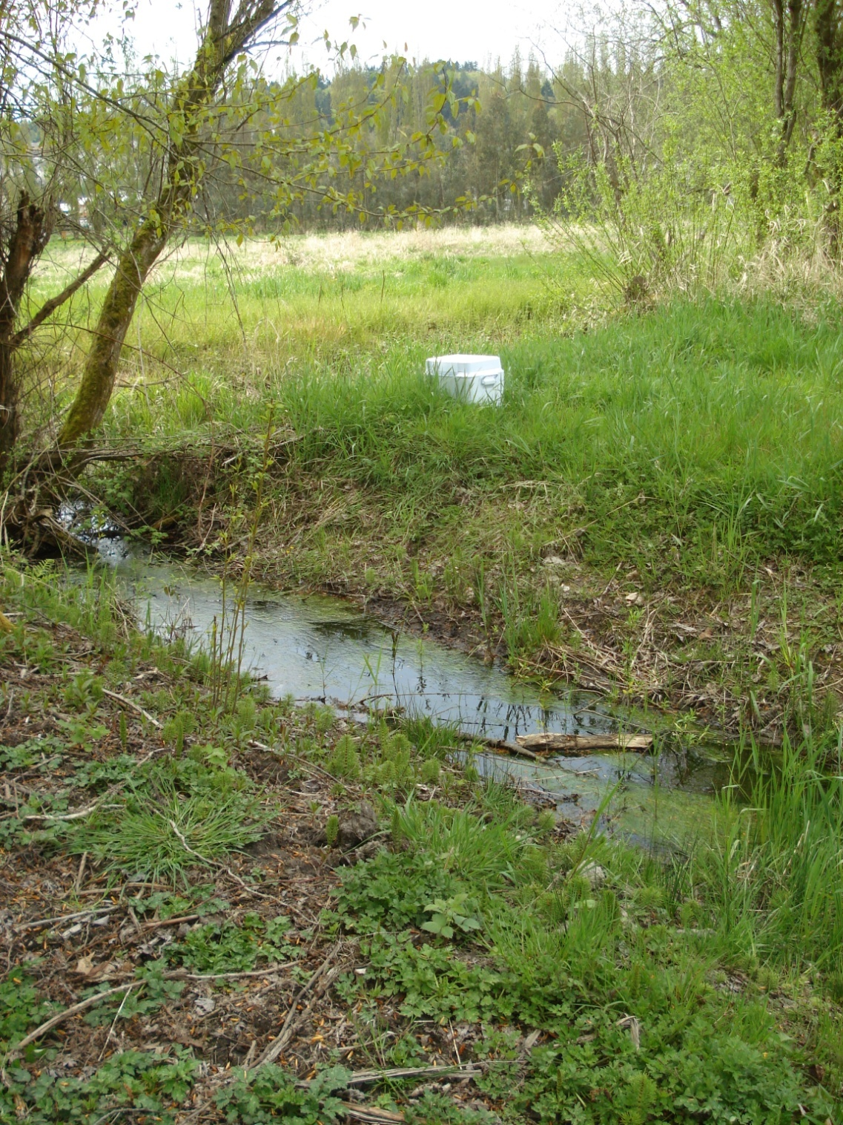
Site B
Drainage ditch with stagnant water and algae bloom.

Slide 11
Sampling at Site B

Slide 12
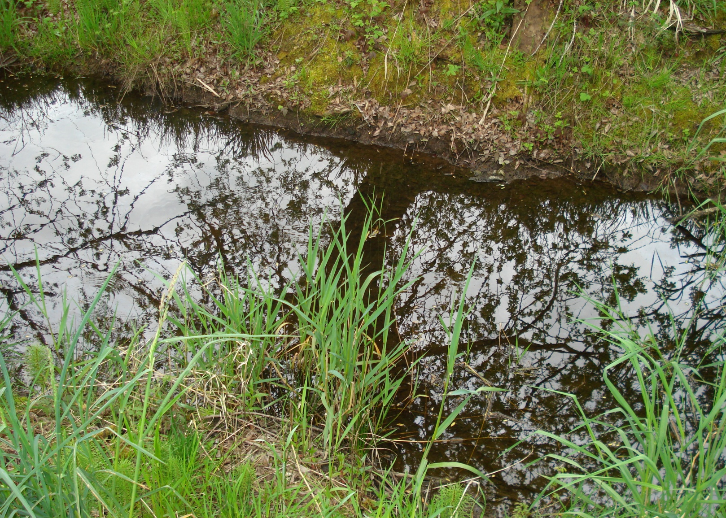
Site A
Flowing drainage ditch. Note lack of algae bloom.

Slide 13
Sampling at Site A

