Slide 1
Crops and Transpiration Report

Slide 2
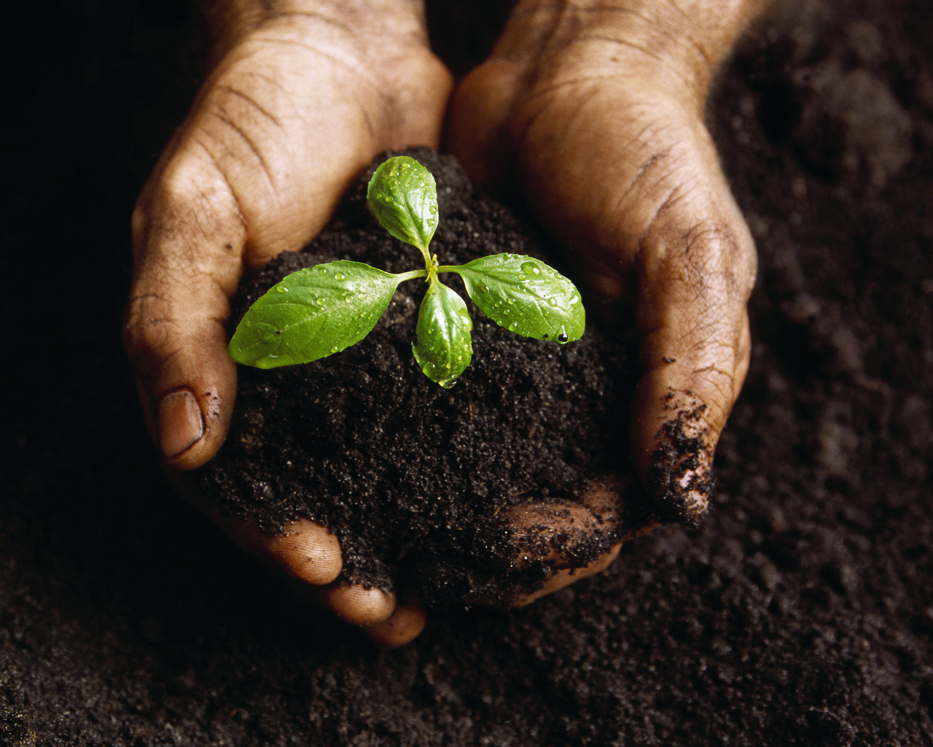
Factors Influencing Crops Water Needs
http://www.fao.org/docrep/s2022e/s2022e07.htm
Notes:
To insert this slide into your presentation
Save this template as a presentation (.ppt file) on your computer.
Open the presentation that will contain the image slide.
On the Slides tab, place your insertion point after the slide that will precede the image slide. (Make sure you don't select a slide. Your insertion point should be between the slides.)
On the Insert menu, click Slides from Files.
In the Slide Finder dialog box, click the Find Presentation tab.
Click Browse, locate and select the presentation that contains the image slide, and then click Open.
In the Slides from Files dialog box, select the image slide.
Select the Keep source formatting check box. If you do not select this check box, the copied slide will inherit the design of the slide that precedes it in the presentation.
Click Insert.
Click Close.

Slide 3
Effect of Major Climatic Factors On Crop Water Needs
Climate Factors | Crop water need
 | High | Low
Temperature | Hot | Cool
Humidity | Low(dry) | High(humid)
Wind speed | Windy | Little wind
Sunshine | Sunny | Cloudy
Notes:
EFFECT OF MAJOR CLIMATIC FACTORS ON CROP WATER NEEDS

Slide 4
The 21 Acres Planting List for 2010
Artichoke
Bean
Beet
Broccoli
Brussel sprouts
Burdock
Cabbage
Carrot
Cauliflower
Celeriac
Celery
Collards
Corn
Cucumber
Daikon
Dill
Edamame
Eggplant
Fennel
Greens
Kale
Kohlrabi
Leek
Lettuce
Melon
Onion
Pak Choi
Parsley
Parsnip
Peas
Pepper
Potato
Pumpkin
Radicchio (Hybrids)
Radish
Rapini
Rutabaga
Salad Greens
Spinach
Squash
Swiss Chard
Tomatoes
Turnips
Winter Squash
http://cahnrsnews.wsu.edu/Images/21acres-02.jpg
Notes:
To insert this slide into your presentation
Save this template as a presentation (.ppt file) on your computer.
Open the presentation that will contain the image slide.
On the Slides tab, place your insertion point after the slide that will precede the image slide. (Make sure you don't select a slide. Your insertion point should be between the slides.)
On the Insert menu, click Slides from Files.
In the Slide Finder dialog box, click the Find Presentation tab.
Click Browse, locate and select the presentation that contains the image slide, and then click Open.
In the Slides from Files dialog box, select the image slide.
Select the Keep source formatting check box. If you do not select this check box, the copied slide will inherit the design of the slide that precedes it in the presentation.
Click Insert.
Click Close.

Slide 5
Monthly Average Reference Evapotranspiration Rate
Monroe, Washington Irrigation Guide
Month | Eto (mm/day)
May | 4.15
June | 4.78
July | 5.67
August | 4.54
September | 3.16
Notes:
Monthly Average Reference Evapotranspiration
Goldendale, Washington AgriMet Station

Slide 6
Crop Evapotranspiration Formula
ETo = reference evapotranspiration (mm/day)
Kc = crop factor
ET crop = crop evapotranspiration or crop water need (mm/day)
http://www.fao.org/docrep/s2022e/s2022e07.htm
Notes:
To insert this slide into your presentation
Save this template as a presentation (.ppt file) on your computer.
Open the presentation that will contain the image slide.
On the Slides tab, place your insertion point after the slide that will precede the image slide. (Make sure you don't select a slide. Your insertion point should be between the slides.)
On the Insert menu, click Slides from Files.
In the Slide Finder dialog box, click the Find Presentation tab.
Click Browse, locate and select the presentation that contains the image slide, and then click Open.
In the Slides from Files dialog box, select the image slide.
Select the Keep source formatting check box. If you do not select this check box, the copied slide will inherit the design of the slide that precedes it in the presentation.
Click Insert.
Click Close.

Slide 7
Collecting Data
Step 1
Determine the total growing period
Step 2
The initial stage
Determinate the Kc values for each crop for each of the growth stages
Step 3
The climate
The crop development stage
mid - season stage
late season stage
Determine the various growth stage of each crop
the type of crop
the growth stage of the crop
the climate
The planting date
The types of crops and the variety

Slide 8
Growing Period in 2010
Crop Name | Planting Date | Harvest Date | Growing Days
Beans | 2-May | 31-Aug | 121
Cabbage | 16-May | 16-Sep | 123
Carrots | 1-May | 1-Aug | 92
Cucumber | 1-May | 10-Jul | 70
Eggplant | 15-May | 24-Jul | 70
Lettuce | 1-Jun | 14-Jul | 43
Melon | 1-Jun | 28-Aug | 88
Onion | 15-Apr | 10-Jul | 86
Peas | 21-Apr | 16-Jun | 56
Peppers | 15-May | 21-Aug | 98
Potato | 1-Jun | 13-Aug | 73
Radish | 15-May | 10-Jun | 26
Edamame | 15-May | 1-Sep | 109
Spinich | 1-May | 5-Jul | 65
Squash | 1-Jun | 20-Jul | 49
Tomato | 1-May | 28-Aug | 119

Slide 9
Growth Stage of Each Crop
http://www.fao.org/docrep/s2022e/s2022e0z.gif
Notes:
To insert this slide into your presentation
Save this template as a presentation (.ppt file) on your computer.
Open the presentation that will contain the image slide.
On the Slides tab, place your insertion point after the slide that will precede the image slide. (Make sure you don't select a slide. Your insertion point should be between the slides.)
On the Insert menu, click Slides from Files.
In the Slide Finder dialog box, click the Find Presentation tab.
Click Browse, locate and select the presentation that contains the image slide, and then click Open.
In the Slides from Files dialog box, select the image slide.
Select the Keep source formatting check box. If you do not select this check box, the copied slide will inherit the design of the slide that precedes it in the presentation.
Click Insert.
Click Close.

Slide 10
Kc values
 | Initial | Crop Dev. | Mid-season | Late-season
Green beans | 0.35 | 0.70 | 1.10 | 0.90
Cabbage | 0.45 | 0.75 | 1.05 | 0.90
Carrot | 0.45 | 0.75 | 1.05 | 0.90
Cucumber | 0.45 | 0.70 | 0.90 | 0.75
Edmame | 0.55 | 0.75 | 1.10 | 0.60
Eggplant | 0.45 | 0.75 | 1.15 | 0.80
Lettuce | 0.45 | 0.60 | 1.00 | 0.90
Melon | 0.45 | 0.75 | 1.00 | 0.75
Onion | 0.45 | 0.75 | 1.00 | 0.75
Peas | 0.45 | 0.80 | 1.15 | 1.05
Pepper | 0.35 | 0.70 | 1.05 | 0.90
Potato | 0.45 | 0.75 | 1.15 | 0.85
Radish | 0.45 | 0.60 | 0.90 | 0.90
Spinach | 0.45 | 0.60 | 1.00 | 0.90
Squash | 0.45 | 0.70 | 0.90 | 0.75
Tomato | 0.45 | 0.75 | 1.15 | 0.80

Slide 11
Data Table
Crop Name | Initial Stage (days) | Ini. K_{c} | Crop dev. Stage (days) | Dev K_{c} | Mid-season (days) | Mid Season K_{c} | Late Season (days) | Late Season K_{c}
Beans | 20 | 0.35 | 30 | 0.7 | 31 | 1.1 | 31 | 0.9
Cabbage | 20 | 0.45 | 25 | 0.75 | 60 | 1.05 | 16 | 0.9
Carrots | 20 | 0.45 | 30 | 0.75 | 30 | 1.05 | 10 | 0.9
Cucumber | 10 | 0.45 | 20 | 0.7 | 20 | 0.9 | 12 | 0.75
Eggplant | 10 | 0.45 | 20 | 0.75 | 30 | 1.15 | 10 | 0.8
Lettuce | 10 | 0.45 | 20 | 0.6 | 10 | 1 | 4 | 0.9
Melon | 15 | 0.45 | 25 | 0.75 | 30 | 1 | 18 | 0.75
Onion | 15 | 0.45 | 30 | 0.75 | 25 | 1 | 8 | 0.75
Peas | 15 | 0.45 | 25 | 0.8 | 30 | 1.15 | 8 | 1.05
Peppers | 20 | 0.35 | 30 | 0.7 | 35 | 1.05 | 15 | 0.9
Potato | 15 | 0.45 | 25 | 0.75 | 25 | 1.15 | 9 | 0.85
Radish | 5 | 0.45 | 5 | 0.6 | 10 | 0.9 | 7 | 0.9
Edamame | 20 | 0.35 | 30 | 0.75 | 60 | 1.1 | 25 | 0.6
Spinich | 20 | 0.45 | 30 | 0.6 | 40 | 1 | 10 | 0.9
Squash | 20 | 0.45 | 30 | 0.7 | 30 | 0.9 | 15 | 0.75
Tomato | 30 | 0.45 | 40 | 0.75 | 40 | 1.15 | 25 | 0.8

Slide 12
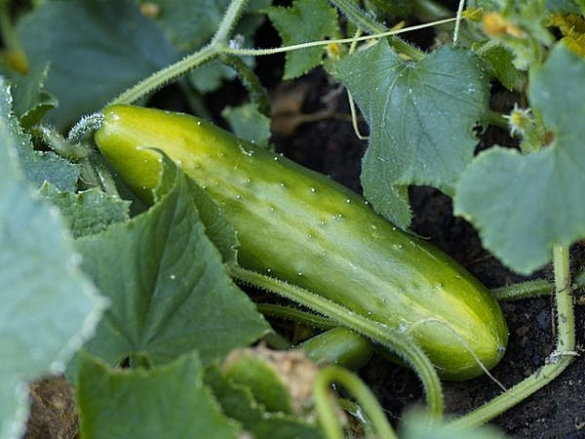
Example Problem
Crop 1: _CUCUMBER_
Planting date: __May 2_ Harvest date: __July 10_
Duration of total growing period: __70__days
Initial stage: __10_____ days __May 2 – May 11___
Crop dev. Stage: __20_____days __May 12 - May 31__
Mid-season stage: __20_____days __June 1 – June 20__
Late season stage: __20_____days __June 21 - July 10__
Crop factors, Kc
Initial stage: ___0.45____
Crop dev. Stage: ___0.70____
Mid-season stage: ___0.90____
Late season stage: ___0.75____

Slide 13
SOLUTION

Slide 14
Evapotranspiration Rates Per Month, Per Crop (inches)
 | May Etcrop | June Etcrop | July Etcrop | August Etcrop | September Etcrop
Crop Name
Beans | 1.66 | 3.82 | 5.95 | 4.09 | N/A
Cabbage | 1.25 | 2.87 | 6.07 | 4.77 | 1.58
Carrots | 2.08 | 3.82 | 3.97 | 0.27 | N/A
Cucumber | 2.49 | 4.06 | 1.13 | N/A | N/A
Eggplant | 1.25 | 4.78 | 4.54 | N/A | N/A
Lettuce | N/A | 2.39 | 2.84 | N/A | N/A
Melon | N/A | 2.87 | 5.39 | 3.41 | N/A
Onion | 3.11 | 4.54 | 1.42 | N/A | N/A
Peas | 3.74 | 3.11 | N/A | N/A | N/A
Peppers | 0.83 | 3.11 | 5.67 | 2.95 | N/A
Potato | N/A | 2.87 | 5.67 | 2.04 | N/A
Radish | 1.25 | 1.43 | N/A | N/A | N/A
Edamame | 0.62 | 3.82 | 6.24 | 3.86 | 0.16
Spinach | 2.08 | 4.54 | 1.13 | N/A | N/A
Squash | N/A | 2.87 | 3.40 | N/A | N/A
Tomato | 1.66 | 3.59 | 6.24 | 3.86 | N/A

Slide 15
Irrigation Requirements Per Month, Per Crop (inches)
 | May IR | June IR | July IR | August Etcrop | September Etcrop | Total Plant Life Irrigation
Crop Name |  |  |  |  |  | Requirements (inches)
Beans | -0.39 | 2.02 | 4.92 | 2.81 | N/A | 9.36
Cabbage | -0.81 | 1.07 | 5.04 | 3.49 | -0.35 | 8.44
Carrots | 0.03 | 2.02 | 2.94 | -1.01 | N/A | 3.98
Cucumber | 0.44 | 2.26 | 0.10 | N/A | N/A | 2.81
Eggplant | -0.81 | 2.98 | 3.51 | N/A | N/A | 5.68
Lettuce | N/A | 0.59 | 1.81 | N/A | N/A | 2.40
Melon | N/A | 1.07 | 4.36 | 2.13 | N/A | 7.55
Onion | 1.06 | 2.74 | 0.39 | N/A | N/A | 4.19
Peas | 1.69 | 1.31 | N/A | N/A | N/A | 2.99
Peppers | -1.22 | 1.31 | 4.64 | 1.67 | N/A | 6.40
Potato | N/A | 1.07 | 4.64 | 0.76 | N/A | 6.47
Radish | -0.81 | -0.37 | N/A | N/A | N/A | -1.17
Edamame | -1.43 | 2.02 | 5.21 | 2.58 | -1.77 | 6.61
Spinich | 0.03 | 2.74 | 0.10 | N/A | N/A | 2.87
Squash | N/A | 1.07 | 2.37 | N/A | N/A | 3.44
Tomato | -0.39 | 1.79 | 5.21 | 2.58 | N/A | 9.18
Total Monthly IR(in) | -2.61 | 25.69 | 45.23 | 15.00 | -2.12

Slide 16
Irrigation Requirements Per Month, Per Crop (gal)
 | May IR | June IR | July IR | August Etcrop | September Etcrop | Total Plant Life Irrigation
Crop Name |  |  |  |  |  | Requirements (inches)
Beans | -0.25 | 1.30 | 3.15 | 1.80 | N/A | 5.99
Cabbage | -0.52 | 0.68 | 3.22 | 2.23 | -0.22 | 5.40
Carrots | 0.02 | 1.30 | 1.88 | -0.64 | N/A | 2.55
Cucumber | 0.28 | 1.45 | 0.07 | N/A | N/A | 1.80
Eggplant | -0.52 | 1.91 | 2.24 | N/A | N/A | 3.64
Lettuce | N/A | 0.38 | 1.16 | N/A | N/A | 1.53
Melon | N/A | 0.68 | 2.79 | 1.36 | N/A | 4.83
Onion | 0.68 | 1.75 | 0.25 | N/A | N/A | 2.68
Peas | 1.08 | 0.84 | N/A | N/A | N/A | 1.91
Peppers | -0.78 | 0.84 | 2.97 | 1.07 | N/A | 4.09
Potato | N/A | 0.68 | 2.97 | 0.49 | N/A | 4.14
Radish | -0.52 | -0.23 | N/A | N/A | N/A | -0.75
Edamame | -0.91 | 1.30 | 3.33 | 1.65 | -1.13 | 4.23
Spinich | 0.02 | 1.75 | 0.07 | N/A | N/A | 1.84
Squash | N/A | 0.68 | 1.52 | N/A | N/A | 2.20
Tomato | -0.25 | 1.14 | 3.33 | 1.65 | N/A | 5.88
Total Monthly IR(gal) | -1.67 | 16.44 | 28.95 | 9.60 | -1.36

Slide 17
By: Anthonee Gibbs Sofia Tangcharoensiri Brandon Iwasaki

