Slide 1
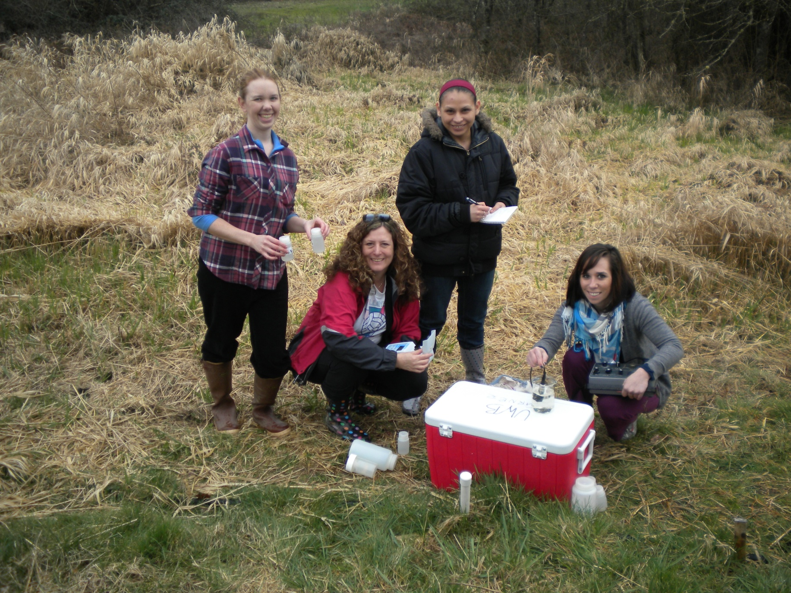
Well Water Quality 21 Acres

Slide 2
21 Acres Location

Slide 3
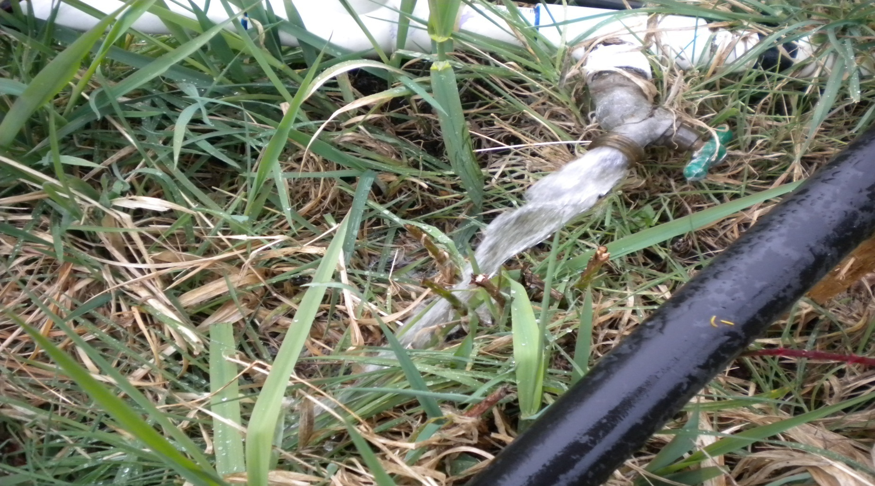
On-site water supply at 21 Acres

Slide 4
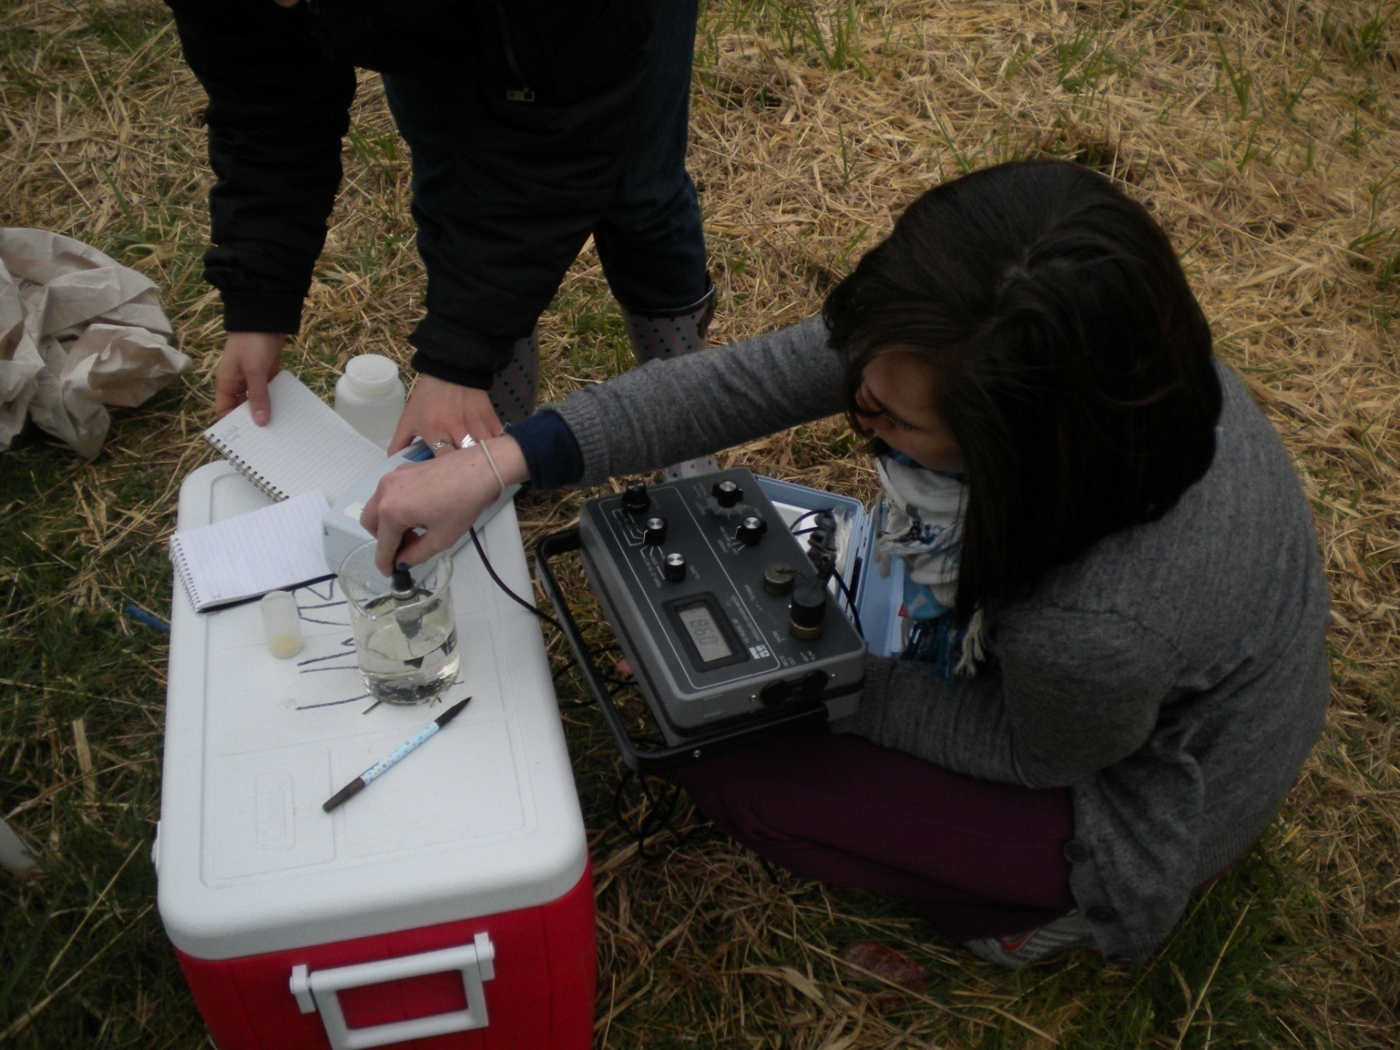
Field Assessments
Jessica

Slide 5
Field run test results for water quality collected 2.23.2010
Sample | Temp (°C) | D.O (mg/L) | D.O. % | Ph | Conductivity (m) | Turbidity (NTU)
Initial 1 - From cistern | 9.8 °C | 2.08 | 19.8 | 7.8 | 373 | 0.68
Initial 2 - From cistern | 10.4 °C | 1.05 | 11.0 | 7.7 | 362 | 0.49
Initial 1 - From well | 10.3 °C | 2.82 | 26.3 | 7.4 | 330 | 2.06
Sample 1 - From well | 10.3 °C | 2.48 | 22.8 | 7.4 | 331 | 0.79
Sample 2 - From well | 10.2 °C | 2.21 | 20.7 | 7.4 | 332 | 0.31
Sample 3 - From well | 10.2 °C | 2.10 | 21.1 | 7.4 | 339 | 0.88
Field run test results for water quality collected 3.2.2010
Sample | Temp (°C) | D.O (mg/L) | D.O. % | Ph | Conductivity (m) | Turbidity (NTU)
Initial 1 - From cistern | 11.5 | 1.37 | 13.3 | 7.6 | 329 | 0.37
Initial 2 - From cistern | 11.4 | 1.77 | 18.1 | 7.6 | 321 | 0.52
Initial 1 - From well | 11.1 | 1.39 | 13.6 | 7.5 | 320 | 0.51
Sample 1 - From well | 10.8 | 1.36 | 12.3 | 7.4 | 320 | 0.27
Sample 2 - From well | 10.8 | 1.76 | 15.7 | 7.3 | 312 | 0.34
Sample 3 - From well | 10 | 1.08 | 9.6 | 7.5 | 323 | 0.46

Slide 6
Field Assessments
Temperature Results
pH Results

Slide 7
Field Assessments
Dissolved Oxygen Results
Dissolved Oxygen Results

Slide 8
Field Assessments
Conductivity Results
Turbidity Results

Slide 9
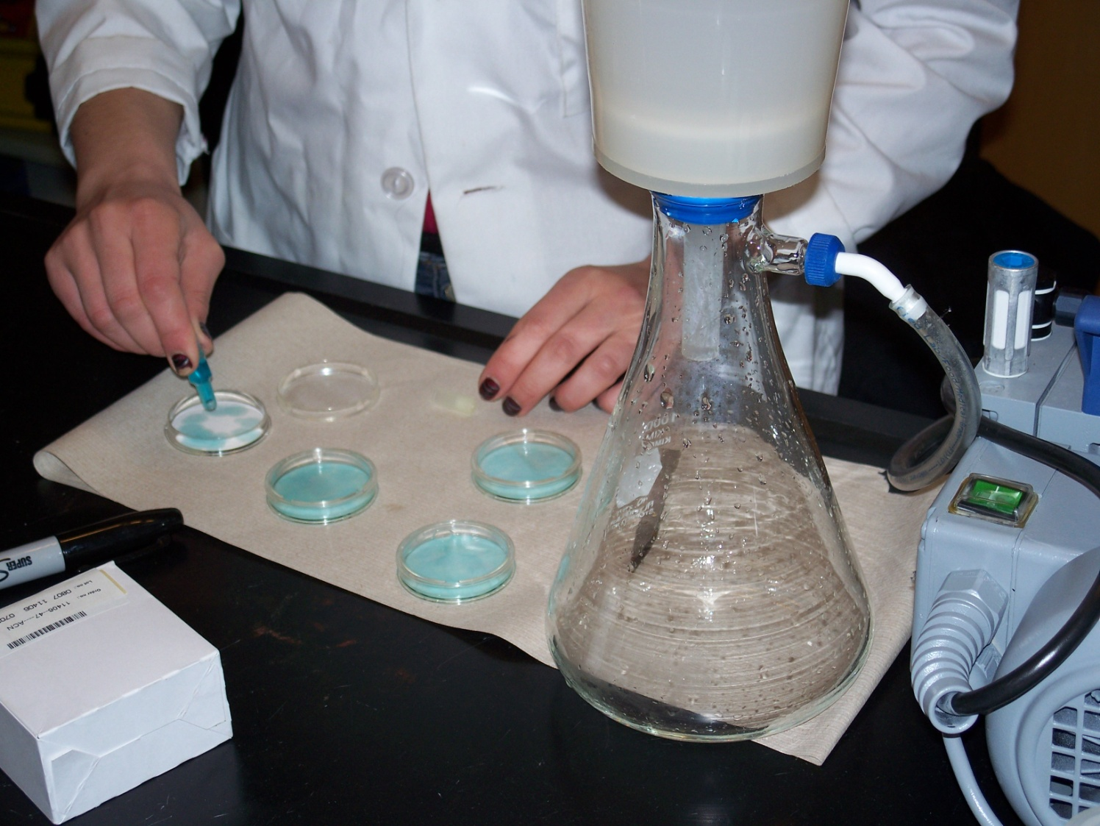
Cheryl
FECAL COLIFORM

Slide 10
Fecal Coliform Lab Results for Well Water Quality Collected 2-23 and 3-8 2010
Colony Type | # of colonies from all 4 samples | Volume of all samples | = | Answer | x100 | = | % Density
Fecal coliform 2/23 | 17 | 500 | = | 0.034 | x100 | = | 3.4
E. Coli 2/23 | 4 | 500 | = | 0.008 | x100 | = | 0.8
Fecal coliform 3/8 | 6 | 500 | = | 0.012 | x100 | = | 1.2
E. Coli 3/8 | 5 | 500 | = | 0.01 | x100 | = | 1

Slide 12
Nutrients
Maxine

Slide 13
Nutrient Analysis

Slide 14
Nutrient Lab Results For Water Quality Collected 2-23-2010
Sample ID | Ammonia (mg/L) | Phiosphate (mg/L) | Nitrate + Nitrite (mg/L)
NAB 2-23 | 0.067803 | 0.006517 | 0.032573
NA1 2-23 | 1.325226 | 1.138331 | 0.103419
NA2 2-23 | 1.30266 | 1.1348 | -0.00828
NA3 2-23 | 1.32085 | 1.14505 | -0.000709
average | 1.316245333 | 1.139393667 | 0.031476667
stdev | 0.011966967 | 0.005206973 | 0.062418783

Slide 15
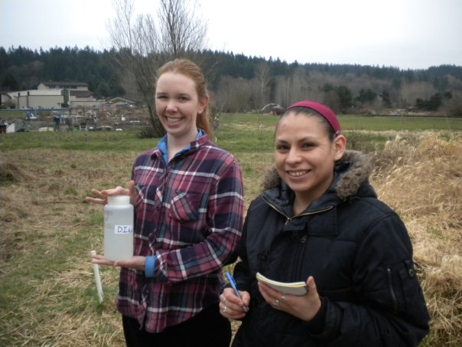
Jamie
SUMMARY FOR 21 ACRES IRRIGATION PLAN

Slide 16
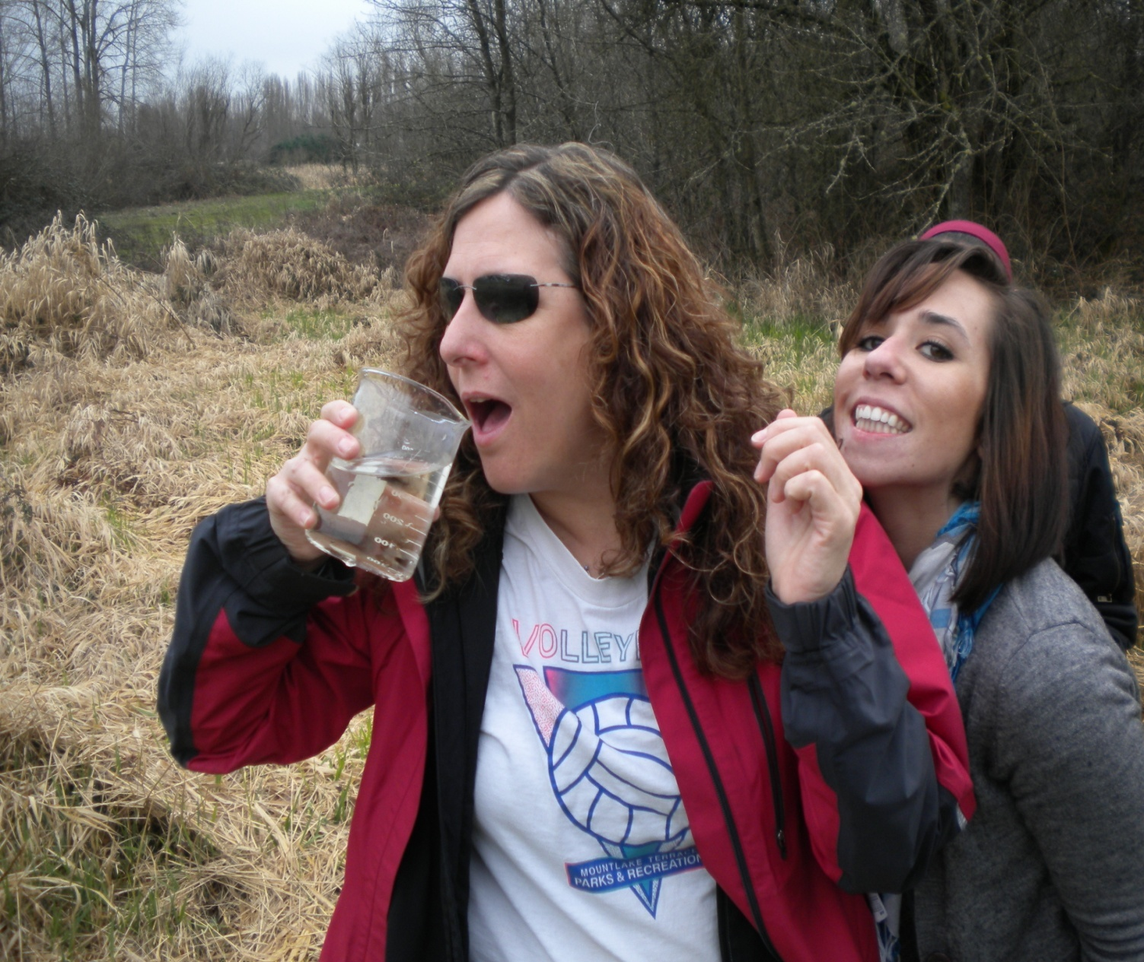
BIS 318 Winter 2010 Jessica Lyn Rider, Cheryl Watts, Jamie Prantil and Maxine Luna
Thank you
Uwb Lab Staff/Equip.
21 acres staff
Team members

