Slide 1
Numerical Reproducibility
Working Group 4
12/12/12

Slide 2
“The cause célèbre for this workshop is that we will develop a system of technical tools, processes, and responsibilities to ensure the scientific integrity of results obtained by scientific computing.”
-D. Bailey
What are we including in the definition of numerical reproducibilty?
Computation and Data Analysis

Slide 3
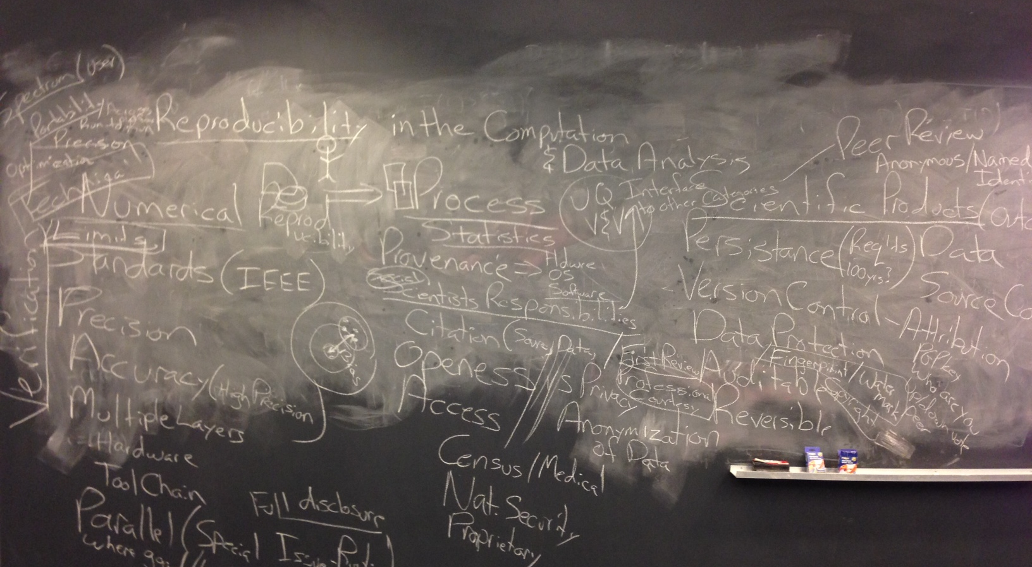
Here’s what we came up with:

Slide 4
Distillation of the above: the scientific process for reproducibility
Defining reproducibility goals for the problem, stating that upfront
The process to achieve the stated goals
Reporting of the results

Slide 5
Defining Reproducibility: technical elements/technique
standards (IEEE, BFB)
Accuracy (e.g. high precision) Is there a spectrum of accuracy?
Portability, optimization, precision
Multiple layers
Hardware
Toolchain
Parallel (special issue of runtime)
Limits of reproducibility
Reporting of good vs. bad results
verification

Slide 6
Standards and Practices A:
Hardware and Tools
Provenance
Hardware
OS
Software

Slide 7
Standards and Practices B:
Scientists responsibilities
Citation
Source, data
Support DOI’s for data so scientists can be cited
Proprietary
Statistics
First Review, professional courtesy
Openness/access/privacy
What about issues of certain data such as census, medical, national security
There are issues with the anonymization of data
Dubious methods of reporting results
These processes will also connect to V&V and UQ

Slide 8
Scientific Products: outcome
includes peer review to increase quality
Provenance/version control, issues of changing the data after its creation without a trail.
Auditable, Reversible, data protection , attribution
What is the difference between access and openness (do you have access to Matlab or a supercomputer?)
Up/down votes by peers, curation
Anonymous versus public review
Persistence (data longevity)
What are the requirements, Data, Source code
Fingerprints and watermark, copyright
Techniques for research to prevent nefarious copying or stealing of code/data
i.e. avoiding plagiarism so that researchers are comfortable sharing their results and methods
full disclosure, either in paper or supplementary

Slide 9
Participants
Aruliah, Bailey, Barba, Brodtkorb, Clemons, DeBardeleben, Dienstfrey, Evans (scribe), Hentgartner, Michalak, Robey (chair), Rosenquist

