Slide 1
What do archeologists know about cities that other people don’t?

Slide 2
What do cultural anthropologists know about cities?

Slide 3
What do cultural anthropologists know about cities?
Very little

Slide 4
What do cultural anthropologists want to know about cities?

Slide 5
What do cultural anthropologists want to know about cities?
Everything everyone else already knows

Slide 6
2 themes for the day:
1. Key issues in urban anthropology
2. De Certeau and the practice of the city

Slide 7
Cities have always been a problem for cultural anthropology.
Why?

Slide 8
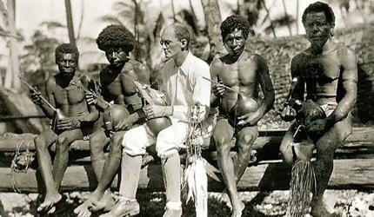
It’s his fault…

Slide 9
Bronislaw Malinowski
(1884-1942)
The twin legacies of Malinowski…
(What are they?)

Slide 10
Bronislaw Malinowski
(1884-1942)
Participant / observation as anthropology’s method
Functionalism as anthropology’s theory

Slide 11
A discipline of the rural:
Participant / observers sought spaces of “pure” culture
Functionalism required a small, bounded object of study

Slide 12
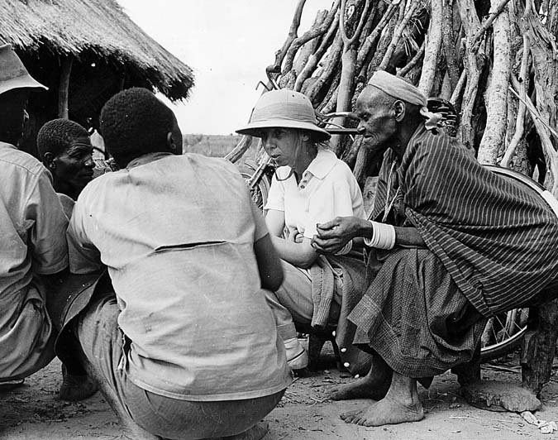
Elizabeth Colson in Northern Rhodesia (Zambia), 1950s

Slide 13
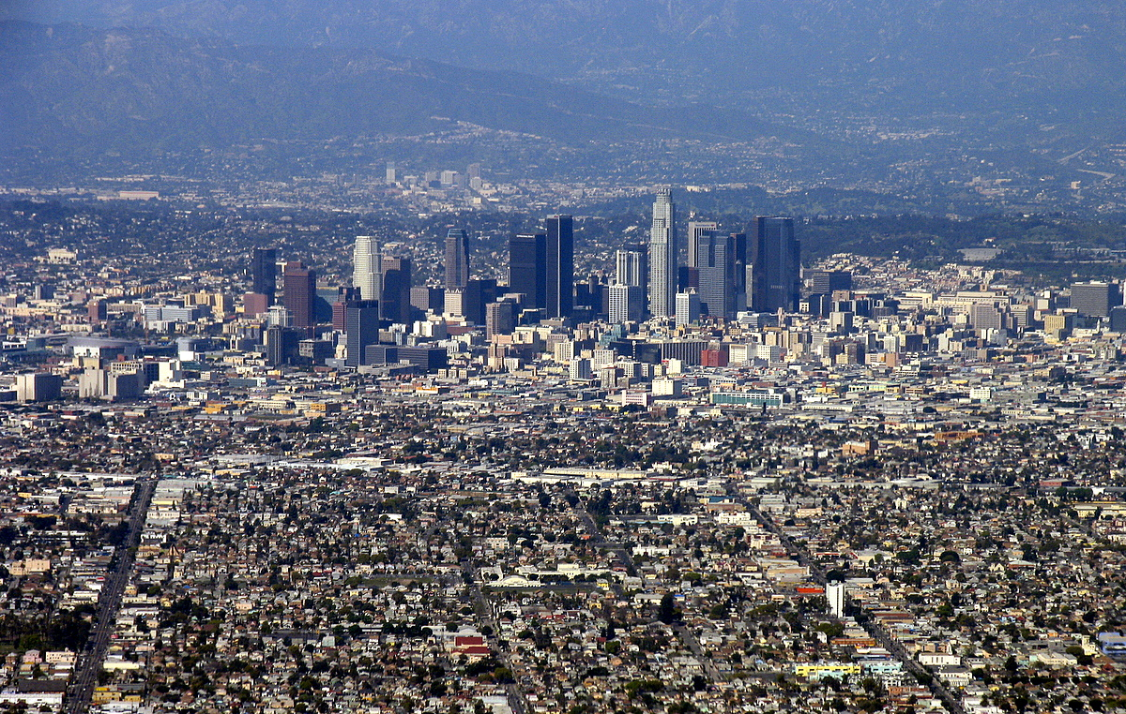

Slide 14
Key moment #1:
Urbanization as detribalization (1920s-1970s)

Slide 15
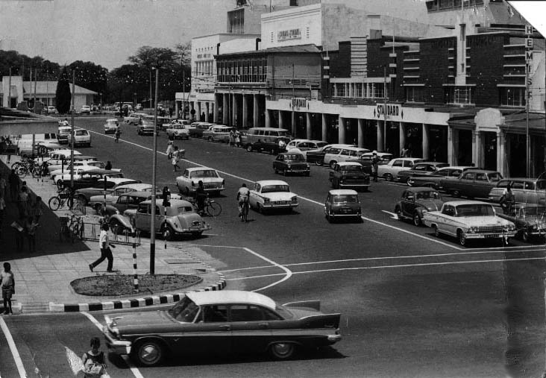
Kitwe, Northern Rhodesia Copperbelt (1955)
Is this the end of culture? Or the beginning?

Slide 16
A culture of the city…
…marked by the proliferation of identities.
“An African townsman is a townsman. An African miner is a miner.”
- Max Gluckman

Slide 17
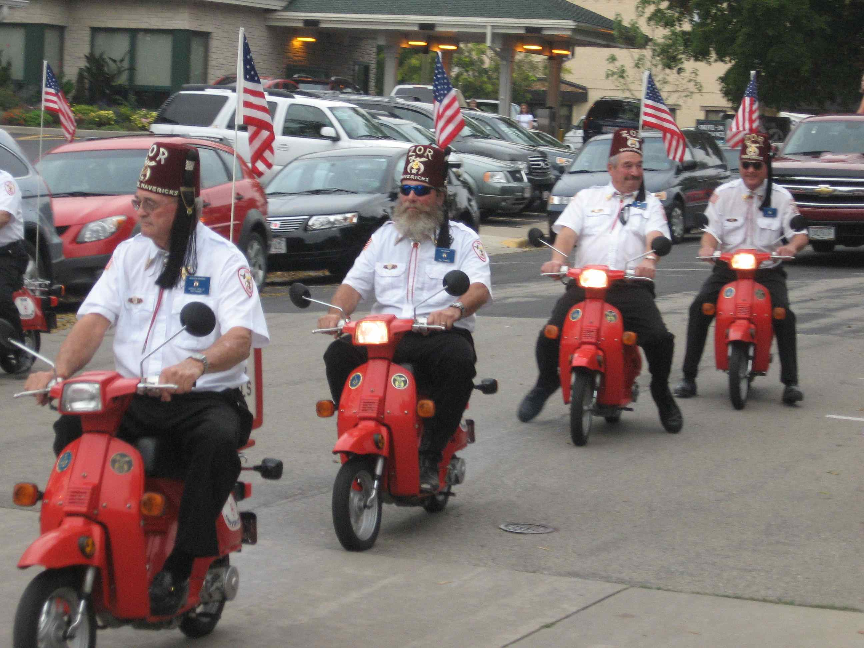
From tribalism…
to voluntary association

Slide 18
Key moment #2:
Oscar Lewis and the culture of poverty

Slide 19
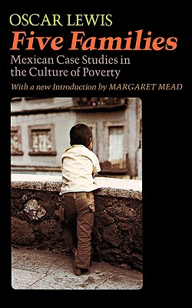
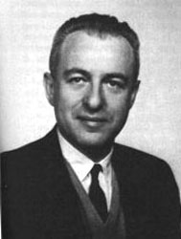
Oscar Lewis
1914-1970
What is the culture of poverty?
Five Families: Mexican Case Studies in the Culture of Poverty (1959)

Slide 20
Poverty is a culture
It is a learned set of behaviors, passed down through generations
The culture of poverty exists (somewhat) independently of economic and other structural forces
"The subculture [of the poor] develops mechanisms that tend to perpetuate it,
especially because of what happens to the world view, aspirations,
and character of the children who grow up in it.”

Slide 21
The culture of poverty legacy…
Urban anthropology’s fixation on the poor as a group / object
“Pop” anthropology (for example, the Moynihan Report)

Slide 22
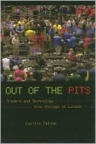
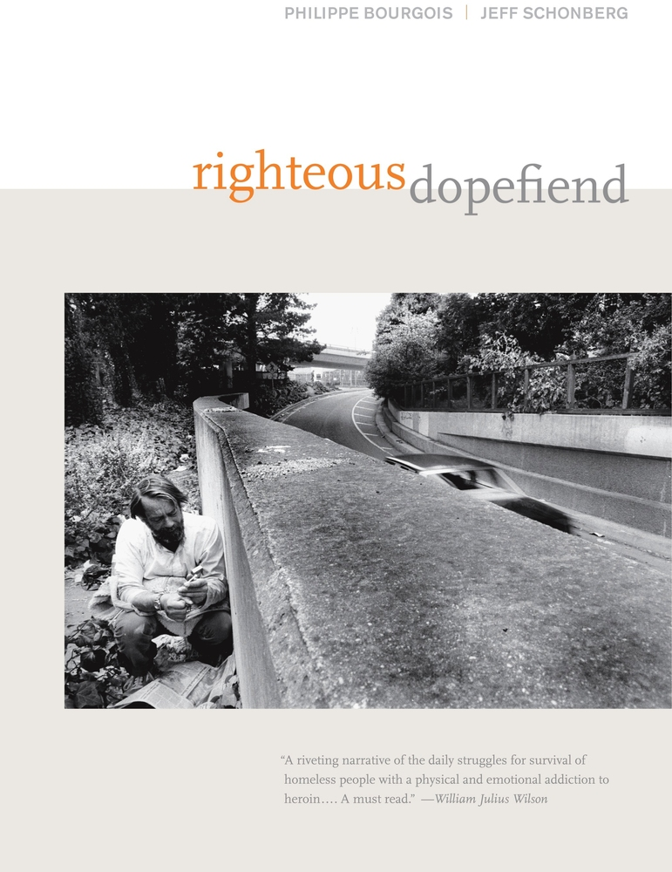

Slide 23
Key moment #3:
The Chicago School

Slide 24
The Chicago School
Beginning in 1920s-1930s
Robert E. Park, Louis Wirth

Slide 25
The Chicago School
Beginning in 1920s-1930s
Robert E. Park, Louis Wirth
Cities experience a natural evolution through developmental stages

Slide 26
The Chicago School
Beginning in 1920s-1930s
Robert E. Park, Louis Wirth
Cities experience a natural evolution through developmental stages
Cities have internal “eco-systems” - slums, commercial centers, wealthy residential neighborhoods

Slide 27
The Chicago School
Beginning in 1920s-1930s
Robert E. Park, Louis Wirth
Cities experience a natural evolution through developmental stages
Cities have internal “eco-systems” - slums, commercial centers, wealthy residential neighborhoods
The city eco-system determines behavior

Slide 28
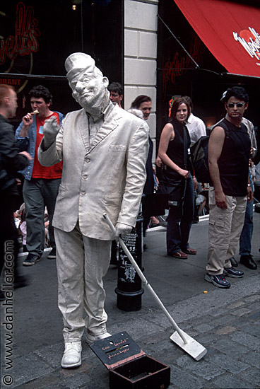
The anthropological response…
The city is a stage and we play multiple roles within it.
(Erving Goffman)
Photo by Dan Heller

Slide 29
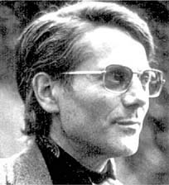
Michel De Certeau
1925-1986
Practice Theory
(structure vs. agency)

Slide 30
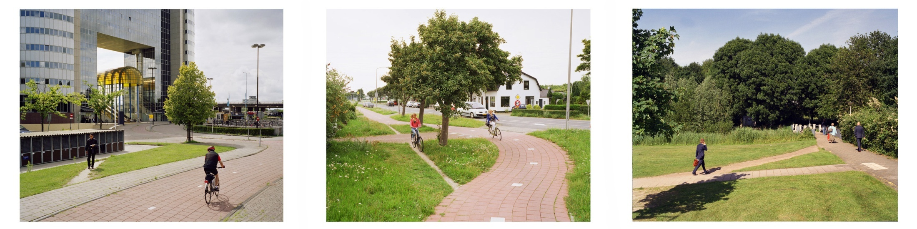
Jan-Dirk van der Burg Olifantenpaadjes /[desire lines]

Slide 31
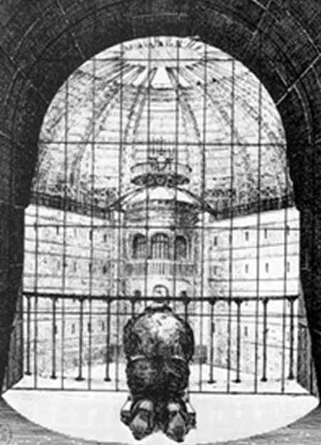
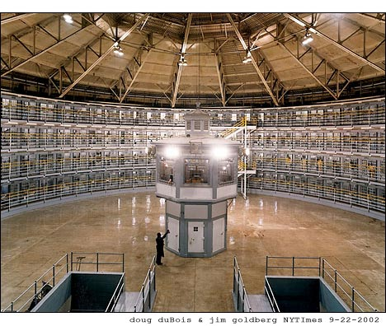

Slide 32
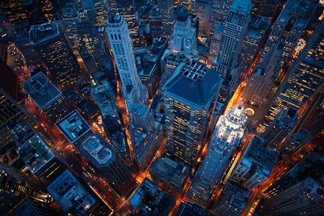
Photo by Cameron Davidson

Slide 33
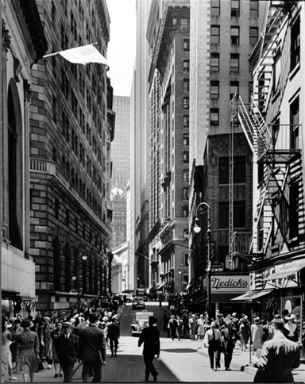
Photo by Andreas Feinenger

Slide 34
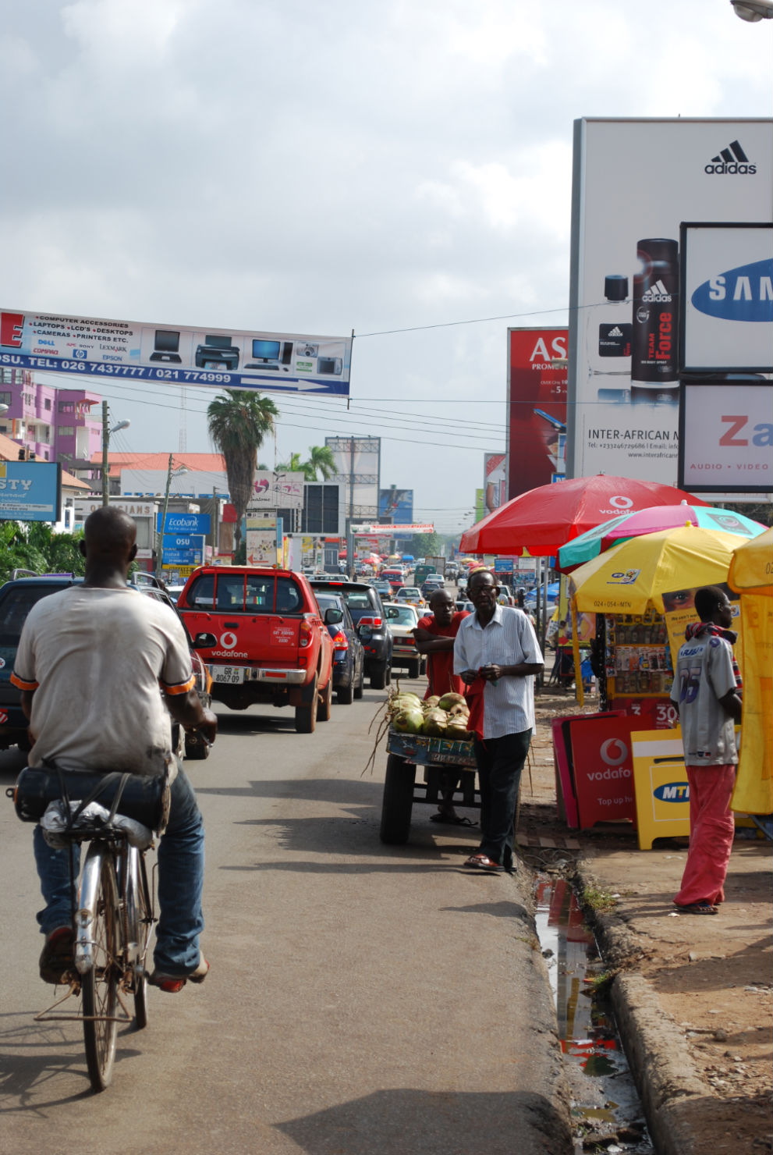
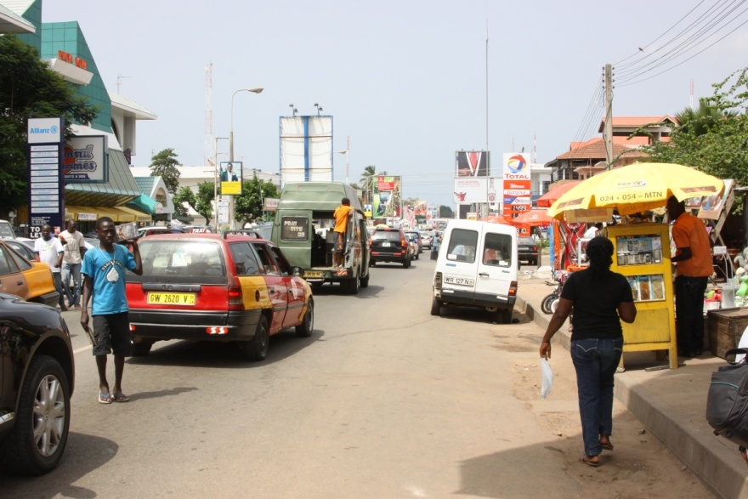
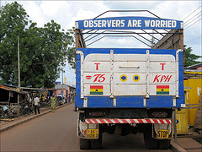
Photo by baloo2303
Photo by Laura Bain
Photo by “Tim”
Oxford Street, Accra

Slide 35
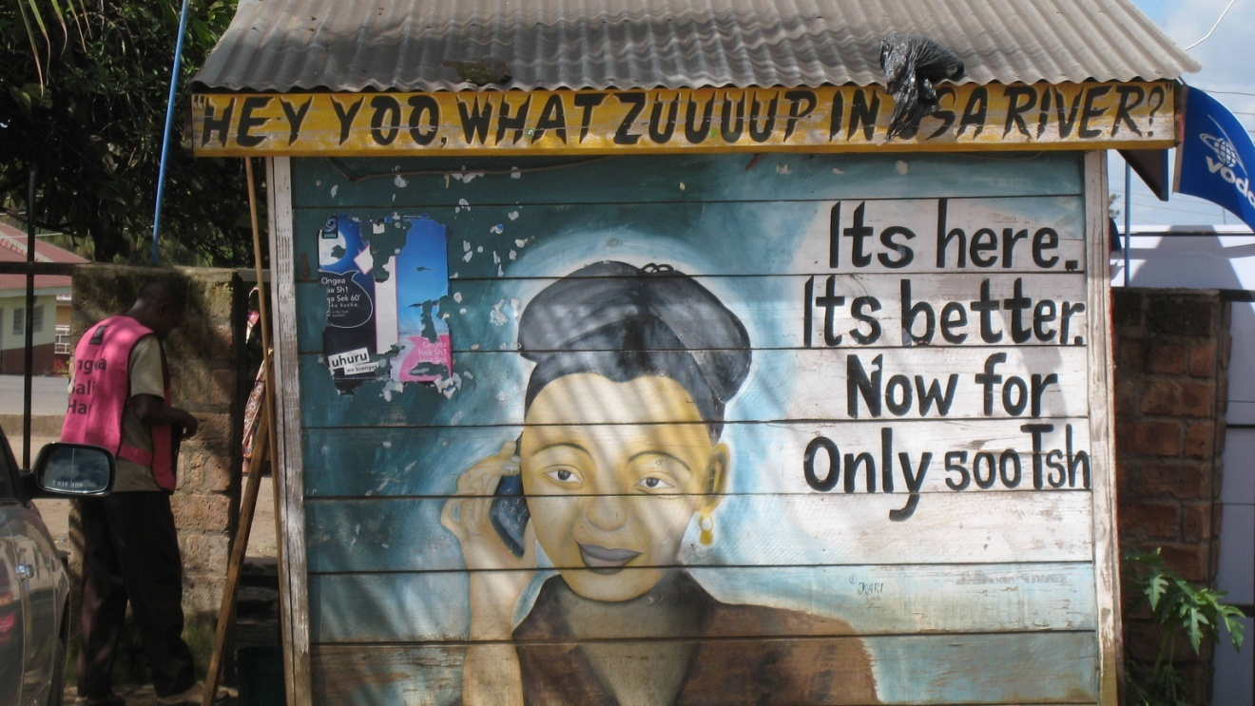
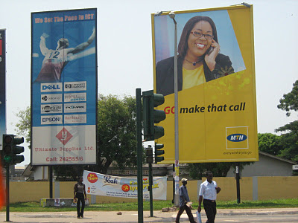
Photo AllAfrica.com, outside Arusha, Tanzania
Photo Accradailyphoto.com

