Slide 1
What do archaeologists know about cities that other scholars don’t?

Slide 2
V. Gordon Childe

Slide 3
Childe’s stages of development
Savagery (hunter/gatherer/forager)
Barbarism (Neolithic revolution, farmer/pastoralist)
Civilization (Urban revolution, complex specialized economies)

Slide 4
Childe’s ten characteristics of the Urban Revolution
Large population and large settlements (cities)
Full-time specialization and advanced division of labor
Agricultural surplus funds government and a differentiated society
Monumental architecture
A ruling class
Writing to record and track surplus
Writing enables predictive sciences (arithmetic, geometry, astronomy, calendars)
Sophisticated art styles
Long-distance trade—import of food, luxury goods
The state—social class, not just kin based

Slide 7
Fertile Crescent chronology
Paleolithic (~40,000 – 12,800 BP) mobile hunter-gatherers
Natufian (12,800-10,500 BP), sedentary hunter-gatherers in large semi-subterranean oval stone structures
Jericho-first settled 11,000 BP, 100 houses, massive walls
…but: Göbekli Tepe-11,600 BP--monumental architecture, no settlement?
(Younger Dryas the “Big Freeze” 12,800 – 11,500)
Neolithic (10,500-6,500 BP), first evidence of farming, villages with rectangular houses
Çatalhöyük-9,000 BP—dense settlement but no monumental architecture
Metal ages (Chalcolithic, Bronze, Iron, etc.; 6,500 - )
Sumerian cities (e.g. Ur), Iraq-6000 BP—first “true” cities with all of Childe’s hallmarks

Slide 8
Göbekli Tepe, Turkey 11,600 BP

Slide 9
Göbekli Tepe

Slide 11
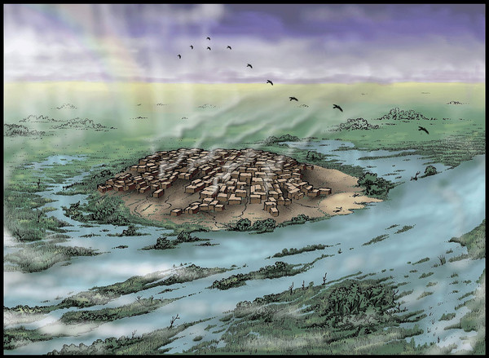
Çatalhöyük, Turkey
9,000 BP

Slide 12
“goddess cult”?

Slide 13
Ur, Iraq 5,000 BP (temple c. 4000 BP)

Slide 14
Other early cities
Indus Valley-5300 BP
China-5000 BP
Egypt-4800 BP
Peru-4600 BP
Mesoamerica-4000 BP

Slide 15
Primal causes?
Farming
Large groups (religion, war, etc.)
Rural depopulation
Trade
Powerful rulers

Slide 16
Monica Smith

Slide 17
Smith’s claims
Ancient and modern cities are similar
Cities can exist without states
Cities are “socially constructed” from the bottom up (neighborhoods)
There is no one “cause” of cities, but many possible push-pull factors

Slide 18
Ancient and modern city similarities (Smith)
1. no real boundary between ‘‘urban edge’’ and hinterland
2. exotic goods from hinterlands are social markers
3. city life attractive to people in the hinterland
4. broad avenues and plazas, architecture that is symbolic of the urban order, and neighborhoods that form around occupational specializations
5. Information exchange is increased, which leads to innovations
6. “consensuality” as inhabitants find they are better off when they exchange goods
7. new identities are open to people in cities vs. hinterlands
8. the countryside is restructured in response to urban needs and demands

Slide 19
John Miksic

Slide 20
Orthogenetic vs heterogenetic cities (Miksic)
orthogenetic | heterogenetic
stability | change
ritual | entrepreneurship
military | trade
inland | port
monumental architecture | dense populations
centers of ecozones | borders of ecozones
production outside city | production inside city
exotic goods | money
Angkor, Oc-Eo | Kota Cina, Singapore, Trowulan
visible archaeologically | hard to see archeologically

