Slide 1
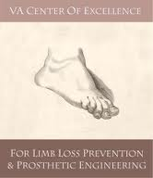
Towards a Biarticular Prosthesis:
Model Development and Sensitivity Analysis of Clutched Spring Parameters
Andrea Willson
University of Washington
VA Center of Excellence for
Limb Loss Prevention &
Prosthetic Engineering

Slide 2
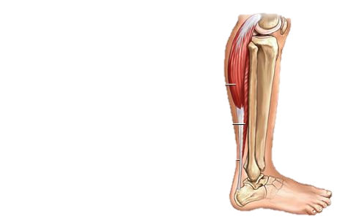
Introduction
Gastrocnemius
Soleus
Gastronemius (GAS): accelerates leg into swing in late stance phase [1]
Soleus (SOL): accelerates trunk forward [1]
Other muscles compensate for lack of biarticular GAS function [2]
SOL
GAS
Neptune RR, et al. J Biomech, 34, 1387-1398, 2001.
Zmitrewicz RJ, et al. J Biomech, 40, 1824-1831, 2007.
Notes:
Passive prostheses only match uniarticular function of the soleus

Slide 3
Overall Research Goals
Develop biarticular clutched spring prosthesis that replicates functional role of GAS
Reduce compensatory muscle forces
Reduce metabolic cost of amputee walking
Use simulation to determine optimal spring parameters

Slide 4
Specific Aims
Develop amputee model for OpenSim
Analyze how variations in spring parameters affect knee and ankle dynamics
Attachment point
Clutch timing
Stiffness

Slide 5
Amputee Model
Residual limb mass properties derived from literature [4,5]
CAD model based on prosthesis measurements used to determine prosthetic mass properties
Pin joint created in same relative position as intact ankle to replicate flexion in prosthesis
4. Silverman AK, Neptune RR. J Biomech, 45, 2271-2278, 2012.
5. Smith JD, et al. J Vis Exp, 87, 2014.

Slide 6
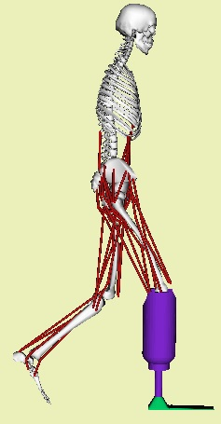
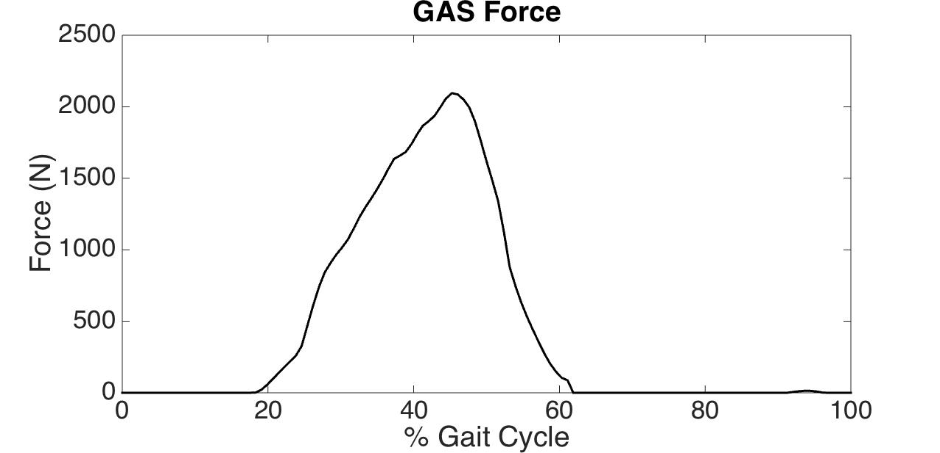
Methods
Use Static Optimization with amputee model and passive biarticular spring element
Choose baseline spring parameter values based on physiological GAS
Proximal Attachment point
Clutch timing
Stiffness
Vary each parameter individually to assess changes in:
Biarticular spring force
Biarticular spring contribution to knee, ankle moment
Clutch engaged

Slide 7
Baseline Trial
Spring matched to physiological GAS parameters:
Stiffness of 100 N/mm [6]
Clutch timing = GAS length @20% gait cycle
Proximal and Distal attachment points match GAS
6. Krishnaswamy P, et al. PLoS Comput Biol, 7 (3), 2011.

Slide 8
Results: Varied Proximal Attachment Point
Notes:
RL and stiffness are both directly related to force production, while MR can alter the joint moment contribution without requiring an increase in force.

Slide 9
Results: Varied Clutch Timing

Slide 10
Results: Varied Spring Stiffness

Slide 11
Discussion
Knee moment arm
Knee moment Ankle moment
Clutch engagement time
Knee moment Ankle Moment
Spring stiffness
Knee moment Ankle Moment

Slide 12
Implications for Device Design
Joint moment contributions are very sensitive to changes in attachment point
Larger moment arm at knee will allow for the spring stiffness to be greatly reduced
Soft tissue compliance at proximal attachment

Slide 13
Acknowledgments
Contributors:
Routson, Rebecca 1,3
Steele, Kat 1
Czerniecki, Joseph 2,3
Morgenroth, David 2,3
Aubin, Patrick 1,3
1. University of Washington
Department of Mechanical Engineering
2. University of Washington
Department of Rehabilitation Medicine
3. Department of Veterans Affairs
RR&D Center of Excellence, Seattle, WA USA

