Slide 1
A Look at the Plasticity of Tactile Perception
Maddie Graham

Slide 2
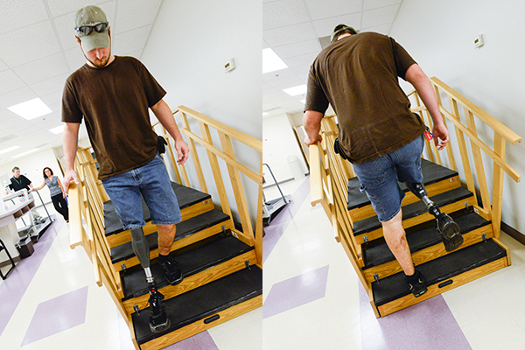
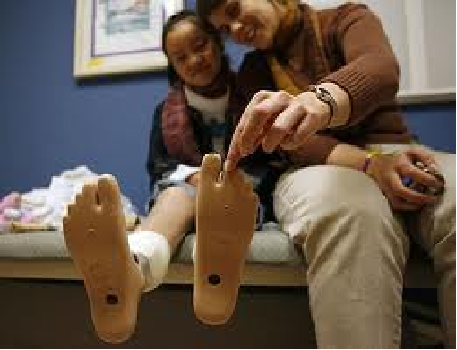
motivation
Amputees: loss of sensory capabilities
walking up and down stairs
feeling the sensation of touch
http://hscweb3.hsc.usf.edu/blog/2012/09/07/usfs-advanced-prosthetics-research-benefits-combat-wounded-veterans/
http://prashantborde123.blogspot.com/2013_02_01_archive.html
Notes:
Here is your note

Slide 3
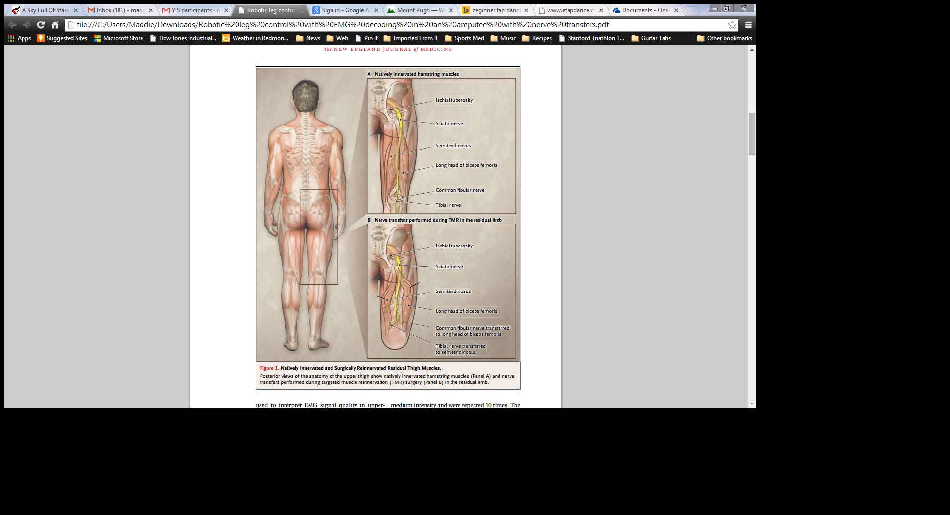
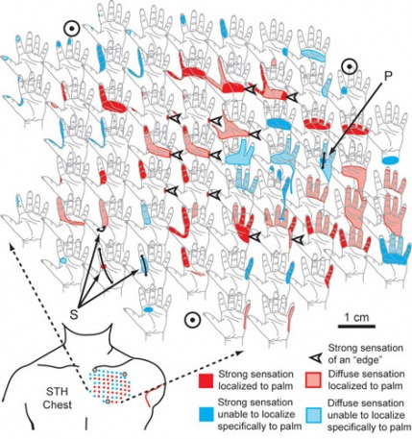
Targeted Reinnervation (TR) Surgery
Restores sensation
Potential for improved prosthetics with sensory feedback
Hargrove, Levi J. et al. The New England Journal of Medicine 1237-42, 2013.
http://humanrobotinterface.weebly.com/providing-feedback.html

Slide 4
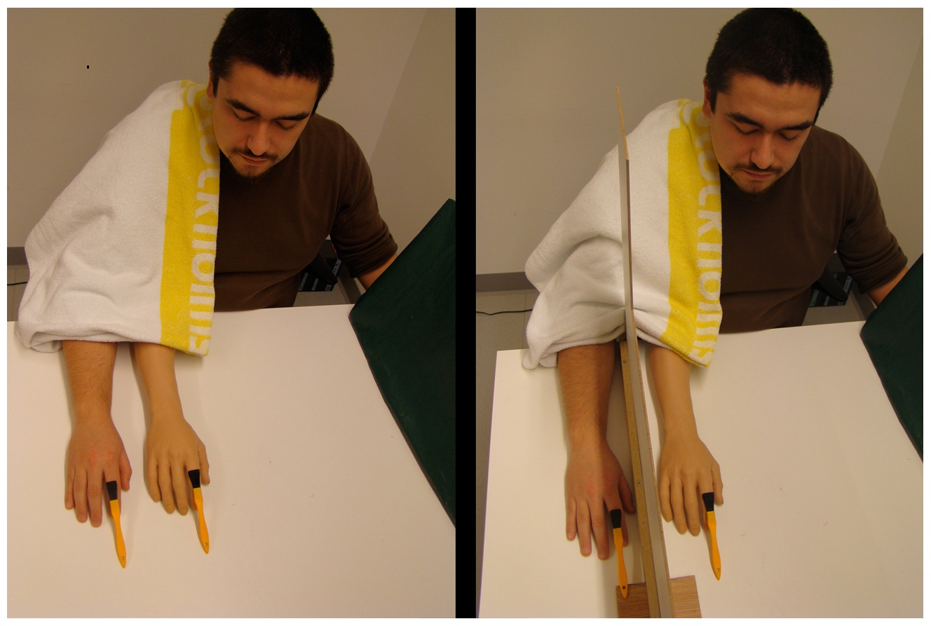
Sensory Perception
Plastic – adapts to environment and experiences
Rubber hand illusion
http://www.kurzweilai.net/images/Supernumerary_hand_illusion1.jpg

Slide 5
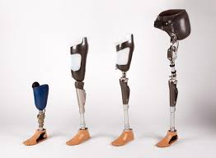
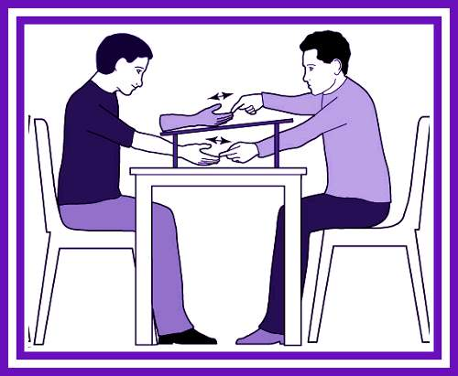
IN Summary
http://www.ottobock.in/fitting-options-for-leg-amputees.asp
http://briandavidphillips.net/wp-content/uploads/2011/11/handillusion.jpg

Slide 6
hypothesis
Using a tactile-visual discrepancy test on subjects, we hope to find that tactile perception is constantly adapting to one’s environment.

Slide 7
Proposed Experiment
1
2
3
4
5
6
7
8
9
10
Methods:
  Initial assessment, Intervention, Final assessment
Initial Assessment

Slide 8
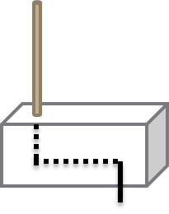
Intervention
1
2
3
4
5
6
7
8
9
10
Subjects will be deceived into believing the touch they feel originates from elsewhere

Slide 9
Final assessment
Goal: To guide someone’s sense of self
Repeat the initial assessment and compare the results
How much was the subject’s perception biased?

Slide 10
results
Distal shift: shows that the person made a new body schema map of their leg
Significance: someone can adapt to new sensory information

Slide 11

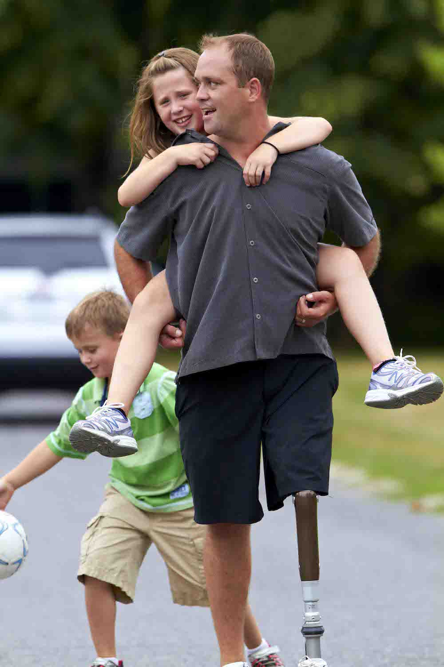
Conclusion
If sensations in the lower limb are plastic:
the brain can be trained
sensory feedback prosthesis may be more commercially available
http://prosindiana.com/prosthetics/lower-extremity/
http://www.ledbrookclinic.co.uk/wp-content/uploads/2014/03/prosthetic-leg.jpeg

