Slide 1
Weirs
Generally, any flow obstruction that causes water to rise to flow over it, but used exclusively for intentional obstructions
Uses include flow measurement (sharp-crested weirs) and control of water surface profile, e.g., by inducing super-critical flow (broad-crested weirs)

Slide 2
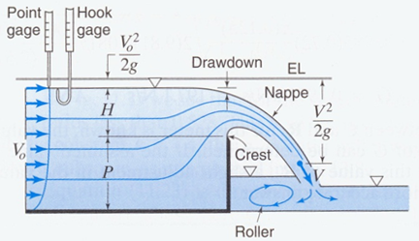
Definition Diagram and Analysis of Sharp-Crested Weirs
Drawdown at crest is typically ~0.15 H

Slide 3
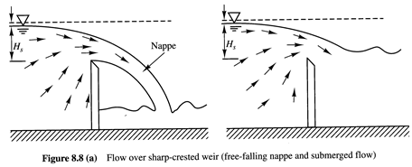
Nappe entrains air underneath it and can collapse onto the downstream side of the weir; following analysis assumes that this does not occur (can ventilate this area to assure an air space)

Slide 4
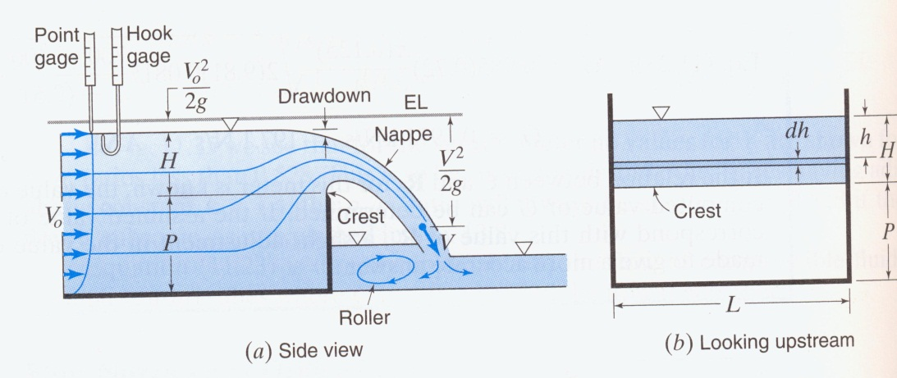
Consider thin layer dh in plane of weir in a rectangular channel. Assuming V²>>V_{o}² and negligible frictional headloss, V=(2gh)^{0.5}, so (replacing L by b):
where H_{C} is the distance from the crest of the weir to the water surface at that location.

Slide 5
Measurements of the water surface elevation above the weir crest are typically made upstream of the weir, where the water surface has not been significantly affected, and this value of H is used instead of H_{C} in the calculation. To account for this and other approximations, an empirical coefficient is added to the equation:
C_{w} can be approximated by 0.611+0.075(H/P_{w}) and is typically in the range 0.64-0.70.

Slide 6
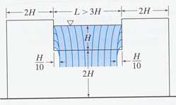
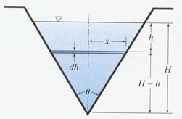
Other Common Shapes for Sharp-Crested Weirs
Contracted weir
V-notch or Triangular weir
Weir can totally block part of the channel width, in which case the channel is contracted.
V-notch weir useful if low flows are of interest, since they could cling to the plate of a rectangular weir. For V-notch weirs:
C_{w,V-notch} typically ~0.6

Slide 7
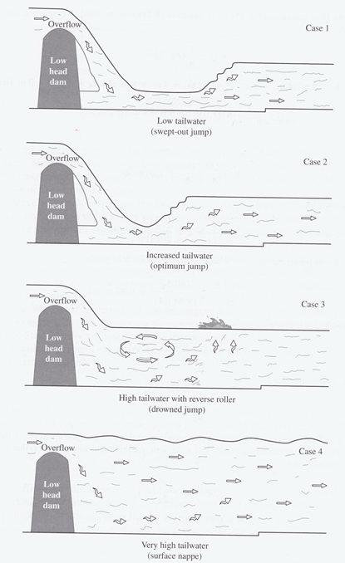
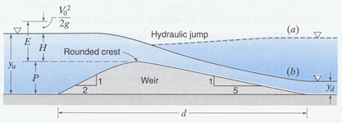
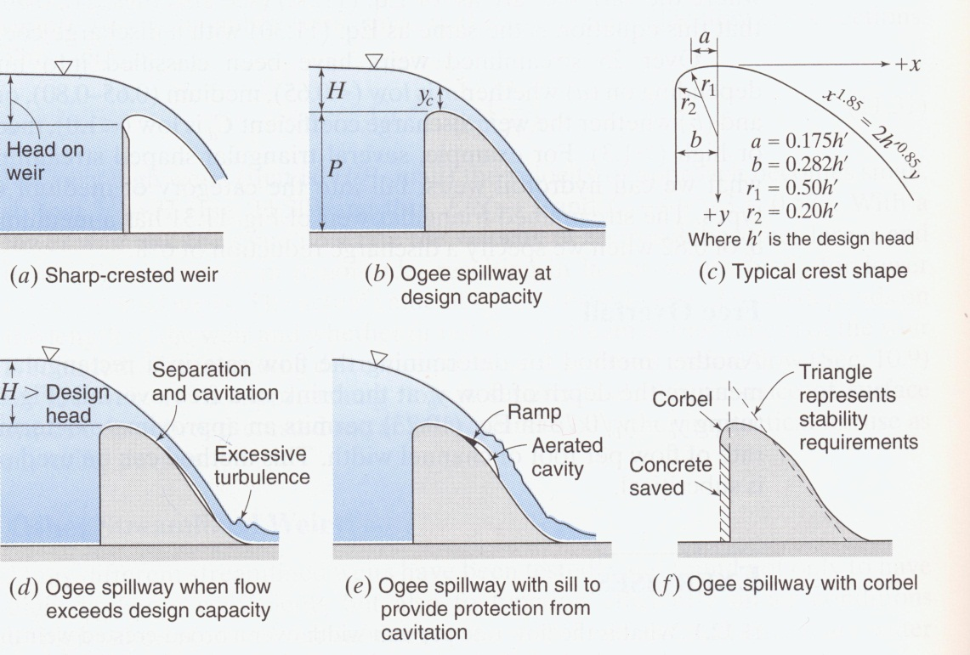
Streamlined or Broad-Crested Weirs

Slide 8
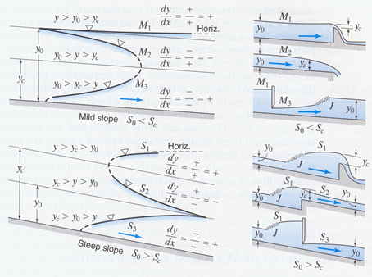
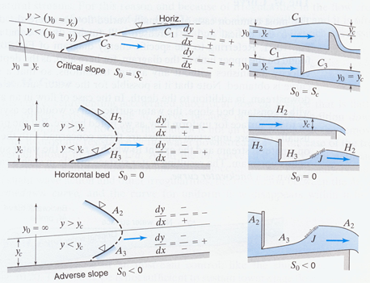
Water Profiles (CEE 477)

