Slide 1
Example: Uniform Flow at Known Q and y
Water flows in a rectangular 6-ft-wide timber flume with n=0.013. What channel slope is needed to convey water uniformly at 20 ft/s when the depth is 3 ft?

Slide 2
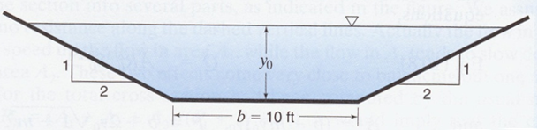
Example: Channel Characteristics and Uniform Depth
A channel has bed slope of 0.0006 and n=0.016. Find and plot Q vs. y, considering depths of 2, 4, 6, and 8 ft.

Slide 3
Example: Uniform Flow at Different Depths
y₀ (ft) | A (ft²) | P_{wetted} (ft) | R_{h} (ft) | R_{h}^{2/3} | Q (ft³/s) | V (ft/s)
2 | 28 | 18.9 | 1.48 | 1.30 | 83 | 2.96
4 | 72 | 27.9 | 2.58 | 1.88 | 308 | 4.28
6 | 132 | 36.8 | 3.58 | 2.34 | 703 | 5.33
8 | 208 | 45.8 | 4.54 | 2.74 | 1298 | 6.24

Slide 5
Wide and Shallow Flow
If depth for a given flow rate is sought, T&E solution required.
However, if channel is very wide compared to its depth, we can assume friction due to vertical components of bed is negligible. In that case, R_{h} is independent of y₀ , and y₀ can be found directly:

Slide 6
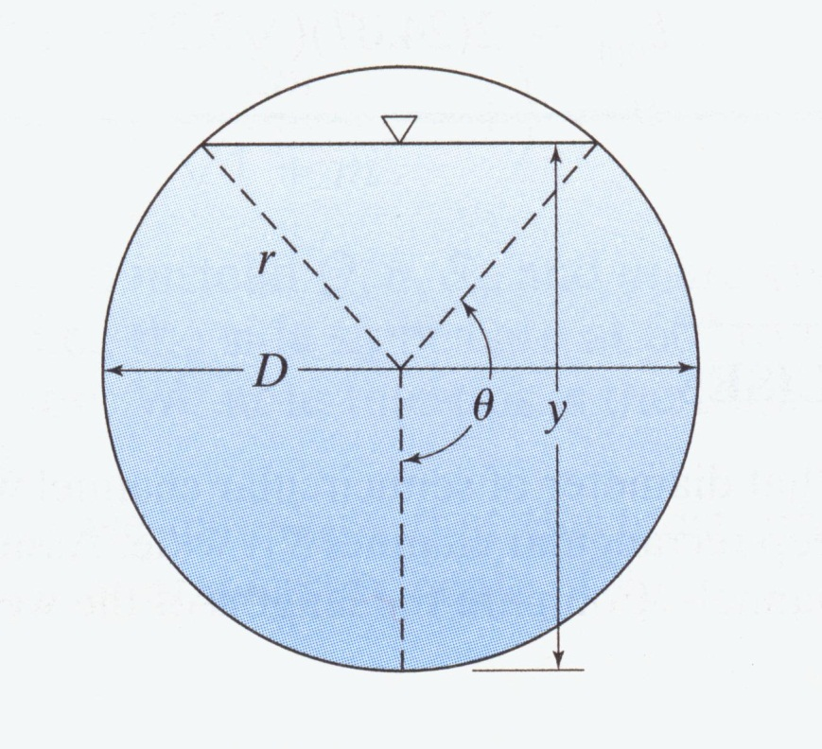
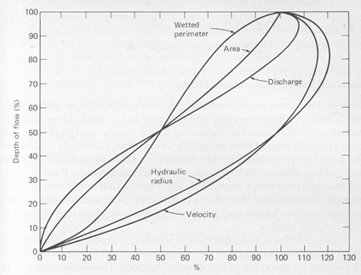
Hydraulic Sections of a Circle

Slide 7
Example
A 6-ft diameter concrete pipe is laid on a slope of 0.001 and has uniform flow at a depth of 4 ft. What is the discharge?
Approach #1
Solve for θ:
Solve for R_{h}:
Solve for A:
Solve for Q:

Slide 8
Approach #2
Solve for Q_{full}:
When depth of flow is 67%, Q/Q_{full} is ~78%.

Slide 9
Example
What depth of flow would develop if the flow rate in the preceding example increased to 120 ft³/s?
Approach #1
Solve for θ by T&E or Solver, then substitute into:

Slide 10
Approach #2
Compute Q/Q_{full}:
When Q/Q_{full} is 90%, y/y_{full} is ~75%.

Slide 11
Best Hydraulic (Cross-)Section
For a given slope and roughness, velocity is maximized by maximizing R_{h}. Equivalently, for a given slope, roughness, and cross-section, Q is maximized by minimizing P_{wetted}.
The channel shape that yields this condition is called the best hydraulic cross-section or the most efficient cross-section.
Absent other factors, the most efficient cross-section would be preferred, although:
Shallower designs are often preferred to reduce excavation costs
Straight sides are usually easier (cheaper) to construct than curves
High right-of-way costs favor deeper and narrower designs

Slide 12
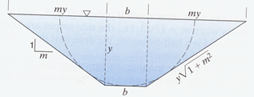
From geometry, the shape with the largest R_{h} is a circle or half-circle. That shape is practical for channels made of metals, but not other materials.
Typically, wooden flumes are rectangular, and excavated canals are trapezoidal. For such a trapezoidal channel:

Slide 13
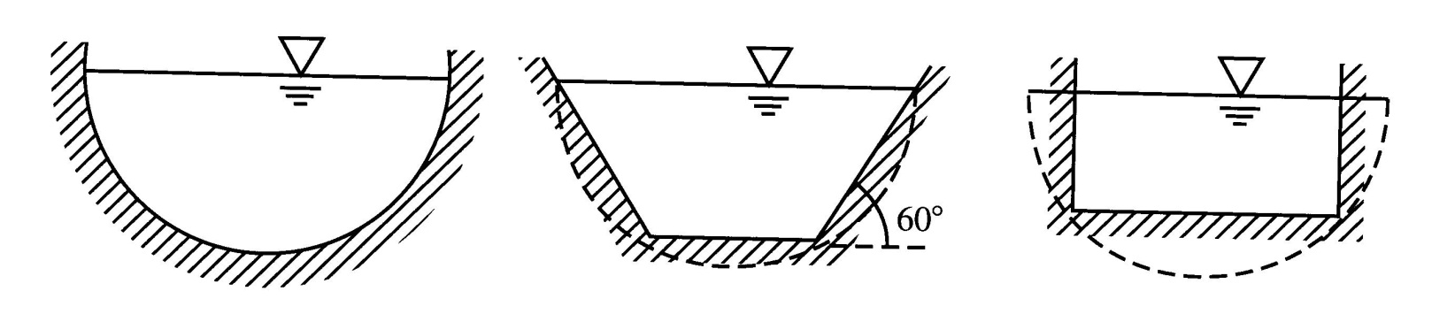
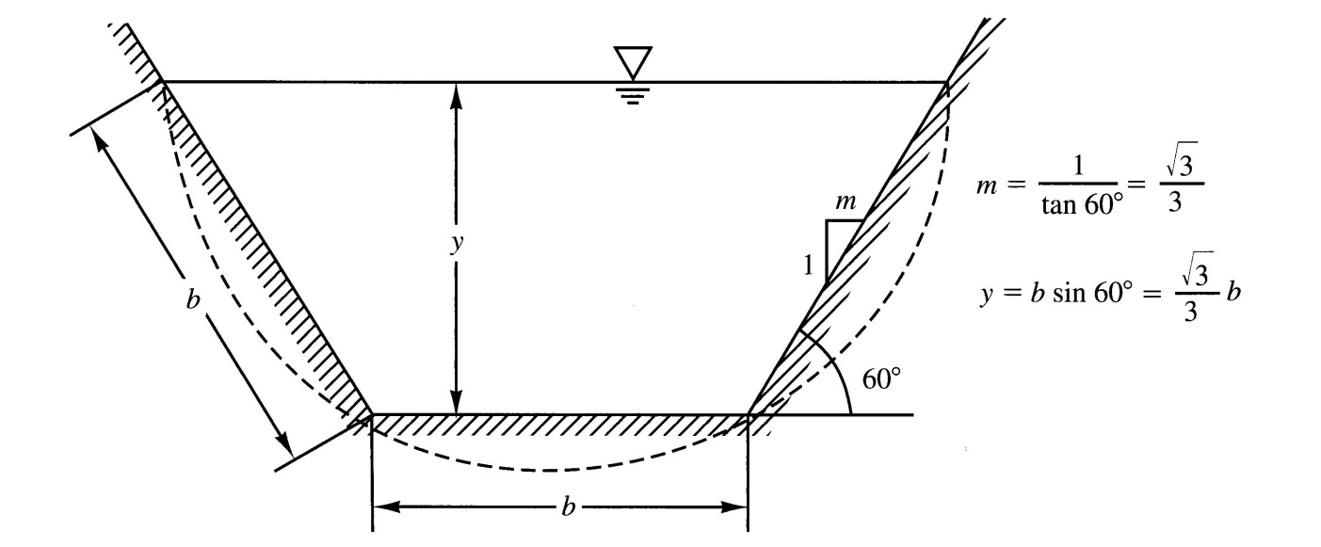
Differentiate with respect to y or m to find optimum dimensional ratios.
For a given general shape, optimal ratios turn out to cause the channel to be circumscribed by a semi-circle:
For the common case of a trapezoidal channel, optimum slope is 60º:

Slide 14
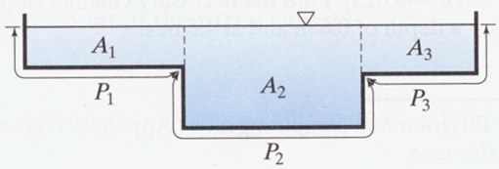
Flow in Channels with Non-Uniform Roughness
Treat as a group of independent open channels in parallel, with different y and R_{h} and n, but same S_{o}. Assume no resistance across imaginary water-water boundaries.

Slide 15
Example: Non-Uniform Roughness
w
d
a
b
For modeling purposes, a natural channel is being simulated using the cross-section shown above, with gravel on the main stream bed (n=0.025) and grass on the side slope (n=0.035). The bed slope is 0.006, and the dimensions shown are: a = 1m; b = 3m; d = 2m; w = 8m.
A hydrology model suggests that the 50-year storm could generate a flow of 20 m³/s. Under those conditions, is the stream likely to overflow the banks? If not, how deep will the flow be?

Slide 16
Assuming the flow is high enough to overflow at least the rectangular portion of the channel, we can model it as passing through two open-channel systems in parallel.
For the left-hand channel, A_{flow} = by, and P_{wetted} = a + b + y. When the channel is full, A_{flow} = bd = 6 m², and P_{wetted} = a + b + d = 6 m.
For the right-hand channel, the side slope is the hypotenuse of a right triangle, with the other sides having lengths of 1m (vertically) and 5m (horizontally), so its full length is 5.10 m. This length is the wetted perimeter of the right-hand channel when it is full; the corresponding cross-sectional area is 0.5(d − a)(w − b), or 2.5 m².
Thus, designating the left- and right-hand channels as L and R:

Slide 17
The flow in the whole channel when it flows full is therefore:
The units are SI, so the flow when the channel is full is 22.0 m³/s, and the 50-year storm is not expected to cause flooding.

Slide 18
As noted, when the channel is not full, the flow area and wetted perimeter of the left-hand channel are: A_{flow} = by and P_{wetted} = a + b + y.
The lengths of all three sides of the right triangle characterizing the flow area of the right-hand channel are smaller than when the channel if full by a factor equal to (y − a)/(d − a) = (y − 1)/1 = y − 1. Thus:

Slide 19
Solving by T&E or Solver for y, we find y = 1.75 m.

Slide 20
Gradually Varied Flow
If flow conditions change gradually, the Manning equation is commonly used to represent the V-y-S_{f} relationship over stretches where V and y do not change dramatically, using their average values to compute S_{f} and h_{L}.
Previously, we applied the energy equation for uniform flow between two points on the water surface of an open channel. Defining z as the elevation of the channel bottom, we found:

Slide 21
For a short reach of length Δl with gradually varying flow, we can write:
where the overbar indicates an average value over Δl. Estimating the average friction slope by using the Manning equation with average values of V and R_{h}, we obtain and expression for the flow distance required for a given change in E:
Include 1.49 only if using BG units.

Slide 22
Example. A smooth (n=0.012) rectangular channel with b = 6 ft and S_{o}=0.002 supports a steady flow of 160 ft³/s. At one point in the channel, the depth is 3.20 ft. Estimate the water depth for the reach extending to 600 ft downstream.
Solution. We can set up a spreadsheet, considering small increments in y and using the preceding equation to solve for the distance Δl required for that Δy to occur.
y (ft) | V (ft/s) | P | A | R_{h} | E | ΔE | V_{avg} | R_{h,avg} | S_{f,avg} | ΔL | L
3.20 | 8.332 | 12.40 | 19.20 | 1.548 | 4.278 |  |  |  |  |  | 0
3.22 | 8.282 | 12.44 | 19.32 | 1.553 | 4.285 | 0.00689 | 8.256 | 1.555 | 0.00245 | 13.46 | 13.46
3.24 | 8.230 | 12.48 | 19.44 | 1.558 | 4.292 | 0.00713 | 8.205 | 1.560 | 0.00241 | 15.21 | 28.67
3.44 | 7.752 | 12.88 | 20.64 | 1.602 | 4.373 | 0.00924 | 7.730 | 1.605 | 0.002063 | 95.91 | 444.46
3.46 | 7.707 | 12.92 | 20.76 | 1.607 | 4.382 | 0.00943 | 7.685 | 1.609 | 0.002032 | 147.35 | 591.81

Slide 24
Why does the water depth change so slowly downstream? What depth will the stream ultimately reach if the shape and slope of the channel remain constant?
Under uniform flow conditions:

