Slide 1
For a given q:
any y can exist, and each y is linked to a specific V and E.
any V can exist, and each V is linked to a specific y and E.
E must be greater than some minimum value, and if it is, each value can exist at two possible y’s and corresponding V’s. (Note: in uniform flow, y is constant, so E is constant. However, constancy of E does not assure uniform flow.

Slide 2
Review – Equations used thus far:
No mention of slope, roughness, hydraulic radius, etc.; i.e., nothing about channel itself.
To incorporate information about the channel, need to consider energy equation and its relation to E.

Slide 3
Energy equation between two locations separated by distance L in an open channel with steady flow:
The change in specific energy between two locations equals the decline in elevation of the channel bottom minus the headloss. Thus, in uniform flow, E is constant because the increase in E due to elevation drop is exactly balanced by the decrease in E due to friction.

Slide 4
What happens as water moves under conditions of non-uniform flow?
Specific energy can increase or decrease, depending on relative magnitudes of Δz and h_{L}.
In a system with steady flow, the flow regime remains on the same E vs. y curve (constant q_{avg}); a decrease in E leads to lower y and higher V for sub-critical flow, and the reverse for super-critical flow.
If E declines below E_{min} for the given q, the flow rate leaving that location drops below q, and water backs up (‘damming’).

Slide 5


Example. What happens when water flowing sub-critically in an open channel encounters a step change in the channel bottom elevation?

Slide 6

Example. What happens if the step change gets bigger?
(1)
(2)
(3)
(4)
Upstream
Over Hump
Downstream
(4)
(0,1,2)
(0,1,2,3)
(0)
(2)
(1)
(4)
(3)

Slide 7
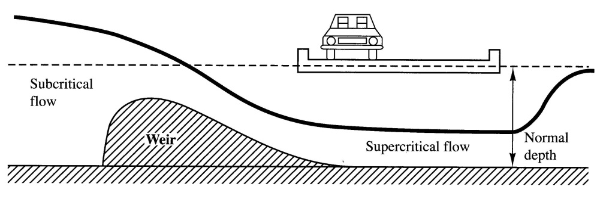

Slide 8
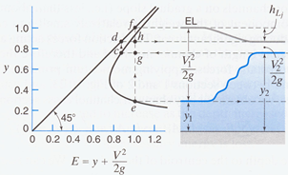
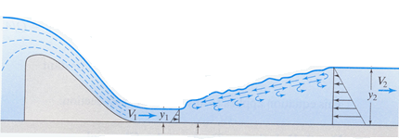
Modeling Hydraulic Jumps
What happens to y, V, Fr, and E across a hydraulic jump?
y _Increases________
V _Decreases________
Fr _Decreases from >1 to <1
E _Decreases________

Slide 9
Typically:
How do we analyze acceleration/ deceleration in fluids?
Assuming that wall friction and gravitational forces are negligible compared to pressure forces over the distance of interest:
For rectangular channels, substitute

Slide 10
For a given y₁, this eqn is cubic in y₂. But, one root is negative, and the constraint that y₂ >y_{c} allows us to choose between the other two and solve the equation as a quadratic.

Slide 11
For rectangular channels:

Slide 12
Example. A hydraulic jump occurs in a 5-m-wide rectangular channel carrying 8 m³/s. The depth after the jump is 1.75 m.
What is the depth before the jump?
What are the losses of head and power across the jump?

Slide 13
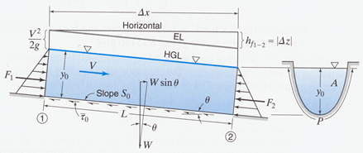
Consider uniform flow with a CV in the shape of a rectangular box.
Pressure forces upstream and downstream are equal and opposite, so only forces on the water are gravity and friction. Since water is not accelerating, these forces must also be equal and opposite.
Pressure head and velocity head are constant over l, so loss of total head (h_{L}) equals loss of gravitational head (Δz). Correspondingly, S_{o}= S_{w}= S_{f}.

Slide 14
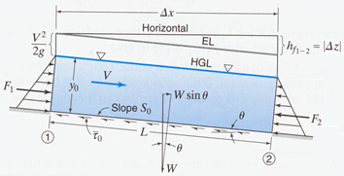
Gravitational force in direction of flow is Wsinθ; opposing frictional force is τ_{o}P_{wetted}l, where τ_{o} is shear stress on the bottom, and P_{wetted} is the wetted perimeter. So:
τ_{o} is important for predicting scour of sediments, settled solids (e.g., in runoff or sanitary sewers), fish eggs, etc., from bottoms of open channels.

Slide 15
By analogy with pipe flow, assume that h_{L}/l in open channels can be expressed as (f/D*)(V²/2g), where D* is a representative length; choose D* to be 4R_{h}. Then, for uniform flow:
Above equation is known as the Chezy equation (1768), and C as the Chezy coefficient. Equation is analogous to D-W eqn for pipe flow, with prediction of C the key to its usefulness.

Slide 16
Based on empirical results, Manning reported that C varies with R_{h}^{1/6}, so:
Equation for V is the Manning Eqn (1890) , and n is the Manning coefficient. Increase in n corresponds to increased friction and h_{L}. Values tabulated for a wide range of channel characteristics. Formally applicable only to uniform flow (where V and R_{h} are constant), but often applied to gradually varying flow to relate average values of S_{f} , V, and R_{h} in a reach.
n has units of s/m^{1/3}, but is always reported as dimensionless. Using that convention, if R_{h} is in ft instead of m, coefficient becomes 1.49.
For a given channel shape (i.e., cross-section), R_{h} depends only on y, so a given y leads to one and only one value of V (or Q). This value of y is known as the uniform depth or normal depth for the specified V or Q.

Slide 17
