Slide 1
Overview of Open Channel Flow
Definition: Any flow with a free surface at atmospheric pressure
Driven entirely by gravity
Cross-section can vary with location and time, and is often irregular
Examples
  Rivers, streams, natural channels
  Storm runoff, flood waves, tides, tsunamis
  Canals, culverts, aqueducts, other constructed channels
  Sewers for stormwater and sanitary wastes
  Weirs, gates, and other flow-measuring or flow-control devices

Slide 2
Velocity Profiles in Open Channels vs. Pipe Flow
Pipe flow:
Laminar Turbulent
Open channel flow:
Laminar Turbulent

Slide 3



<2,100 4,000~50,000 >~50,000
Laminar Turbulent Turbulent
(Transitional) (Fully)
<500 1,000~12,500 >~12,500

Slide 4
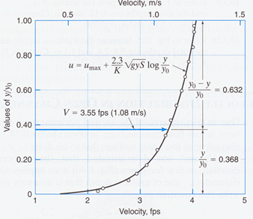
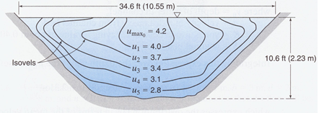

Slide 5
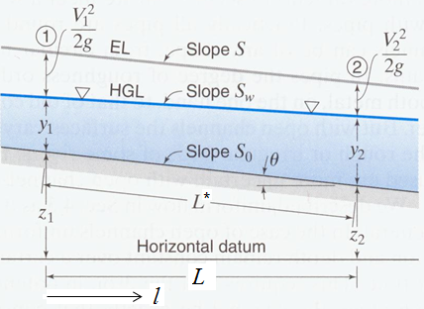
System Description and Definition of Key Parameters
l* is length in direction of flow, l is horizontal distance, z is distance in vertical direction from datum, y is vertical distance from bottom of channel, and θ is angle that channel bottom makes with the horizontal.
HGL is always at water surface; designate slope of water surface as S_{w}.
EL is above HGL (i.e., water surface) by V²/2g. Slope of EL often referred to as the friction slope, S_{f}, or the energy slope, S_{e}.

Slide 6
Bottom slope, S_{o}, equals sin θ and is typically very small (~0.000118 on average for Mississippi R. from headwaters to mouth).
Because θ is so small, l and y are typically assumed to equal length along flow path and distance perpendicular to bottom, and sin θ is approximately equal to tan θ; those assumptions are made here. In this case, S_{f} = h_{L}/l.
A length of channel under consideration, typically assumed to have constant θ, is called a reach.

Slide 7
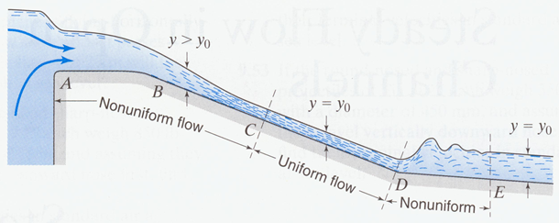
Steady flow refers to a flow pattern (y vs. l) that is constant over time; might or might not be constant over distance. We consider only steady flow here.
Steady flow can be uniform, gradually varying, or rapidly varying, which refer to the flow patterns over distance. In uniform flow, y is constant, so by continuity V is constant, and therefore S_{w}=S_{f}.
Along a cross-section perpendicular to streamlines (i.e., to channel bottom), pressure profile is hydrostatic, meaning z+(p/γ) is constant. Strictly true only for parallel streamlines, but approximately true in gradually varying flow also.

Slide 8
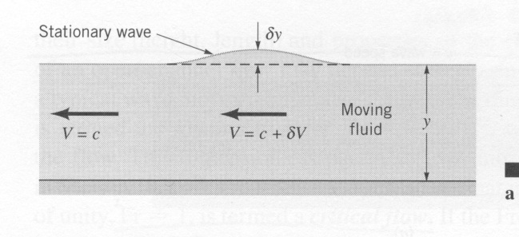
Characteristics of Surface Waves
Consider a shallow, stationary wave, generated by movement of bulk water downstream at the wave velocity c, as the wave moves upstream. System can be envisioned as the small ‘hump’ of water sliding upstream over the block of water flowing below it, generating a steady-flow scenario.

Slide 9
For frictionless flow, Bernoulli eqn. and continuity yield:
Differentiating both:

Slide 10
For a more general situation where the wave is not stationary, its net velocity relative to a stationary observer is c−V. If V<c, the net motion is in the direction of the wave, and if V>c, it is in the direction of the bulk flow. The ratio V/c is the Froude number, Fr, so for a surface wave:
If Fr<1, a wave propagates both upstream and downstream from its source and is ‘in hydraulic communication’ with upstream locations, and the flow is sub-critical. If Fr>1, the wave does not propagate upstream, and the flow is super-critical. If Fr=1, the flow is critical. The status of the flow in this regard has major implications for its behavior.

Slide 11
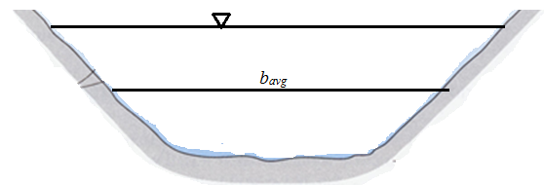
Characterizing Fluid Energy in Open Channel Flow
Consider steady flow in a channel with fixed cross-sectional shape. If the average depth at a location is b_{avg}, by continuity:
In a given channel, a specific b_{avg} is associated with any given y. Thus, steady flow can be maintained with any y, including y’s that change with location, as long as V = Q/(yb_{avg}) at every location.

Slide 12
For simplicity, consider a rectangular channel of fixed width b. For steady flow:

Slide 13
Previous plot fully describes V vs. y, but it is sometimes convenient to show the same info in other ways. For instance, we could compare contributions of depth and velocity directly by expressing both in terms of head.

Slide 14
For certain analyses, it is useful to define the specific energy, E, equal to y + V²/2g. E is actually head (not energy), and can be thought of as the energy of the water per unit weight, above and beyond that provided automatically by the terrain.
For water in a rectangular channel:
For a given q, E depends only on y. At low y, E is proportional to 1/y², and at high y, E approaches y. Thus, E becomes large at low and high y, and passes through a minimum at intermediate y.

Slide 16
The minimum value of E for a given q can be found by setting dE/dy = 0. The results are:
At E_{min}:
Thus, at the critical condition (E_{min}), Fr = 1.0. If Fr is <1.0 or >1.0, conditions are sub-critical and super-critical, respectively.

Slide 18
