Slide 1
Example. For pump characterized on previous slide, is cavitation a concern if a flow of 3500 gpm of 80ºF water is required, and the pump suction is 12 ft above the source reservoir? Headloss in the inlet pipe is given by h_{L}≈6x10⁻⁷Q², with h_{L} in ft and Q in gpm.

Slide 2
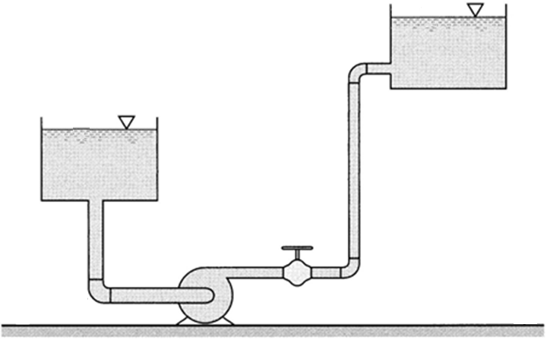
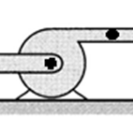
Pump curve describes how much head the pump will provide at a given Q. Now consider how much head is needed to operate at that Q in a given system (h_{sys}) .
If source and sink are at different elevations, head equal to Δz must be provided, independent of Q.
z₂
h_{L,discharge}
Δz
z₁
h_{sys} = Δz + Σh_{L} ≈ Δz + K_{eq}Q^{n}
h_{L,2} = K₂Q^{n}
Frictional headlosses also contribute. These do depend on Q.
h_{L,1} = K₁Q^{n}
h_{L,valve}
z ≡ 0

Slide 3
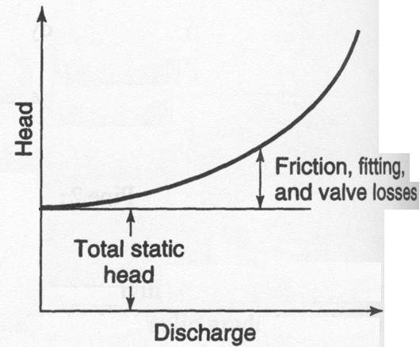
h_{sys} = Δz + Σh_{L} ≈ Δz + K_{eq}Q^{n}
h_{sys}
Σh_{L}
Δz

Slide 4
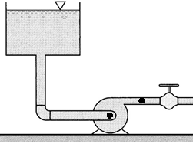
z₂
z₁
h_{L,2} =
h_{L,2} = K₂Q^{n}
h_{L,1} =
h_{L,1} = K₁Q^{n}
z ≡ 0
(h_{pump} is same as TDH; Munson is inconsistent, using h_{a} sometimes for h_{pump} and sometimes for h_{sys})

Slide 5
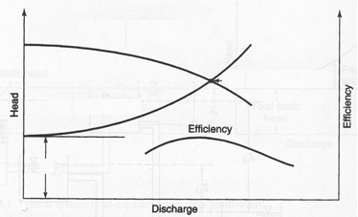
For stable operation, the flow rate is such that the pump supplies an amount of head equal to what the system demands.
Pump curve (h_{pump})
Operating point
System curve (h_{sys})
z₂−z₁=h_{min}

Slide 6
Pump curve (TDH or h_{pump})
System curve (h_{sys})
z₂−z₁=h_{min}
h_{pump} or TDH is the total head added by the pump, as expressed by the pump curve (TDH vs. Q). This relationship characterizes the pump, independent of the system in which it is installed.
h_{sys} is the head dissipated due to friction and changes in elevation when fluid passes through the system at a flow rate Q. This relationship characterizes the system, independent of how the flow is generated.

Slide 7
Example. A pump curve can be approximated by the equation h_{pump}= 180 − 6.1x10⁻⁴Q², with h_{L} in ft and Q in gpm. If the pump is used to deliver water between two reservoirs via a 4-in-diameter, 600-ft long pipe against a static head of 50 ft, what flow rate will develop, if f=0.02? Ignore minor headlosses.

Slide 8
Pump curve
System geometry
D-W or H-W

Slide 9
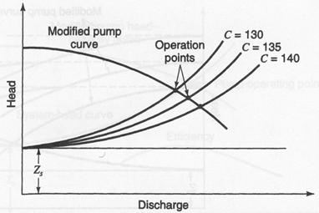
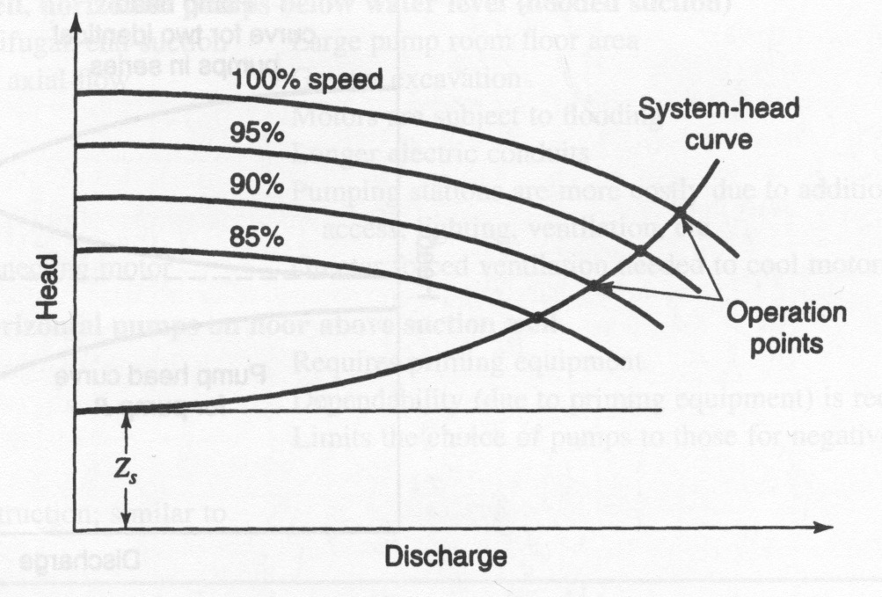
Changes in system capacity as pipes age
Dependence of system behavior on impeller speed

Slide 10
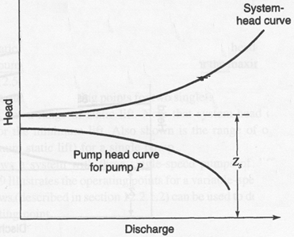
Pump and system curves that don’t intersect

Slide 11
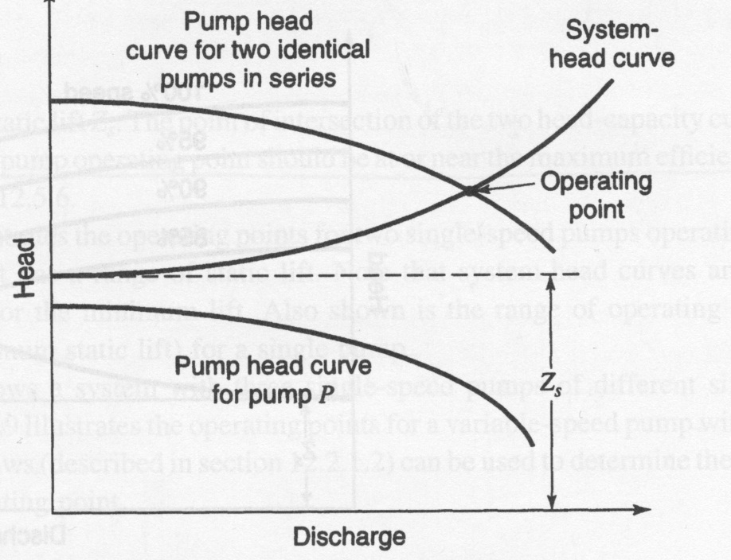
Composite pump curve for identical pumps in series

Slide 12
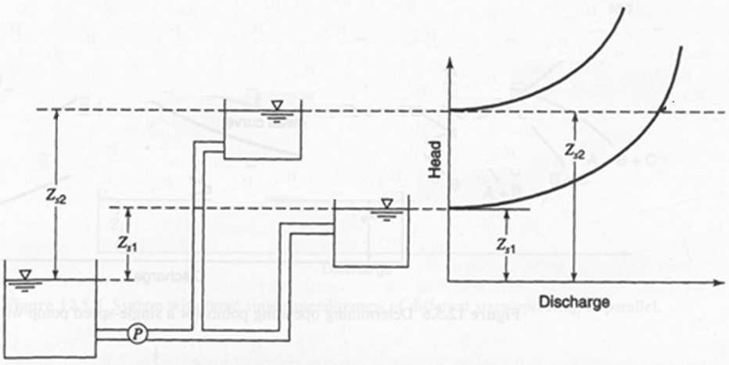
Two discharge pipes (and two system configurations) supplied by a single pump
How do the discharge rate and head for the pump relate to the flow rates and heads in the two pipes?

Slide 13
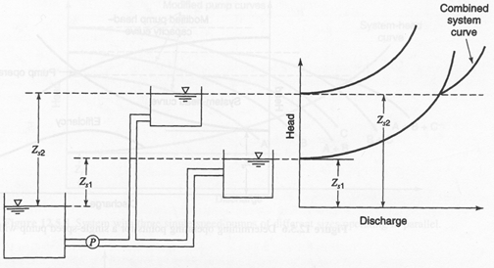
Composite system curve for two discharge pipes from a single pump

Slide 14
Composite system curve for two discharge pipes from a single pump

Slide 15
z₂
Energy equation is sometimes rearranged to equate a ‘modified’ pump curve with a ‘modified’ system curve
z₁
h_{L,2} = K₂Q^{n}
h_{L,1} = K₁Q^{n}
z ≡ 0
Conventional: Head added by pump equals head lost in rest of system
Modified: Head at some point in system is same based on ‘path’ from either direction

Slide 16
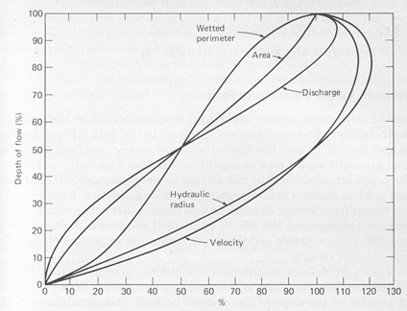
Similitude and Affinity Laws for Pump Performance
Similitude is useful for extrapolating experimental results to uninvestigated systems
Dimensional analysis allows us to take maximum advantage of similitude relationships by identifying universally valuable parameter combinations
For membrane efficiency: r_{part}/r_{pore}
For partially full pipe flow: h_{liq}/D
A
B
C

Slide 17
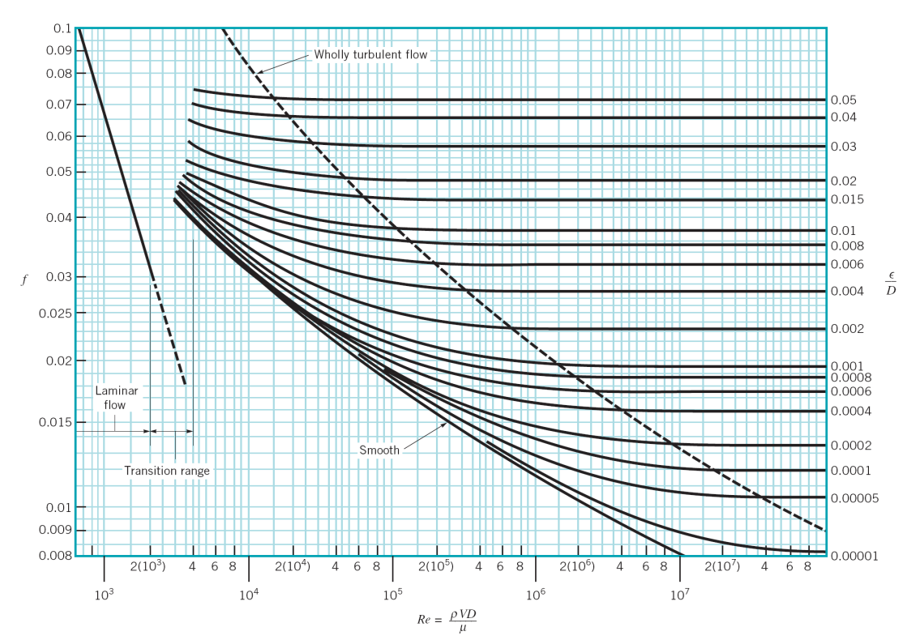
Procedure: Identify important dependent parameters and make assumptions about independent parameters that control them, i.e.,
Use dimensional analysis to convert these parameters into dimensionless terms, Dep_{i}* and In_{j}*, such that each Dep_{i}* term contains only one Dep_{i} and one or more In_{j}. Elimination of dimensions causes the number of In_{j}* terms to be less than the number of In_{j} terms; e.g.:

Slide 18
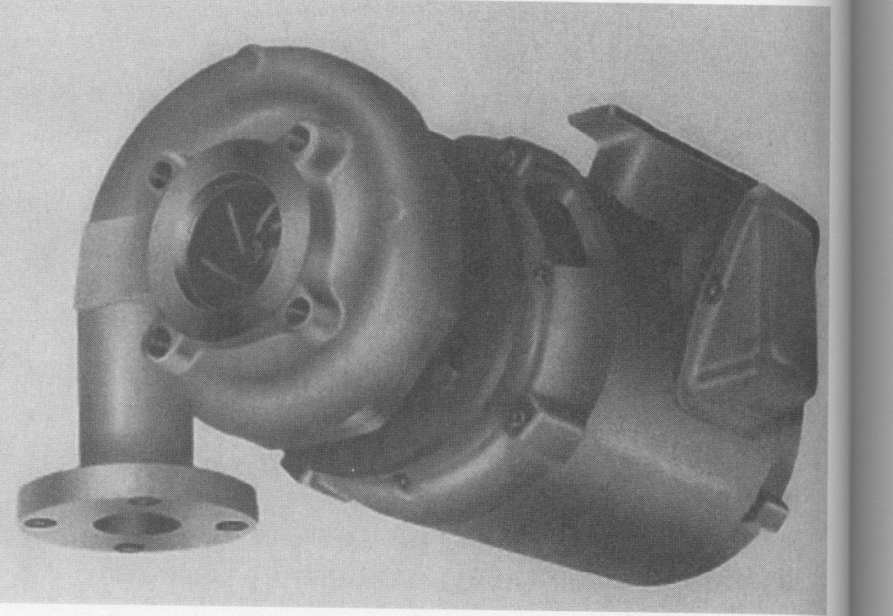
In hydraulics, similitude typically requires geometric similarity
For pumps, TDH, P_{shaft}, and η are logical Dep_{i}’s; D, l_{i}, ε, Q, ω, ρ, and μ are logical I_{j}’s, e.g.:
One set of dimensionless groups is:
Head rise coefficient
Power coefficient
Efficiency

Slide 19
First and second independent parameters are constant for geometrically similar pumps, and fourth is unimportant for high-Re flow (which is typical in pumps). Q/(ωD³) is called the flow coefficient, C_{Q}. So:

Slide 20
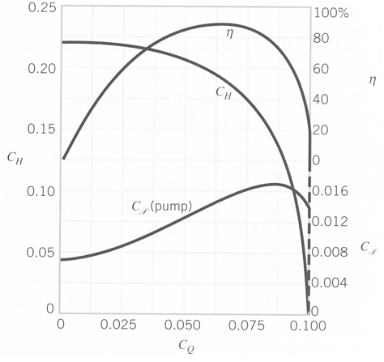
C_{H}, C_{P}, and η can be determined for a pump as a function of C_{Q}. Then these relationships will apply to all geometrically similar pumps.
η
Tentatively select a pump
Obtain C_{H}, C_{P}, and η as fcn of C_{Q} for a geometrically similar pump from manufacturer
Determine C_{Q} for the proposed Q, ω, and D in your system
Determine C_{H} and C_{P} for your system
Assess whether anticipated performance is satisfactory; if not, modify ω or D to improve performance at given Q
C_{H}
η
C_{H}
C_{P}
C_{P}
C_{Q}

Slide 21
A series of homologous pumps is characterized by the following curves. One such pump has an impeller diameter of 0.75 m and operates with maximum efficiency at 1500 rpm (= 25 rps). What is TDH?
If the impeller speed is adjusted to 2000 rpm, and a valve is adjusted to maintain the original discharge rate, what will the new efficiency and TDH be?
η
C_{H}
η
C_{H}
C_{P}
C_{P}
C_{Q}

Slide 22
Under initial conditions (1), η =η_{max}, so C_{Q}≈ 0.065 and C_{H}≈ 0.19.
η
C_{H}
η
C_{H}
C_{P}
C_{P}
C_{Q}

Slide 23
After the increase in impeller rotation speed (2), Q and D remain the same, and ω increases by 33%, so:
η
C_{H}
η
C_{H}
C_{P}
C_{P}
At this value of C_{Q},
η ≈ 62% and C_{H} ≈ 0.21.
C_{Q}

Slide 24
Increasing ω by 33% almost doubles TDH.

