Slide 1
Our Plan – Weeks 6 and 7
Review energy relationships in single pipes
Extend analysis to progressively more complex systems
  Pipes in parallel or series
  Pipe networks with known flow direction in each pipe
  Interconnected pipe loops and reservoirs where flow direction is not obvious
Consider key factors in selection of pumps to add energy to fluid in a system
Consider some special cases of transients in pipe systems – cavitation and water hammer

Slide 2
Overview of “Turbomachines”
Pumps convert mechanical energy to fluid energy; turbines do the opposite
A pump usually refers to a machine used for incompressible fluids (water, oil); fans, blowers, or compressors for compressible fluids
Pump categorization
  Variable volume delivered per cycle, depending on system head (governed by hydraulics)
  Fixed volume delivered per cycle (positive displacement, governed by mechanics)
    Gear pump http://www.youtube.com/watch?v=kgoZM4sFVE0&feature=related
    Peristaltic
    Piston

Slide 3
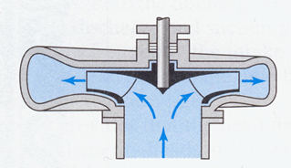
Hydraulic Pump Categorization
Based on primary direction of fluid flow relative to shaft
  Radial (centrifugal pumps)
  Axial (boat propellers)
  Mixed
Single- vs multi-stage
Constant vs variable speed
From Finnemore and Franzini [2002]

Slide 4
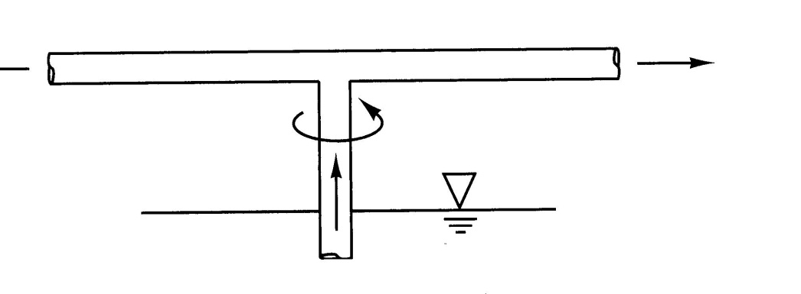
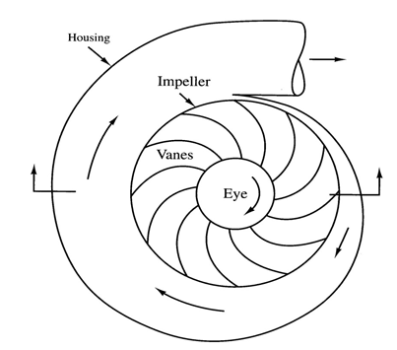
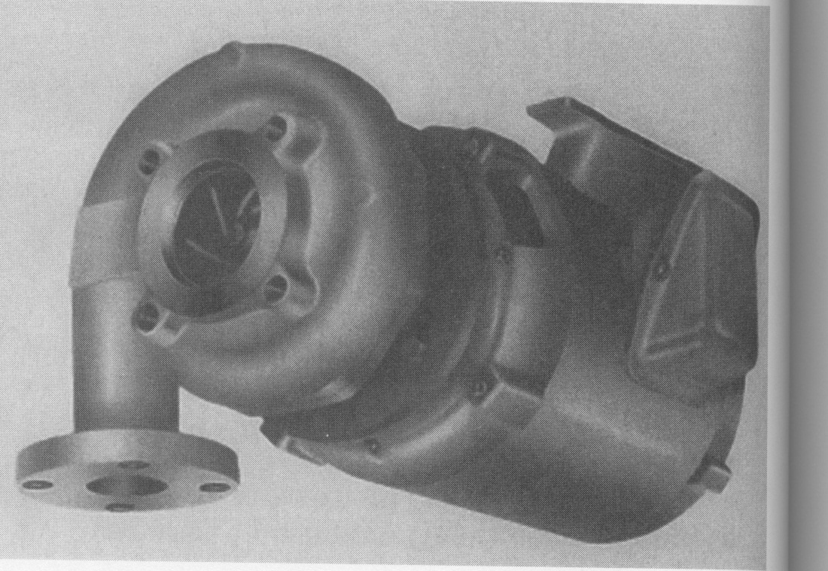
Motor
Shaft
Impeller and vanes
Volute
Suction and discharge
Demour centrifugal pump (1730) [from Houghtalen et al., 2010]
From Houghtalen et al., 2010
From Mays [2010]

Slide 5
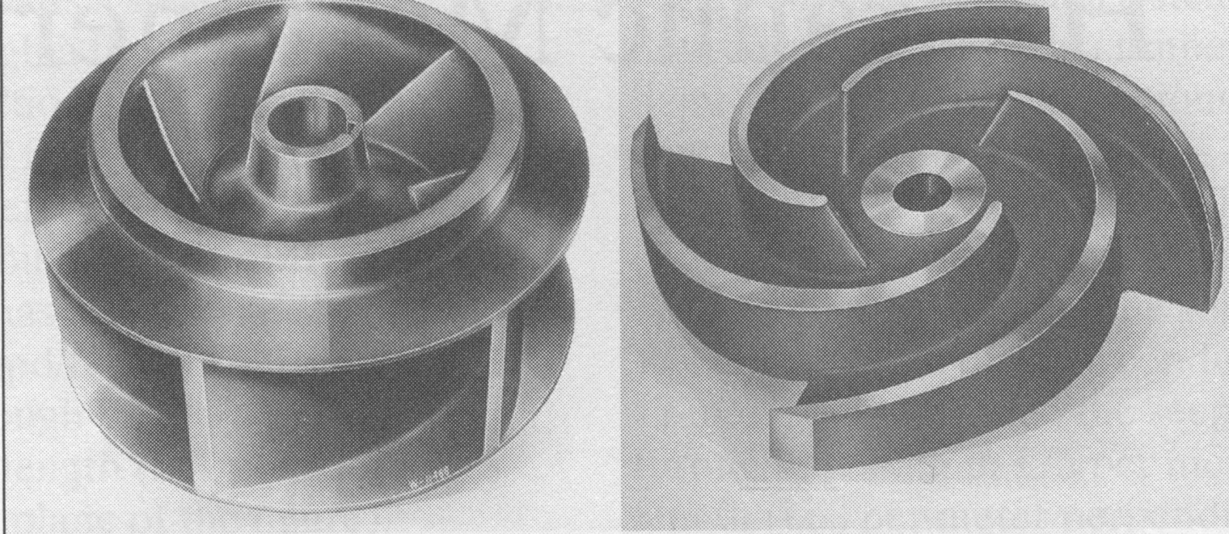
Closed (shrouded) and open (unshrouded) impellers [from Finnemore and Franzini, 2002]

Slide 6
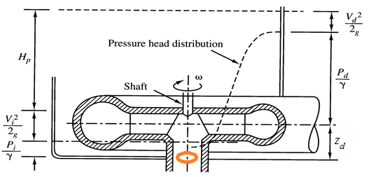
Changes in Head Inside a Centrifugal Pump, Ignoring Headloss
OutIet (discharge) location
Inlet (suction) location and datum for elevation
From Houghtalen et al., [2010]

Slide 7
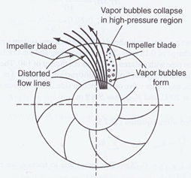
Pressure Changes Inside a Pump
From Mays [2010]
http://www.youtube.com/watch?v=oRYYP4F8LTU&feature=related (recommended viewing: 0:00-0:40, 9:05-end)
http://www.youtube.com/watch?feature=endscreen&NR=1&v=6A1QspfCuBg

Slide 8
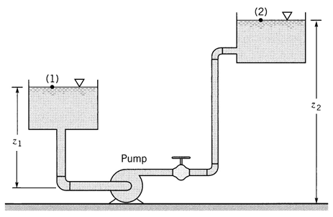
Static Suction Head and Suction Lift
Suction head is the head at the pump inlet (suction location)
Static suction head is the suction head under no-flow (static) conditions, equal to Δz from the feed reservoir to the inlet
Pump below source; static suction head >0

Slide 9
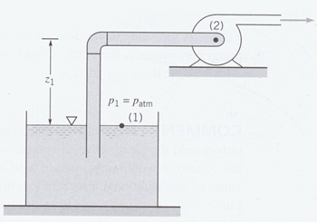
(Static) Suction lift is the opposite of the (static) suction head and is sometimes used when the pump inlet is above the source
Pump above source; negative static suction head, or positive static suction lift

Slide 10
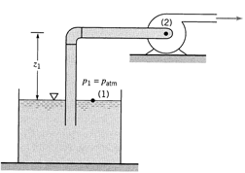
Net Positive Suction Head (NPSH)
  Net Positive Suction Head Available (NPSH_{A}): The absolute dynamic head at the pump inlet (suction) in excess of the vapor pressure
  NPSH_{A} is the theoretical amount of head that could be lost between suction and point of minimum pressure without causing cavitation
  (but this always overestimates actual amount that can be lost, because some velocity head must remain, even at point of p_{min}).

Slide 11
NPSH and Cavitation
  Net Positive Suction Head Required (NPSH_{R}): The minimum value of NPSH_{A} that is needed to prevent cavitation in the pump, i.e., the value of NPSH_{A} that causes p_{min} to equal p_{vap}.
  NPSH_{R} is determined experimentally by pump manufacturers and reported as a function of pump flow rate (usually called ‘capacity’).
  To avoid cavitation, always operate with NPSH_{A} ≥ NPSH_{R}.

Slide 12
The Maximum Allowable Elevation of a Pump

Slide 13
Suction lift, z_{sl}, must be less than the expression on the left to avoid cavitation, so that expression indicates the maximum allowable suction lift (i.e., maximum elevation of the pump above the reservoir).

Slide 14
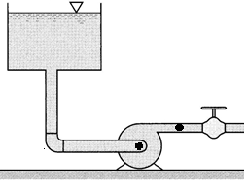
Performance of a Single-Stage, Fixed-Speed Centrifugal Pump
Conduct a test using a pump with a constant impeller rotational speed. Measure head added between suction and discharge (Total Dynamic Head, TDH) at various valve openings.

Slide 15
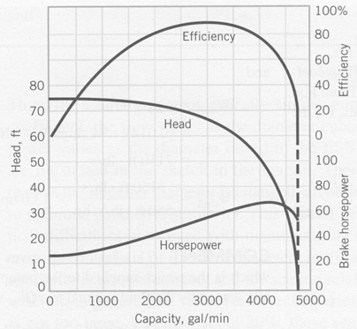
As valve is opened more, Q increases and TDH decreases
Pump (performance) curve

