Slide 1
E
2
A
1
Water
C
B
3
4
D
Pipe | l (ft) | D (in) | C_{HW} | K | K^{− 1/n}
1 | 1200 | 8 | 110 | 6.84 | 0.354
2 | 800 | 6 | 110 | 18.5 | 0.207
3 | 900 | 4 | 90 | 217 | 0.0545
4 | 500 | 6 | 90 | 16.8 | 0.218
2+3 |  |  |  | 12.0 | 0.261
1-4 | 5237 | 8 | 100 | 35.6
Note that the calculation of the length of the pipe equivalent to 2+3 was unnecessary if our only interest is in an equivalent pipe for the whole network

Slide 2
Flow Analysis in Systems with Multiple Pipes
Two levels of complexity
One inlet, one outlet, flow directions known
Multiple inlets/outlets, flow directions need to be determined
In both cases, key equations are the same
Continuity at junctions or nodes: total flow rate entering equals total flow rate leaving
Total head is well-defined at any point, so headloss between any two points is independent of path taken, and headloss around a loop is zero

Slide 3
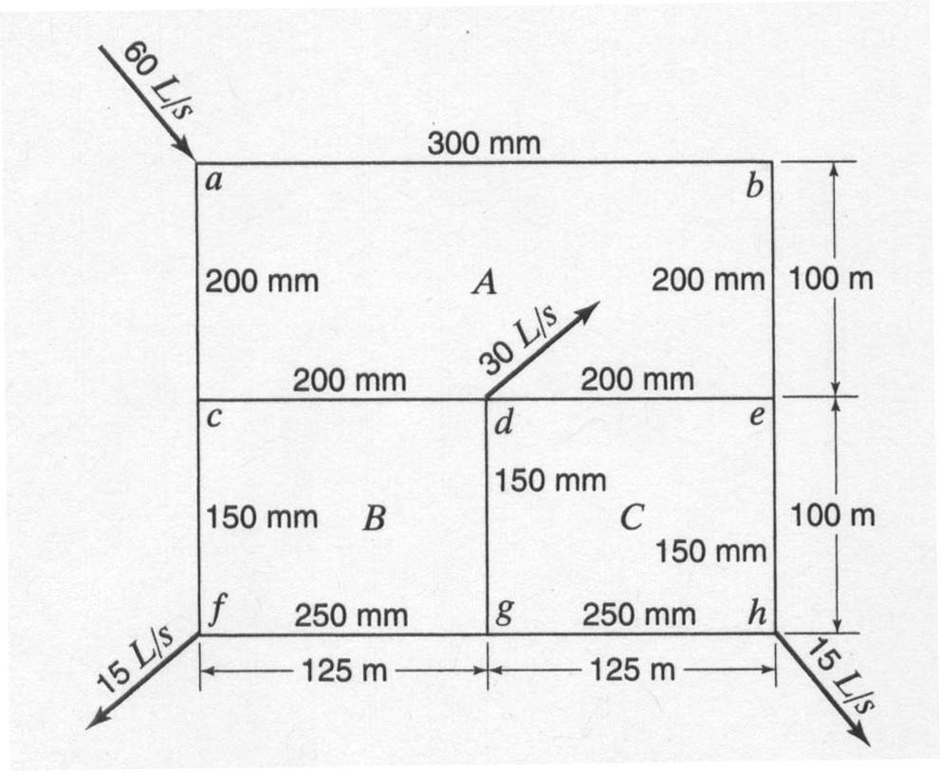
Relaxation Methods for Analyzing Complex Pipe Networks: Theory and Example
Find the flows in all the pipes in the network shown below. All the pipes are new cast iron with ε = 2.5x10⁻⁴ m. Use the Haaland eqn. to estimate friction factors. What is the headloss between points a and d?

Slide 4
Define a set of independent pipe loops such that every pipe is part of at least one loop, and no loop can be represented as a sum of other loops. The easiest way to do this is to choose all of the smallest possible loops in the network.

Slide 5
Guess values of Q that satisfy continuity at each node, assigning a positive value if the (assumed) direction of flow is clockwise in the loop. This means that the flow in a given pipe will be positive when analyzing one loop, and negative when analyzing the adjacent loop.

Slide 6
 |  | Assumed
Loop | Pipe | Q
A | ab | 20
 | be | 20
 | ed | 10
 | dc | 5
 | ca | -40
B | cd | -5
 | dg | -25
 | gf | -30
 | fc | -45
C | de | -10
 | eh | 10
 | hg | -5
 | gd | 25

Slide 7
Compute the headloss in each pipe, using the same sign convention as for flow, so that h_{L} in each pipe has the same sign as Q, for a given loop.
Compute the headloss around each loop. If the headloss around every loop is zero, then all the pipe flow equations are satisfied, and the problem is solved. Presumably, this will not be the case when the initial, arbitrary guesses of Q are used.

Slide 8
 |  | Assumed | Haaland | DW eqn
Loop | Pipe | Q | f | h_{L}
A | ab
 | be
 | ed
 | dc
 | ca
 |  |  | Sum =
B | cd
 | dg
 | gf
 | fc
 |  |  | Sum =
C | de
 | eh
 | hg
 | gd
 |  |  | Sum =

Slide 9
For each loop, determine a ΔQ to be applied to each pipe in the loop, so that the headloss around the loop is closer to zero. By changing the flow rates in all the pipes in a loop by the same amount, we assure that the increase or decrease of the flow into a node is balanced by the exact same increase or decrease of the flow out, so that continuity is still satisfied.

Slide 12
Apply the ΔQ values to all pipes. If a pipe is in two loops, apply both ΔQ‘s to it.
In Loop A
In Loop B
In Loop C

Slide 13
Headloss from a to d:

Slide 14
For some systems, it is more convenient to guess h at the various nodes or the headlosses in all the pipes, and then compute the flows, rather than guess the flow rates and compute the headlosses.
In those cases, after each iteration, we test whether continuity is satisfied at each node. If it is not satisfied, the head at that node (j) is increased by the following amount, and the process is repeated until continuity is satisfied.

