Slide 1
http://faculty.washington.edu/markbenj/CEE345/
CEE 345, Spring 2012 Part 2: Hydraulics and Open Channel Flow
Instructor: Mark Benjamin, 335 More Hall; 543-7645, markbenj@uw.edu
Text: Munson et al.., Fundamentals of Fluid Mechanics, 6th ed.
Pipe networks, pump selection, hydraulic transients
Flow dependence on depth & slope in rivers, streams, culverts, storm and sanitary sewers
Weekly HW, due beginning of class; no late homework
One lab in HHL; no write-up, but data used in HW
Four Thursday sessions – computer lab, HW, practice problems
Exam on hydraulics on Friday, May 18; open channel questions on final exam

Slide 2
Our Plan – Weeks 6 and 7
Review energy relationships in single pipes
Extend analysis to progressively more complex systems
Pipes in parallel or series
Pipe networks with known flow direction in each pipe
Interconnected pipe loops and reservoirs where flow direction is not obvious
Consider key factors in selection of pumps to add energy to fluid in a system
Consider some special cases of transients in pipe systems – cavitation and water hammer

Slide 3
Overview of Pipe Networks
‘Pipe flow’ generally refers to fluid in pipes and appurtenances flowing full and under pressure
Examples: Water distribution in homes, industry, cities; irrigation
System components
Pipes
Valves
Bends
Pumps and turbines
Storage (often unpressurized, in reservoirs, tanks, etc.)

Slide 4
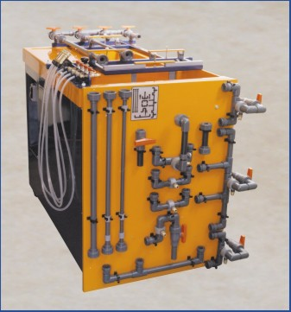
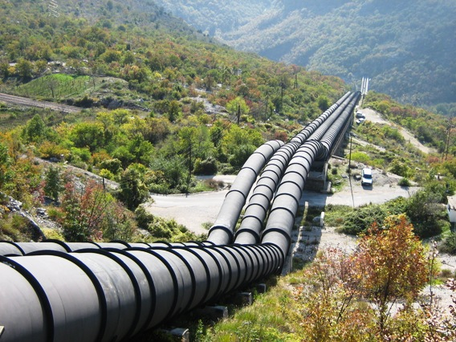
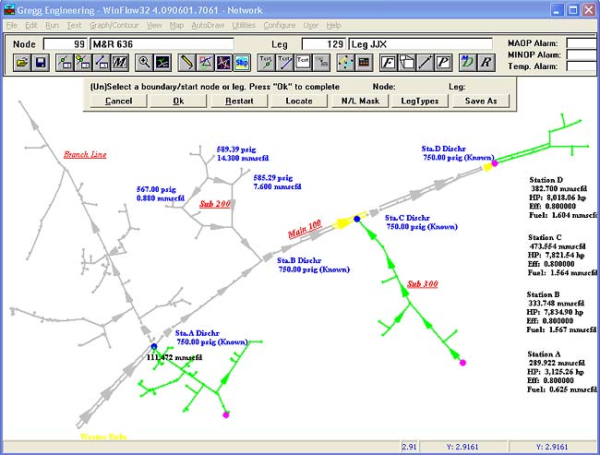
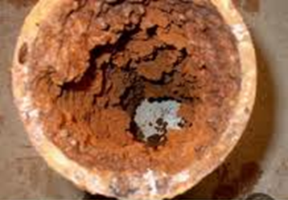
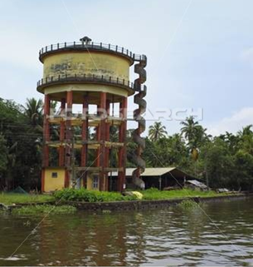

Slide 5
Energy Relationships in Pipe Systems
Energy equation between any two points:
Analysis involves writing expressions for h_{L} in each pipe and for each link between pipes (valves, expansions, contractions), relating velocities based on continuity equation, and solving subject to system constraints (Q, p, or V at specific points).

Slide 6
Energy Losses in Piping Systems
Darcy-Weisbach equation for headlosses in pipes (major headlosses):

Slide 7
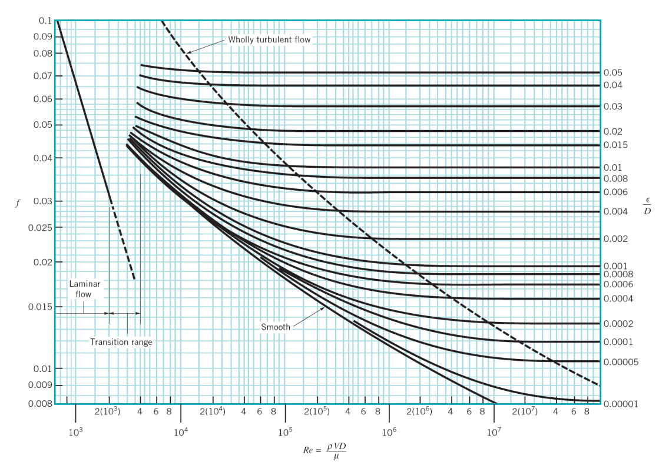
Estimating f Graphically

Slide 8
Trends in f
f declines with increasing Re, e.g., increasing V at fixed D.
In laminar region, f = 64/Re
In turbulent region, for given ε/D, f declines more slowly than in laminar region; eventually, the decline stops altogether.

Slide 9
Mathematical Expressions for f
Colebrook and Haaland eqns yield good estimates of f in turbulent flow
Useful for calculations in spreadsheets or special software for pipe flow analysis

Slide 10
Understanding Headloss in Pipes
Darcy-Weisbach equation:
For travel distance of one pipe diameter ( ):
f is the ratio of energy lost via friction (i.e., shear) to the kinetic energy of the water when the water travels a distance of one pipe diameter

Slide 11
Example
Compare the velocity and pressure heads for typical conditions in a street main: V = 1.5 m/s; D = 0.5 m; p = 500 kPa
If f = 0.02, h_{L} for each 0.5 m of pipe is 2% of the velocity head, or 0.0023 m, corresponding to 0.0045% of the pressure head.

Slide 12
Typical Pipe Flow Problems
Type I: Pipe properties (ε, D, l) and V known, find h_{L}.
Determine f from Moody diagram or an equivalent equation, and h_{L} from the DW eqn

Slide 13
Example
A 20-in-diameter galvanized pipe (ε = 0.0005 ft) 2 miles long carries 4 cfs at 60ºF. Find h_{L} using (a) the Moody diagram and (b) the Colebrook eqn.

Slide 14
Colebrook eqn:
 | F | G | H
9 | e/D | 0.0003 | 0.0003
10 | Re | 251000 | 2.51E+05
11 | f | 0.03 | 0.03
12 | LHS | =1/SQRT(G11) | 5.774
13 | RHS | =-2*LOG(G9/3.7 + 2.71/G10*G12) | 7.687
14 | LHS - RHS | =G12-G13 | -1.913

Slide 15
e/D | 0.0003
Re | 2.51E+05
f | 0.017422
LHS | 7.576
RHS | 7.576
LHS - RHS | 2.55E-07

Slide 16
Typical Pipe Flow Problems
Type II: Pipe properties (ε, D, l) and h_{L} known, find V.
Guess V, determine f and h_{L} as in Type I, iterate until h_{L} equals known value, or
Solve Colebrook and DW eqns simultaneously to eliminate V, yielding:

Slide 17
Solving Type II Pipe Problems: Iterative Approach

Slide 18
Rearranged D-W eqn:

Slide 19
Example
For the pipe analyzed in the preceding example, what is the largest flow rate allowable if the total frictional headloss must remain <8 ft?

Slide 20
Example
For the pipe analyzed in the preceding example, what is the largest flow rate allowable if the total frictional headloss must remain <8 ft?
Substituting known values,

Slide 21
Typical Pipe Flow Problems
Type III: ε, l, V, and h_{L} known, find D.
Several approaches, all iterative; e.g., Guess D, determine V as in Type II, iterate until V equals known value
Example
What diameter galvanized pipe would be required in the preceding examples if a flow rate of 10 cfs was needed, while keeping the total frictional headloss at <8 ft?

Slide 22
Solving Type III Pipe Problems: Iterative Graphical Approach

Slide 23
Solving Type III Pipe Problems: Iterative Analytical Approach
What diameter galvanized pipe would be required in the preceding examples if a flow rate of 10 cfs was needed, while keeping the total frictional headloss at <8 ft?

Slide 24
g | 32.2
hL | 8
l | 10560
eps | 0.0005
nu | 1.22E-05
D_guess | 2
LHS = Q | 10
RHS | 7.72E+00
LHS − RHS | 2.28E+00
g | 32.2
hL | 8
l | 10560
eps | 0.0005
nu | 1.22E-05
D_guess | 2.206594
LHS = Q | 10
RHS | 1.00E+01
LHS − RHS | -8.22E-07

Slide 25
Dependence of h_{L} on D and V

Slide 26
Dependence of h_{L} on D and V
In laminar region:
In turbulent region, when f becomes constant:
For a given pipe
For a given pipe
Under typical water distribution conditions, h_{L} in a given pipe can be expressed as kQ^{n} with n slightly <2.

Slide 27
Example
For the systems analyzed in the first two examples, what value of n causes the data to fit the equation h_{L} = kQ^{n}?

Slide 28
Alternative Equations for Flow - Headloss Relationships in Turbulent Pipe Flow
Hazen-Williams equation – widely used for h_{L} as function of flow parameters for turbulent flow at typical velocities in water pipes:
Coefficients shown are for SI units; for BG units, replace 0.849 by 1.318 and 10.7 by 4.73.

Slide 29
Comparison of Equations for Transitional and Turbulent Curves on the Moody Diagram
 | D-W | H-W* | Manning*
V
Q
h_{L} (=S*l)
*Coefficients shown are for SI units (V in m/s, and D and R_{h} in m); for BG units (ft/s and ft), replace 0.849 by 1.318; 0.354 by 0.550; 0.278 by 0.432; 10.7 by 4.73; 1/n by 1.49/n; 0.397 by 0.592; 0.312 by 0.465; and 10.3 by 4.66.

Slide 30
Energy Losses in Bends, Valves, and Other Transitions (‘Minor Losses’)
Minor headlosses generally significant when pipe sections are short (e.g., household, not pipeline)
Caused by turbulence associated with flow transition; therefore, mitigated by modifications that ‘smooth’ flow patterns
Generally much greater for expansions than for contractions
Often expressed as multiple of velocity head:
K is the ratio of energy lost via friction in the device of interest to the kinetic energy of the water (upstream or downstream, depending on geometric details)

Slide 31
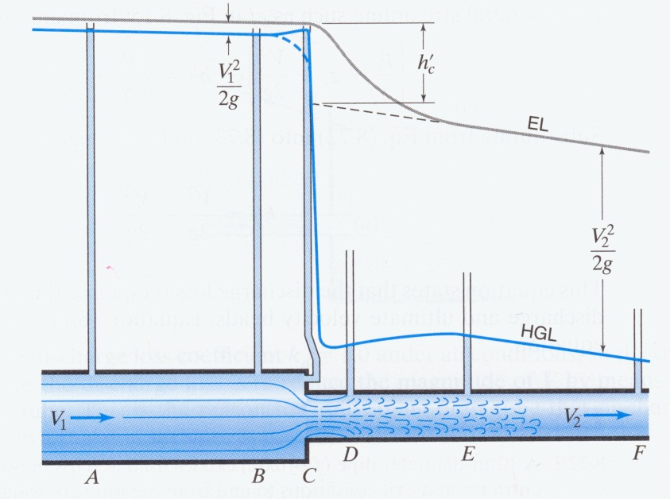
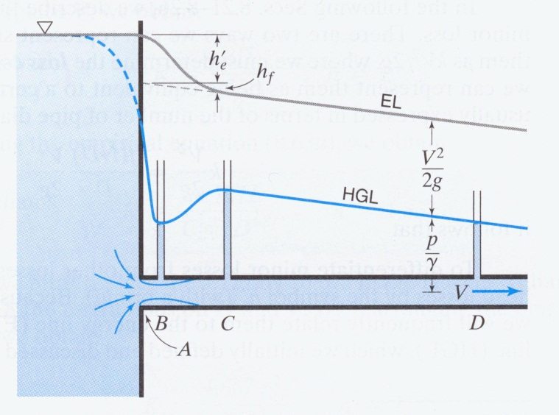
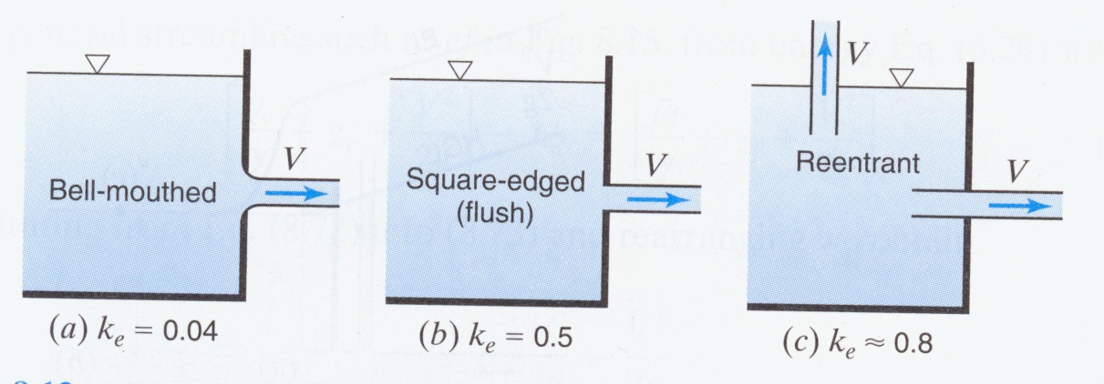
Energy Losses in Contractions
All images from Finemore & Franzini (10e, 2002)

Slide 32
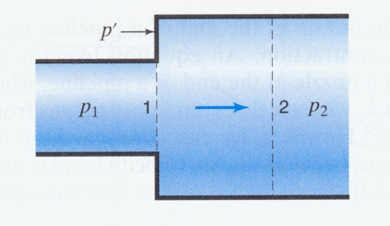
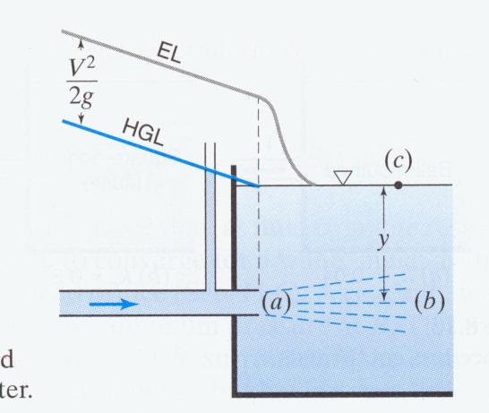
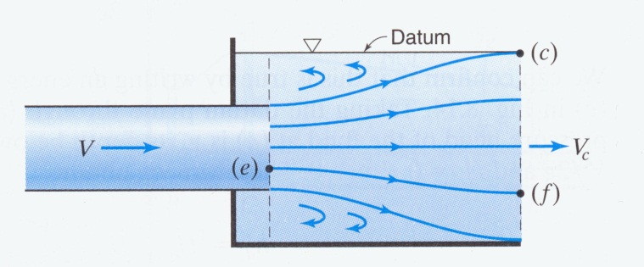
Energy Losses in Expansions
All images from Finemore & Franzini (10e, 2002)

Slide 33
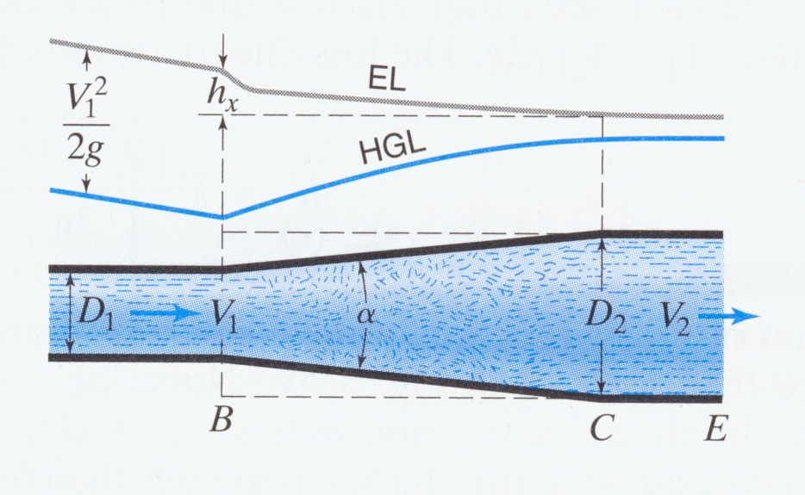
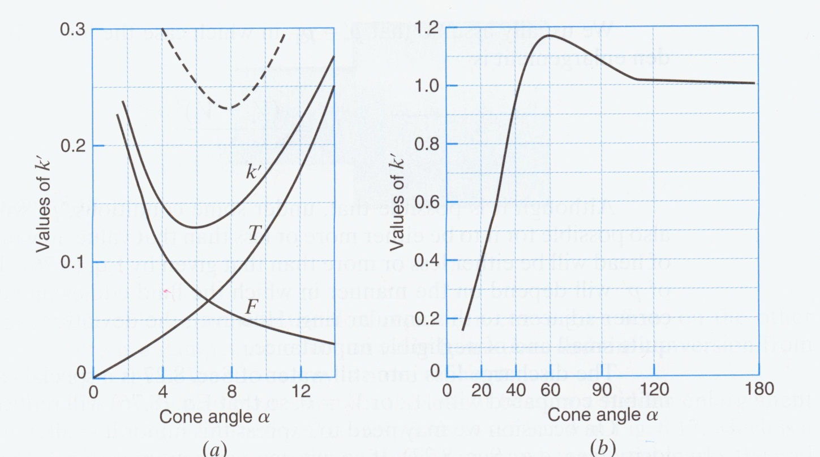
Energy Losses in Expansions
Conical diffuser
k’, rough
k’, smooth
All images from Finemore & Franzini (10e, 2002)

Slide 34
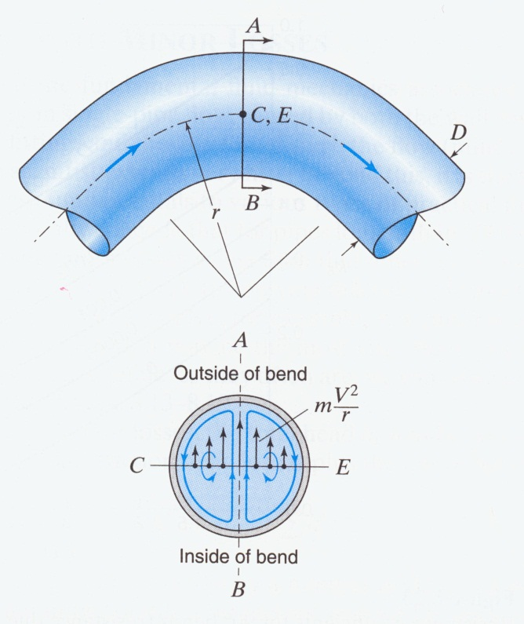
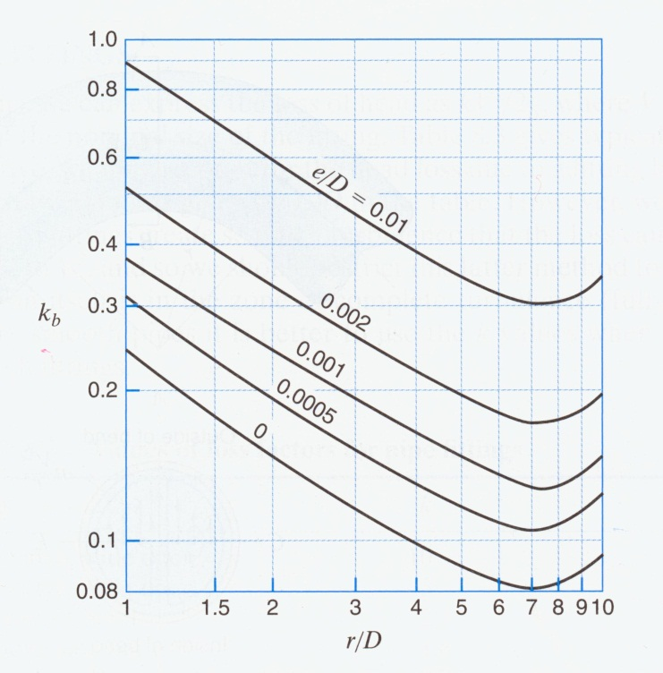
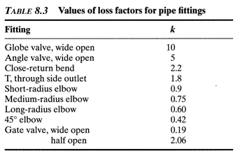
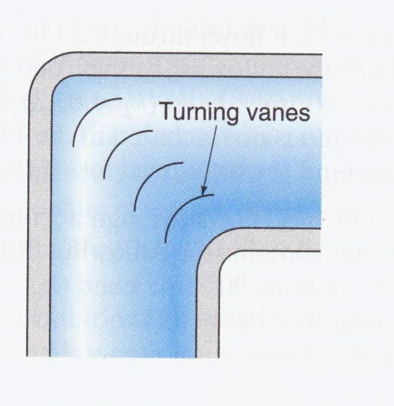
Energy Losses in Pipe Fittings and Bends
All images from Finemore & Franzini (10e, 2002)

Slide 35
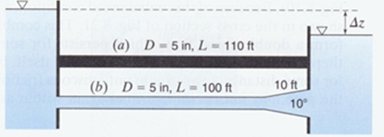
Example
A 5-in-diameter pipe with an estimated f of 0.033 is 110 feet long and connects two reservoirs whose surface elevations differ by 12 feet. The pipe entrance is flushed, and the discharge is submerged.
Compute the flow rate.
How much would the flow rate change if the last 10 ft of the pipe were replaced with a smooth conical diffuser with a cone angle of 10º?

Slide 37
From graph, for a smooth, 10º cone, k_{cone} = 0.175

