Slide 1
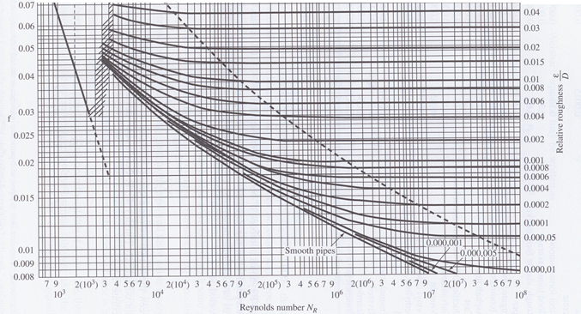
Information the Might be Useful for the Exam

Slide 2
Unit conversions and physical properties of water
1 ft³ = 7.48 gal; 1 cfs = 448.8 gpm; 1 hp = 550 ft-lb/s
20ºC: ρ = 998.2 kg/m³ γ = 9.79 kN/m³ ν = 1.00x10⁻⁶ m²/s
μ = 1.00x10⁻³ N-s/m² p_{vap} = 2.34 kPa = 0.00234 atm
60ºF: ρ = 1.94 slug/ft³ γ = 62.4 lb/ft³ ν = 1.21x10⁻⁵ ft²/s
μ = 2.34x10⁻⁵ lb-s/ft² p_{vap} = 0.256 lb/ft²

Slide 3
Equations characterizing friction and headloss in turbulent pipe flow:
Colebrook Eqn.
Haaland Eqn.

Slide 4
Hazen-Williams Eqn for SI units (for BG units, replace 0.849 by 1.318, 10.7 by 4.73, and 0.278 by 0.432):
Headloss equations for equivalent pipes:
Iterative corrections for analysis of pipe networks:

Slide 5
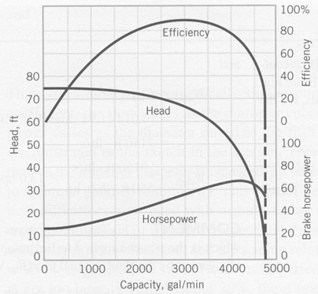
  Net Positive Suction Head Available (NPSH_{A}): The absolute dynamic head in the pump inlet in excess of the vapor pressure
Some useful dimensionless groups for pump similitude:
To a good approximation, for geometrically similar pumps, all are functions of only .

Slide 6
Some Basic Information Expected to be Known
For a given pipe:

Slide 7
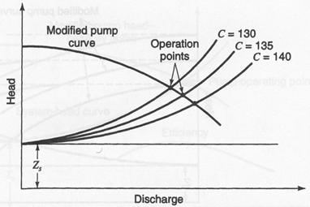
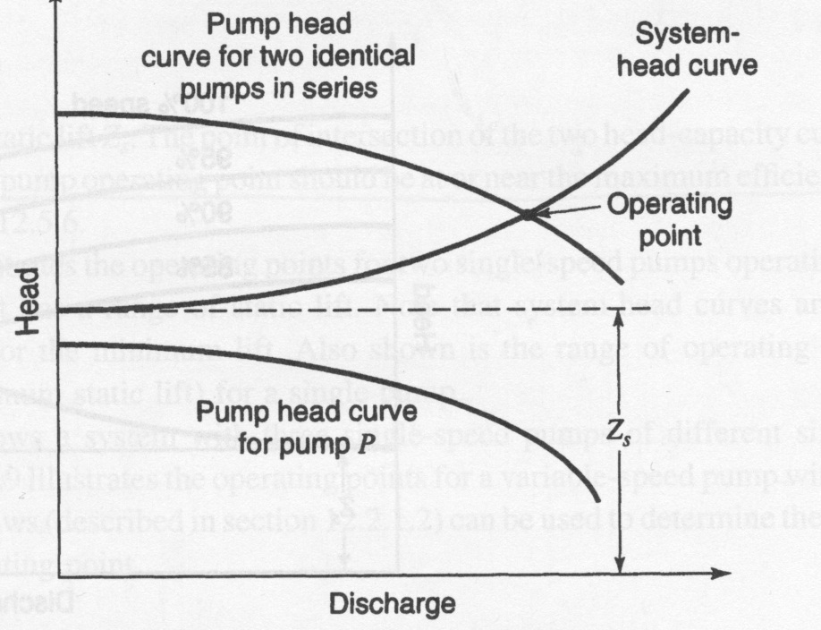
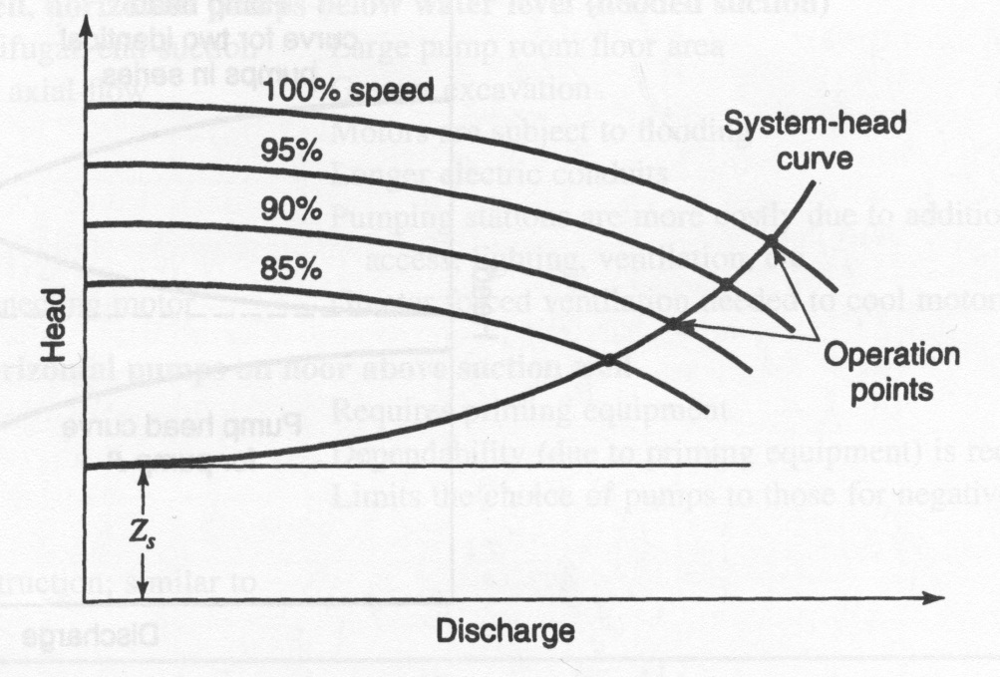
Explain some aspect of these diagrams. For example, why do the curves change as they do?; what would happen if a new pump or pipe were added to the system, or if an existing pump were replaced with a similar one with a larger diameter?; etc.

Slide 8
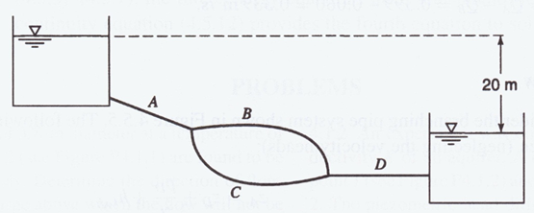
Typical Exam Questions
Characterize a pipe equivalent to A, B, C, and D.
If an equivalent pipe were identified, and a second pipe parallel to D were then installed, would the length of the equivalent pipe increase, decrease, or not change?

Slide 9
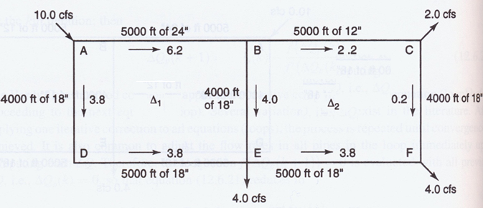
Given initial guesses of Q and the values of K and n for h_{L}=KQ^{n} in each pipe, what would be the correction to the flow in pipe BE?

Slide 10
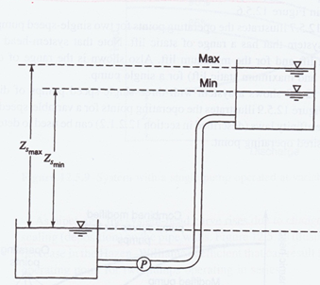
Sketch reasonable pump curves and system curves for the above network, for conditions where the upper reservoir is at its (1) highest and (2) lowest levels.

Slide 11
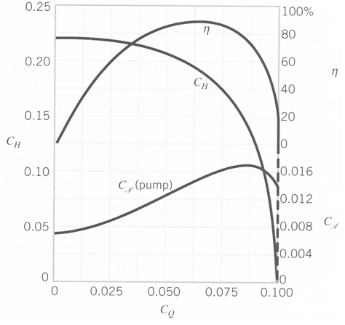
η
If the conditions in a system with this fixed-speed pump changed so that C_{Q} increased from 0.05 to 0.06, how much would the fluid power change, if at all?
C_{H}
η
C_{H}
C_{P}
C_{P}
C_{Q}

